Slide 1
ACOG FPAR Update
Steve Hasley, MD
Susan Matney, PhD, RNC-OB, FAAN
3/27/2016

Slide 2
Agenda
Review of Development Process
FPAR Analysis
  Lab Results
  Data Elements
LOINC Submission
Next Steps

Slide 3
ACOG OPA FHIR Development Process
Create Logical
Models
And Standard
Content
Domain
Analysis
ACOG
Approve
Models
Model
Repository
Project Needs
Pediatric Growth Chart
Neonatal Bilirubin
OPA Data Collection
MQIP
ACC registries
Comm Acq Pneumonia
Etc.
Terminology
Server
(SOLOR)
Create
Physical
Artifacts (FHIR
Profiles)
Conformance
Testing
Create
Software and
Services
Artifact
Repository
(FHIR profiles)

Slide 4
FPAR 2.0 Data Elements
Facility Identifier
Clinical Provider ID
Patient Identifier
Date of Birth
Birth Sex
Smoking Status
Blood Pressures
Height & Weight
Parity
Gravidity
Limited Language Proficiency
Ethnicity
Race
Household Size
Annual Household Income
Health Insurance Coverage
Visit Payer Type
Pregnancy Status
Pregnancy intention
Sexual Activity Status
Contraceptive Method at Entry & Exit
Reason for No Contraceptive Method
Date of Last Pap, HPV, Chlamydia, Gonorrhea, and HIV tests
Lab Test Results
Referral Completion Date for Positive HIV Tests
Contraceptive Counseling
Counseling to Achieve Pregnancy
Notes:
To inform those performance measures and allow us to maintain counts of those critical services that Title X is funding, these are the draft data elements that OPA is looking to collecting at the encounter or visit level. The elements in black font are elements we’ve already been collecting through regular Title X reporting. The variables in green are new additions that will enable calculation of performance measures and contribute to quality improvement efforts.

Slide 5
  Labs
OPA asking for “Date Last” for a GROUP of lab results
Lab results may be stored as LOINC observations or coded with CPT
Need to retrieve multiple data elements to populate one field
If nothing retrieved, need to determine if ordered

Slide 6
Screen Shot
Note in screen shot there is no CT or GC result
Notes:
Take back to them and ask why they do not want the CT or GC result. ?? Need to take with
Map CPT to LOINC code (still want the LOINC codes)

Slide 7
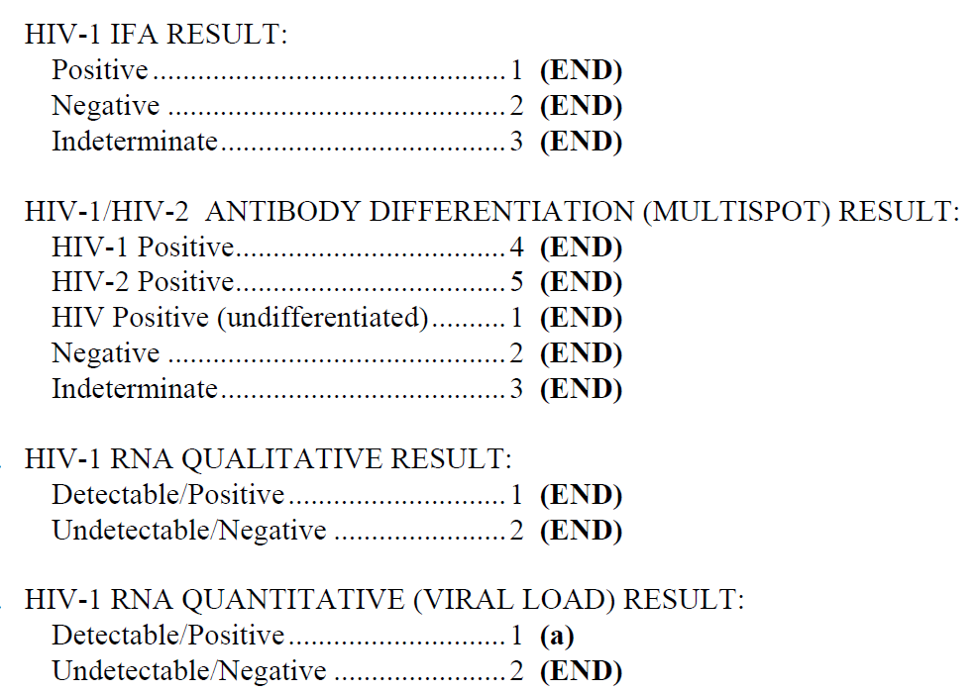
  Example for HIV
HIV Screen
Result
Multiple Tests
Differing
Value
Sets

Slide 8
Proposed Solution
Create data elements for every possible result value
Create value set in VSAC aligning with the “one” question on the form
Value set observation IDs can be used:
  To populate the C-CDA lab section OR
  To populate lab observations profiles
  To determine if it has been ordered (when not resulted)
  For OPA to use to identify the observations required for analysis for a specific question

Slide 9
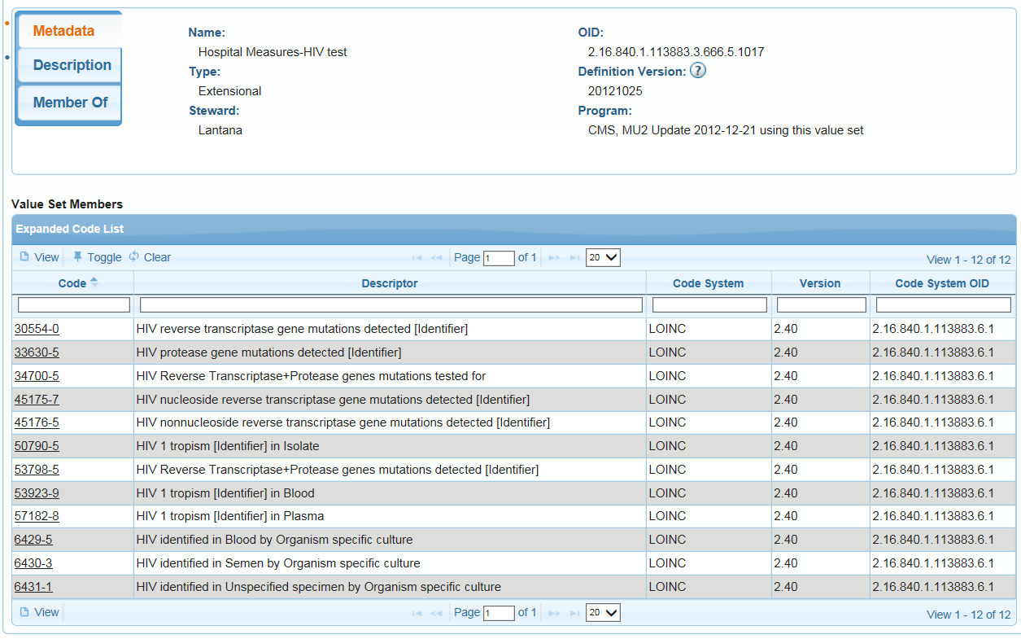
  Example for Value Set HIV

Slide 10
  Contraception Type
Multiple “types” of data required to populate answer (meds, procedures, devices)
Data in stored in EHR will be a “subtype” of the answer
  medroxyprogesterone acetate 150 MG/ML Injectable Suspension = Injectable
  Ethinyl Estradiol 0.03 MG / norethindrone acetate 1.5 MG Oral Tablet = Oral Contraceptive
  168 HR Estradiol 0.00188 MG/HR / Levonorgestrel 0.000625 MG/HR Transdermal Patch = Patch
Need to retrieve multiple data instances (not elements) to populate answers
Question – do vendors run a query to derive the answer, OR…send the discreet data and OPA derives answer?

Slide 11
Possible Solution
Create a “Grouping” value set
  Commonly used for quality measures
  “Child” value sets in the grouping will contain the values that are used to derive the answer
  Different “types” of data or different terminologies can be in a child value set

Slide 12
Possible Solution - Grouping Value Set
Contraceptive Method Grouping
Contraceptive Implants
Oral
Contraceptives
Contraceptive
Patches
Barrier Methods
Sterilization
Procedures
Notes:
How do you handle “other”

Slide 13
Grouping Value Set Discussion
Requires vendor to query across multiple data types and patient instances
  Query will retrieve the medication, device or procedure
Value set value IDs can be used:
  To populate the C-CDA lab section OR
  To populate the FHIR profiles
  For OPA will need to have a terminology server with the children concepts to identify the discreet classification answer

Slide 14
Plan B Screen shot from a typical build
BC Method
E/P Pill
Ring
Depo
BTL
Male Condom
IUD Prog
IUD Copper
Diaphragm
Female Condom
Hyst
Vasc
LAM
Implants
P only Pill
Patch
So we could just take the button(s) that the MA clicks, and be done
Not nearly as elegant, but quick

Slide 15
Data Element Revisions
“Pregnancy History” changed to 1) Gravida and 2)Parity
“Limited Language Proficiency” updated to “Limited English Proficiency
Sexual Activity” = Ever Sex, last 3 months, last 12 months updated to three data elements
Data of Pap changed to Date of Pap Tests last five years
Added HIV Referral, HIV Counselling
Many definition changes

Slide 16
LOINC Submission
Mapped all data elements to LOINC
LOINC request completed and reviewed and Clinical LOINC meeting
Created Top Level FPAR Panel with Subpanels
  Subpanels Align with FHIR Resources
  Created Panels for Labs
Review Submission

Slide 17
HEDIS/FPAR Evaluation Process
Pulled HEDIS Lab Panels from LOINC that aligned with FPAR
  HEDIS 2014-2017 Value Set - Cervical Cytology/FPAR Pap Smear Tests Panel
  HEDIS 2017 Value Set - Chlamydia Tests/FPAR Chlamydia Tests Panel
  HEDIS 2017 Value Set - HPV Vaccine Administered FPAR HPV Tests Panel
  HEDIS 2017 Value Set - Pregnancy Test Exclusion Pregnancy Lab Panel
Compared HEDIS Panels against FPAR proposed panels
Communicated with Regenstrief
  HEDIS Panel Context of Use
  Differences

Slide 18
HEDIS use recommendation
Reviewed HEDIS as a starter to ensure we captured all the codes
After reviewing HEDIS we determined that it’s best to create FPAR Panels
OPA/ACOG many want to a quick review of the HEDIS panels to ensure we have all the LOINC codes we want in our panels

Slide 19
Lab SNOMED CT Value Sets
Pulled LOINC Answers from LOINC
  Not all lab codes have an enumerated value set in LOINC
  Queried Intermountain EDW to discover answers
  Discussed with Intermountain IT lab expert
Propose we create ONE ordinal value set for the non-pregnancy labs with the values:
  Positive
  Negative
  Not Detected
  Detected
  Indeterminate
  Equivocal
Value set for pregnancy tests
  Positive
  Negative
  Indeterminate
  Equivocal

Slide 20
Next Steps
Map to SNOMED CT
Request New SNOMED CT Codes
Load Lab and Answer value sets
Created or Update Clinical Element Models
  Standard Terminology Bindings
  Value sets
Create FHIR Profiles
Testing
Develop SMART on FHIR App

Slide 21

Questions

