Slide 1
CIMI Wound Assessment Project
Jay Lyle, PhD (JP Systems)
Susan Matney, PhD, RNC-OB, FAAN (Initiative Lead)
3/28/2017

Slide 2
Agenda
Project History
Inception to model process
Current Model
Status

Slide 3
Pressure Injury Modeling Background
KP-VA Collaborative in 2010 defined an information model driven by nursing practice to enable:
Data capture
Data re-use
Data sharing within and outside organizations.
Measurement and extraction of data for meaningful EHR use to support quality, safety, efficiency and decision support.
2013 ONC mandated the model and terminology for a Mobilizing Data for Pressure Ulcer Challenge Grant
2016 pressure injury criteria updated by NPUAP
2016 Project Approved for CIMI pilot project under Patient Care

Slide 4
Inception to Model
Information Requirements
CIMI Requirements Specification Design
Design Patterns
ISO 13606
Skin Breakdown Risk
Domain Analysis Model
Information model
openEHR
Constraint templates
Clinical Quality Information
Skin Assessment
LOINC Panel
Terminology
SNOMED CT
Concept Model

Slide 5
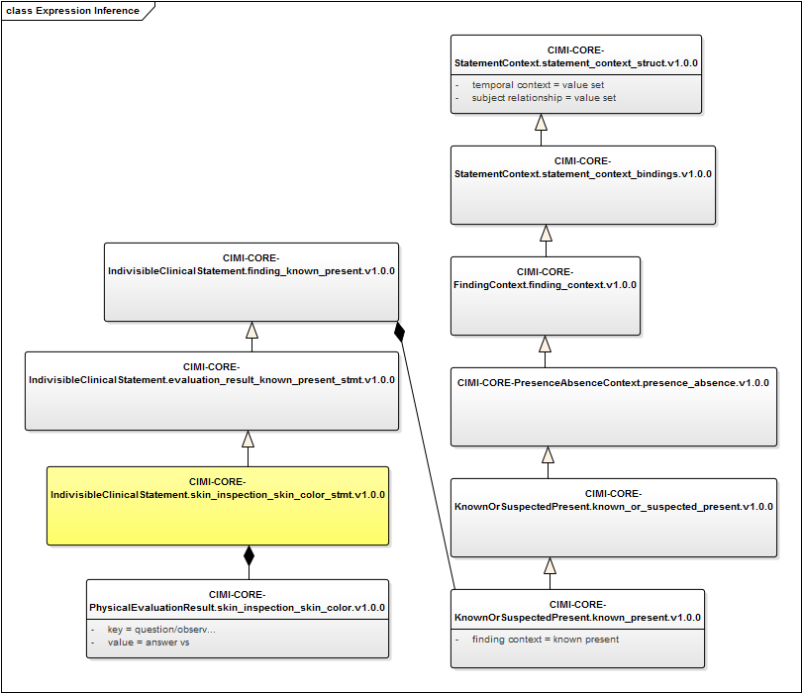
Semantic Framework for Model
Skin color Observation
Inherits time, subject
Inherits positive assertion
Contains “key” & “value” topic
Supports generation of logical expressions

Slide 6
Process
Reviewed the Questions and Answers in the Spreadsheet
Determined what was in and out of scope
Aligned Questions with CIMI Patterns
Wound = assertion
Wound measurements = EvaluationResults
Defined how we are going to do “Panels”
Modeled in BMM (Claude will demo)
Starting working with SOLOR on value sets

Slide 7
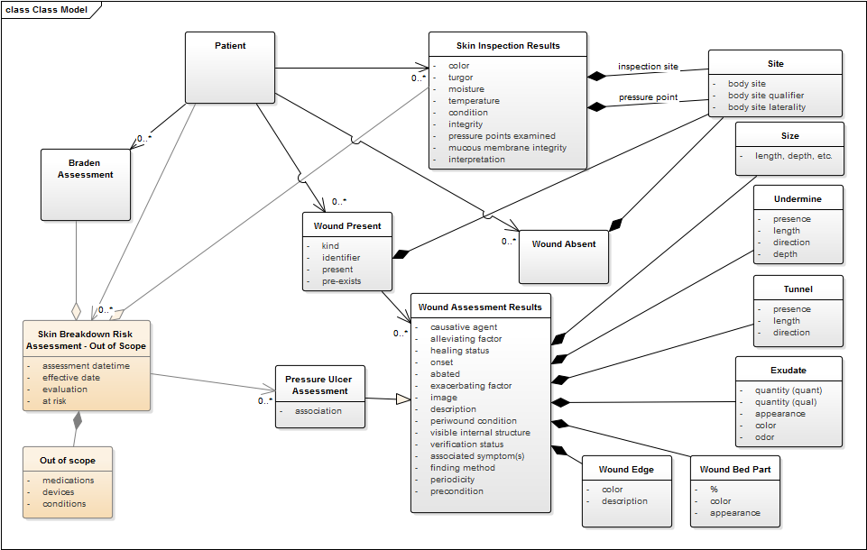
Skin Assessment Model
Notes:
Need to update picture

Slide 8
Status
Skin and Wound Assessment data elements are defined
SOLOR developers working on value sets within SOLOR
Reviewing definitions
Aligning with SNOMED CT
Identifying existing vs. new content
LOINC observations need to be linked to SNOMED CT Observable Entities
FHIR profiles are future

Slide 9
Questions

