Slide 1
Conformance and Certification
Mark Kramer, Ph.D.
Open Health Services Department K84C
MITRE Corporation
HSPC Conformance and Certification Summit
June 28-30, 2017

Slide 2
MITRE is a not-for-profit corporation chartered to work in the public interest.
MITRE operates Federally-Funded Research and Development Centers (FFRDCs)
MITRE can't manufacture products, compete with industry, or work for commercial companies
MITRE is a neutral and objective party
10 years history working with ONC, CMS, HL7 and others on testing and certification

Slide 3
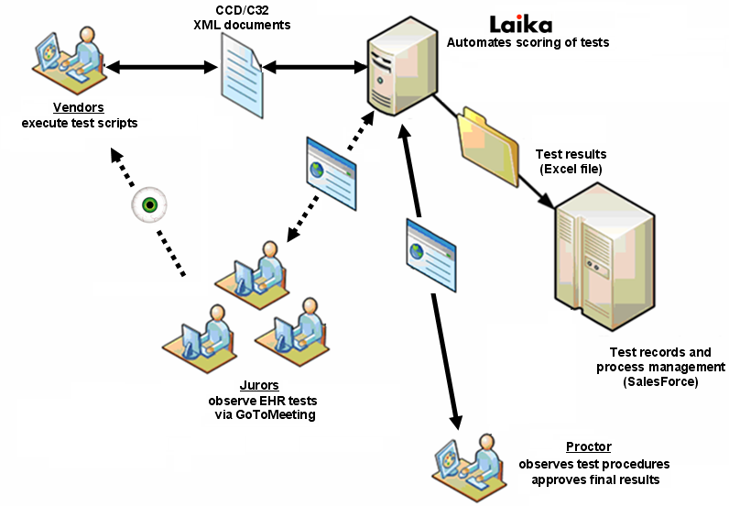
CCD/C32 Certification Testing (2008)
The Certification Commission for Healthcare Information Technology (CCHIT) was an independent, not-for-profit group that certifies electronic health records (EHR) and networks for health information exchange (HIE) in the United States.

Slide 4
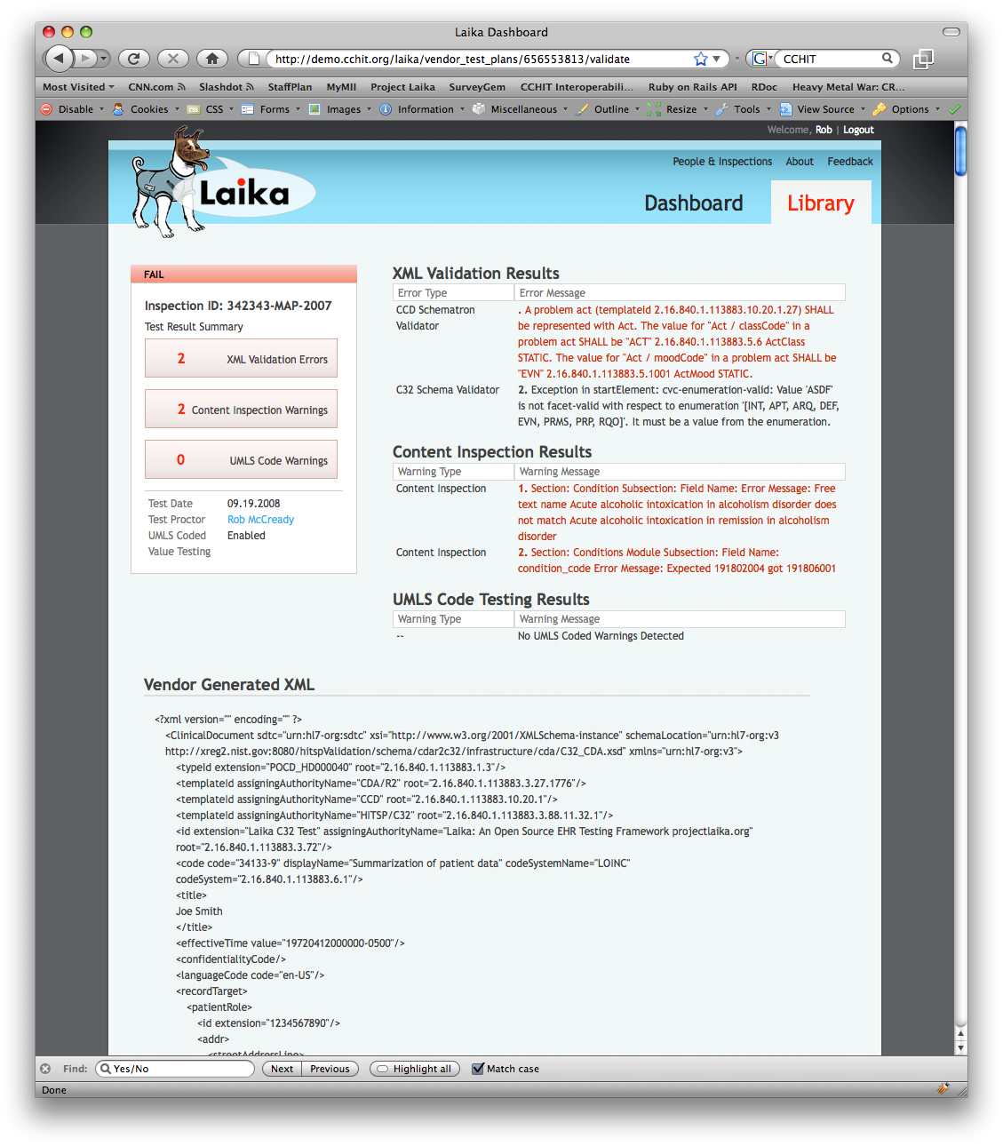
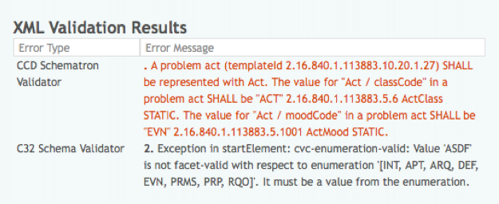

Slide 5
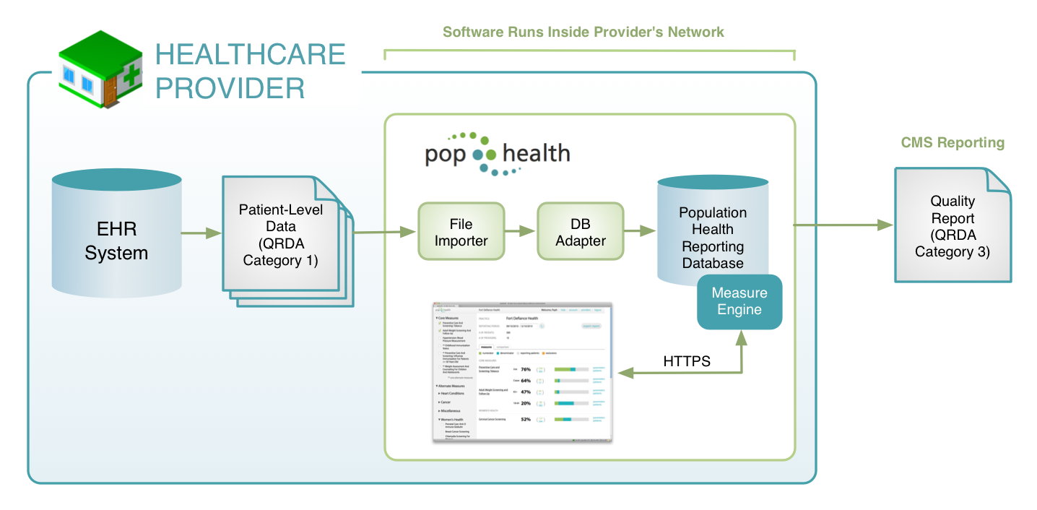
Clinical Quality Measures (2009-2010)

Slide 6
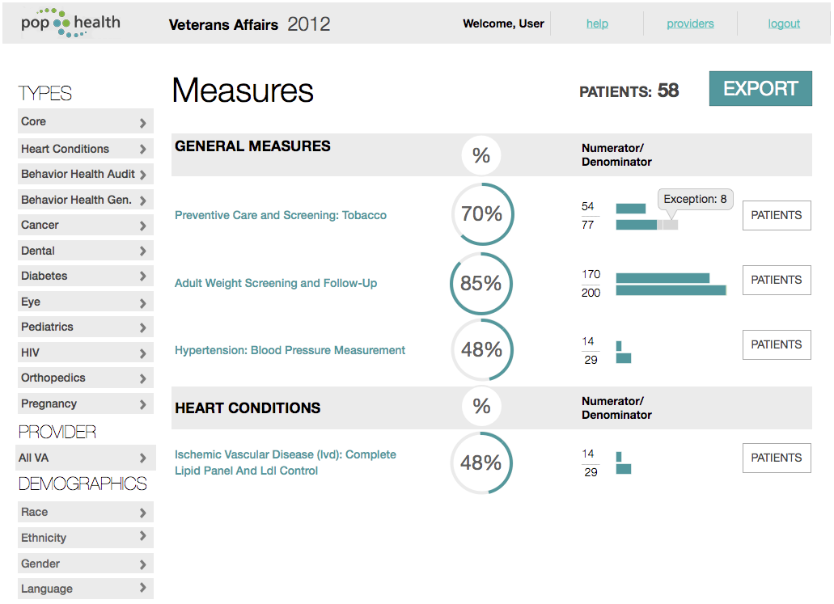
Clinical Quality Measure Scorecard

Slide 7
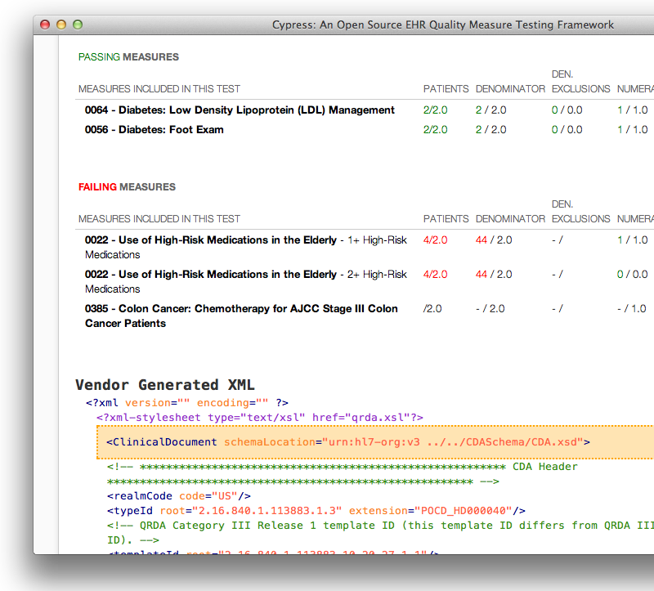
CQM Certification
Cypress tests the ability of an EHR to:
Calculate Clinical Quality Measure results
Generate reports for CMS in XML data standard format (QRDA)
Cypress is the ONC Authoritative Meaningful Use (MU) Stage 2 Clinical Quality Measure (CQM) Testing and Certification Tool
Since January 2013, certified 1187 different EHR products for MU
200M Americans have had their health data stored in EHRs tested and certified by Cypress

Slide 8
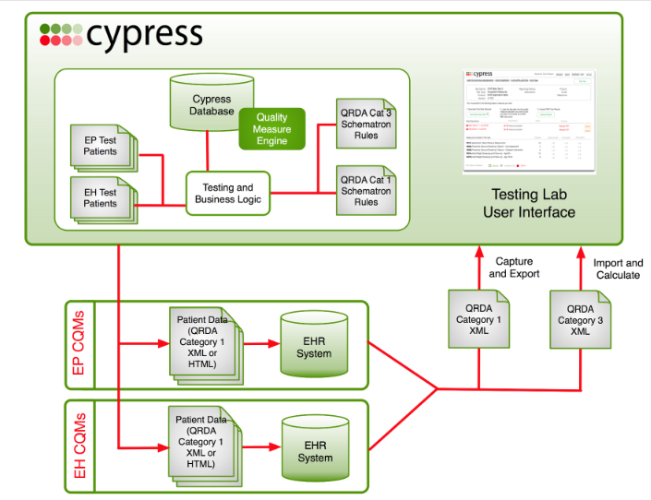
Concept of Operations

Slide 9
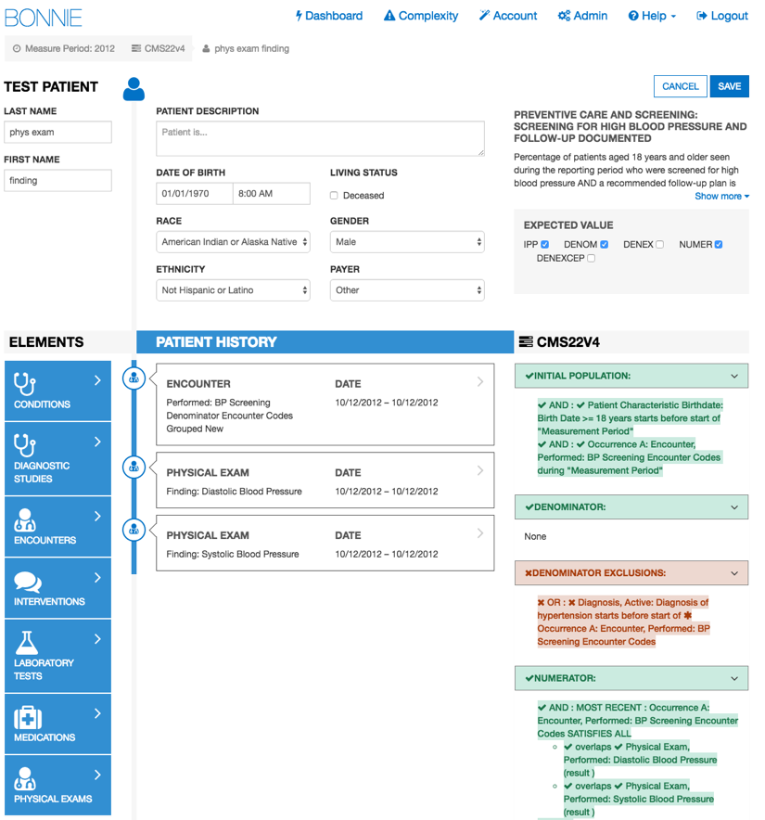
Test Tool for Quality Measure Developers
An open source testing tool that allows Clinical Quality Measure developers to test and verify the behavior of their eCQM logic.
Outcomes:
1,305 registered users have created 17,263 synthetic patient records to test and understand errors in measure performance
67% reduction in the length of measure reviews
80% reduction in measure errors

Slide 10
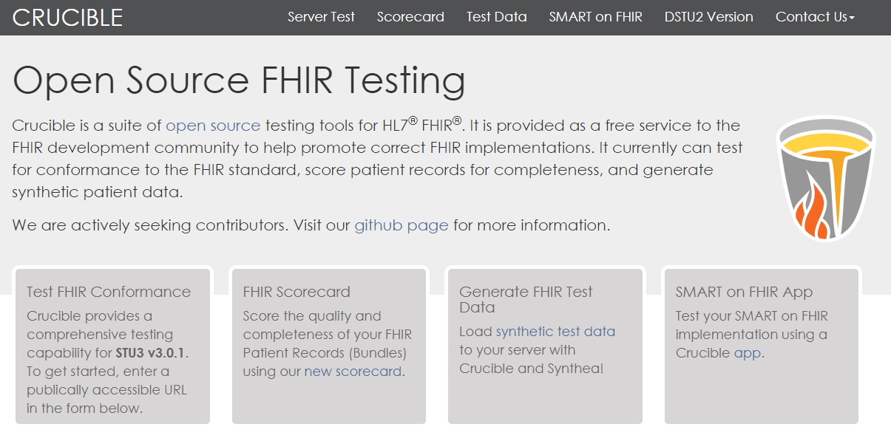

Slide 11
FHIR Conformance Testing
Web-based testing and visualization platform
Created and based on FHIR’s TestScript resource
Open-source – contributors from outside core team
Capabilities:
Versions for DSTU 2 and STU 3
Test suites for Argonaut IG
Tests for SMART-on-FHIR servers

Slide 12
Current FHIR Servers under Test

Slide 13
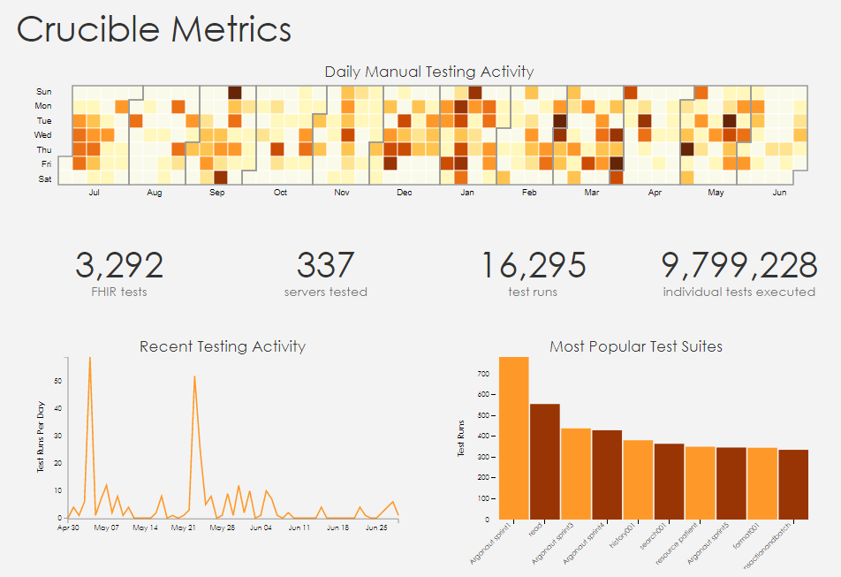
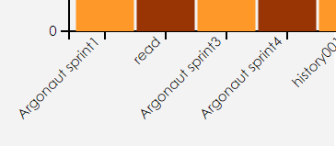

Slide 14
FHIR Scorecard (NEW)
Interoperability requires best practices that lie beyond the base FHIR specification
This scorecard borrows rubrics from C-CDA scorecards by ONC and SMART

Slide 15
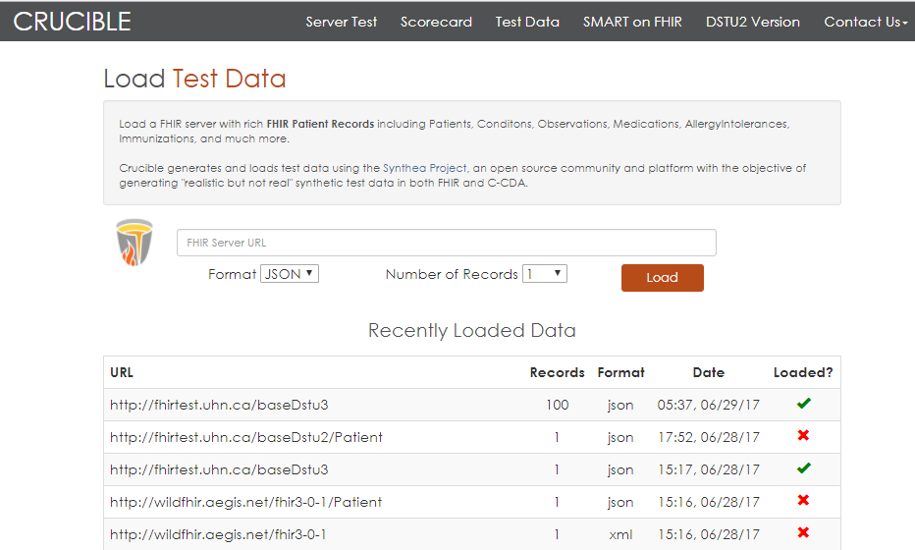
Test Data

Slide 16
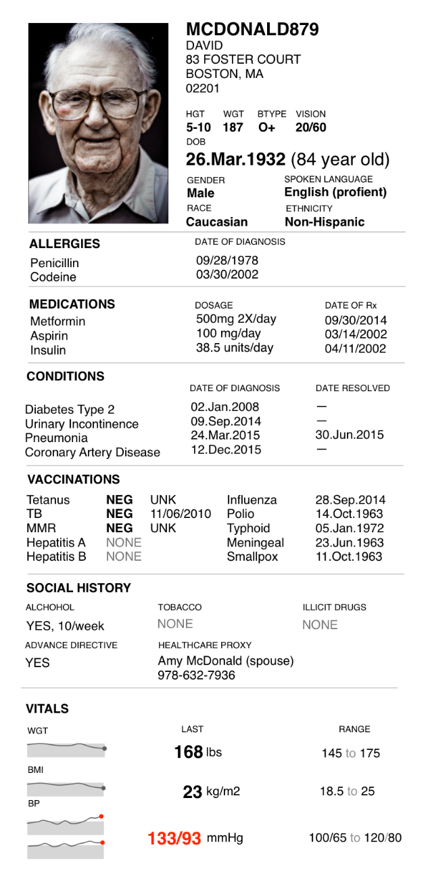
Synthea: Synthetic Health Patient Simulation
Provides unlimited high-quality health records for testing and innovation
Synthetic, realistic but not real, patient data and associated health records covering every aspect of healthcare.
The resulting data is free from legal, cost, privacy, and security restrictions for a variety of secondary uses in academia, research, industry, and government where realistic data is sufficient
Output in FHIR STU3 and C-CDA

Slide 17
Diseases Covered in Synthea
 | Top 10 Reasons Patients Visit PCP | Top 10 Years of Life Lost
1 | Routine infant/child health check | Ischemic Heart Disease
2 | Essential Hypertension | Lung Cancer
3 | Diabetes Mellitus | Alzheimer’s Disease
4 | Normal Pregnancy | COPD
5 | Respiratory Infections (Pharyngitis, Bronchitis, Sinusitis) | Cerebrovascular Disease
6 | General Adult Medical Examination | Road Injuries
7 | Disorders of Lipoid Metabolism | Self-Harm
8 | Ear Infections (Otitis Media) | Diabetes Mellitus
9 | Asthma | Colorectal Cancer
10 | Urinary Tract Infections | Drug Use Disorders (limited to Opioids)
+ opioid addition and treatment, childbirth, epilepsy, and many others
Notes:
Years of Life Lost is from the Global Burden of Disease (GBD) for the United States in 2015

Slide 18
Appendicitis

Slide 19
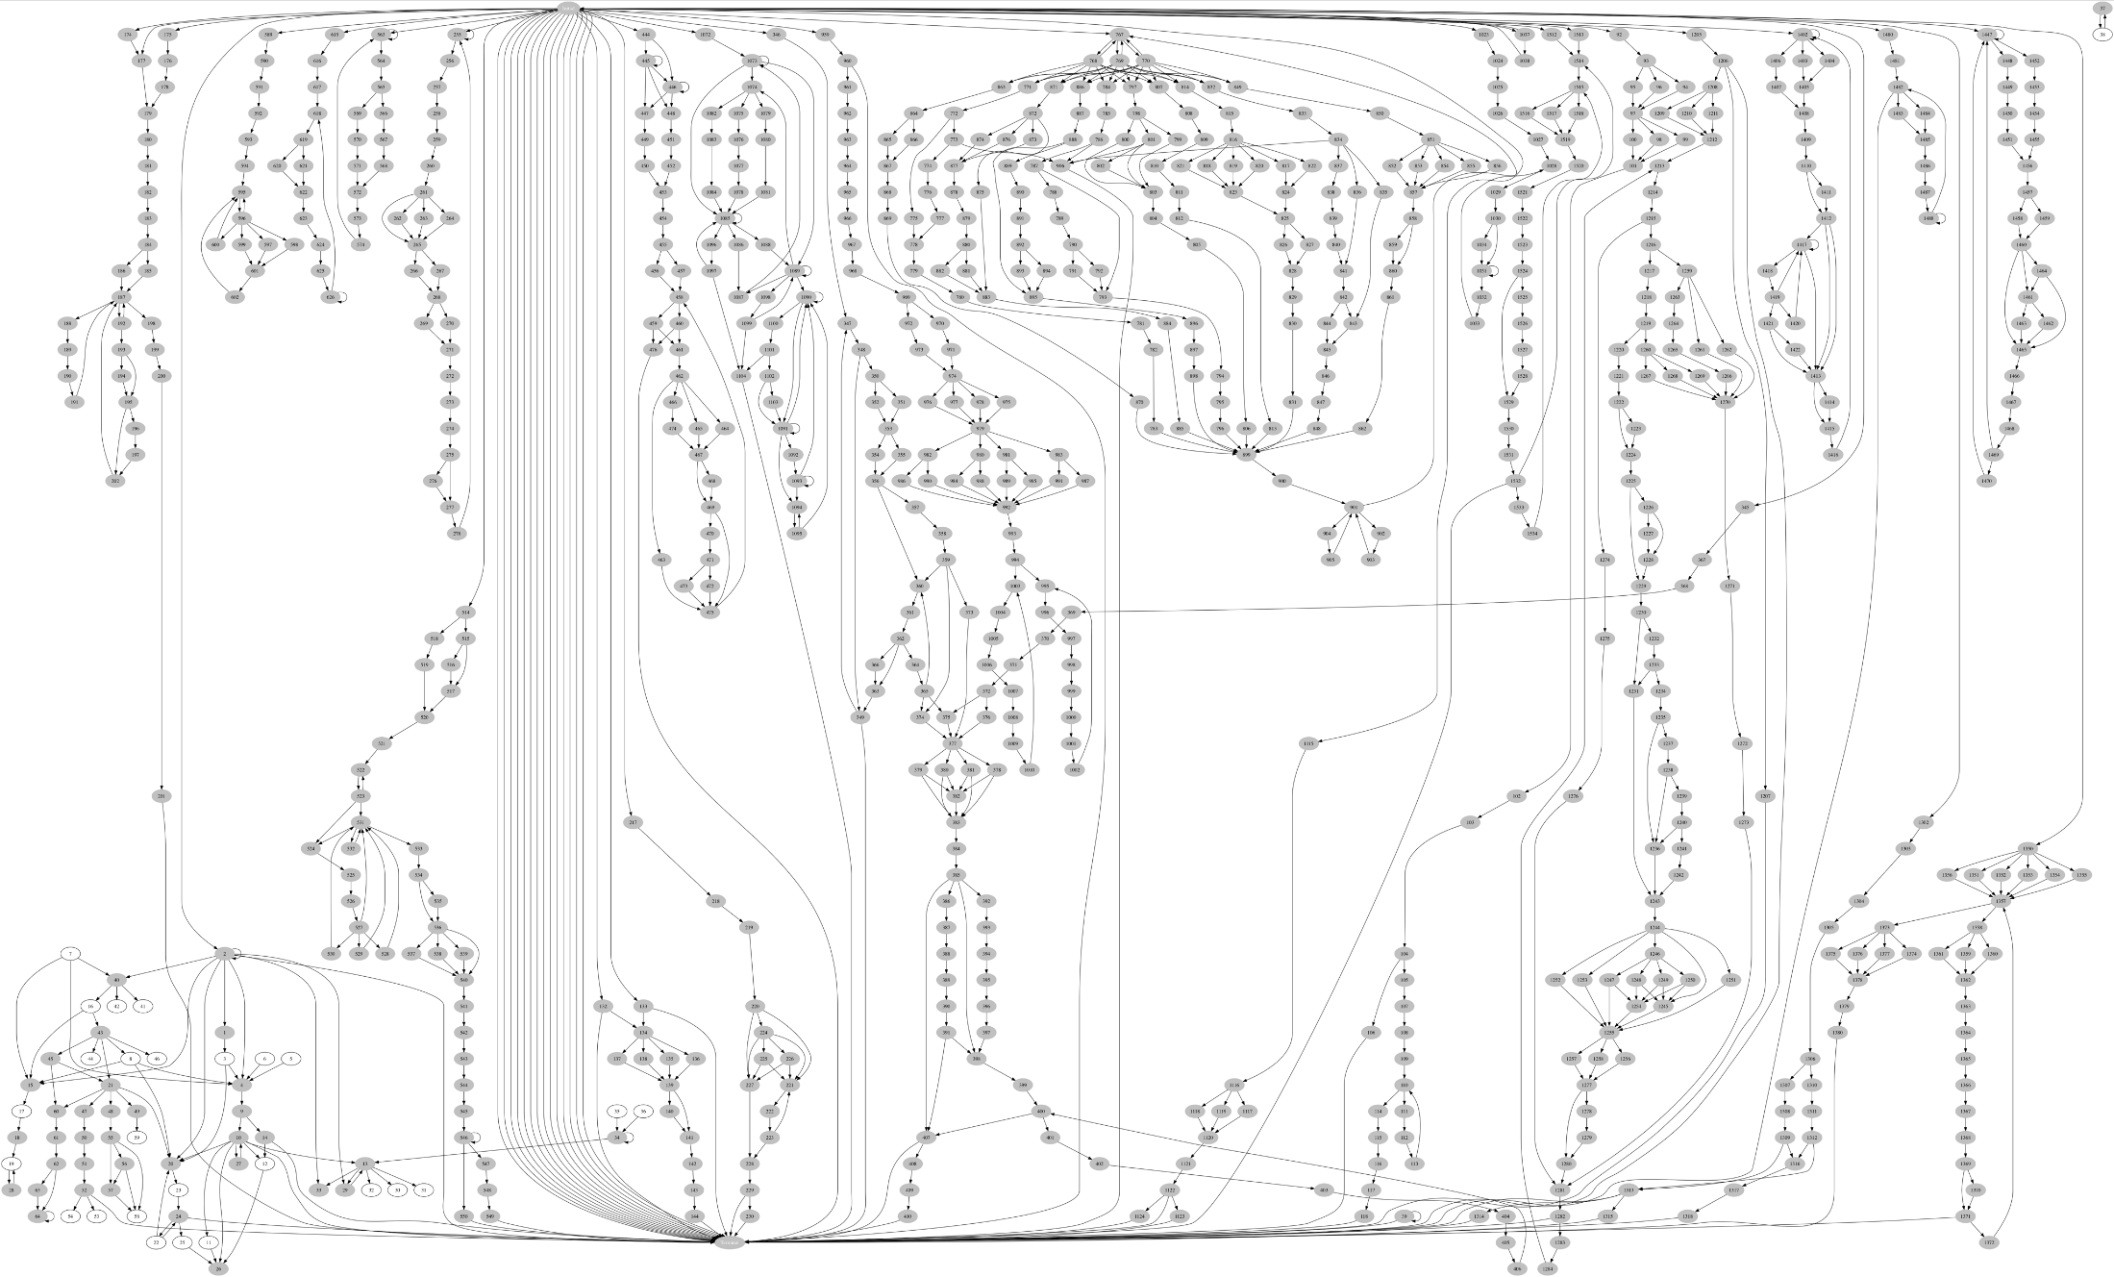
Disease Models (as of December 2016)
Notes:
1488 nodes
Red outline is Appendicitis module from previous slide

Slide 20
SyntheticMass (NEW)
https://syntheticmass.mitre.org
1,000,00+ synthetic patients in FHIR format
Based on real census data, disease incidence and prevalence

Slide 21
MITRE’s Business Models
Not for profit, but development is not free
Initial development:
Government contract (Laika, Cypress, Bonnie)
MITRE internal R&D funding (Crucible, Synthea)
Potential sustainment solutions:
Funding from sponsor (Bonnie)
Transition to sponsor (Clinical Quality Language)
Adoption of open source code by commercial company(-ies)
Find an open source host organization (PopHealth to OSEHRA)
Build a self-sustaining open-source community (Synthea)

Slide 22
?

Slide 23
Lessons Learned

Slide 24
1. Testing is Essential
You don’t know how good or bad things are until there are standard tests (and they are usually bad)
With a good testing tool, things improve rapidly and dramatically
Improvement happens whenever software is tested, but nothing focuses the mind like the threat of (non-)certification
People should be able to test what they want, whenever they want

Slide 25
2. Begin with the End Goal in Mind
Clarity of goals drives the creation of appropriate tests, e.g.:
Completeness, e.g. implementation of full API
Correct function, e.g., xx % correct identity resolution on a test set
Correct content, e.g., right information in a Transitions of Care document
Correct representation of clinical situations, e.g., vital signs

Slide 26
3. Set the Bar at the Right Height
Too low – certification is meaningless
Too high – people will ignore certification, or put their energy into protesting the requirements
Think about multiple levels of certification
It is human nature to just BARELY clear the bar – so keep the end in mind!

Slide 27
4. Think Laterally About How to Test
Example: Testing “Semantic Interoperability”
Inspect to make sure the system uses the right information model, value sets and code systems
No brainer…
Possible additional tests:
Load the system with realistic test data set
Send it queries
e.g., How many patients under the age of 65 have diabetes? How many have had a foot exam in the last 6 months? How many take metformin?
If it answers correctly, the system “understands” the data (in a practical sense)
Or
Try round-tripping the data

Slide 28
5. Make Testing a Pleasure, not a Chore
Web-based if possible
Dead simple to use
Attractive and graphical
Clear feedback on problems
Helps to determine if the failure is due to the application or the test

Slide 29
6. Open Source Works
Be OPEN – except with the final exam:
Publish the conformance criteria
Publish the testing workflow
Publish the conformance test scripts
Provide sample test sets
Open Source builds communities:
Involve government, vendors, providers, academics, start-ups, etc.
Communities working together improve together
MITRE healthcare projects use industry-friendly Apache 2 Open Source distribution license
Provides numerous freedoms for use of MITRE-developed software

Slide 30
7. Test Sets are Essential
Test sets are invaluable
Scale matters (non-functional; may be beyond conformance)
Real records (anonymized or not) are not ideal to data is not good for open experimentation
It is difficult to hand-generate test data
Synthea has proven a valuable resource in education, testing, and innovation

Slide 31
Questions

Slide 33
Synthea Open Source Collaborators
Jeff Eastman (MiHIN)
Tom Gallagher (University of Montana)
Kuda Dube, Scott McLachlan (Massey University [NZ])
Mark Braunstein (Georgia Tech)
Jaya Rao, Daniel Sahu, Lichen Shen
James Agnew (HAPI)
Sen Yang (Rutgers)
Ida Sim (UCSF, Open mHealth)
Aristotle Mannan (Boswell)
Sona Vasudevan (Georgetown School of Medicine)
+ more every few weeks

