Slide 1
A Picture from the Pieces
Laura Heermann Langford PhD, RN
Laura.Heermann@imail.org
September 21, 2017

Slide 2
Acronym Soup
Notes:
CQL – language that sits on top of CIMI and FHIR

Slide 3
This is today….
#1 Super Specialist
Best DM Care APP
Optimal Care Registry
EHR
1
EHR
2
EHR
3

Slide 4
Tomorrow: Plug and Play Interoperability
#1 Super Specialist
Best DM Care APP
Optimal Care Registry
EHR
1
EHR
2
EHR
3

Slide 5
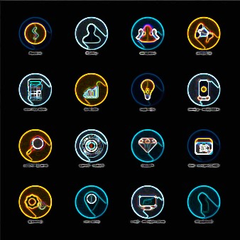
Imagine….
Semantically Interoperable
Healthcare focused Apps
Healthcare App Store

Slide 6
What needs to happen to make this work?
Data elements consistently defined
Standardized data exchange
Standardized knowledge representation and (content) exchange
Semantically Interoperable
Healthcare focused Apps
Healthcare App Store

Slide 7
What needs to happen to make this work?
Data elements consistently defined - CIMI
Standardized data exchange - FHIR, SMART on FHIR, HSPC SOA Platform
Standardized knowledge representation and (content) exchange - BPMN, etc.
Semantically Interoperable
Healthcare focused Apps
Healthcare App Store

Slide 8
Data Comes in Different Shapes and Colors
Finding – Suspected Lung Cancer
Finding – Suspected Cancer
Location – Lung
Finding – Cancer
Location – Lung
Certainty – Suspected
(Let’s say this is the preferred color and shape)
47

Slide 9
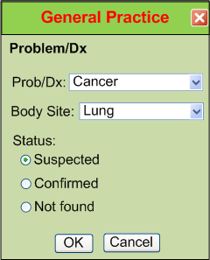
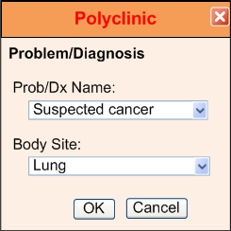
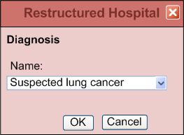
IsoSemantic Models – Example of Problem
(based on example from Dr.Linda Bird)
e.g. “Suspected Lung Cancer”
EHR Vendor ABC
EHR Vendor 123
EHR Vendor XYZ
6

Slide 10
Data Standardized in the Service
Application
Application
and User
Data in preferred shape and color
Shape and color translation
Shape and color of data
in the local database
48

Slide 11
Partial Interoperability
Application
Application
and User
Standard Terms
(Non-standard Structure)
Term
Translators
Local databases,
CDA, HL7 V.2, etc.
49

Slide 12
Preferred Strategy – Full Interoperability
Application
Application
and User
Standard Structure
AND Standard Terms
(As defined by CIMI Models)
Requirements
Term and
Structure
Translators
Local databases,
CDA, HL7 V.2, etc.
50

Slide 13
What does it mean to be SMART on FHIR
Open, standards based platform
Defines a some initial profiles of FHIR resources and other web technologies
Specifically (well adopted in healthcare)
Open ID connect
OAuth2
Manages identity concerns, security, authentication concerns – consistently.
Also has
CDS Hooks – consistent support for CDS (clinical decision support) alert delivery. Limited use case for one type of alert that fits a specific pattern.
SMART Genomics
SMART is just an entry point – it is what is available today

Slide 14
Progress
FHIR is easy to implement
FHIR has unprecedented support from EHR vendors
SMART on FHIR enables quick development

Slide 15
The Danger
No true interoperability because
Vendors use different models/profiles
Government agencies use different models/profiles
Provider organizations use different models/profiles
Professional organizations use different models/profiles

Slide 16
Development Strategy
Rather than have FHIR implementers start with a base FHIR resource and “fill in the blanks”, have them select a FHIR profile from a library of approved profiles

Slide 17
MISSION
Improve health by creating a vibrant, open ecosystem of semantically interoperable applications
Consistent implementation and libraries for:
Terminology and Modeling
SMART on FHIR Profiling
SOA Platform Services
Knowledge Representation and Content Sharing
Provider Led Non-Profit Organization

Slide 18
Super Great Pain Management
Application
Update Medication Order
Interface Service
SBS
SBS
EHR1 Order
Services
Update PharmacyOrder
WHERE orderNumber = “4674” …
Local Service
Data
Big IDN
Database

Slide 19
Best for Pregnant Women Pain Management
Application
Update Medication Order
Interface
COS
SBS
EHR1 Order
Services
Update PharmacyOrder
WHERE orderNumber = “4674” …
Service
Data
Big IDN
Database

Slide 20
Best for Pregnant Women Pain Management
Application
Update Medication Order
Interface
SBS
FP System Order
Services
Update PharmacyOrder
WHERE orderNumber = “4674” …
Service
Data
Family Practice
Oracle
Tables

Slide 21
. . .
Application
Interface
. . .
Service
Data

Slide 22
Best for Pregnant Women Pain Management
Super Great Pain Management
. . .
Application
Interface
SBS
Data Transformation
Service
EHR1 Order
Services
. . .
FP System Order
Services
Data
EHR Vendor XYZ
EHR Vendor ABC
EHR Vendor 123

Slide 23
Best for Pregnant Women Pain Management
Super Great Pain Management
. . .
Terminology and Model Libraries
Clinical Content Representation
Application
Model Review
Interface
SBS
Model Review
Repository of
Shared Models
in an approved
Formalism
Repository of
Shared Models
in an approved
Formalism
Data
Transformation
Model Review
Repository of
Shared Models
in an approved
Formalism
Service
EHR1 Order
Services
. . .
FP System Order
Services
Data
CIIC
(I4)
EHR Vendor XYZ
EHR Vendor ABC
EHR Vendor 123

Slide 24
Today
The Future
#1 Super Specialist
Best DM Care APP
Optimal Care Registry
#1 Super Specialist
Best DM Care APP
Optimal Care Registry
EHR
1
EHR
2
EHR
3
EHR
1
EHR
2
EHR
3

Slide 25
Thank you!

Slide 26
Questions?

