Slide 1
i4 Summit
Intermountain, Cerner, Siemens, Nuance iActivity Collaboration Project
Keith S. White, MD; Medical Director Imaging Services
Ben Gordon, MD; Imaging IS Section Chief

Slide 2
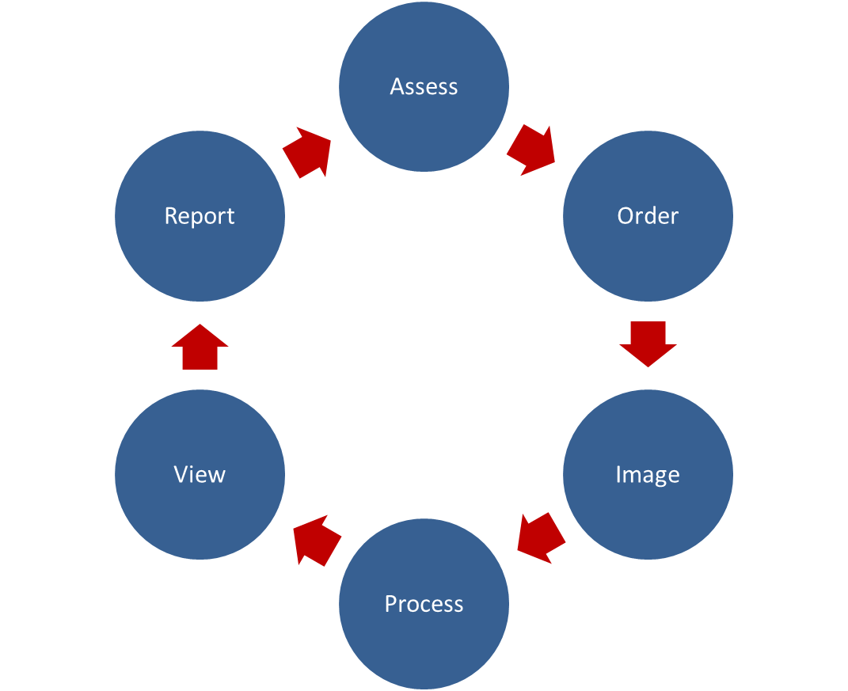
Imaging Value Chain
Imaging Information Chain

Slide 3
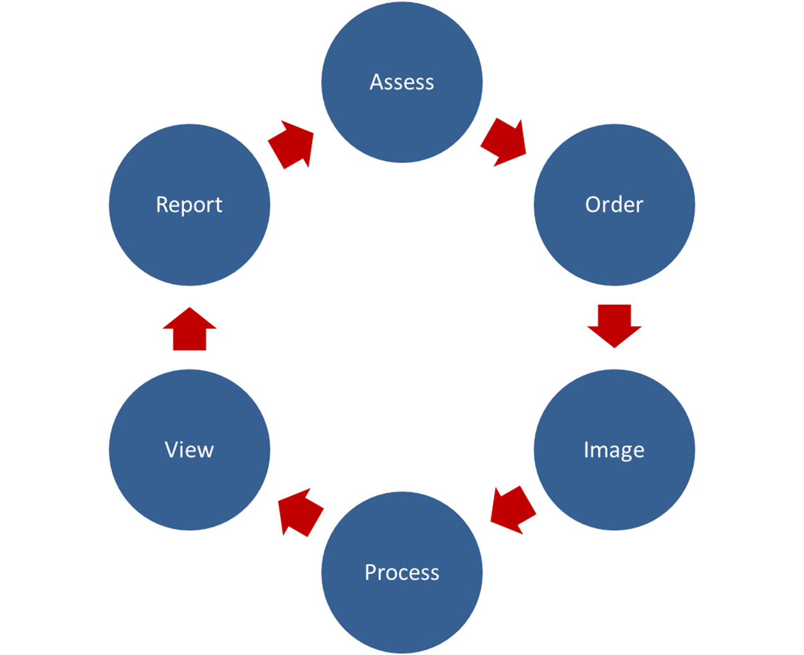
Rai·son d'ê·tre
Intervention
Results
Context
the most important reason or purpose for something's existence.
Images

Slide 4
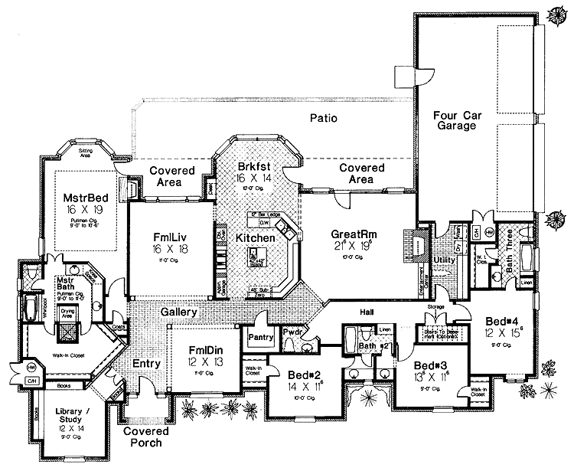
Care Process Model
An evidence-based blueprint for providing patient care for a specified clinical condition

Slide 5
Pulmonary Embolus
Diagnostic CPM

Slide 6
Pulmonary Embolus
Treatment CPM

Slide 7
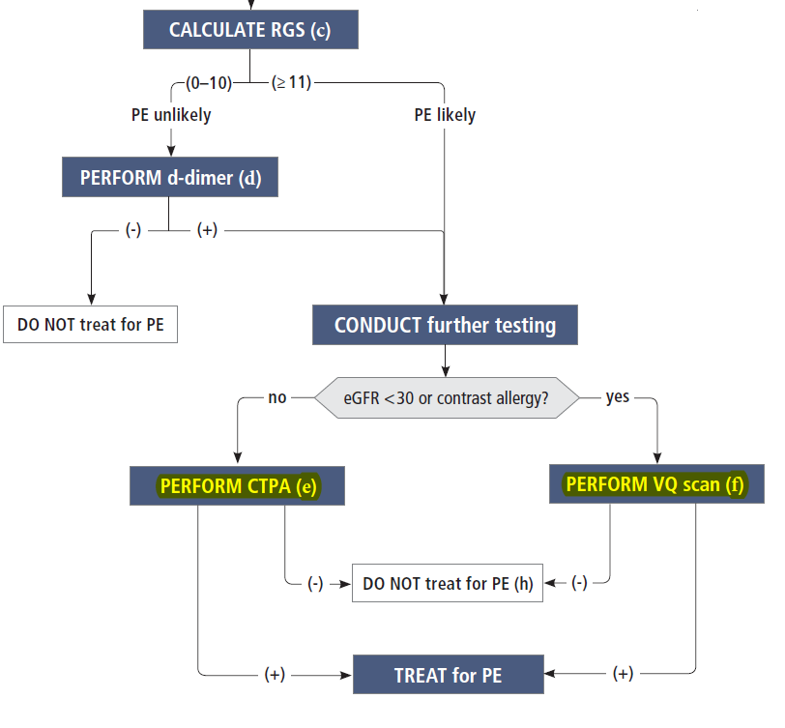
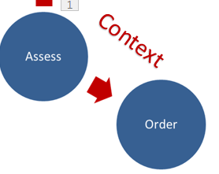

Slide 8
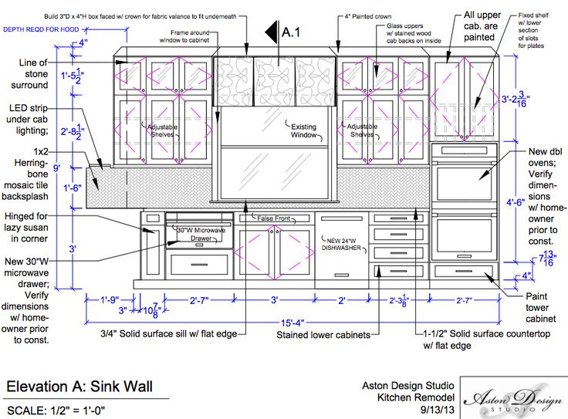
Service Process Model
An evidence-based blueprint for providing a clinical service in a specified clinical context

Slide 9
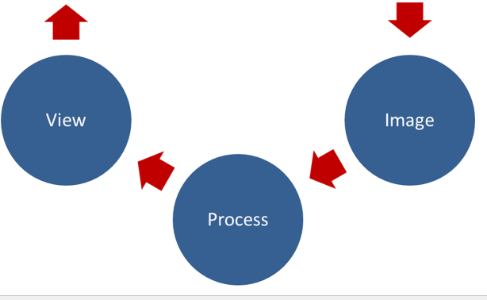
Imaging SPM
Appropriate Use Criteria
Patient Prep
Imaging Protocol
Structured Report
Input Forms
Synoptic Elements
Ref Material
Context
Results

Slide 10
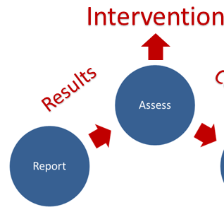

Slide 11
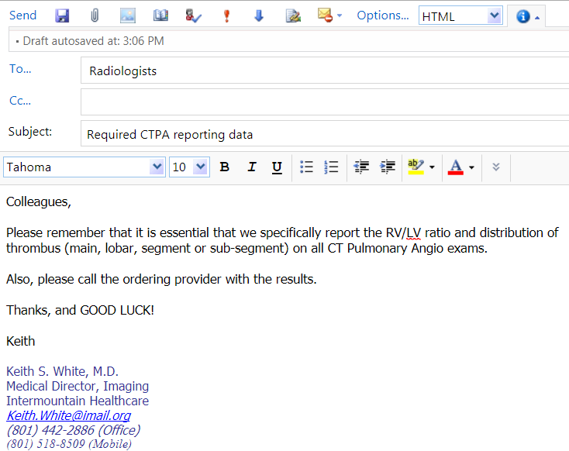
Why Computable?

Slide 12
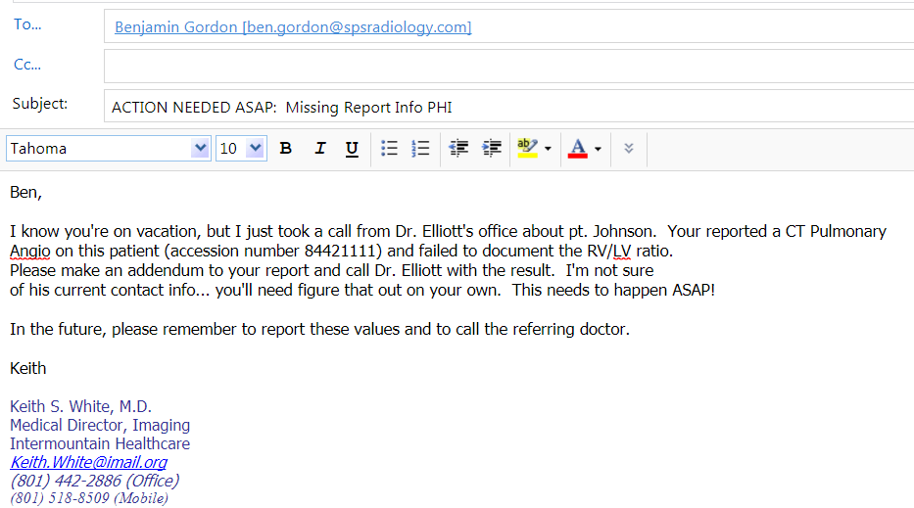
Why Computable?

Slide 13
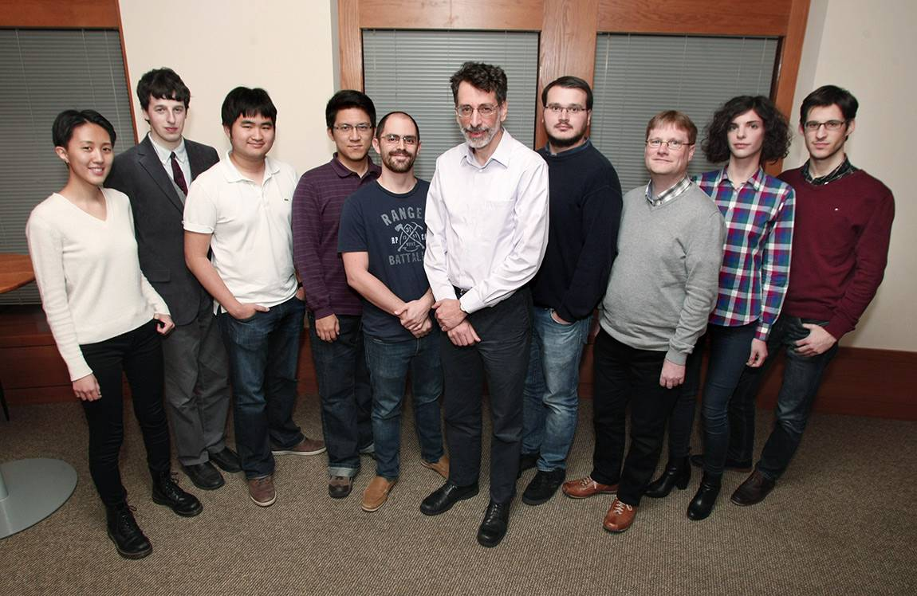
What We Need
Clinical Engagement and Cooperation
Viable Business Model, Supplier Engagement
Technical Framework and Support/Expertise

Slide 14
Clinical Engagement and Cooperation
Cultural change
Multiple projects, all speaking the same language
Coordinated disciplined definition of terms and models
Governance to approve/endorse models for broad use

Slide 15
Viable Business Model, Supplier Engagement
Funding for framework development and management
Clarity, predictability
Data showing improved outcomes and/or decreased total cost of care
Market demand

Slide 16
Technical Framework and Support/Expertise
Semantically sound framework for developing, accessing and sharing terms, models and processes
Easy to use content development tools
Accessible libraries of common terms, models, processes
Runtime native workflow applications able to “run” content at point of care
Effective, supported mechanisms to exchange data between solutions

Slide 17
Principles of iActivity Project
Principles to Practice
Connect to EMR
Enable Runtime
Author Content

Slide 18
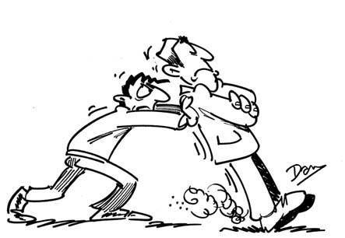
Author content
Multidisciplinary approach
Radiologists and referring doctors often have differing views on what’s important
Clinicians want more definitive/concise answers, don’t care about nuances
Highly iterative process
Radiologists resist standardization in reporting. Reporting highly connected with reading workflow that radiologist learned and has become habitual

Slide 19
Author content
Choose and/or create coded concepts
Many coded concepts not available in any available ontology
Codes can be redundant
not conceptually true to use case
observe tracks of prior projects in ontologies

Slide 20
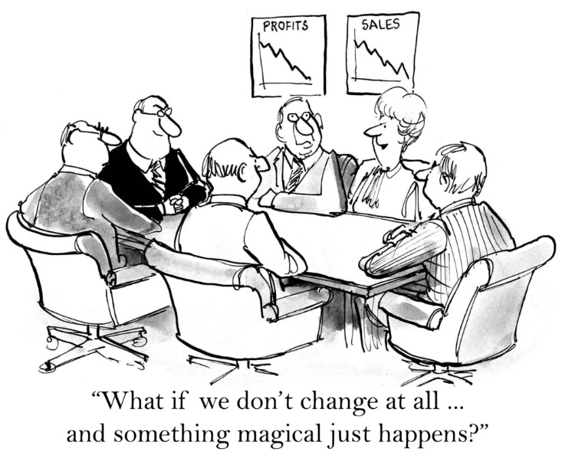
Author Content
Build coded concepts into semantic models, attach meaning (codes)
Clinical Modeling Engineer (Data Modeler) proved invaluable

Slide 21
Author Content
Define operable context
Contexts had to also be coded
especially difficult to connect reasons for exam
Poor data coming from EMR (CPOE doesn’t live up to the promise)
Immature implementation, few contexts available

Slide 22
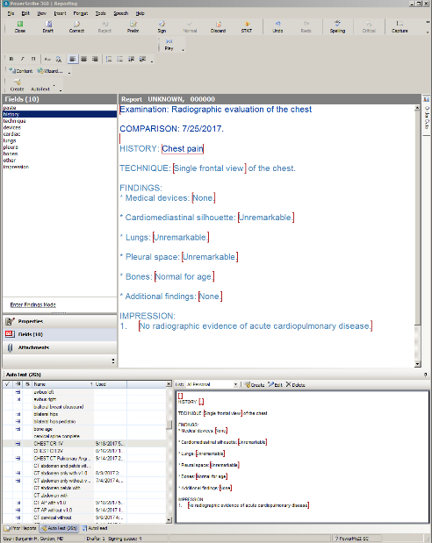
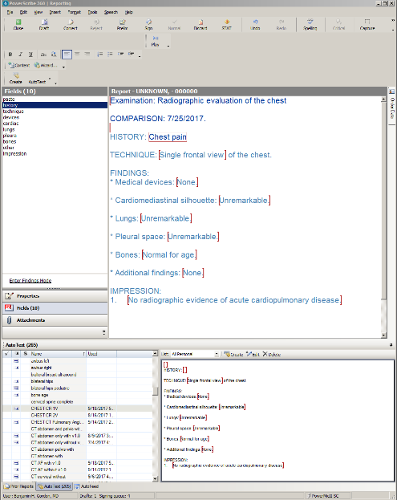
Author Content
Build and associate with 3rd party runtime templates
Use existing 3rd party tools to allow seamless integration into existing workflow
Requires redundant authoring and synchronization, not scalable
Constrained by existing 3rd party capabilities
3rd party technologies evolving in somewhat unpredictable ways
Reporting
Tool
A
Reporting
Tool
B
Composition Tool

Slide 23
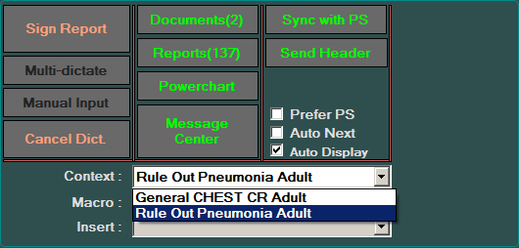
Enable Run time
Choose default context
Default context often wrong
May relate more to bias of radiologist
Modify Context as needed
Powerful concept, well received
Load model
Load desired template into 3rd party run time
Override existing default templates
Ability to add content to exisiting report
Our application leverages existing APIs to other runtimes not fundamentally built for purpose of generating structured data

Slide 24
Enable Run time
Enforce collection of data required by model
Enforced regardless of template utilized – allows enforcement of key component without requiring complete standardization of template
Data elements viewed as redundant by radiologists attached to descriptive reporting.

Slide 25
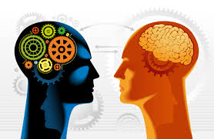
Enable run time
Extract required data from report
Move toward runtime collection of data and export rather than rely on report text (ultra-smart NLP)

Slide 26
Enable Run Time
Store data (meaning/codes) into custom database
Searchable database powerful tool to onboard radiologists and multidisciplinary teams to concept – Radiologists see value in data desire more.
Database available to radiologists for outcome research etc.

Slide 27
Connect to the EMR
Build HL7 interface to EMR
Coordination of multiple teams
Generic, needs downstream tie to EMR
Develop storage architecture into EMR
Required for each synoptic element
Requires deep knowledge of EMR storage architecture
In many cases, need EMR supplier to accomplish repeatedly
Connect with meaningful EMR workflow (results review, messaging, care pathway, etc.)
Encoded radiology data is new concept, opportunities just beginning to be understood
Clinicians often can’t connect to an intervention
More than results review, EMR mental block

Slide 28
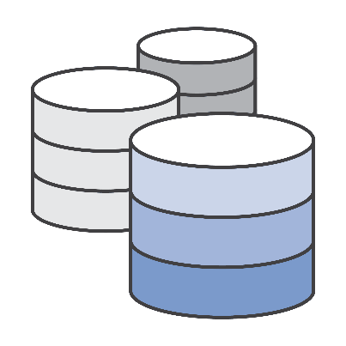
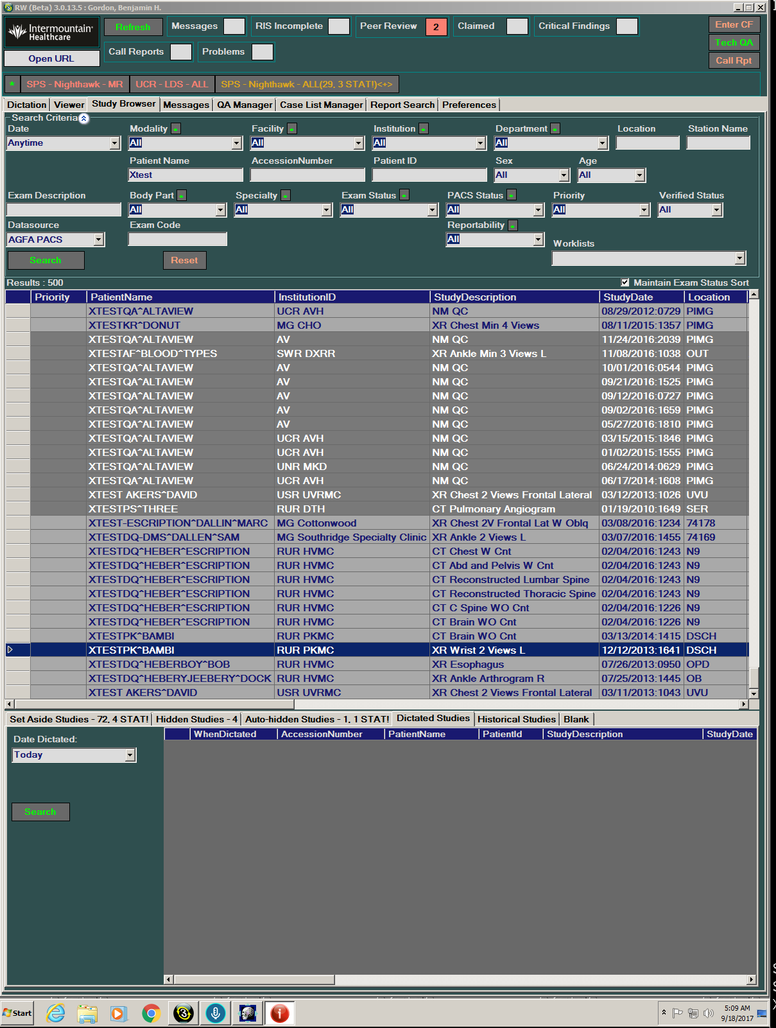
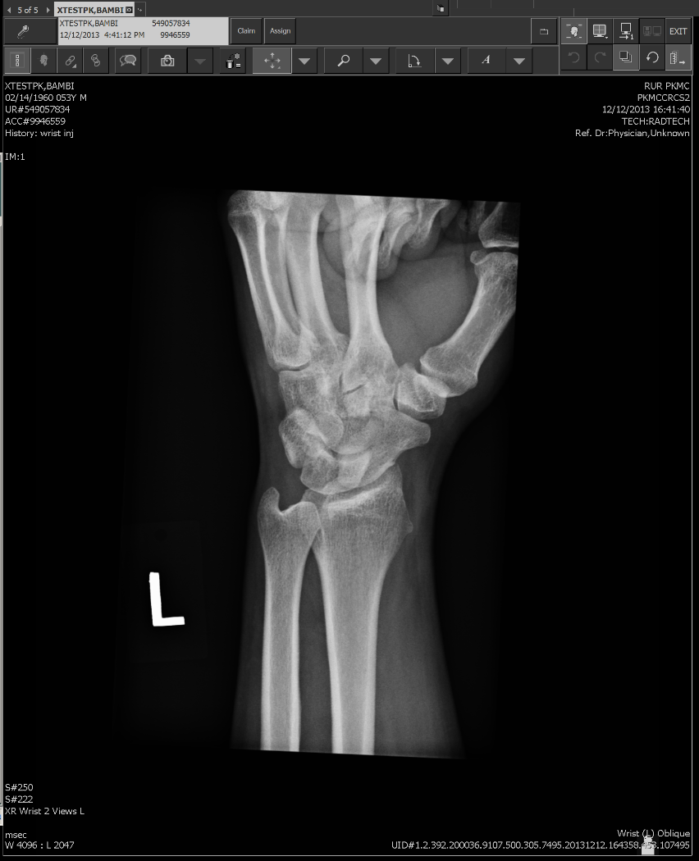
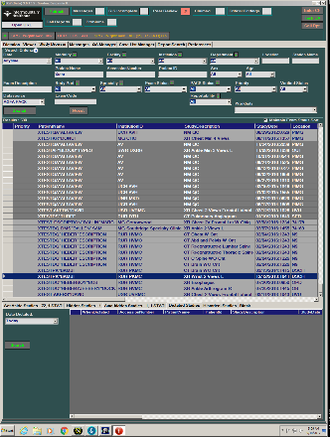
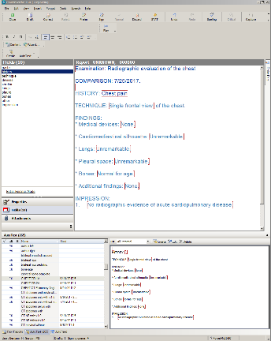
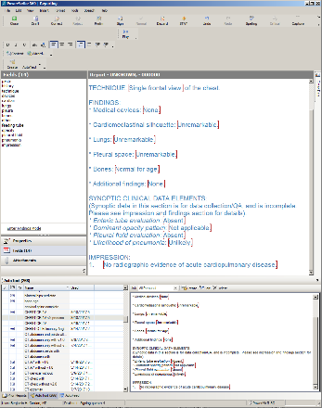
Clinical Knowledge Repository
iActivity Database
Exam Code
Gender
Patient Location
Reason for Exam
Age
Matching clinical context?
No
Yes
Workflow Manager
iActivity will load context specific template in reporting tool
Reporting Tool
Viewer
Reporting tool selects default template
Start Dictation

Slide 29
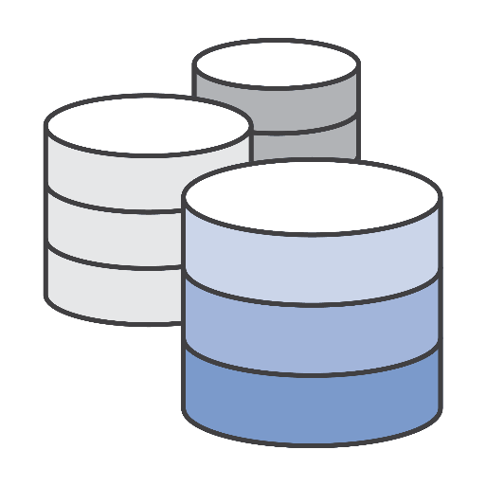
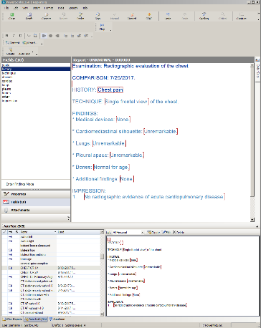
Context Management
Wrong Context?

Slide 30
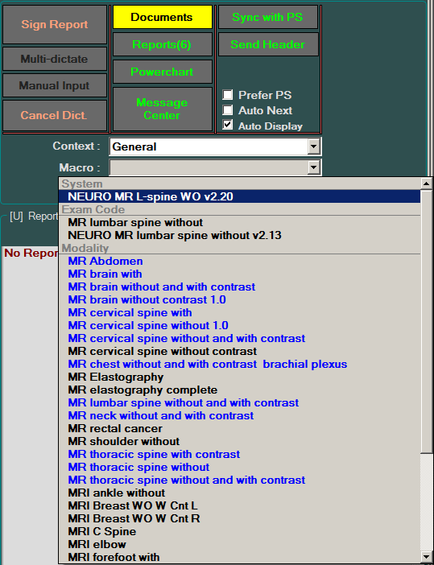
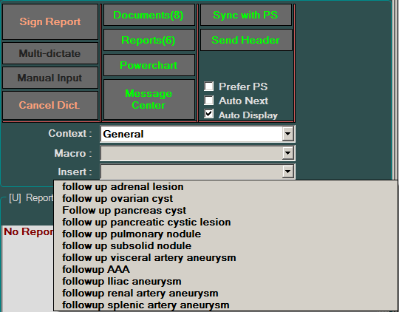
Template management

Slide 31
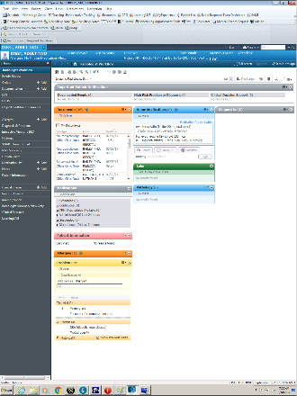
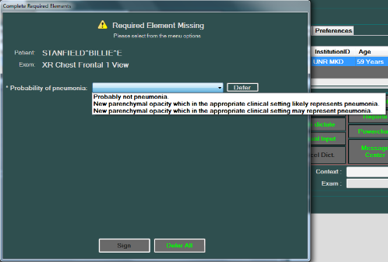
Context not specified or required elements satisfied?
Yes
Reporting Tool
EMR
No
Sign off Report
Missing Required Element Workflow

Slide 32
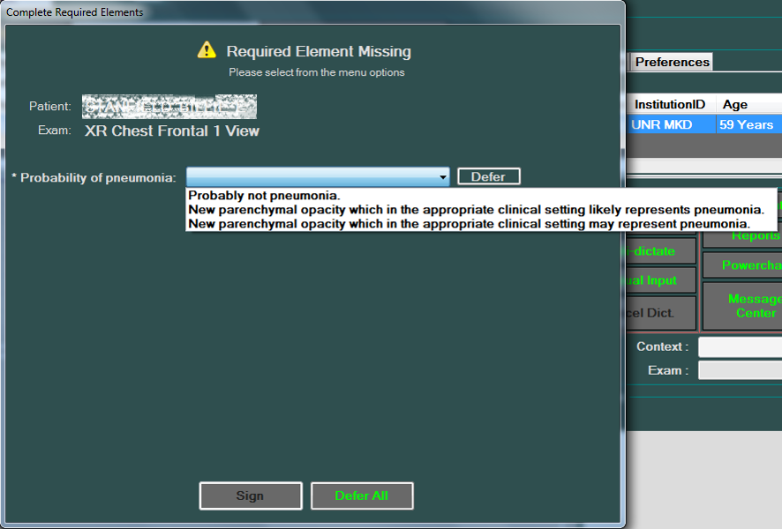
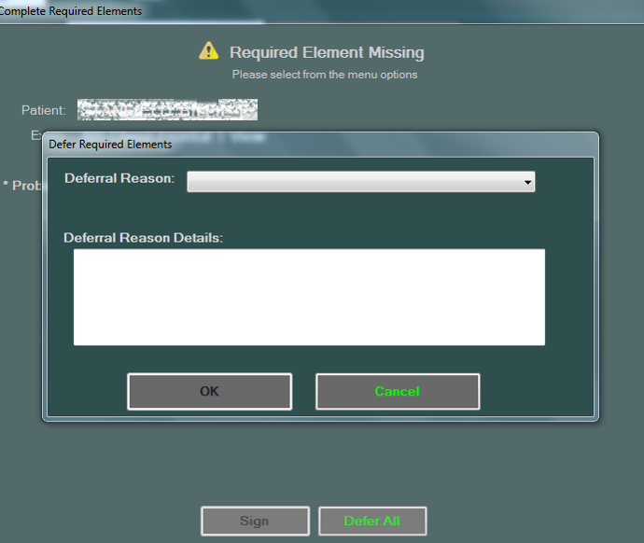
Missing Required Element Workflow

Slide 33
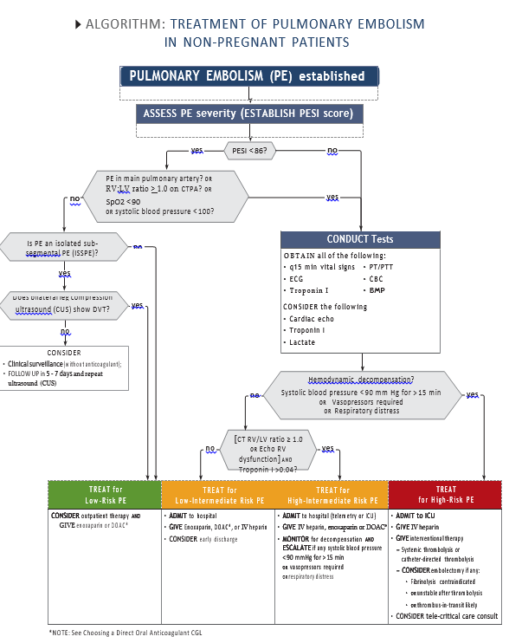
Actionable Data Use Case

Slide 34
Activity Based Design (ABD)
Intermountain Healthcare/Cerner Prototype

Slide 35
Simple Framework Manages Extreme Complexity

Slide 36
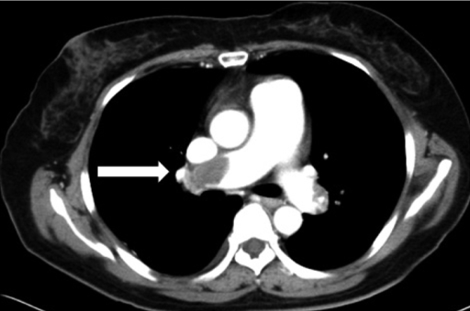
ABD Architectural Overview
Manage Suspected PE Process
Activity Authoring
Activity Runtime
PA02 = 81%
RGS = 12
eGFR = 78
Lobar PE
RV/LV Ratio 1.1
Intra-arterial thrombolysis
etc.
Workflows
Execution Steps
Rules
Handoffs
Required Data

Slide 37
Core ABD Concepts
The majority of clinician workflows can be described by a manageable number of activities
Activities can be described in computable form using standard ontologies and semantic models
Activity content should be developed and managed within independent standards-based frameworks by clinical teams

Slide 38
Core ABD Concepts Cont.
Content development is a massive task that will be best advanced by the work of collaborative teams
Computable activities can be deployed naturally at the point of care in run-time applications
Comprehensive documentation, costing and linkage to downstream activities are native byproducts of activity-enabled workflows

