Slide 1
Russell B. Leftwich, MD Senior Clinical Advisor, InterSystems Corporation September 21, 2017 - Washington, DC
Imaging Information Interoperability Iniatitive
On the origins and nature of FHIR

Slide 2
?
What if HL7 created a new interoperability standard starting from scratch?

Slide 3
HL7® FHIR®
Fast
Healthcare
Interoperability
Resources
® Health Level Seven, HL7 and FHIR are registered trademarks of Health Level Seven International, registered with the United States Patent and Trademark Office.

Slide 4
HL7 version2 (2.x) is 30 years old.
HL7 CDA® is over 10 years old.

Slide 5
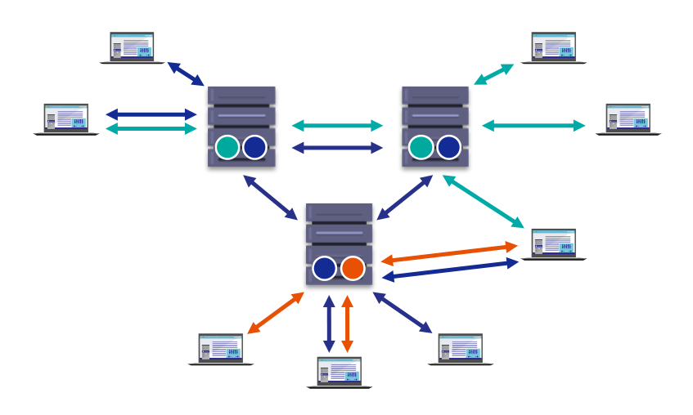
Interoperability: 1990

Slide 6
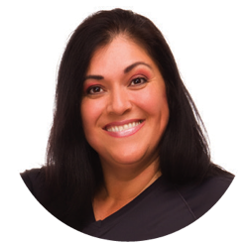
Interoperability: The future
Government:
CDC & FDA
Social service agency
Home and mobile devices
Genomics lab
Pharmacy
Rehab
Specialist
Hospital
Home care agency
Family
Payer
Laboratory
Primary Care
Patient
Ambulance
Pharma/device company
Researcher
Long term care
Schools
Notes:
Ensure that people, processes and equipment all see the whole patient
Move care to the lowest intensity setting
Engage the patient as a member of the team
Coordinate across the whole health and care community

Slide 7
The Burning Platform: Overwhelming complexity
Human
cognitive
capacity
William Stead, et al
Academic Medicine. 86(4): 429-434, April 2011.

Slide 8
REST: The Essence of FHIR
REpresentational State
Google, Twitter, FaceBook
Your favorite travel website
Notes:
“Resources” with an explicit and stable URI
The name for what gets exchanged in REST
Defined behaviour and meaning
Known identity / location
Quite an abstract idea
Formats: XML / JSON (+RDF, coming)
Exchange using HTTP (Security: SSL / Oauth / OpenID)
Often “REST” is followed loosely, hence “RESTful”

Slide 9
Your favorite travel site
AnyAirplaneFlight.com
Notes:
“Resources” with an explicit and stable URI
The name for what gets exchanged in REST
Defined behaviour and meaning
Known identity / location
Quite an abstract idea
Formats: XML / JSON (+RDF, coming)
Exchange using HTTP (Security: SSL / Oauth / OpenID)
Often “REST” is followed loosely, hence “RESTful”

Slide 10
FHIR is both the technology and
the agreement on the meaning of the data.
Notes:
“Resources” with an explicit and stable URI
The name for what gets exchanged in REST
Defined behaviour and meaning
Known identity / location
Quite an abstract idea
Formats: XML / JSON (+RDF, coming)
Exchange using HTTP (Security: SSL / Oauth / OpenID)
Often “REST” is followed loosely, hence “RESTful”

Slide 11
FHIR Resources: Basic building blocks
®
Defined behavior and meaning
“of interest”
to healthcare
Smallest unit of transaction
“Resources” are:
Known identity / location
Small logically discrete units of exchange

Slide 12
FHIR Extensions: 80/20 Rule
FHIR Resources have data elements if 80% of existing systems include them
Extensions are the other 20%
Meet specific use cases
The encoding looks no different,
just not in the standard
FHIR specification includes rules for extensions so that they are more easily exchanged.
Notes:
FHIR Resources if 80% of existing systems include
FHIR was built by implementers
Maiden name is not in the 80%
Streamline development by including what is common
Extensions are the other 20%
Meet specific use cases
The encoding looks no different, just not in the standard
Everything is still shared, available
FHIR servers with public access to Extensions
HL7 will eventually host server to share

Slide 13
FHIR Profiles
Profiles are basis of implementation
Built for specific use cases from simple to complex
Encompass the entire scenario
Profiles include constraints for a use case
Multiple Resources & Extensions: FHIR building blocks
Vocabulary/terminology/code binding
Interoperability is in the FHIR Profiles
FHIR Profiles are based on information models
Only shared profiles create interoperability
Notes:
And few systems will ever see more than 40-50

Slide 14
Ah-ha moment on FHIR
Regardless of paradigm the content is the same*
It’s straight-forward to share content across paradigms
e.g. Receive a lab result in a message. Package it in a discharge summary document
It also means constraints can be shared across paradigms
e.g. Define a profile for Blood Pressure; use same resources in messages, documents, REST and services
* Ah-ha!!

Slide 15
FHIR Supports 4 Interoperability Paradigms
RESTful
Documents
Messages
Services

Slide 16
The Challenge

Slide 17
A black horse with white stripes ….. or a white horse with black stripes?
Photo by Lukas Kaffer

Slide 18
Profile for a Procedure in FHIR
Patient
Condition
DiagnosticReport
Subject
Related Item
Report
Procedure
Encounter
Performer
Encounter
Practitioner

Slide 19
Isn’t FHIR just a draft standard that is still being developed and tested ?
Notes:
“Resources” with an explicit and stable URI
The name for what gets exchanged in REST
Defined behaviour and meaning
Known identity / location
Quite an abstract idea
Formats: XML / JSON (+RDF, coming)
Exchange using HTTP (Security: SSL / Oauth / OpenID)
Often “REST” is followed loosely, hence “RESTful”

Slide 20
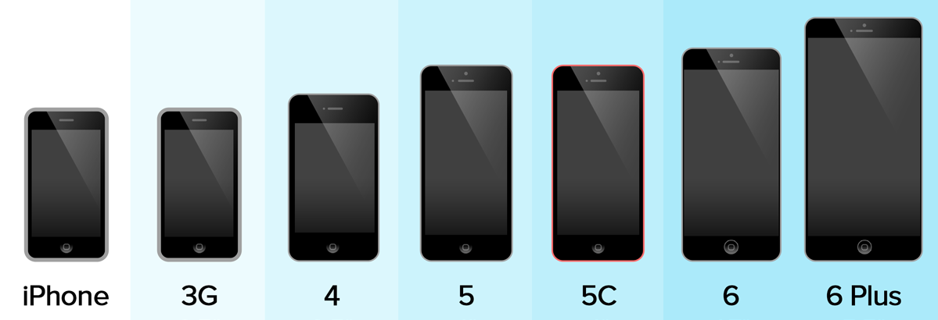
iPhone Maturity Model
People purchased and used the iPhone 2
It did not have all of the features of iPhone 3
Some features were improved, some were added
iPhone 6 is even better, but you can still use earlier iPhones

Slide 21
So, then FHIR will soon replace everything ?
Notes:
“Resources” with an explicit and stable URI
The name for what gets exchanged in REST
Defined behaviour and meaning
Known identity / location
Quite an abstract idea
Formats: XML / JSON (+RDF, coming)
Exchange using HTTP (Security: SSL / Oauth / OpenID)
Often “REST” is followed loosely, hence “RESTful”

Slide 22
The Lifecycle of Standards
HL7 V2
HL7 CDA
HL7 FHIR®
HL7 V3
Notes:
Discussion Points:
This slide should be your pivot towards talking about FHIR within the context of HealthShare
The point of this slide is to illustrate how, even when we reach peak rates of FHIR adoption, you will still live in a heterogenous landscape of standards.
The Y-Axis is a conceptual synthesis of market usage of the standard and industry standard mindshare
The X-Axis is time on the scale of decades. The very left hand side is shortly after the inception of V2 HL7 in the 1980’s. The dotted red line represents now (2016). The right end of the graph is 10-15 years in the future.
This graph isn’t driven by data, it’s simply a conceptual illustration
The key take away is that all standards peak in adoption and mindshare and then slowly taper off over time as systems are replaced or upgraded.
Currently, we’re at what is essentially “peak CDA” and V2 and V3 HL7 are falling off. Meanwhile FHIR is building towards what will likely be a strong peak in 5-10 years.
The key takeaway here is that even when we get to a point where FHIR dominates the market, you will still have to deal with V2 and CDA standards.
This is where HealthShare is key to an organization’s success. Because HealthShare can speak a wide range of standards, and convert between them, it is ideally positioned to bridge the ”standards gap” between legacy standards and FHIR.

Slide 23
Bridging Systems in a Hybrid Environment
Health Information Exchg
FHIR
FHIR
Data
Transform
FHIR
Index
FHIR Resource Repository
CDA
FHIR
FHIR
Transform
CDA
IHE (XDS.b)
HL7v2
HL7v2
Notes:
FHIR in, FHIR out
FHIR in, CD, HL7v2 out
CDA, v2 in, FHIR out
Can split, can augment. Generic description of use case: HealthShare bridging clinical systems.

Slide 24
FHIR Enabled Health Information Exchange
FHIR enabled HIE platform
Login
OAuth/OpenID
FHIR-based REST client
Data
Transform
Legacy Gateway or EHR
1 … *
Search
PUT/POST
Index
FHIR Resource Repository
FHIR
Transform
Notes:
Log in
Search for patient and retrieve patient resources of potential matches
Select a particular patient, which launches hook to external clinical system (EHR or legacy system, etc…)
Retrieve data from external system
Convert data to FHIR resources (needs to be in SDA at some point, full clinical document- ignore for this diagram)
Bundle of resources and store each in resource repository
Index resources
Client can GET or Search for resources based on what’s been indexed

Slide 25
Thank You
?
Questions?
Russell.Leftwich@InterSystems.com
Twitter: @DocOnFHIR

