Slide 1
BPMN Tutorial
November 14, 2017
Stephen A. White, Ph.D.

Slide 2
Agenda
Introduction/Background
Diagram Elements
  Activities
  Events
  Gateways
  Connectors
Other Elements and Concepts

Slide 3
Introduction
Introduction/Background
I am a contractor for VHA with 30 years of process modeling experience, ranging from modeling pilot workload to commercial business processes.
I have worked with many business domains, such as telco, finance, insurance, and now healthcare.
I have been involved with BPM standards development. In particular, I was the lead editor of the BPMN specification and was a contributor to the CMMN specification.

Slide 4
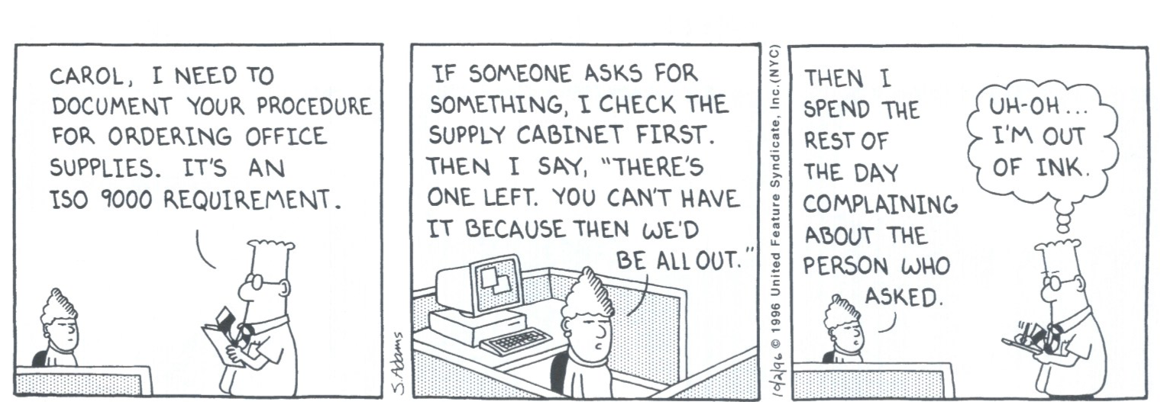
What is Process Modeling?
Introduction/Background
To put it simply: The capturing of business activities and supporting information.
  Business processes describe how a business pursues its objectives.
Scott Adams: Journey to Cubeville Vol 12 – A Dilbert Book. 1998 ISBN 13: 978-0-8362-6745-7

Slide 5
What is BPMN?
Introduction/Background
The Business Process Model and Notation (BPMN) defines how specialized flowcharts can be used to represent business processes.
  It is a graphical notation since it defines the shapes and markers of the process elements in the flowchart.
  It is a model since it explicitly defines the behaviors of processes through the relationships between the process elements.

Slide 6
What is BPMN?
Introduction/Background

Slide 7
Origins of BPMN
Introduction/Background
In 2000, the Business Process Management Institute (BPMI—now merged into the OMG) started developing the Business Process Modeling Language (BPML - an XML process execution language) and recognized the need for a graphical representation.
  BPML was later replaced by WS-BPEL as the execution language.
August, 2001, the Notation Working Group is formed. The group was composed of 35 companies, organizations, or individuals.
BPMN 1.0
  May, 2004, the BPMN 1.0 specification was released to the public.
  February, 2006, BPMN 1.0 was adopted as an OMG standard.
BPMN 2.0
  January, 2011, BPMN 2.0 was adopted as an OMG standard.
  July 2013, BPMN 2.0 was adopted as an ISO standard (ISO/IEC 19510:2013).

Slide 8
BPMN is a Language
Introduction/Background
Think of BPMN as any language, such as English.
  It has a vocabulary and semantics.
  Its purpose is to describe business processes and their behavior.
Think of a BPMN process model as a type of written document, even though it does have graphical elements.
BPMN provides a larger vocabulary and set of semantics than is needed for most process modeling purposes and audiences.
  But BPMN is designed to provide the ability for process modelers to define all types of business situations.

Slide 9
BPMN Development Drivers
Introduction/Background
The two main drivers for the development of BPMN were:
  BPMN must be:
    Acceptable and usable by the business community (i.e., it should be easy to use).
    Able to generate executable processes through a BPMN Model—i.e. a combination of graphical elements and supporting information (attributes).
BPMN is intended to be Extensible.
  Different industries and modeling domains may have requirements unique for their models.
  BPMN has formal extension mechanisms to allow new elements, markers, and icons to be added to Process models (e.g., new Task types, etc.).
    However, any extension must not conflict with any existing modeling element or semantics.

Slide 10
Agenda
Introduction/Background
Diagram Elements
  Activities
  Events
  Gateways
  Connectors
Other Elements and Concepts

Slide 11
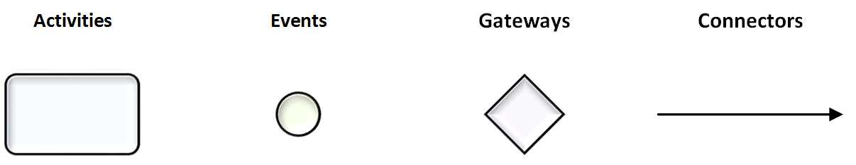
Diagram Elements

Slide 12
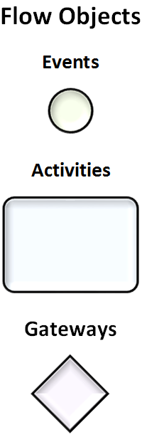
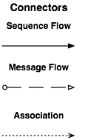
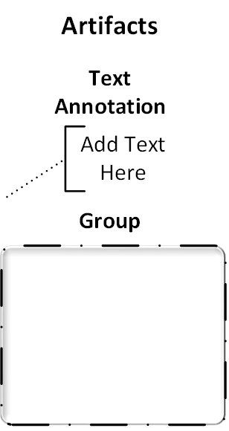
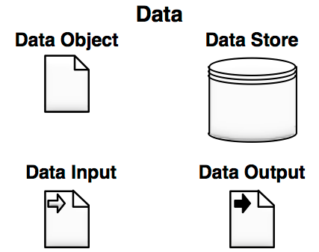
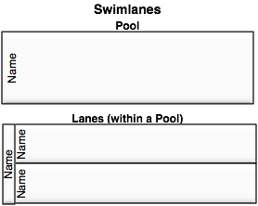
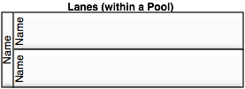
Diagram Elements

Slide 13
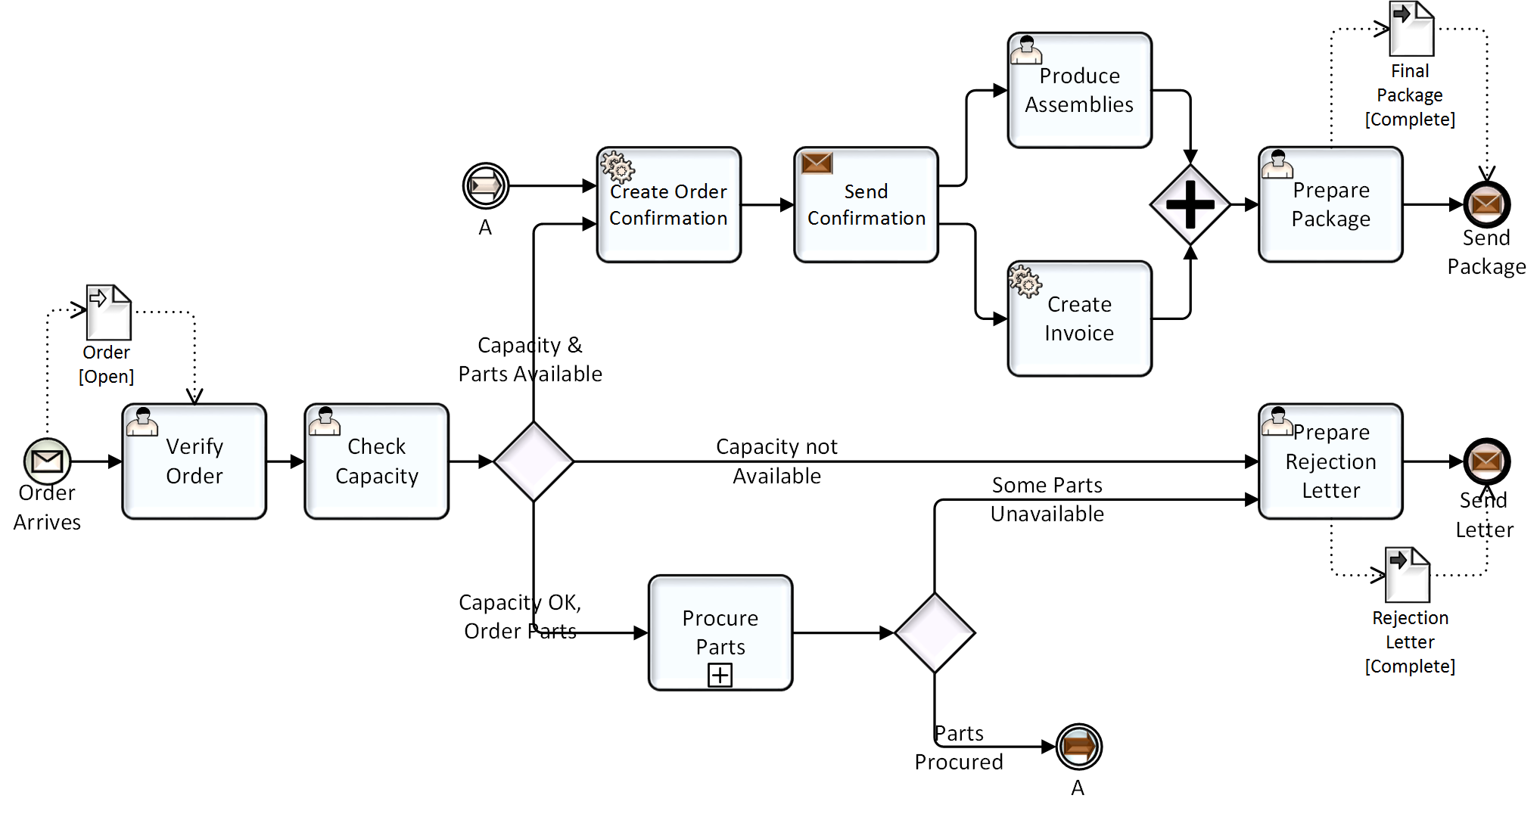
Diagram Elements

Slide 14
Understanding Behavior
Diagram Elements
Process models are more than just a collection of Activities, Events, and Gateways.
The relationships between these elements and their properties define a consistent and understandable behavior.
  Anyone who is familiar with BPMN should be able to read and understand the behavior of a BPMN model.
This tutorial will describe the Process elements and their relationships — using diagrams and animation to illustrate the behaviors.
By understanding how the Process flows, it will help you model the variety of situations that exist across organizations.
  BPMN was developed to provide a modeling capability that does not constrain users too tightly and make model creation as flexible as possible.
  Thus, Process behavior can be complex at times. So, it is important to understand how the Process elements behave and interact.

Slide 15
Agenda
Introduction/Background
Diagram Elements
  Activities
  Events
  Gateways
  Connectors
Other Elements and Concepts

Slide 16
Activities
An activity is work that is performed within a business process.
  They are rounded rectangles in a BPMN diagram.
An activity can be:
  Atomic (Fig. A) - Task,
  Non-atomic (compound—Fig. B) - Sub-Process,
  Linked (Fig C) - Call (Linked) Activity, or
  Event triggered (Fig. D) - Event Sub-Process.
We will review these in the next few slides.

Slide 17
Tasks
Activities
A Task is an atomic activity that is included within a Process. A Task is used when the work in the Process is not broken down to a finer level of Process Model detail.
  There are specialized types of Tasks for:
    User Performance (Fig. A),
    System Performance (Fig. B), or
    Business Rule (Fig. C), and others.
A
B
C

Slide 18
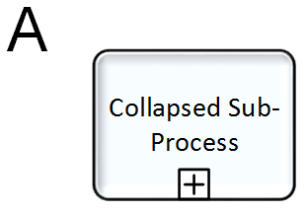
Sub-Processes
Activities
A Sub-Process is a compound activity that is included within a Process.
  It is compound in that it can be broken down into a finer level of detail (a Process) through a set of sub-activities.
It can be shown in a collapsed form (Fig. A), which hides its internal details.
  It uses the activity rounded rectangle shape and has a plus sign marker in the bottom-center of the shape to indicate that it is a Sub-Process, and can be expanded.

Slide 19
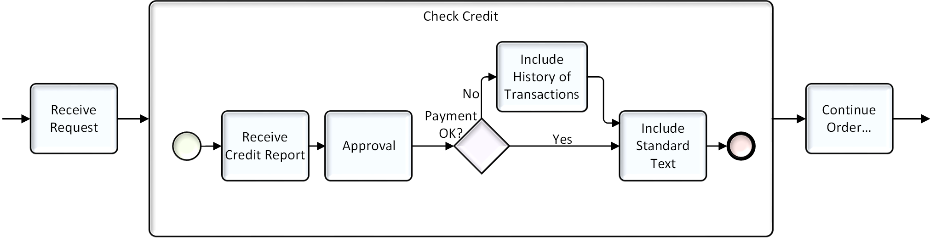
Sub-Processes
Activities
It can be shown in an expanded form (Fig. B), which exposes its internal details.
B

Slide 20
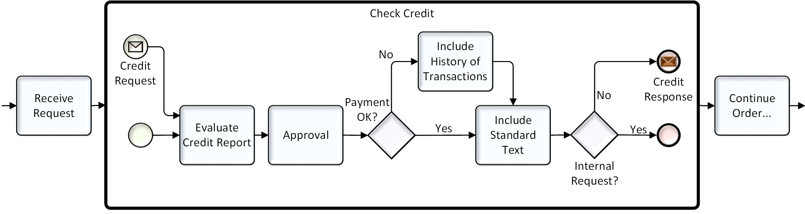
Linked Processes (Call Activities)
Activities
Call Activities, or more informally called Linked Processes, can be reused in other Processes or can be top-level Processes themselves
They must have a None Start Event to be a Linked Process
  They can have other Start Events if they will start independently
  Data from the parent (calling) Process must be transferred in and out of the Linked Process

Slide 21
Agenda
Introduction/Background
Diagram Elements
  Activities
  Events
  Gateways
  Connectors
Other Elements and Concepts

Slide 22
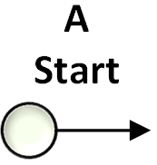
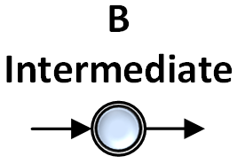
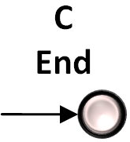
Events
An Event is something that “happens” during the course of a business process.
BPMN Event shapes are circles, but they are more accurately defined as being either:
  An event listener (catcher) or
  An event generator (thrower).
  They catch “triggers” and throw “results.”

Slide 23
Events
Events are also categorized as to where they affect the flow of the Process. They can:
  Start the process (Fig. A): Start Events have a thin line style boundary.
  Occur within the flow (Fig. B): Intermediate Events have a double line style boundary.
  End (Fig. C) the flow: End Events have a thick line style boundary.

Slide 24







Start Events
Events
Start Events indicate where a Process will begin.
Start Events are only event listeners (catchers) - not event generators (throwers).
There are types of “Triggers” that define the circumstances that can start the Process.
A Start Event has no inbound Sequence Flow.

Slide 25
Intermediate Events in Normal Flow
Events
Events that are placed within the process flow represent things that happen during the normal operations of the process.
  They can represent the listening (“catch) for the Event (i.e., the receipt of a message).
  They can represent the generation (“throw”) of the Event (i.e., the sending of a message).
Here is a simple example of how Intermediate Events are used in Normal Flow:
Intermediate Event Generator
Intermediate Event Listener

Slide 26
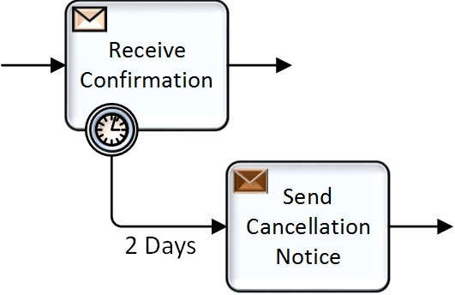

Intermediate Events on Activity Boundaries
Events
Events that are attached to the boundary of an activity indicate that the activity will be interrupted if the Event is triggered (see simple example to the right – Figure A).
Only Event Listeners (catchers) can be used on an activity boundary.
Some of the Boundary Events can be set so they do not interrupt the activity they are attached to.
  Non-interrupting Boundary Events have a dashed, double-line style boundary (see Figure B to the right).
They are used for error handling, exception handling, and compensation.
A
B

Slide 27
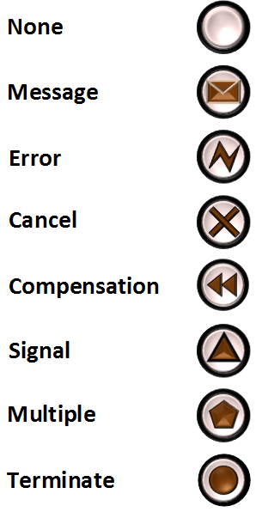
End Events
Events
End Events indicates where a process path ends and will only generate Events - they are not listeners.
The End Event shape is a circle with a thick line style boundary and an open center.
  The center is open to allow markers that show the type of result (type of Event to be generated).
If there are ongoing parallel paths, the process will continue until all paths have ended (except for the Terminate End).

Slide 28
Agenda
Introduction/Background
Diagram Elements
  Activities
  Events
  Gateways
  Connectors
Other Elements and Concepts

Slide 29
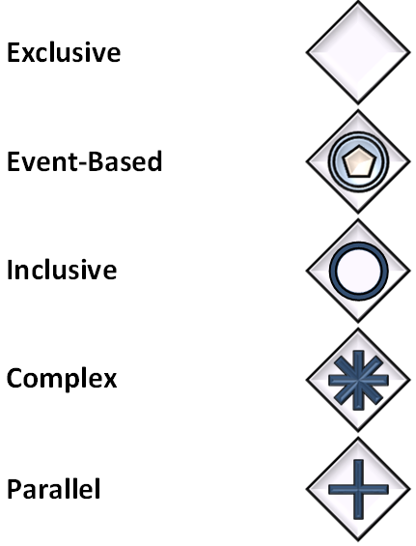
Gateways
Gateways are modeling elements that control how Sequence Flows interact as they converge and diverge within a Process.
  The flow can be made to be alternative, parallel, or other variations.
All Gateways use the familiar diamond shaped used for branching in simple flowcharts.
  Different internal markers indicate different types of behavior.

Slide 30
Gateways
All Gateways both split and merge the flow.
  The splitting and merging for a type of Gateway will be matched.
    That is, a Gateway cannot be Parallel on the input side and Exclusive on the output side.
If the flow does not need to be controlled, then a Gateway is not needed.
  Thus, a diamond represents a place where control is needed.

Slide 31
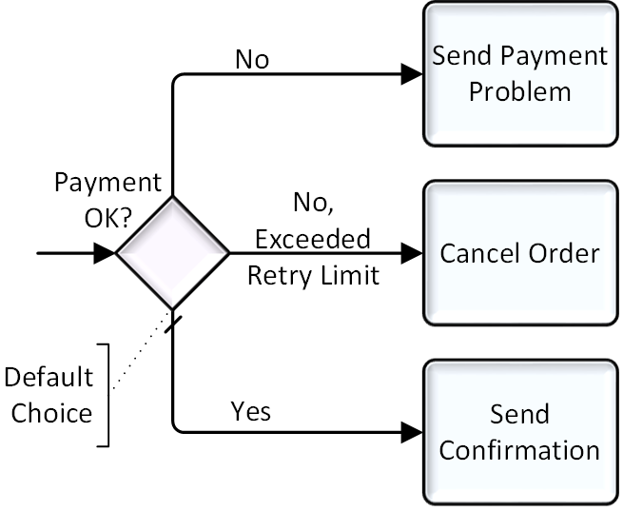
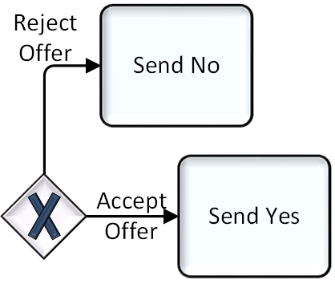
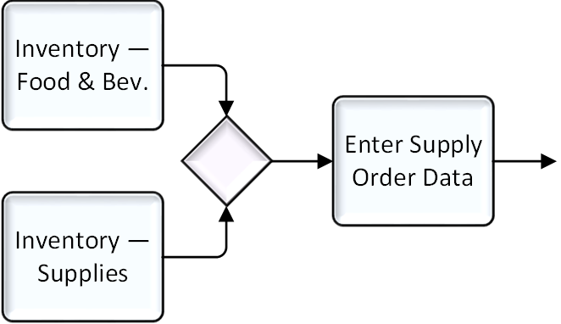
Exclusive Gateways
Gateways
Exclusive Gateways are the most commonly used type of Gateways.
  They can be shown with an internal “X” marker (Fig. B) or without (Fig. A). Without is the most common use.
The Gateway (Decision) creates alternative paths based on defined conditions.
  Only one of the paths can be taken during performance.
For merging, all paths will “pass through” the Gateway (Fig. C).
A
B
C

Slide 32
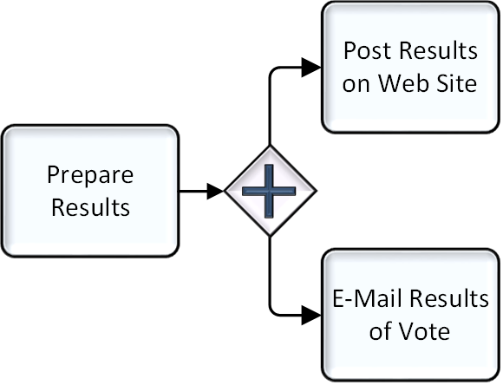
Parallel Gateways
Gateways
Parallel Gateways are places in the “Process” where multiple parallel paths are defined.
  The “+” marker is used to identify this type of Gateway (see Figure A).
Each outgoing Sequence Flow for a Parallel Gateway will receive a Token.
  There is no evaluation or exclusion.
A

Slide 33
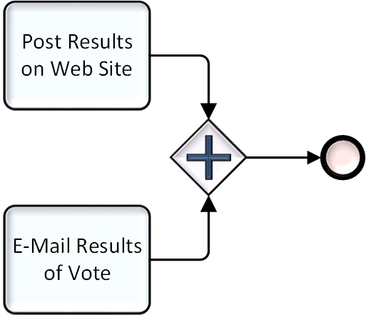
Parallel Gateways
Gateways
The Gateway is also used to synchronize (wait for) parallel paths (see Figure D).
Care is required to match numbers of paths to the actual number of incoming tokens.
If the number of incoming Sequence Flow is not correct, then the Parallel Gateway will get stuck waiting for the flow to arrive down a path that will never occur.
  A Process that is stuck will never properly complete unless interrupted by some other mechanism.
D

Slide 34
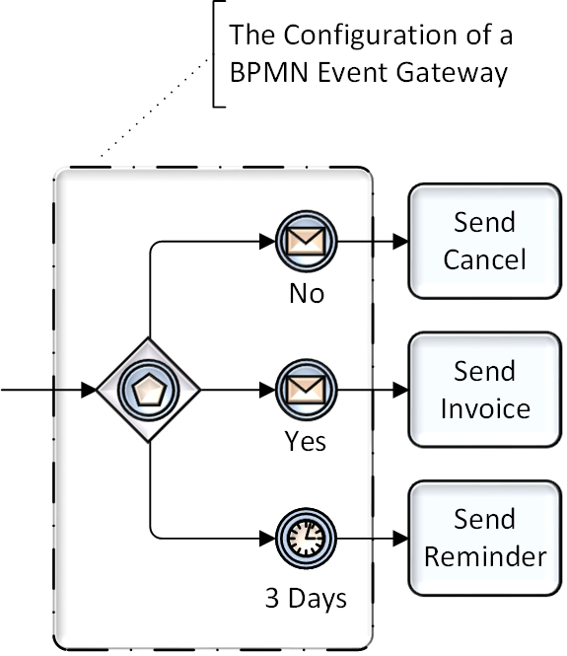
Event Gateways
Gateways
A
This type of Gateway is a point in the process where exclusive alternatives are based on Events (see Figure A), rather than conditions as with the Exclusive Gateway we saw earlier.
  This is why the marker within the Gateway diamond is the Multiple Intermediate Event listener.
It is unique in BPMN since It is actually a combination of Process objects that provides the behavior rather than a single Gateway element.

Slide 35
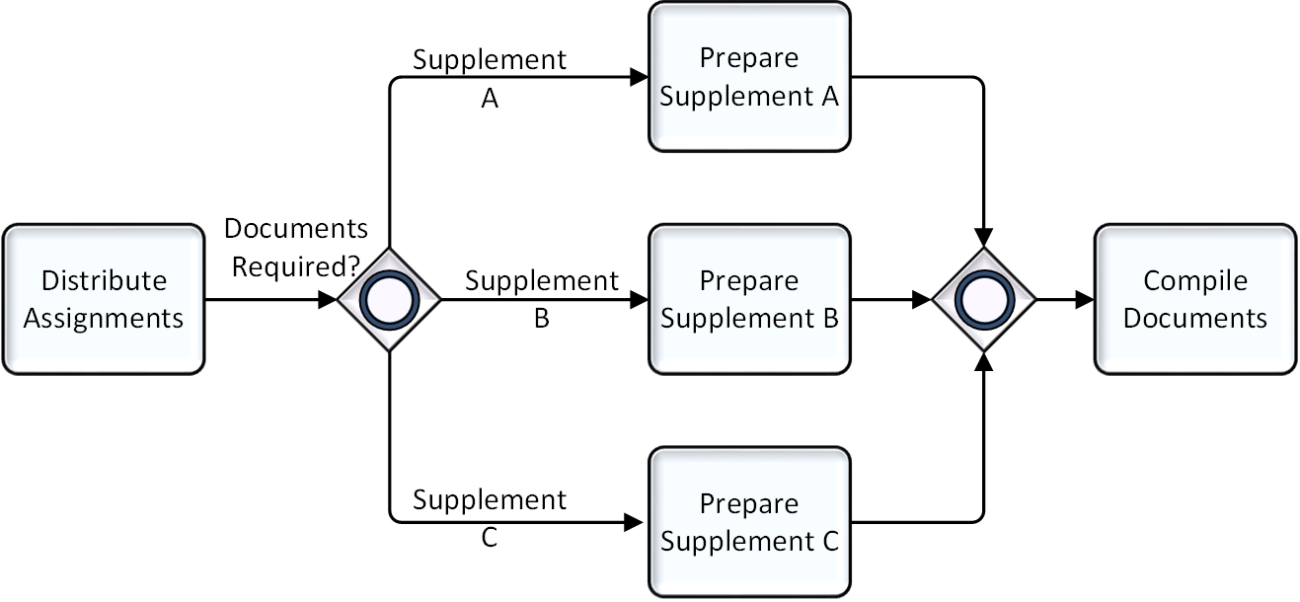
Inclusive Gateways
Gateways
Inclusive Gateways are mechanisms where there is more than one possible outcome.
  The “O” marker is used to identify this type of Gateway.
Like an Exclusive Gateway, an Inclusive Gateway, with its outgoing Sequence Flow, creates alternative paths based on defined conditions.

Slide 36
Agenda
Introduction/Background
Diagram Elements
  Activities
  Events
  Gateways
  Connectors
Other Elements and Concepts

Slide 37


Connectors
Connectors are the lines that are used to connect two objects on a diagram. There are four different types of BPMN Connectors:
  A Sequence Flow is used to show the order that activities will be performed in a Process.
  A Message Flow is used to show the flow of messages between two entities that are prepared to send and receive them.

Slide 38
Agenda
Introduction/Background
Diagram Elements
  Activities
  Events
  Gateways
  Connectors
Other Elements and Concepts

Slide 39
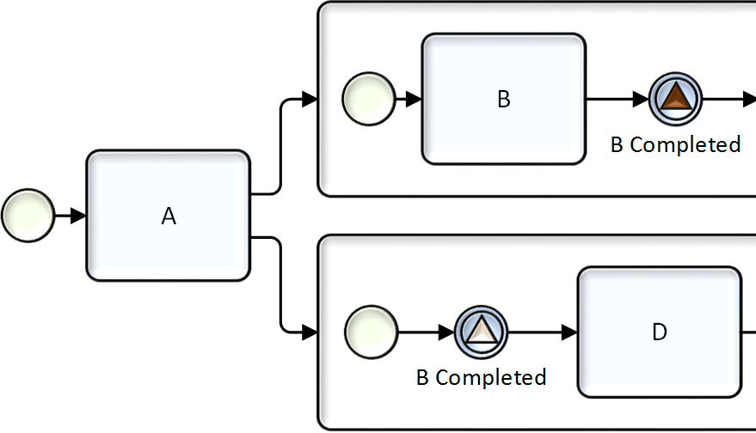
Using Link Events
Other Elements and Concepts
Signal Events provide a general communication capability within and between Processes.
A Signal is like a Message, but it does not have a defined target (i.e., a business role or business entity).
  Messages are directed, but Signals are broadcasted out to any listening Signal Intermediate Event or Boundary Event.
    They are similar to a Signal Flare that is shot up in the air for whoever is looking, and who can choose to react.
In the figure to the right, the Signal configuration delays the start of Task D until Task B has completed.
  This dependency is set even though the two Tasks are placed in different Sub-Processes.

Slide 40
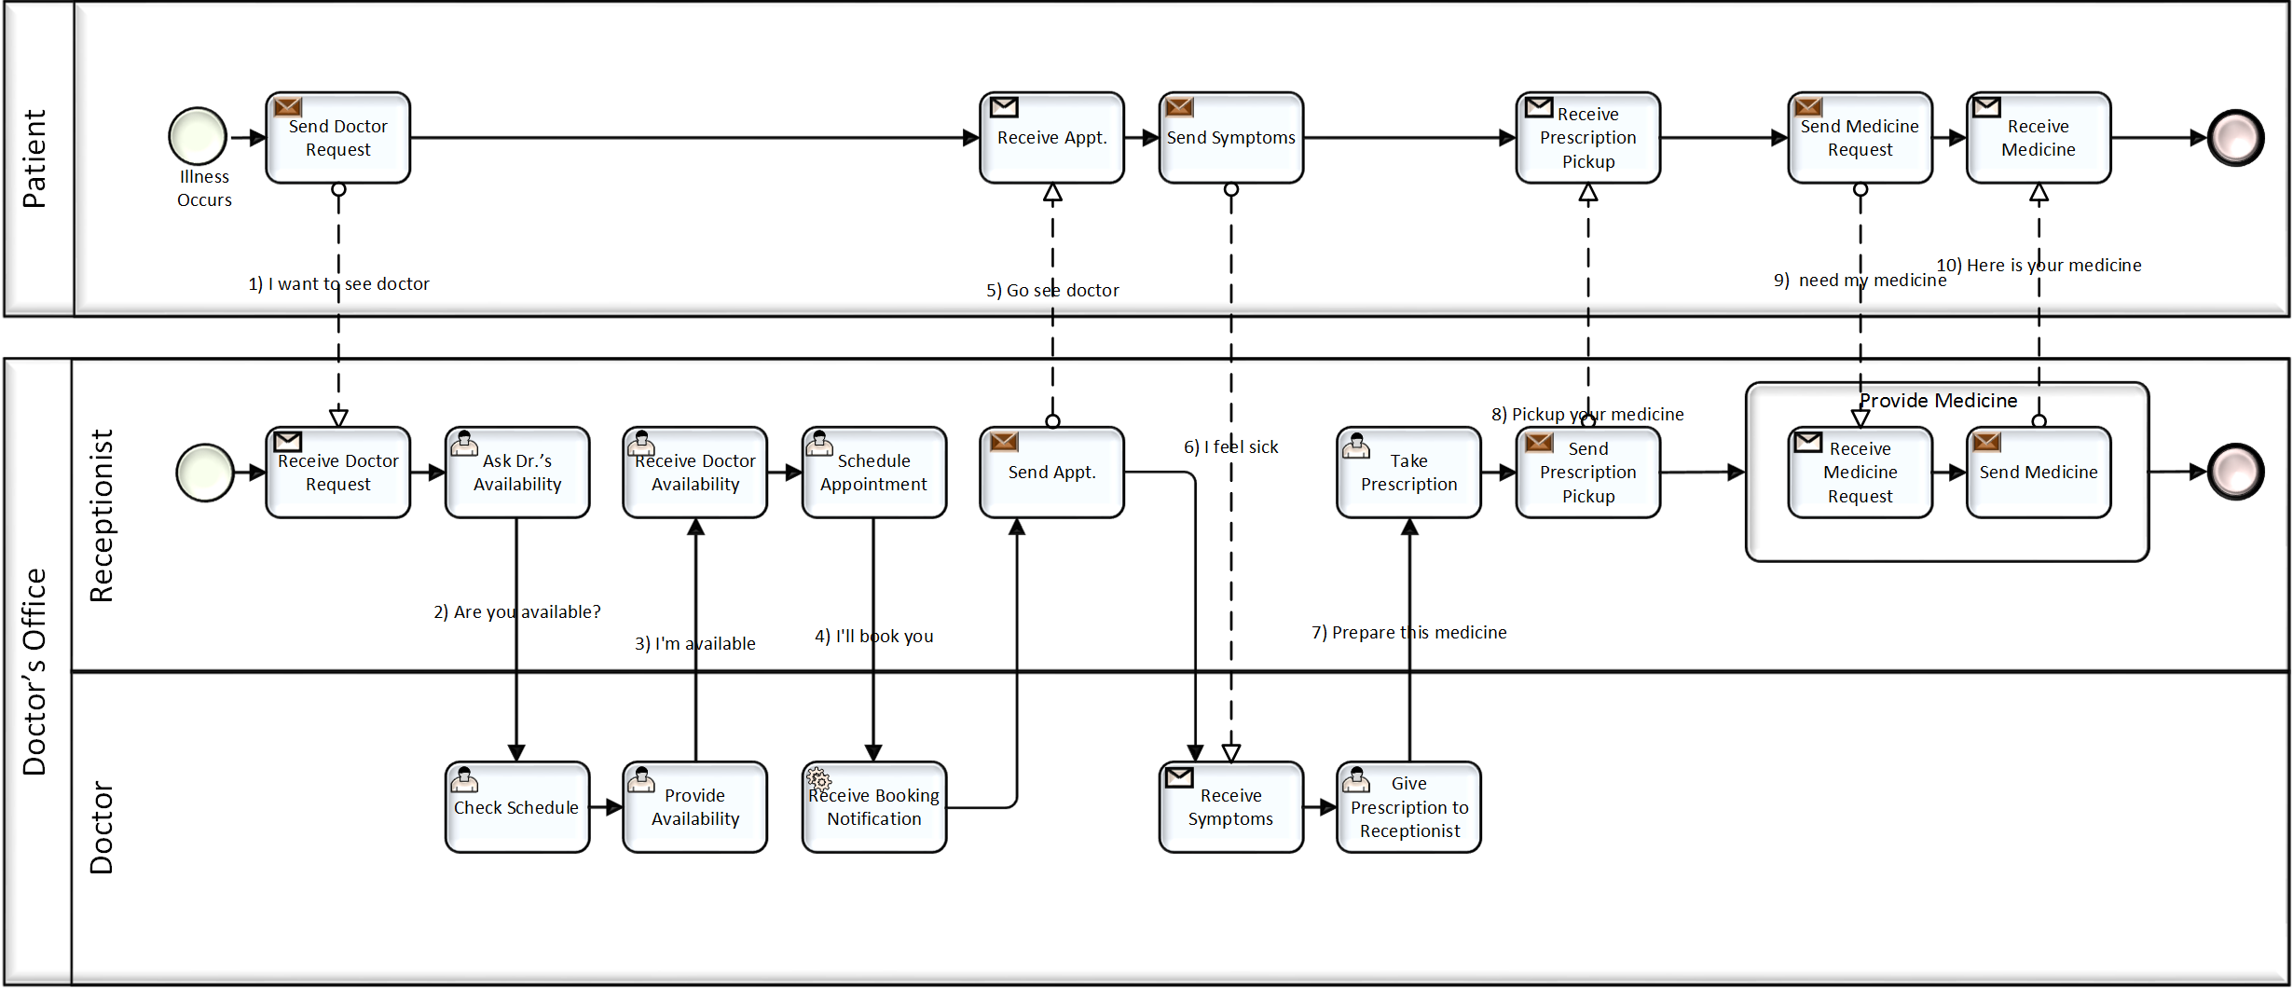
Swimlanes
Other Elements and Concepts
BPMN uses the concept known as “swimlanes” to help partition and organize activities.
There are two main types of swimlanes: Pool and Lane.
  Pools represent Participants in an interactive (e.g., Business-to-Business - B2B) Collaboration Diagram.
Pools
Pool

Slide 41
Swimlanes
Other Elements and Concepts
BPMN uses the concept known as “swimlanes” to help partition and organize activities.
There are two main types of swimlanes: Pool and Lane.
  Pools represent Participants in an interactive (e.g., Business-to-Business - B2B) Collaboration Diagram.
Lanes
Pool

Slide 42
Collaborations
Other Elements and Concepts
The Process in a Pool can be a fully defined model depicting an organization’s internal work (Fig. A).
A

Slide 43

Data Objects
Other Elements and Concepts
Data Objects are used to show how data and documents are used within a Process.
  Data Objects are portrait oriented rectangles with the upper right corner folded over (see figure to the right).
Data Objects have modeler-defined properties that are used to store data values that can be used in Process conditions.
  E.g., the “Order” Data Object could have properties such as “customer name,” “order number,” etc.
  These properties can be used in Gateway or Conditional Sequence Flow conditions.

Slide 44

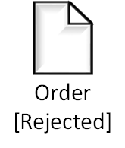
Data Objects
Other Elements and Concepts
A modeler-defined state can be assigned to a Data Object.
  See the bracketed text “[Approved]” and “[Rejected]” in the figures below.
As the Data Object is output from activities in a Process, its state can be updated.
  Thus, a Process can show how the Data Object state changes throughout the Process.
    Note that BPMN doesn't provide an inherent way to model the Data Object states in a diagram. But process modeling tool vendors can include state diagram capabilities if they want, using UML Statecharts or Petri Nets, etc.

Slide 45
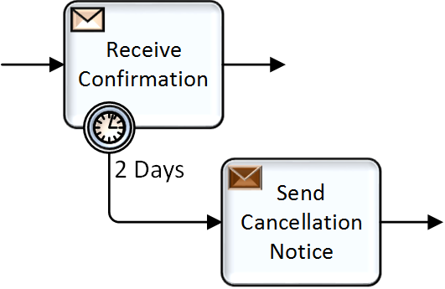
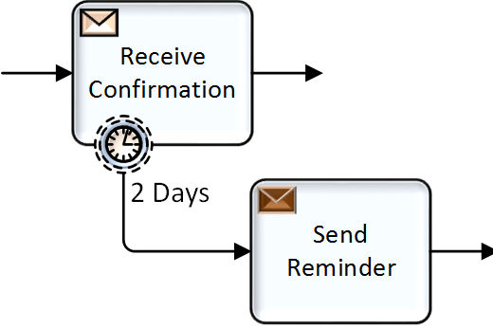
Exception Handling
Other Elements and Concepts
Intermediate Events attached to the boundary of an activity (Boundary Events) represent triggers that can interrupt the activity.
  All work within the activity will be stopped and token will proceed from the Event.
  Timers, Messages, etc., can be Triggers.
These are considered as exceptions to the normal flow.
  Boundary Events can also be set so that they do not interrupt the activity. These have a dashed boundary (see Fig B).
  There are differences when the exception is an Error. We discuss this below…
A
B

Slide 46
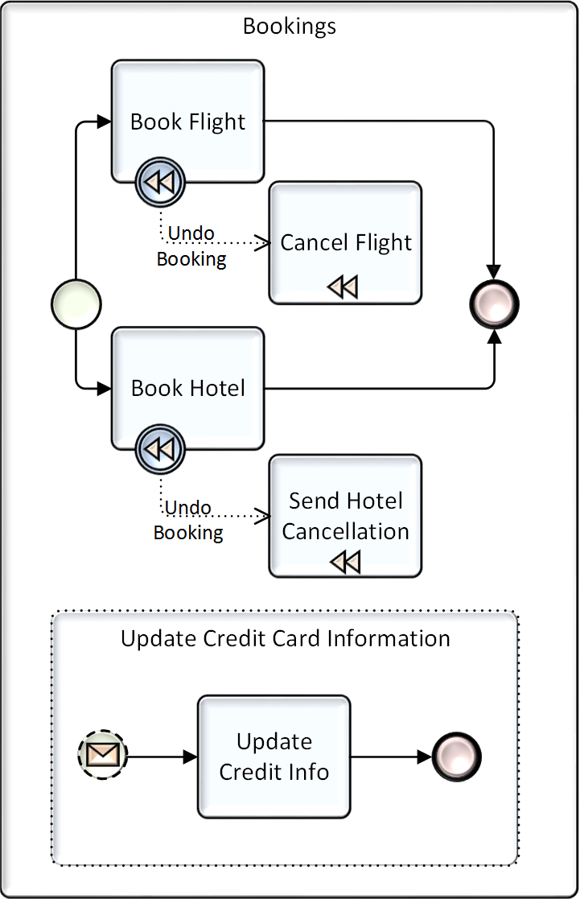
Event Sub-Processes
Other Elements and Concepts
Event Sub-Processes, added in BPMN 2.0, are specialized types of Sub-Processes.
They are disconnected activities that are also optional.
  That is, they don’t need to be performed for the Process to complete.
  They have a dotted boundary (See Figure A).
They are not allowed to have incoming or outgoing Sequence Flows.
They are enabled (receive a Token) when the Process starts.
A

Slide 47
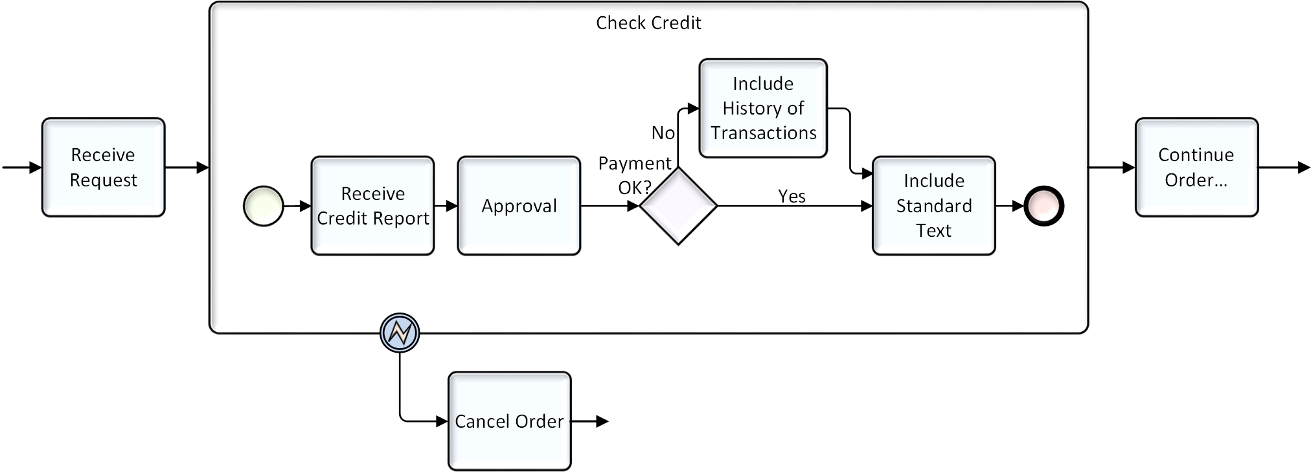
Error Handling
Other Elements and Concepts
Error Boundary Events attached represent a situation that is serious enough to cancel that activity and direct the flow in a way to correct the situation.
  All work within the activity will be stopped and the flow will proceed from the Event.

Slide 48
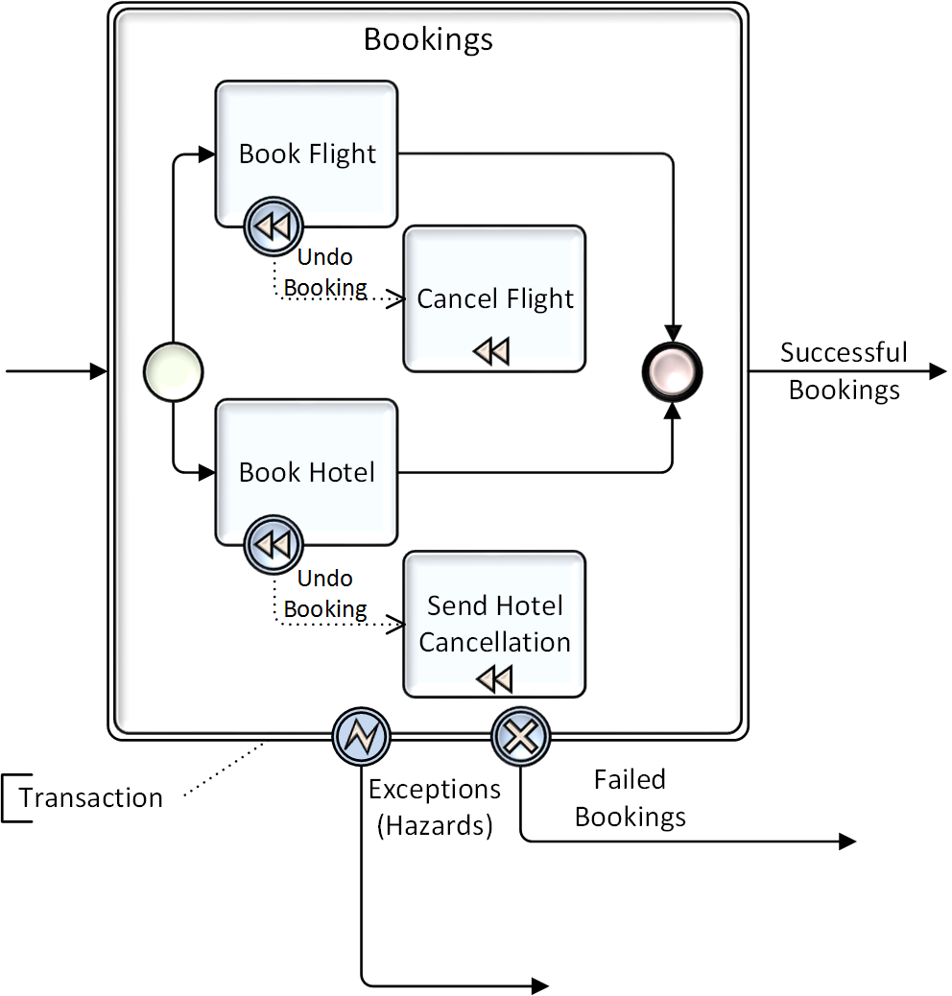
Transactions and Compensation
Other Elements and Concepts
Transactions and compensation are related, but compensation can occur without a Transaction.
A Transaction is a formal business relationship and agreement between two or more Participants.
  In BPMN, The Transaction Sub-Process is from the point of view of one of those Participants (for that Process).
A Transaction is an activity that has a double border (Fig.).

Slide 49
Transactions and Compensation
Other Elements and Concepts
A Compensation Task or Sub-Process is used to undo the work.
  They are marked with the “rewind” symbol.
Compensation activities are only connected with Associations.
They cannot be performed during the normal flow of the Process - only when Compensation is triggered.

Slide 50
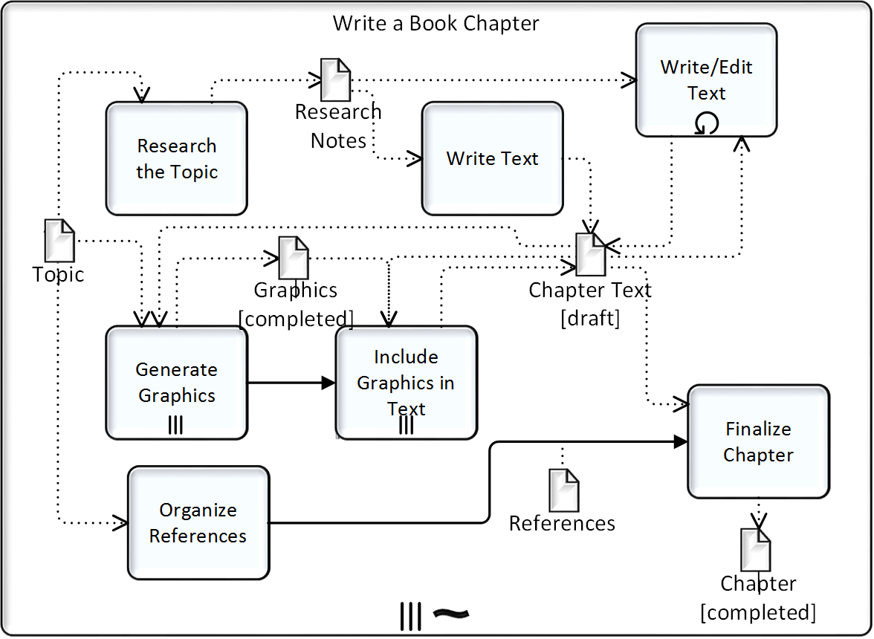
Ad-Hoc Sub-Processes
Other Elements and Concepts
There is no pre-defined Sequence Flow

Slide 51
BPMN's Relationship to Other BPM Models
Other Elements and Concepts
Business Process Management (BPM) is supported by a wide range of business models.
  Process is in the conceptual center of BPM (see figure below), but it is not the only model or concern that is important for BPM.
Business Process Management (BPM)
Policies/Risks/ Metrics
Strategy (e.g., BMM)
Business Functions (e.g., ArchiMate)
Metadata
Process Model (e.g., BPMN)
Nesting
Data Model (e.g., UML)
Metadata
Organiza-tion Model/
Roles
Data Objects
Users
Tasks
Gateways
Resource
Assignments
Implementation
Rules/Decisions (e.g., DMN)
Service Models (e.g., SoaML)
Techno-logy

Slide 52
Questions
???????

Slide 53
Background Slides

