Slide 1
CEMs
FHIR resources
Notes:
Some institutions might use the service layer only to communicate externally; others might use it as an interface between their apps and their backend.

Slide 2
CEMs
FHIR resources
Manually analyze, extract features
xls representing “HSPC DCM”
Notes:
Some institutions might use the service layer only to communicate externally; others might use it as an interface between their apps and their backend.

Slide 3
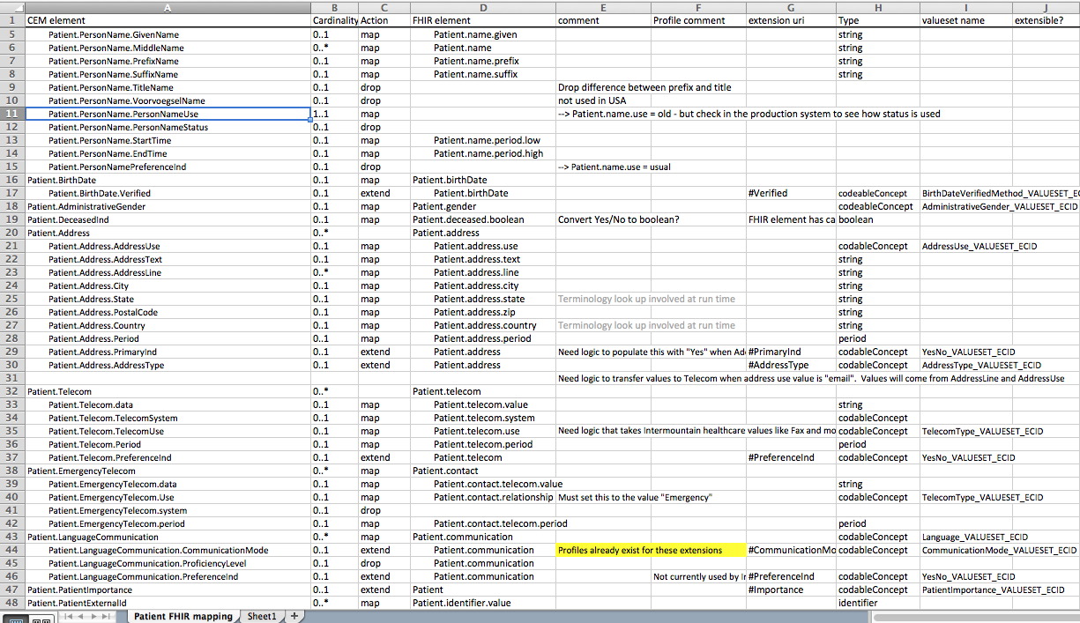
CEM to FHIR mapping

Slide 4
CEMs
FHIR resources
Manually analyze, extract features
xls representing “HSPC DCM”
Manual/automated generation
Proposed FHIR profiles,
published at the FHIR site
Notes:
Some institutions might use the service layer only to communicate externally; others might use it as an interface between their apps and their backend.

Slide 5
CEMs
FHIR resources
Manually analyze, extract features
xls representing “HSPC DCM”
Manual/automated generation
Proposed FHIR profiles,
published at an HSPC site
Notes:
Some institutions might use the service layer only to communicate externally; others might use it as an interface between their apps and their backend.

Slide 6
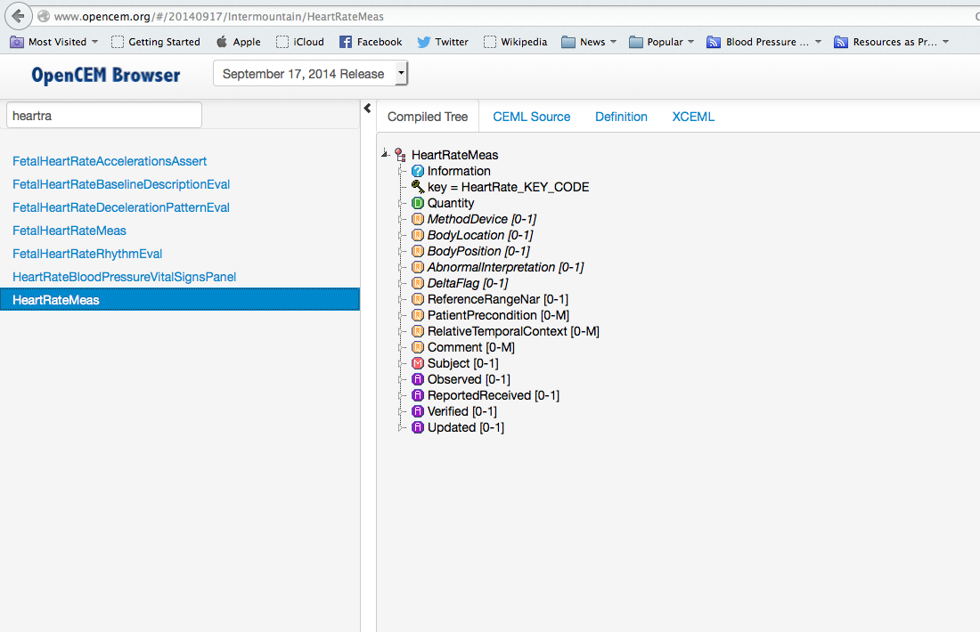
opencem.org

Slide 7
CQF
models
CEMs
FHIR resources
Manually analyze, extract features
xls representing “HSPC DCM”
Manual/automated generation
Proposed FHIR profiles,
published at an HSPC site
Review process
HSPC-standard FHIR profiles
Notes:
Some institutions might use the service layer only to communicate externally; others might use it as an interface between their apps and their backend.

Slide 8
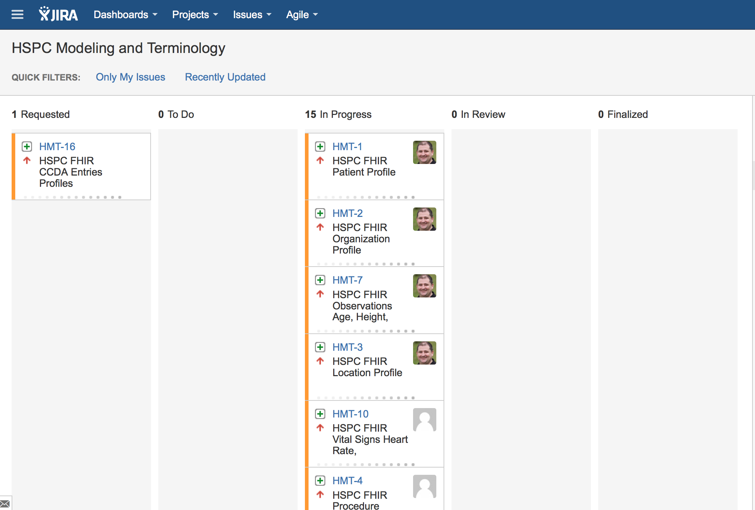

Slide 9
HSPC FHIR Profile Status
Waiting for Publication
Location
Organization
Patient
Practitioner
StandardLabObs/StandardLabObsQuantitative
Age
Height
Weight

Slide 10
HSPC FHIR Profile Status
Being worked on
Observation
Encounter
Medication Administration
Medication Statement
Procedure

Slide 11
CQF
models
CEMs
FHIR resources
Manually analyze, extract features
xls representing “HSPC DCM”
Manual/automated generation
Proposed FHIR profiles,
published at an HSPC site
Review process
HSPC-standard FHIR profiles
Notes:
Some institutions might use the service layer only to communicate externally; others might use it as an interface between their apps and their backend.

