Slide 1
Healthcare Services Platform Sandbox

Slide 2
The HSPC Sandbox https://hspc.isalusconsulting.com
HSPC Sandbox Architecture : Scot Post van der Burg
Asthma Ally – OSIA Medical : Bryn Rhodes, Rob Reynolds
AppWorks – ASU : Aziz Boxwala
Building a Javascript Client Application : Amy Ballard

Slide 3
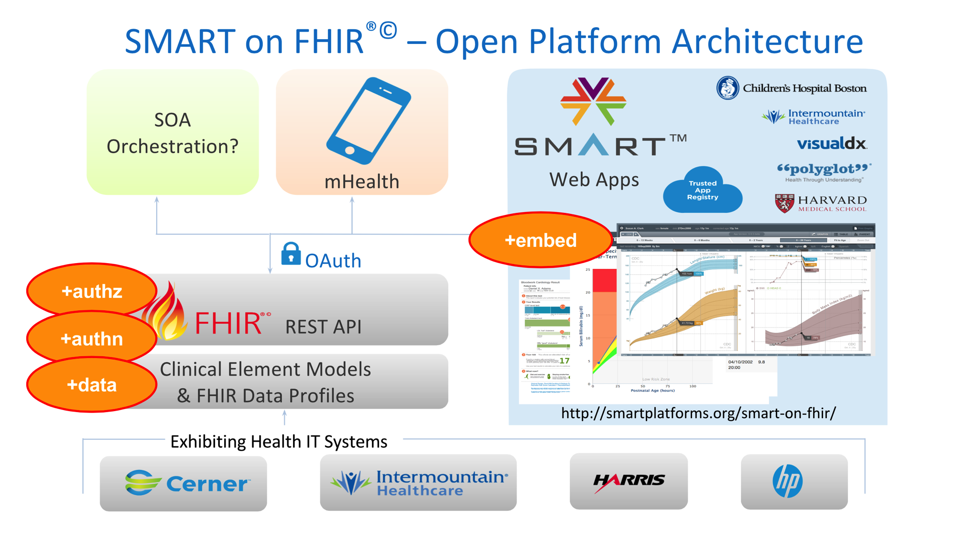
The HSPC Specification

Slide 4
HSPC Sandbox Architecture
Clinical Resource Server
Clinical Database (MongoDB)

Slide 5
HSPC Sandbox Architecture
Clinical Resource Server
Clinical Data
Patients
Observations
Conditions
Problems
Medications etc.
Clinical Database

Slide 6
HSPC Sandbox Architecture
Clinical Resource Server
Clinical Data
Patients
Observations
Conditions
Problems
Medications etc.
Clinical Database
Building a set of clinical test data representative of the real world
De-identification
Donation (Intermountain Healthcare)
Statistical methods

Slide 7
HSPC Sandbox Architecture
Clinical Resource Server
Open REST API
Create
Read
Update
Delete
Search
Clinical Database
Open REST API
Reading Data:
HTTP GET
Read: https://hspc.isalusconsulting.com/open-hsp-api/Patient/1234
Search: https://hspc.isalusconsulting.com/open-hsp-api/Patient?name:text=james

Slide 8
HSPC Sandbox Architecture
Clinical Resource Server
Open REST API
Create
Read
Update
Delete
Search
Clinical Database
Open REST API
Writing Data:
Create: HTTP POST
Update: HTTP PUT
Location: https://hspc.isalusconsulting.com/open-hsp-api/Patient

Slide 9
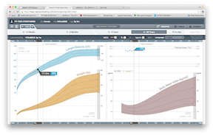
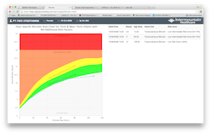
HSPC Sandbox Architecture
Clinical Resource Server
Open REST API
Create
Read
Update
Delete
Search
Clinical Database
Open REST API
Supported Resources:
AdverseReaction
Alert
Condition
Encounter
FamilyHistory
Medication
MedicationPrescription
MedicationStatement
Observation
Patient
Substance

Slide 10
HSPC Sandbox Architecture
Clinical Resource Server
Secure API
OAuth2
SMART on FHIR
Client Profiles:
Public
Confidential
Clinical Database
Open REST API
Secure REST API
HTTP GET
Authorization: Bearer eyJhbGciOiJSUzI1NiJ9.eyJhdWQiOlsiYTgxZjhhMTQtNzhlZ
Request URL: https://hspc.isalusconsulting.com/open-hsp-api/Patient/1234

Slide 11
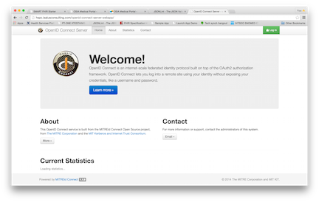
HSPC Sandbox Architecture
Clinical Resource Server
Authorization Server
Clinical Database
Open REST API
Secure REST API
OAuth2
Secure Self-service Client Registration
Dynamic Client Registration
User Provisioning

Slide 12
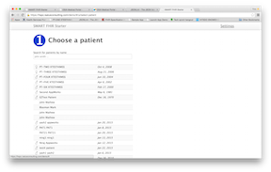
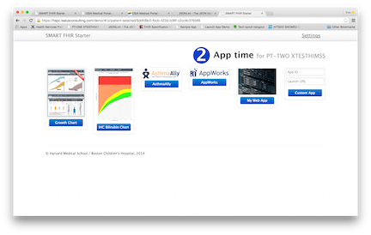
HSPC Sandbox Architecture
Clinical Resource Server
Authorization Server
Clinical Database
Open REST API
Secure REST API
“EHR” Interface (FHIRStarter)

Slide 13
HSPC Sandbox Architecture
Clinical Resource Server
Authorization Server
Clinical Database
Open REST API
Secure REST API
“EHR” Interface (FHIRStarter)
Establish Patient Context
Launch Applications
Kick-off Authorization Flow

Slide 14
HSPC Sandbox Architecture
Clinical Resource Server
Authorization Server
Clinical Database
Open REST API
Secure REST API
“EHR” Interface (FHIRStarter)

Slide 15
HSPC Sandbox Architecture
Clinical Resource Server
Authorization Server
Clinical Database
Open REST API
Secure REST API
“EHR” Interface (FHIRStarter)
SMART on FHIR Specification
Implementation Specific

Slide 16
Clinical App Launch Flow
Clinical Resource Server
Launch Notification Endpoint
“EHR” Interface (FHIRStarter)
SMART on FHIR Specification
Implementation Specific

Slide 17
Clinical App Launch Flow
Clinical Resource Server
Launch Notification Endpoint
1. HTTP POST: patientId = 1234;
RESP: launchId = DHFMD1;
“EHR” Interface (FHIRStarter)
SMART on FHIR Specification
Implementation Specific

Slide 18
HSPC Sandbox Architecture
Clinical Resource Server
Launch Notification Endpoint
1. HTTP POST: patientId = 1234;
RESP: launchId = DHFMD1;
“EHR” Interface (FHIRStarter)
2. http://bilirubin-chart/launch.html?iss=http://hspc.isalusconsoulting.com/hsp-api&launchId=DHFWD1
SMART on FHIR Specification
Implementation Specific

Slide 19
HSPC Sandbox Architecture
Clinical Resource Server
Launch Notification Endpoint
Metadata Endpoint
1. HTTP POST: patientId = 1234;
http://../metadata
RESP: launchId = DHFMD1;
RESP:
https://../authorize
https://../token
“EHR” Interface (FHIRStarter)
2. http://bilirubin-chart/launch.html?iss=http://hspc.isalusconsoulting.com/hsp-api&launchId=DHFWD1
SMART on FHIR Specification
Implementation Specific

Slide 20
Authorization Flow (Public Client)
Authorization Server
IHC Bilirubin Chart

Slide 21
Authorization Flow (Public Client)
Authorization Server
https://hspc.isalusconsulting.com/../authorize

Slide 22
Authorization Flow (Public Client)
Authorization Server
https://hspc.isalusconsulting.com/../authorize
https://hspc.isalusconsulting.com/openid-connect-server-webapp/authorize?
response_type=code&
client_id=bilrubin_chart&
redirect_uri=https://hspc…./bilirubin_chart/index.html&
scope=launch:DHFMD1&+patient/Observation.read+patient/.read&
state=483f88wuw8ue8u

Slide 23
Authorization Flow (Public Client)
Authorization Server
https://hspc.isalusconsulting.com/../authorize
https://hspc.isalusconsulting.com/openid-connect-server-webapp/authorize?
response_type=code&
client_id=bilrubin_chart&
redirect_uri=https://hspc…./bilirubin_chart/index.html&
scope=launch:DHFMD1&+patient/Observation.read+patient/.read&
state=483f88wuw8ue8u
Bilirubin Chart application is asking for access to: Launch context, the patient’s
observations and demographic information.

Slide 24
Authorization Flow (Public Client)
Authorization Server
https://…/bilirubin_chart/index.html
https://hspc.isalusconsulting.com/../bilirubin_chart/index.html?
code=H7su2383&
state=483f88wuw8ue8u
Authorization server calls the app’s registered redirect URI with an “authorization code”

Slide 25
Authorization Flow (Public Client)
Authorization Server
HTTP POST
https://hspc.isalusconsulting.com/../token
https://hspc.isalusconsulting.com/openid-connect-server-webapp/token?
grant_type=authorization_code&
code=H7su2383&
redirect_uri=https://hspc…./bilirubin_chart/index.html
Application exchanges “authorization code” for access token

Slide 26
Authorization Flow (Public Client)
Authorization Server
HTTP POST
https://hspc.isalusconsulting.com/../token
Response:
{
“access_token” : “asidsiew0e9w9uw9we9wuewe9u”,
“token_type” : “bearer”,
“expires_in” : “3600”,
“scope” : “patient/Observation.read patient/Patient.read”
“intent” : “client-ui-name”,
“patient” : “1234”
}

