Slide 1
THE HEALTHCARE INNOVATION ECOSYSTEM
Introductory Review
HSPC Meeting
Washington DC, June 18, 2015

Slide 2
Contact Information
Stanley M. Huff, MD Chief Medical Informatics Officer Intermountain Transformation Laboratory 5022 South State Street
Murray, UT 84107 Office: 801.507.9111 | Cell: 801.573.6470 Fax: 801.507.9400 | stan.huff@imail.org

Slide 3
Agenda
Why the Health Care Services Platform Consortium?
HSPC – functions and principles
Organizational structure
Key relationships with other organizations
The vision of the future
Goals for this meeting

Slide 4
Why HSPC?

Slide 5
Homer Warner and HELP
Intermountain can only provide the highest quality, lowest cost health care with the use of advanced clinical decision support systems integrated into frontline clinical workflow
Dr. Homer Warner
Notes:
5

Slide 6
Decision Support Modules
Antibiotic Assistant
Ventilator weaning
ARDS protocols
Nosocomial infection monitoring
MRSA monitoring and control
Prevention of Deep Venous Thrombosis
Infectious disease reporting to public health
Diabetic care
Pre-op antibiotics
ICU glucose protocols
Ventilator disconnect
Infusion pump errors
Lab alerts
Blood ordering
Order sets
Patient worksheets
Post MI discharge meds

Slide 7
Strategic Goal
Be able to share data, applications, reports, alerts, protocols, data entry screens, and decision support modules with anyone
Goal is “plug-n-play” interoperability

Slide 8
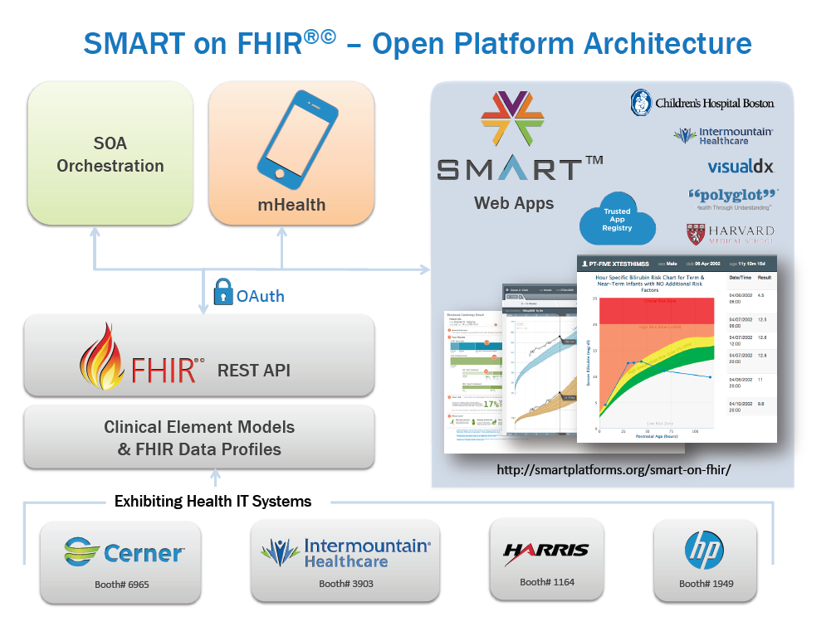
FHIR Profiles from CIMI Models
(uing standard terminology)
Heterogeneous Systems
Commercial
EHR
Home Grown
System
System
Integrator
Others…

Slide 9
Characteristics of a new Ecosystem
Consistent and unambiguous data collection
Data stored and accessed through truly semantically interoperable services
Sharing of data for direct patient care, population based analytics, and research
Sharing of applications, executable clinical decision support and knowledge

Slide 10
What Is Needed to Enable a New Ecosystem?
Standard set of detailed clinical data models coupled with…
Standard coded terminology (SNOMED CT, LOINC, RxNorm, others)
Standard query language
Standard API’s (Application Programmer Interfaces) for healthcare related services
Open sharing of models, coded terms, and API’s
Sharing of decision logic and applications

Slide 11
HSPC Functions and Principles

Slide 12
Essential Functions of the Consortium
Select the standards for interoperable services
Standards for models, terminology, security, authorization, context sharing, transport protocols, etc.
Modeling: SNOMED, LOINC, RxNorm – FHIR Profiles – do it together
Publish the models, and development instructions openly, licensed free-for-use
Provide testing, conformance evaluation, and certification of software
Gold Standard Reference Architecture and its Implementation
We will work with an established company to provide this service
Fees that off set the cost of certification will be charged to those who certify their software
Implementation of the standard services by vendors against their database and infrastructure
Everyone does not have to do every service
There must be a core set of services that enable a marketplace

Slide 13
Other Functions of the Consortium
Participation in “other” functions is optional for a given member
Enable development “sandboxes”
Could be provided by companies or universities
Could be open source or for-profit
Set up an actual “App Store”
Many companies already have their own app stores
Vendor certification that a given application can be safely used in their system
Accommodate small companies or individuals that won’t have their own app store
Create a business framework to support collaborative development
Pre-agree on IP, ownership, co-investment, allocation of revenue
Try to avoid unique contracts for each development project
Provide a way for people to invest (Venture capital)

Slide 14
Other Functions – for discussion
Needs
Reference implementation (for testing and certification)
Sand boxes – to speed development
SOA
Define and implement a technology stack
Platform architecture
Proposal – Form a Technical Committee to define scope and make a work plan

Slide 15
Principles
Not-for-profit entity
There could be an associated for-profit entity some day
Provider led
Simple majority of providers on the Board of Directors
All organizations will have equal influence and opportunity
Intermountain and LSU will not be “special”
Start small, be effective, and then grow
We want to allow everyone that is interested to participate
Allow diverse strategies and participants
Open source and for-profit
One person business up to multi-national corporations
Healthcare providers and healthcare software developers
Students and professional software engineers

Slide 16
Principles (continued)
Initially, focus on the minimum set of standards and technology
Increase options as we gain experience and success
HSPC is not producing software (mostly)
HSPC members or groups of members produce software
HSPC will need to provide a reference implementation for purposes of certification
No “central planning” by HSPC of app development
Participants decide what they want to build and invest their own resources
We DO need to agree about the minimum set of services that will enable a marketplace

Slide 17
Organizational Structure

Slide 18
Healthcare Services Platform Consortium Organizational Chart
Board
of
Directors
Advisory
Committees
Secretary
Non Voting
Non Voting
Technical Steering Committee
Voting
General
Counsel
CEO
CFO
Marketing
Membership
Business
Development
Support
CTO

Slide 19
Voluntary Board Advisory Committees and TSC and Technical Committees
Advisory
Committees
Technical Steering Committee
Membership
Finance
Marketing
Tier I
Architecture
Tier II
Architecture
Sandbox
Modeling
and Terminology

Slide 20
Organizational Guiding Principles
Board of Directors (BOD)
Selected by Benefactor Members
Each Benefactor Member can elect one board seat for every 200K contribution to HSPC
May be elected in the event that the Board seats exceed seven BOD members
Serve a 3 year term at the pleasure of the benefactor members
Strategic role – the Board does not manage day-to-day activities
Board Level Advisory Committees
Serve to advise on strategy at the pleasure of the board
Voluntary
Chairs appointed by the BOD
Chairs can come from operational staff or at large
To vote must be Associate Members or higher
One vote per membership
Technical Committees
Report to the Technical Steering Committee, which reports to the Board
CTO is an ex-officio member of the TSC
Leadership of TCs elected by the members of the TC (benefactor and associate members)
Operations
Responsible for execution under the direction of the CEO
Follow strategic objectives set by the BOD
Disputes will be resolved by the HSPC BOD

Slide 21
Key Organizational Relationships (not exhaustive)

Slide 22
CIMI (Clinical Information Modeling Initiative)
HSPC will use CIMI models for creation of implementable models including detailed HL7 FHIR profiles
CIMI plans to become a part of HL7

Slide 23
HL7
HSPC will use HL7 FHIR for data services
CIMI plans to become a part of HL7
HSPC will use HL7 as the forum for creating industry wide agreement about:
Detailed profiles for true interoperability
Consensus of professional and clinical bodies about data that needs to be collected and shared (workflow or process interoperability)

Slide 24
Joint CIMI and HL7 FHIR Meeting
Meetings will be hosted by Intermountain Healthcare in Salt Lake City, August 10-11
Everyone is invited!
Aug 10: Technical meeting: laying out a course for CIMI to write profiles/clinical models
Aug 11: Clinical meeting: creating broad consensus on profiles for true interoperability

Slide 25
SMART
HSPC will use SMART as a EHR integration strategy
HSPC will work together with SMART on all activities of mutual interest
We will create a written document (MOU?) to describe the relationship between the two organizations

Slide 26
Center for Medical Interoperability
Work for support of CIMI and HSPC as part of C4MI technical programs
Possible activities
Host a vendor and provider neutral app store
Create a reference implementation of HSPC services
Host a development sandbox
Logistic support
Meetings, websites, publicity
Host a model repository (and other knowledge artifacts)
Support online terminology services
Tool development
Conformance testing and certification

Slide 27
National Library of Medicine
Proposed: A public repository and distribution center for CIMI/HSPC developed value sets (VSAC)

Slide 28
Argonauts
Don’t know for sure
A call is planned to discuss the relationship
Work together on HIMSS demonstrations?
Work together to create industry wide consensus for profiles to be used for “true” interoperability?

Slide 29
Vision for the Future

Slide 30
Apps that address specific focused problems…
Like Google Maps…
Provider-facing services
Focused decision support
Visualization
Disease management
Specialty workflows
National Shared Services
Genomic testing & CDS
Pharmacogenomic screening
CDC Ebola screening?
CDC immunization forecaster
Prior Authorization / Appropriateness
App 1
App 2
App 3
EHR

Slide 31
Apps that enable data sharing…
Like Facebook…
App 1
Next-gen Interoperability
Population Health integration
HIE integration
Data capture for research
Clinical Trial recruiting
Quality Repositories
EHR
1
EHR
2
EHR
3

Slide 32
Apps that empower patients / consumers…
Like ???? …
Apps as Prescriptions
Chronic disease management
Pt-Provider Communication
Remote monitoring
Outcome capture & Clinical Effectiveness Monitoring
SMART Phone App
EHR
Pop Health

Slide 33
HSPC Internet Sites
Wiki: https://healthservices.atlassian.net/wiki/display/HSPC/Healthcare+Services+Platform+Consortium
Website: http://hspconsortium.org/#/

Slide 34
Goals For This Meeting
Review use cases
Document the use cases
Make specific plans for development and implementation
Make plans to integrate FHIM and VA modeling and terminology efforts
Determine how we can work together
Initiate a platform technical committee?
Initiate a testing and certification technical committee?
Create an initial roadmap for activities for the next 6 months

Slide 35
Q & A

Slide 36
Appendix

Slide 37
OUR MISSION
Improve health by creating a vibrant, open ecosystem of interoperable applications.

Slide 38
OUR VISION
Be a provider-led organization that accelerates the delivery of innovative healthcare applications that improve health and healthcare.

Slide 39
HSPC History
HSPC was incorporated as a not-for-profit corporation on August 22, 2014
Meetings
May 2013 Salt Lake City
August 2013 in Phoenix
January 2014 Salt Lake City
May 2014 in Phoenix
July 2014 Salt Lake (Technical modeling meeting)
August 21-22 2014, Washington DC, hosted by IBM
February 4-6, New Orleans, Louisiana, hosted by LSU
June 17-19, Washington DC

Slide 40
OUR GOAL
Our goal is to create an open marketplace featuring the industry’s first vendor-neutral Healthcare App Store and to foster a vibrant entrepreneurial community to deliver the best solutions quickly, easily and seamlessly to improve the quality of today’s accountable care.
Achieving the gold standard of true semantic interoperability, our services platform seeks to dramatically augment today’s standards efforts by providing a ground-breaking collaborative platform and real world laboratory to advance the native interoperability of healthcare applications.

Slide 41
ABOUT HSPC
The Healthcare Services Platform Consortium (HSPC) is a provider-driven organization of leading healthcare organizations, IT vendors, systems integrators, and venture firms dedicated to unlocking the power of entrepreneurial innovation to improve healthcare outcomes.
Through HSPC’s open marketplace and services platform, we seek to foster a new level of provider-vendor collaboration and innovation to meet one of the industries’ greatest needs -- accelerating the creation, sharing and delivery of promising software applications at the point of care.

Slide 42
OUR MEMBERS
HSPC’s founding members are established leaders in shaping the course of healthcare.
Intermountain Healthcare
Department of Veterans Affairs
LSU Health
Regenstrief Institute
Harris Corporation
They are joined by a growing membership of forward thinking providers, vendors, technology providers, researchers and venture firms, all committed to creating a new and open, market-based paradigm to drive innovation at the point of patient care.

Slide 43
HOW WE’LL DO IT
Collaborate with members to create a specification (based on existing industry standards where possible)
Truly semantically interoperable data access specification
Security standard for clinical applications and data access.
Authorization, Authentication, Application Launch Context, etc.
Clinical Care Pathways
Coordinated Care across multiple providers
Proactively seek new members
Provide a development sandbox representative of a real world hospital system.
Host an App Store

