Slide 1
Workflow Modeling for Medicine
An experience with BPMN2 at Intermountain

Slide 2
BPMN 2.0
Business Process Model and Notation 2.0
  OMG Standard
  Roots are in Graphical Modeling Environments for Business Processes
  Version 2.0 => Computability
Requires Services
  Used for Service Orchestration
  Allows Construction of Applications by Integrating Services
    Provides Standard Workflow Components
    Provides Integration for Custom Services

Slide 3
Designing a CDSS for Complex Electronic Protocols
Human Task Client Framework
Protocol Execution Environment
BPMN2 Engine
HumanTask Processor
MetaData
Human Tasks
Custom BPMN Service Tasks
User Interface Generator
Predictive Modeling Services
Data Transformation Services
Etc…
Data Services
Etc.
Order Communications Services
Patient Identification Services
Data Write Services
Data Read Services
Publish/
Subscribe Services
(Data Drive)
Hosting EHR
EHR-Based Resources
Business Process Model and Notation (BPMN) Engine
Standard UI Generator (WS-Human Task)
Appropriate Services from HER (HSP)
Special Services
  To Manage Data Models
  To Provide Added Inferencing Capability
    Physiologic Models
    Predictive Models
    NLP Services
    Custom Java-Based Tools
UI Client-Tightly Integrated with Hosting EHR

Slide 4
BPMN-Frameworks Consume Services
(provided by EHR-based environment to workflow engine-HSP)
Security
Patient Lookup/Retrieval
Clinical Data Access
Clinical Data Storage
Order Query
Order Communications
User Communications
  Client Integration
  Alert Delivery
Etc.

Slide 5
Framework has Internal Services
(services used in managing workflow engine activity)
Start Protocol
  Registers patient into protocol, records protocol status.
Save Protocol
  Serializes protocol to storage.
Get Protocol State
  Recovers protocols and protocol states for a given patient
Alert Service
  Build and store Alert Event/attach to relevant user task
Get active user tasks
  Finds protocol associated active user tasks
Complete user tasks
  Signals completion of user tasks/updates protocol data
Etc.

Slide 6
Two Examples
Pulmonary Embolism Workup
  Built using BPMN 2.0 authoring
  Delivered using BPMN 2.0 runtime
  Used Activiti (open-source version)
Pneumonia Protocol
  Originally build in Java/Drools
  Conversion to BPMN 2.0
  Uses Complex Event Processing Framework

Slide 7
Example: A Protocol for the workup of Pulmonary Embolism
(an example from the Intermountain Intensive Medicine Program)
Goal:
  Identify Patients undergoing workup for PE
  Evaluated Likelihood of PE
  Apply a Pulmonary Embolism Workup Protocol
Approach:
  Watch for Initial PE Workup
  Suggest Enrollment in PE Protocol
  Protocol Provides Diagnostic Suggestions
    Risk-Based Determination of Best Workup Strategy
    Feedback of Relevant Data, Risk Scores, Workup Suggestions

Slide 8
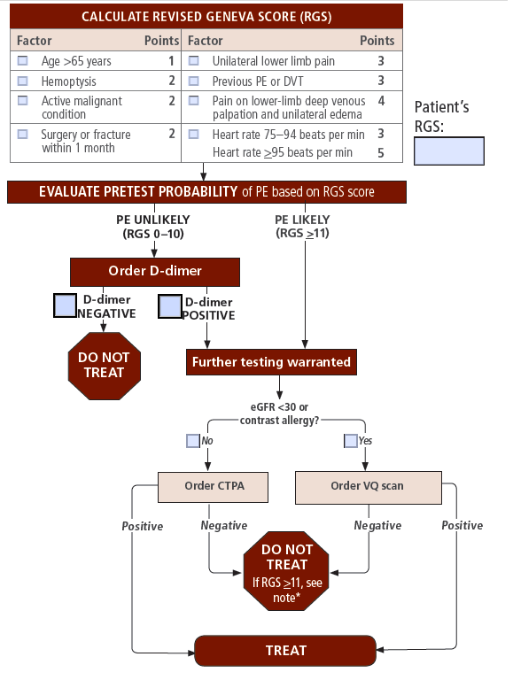
Workflow Automation for Pulmonary Embolism
Diagnose PE in the ED
Trigger from PE-oriented procedures
  D-Dimer, CT-PA, Vent/Perf Scan, etc.
Offer Finding Interpretation and Diagnostic Assistance

Slide 9
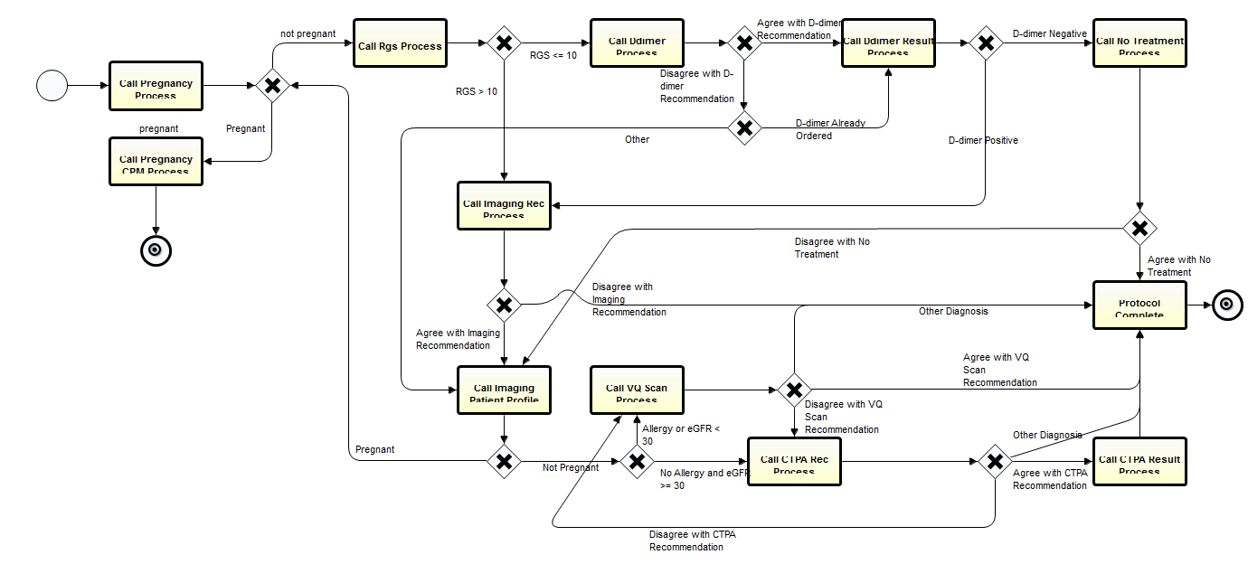
Pulmonary Embolism Workflow
Notes:
Developed with docs.
Started with pencil and paper workflows, then functional prototypes, then workflow.
Problem with prototype was, all of the logic was not evident.
We really had to work at it to get the docs to concentrate on the workflow and think through it.
They were immediately drawn in to the prototype, like watching a story. You have to think to work through workflow.
--
Each square here is a subprocess. X’s are gateways. Flowcharting on steroids. Flowcharting with semantics.
3 Levels in the the BPMN process: high level design, happy path; exceptional paths; wiring up services.

Slide 10
Pulmonary Embolism Workflow
Explode Activity
Notes:
Developed with docs.
Started with pencil and paper workflows, then functional prototypes, then workflow.
Problem with prototype was, all of the logic was not evident.
We really had to work at it to get the docs to concentrate on the workflow and think through it.
They were immediately drawn in to the prototype, like watching a story. You have to think to work through workflow.
--
Each square here is a subprocess. X’s are gateways. Flowcharting on steroids. Flowcharting with semantics.
3 Levels in the the BPMN process: high level design, happy path; exceptional paths; wiring up services.

Slide 11
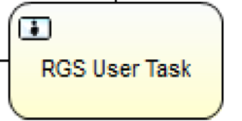
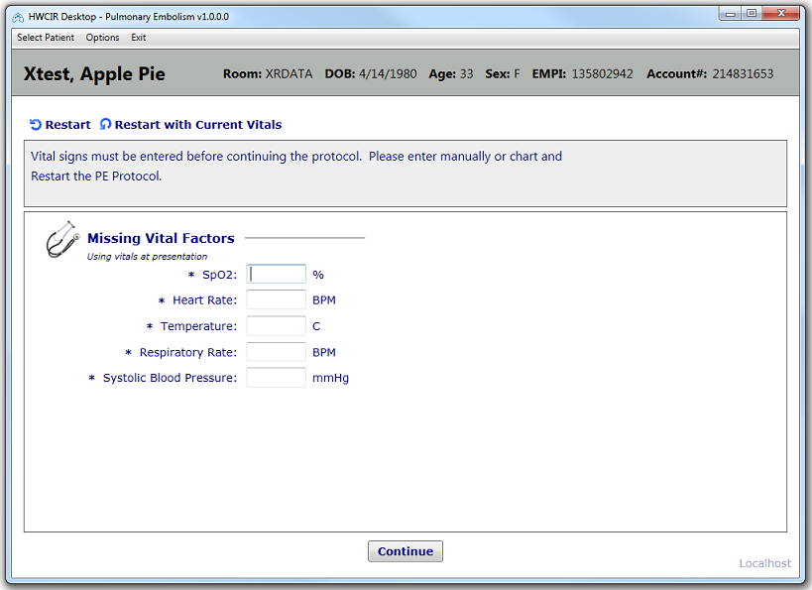
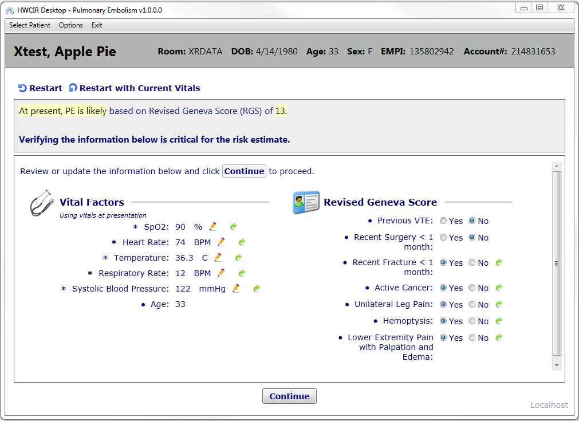
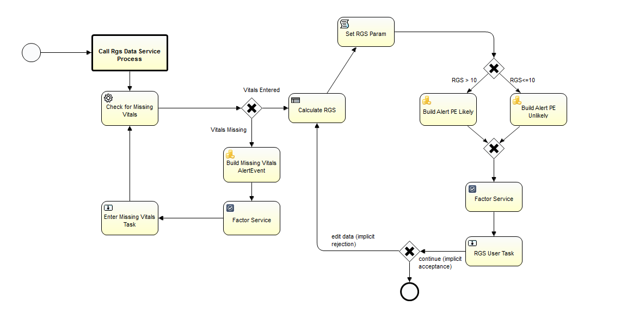
RGS Detail
Go to Missing Vitals Screen
Go to RGS Screen

Slide 12
Example: Pneumonia Care Protocol
(an example from the Intermountain Intensive Medicine Program)
Goal:
  Rapidly Screen for Pneumonia Patients in the ED
  Assess Risk of Death
  Apply a Pneumonia Care Protocol
Approach:
  Use Probabilistic System to Screen Patients
  Suggest Enrollment in Pneumonia Protocol
  Protocol Provides Therapeutic Suggestions
    Explicit Admission Suggestions
    Explicit Treatment Suggestions

Slide 13
Identify pneumonia patients being seen in the Emergency Department.
• Abnormal vital signs
• Compatible chief complaint
• Positive CXR (determined by natural language processing of dictated report)
Electronically alert ED physician, asking to confirm diagnosis of pneumonia
Search database for HCAP risk factors.
• Hospitalization within 90 days
• Nursing home residence
• Dialysis or wound care center
• Prior positive culture for MRSA
Ask ED physician to confirm or refute presence of HCAP risk factors.
⇒
↓
Order cultures/urine antigen studies per guidelines
• ICU all, ward per pre-selected check box, home none
• Auto-generated orders
Calculate eCURB, PaO2/FiO2, severe CAP criteria
• 30 day predicted mortality
Additional indications for admission
• Hypoxemia, presence of pleural effusion
• Co-morbid illness
• Inability to take oral medications
• Poor social support/homeless
• Failure of outpatient therapy
Recommendation for Home vs Ward vs ICU admission.
←
↓
Antibiotics per site of care and HCAP/ MRSA/Pseudomonas risk factors. Prescription generated, first dose administered
Notes:
13

Slide 14
Workflow for Pneumonia
Example: Community-Acquired Pneumonia
Does the patient have pneumonia?
Should we used the protocol?
Apply Pneumonia Care Protocol.

Slide 15
Pneumonia Detector
(a Bayesian Network using 40 clinical factors)

Slide 16
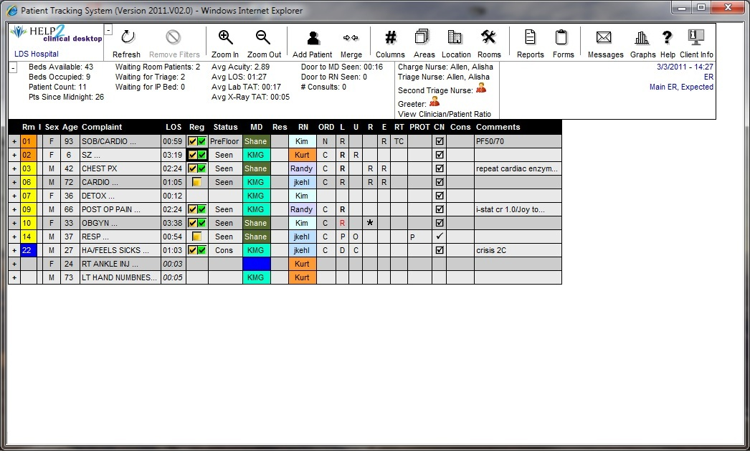
Alerting for Pneumonia in the Patient Tracking System
(Screening Framework (CEP) Watches Patient Data/Alerts for Pneumonia)
  Imbed logic, orders into process of care
  Imbed logic, orders into process of care

Slide 17
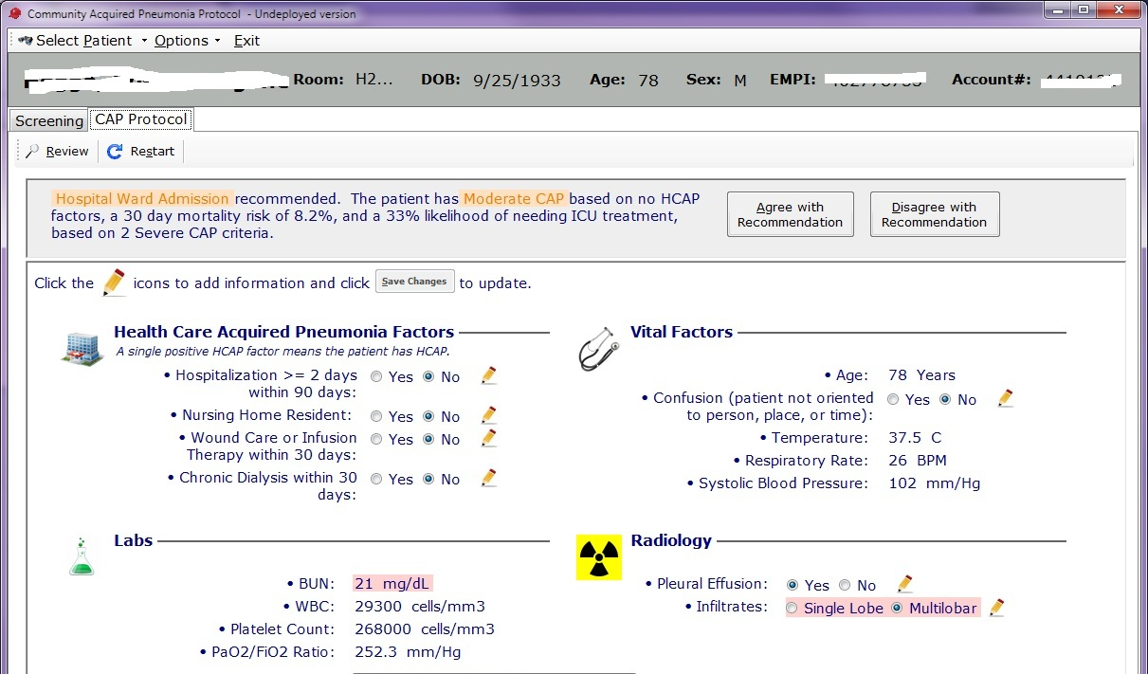
Admission/Discharge Recommendations
(Admission determinations based on severity and risk factors)

Slide 18
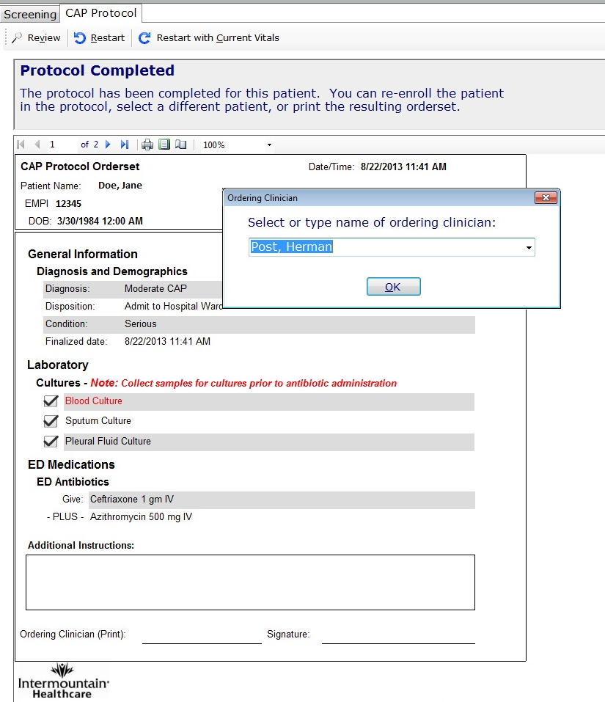
System Produces Individualized Recommendations:
Triage
Diagnostic Testing
Antibiotic Selection
18
Notes:
Recommends individualized triage, diagnostic testing, and antibiotic selection at the point of care
Linked to prescriptions
Allows physician to override recommendations
Physicians report tool improves management without impacting work flow

Slide 19
Advanced CDS Delivery Framework
Goals:
  Rapidly develop and deploy clinical protocols
  Maintain protocols over time
Attributes
  Standardized CDS management tools
  Multi-component inferencing environment
  Broad (standardized) data access
  Access to key care-oriented services (ordering, etc.)
  Multiple, flexible alerting channels
  Standardized, component-based client environment
  Formal workflow authoring/delivery system
  Broad workflow logging system

Slide 20
Comments and Questions
Questions???

