Slide 1
Architecture Roadmap
HSPC Specification

Slide 2
Outline
Review the HSPC sandbox architecture
Review the draft HSPC architectural specification
Discuss use cases
Prioritize efforts

Slide 3
HSPC Specification Levels
Test
Patterns & Principles
Requirements
P r o
J e c t
Common Models
Functionalities
Specification
Standards
Overarching Design
Reference Architecture
Architecture
Collaborative Open Source
Implementation
Reference Implementation
Implementation
Deployment
Reference Sandbox(es)
Sandbox
Deployment
Dev. Installation

Slide 4
2- tier Architecture
Application Layer
FHIR
Data Access Layer
Synth Gen
EHR
Public DB
Other...

Slide 5
3+ tier Architecture
Application Layer
FHIR
API Layer
Service Layer
FHIR
Data Access Layer
Synth Gen
EHR
Public DB
Other...

Slide 6
Knowledge Architecture
K-Driven Services
leverage
built on
consume
K Runtime
(matching of K and Data)
expressed as
runs on
feeds
Content (Assets)
Artifacts
built on
models
Information Platform
manages
stores
delivers
K Repo
(may be virtual- KaaS)
K Access Platform
Data Access Platform
K Management Platform
exposes
informs
K Acquisition Platform
K Capture Tooling
K Discovery Platform

Slide 7
By Nature
By Domain
Metamodels
Qualitative
Quantitative
Plans
Progression Models
Guidelines
Disease Models
Metadata
Score Models
Predictive Models
Info
Pathways
Processes
Focused
Protocols
Preferences
Assets
Norms / Policies
Rules
Constraints
CDS interventions
Documentation T.
Foundational
Belief Models
Action / Event / Situation Models
Order Sets
Measures
Queries
Ontologies
Clinical Information Models
Archetypes
Terminologies
Expressions
Bio / Cell
Medical Ontologies
Artifacts
PROForma
UML
GLIF
CMMN
GLARE
PMML
Arden
BPMN
RIM
Languages
SBVR
HeD
HQMF
XBN
** - RuleML
RIF - **
HL7 v2.x
CQL
SWRL
XCML
FHIR
SQL
AML
OWL
UMLS
ADL
RDF
(domain) - ML
SKOS

Slide 8
Knowledge Asset Life Cycle
Knowledge Curation + Repo
Discover / Describe
Exchange
Repo
Register / Notify
Acquire
Author
Generate
Publish / Retrieve
Discover
Translate
Store
Execute
Ontology Repositories
Index
Deploy
Dictionaries
Repos by type
Libraries
Rule Bases
Guideline Repositories

Slide 9
EPS
FHIR
HAPI
Event-Driven
Query-Driven
Data Access Layer
DDS
OpenDDS
Validation
Enriched Data
Import
UIMA
Enrichment
O-Auth
Mirth
Security
Clax
Link
Auth
Filter
Calc
“HL7”
OWL
AML / ADL
Policy
CQL
XCML
Normalization
Export
Compare
Reshape
Transform
“Crowd”
Terms
CIMI/ CEM
openEHR
SOLOR+
SKOS?
v2.x
FHIR
RIM
JDBC
JPA
Data Abstraction Layer
Data Platform
Synth Gen
EHR
Public DB
Dataset
OpenEMR
OpenMRS

Slide 10
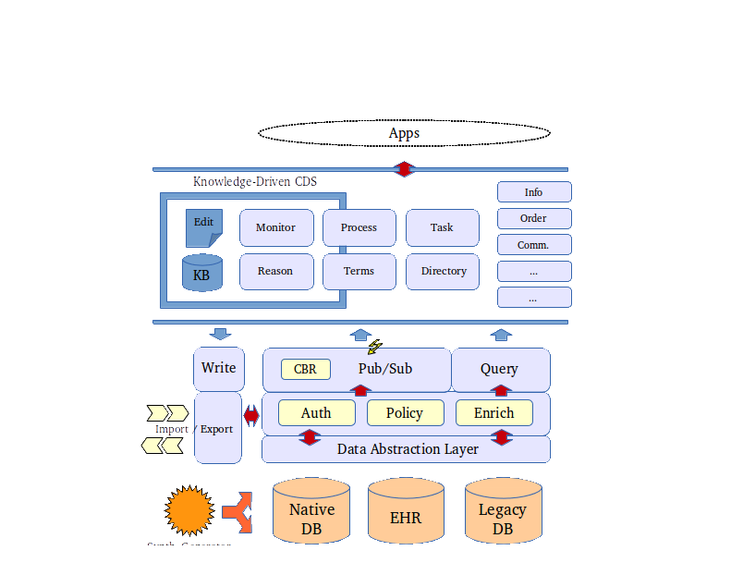
Arch. (Collapsed)

Slide 11
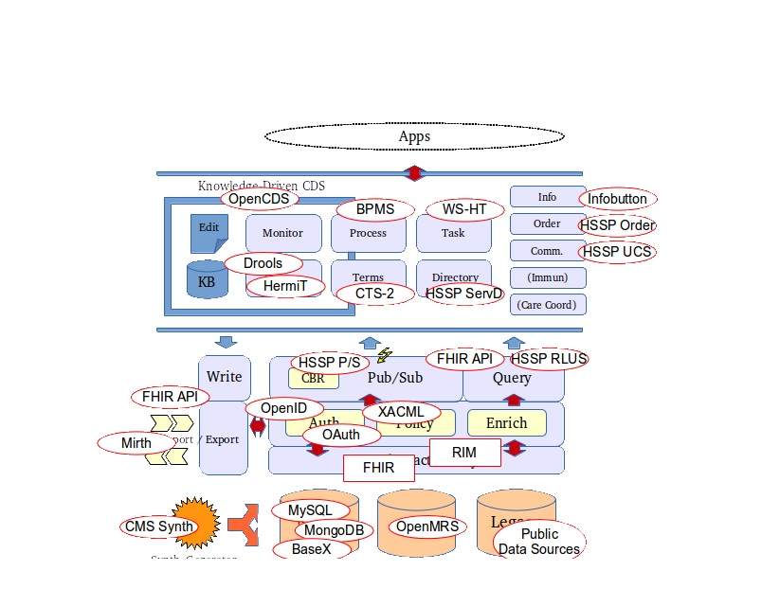
Arch. (Collapsed) + Candidate APIs

