Slide 1
A Brief Review of CIMI and HSPC
Stanley M Huff, MD
Chief Medical Informatics Officer
Intermountain Healthcare
stan.huff@imail.org

Slide 2
Introduction
Stanley M. Huff, MD
Professor (Clinical) Department of Biomedical Informatics
Chief Informatics Officer, Intermountain Healthcare
Chair of the Board of HL7
Member of the ONC HIT Standards Committee
Co-chair of the LOINC Committee
Chair of the Board of HSPC
Leader of CIMI

Slide 3
CIMI
The Clinical Information Modeling Initiative (CIMI) is a community of interest that is producing detailed clinical information models to enable interoperability of health care information systems
CIMI models are free for use for all purposes
See http://www.opencimi.org/ for more details

Slide 4
Graphic Presentation of a Detailed Clinical Model
SystolicBPObs
SystolicBP
data
138 mmHg
quals
BodyLocation
BodyLocation
data
Right Arm
PatientPosition
PatientPosition
data
Sitting

Slide 5
Clinical Information Modeling Initiative
Mission
Improve the interoperability of healthcare systems through shared implementable clinical information models.
(A single curated collection.)

Slide 6
Clinical Information Modeling Initiative
Goals
Create a shared repository of detailed clinical information models
Using an approved formalism
Archetype Definition Language (ADL)
Archetype Modeling Language (AML)
Based on a common set of base data types
With formal bindings of the models to standard coded terminologies
Repository is open to everyone and models are licensed free for use at no cost

Slide 7
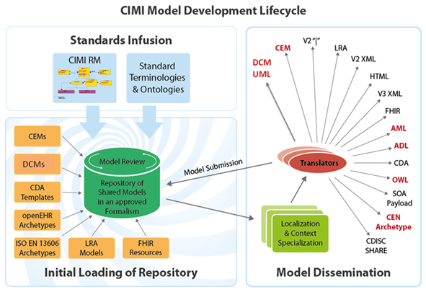

Slide 8
Access to the models
Browse and download models
CIMI models
http://www.clinicalelement.com/cimi-browser/#/
Intermountain models
http://www.opencem.org/#/

Slide 9
THE HEALTHCARE INNOVATION ECOSYSTEM
An Opportunity to Foster Truly Interoperable Health Care Applications

Slide 10
OUR MISSION
Improve health by creating a vibrant, open ecosystem of interoperable applications

Slide 11
OUR VISION
Be a provider-led organization that accelerates the delivery of innovative healthcare applications that improve health and healthcare

Slide 12
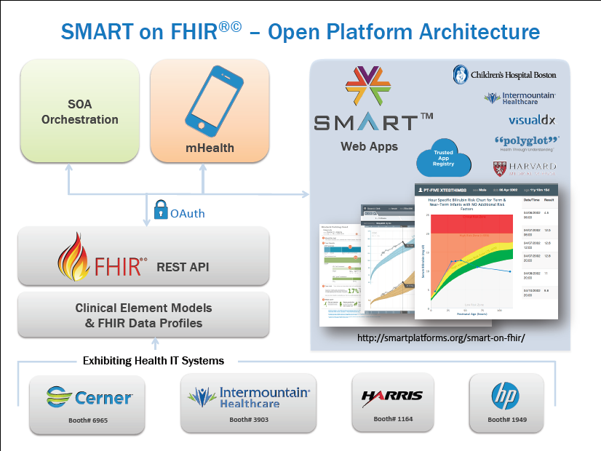
Standards Based Services - HIMSS
FHIR Profiles from CIMI Models
(uing standard terminology)
http://smartplatforms.org/smart-on-fhir/

Slide 13
Apps that address specific focused problems…
Like Google Maps…
Provider-facing services
Focused decision support
Visualization
Disease management
Specialty workflows
National Shared Services
Genomic testing & CDS
Pharmacogenomic screening
CDC Ebola screening?
CDC immunization forecaster
Prior Authorization / Appropriateness
App 1
App 2
App 3
EHR

Slide 14
Apps that enable data sharing…
Like Facebook…
App 1
Next-gen Interoperability
Population Health integration
HIE integration
Data capture for research
Clinical Trial recruiting
Quality Repositories
EHR
1
EHR
2
EHR
3

Slide 15
Apps that empower patients / consumers…
Like ???? …
Apps as Prescriptions
Chronic disease management
Pt-Provider Communication
Remote monitoring
Outcome capture & Clinical Effectiveness Monitoring
SMART Phone App
EHR
Pop Health

Slide 16
HSPC Technology Assumptions (already decided)
Services – FHIR
Generate FHIR profiles from existing model content
Data modeling
CIMI models
Terminology
LOINC, SNOMED CT, RxNorm, HL7 tables
EHR Integration – SMART

Slide 17
HSPC History
HSPC was incorporated as a not-for-profit corporation on August 22, 2014
Meetings
May 2013 Salt Lake City
August 2013 in Phoenix
January 2014 Salt Lake City
May 2014 in Phoenix
July 2014 Salt Lake (Technical modeling meeting)
August 21-22 2014, Washington DC, hosted by IBM
February 4-6, New Orleans, Louisiana, hosted by LSU
June 17-19, Washington DC
August 10-13, Salt Lake City
September 28-30, Phoenix (tentative)

Slide 18
Essential Functions of the Consortium
Select the standards for interoperable services
Standards for models, terminology, security, authorization, context sharing, transport protocols, etc.
Modeling: SNOMED, LOINC, RxNorm – FHIR Profiles – do it together
Publish the models, and development instructions openly, licensed free-for-use
Provide testing, conformance evaluation, and certification of software
Gold Standard Reference Architecture and its Implementation
We will work with an established company to provide this service
Fees that off set the cost of certification will be charged to those who certify their software
Implementation of the standard services by vendors against their database and infrastructure
Everyone does not have to do every service
There must be a core set of services that enable a marketplace

Slide 19
Other Functions of the Consortium
Participation in “other” functions is optional for a given member
Enable development “sandboxes”
Could be provided by companies or universities
Could be open source or for-profit
Set up a vendor and provider neutral “App Store”
Many companies already have their own app stores
Vendor certification that a given application can be safely used in their system
Accommodate small companies or individuals that won’t have their own app store
Create a business framework to support collaborative development
Pre-agree on IP, ownership, co-investment, allocation of revenue
Try to avoid unique contracts for each development project
Provide a way for people to invest (Venture capital) in HSPC technologies

Slide 20
Opportunities
Quality and disease specific repositories
Sharing of data for patient care
Sharing of clinical decision support and other applications
Patient engagement

Slide 21
HSPC is about more than just data virtualization

Slide 22
SOA Services Layers
UI
Orchestration of Services and Busines Layer
Data Virtualization
Support common UI Standards
Provide services for imbedding application in existing EMR/EHR frameworks
Implement a multi-layered services architecture (SOA)
Support common Decision Support models (BPMN2/Drools)
Master Data Management Services
Support FHIR/Restful Services models that support launch and forget applications and applications that support a full SOA services stack
Deploy FHIR profiles in collaboration with Argonaut, the VA, Intermountain, Regenstrief, Mayo/ASU and LSU.
Support common workflow models (BPMN2)
Identity Management Services
Data and vocabulary transformation Services
Context management services

Slide 23
SOA Guiding Principles
Three tiered services model
Maintain atomic services that are consistent in performance and behavior
Can be administered once in a framework
Can be orchestrated under a true SOA governance
Can be consumed by anyone implementing the HSPC reference architecture
Can be addressed by synchronous and asynchronous service requests
Are implementable out of the box
Are supportable and documented to a standard
Provide HSPC supported services as open source

Slide 24
Principles
Not-for-profit entity
There could be an associated for-profit entity some day
Provider led
Simple majority of providers on the Board of Directors
All organizations will have equal influence and opportunity
Intermountain and Harris will not be “special”
Start small, be effective, and then grow
We want to allow everyone that is interested to participate
Allow diverse strategies and participants
Open source and for-profit
One person business up to multi-national corporations
Healthcare providers and healthcare software developers
Students and professional software engineers

Slide 25
Principles (continued)
Initially, focus on the minimum set of standards and technology
Increase options as we gain experience and success
HSPC is not producing software (mostly)
HSPC members or groups of members produce software
HSPC may need to provide a reference implementation for purposes of certification
No “central planning” by HSPC of app development
Participants decide what they want to build and invest their own resources
We DO need to agree about the minimum set of services that will enable a marketplace

Slide 26
Sample of Participants
HL7 FHIR – Grahame Grieve
SMART – Josh Mandel
Cerner – David McCallie, Marc Overhage
Epic – Janet Campbell
VA – Jonathan Nebeker, Paul Nichol
openEHR – Thomas Beale
Open Health Tools – David Carlson
Harris – Vishal Agrawal
Intermountain Healthcare
Systems Made Simple – Viet Nguyen
LSU – Frank Opelka, Wayne Wilbright, John Couk
Center for Medical Interoperability – Todd Cooper
RelayHealth – Arien Malec
NLM – Clem McDonald
Infocare Healthcare – Herb White
Mayo Clinic – Cris Ross
Clinical Architecture – Shaun Shakib
Cognitive Medical Systems – Doug Burke
IBM – Jeff Rogers, Dennis Leahy
ASU – Aziz Boxwalla, Robert Greenes
Regenstrief Institute – Douglas Martin

Slide 27
Key Organizational Relationships (not exhaustive)

Slide 28
Argonauts
Don’t know for sure
A call is planned to discuss the relationship
Work together on HIMSS demonstrations?
Work together to create industry wide consensus for profiles to be used for “true” interoperability?

Slide 29
HL7
HSPC will use HL7 FHIR for data services
CIMI plans to become a part of HL7
HSPC will use HL7 as the forum for creating industry wide agreement about:
Detailed profiles for true interoperability
Consensus of professional and clinical bodies about data that needs to be collected and shared (workflow or process interoperability)

Slide 30
SMART
HSPC will use SMART as a EHR integration strategy
HSPC will work together with SMART on all activities of mutual interest
We will create a written document (MOU?) to describe the relationship between the two organizations

Slide 31
Center for Medical Interoperability
Work for support of CIMI and HSPC as part of C4MI technical programs
Possible activities
Host a vendor and provider neutral app store
Create a reference implementation of HSPC services
Host a development sandbox
Logistic support
Meetings, websites, publicity
Host a model repository (and other knowledge artifacts)
Support online terminology services
Tool development
Conformance testing and certification

Slide 32
HSPC Internet Sites
Wiki: https://healthservices.atlassian.net/wiki/display/HSPC/Healthcare+Services+Platform+Consortium
Website: http://hspconsortium.org/#/

Slide 33
Q & A

