Slide 1
Perioperative Use Case
Best Care through
Continuously Delivering
Next Best Practices

Slide 2
Summary
Reviewed work to date (from June DC meeting)
Identified more targeted use case
Identified functional needs/value prop
Identified technical component needs
Discussion of optimal means to quickly show results
Identified next steps

Slide 3
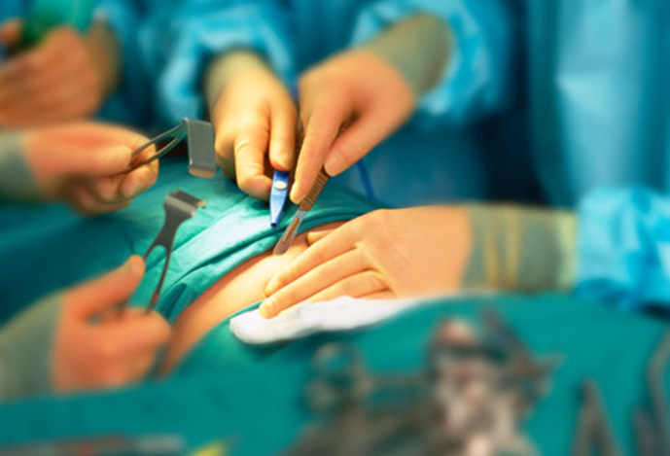
Surgical Use Case Overview
No domain where the ideal of quality is more paramount than in the experience of Surgery.
Excellence, meticulousness, and integrity are core values held in highest regard by practitioner and patient alike.
Preparedness, accountability, and continuous improvement are the chief means of upholding these principles
Data, information, and knowledge the essential raw-materials.
Notes:
While Surgery is certainly recognized as an invasive and rigorous undertaking, it is also an extraordinarily information and knowledge intensive endeavor. As such, it is perhaps only surpassed in the historical context of human cognitive endeavors by the broader scope of the field of Biomedicine.

Slide 4
The Challenge
How do we best acquire, manage, and deliver the data, information, and knowledge essential to achieving surgical excellence?
  Accurate
  Trusted
  Timely
  Relevant
  Meaningful
  Actionable
  Detailed
  Complete
Pre-Op
Peri-Op
Post-Op
Discharge
Notes:
The challenge at hand is therefore how do we best acquire, manage, and deliver the data, information, and knowledge essential to achieving surgical excellence? Data, information, and knowledge that is accurate, trusted, and timely as well as relevant, meaningful, and actionable. That is sufficiently detailed and complete to reflect a patient’s current, historical, and probable or possible state of health, disease, and treatment. That is specific, pertinent, and contextualized enough to be effectively, efficiently, and safely acted upon- and acted upon by the appropriate resource at the appropriate time and for the appropriate use. Data, information, and knowledge that is acquired, managed, and delivered such that it not only doesn’t hinder, but enables the highest degree of excellence in the delivery of surgical care.

Slide 5
The Goal
Ensure that the patients’ current and historical state of health, disease, and treatment (medications, diagnosis and pertinent clinical findings) and plan for intended care are accurately captured, updated, and transitioned from pre-operative, peri-operative, intra-operative, post-operative, and post discharge with sufficient detail and quality to provide high quality, safe, and efficient care for the patient.

Slide 6
The Requirements (1/2)
Common functional/non-functional requirements
A logical model for representing patient data that is shared across pre-operative, peri-operative, intra-operative, and post-operative environments
Support for post-coordinated expressions
  Information not already in SNOMED CT, LOINC, and RxNORM can be properly captured
Notes:
Common functional/non-functional requirements for all 10 Use Cases:
A logical model for representing pertinent comprehensive, accurate, specific, and clinically meaningful patient data that is shared across pre-operative, peri-operative, intra-operative, and post-operative environments
Support for post-coordinated expression so that information identified at the point of capture that is not already in SNOMED CT, LOINC, and RxNORM can be properly captured, without waiting for years for the standards to be updated, or forcing us to abandon the standard
An ability to extract arbitrary pre- or post-coordinated data from logical model for secondary purposes
Ability to enrich primary source data with derivations (scores, calculations), annotations (NLP), and Scores, as well as likely/potential disease or intervention states
All inferred data will have audit trails with non-repudiation
All inferred data will represent the provenance (qualifier) of that data
All inferred data will include affordance for uncertainty/ inexactness (likelihood of disease)
An ability to access high-resolution device acquired data, both real-time and persisted
Ability to assign pertinent process and outcome metrics to individual patients

Slide 7
The Requirements (2/2)
Extract pre- or post-coordinated data from logical model for secondary purposes
Enrich primary source data with derivations, annotations, and scores, as well as likely/potential disease or intervention states
  Audit trails with non-repudiation
  Provenance (qualifier) of that data
  Affordance for uncertainty/ inexactness (likelihood of disease)
Access high-resolution device acquired data, both real-time and persisted
Assign pertinent process and outcome metrics to individual patients

Slide 8
September Meeting Update
Targeted the Pre-Operative use case Homed in on more specifically-targeted capability
Primary functional aims
  Gather Relevant data:
    Historical data
    HL7 messages, Identified events,
    EMR data
  Aggregate to local registry
  Post to national registry

Slide 9
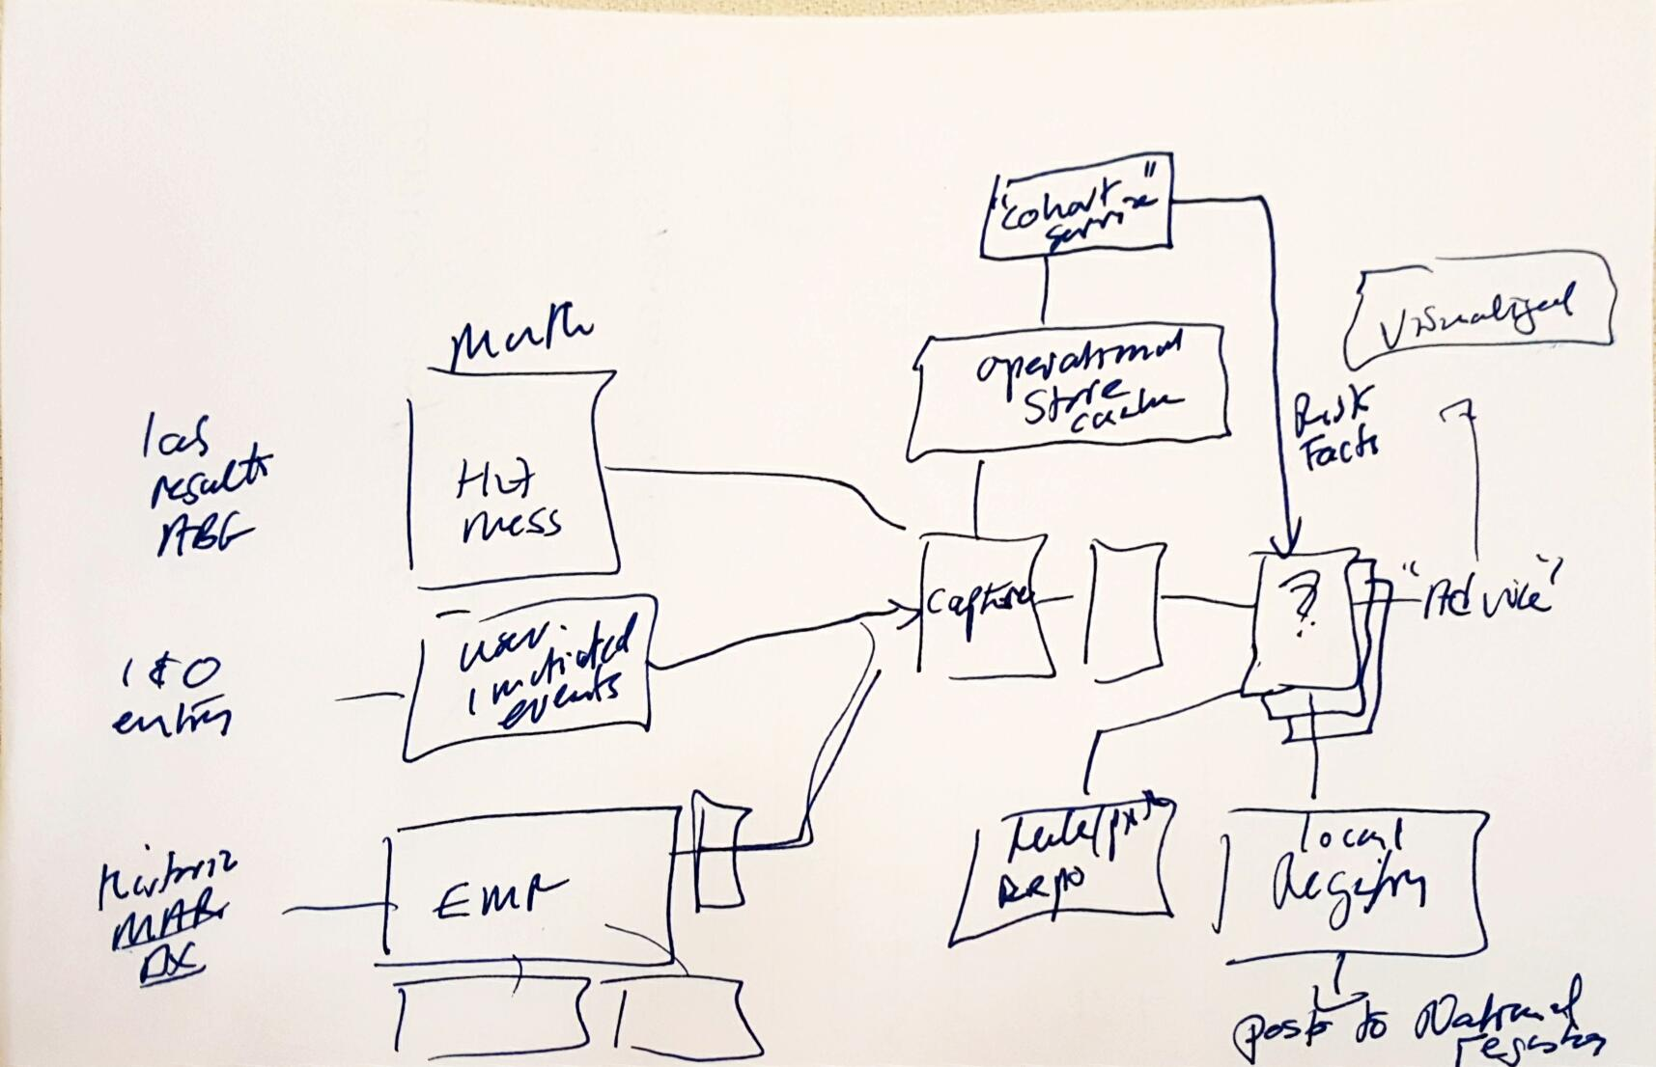
Component Schematic

Slide 10
Next Steps
More complete definition of the use case
Environment for hosting functionality
Sourcing existing (proprietary or open source) components that are needed
Further discussion on clinical environment where this use case may be developed deployed

Slide 11
Next Steps
Explicit definition of the use case
Environment for hosting
Sourcing existing (proprietary or open source) components that are needed
Further discussion on 'deployment end point' for this effort

