Slide 1

Clinical Track Slides

Slide 2
Clinical Track Overview
Day | Time | Title
Monday | 2:30 – 4:00 | Tutorial: Clinical Modeling for Clinicians
Tuesday | 1:00 -- 2:30 | CIIC Projects Approach and Updates
 | 3:00 – 4:30 | Collaboration Tools for Clinicians
Wednesday | 9:00 – 10:15 | Framework for Clinician Review of Clinical Data Models
 | 10:30 – 11:45 | CIIC Building the Community

Slide 3
Context for All Discussions
CIIC is in a position to develop processes, tools, and methodologies designed to facilitate clinical engagement in data and knowledge modeling
We have brought to this meeting “straw” approaches that are intended to be the starting point for obtaining your input
We expect these to change as a result of these discussions and as we move the work forward
If our approaches will not work for clinicians, we will not succeed

Slide 4
Risks of the current fragmented approaches
CIIC is premised on a shared investment model
  Too big of an investment to do alone
  Going it alone duplicates effort and cost
  Going down separate paths will result in models that will meet your organization’s needs, but all of your data users and suppliers will have to define mappings to your specific models
    Can reduce data quality
    Can discourage participation in registry or research
Is your organization experiencing these barriers to your work on interoperability?

Slide 5
Why Bring Your Work to CIIC?
Ability to drive interoperability solutions not be driven by others
All models will be openly available at no cost
Quality assurance to ensure that models are plug and play independent of EHRs and other applications
A community of interested parties to collaborate with your organization
Model governance across user communities
Use of a structured methodology developed by experts with years of experience
Access to a repository of models that provide the foundation for addressing your requirements
Plan to build on the model development work to establish similar approaches for standardized knowledge sharing

Slide 6
HSPC/CIIC Project Support
Core services
  Maintain and provide access to the model repository
  Provide tooling to support collaboration on model development and review
  Conduct quality review of models developed by projects
  Manage open consensus process for review and approval of models
    Comments from interested parties
    Coordinate with model stewards
  SOA reference architecture and reference implementation
  Implement and maintain conformance testing
  Educational programs
Supplemental services
  Modeling experts to support project team
  Project management
  Work group facilitation
  Implementation support, e.g., app development
  Advisory services
Would your organization see a value proposition for these services?

Slide 7
CIIC Projects Process and Update

Slide 8
Improving Healthcare Data Interoperability -
Duke Clinical Research Institute Pew Project
James E. Tcheng, MD
Rebecca Wilgus, RN, MSN
Grant support provided by the Pew Charitable Trusts

Slide 9

Swivel Chair Interoperability Wes Rishel
EHR System
Registry Data Entry

Slide 10
Registry Issues
Data capture burden
  Data capture not integrated into clinical care
  Cost of data acquisition via chart abstraction
  Lack of data standards
  Lack of data transmission standard
Analytics utility
  Analytics not integrated into clinical care
  6 month delay (summary reports)
  Misalignment of federal programs
  Value, ROI

Slide 11

Improving Healthcare Data Interoperability – The Pew Project
Convening the Registry Community
Current state of registries
  How well are data standards implemented?
Current state of national data models
  [same question!]
Authoring the “Easy Button”
  All in one package of best practice recommendations (for db developers)

Slide 12
Scope
Patient ID (family name, given name)
Sex (birth sex)
Date of birth
Race, ethnicity
Smoking status, EtOH, illicit substances
Risk factors
Vital signs
Laboratory results
Medications
Care team members (attending physician, physician operator)
Procedures
Unique device identifiers (UDI)
Vital status (alive / dead)

Slide 13
Sex (NOT Gender!!) - 20/24 registries
Data Collection Variability
Data Element Name (CRF Label) | Permissible Values | Concordance
Gender | Male | 5
 | Female
Patient Gender | Male | 2
 | Female
Gender | 1=Male | 1
 | 2=Female
 | -1=Unknown/Missing
Gender | M | 1
 | F
Sex | Male | 3
 | Female
Sex | Male | 2
 | Female
 | Unknown
Sex | M | 1
 | F
 | UN
Sex | Male | 1
 | Female
 | Other
 | Unknown
Sex (at birth) | Male | 1
 | Female
Data Collection Variability
Data Element Name (CRF Label) | Permissible Values | Concordance
Patient's Sex at Birth | m=male | 1
 | f=female
 | u=unknown
Indicate the patient's sex at birth | Yes No | 1
And are you? | Male | 1
 | Female

Slide 14
Key CDE Metadata
Question or prompt
May have associated controlled terminology
Value, result or answer
May have associated controlled terminology
HCV status:
Clinical concept label (e.g., human prompt for CRF, data entry screen)
Clinical definition of the concept, synonyms
Allowed values (aka permissible values, value set)
Allowed values definitions
Db field label (all caps, no spaces, underscores only, limited chars, …)
Data type / format (e.g., free text, constrained list, integer, …)
Business rules (e.g., range / edit checks, consistency, validation, …)
Preferred SDO binding
Reference(s)

Slide 15
Implications
Data standards work is driven by use cases
  NQRN Registries on FHIR
  CMSS registries community
  MDEpiNet NESTcc projects (e.g., BUILD, RAPID)
  FDA Coordinated Registry Networks
  HL7 CIC – Common Clinical Registry Framework (CCRF) DAM
Informatics processes and formalisms key if CDEs are to be adopted across healthcare
  FHIR, HL7 v2 do not cover clinical → registry use case
  CDE metadata is a good start; still need modeling
  Native, interoperable clinical data is the frontier

Slide 16
OPA/ACOG FPAR 2.0 project
Steve Hasley, ACOG CMIO

Slide 17
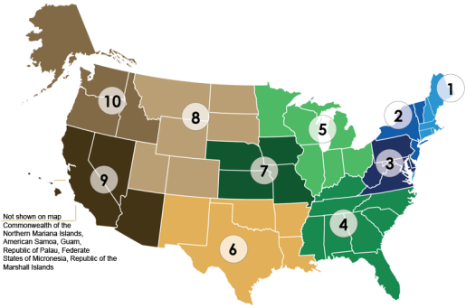

Title X: A diverse and wide network
The 10 HHS Federal Regions
7.2 | million encounters annually
4.1 | million clients
4,127 | Service delivery sites
1,134 | Sub recipients
50+ | States & territories funded by
94 | Grantees monitored by
20 | Regional OPA FTEs supported by
10 | Regional Health Administrators
5 | National Training Centers
1 | OPA HQ
Family Planning saves tax payers $7.09 for every $1 invested!
Source: www.guttmacher.org
Source: Family Planning Annual Report: 2014 (Aug 2015)

Slide 18


Converge: Draft 2.0 Data Elements
Client ID
Provider ID
Visit date
Date of birth
Sex
Ethnicity
Race
Limited English Proficiency status
Household size
Income
Health insurance coverage
Pregnancy intention
Current pregnancy status
Sexually active status
Contraceptive method at entry & exit or Reason for no method
Date of last pap and/or HPV test
Screening tests for Chlamydia, Gonorrhea, and HIV
HIV positive test result
Linkage to HIV medical care
Systolic and Diastolic BP
Height and Weight
Smoking status
FPAR2.0@hhs.gov
Notes:
To inform those performance measures and allow us to maintain counts of those critical services that Title X is funding, these are the draft data elements that OPA is looking to collecting at the encounter or visit level. The elements in black font are things that we anticipate you are already collecting for current FPAR reporting, while those in purple indicate a new variable to FPAR 2.0. This list has morphed a bit in the past 2 years and is still subject to change as we continue to assess what is possible to structure and extract from EHR and what variables are most useful to inform our metrics. At least a couple of these data elements do not seem to even exist yet within many vendors’ systems, so that’s work we are actively taking on that I’ll get to in a minute.
We know that privacy is a big concern so we have already begun work to create a state of the art protocol to that will ensure the data are deidentified and secure – I’ll talk more about that work in a minute. Our goal is to finalize these data elements by this coming August.
Okay – so now that you know what we want in terms of measures and elements - how would you go about this if you were us? How would you get these to become standardized within all of the EHR systems that 4,000 health centers across this country?

Slide 19
Development of FHIR profile
First, make sure the baseline clinical model is what you want
Then make sure underlying terminologies support your model
  LOINC, SNOMED CT, RxNorm
Then make the FHIR model

Slide 20
Current State
SOF app ready to test against production data
C-CDA arm also in testing

Slide 21
Issues
DSTU 2 /US Core is not enough
STU 3 provider-facing servers don’t exist
STU 4 is due when??
Will mapping of various data elements be consistent across vendors
  Is Pregnancy Intent an observation, or a condition, or something else?
  Closing the loop in referrals.
VSAC availability

Slide 22








Cancer Data Interoperability Project
Every patient’s journey improves all future care
Steve Bratt
Leader, Health Standards and Interoperability Group
The MITRE Corporation
sbratt@mitre.org
Presented at the 17th General Meeting of HSPC Joint with CIIC / Bethesda, MD / 31 July 2018

Slide 23

Current State of Cancer Research
Clinical Trials Data
3% of patients
Cancer
Care
Breast Cancer
Real World Data
97%
of patients
Missed Opportunities
Substantial Curation Costs
Low Quality Real-World Data

Slide 24
Future State of Cancer Research
Safer Care
Clinical Trials Data
3% of patients
Better Therapies
Cancer
Care
Breast Cancer
Real World Data
Improved Outcomes
Lower Costs
Growing %
of patients
Shrinking %
of patients
Lower Curation Costs
Low Quality Real-World Data
Fewer Missed Opportunities

Slide 25




Cancer Data Interoperability Project
[integrating the MITRE-funded Standard Health Record (SHR) for Oncology initiative]
Objective
Enable capture of structured cancer care data (Real World Data) that is as high-quality complete, accurate and computable as clinical trials data
Define: Right Data in Standard Format
Goal: Advance detailed clinical model and FHIR IG for breast cancer as HL7 standard (CIC, CIMI)
Oncology Spec
Capture: Collect and Visualize
Goal: Demonstrate low burden, incentivized collection of high-quality, standardized treatment data at point of care
Breast Cancer
Flux Notes
Use: Validate Approach
Goal: At cancer centers, demonstrate that collection of real-world data (RWD) can be as complete and accurate as clinical trials data
ICAREdata Study

Slide 26




Development of models, profiles and IGs
Terminology needs
Standard Terminologies
HL7 Cancer Interop Group
FHIR IGs
Clinical Partners
Model Repository
CDA
Requirements and Modeling
Curation Study
V2
Existing Standards & Stakeholders
Detailed Clinical Models
Some of these artifacts may be in the repository
Existing Models
Shared models
http://standardhealthrecord.org/

Slide 27
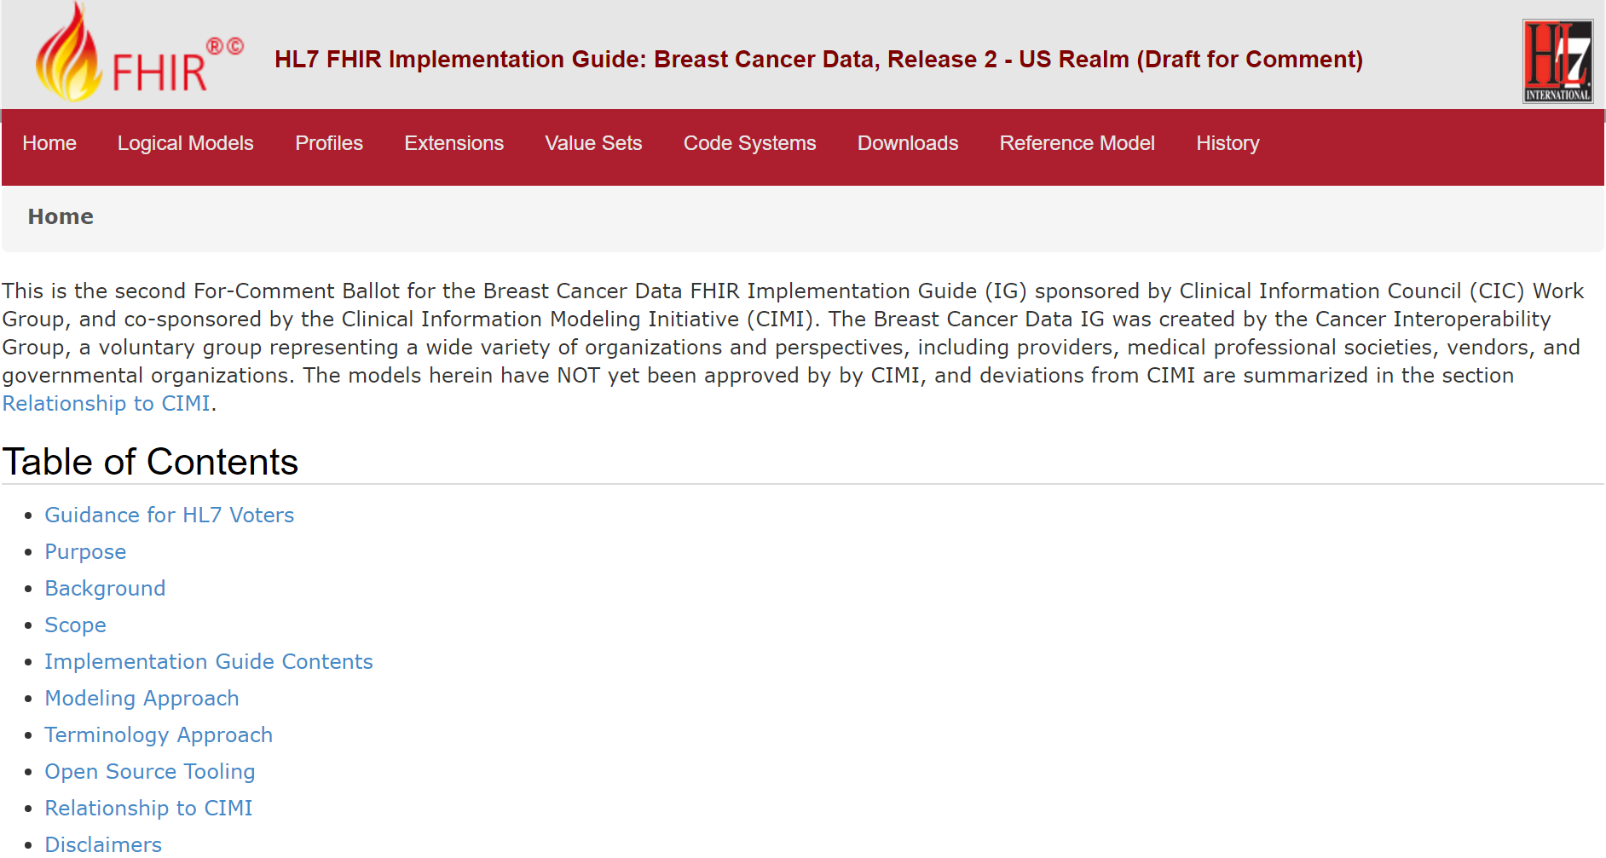
Cancer Interoperability Group
Sponsored by CIC WG, co-sponsored by CIMI WG
Broad involvement; 75 people engaged on weekly basis
  Government (NCI, NIH, NCCN, CMS, NMDP, CCR…)
  Providers (Partners, Intermountain, Allegheny, Hartford…)
  Medical Professional Societies (CAP, ACRO, ACS, ASCO…)
  Vendors/Analytics (Philips, Optum, Penrad, Flatiron, Quintiles, …)
Key milestone
  “For comment” HL7 ballots on FHIR IG (CIMI models and FHIR profiles) in May and September 2018
http://build.fhir.org/ig/HL7/us-breastcancer/index.html
Notes:
National Cancer Institute, National Institutes of Health, National Comprehensive Cancer Network, National Marrow Donor Program, Canadian Cancer Registry
College of American Pathologists, American College of Radiation Oncology, American College of Surgeons

Slide 28
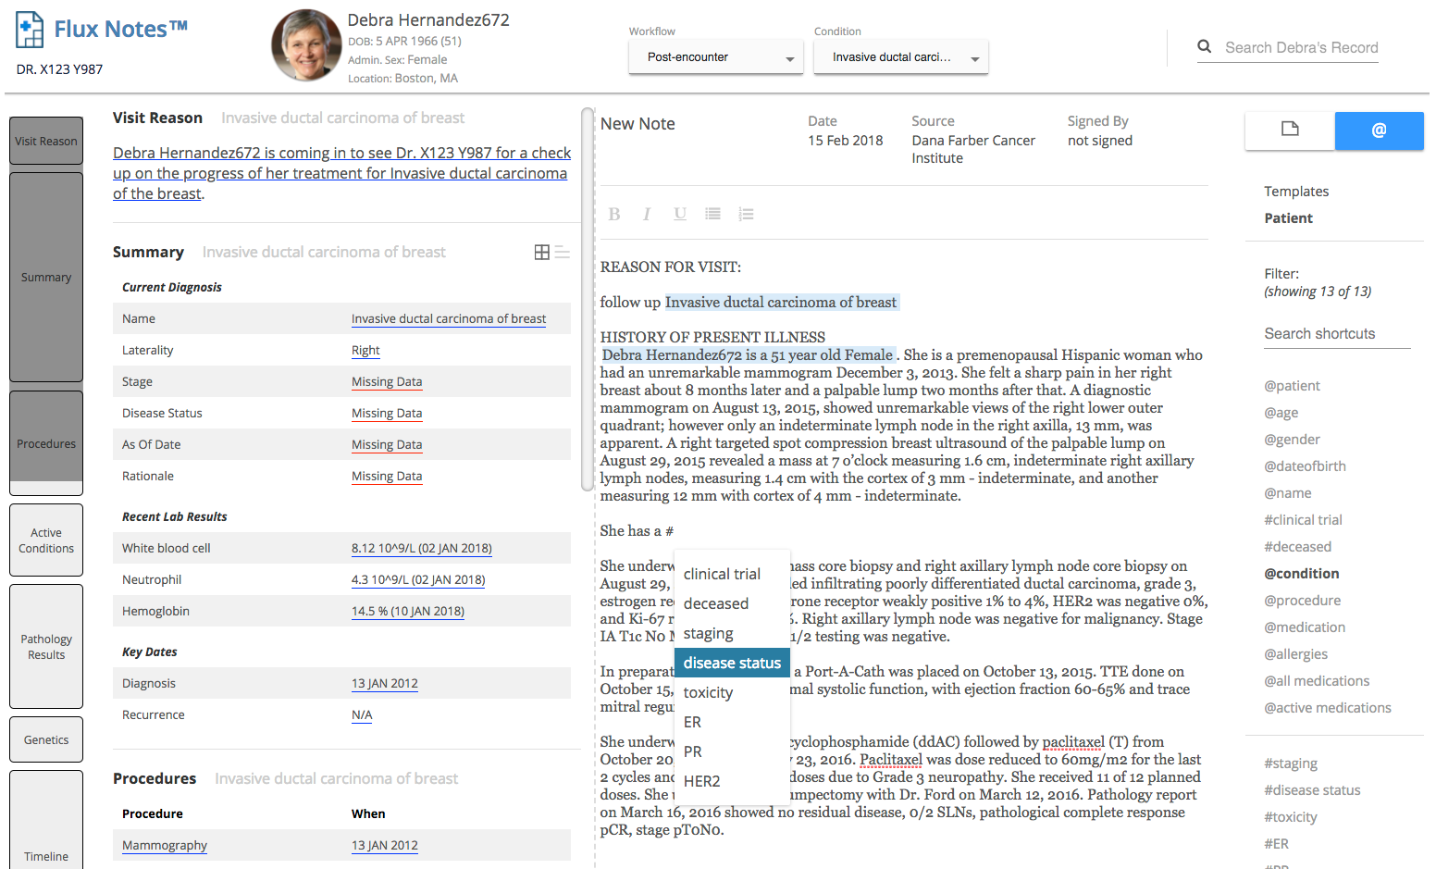
Flux Notes™ Open Source System
Capture and view structured real-world clinical care data
Captures structured clinical care data through clinical notes, using text and voice – Aiming toward self-documented encounters
Visualizes longitudinal and population data useful for better care
Aligns incentives, reduce burden
Builds from and feeds into the data models
http://www.fluxnotes.org

Slide 29









Partners and iCAREdata Pilot Sites
Legend
Committed
Onboarding
Executing
*
* 2 Clinical Studies
Notes:
Dr. Otto Metzger, Breast Cancer Oncologist, Dana Farber Cancer Institute
Dr. Peter Kaufman, Hematology / Breast Cancer Oncologist, Dartmouth Norris Cotton Cancer Center
Dr. Kamara Mertz-Rivera, Director of Clinical Research, Gibbs Cancer Center, Spartenburg, SC
Dr. Phil Stella, Medical Director of the Oncology Program , St. Joseph Mercy Hospital Cancer Center, Ann Arbor
Dr. Daniel Anderson, Medical Oncologist / Hematologist, MMCORC, St. Louis Park, MN
Dr. Matthias Weiss, Hematology / Oncologist, Wisconsin NCORP
Dr. Daniel Flora, Hematology / Medical Oncologist, St. Elizabeth Edgewood, KY
Dr. Sean Khozin, MD, MPH, Associate Director (Acting): FDA Oncology Center of Excellence

Slide 30
Cancer Data Interoperability Project
Planned path forward
FY 2019
  Extend to create a Core Cancer Model
  Extend pilot
FY 2020+
  Conduct clinical trials using RWD
Every patient’s journey improves all future care

Slide 31
Keys to Success (so far)
Integrated team
  Clinical (the customers), informatics, engineering, project management
Resources
  Sustained funding + stakeholder partnerships
Project with specific, impactful use cases and deliverables
  … however, be conscious not to preclude expansion
Agile
  ~1-4 week deliverables, including integration, testing and learning
Open Source
  Commercial innovation will thrive with the foundation is open

Slide 32
Extra slides

Slide 33







Realizing the Vision: Every patient’s journey improves all future care
1. Each episode of care is captured effectively
2. Patient journey is collected across all care locations
Reduce clinician burden
Improve the quality of real-world data
Collect the right data in a standardized, computable form
Integrate and synchronize episodes of care
Improve the totality of evidence with every patient treated
Generate real-world evidence
4. Better care is delivered to all patients
3. Aggregated health data inform insights into clinical care
Enable complete and accurate data to effectively care for every patient
Use data and technology to support better outcomes through decision support
Safety and efficacy in real-world populations
Evaluate multiple combinations, optimal duration, and dose of therapy
Understand impact of therapies across varied and rare subpopulations

Slide 34
Curation Process Challenges
Example Patient: Medical record is approximately 350 pages that spans ~2 years of care
Unstructured clinical notes are information dense
  50 clinical notes
  40-60 “atomized” clinical statements per clinical note
  ~2 minutes to record / reconcile each statement
Ambiguity in medical record
  E.g., Inconsistencies between different parts of the medical record require treating clinician input
Unstructured data within structured data
  E.g., Unstructured medication instructions given within structured list of medications
Significant effort to code clinical information
Electronic Health Record
Structured
2 hours
10%
Procedures
Encounters
Semi-structured
6 hours
15%
Labs
Medications
Unstructured
84 hours
Medical History
Assessment
75%
Clinical Findings
Plan
We estimate it would take ~100 hours to curate a comprehensive SHR for 1 MBC patient *
* This is an estimate based on curating the structured / semi-structured data and ~10% of the unstructured data

Slide 35
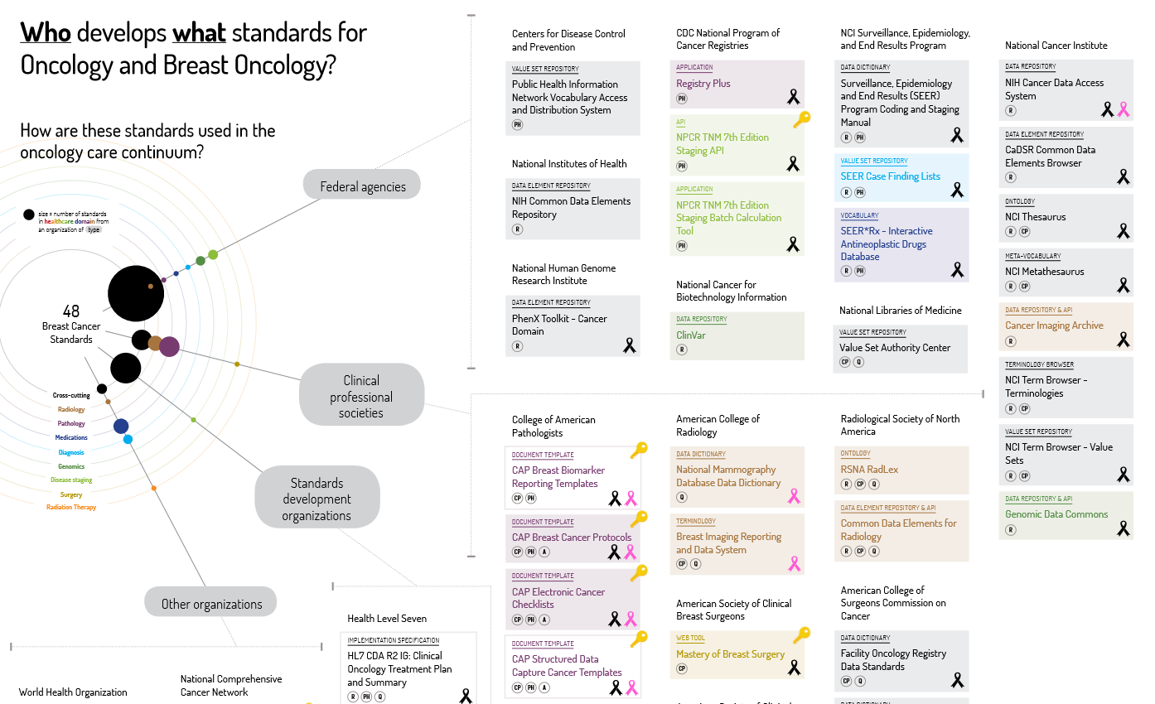
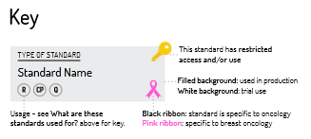
Standards Landscape Survey
21 Organizations
48 Standards
Notes:
XX standards by YY organizations

Slide 36
ICAREdata Study Goal
Support the collection of high quality¹ real-world data (RWD) in a way that enables clinical oncology research
Increase data pool
(RCT data + RWD)
Establishing large scale, prospective collection and integration of high quality clinical data across multiple clinical care sites to augment data collected from clinical trials.
Inform therapeutics
development
Developing effective treatments for patients with rare tumors or uncommon disease types and understanding the natural history and response to therapy for diseases where multiple sequential therapeutic regimens are employed.
Inform regulatory
decision making
Helping to determine how to best use real-world evidence for medical product regulatory decision-making and achieving efficient and accurate post-market surveillance of FDA-approved therapeutics.
Inform data driven
patient care
Understanding efficacy and safety of approved therapeutic agents in underrepresented and minority populations and accumulating a large number of patients and data required to achieve success in personalized medicine.
1. High quality data is data that is complete, accurate and computable.
Notes:
The goal of the ICAREdata study is to support the collection of high-quality real-world data, that is complete, accurate, and computable, in a way that enables clinical oncology research. Establishing a large scale, prospective collection and integration of high quality clinical data across multiple clinical care sites would increase the available data to include both data from RCTs and high-quality real-world data. This approach would also allow development of effective treatment strategies for cohorts of patients that are not amenable to study in RCTs such as rare tumors or uncommon disease types as well as allow an understanding of the natural history and response to therapy for diseases where multiple sequential therapeutic regimens are employed. Additionally, our goal is to inform regulatory decision making by helping to determine how to best use real-world evidence for medical product regulatory decision-making and achieving efficient and accurate post-market surveillance of FDA-approved therapeutics. Lastly, this will inform data driven patient care by understanding the efficacy and safety of approved therapeutic agents in underrepresented and minority populations and accumulating a large number of patients and data required to achieve success in personalized medicine.

Slide 37
CIIC Process Overview

Slide 38
Process Model Scope
Project Intake
Requirements
Create Models
Develop Applications
Piloting
Conformance and Certification Testing
Project Intake – Define need and scope
Requirements – Describe use of data and data requirements
Create Models – Define detailed clinically valid models
Develop Applications – Implement models
Piloting – Test models in real world settings
Conformance and Certification Testing – Enable developers to validate that they have correctly implemented models

Slide 39
Process Model Overview
Project Intake
Requirements
Create Models
Develop Applications
Piloting
Conformance and Certification Testing
Identify Need for
Standard Data
Participate in Clinical Modeling Education
Document Model Request
Elaborate Requirements
Develop Pilot Plan
Incorporate Models Into Conformance Testing Tools
Define Project
Develop Context of Use Scenarios
Assess Existing Models
Determine Technical Approach
Select Pilot Sites
Provide Conformance Testing Services
Submit Application
Identify Data Requirements
Accept Models
Develop Software
Implement Pilot
Project Review and Acceptance
Modify Models
Test Software
Evaluate Pilot
Create Models
Approve Software
QA Models
Identify Model Updates
Identify Model Updates
Inform Interested Parties
Interested Party and Steward Review
Interested Party and Steward Review
Interested Party and Steward Review

Slide 40
Today’s Focus
Project Intake
Requirements
Create Models
Develop Applications
Piloting
Conformance and Certification Testing
Identify Need for
Standard Data
Participate in Clinical Modeling Education
Document Model Request
Elaborate Requirements
Develop Pilot Plan
Incorporate Models Into Conformance Testing Tools
Define Project
Develop Context of Use Scenarios
Assess Existing Models
Determine Technical Approach
Select Pilot Sites
Provide Conformance Testing Services
Submit Application
Identify Data Requirements
Accept Models
Develop Software
Implement Pilot
Project Review and Acceptance
Modify Models
Test Software
Evaluate Pilot
Create Models
Approve Software
QA Models
Identify Model Updates
Identify Model Updates
Inform Interested Parties
Interested Party and Steward Review
Interested Party and Steward Review
Interested Party and Steward Review

Slide 41
Project Intake
Project Intake
Identify Need for
Standard Data
Organization determines that there is a need for standardized clinical data models
Defines a project that includes work to develop standardized clinical data models
Decides to collaborate with CIIC on data modeling work
Submits application to CIIC
CIIC reviews application
CIIC community informed that a project has been accepted and can indicate that their organization is an interested party
Define Project
Submit Application
Project Review and Acceptance
Inform Interested Parties
Has anyone submitted a project application to CIIC?

Slide 42
CIIC Project Application
Project Title
Primary contact
Organization
  List your primary organization affiliation related to this project
Email
Phone
Formal team collaborators
  Include all additional stakeholder involvement e.g., clinical, technical, informatics, terminology, process, implementer, system, health IT developer, health information exchange (HIE), registry or other, patient advocates. Describe briefly how they will be involved with the project?
Project scope
  Ensure that your scope statement is clear and concise
Goals
  Describe your project goals and use case(s)
Value proposition
  Explain the expected value of the project, from the perspective of both the project team itself, and also from that of your external stakeholders. In articulating this value proposition, consider different perspectives such as improvement of economic or health outcomes, regulatory, process of care, safety, interoperability, multidisciplinary, patient-centered.

Slide 43
CIIC Project Application
Deliverables
  What are the expected project deliverables? Describe the potential for reuse in other settings. How will this project’s output represent an improvement from the current state? Please include project phases if appropriate, to help us understand what portion is in scope for the next 6-12mo. What deliverables do you expect at the end of this period?
Implementation
  Describe the implementation plan for the project, including testing and validation?
Relationship to existing work
  Is there existing content that may be related or overlapping? Will you reuse content from other sources where clinically appropriate?
Resources
  List the resources i.e., time, financial, data, human capital that you have available to support the project. What additional resources do you anticipate needing, regardless of whether you plan to pursue them through CIIC, or separately?
Sustainability
  Do you intend to support maintenance of this content through ongoing stewardship? How often do you expect to update this content and respond to feedback? Who is the steward, if already identified?
Licensing of intellectual property
  Will your content be available through open source? Are there any intellectual property issues you anticipate?
Project documents - upload
  If you have project documents you'd like to share with CIIC, please upload them here.
  Project documents - links
  If you have project web or document links you'd like to share with CIIC, please include the URLs here.
Comments from anyone who has submitted an application
Would your organization find this application burdensome?
Anything missing?

Slide 44
CIIC Agreements
Respond to feedback and engage external participants
Use open source with allowable IP
Have a primary focus on clinical care
Agree to utilize shared process and tooling
Agree to a shared, standards -based technical approach
Reuse existing content if appropriate to the use case
Transparency from sharing ongoing progress and developed content through CIIC
Ongoing stewardship of content
Implementation and real-world use of what is developed
Quality assurance and testing

Slide 45
CIIC Agreements
Having multi-stakeholder involvement throughout the process, including as appropriate the following stakeholder groups
  Clinical
  Technical, informatics and terminology
  Process
  Implementer
  System; the developer, health information exchange, registry or otherwise depending on use case. Broader is better
  Patient
Would your organization accept these agreements?
Anything missing?

Slide 46
Project Acceptance Criteria
Acceptance of CIIC Agreement
Value proposition to advancing interoperability
Sufficient resources to meet the scope of the project
Support for CIIC core services
Implementation commitment
HSPC/CIIC member
Do these make sense?
Anything missing?

Slide 47
Project Selection/Engagement/Commitment /Recognition Process
Clinical Steering Committee concurrence

Slide 48
Current Project Applications
Submissions received
  FDA – Women’s Health Registry
  Cancer Interoperability
  Registries
  Pain Assessment
  ODH
  ….
Next steps

Slide 49
Define Requirements
Define Requirements
Participate in Clinical Modeling Education
CIIC will provide clinical modeling education to project participants
Projects will develop a description of the clinical or other context in which the data will be used
Based on the clinical scenarios, projects will develop a list of data requirements
Develop Context of Use Scenarios
Identify Data Requirements
Describe Experience

Slide 50
Context of Use
Scenarios
  Scope
  Assumptions
  Description
  Actors
  Data used or created
  Business rules
  Workflow
Assumptions
  We would provide an example and instructions and a template or other tool
How much and what type of support might be needed for your organization?

Slide 51
Data Requirements
List of data requirements
  Data elements
    Definitions
    Data type
  Values
    Definitions
How much and what type of support might be needed for your organization?

Slide 52
Model Repository and Model Adoption
Model Repository
Model Id | Status | Version | Isosemantic Family | Model content | Meta data
Hematocrit | DSTU | 2 | 2123 | XXXX | YYY
Blood Pressure | Incomplete | 1 | 4578 | XXXX | YYY
Heart Rate | In Use | 3 | 4190 | XXXX | YYY
White Cell Count | In Use | 5 | 1789 | XXXX | YYY
Serum Glucose | DSTU | 2 | 3675 | XXXX | YYY
Serum Bilirubin | In Use | 3 | 5367 | XXXX | YYY
Model Adoption
Model Id | Realm | Use Case | Situation | Meta data
Heart Rate | US | Public Health Reporting | Pop Health | YYY
Hematocrit | AUS | Standard Lab Results | Data sharing | YYY
Serum Glucose | US | MU Quality Measure | CDS | YYY
Serum Glucose | International | CIMI | Data sharing | YYY
Serum Glucose | International | openEHR | Data sharing | YYY
Serum Bilirubin | HSPC | Neonatal Bilirubin App | CDS | YYY

Slide 53
Create Models
Create Models
Document Model Request
This phase would require support of an expert clinical information modeler with knowledge of the CIMI model standard and the CIIC model repository
CIIC would provide tools or structured format for documenting model requests
The expert clinical modeler would work closely with the project team to:
  Review and assess the previously developed models
  Identify needed changes to existing models
  Develop new models
CIIC will have an internal process to provide quality review of new models and updates to existing models
New models and updates to existing models would be made available for comment by interested parties and the model stewards
Assess Existing Models
Accept Models
Modify Models
Create Models
QA Models
Interested Party and Steward Review
Describe Experience

Slide 54
Collaboration Tools for Clinicians

Slide 55
Collaboration Tools for Clinicians
Project application and intake
Tools to assist clinicians in articulating their requirements
Model repository
  Searching
  Mechanics for reviewing models and proposed updates to models
Communications

Slide 56
CIIC Project Application
Project Title
Primary contact
Organization
  List your primary organization affiliation related to this project
Email
Phone
Formal team collaborators
  Include all additional stakeholder involvement e.g., clinical, technical, informatics, terminology, process, implementer, system, health IT developer, health information exchange (HIE), registry or other, patient advocates. Describe briefly how they will be involved with the project?
Project scope
  Ensure that your scope statement is clear and concise
Goals
  Describe your project goals and use case(s)
Value proposition
  Explain the expected value of the project, from the perspective of both the project team itself, and also from that of your external stakeholders. In articulating this value proposition, consider different perspectives such as improvement of economic or health outcomes, regulatory, process of care, safety, interoperability, multidisciplinary, patient-centered.

Slide 57
CIIC Project Application
Deliverables
  What are the expected project deliverables? Describe the potential for reuse in other settings. How will this project’s output represent an improvement from the current state? Please include project phases if appropriate, to help us understand what portion is in scope for the next 6-12mo. What deliverables do you expect at the end of this period?
Implementation
  Describe the implementation plan for the project, including testing and validation?
Relationship to existing work
  Is there existing content that may be related or overlapping? Will you reuse content from other sources where clinically appropriate?
Resources
  List the resources i.e., time, financial, data, human capital that you have available to support the project. What additional resources do you anticipate needing, regardless of whether you plan to pursue them through CIIC, or separately?
Sustainability
  Do you intend to support maintenance of this content through ongoing stewardship? How often do you expect to update this content and respond to feedback? Who is the steward, if already identified?
Licensing of intellectual property
  Will your content be available through open source? Are there any intellectual property issues you anticipate?
Project documents - upload
  If you have project documents you'd like to share with CIIC, please upload them here.
  Project documents - links
  If you have project web or document links you'd like to share with CIIC, please include the URLs here.
Would the current Google docs approach be sufficient in the near-term?

Slide 58
Context of Use
Scenarios
  Scope
  Assumptions
  Description
  Actors
  Data used or created
  Business rules
  Workflow
Assumptions
  CIIC would provide an example an instructions
Need mechanisms to track comments and feedback
  Iterative
  Asynchronous
Would a Google docs approach be sufficient in the near-term?
Would this provide sufficient support for collaboration and comments?

Slide 59
Data Requirements
List of data requirements
  Data elements
    Definitions
    Data type
  Values
    Definitions
Mock-ups of screens
Screenshots/Forms and other documentation
Need mechanisms to track comments and feedback
  Iterative
  Asynchronous
Would a Google sheets approach be sufficient in the near-term?
Would this provide sufficient support for collaboration and comments?
Would a screen mockup tool be more intuitive for clinicians than a spreadsheet?

Slide 60
Project Coordination Tools
Management of contact lists for communication
Meeting management
Documentation of decision making
Project tracking
Are these tools a priority or do project sponsor organizations have tools to meet these requirements?
Should these be provided by CIIC to provide transparency across the community?

Slide 61
Framework for Clinician Review of Clinical Data Models

Slide 62
Data Model Governance Process Characteristics
Open
Nimble
Light weight
Scalable

Slide 63
What does it mean to be a clinically correct model?
The model properly addresses the requirements and scenarios as stated
The model is a correct representation from these perspectives:
  Clinical
  Terminology
  Technical – compliant to the CIMI adopted formalism
Who has standing to judge a model?
  Does CIIC develop a process to determine standing?
  Review board of highly qualified people selected through an open consensus process
Could we live with an 80/20 rule?
What about broadly used models, e.g., blood pressure?

Slide 64
Data Model Governance Process
New projects announced and organizations indicate they are interested parties
At key checkpoints in a project interested parties are notified of proposed new models and changes to existing models
Comments solicited and compiled
Project owner and model steward collaborate on responses to comments
Proposed revisions are published

Slide 65
Data Model Governance Role
Roles
  Project Owners
    Create and revise models associated with their projects
    Participate in review of comments from interested parties and stewards
  Model Stewards
    Entity with “ownership” of a model over time
    Criteria
    Authority
  Interested Parties
    Entity that wishes to provide input on a model
    Criteria
  Technical Reviewers
    Conformance to CIMI

Slide 66
Project Owners
Role
  Create and revise models associated with their projects
  Participate in review of comments from interested parties and stewards
Qualifications
  Designated expert by the project
  Prefer some level of clinical modeling expertise
  HSPC/CIIC membership
Authority
  In collaboration with the model steward establish the “CIIC approved” version of the model
  Review and dispose of comments from interested parties

Slide 67
Model Steward
Role
  Entity with “ownership” of a model over time
Qualifications
  Significant clinical expertise relevant to the data being modeled
  Commitment to support the ongoing maintenance of the model
    Collaborate with projects using the model
    Consider feedback from other users of the model
    Periodic reviews to revalidate
    Designated point of contact
  HSPC/CIIC membership
Authority
  In collaboration with the model steward establish the “CIIC approved” version of the model

Slide 68
Interested Party
Qualifications
  Domain expertise relevant to the model
  Commitment to provide feedback in a timely manner
  Designated point of contact who will gather feedback for their organization
  HSPC/CIIC member
Authority
  Advisory

Slide 69
Technical Reviewers
Role
  Review models to ensure technical conformance with CIMI
Qualifications
  Expert in CIMI modeling formalism and requirements
  Experience with clinical data modeling
Authority
  Confirm that models are CIMI compliant

Slide 70
CIIC – Building the Community

Slide 71
Discussion Purpose
Identify who should be part of the CIIC community
Plan to engage priority target groups
  Identify priority target groups to bring into the community
Define an engagement strategy that is feasible within current resources

Slide 72
Who is here?
Clinical Societies
Providers
Government
Standards
Vendors
Consultants
Academic
NGOs
ACOG
AAFP
ACC
ACP
ACS
AMA
ASCO
SGIM
Intermountain
Brigham
AHRQ
CMS
FDA
NIDDK
NLM
ONC
VA
CDISC
HL7
Open Group
Api Focal
Care Progress
Cognitive
Evidence Care
Wolters Kluwer
Intersystems
Medical Algorithms
Nuance
Optum
Oracle
PenRad
Siemens
Centri Health
Constable
Deloitte
Hi3 Solutions
JP Systems
MD Partners
Parexcel
Perspecta
Duke
LSU
NYU
U of Utah
OSEHRA
Mitre
PCPI
Sequoia

Slide 73
CIIC Community
Who is the community for this work?
Who is here?
Who is not here?
  Nursing
  Other clinicians
Who do we need to get here quickly?
How do we get them here?

Slide 74
What is the meaning of membership?
Can we make the case for a shared investment model?
Should membership be a pre-requisite for various forms of participation:
  Project support
  Access to tools or more sophisticated tools
  Being and interested party or steward

Slide 75
Staying Connected to the Community
How do we nurture this community?
  Not everyone has the budget to attend meetings
    How do we make meeting participation valuable?
  What other methods should we use to engage the community?
    Webinars
    Confluence pages
    Points of contact – CRM
    Peer to peer
Notes:
Why should I pay to attend the meetings in person if we are involving the remote people. Takes too much time to get them on line remotely.
Need a list of principles?
no web connection to meetings? F2F only
Could perhaps have a listen only for web connection to some of the sessions – a blend….
How do we teach people and do crowd sourcing – 2 hours of work that leads to 4 hours of rectify, reconcile the different comments.
How to manage disruptors, how to manage decisions made and later date challenges to the decisions…. Must have a super majority to reconsider a previously made decision.
How are decisions made, what do we vote on – we don’t want to ballot models – but how do we make decisions.
Input – idea generation. Not decision making….

