Slide 1
The Sequoia Project Testing Overview
Trusted Convener of Industry & Government
to Address Health IT Interoperability
www.sequoiaproject.org

Slide 2



The Sequoia Project’s Role
The Sequoia Project is a trusted, independent convener of private sector healthcare
and governmental stakeholders
We work to address the challenges of secure, interoperable nationwide health information exchange (HIE).
SECURE
INTEROPERABLE
NATIONWIDE

Slide 3


Companies Supported by The Sequoia Project
eHealth Exchange operates one of the largest nationwide public-private health information networks in the US
Carequality operates a nationwide interoperability framework to link health information networks

Slide 4


Current Sequoia Project Initiatives
PULSE is a system which provides disaster healthcare volunteers access to information to treat individuals injured or displaced by disasters
RSNA Image Share Validation Program is an interoperability testing program to enable seamless sharing of medical images
Interoperability Matters
Interoperability Matters is an interoperability leadership forum

Slide 5
New Corporate Structure Overview
The Sequoia Project
eHealth Exchange
Non Profit 501(c)(3)
Governed by board of directors
Strategic center for interoperability
Supports / incubates new initiatives
Provides management services to programs and affiliates
Carequality
Mgt
Svcs
Agmt
Mgt
Svcs
Agmt
Non Profit 501(c)(3)
Corporate board governs the company
Coordinating Committee governs the network
Non Profit 501(c)(3)
Corporate board
Steering Committee governs the framework and implementers
Advisory Council retains advisory role
PULSE
RSNA Program

Slide 6

Testing Tooling
The community has developed a large body of test cases, data, and conformity assessment tools that are open source
Designed to ensure interoperability and assure compliance and minimal implementation
The Sequoia Project has collaborated on the development of testing tools with IHE International, IHE Services, and NIST to support our RSNA and eHealth Exchange validation testing programs
Will leverage the eHealth Exchange Entrust Validation Certificates
Battle-hardened by years of operations and productized into the new Sequoia Interoperability Testing Platform (ITP)

Slide 7

Sequoia Interoperability Testing Platform (ITP)
Content Testing VM
  Art Décor CDA/C-CDA Authoring Tool
  EVS Client (UI for Systems Under Test) https://gazellecontent.sequoiaproject.org/EVSClient/home.seam
  Objects Checker + Gazelle SVS Simulator
Sequoia Transport & Security Testing VM https://validation.sequoiaproject.org/
  Gazelle Test Management (User Management)
  Gazelle Security Suite (Security Testing)
  Assertion Manager (Checklist Testing)
  EVS Client (UI for Systems Under Test)
  Patient Manager (PD Testing)
  Gazelle Webservice Tester
  XDS Toolkit (QD & RD Testing)
Notes:
Multi-level testing
Profile-level testing
Product testing and validation
Production-level testing to assure production configuration interoperates
Automated, self-service approach
Tightly constrained tests
Focus on known interoperability issues and security,
as well as “negative tests”
Implementation-level testing essential to catch interoperability issues introduced by systems configurations
Testing eco-system with feedback loop into tightly constrained implementation specifications

Slide 8




Content Testing Required 2/5/18 to Solve
Industry-Wide Content Pain Points
  Optionality
  More than one way to do things and inconsistent implementations across vendors
  Terminology
  Inconsistent terminology usage
Specification Ambiguity
  Complexity
  The C-CDA standard is difficult to understand and consume and is lacking in clearly documented examples
Notes:
Optionality – CCD is an Open Template type therefore many participants use it for various use cases
Terminology –
Specification Ambiguity
Complexity

Slide 9

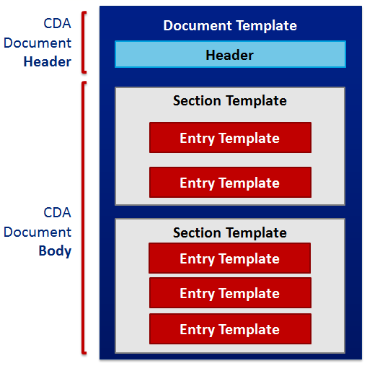
Enhanced Content Testing Program
Industry proven tooling leveraged
Covers the HITSP C32/CCD, HL7 C-CDA CCD R1.1 and R2.1 versions
All Errata included for 1.1 and 2.1 including HL7 2.1 Errata package released May 2018
Identifies warnings and errors not found by other testing tooling
Value Sets https://vsac.nlm.nih.gov/
eHealth Exchange Content Testing Program Website:
https://sequoiaproject.org/ehealth-exchange/testing-overview/content-testing/

Slide 10

Collaborative Process for Creating Consistent & Robust HL7 C-CDAs - (VHIE/Sequoia)
Content Priorities
Clinicians
Others
Data Mapping
SDO Requirements
C-CDA Creation
Identify Sources
Business Office
Vendor Specific Data Model Overlay
Semantic Interoperability Transformation
Internal/External Transformation
Value Sets
System Configuration
Notes:
We’re pioneering a leading content testing program and intend to raise the bar every year.

Slide 11

Value from the Largest Public-Private Health Information Network
2019 © The Sequoia Project. All rights reserved.

Slide 12






The Largest Public-Private Health Information Network
eHealth Exchange Connects:
All 50 States
Four Federal Agencies
(VA, SSA, DoD, CMS)
75%
of U.S. Hospitals
70,000
Medical Groups
3,400+
Dialysis Centers
8,300
Pharmacies
Supporting more than 120 million patients
59 Regional and State HIEs
Shared Governance and Trust Agreement
Common Standards, Specifications & Policies
Notes:
Jay
National network with key Federal partnerships
Significant volume. (Dignity/Cerner retrieves 22M Care Summaries via eHx annually)
Data quality requirements & certification

Slide 13














eHealth Exchange Validated Products
OpenHRE
Clinical Exchange Platform
Cerner Resonance
Connect
Care Everywhere
Greenway Exchange
Prism
InterSystems Healthcare
LTS HEX
Network
Optum HIE
Exchange Gateway
Exchange Gateway
Jiva HIE Connect

Slide 14
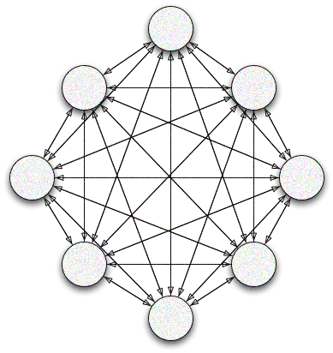
Federated Architecture
Participant
eHealth Exchange Participants
Carequality Participants

Slide 15


Centralized Architecture - Hub Accelerates Expanded Reach
Setup Once
Health System
(eHealth Exchange)
Connect with Many
Regional HIE
(eHealth Exchange)
athenahealth Network
(Carequality)
eHealth
Exchange
Hub
Surescripts
CommonWell Health Alliance
athenahealth
NextGen Healthcare
eClinicalWorks
Epic Care Everywhere
GE
Netsmart
Etc.
Physician Group
(eHealth Exchange)
CommonWell
Network
(Carequality)
Patient Discovery
Query Documents
Document Retrieve
Hub facilitates translations required by Carequality
Federal Partner
(eHealth Exchange)
Epic
Network
(Carequality)
Multiple endpoints
Pharmacy
(eHealth Exchange)

Slide 16
2019 eHealth Exchange Roadmap
Hub Platform
Carequality
FHIR Directory
PULSE Integration
Purpose of Use
Record Locator
Enhance Architecture
Expand
Reach
Streamline
Prepare
Expand Breadth
Notify
Refer
Qualified Health Information Network (QHIN) Analysis
 |  | Future Years |  | Future Years | Future Years | Future Years
 |  | FHIR Resources* |  | PDMP* | Push vs Pull | Direct Messaging
 |  | Patient Matching |  | Image Exchange

Slide 17
Key Issues to Solve
Opportunities
Broad connectivity must be cheaper and easier
Complexity & Expense
Centralization
Purposes of Use
PULSE
Participants need access to additional networks
Reach
Carequality
PDMP
Timeliness
Push CDAs & Discrete Data
Where to Search (RLS)
PULSE
Need to coordinate care sooner
Must complement reactive searches
Participants often need to focus specifically on medications, lab results
Discrete Data
FHIR
Notes:
Incredibly valuable capability today:
We’re able to search a inside a huge network & receive a tremendous amount of valuable data
But if we examine this process through a critical lens, we might admit:
Only connected to a Handful of providers
Only for Tx
Only searching when we already know care delivered elsewhere
Must sort through a lot of info
How can we make data exchange SIMPLER, MORE AFFORDABLE, MORE TIMELY, & MORE PRECISE?
How can we improve data exchange to make patient care safer & more effective?

Slide 18
Trusted Exchange Framework and Common Agreement
Accelerating seamless, interoperable health information exchange among networks

Slide 19
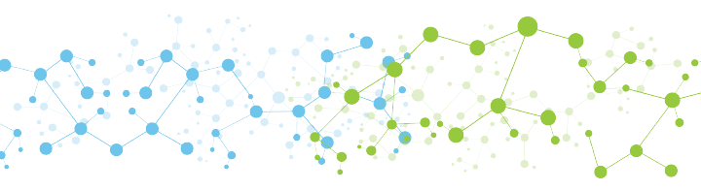
The Solution
Carequality creates a standardized, national-level interoperability
framework to link all data sharing networks
Carequality is creating a web of interconnected networks

Slide 20
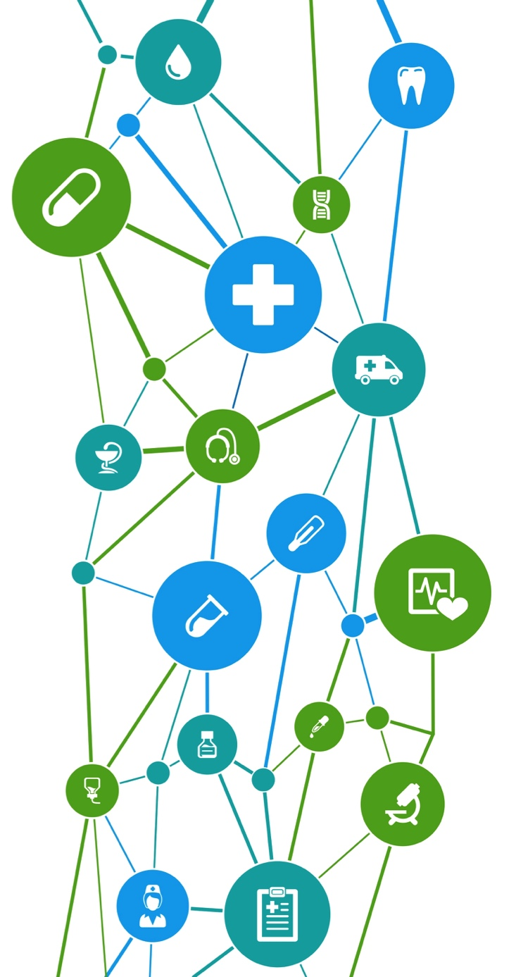
The Power of Connecting Communities
How do you get nationwide connectivity? Clinic by clinic, hospital by hospital?
Data sharing networks have already connected many participants. The connections grow exponentially by connecting these user communities to one another, as groups.
If you connect six clinics, you might reach a few dozen physicians.
If you connect six networks, you can reach thousands of physicians.

Slide 21



Essential Elements
Common rules of the road: In order for the varied participants to trust each other with health information, everyone needs to have a legal obligation to abide by the same rules.
Well-defined technical specs: Shared rules are not enough; clear standards must be laid out in an implementation guide that all implementers can follow.
A participant directory: To connect using the common standards, systems must know the addresses and roles of each participant.

Slide 22






























Current Carequality Connected Agreement Signees
HIEs and HINs
Technology Vendors
Service Providers
PHRs
Other

Slide 23

In Production:

Slide 24
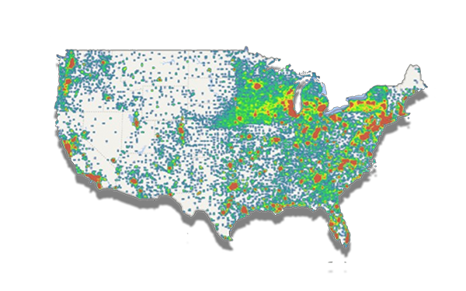
Accelerating Health Data Sharing in America
35,000+ Clinics
1,250 Hospitals
600K+ Providers
14M Clinical Documents
Exchanged Monthly

Slide 25

An initiative of

Slide 26

History
2013: California Emergency Medical Services Authority (EMSA) 1st HIE in EMS Summit
March 2016: EMSA awards Ai the PULSE development contract
January 2018:
PULSE becomes Sequoia program; Advisory Council formed
March 2015: HHS Idea Lab funds use case and technical architecture development of PULSE
July 2017: PULSE Go-live with Ai as operator
April 2014: ONC engages Ai to evaluate use of HIE infrastructure for disaster preparedness and response
July 2015: ONC awards EMSA a grant to advance HIE statewide during a disaster and regionally in daily EMS
January 2017: HHS IDEA Lab blog publishes PULSE post
November 2017:
PULSE activated for CA fires

Slide 27

What Does PULSE Do?
Patient Unified Lookup Service for Emergencies
How Does PULSE Work?
Disaster Healthcare Volunteers log into the PULSE portal and are authenticated against
the state’s credentialed volunteer database
Authorized volunteers in alternative care facilities,
search for patient records
from all connected providers and networks
Volunteers retrieve view patient records while treating them at the alternative care facilities
PULSE enables authorized disaster healthcare volunteers to access health records to treat people injured or displaced due to disasters

Slide 28







http://sequoiaproject.org/rsna/validated-products/
Notes:
Delighted to have an opportunity to work in collaboration with the RSNA in support of an innovative testing program to enable nationwide exchange of images.
We applied our considerable expertise from supporting the eHealth Exchange validation program since 2013.

Slide 29

Foundational Standards for Image Sharing and Validation
Ontologies - RadLex, SNOMED-CT
DICOM medical imaging standards
HL7 messaging
IHE-Integrating the Healthcare Enterprise
  Radiology Technical Framework
  Organizes the existing standards into practical, efficient workflows
Future releases: DICOM Web and HL7 FHIR
https://www.healthit.gov/isa/
Notes:
Chris
Discuss standard leveraged in current bundles
Speak to future plans as the HL7 FHIR and DICOM Web standards mature

Slide 30

RSNA Image Share Validation Program
Fills a national Standards Gap
  Product conformity assessment testing
IHE profiles provide specifications for testing
Modular Standards/Specifications/Test Cases
  Cross-Enterprise Document Sharing for Imaging (XDS-I)
    Document Source and Document Consumer
    Registry and Repository
  Cross-Community Access for Imaging (XCA-I)
    Initiating Gateway
    Responding Gateway
  RSNA Image Share PHR
Notes:
Chris
Speak about the IHE Technical Framework referenced in specs link
Discuss bundles
The renumbering for Source/Consumer and Initiating Gateway/Responding Gateway make it hard to see what actually changed.
From Steve Moore
There were substantial changes to the XDS-I Source tests. We now do a better job of testing the linkage of metadata to values in the original DICOM images.
For the Consumer tests, we generated better metadata based on the original DICOM data. In the previous testing, metadata was not generated per the XDS-I requirements.
Initiating and Responding Gateway test requirements did not actually change.
All bundles do have a change for security requirements. All bundles require ATNA testing which includes TLS communication and syslog message validation.

Slide 31
What’s Gemini?
A joint initiative of HL7 and IHE – not a separate organizational entity
  Operates under the Statement of Understanding between HL7 International and IHE International
Oversight by a joint Steering Committee that includes 3 representatives from from each organization
Mission is to make further advances in interoperability by capitalizing on the advantages of FHIR and combining the relative strengths of both organizations
Will result in the creation of new, robust, jointly-owned specifications developed under the collaboration
Specifications will be based primarily on

Slide 32
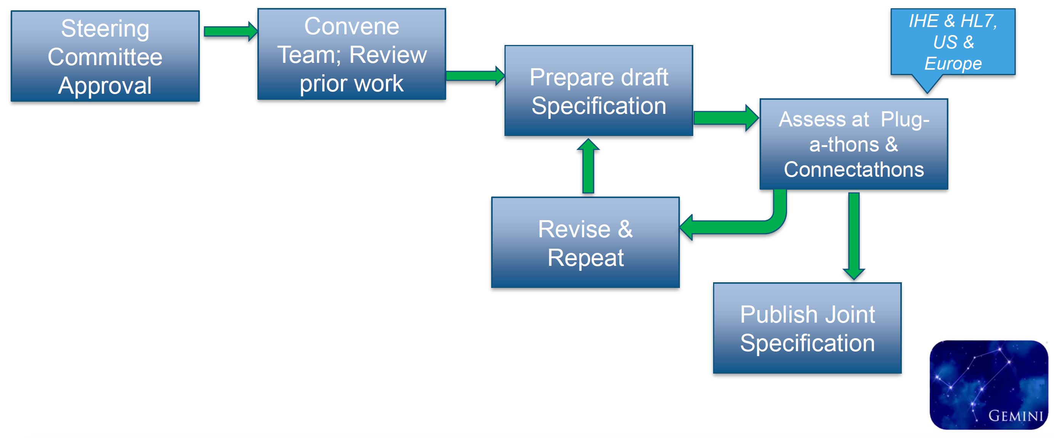
Leaping Forward through Collaboration

Slide 33
Some Gemini Projects
Endorsed: Breast Cancer Staging (HL7 Project) Work in Progress
Approved: Medical Imaging for Cancer Care
  Goal: seek to make incremental progress over the course of IHE and HL7 Connectathons , culminating in a joint publication
  Primary HL7 work groups participating include Health Care Devices, Image Integration and CIMI
  Primary IHE domains include Radiology and Patient Care Coordination
Under Consideration: e-Immunization
Possible Future Consideration: Patient Care, Incorporating CS Hooks

Slide 34
FHIR Conformance Testing - What
Implementers test conformance to base specifications
Implementers test conformance to published implementation guide(s)

Slide 35
Conformance Testing - Resources
Test/Validate resources exchanged: does not test behavior of the implementer or how they use the data exchanges
  Schema: FHIR Specification provides schema for XML, JSON and RDF
  Validating a Resource means checking the following aspects are valid:
    Structure, Cardinality, Value Domains, Coding/CodeableConcept bindings, Invariants, Profiles, Questionnaires, Business Rules
  FHIR Validator: http://hl7.org/fhir/validation.html
    http://wiki.hl7.org/index.php?title=Using_the_FHIR_Validator
    Validate terminology content of resource
    Validate against Implementation Guides
  FHIR.org – to offer manual validation service staffed by FHIR experts to manually examine a resource and ensure content is valid against rules that only a human can test

Slide 36
Conformance Testing - Servers
Testing Servers: Known inputs defined, tests are applied to server responses to validate server’s response is correct
  FHIR includes a TestScript resource (infrastructure support resource)
    TestScript resource is used to define tests to be executed on one or more FHIR servers. Part of the Conformance Framework used to validate the behavior of FHIR systems specifically their correct implementation of
      StructureDefinition
      ValueSet
      OperationDefinition
      CapabilityStatement
      ImplementationGuide
      Or others that govern system behavior
    The following services use the TestScript resource and other knowledge to test servers:
      Touchstone - AEGIS Testing Service
      Crucible - Mitre Test Service
https://inferno.healthit.gov/inferno

Slide 37
Conformance Testing - Clients
Testing Clients: Test Harness or Human can perform testing applied to the client requests and known inputs and application behavior are validated
  AEGIS Touchstone can perform TestScript based testing of FHIR clients

Slide 38
The Da Vinci Project:
Unlocking Payer Information to Improve Patient Care

Slide 39
2019 Use Cases and Project Deliverables
Data Exchange for Quality Measures
Coverage Requirements Discovery
Documentation Templates and Coverage Rules
Project Deliverables
Define requirements (technical, business and testing)
Create Implementation Guide
Create and test Reference Implementation (prove the guide works)
Pilot the solution
Deploy the solution
Health Record Exchange:
Clinical Data Exchange
Health Record Exchange:
Payer Data
Exchange
Prior-Authorization Support
Gaps in Care & Information
Risk Based Contract Member Identification
Alerts:
Notification (ADT),
Transitions in Care, ER admit/discharge, …
In HL7 ballot reconciliation as draft standard
Under active development
2019 Use Cases
Use Cases in Discovery
Performing Laboratory Reporting
Chronic Illness Documentation for
Risk Adjustment
Patient Cost Transparency
39

Slide 40
Dara’s Journey
The vignette describes a clinical encounter for a 78-year-old Asian woman named Dara. The encounter spans primary care, specialty care, hospitalization and return to primary care. The information exchanges include:
  payer scheduled appointments,
  retrieving payer information and incorporating it into the patient’s clinical record,
  integrating coverage requirements in the provider’s clinical workflow and
  support for automatic reporting of quality measures.

Slide 41
Interactions (all FHIR based)
Interaction | Interaction Description | Standards Used | Location | Provider System
1 | Scheduling | FHIR DSTU2 | Cardiologist | Cerner EHR
2 | Request Payer Data | Payer Data Exchange | Cardiologist | Cerner EHR
3 | Coverage for Home Oxygen | Coverage Requirements Discovery | Hosp (discharge) | Rush (Epic EHR)
4 | Med Reconciliation Attestation | Data Exchange for Quality Measures | Primary Care | Reference
Each interaction involves a different payer to demonstrate interoperability across Da Vinci payer members. Under normal circumstances a single payer would be involved with all of the interactions for a specific patient.
41

Slide 42





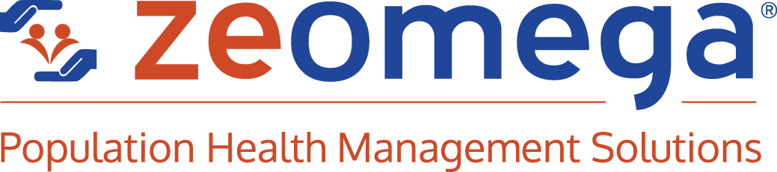












Participants
Provider / EHR
Payer / Technology Partner
Payer
Testing/Monitoring
Reference Implementation

Slide 43







Unlocking Payer Information to Improve Patient Care
Cardiologist
Hospital
Presentation
Primary Care
Provide Payer Data
Coverage Requirements
Reference Implementation
The vignette describes a clinical encounter for a 78-year-old Asian woman named Dara. The encounter spans primary care, specialty care, hospitalization and return to primary care. The information exchanges include payer scheduled appointments, retrieving payer information and incorporating it into the patient’s clinical record, integrating coverage requirements in the provider’s clinical workflow and support for automatic reporting of quality measures.
Scheduling
Medication Reconciliation Attestation
43

Slide 44
Dara’s Journey
The vignette describes a clinical encounter for a 78-year-old Asian woman named Dara. The encounter spans primary care, specialty care, hospitalization and return to primary care. The information exchanges include:
  payer scheduled appointments,
  retrieving payer information and incorporating it into the patient’s clinical record,
  integrating coverage requirements in the provider’s clinical workflow and
  support for automatic reporting of quality measures.

Slide 45


Unlocking Payer Information to Improve Patient Care
Interaction | Interaction Description | Exchange | Standards Used
1 | Scheduling |  | FHIR DSTU2
1a | Authenticate and get token | Payer-EHR -Payer | OAuth
1b | Request Slots (using token) |  | RESTful GET (FHIR DSTU2)
1c | Schedule Appointment (using token) |  | RESTful PUT (FHIR DSTU2)
Cardiologist
Scheduling
45

Slide 46
Dara’s Journey
The vignette describes a clinical encounter for a 78-year-old Asian woman named Dara. The encounter spans primary care, specialty care, hospitalization and return to primary care. The information exchanges include:
  payer scheduled appointments,
  retrieving payer information and incorporating it into the patient’s clinical record,
  integrating coverage requirements in the provider’s clinical workflow and
  support for automatic reporting of quality measures.

Slide 47
Unlocking Payer Information to Improve Patient Care
Cardiologist
Provide Payer Data
Interaction | Interaction Description | Exchange | Standards Used
2 | Request Payer Data |  | Payer Data Exchange
2a | Request Payer Data (provide token) | EHR - Payer | CDS Hooks
2b | Write Data to EHR (using token) | Payer - EHR | RESTFUL PUT (FHIR DSTU2 )
2c | Send CARD with summary |  | CDS Hooks
Note: a production version of this interaction should provide the ability for the provider to “filter” the information using, for example, a SMART on FHIR app before writing to the patients record.
47

Slide 48
Dara’s Journey
The vignette describes a clinical encounter for a 78-year-old Asian woman named Dara. The encounter spans primary care, specialty care, hospitalization and return to primary care. The information exchanges include:
  payer scheduled appointments,
  retrieving payer information and incorporating it into the patient’s clinical record,
  integrating coverage requirements in the provider’s clinical workflow, and
  support for automatic reporting of quality measures.

Slide 49
Unlocking Payer Information to Improve Patient Care
Hospital
Coverage Requirements
Interaction | Interaction Description | Exchange | Standards Used
3 | Coverage for Home Oxygen |  | Coverage Requirements Discovery
3a | CRD request for O2 | EHR - Payer | CDS Hooks
3b | Send CARD with requirements / cost | Payer - EHR | CDS Hooks
49

Slide 50
Dara’s Journey
The vignette describes a clinical encounter for a 78-year-old Asian woman named Dara. The encounter spans primary care, specialty care, hospitalization and return to primary care. The information exchanges include:
  payer scheduled appointments,
  retrieving payer information and incorporating it into the patient’s clinical record,
  integrating coverage requirements in the provider’s clinical workflow and
  support for automatic reporting of quality measures.

Slide 51

Unlocking Payer Information to Improve Patient Care
Interaction | Interaction Description | Exchange | Standards Used
4 | Medication Reconciliation Attestation |  | Data Exchange for Quality Measures
4a | Send Med Reconciliation Attestation | EHR - Payer | RESTful PUT (FHIR STU3)
Primary Care
Reference Implementation
Medication Reconciliation Attestation
51

Slide 52
Appendix: Lessons Learned Operating a
Nationwide Health Information Network
Notes:
Time & Interest-permitting, we have lessons learned from supporting the country’s largest nationwide Health Information Network

Slide 53

#1: Essential Building Blocks
Highly constrained specifications
  Transport, security, web services
  Payload (e.g. clinical documents, images, etc.)
Robust Testing
  Well-defined test cases and automated tools that focus on known interoperability issues and security
  Product testing to assure capabilities are “baked in”
  Implementation-level testing of production configuration of system used in exchange
Work flow and best practices
  Patient matching
  Consent
High-value use cases that drive adoption
  Meaningful use a start
  Other high-value transactions essential to realize value from connectivity
  Alternative payment models
Interoperability policies that work across networks
  Minimize barriers to exchange and foster trust
  Need for clearly articulated responsibilities of parties to exchange
Interoperability eco-system and governance
  Accountability measures to promote and maintain compliance
  Consequences for non-compliance

Slide 54

#2:Testing is Key
Multi-level testing
  Profile-level testing
  Product testing and validation
  Production-level testing to assure production configuration interoperates
Automated, self-service approach
Tightly constrained tests
Focus on known interoperability issues and security, as well as “negative tests”
Implementation-level testing essential to catch interoperability issues introduced by systems configurations
Testing eco-system with feedback loop into tightly constrained implementation specifications
Notes:
Weave in lessons learned from RSNA

Slide 55

#3: Interoperability is an ongoing, evolving process
Health IT systems tested and validated as conformant and interoperable (tightly constrained transport, security, policy, content, clinical work flow incorporates HIE)
Health IT systems utilized and records populated with data
HIE capabilities implemented at scale to enable connectivity
High-value transactions and use cases implemented
Transmissions work reliably
Content sufficiently specified to assure consistency, value, and semantic interoperability to both sender and receiver
Living process to refine and improve capabilities over time
Leverage the growing connectivity footprint in the US and expand to include image exchange
Be part of growing movement to broaden connectivity to support care management and population health

Slide 56
Discussion
Today’s Goals:
Share understandings
Identify synergies
Explore innovation opportunities

