Slide 1



Project:
Cancer Data Interoperability
Core Cancer Data Model, Systems and Pilots to Enable a Learning Health System
Margaret Van Meter, MD
  Intermountain Healthcare, Director of Breast Oncology
  Margaret.VanMeter@imail.org
Steve Bratt, PhD
  Leader, MITRE Health Standards and Interoperability Group
  sbratt@mitre.org
Standard Health Record™
Compass™

Slide 2

The Problem
How to use “real world data” for shared decision making in oncology

Slide 3
The Current Clinical Landscape of Oncology
  Rapid evolution of medications to treat cancers
    23 new FDA drug approvals in 2018
  New protocols alter the sequencing of existing treatments
    Surgery, chemotherapy, radiation
  Limitations of published literature
    Rare diseases
    Stringent entry criteria
    Reliance on subgroup analysis
    Publication bias
    “Straw man” or outdated control arm

Slide 4


Common Scenario
  73 year-old woman triple-negative breast cancer. Lumpectomy revealed 1.8 cm tumor without spread to lymph nodes. She presents to discuss additional treatment options: chemotherapy and radiation.

Slide 5
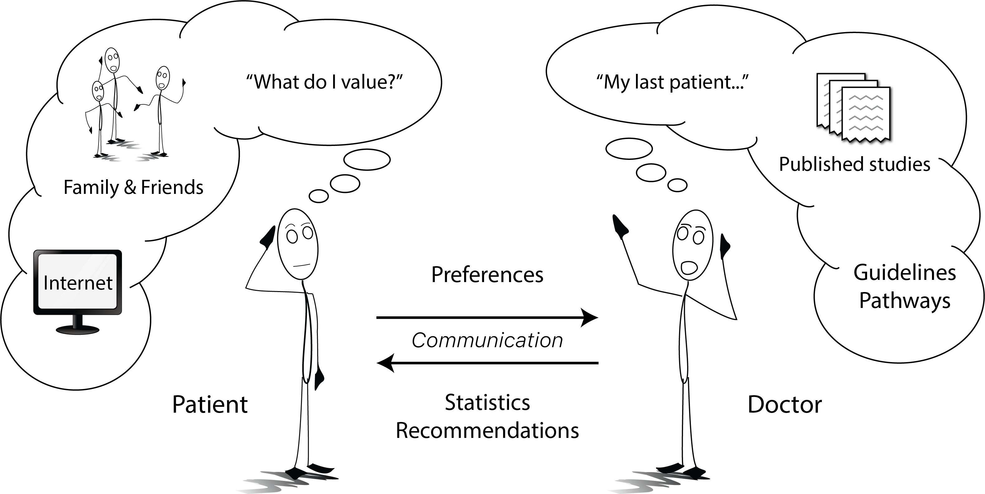
How are Treatment Decisions Currently Made?

Slide 6
Wouldn’t It Be Great If…
  …we could harness real-world data to help patients and their doctors choose the treatment that is “right” for them?
    Aggregate data that is already being collected
    Provide patients and their physicians with recent real-world data about survival rates and side effects associated with each type of therapy
    Accessible format
  73 year-old woman triple-negative breast cancer.
    e.g. Among 450 similar patients, chemotherapy improved 5 year survival by 4% (from 71% to 75%) with a 25% risk of severe nausea/vomiting requiring hospitalization and a 7% risk of severe neuropathy

Slide 7
Approach to Addressing the Need
Build a community (around cancer care and research, here)
Patient-centered
Oncologist-driven (informaticist-supported, not led)
Use-case focused (with view toward expansion)
Agile development and testing
Reuse what’s been done
Align with HL7 and HSPC/CIIC
Pilot in clinical settings
Free models and software, for all to use

Slide 8






Core Community Collaborators
  Mission: To conquer cancer through research, education, and promotion of the highest quality patient care. ASCO is the world's leading professional organization for physicians and oncology professionals caring for people with cancer.
  Mission: A public interest, not-for-profit company, working to discover new possibilities, create unexpected opportunities and lead by pioneering together for the public good to bring innovative ideas into existence. MITRE’s mission-driven team is dedicated to solving problems for a safer world.
  Mission: The Biden Cancer Initiative mission is to develop and drive implementation of solutions to accelerate progress in cancer prevention, detection, diagnosis, research, and care, and to reduce disparities in cancer outcomes.
  Mission: To serve the needs of our local and global community, providing the highest quality health care to patients and their families, expanding the boundaries of medicine through research, and educating the next generation of health care professionals.
  Mission: To coordinate with professional health societies to develop a single Standard Health Information Model library that is open source, can be implemented and used by anyone, and enables innovation.
  Mission: To develop standards that empower global health data interoperability.

Slide 9











2 Use Cases, with Clinical Pilots
Clinical
Research
ICAREdataTM
EHR-based clinical trials endpoints collection:
Demonstrate that collection of structured real-world data (treatment response, toxicity, change in treatment, deviation from clinical pathway) can approach the quality of clinical trials data
CompassTM
Clinical
Care
Demonstrate the use of mCODE data models to allow providers and patients to make informed, shared, data-driven decisions and provide data back to generate new knowledge

Slide 10

Agile Standards Development and Piloting
Open HSPC/CIIC
Model Repository
reuse
HSPC/CIIC: broader clinical review and coordination
4. Clinical Field Testing
5. Clinical Review
Future HSPC/CIIC projects
App developers
EHR vendors
Researchers
Etc.
Governance
HL7 technical review and possible standardization
3. Implement in Applications
1. Clinical Use Cases
Open Source Software Repository
reuse
2. Data Elements, Models & FHIR IG
© 2019 The MITRE Corporation. All rights reserved.

Slide 11
minimal Common Oncology Data Elements
Patients
Standard Health Record for Oncology
  Data elements defined by panel of expert oncologist, and reviewed by stakeholders across the oncology ecosystem
The minimal set of data elements applicable to all cancers, collected for:
  standardized information exchange among oncology information systems
  use by multiple stakeholders
Builds on previous work
  ~50 cancer data and terminology standards
  Cancer Interoperability group (R. Esmond, chair) and HL7 CIC/CIMI work on breast cancer
Providers
Research
CANCER
Patient
Disease
Treatment
Outcomes
Genomics
Vendors
Government / Regulatory
Payers

Slide 12


Model Production Tooling and Pipeline
Being used for SHR / mCODE and multiple Gov’t projects
Rest of the World (not to scale)
mCODE Clinical requirements
clinical review
Mind maps, data dictionaries, etc.
DSTU 2 FHIR IG & Profiles
Github
FHIR Profiles
find/use existing modules
CIMPL Model modules
terminology requirements
STU 3 FHIR IG & Profiles
CIMPL Authoring Environment
Exporters
R4 FHIR IG & Profiles
new modules
FHIR Resources
Base class modules
propose new terms
LOINC
HL7 / CIMI
Terminologies
and value sets
TBD: Testing tools, smart phrases, forms, etc.
SOLOR
RxNorm
Terminologies
and value sets
Terminologies
and value sets
Snomed
Terminologies
and value sets
Logical Model
© 2019 The MITRE Corporation. All rights reserved.

Slide 13
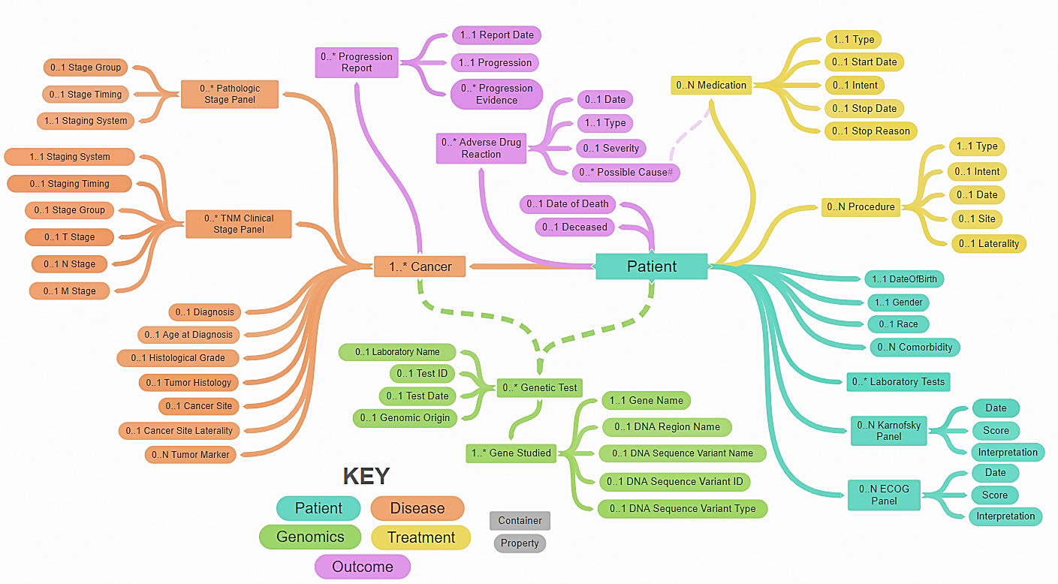
DRAFT mCODETM Data Model Mind Map
http://standardhealthrecord.org/oncocore-ig/modeling.html

Slide 14
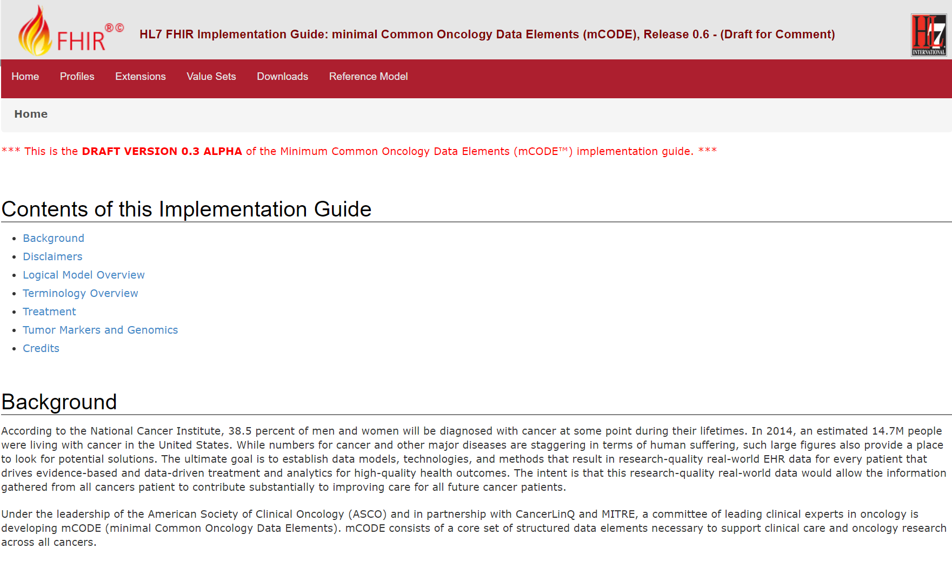
mCODE DRAFT
FHIR IG http://standardhealthrecord.org/oncocore-ig/

Slide 15







Steps Toward a Learning Health System for Cancer
Current
Future
Learning Health System
Clinical
Research
mCODE Outcomes
Brain Mets Study
Clinical
Care
Additional Sites
Additional Sites

Slide 16
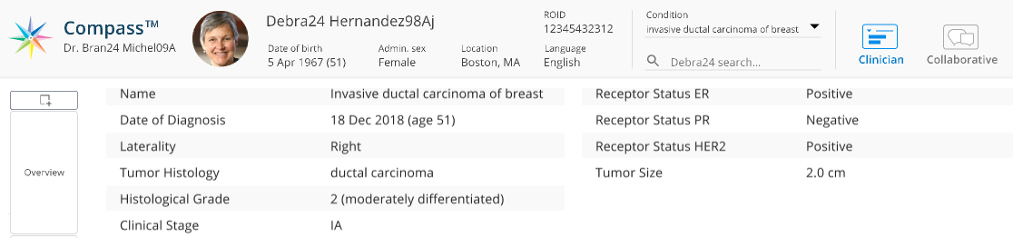

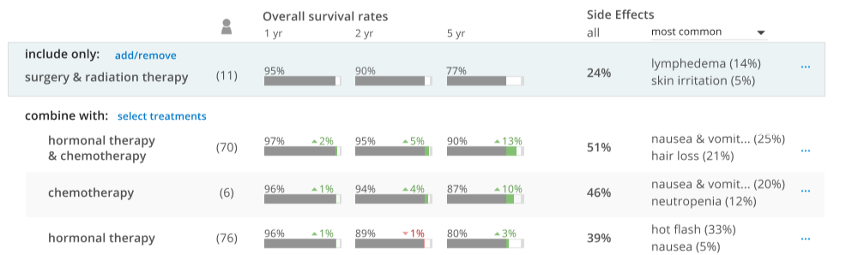
Data elements
Matching to similar patients in CancerLinQ database
Comparable outcomes and side effects from matched patients
© 2019 The MITRE Corporation. All rights reserved.

Slide 17
Challenges from a clinical perspective
  Presenting data in a way that makes sense to both physicians and patients
  Physician understanding strengths and weaknesses of data
  Integrating use of this tool into physician workflow during a busy clinic day

Slide 18
Challenges from an institutional perspective
  Exchanging data
  Legal approval
    Office of Research
    Supply Chain
    IRB review
  Business associates agreement
  Services agreement
  Cybersecurity review
  Business development office review

Slide 19
HSPC / CIIC Value
High-quality, clinical-society-supported repository, where models can be made consistent, evolve and be reused
  Approach to cancer data must work with other diseases, and with health as a whole
Governance process that provides integrity … with low burden
Consistent technical approach and expertise

Slide 20
Thank You!
How to Get Involved
Become an mCODE pilot site
Help improve the mCODE model
Share new use cases for mCODE
Attending the mCODE Summit, planned for the end of 2019

