Slide 1

SHEILD – CIIC Project Overview
SHIELD_{x}- putting IVD data standards to work
Current/Next Steps
Michael Waters, Ph.D.
SHIELD_{x} Team Lead/OIR RWE Representative
Office of In Vitro Diagnostics and Radiological Health (OIR)
Center for Devices and Radiologic Health (CDRH)
Food and Drug Administration (FDA)
Systemic Harmonization and Interoperability Enhancement for Lab Data

Slide 2
NEED: Traceability, Context, Perspective
To advance utility of in vitro diagnostics (IVDs), we need a means for high quality, harmonized and semantically interoperable laboratory coding to be associated with other healthcare data appropriately. This includes establishment of provenance, traceability and appropriate ontologic association (among other things).
Expected Benefits:
  Epidemiology/outbreak monitoring
  Healthcare innovation
  Decision support/knowledge generation
  Public health reporting
  Laboratory cost savings
  Signal detection
  more

Slide 3
SCOPE:
This effort is focused on making associations for diagnostic information through tooling and or processes/procedures, e.g., IVDs and radiologic data.
Currently, more complex molecular diagnostic technologies are excluded from this scope, e.g., Next Generation Sequencing (NGS) as we do not yet have consensus on a way to represent that information clinically.

Slide 4
GOALS & PARTICIPATING GROUPS:
Systemic Harmonization and Interoperability Enhancement for Lab Data
SHIELD Mission:
Accelerate lab data digitization; improve quality & interoperability of IVD data to:
Improve access to high-quality RWE for regulatory decisions,
reduce burdens to the healthcare ecosystem,
promote innovative 21st century solutions to public health challenges,
build NEST (diagnostic arm).
How? – SHIELD employs consensus processes to:
leverage existing lab data standards and infrastructure,
develop standards/tools to fill lab data interoperability gaps and
expedite ubiquitous adoption & implementation of SHIELD infrastructure.
SHIELD Stakeholders (>50 institutions engaged):
FDA (CDRH, CDER, CBER), CDC, NIH, ONC, CMS, CAP, IVD Manufacturers, EHR Vendors, Laboratories, Standards Developers, PEW Charitable Trusts, NEST/MDIC, Academia

Slide 5






GOALS & TIMELINE: (initially expecting 2 years)
W/Standards: Quality in – Quality out.
W/O Standards: Garbage in – Garbage out
Context: An IVD asks a question of a specimen to get an answer.
Patient Test Data
Data Recipients
Data Utility
e.g., Research, Regulatory Decisions,
Outbreak Signals,
Clinical Decision Support,
Meaningful Use,
etc.
  IVD (Code Standard)
  Who’s Asking (UDI)
  Question (LOINC)
  Answer (SNOMED-CT)
Structured Transfer
LIS/EHR
Data Association
Manufacturers
Labs/Providers
Plan:
Government supports manufacturers/industry to provide vetted and harmonized descriptive IVD codes to labs to improve utility for consumers.

Slide 6
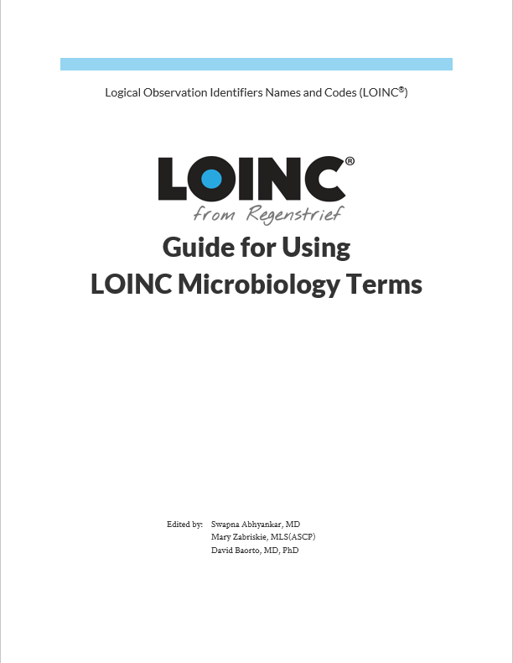
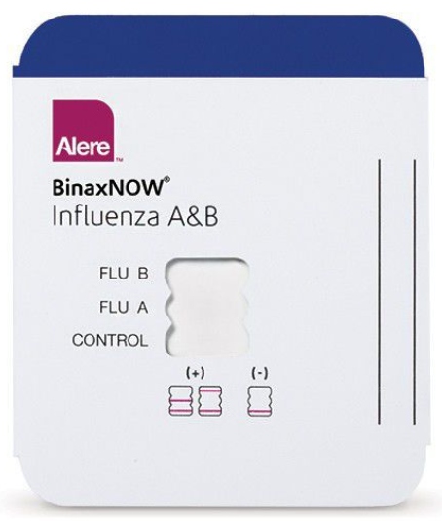
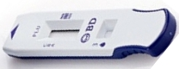
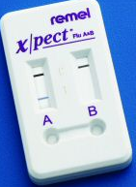
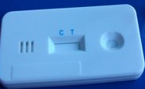
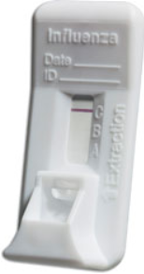
CURRENT STATUS: WORK COMPLETED
Same IVD Type
Same IVD Type
Unambiguous LOINC Codes
Helpdesk Support
43874-7
LOINC Mapping Manual
Influenza virus A Antigen in Nasopharynx
RELMA® LOINC Mapping Tool
43895-2
Example List
Influenza virus B Antigen in Nasopharynx
https://www.fda.gov/downloads/MedicalDevices/DeviceRegulationandGuidance/GuidanceDocuments/UCM610636.pdf
https://loinc.org/guides/micro/

Slide 7

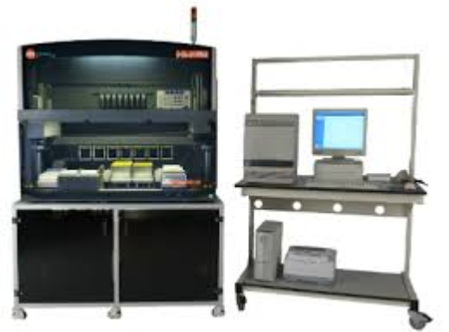
CURRENT STATUS: WORK COMPLETED
IVD Industry Connectivity Consortium
Digital Format for Publication of LOINC to Vendor IVD Test Results (LIVD)
Laboratory Analytical Workflow (LAW)
Laboratory Information System
(LIS)
LOINC
LAW
LIVD
SNOMED-CT
FHIR
Profile
UDI
Role
Coding Standard Nodes
Question
LOINC (Logical Observations Identifiers Names and Codes)
Answer
SNOMED-CT (Systematized NOmenclature of MEDicine – Clinical Terms)
Who’s Asking
UDI (Unique Device Identification System)

Slide 8
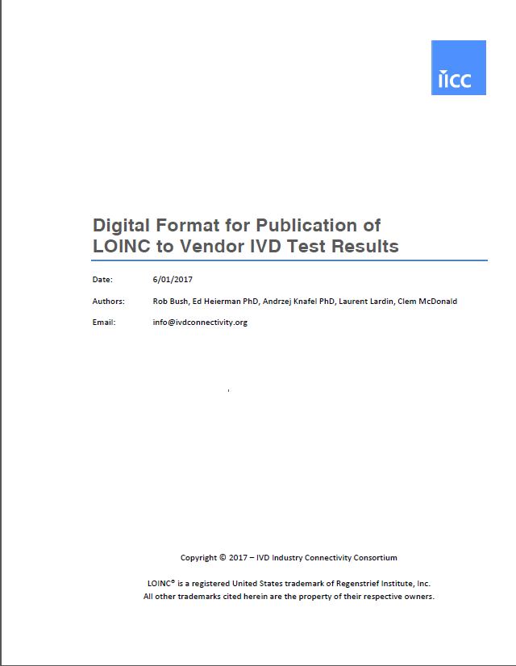
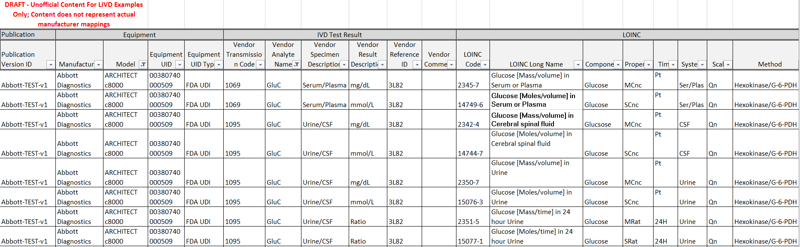
Digital Format for IVD Vendors to Provide LOINC
IVD Industry Connectivity Consortium
Digital Format for Publication of LOINC to Vendor IVD Test Results (LIVD)
Laboratory Analytical Workflow (LAW)
Laboratory Information System
(LIS)
LOINC
LAW
LIVD
SNOMED-CT
FHIR
Profile
UDI
Role
Coding Standard Nodes
Question
LOINC (Logical Observations Identifiers Names and Codes)
Answer
SNOMED-CT (Systematized NOmenclature of MEDicine – Clinical Terms)
http://ivdconnectivity.org/livd/
Who’s Asking
UDI (Unique Device Identification System)

Slide 9
CURRENT STATUS: UPCOMING WORK
Remainder of LOINC manuals should begin soon and be completed by ~March 2021 (funding pending).
A proposed CLSI standard for coding all lab data is under review by CLSI management.
Implementation pilots will be completed by ~March 2021 (funding pending).
LIVD expansion pack for answer sets is under development.

Slide 10

CURRENT STATUS: Expected Compatibility
LOINC
SNOMED-CT
UCUM
Laboratory
LIS/ LIMS
Test Catalog
eDOS
Orders
Vendor 1
LIVD
Analyzer 1
LAW
LOI
Vendor 2
Analyzer 2
LRI
Results
LIVD
LAW
Providers
Vendor 3
LIVD
Analyzer 3
LAW
eDOS now electronic and computable
Orders now standardized, harmonized with EHR requirements
New LRI with harmonized profiles
…
LIVD
…
LAW
IVD
Industry
Pre-Process & Automation
LDA
LBL
LSH
LST
etc.
LIMS/LIS Underlying Standards
MACP, MLCP, Specimen DAM
HL7 V2 Messages, LOINC, SNOMED CT, UCUM, et al

Slide 11

CHALLENGES: Harmonization w/CIMI & SOLOR
Standards Infusion
Core Reference Model
SNOMED CT
LOINC
RxNorm
(SOLOR)
HL7 FHIR Profiles
CDISC
OPA FPAR
Application
Development
SystolicBPObs
SystolicBP
CEMs
HL7 CDA
data
138 mmHg
LOINC or
SNOMED Observable
DCMs
Model Review
Translators
quals
X12
OPA FPAR
Application
BodyLocation
BodyLocation
CDA
Templates
Repository of
Shared Models
in an approved
Formalism
NCPDP
data
Right Arm
openEHR
Archetypes
SNOMED CT
HL7 V2
PatientPosition
PatientPosition
ISO EN 13606
Archetypes
Sitting
FHIM
Models
FHIR
Resources
data
Initial Loading of Repository
Model Dissemination
Notes:
Create an open shared repository of “logical models” in an agreed format
Import existing content whenever possible – not comprehensive
Select one approved logical model for a given kind of data in a given context (data entry, data retrieval and analysis)
Create “approved” mappings to standard implementations
Caveats
This is the first meeting of a “campaign” or a “crusade”
This is a huge project – it will take many years
This is an essential first step to semantic interoperability. We also need
Security
Legal basis for sharing data
Aligned incentives for sharing data

Slide 12
CURRENT STATUS: UPCOMING WORK
Remainder of LOINC manuals should begin soon and be completed by ~March 2021 (funding pending).
A proposed CLSI standard for coding all lab data is under review by CLSI management.
Implementation pilots will be completed by ~March 2021 (funding pending).
LIVD expansion pack for answer sets is under development.

Slide 13
PROCESSES:
We need your help to figure out how to go about the processes for ensuring content provided by manufacturers is aligned and interoperable with the appropriate clinical models, etc.
Would it be possible to receive a little more education on what can be done by this group and how we can optimally interact?

Slide 14
CIIC VALUE/SUPPORT:
Value:
We expect that by plugging in high quality, harmonized and standardized lab data into CIMI models, lab data utility and association will be dramatically increased.
Support:
We anticipate funding for implementation pilots for the standards listed above within healthcare institutions. We are willing to write applications together to attain other funding. (Open to any ideas.)

Slide 15


