Slide 1
Solor Overview and Progress to Date
Keith E. Campbell M.D. PhD
February 27, 2019
http://www.solor.io

Slide 2
Collaboration with HSPC and CIIC
Solor seeks to:
Improve upon quality assurance and other metric calculations by clearly defining what is being measured (e.g. separation of concerns)
Establish a collaborative terminology environment where remote and disparate teams can seamlessly work on health data standards projects
Provide comprehensive transparency of terminology data, especially in the form of version control of edits over time
We want to expand the use and usability of exchanged data.

Slide 3
Why Do We Care About Data in Health Care?
If you can’t measure something, you can’t understand it.
If you can’t understand it, you can’t control it.
If you can’t control it, you can’t improve it.
- H. James Harrington

Slide 4
Semantic Interoperability

Slide 5
The Promise of Health IT
Improve the quality and safety of health-care
Measure the cost and quality of services
Integrate multiple providers across organizations in a continuum of care
Integrate high-quality decision support into the clinical workflow across the continuum of care
The Promise of Health IT Depends on Interoperability

Slide 6
The Promise of Health IT
Improve the quality and safety of health-care
Measure the cost and quality of services
Integrate multiple providers across organizations in a continuum of care
Integrate high-quality decision support into the clinical workflow across the continuum of care
Encoded data is the foundation needed to deliver The Promise!

Slide 7
Types of Interoperability¹
Foundational
Data exchange from one system to another
Structural
The syntax of the data exchange at the data format/field level
Semantic
The exchange of information in a way that the receiving system can interpret the data
¹ https://www.himss.org/library/interoperability-standards/what-is-interoperability
Notes:
Source: https://www.himss.org/library/interoperability-standards/what-is-interoperability

Slide 8
Architectural Separation of Concerns
Procedural Knowledge
P
Decision support and analytics
Define how to process measurements
(Decision support, analytics…)
Assertional Knowledge
A
HL7 FHIR, CIMI, …
Statement Model
S
Define how to record a measurement (Numerical and Subject of Information)
T
SNOMED, LOINC, RxNorm, …
Terminology Knowledge
Define what can be measured (Description Logic and Language)
Solor Architectural Foundation
F
Shared module system
Provides the interoperability foundation

Slide 9
Semantic Interoperability Architecture
Extension Module
Procedural Knowledge
P
E₁
Assertional Knowledge
A
Module
Statement Model
S
M₁
M₁
M₁
E₁ extends M₁
Terminology Knowledge
T
Solor Architectural Foundation
F
Versioned Modules: M₁, M₂, M₃, …

Slide 10
Where We Are Today

Slide 11
Interoperability by Mapping
Mapping is always out of date
Local terminology is not scalable
Potential information loss at each transformation
Unnecessary complexity
Patient safety is compromised
Administrative Data Standards
Content is not driven by implementation needs
Insufficient detail for clinical care
Clinical Data Standards
Lack coherence
Submission process does not meet operational needs
Every System is Different!
Notes:
Internal curation ➔ local

Slide 12
Enabling Semantic Interoperability
Standardize the Standards
Standardize the encoded data model
Standardize the extension model
Meet Operational Needs
Enable sharing of extensions
Open-extensions
Proprietary-extensions
Lowers costs by contributing local extensions to standards
Evolve Existing Systems
Transforms SNOMED CT, LOINC, RxNorm, and others
Notes:
Contribution of local extensions to standards results in lower cost of ownership

Slide 13
Introduction to Solor

Slide 14
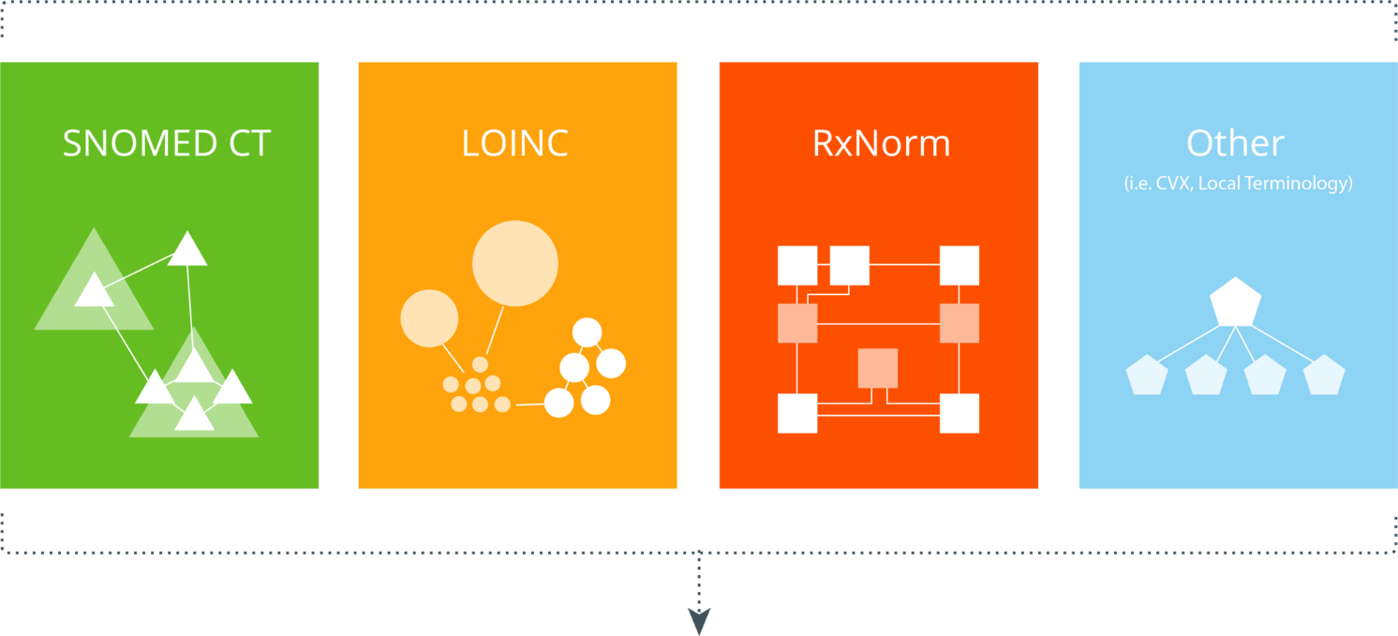
What is Solor?
Integration of terminology in a common model

Slide 15
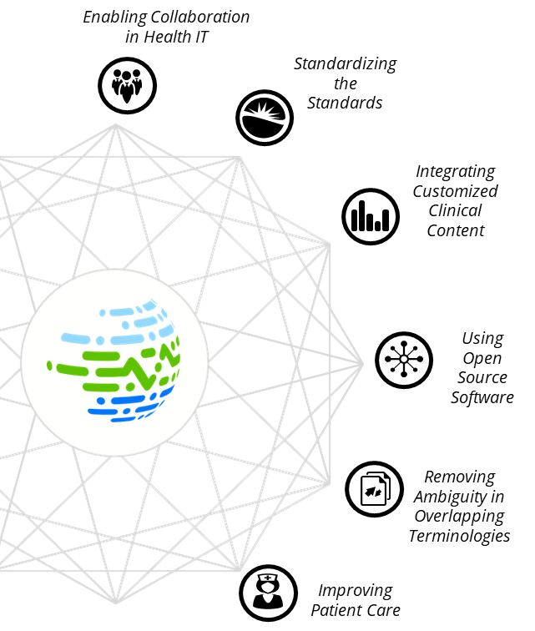
Solor: An Open-Source Ecosystem
Solor is an open-source ecosystem that brings together different health standards by using a single model that can encompass any customized content with the goal to help health care organizations avoid errors in the interpretation of clinical data.
Solor awarded the FedHealthIT 2018 Innovation Award
June 2018
HSPC highlighted Solor as mission critical at the HSPC 17th General Meeting
July 2018

Slide 16
Progress

Slide 17
Solor at HIMSS
Featured as one of VA’s Seamless Care projects
Presented at the Federal Health Pavilion
Met with 69 individuals representing 39 organizations across government agencies and commercial stakeholders
We are pursuing use cases/projects with the following organizations:
FDA Systemic Harmonization & Interoperability Enhancement for Lab Data (SHIELD) and IVD Industry Connectivity Consortium (IICC)
Social Security Administration (SSA)
Centers for Disease Control and Prevention (CDC)
Centers for Medicare and Medicaid Services (CMS)
Agency for Healthcare Research and Quality (AHRQ)
Clinical Architecture
Perspecta
Wolters Kluwer - Health Language

Slide 18
A Common Mission with SHIELD
To develop, harmonize and implement semantic interoperability standards in order to protect and promote public health by:
Improving support for clinical decisions
Reducing burdens to the healthcare ecosystem
Promoting the development of innovative solutions to public health challenges
We are excited to collaborate with FDA SHIELD/IICC to help manage and represent their LOINC IVD catalogs and move them along in their goal to be interoperable internationally.

Slide 19
Integration into a Common Model
SHIELD
LIVD Specifications
LIVD Solor Extension
Solor
Ecosystem

Slide 20
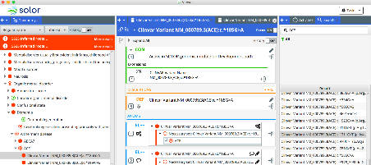
Collaborative Terminology Environment
We are currently developing a knowledge management environment that could potentially be used to integrate LIVD specifications
Learn more at the next event:
Solor – Technical Discussion
Today, 2:30pm – 5pm
Room FCB 2W1L

Slide 21
Continued Collaboration
We are pursuing exciting projects with
FDA SHIELD / IICC working group to integrate device manufacturer data in a standardized common model for laboratories, and
Intermountain Healthcare to develop a methodology to integrate Clinical LOINC to SNOMED for Skin and Wound Assessment Models
Share Your Requirements /
Data Samples
Validate the Solor Interoperability Model
Integrate and Apply Solor to Your Workflow
Discussion on Next Steps

Slide 22
Get Involved
Solor project information on HSPC Confluence
https://healthservices.atlassian.net/wiki/spaces/Solor/overview
Solor Website
http://solor.io
http://solor.io/blog/
For more information
Keith Campbell, Chief Architect, campbell@informatics.com
Susan Matney, Terminology and Modeling Initiative Leader, Susan.Matney@imail.org
Andrew Sills, Software Architect, asills@deloitte.com
Raja Cholan, Informatics Support, rcholan@deloitte.com

Slide 23
Background

Slide 24
Overlap in Content
SNOMED CT
LOINC
Lab LOINC
LOINC: Gentamicin is a component of laboratory tests
SNOMED CT
SNOMED: Gentamicin is a component of laboratory tests
SNOMED CT
LOINC
RxNorm
RxNorm
LOINC: Gentamicin is a component
SNOMED: Gentamicin is a substance
RxNorm: Gentamicin is an ingredient
SNOMED CT
RxNorm
SNOMED: Gentamicin is a product
SNOMED: Gentamicin 0.3% preservative-free eye drops
RxNorm: Gentamicin sulfate 0.3% Ophthalmic Solution
RxNorm: Gentamicin is a product

Slide 25
SNOMED Mapping Example
Organization A
Lab LOINC
Organization B
SNOMED CT
Local code: 12345
Infiltrating ductal carcinoma of lower inner quadrant of breast
Local code: 54321
Infiltrating ductal carcinoma of lower inner quadrant of breast
RxNorm
Provider A
Provider B
SNOMED Code:
408643008
Infiltrating ductal carcinoma of breast
SNOMED Code: 373080008
Malignant neoplasm of lower inner quadrant of breast
Lose location of the carcinoma
Lose morphology of the carcinoma

