Slide 1
Department of Veterans Affairs
Veteran Health Administration
Knowledge Based Systems
Informatics Architecture Support Services
Department of Veterans Affairs
Veteran Health Administration
Knowledge Based Systems
Informatics Architecture Support Services
Grades, Scales, Stages, and Scores
Findings and Issues
Tim Williams, Specialist Master, Deloitte & Touche, LLC
Kirsten Haake, Specialist Master, Deloitte & Touche, LLC
Veterans Health Administration, Office of Informatics & Analytics and Health Informatics Informatics Architecture Support Services Contract VA701-16-C-0039-01 (VET10380.01) Bi Weekly Web Based Workshops
1/15/2019

Slide 2
Symmetry Modeling
In some areas of SNOMED CT, concepts exist, which should be modeled in a “symmetrical” way
We define “symmetrical” as being modeled following a consistent pattern
Concepts, that are “suspects” for potentially not being modeled symmetrically include:
Inverse concepts
Concepts, that are modeled with more than one of the same attribute, but with different values
Parent concepts of Leaf Nodes
Concepts to which Grades, Scales, Stages or Scores are applied

Slide 3
Symmetry Criteria
We considered modeling “symmetrical” if the concepts:
Which are considered opposites of each other (inverse concepts)
Exist in SNOMED and
Reside in the correct hierarchy under the correct parent concept
Which are not modeled with more than one of the same attribute, but with different values (e.g. a clinical course that is both acute and chronic)
Which are parent concepts of a Leaf Node and have all the correct Leaf concepts
Which are Grades, Scales, Stages, and Scores, where all concepts existed and were consistently modeled

Slide 4
Inverse Concepts
Concepts should have an opposing concept
If the opposing concept does not exist, it is considered “asymmetric”
Concept ID | FSN
8587003 | Congenital diverticulum of colon (disorder) ⇨ Acquired diverticulum of colon (disorder)
8656007 | Total traumatic cataract (disorder) ⇨ Total non-traumatic cataract (disorder)
9027003 | Normal pulmonary arterial wedge pressure (finding) ⇨ Abnormal pulmonary arterial wedge pressure (finding)
21370008 | Tenotomy of abductor of hip, open (procedure) ⇨ Tenotomy of abductor of hip, closed (procedure)

Slide 5
Inverse Concepts (cont.)
Opposing concepts should reside in the correct hierarchy under the correct parent
This does not always mean they have to reside under the same proximal parent
Example:
268163008 |Congenital ptosis (disorder)|
Proximal parent: 91158006 |Congenital anomaly of eyelid (disorder)|
271429007 |Acquired ptosis of eyelid (disorder)|
Proximal parent: 11934000 |Ptosis of eyelid (disorder)|
If the opposing concept does not reside in the correct hierarchy and the correct parent, it is considered “asymmetric”

Slide 6
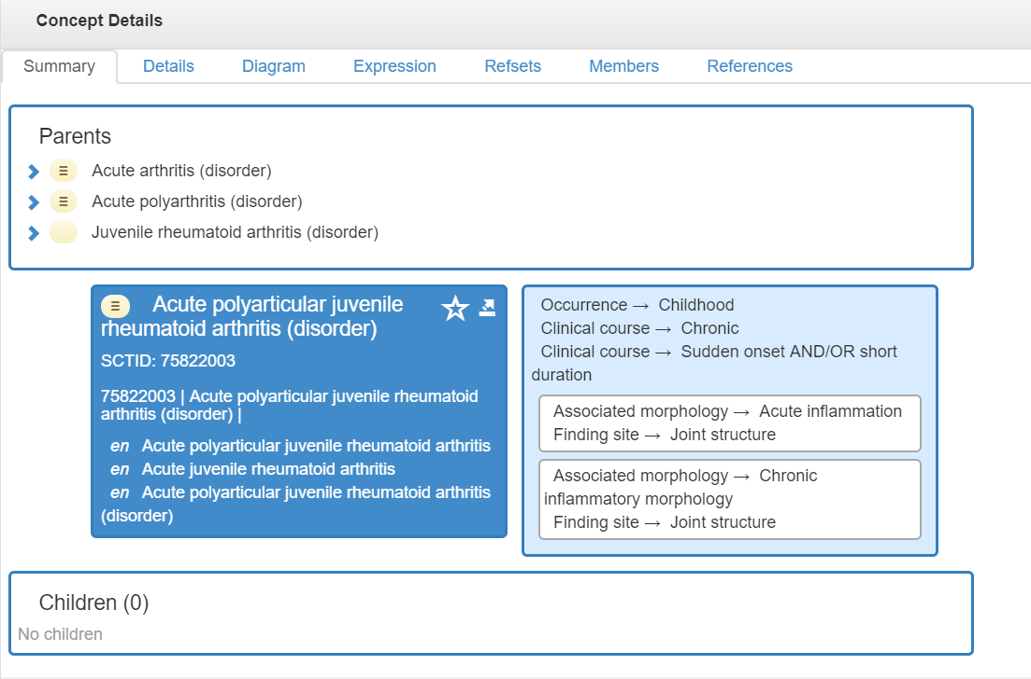
Attribute Modeling
If a concept is modeled with more than one of the same attributes, but with different values, it is considered “asymmetric”

Slide 7
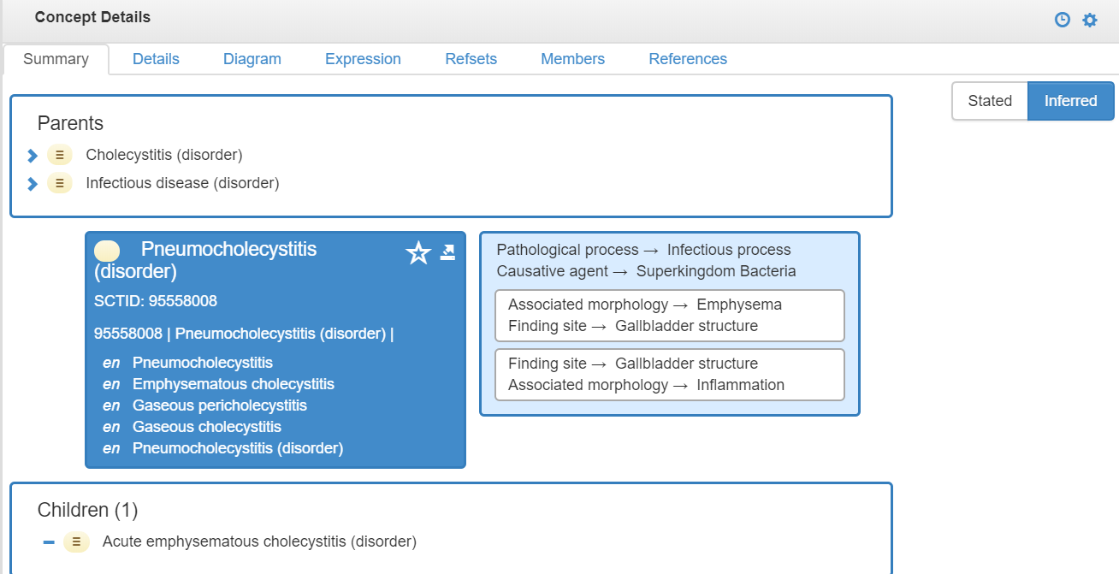
Leaf Node Parents
Parent concepts of a Leaf Node should have the correct Leaf concepts

Slide 8
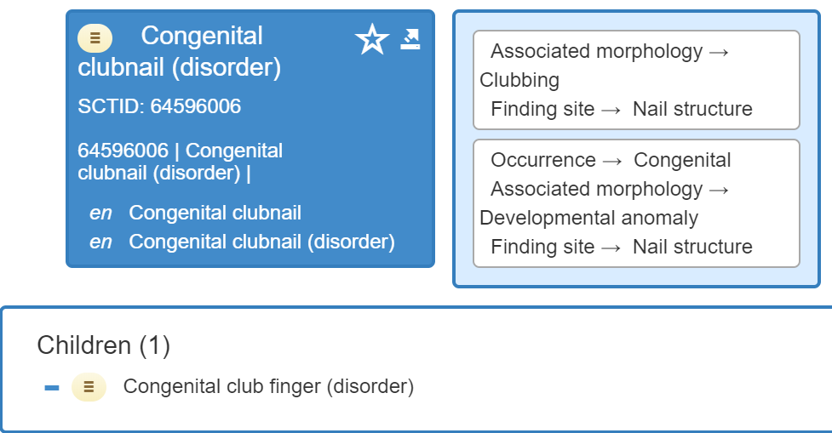
Leaf Node Parents (cont.)
Parent concepts of a Leaf Node that do not have the correct Leaf concepts are considered “asymmetric”

Slide 9
Grades, Scales, Stages, and Scores
This part of the “Symmetry” work is exploratory in nature
The goal was to identify patterns of concepts, where Grades, Scales, Stages, or Scores are applied and examined, if they are applied in a consistent way
We identified and examined a sample of concepts

Slide 10
Grades, Scales, Stages, and Scores (cont.)
We reviewed Stage, Scales, and Grades to ensure that:
All are concepts related to a Stage, Scale, or Grade are present
All appropriate concepts exist in the Finding and Disorder hierarchies
Were modeled consistently

Slide 11
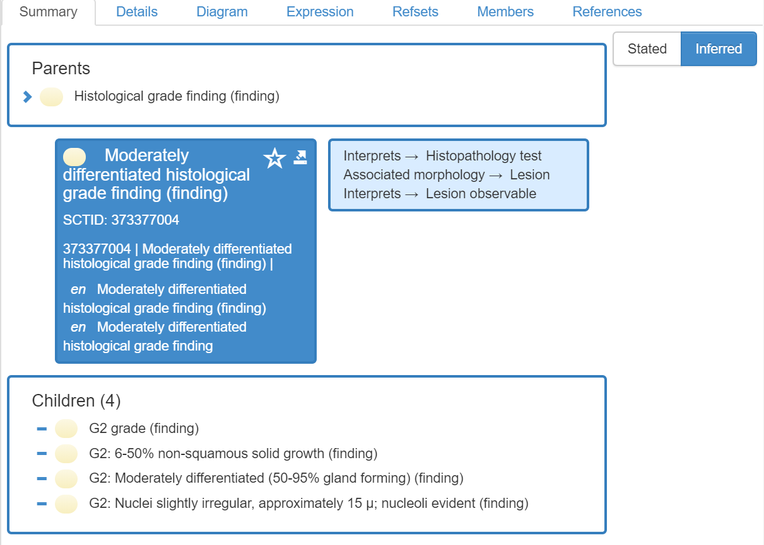
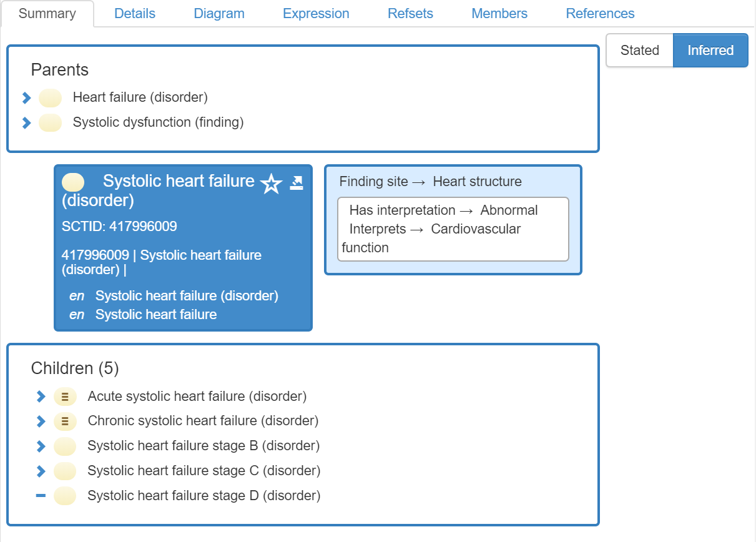
Grades, Scales, Stages, and Scores (cont.)
Examples:

Slide 12
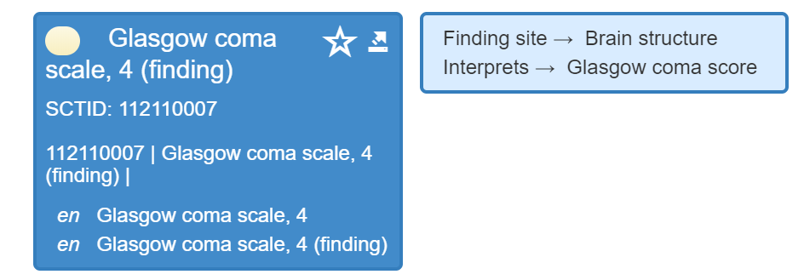
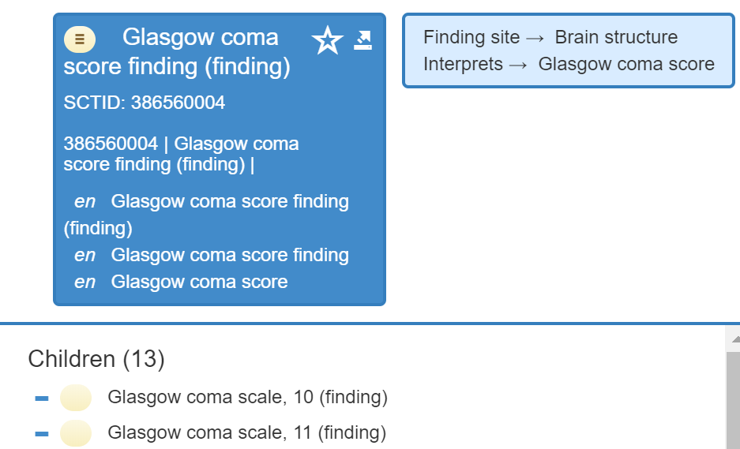
Review Findings
Naming Inconsistencies
Scale and Score are used interchangeably

Slide 13
Review Findings (cont.)
2. Grades, Scales, and Stages without corresponding findings/disorders:
762993000 |Assessment using Morse Fall Scale (procedure) does not have a corresponding finding pertaining to Morse Fall Scale
426938003 |Morse falls risk assessment (assessment scale)|
718584002 |Morse Falls Risk Assessment score (observable entity)| also exist.
277459008 |Daumas-Duport grading system (staging scale)| has no corresponding concepts in Procedures, Observables, or Findings/Disorders

Slide 14
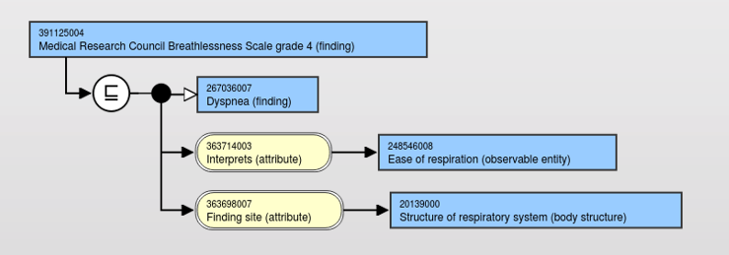
Review Findings (cont.)
3. Interprets procedure vs. observable
Interpret = Procedure (42 concepts)
Interprets = Observable (352 concepts)

Slide 15
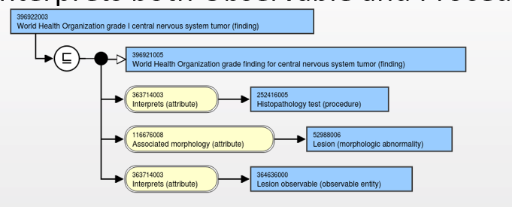
Review Findings (cont.)
4. “Interprets” both or missing concepts
Interprets both Observable and Procedure (41 concepts)
Interprets missing (400 concepts)

Slide 16
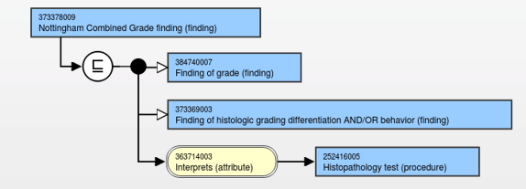
Review Findings (cont.)
5. “Interprets” uses less specific values
Concept uses generic Procedure but a specific Observable exists
372276001 |Nottingham Combined Grade (observable entity)|

Slide 17
Review Findings (cont.)
Concept uses a generic Observable when a more specific one exists
385363007 |International Federation of Gynecology and Obstetrics ovarian tumor stage (observable entity)|

Slide 18
Options For Remodeling
Option 1
71388002 |Procedure (procedure)|
Finding/Disorder
Interprets
Has interpretation
Has scale type
254291000 |Staging and scales (staging scale)|
363787002 |Observable entity (observable entity)|
272396007 |Ranked categories (qualifier value)|

Slide 19
Options For Remodeling (cont.)
Option 1 – Example A
Assessment using American Heart Association (AHA) and American College of Cardiology (ACC) Stages of Heart Failure (Procedure)
120861000119102 |Systolic heart failure stage C (disorder)|
Interprets
Has interpretation
Has scale type
American Heart Association (AHA) and American College of Cardiology (ACC) Stages of Heart Failure (staging scale)
American Heart Association (AHA) and American College of Cardiology (ACC) Stage (observable entity)
261626008 |Stage C (qualifier value)|

Slide 20
Options For Remodeling (cont.)
Option 1 – Example B
716792000 |Assessment using Rancho Los Amigos Levels of Cognitive Functioning Scale (procedure)|
Cognitive Level 1 on Rancho Los Amigos Levels of Cognitive Functioning Scale (finding)
Interprets
Has interpretation
Has scale type
716791007 |Rancho Los Amigos Levels of Cognitive Functioning Scale score (observable entity)|
277733009 |Level 1 (qualifier value)|
719953004 |Rancho Los Amigos Levels of Cognitive Functioning Scale (assessment scale)|

Slide 21
Options For Remodeling (cont.)
Option 2
Finding/Disorder
Interprets
Has interpretation
71388002 |Procedure (procedure)|
272396007 |Ranked categories (qualifier value)|
Has scale type
254291000 |Staging and scales (staging scale)|
363787002 |Observable entity (observable entity)|
Retire or move these Observable Entity concepts to be subtypes of Procedure

Slide 22
Options For Remodeling (cont.)
Option 2 – Example A
120861000119102 |Systolic heart failure stage C (disorder)|
Interprets
Assessment using American Heart Association (AHA) and American College of Cardiology (ACC) Stages of Heart Failure (Procedure)
Has interpretation
261626008 |Stage C (qualifier value)|
Has scale type
American Heart Association (AHA) and American College of Cardiology (ACC) Stages of Heart Failure (staging scale)

Slide 23
Options For Remodeling (cont.)
Option 2 – Example B
Cognitive Level 1 on Rancho Los Amigos Levels of Cognitive Functioning Scale (finding)
Interprets
Has interpretation
716792000 |Assessment using Rancho Los Amigos Levels of Cognitive Functioning Scale (procedure)|
Has scale type
277733009 |Level 1 (qualifier value)|
719953004 |Rancho Los Amigos Levels of Cognitive Functioning Scale (assessment scale)|

Slide 24
Options For Remodeling (cont.)
Option 3
71388002 |Procedure (procedure)|
Finding/Disorder
Has focus
Interprets
Has interpretation
404684003 |Clinical finding (finding)|
254291000 |Staging and scales (staging scale)|
272396007 |Ranked categories (qualifier value)|
363787002 |Observable entity (observable entity)|
Retire or move these Observable Entity concepts to be subtypes of Procedure

Slide 25
Options For Remodeling (cont.)
Option 3 – Example A
Assessment using American Heart Association (AHA) and American College of Cardiology (ACC) Stages of Heart Failure (Procedure)
120861000119102 |Systolic heart failure stage C (disorder)|
Interprets
Has interpretation
Has focus
301458000 |Functional cardiovascular finding (finding)|
American Heart Association (AHA) and American College of Cardiology (ACC) Stages of Heart Failure (staging scale)
261626008 |Stage C (qualifier value)|

Slide 26
Options For Remodeling (cont.)
Option 3 – Example B
716792000 |Assessment using Rancho Los Amigos Levels of Cognitive Functioning Scale (procedure)|
Cognitive Level 1 on Rancho Los Amigos Levels of Cognitive Functioning Scale (finding)
Has focus
Interprets
Has interpretation
373930000 |Cognitive function finding (finding)|
719953004 |Rancho Los Amigos Levels of Cognitive Functioning Scale (assessment scale)|
277733009 |Level 1 (qualifier value)|

Slide 27
Recommendations
Option #3 can be accomplished without the addition of new concept model attributes
It would require the addition of 254291000 |Staging and scales (staging scale)| as an allowable value for Interprets.
A large number of Observables would need to be retired or made a subtype of Procedures.

Slide 28
Discussion
How to Represent Grade/Score/Scale Values ?
Numeric Values
401323002 |Borg Breathlessness Score: 0.5 very, very slight (just noticeable) (finding)|
Alpha-Numeric Values
735623008 |Grade A2 albuminuria (disorder)|
Range of Scores
369776000 |Gleason Score 5-6: Moderately differentiated (finding)|
Some Values are expressed with their scale
33013007 |Gleason grade score 8 out of 10 (finding)|

Slide 29
Questions?
Tim Williams – timowilliams@Deloitte.com
Kirsten Haake – khaake@Deloitte.com

