Slide 1


Department of Veterans Affairs
Veteran Health Administration
Knowledge Based Systems
Informatics Architecture Support Services
MDMI & Use of SOLOR Deep Dive
Ken Lord, Semantic Interoperability Expert
Veterans Health Administration, Office of Informatics & Analytics and Health Informatics Informatics Architecture Support Services Contract VA701-16-C-0039
CLIN 0012, 5.4.1A. Bi Weekly Web Based Workshops
January 2019

Slide 2

Webinar Agenda
MDMI Background
Positioning of MDMI with SOLOR
MDMI Technical Introduction
Why MDMI Needs SOLOR / a Reference Model
Our Present Plan
Future Opportunities

Slide 3

MDMI Background
Model Driven Message Interoperability (MDMI):
  An open Object Management Group (OMG) standard,
  current version 1.0
  provides transformations between information in
  different applications and services
Projects using MDMI:
  Partners Research (CCDA to i2b2)
  SAMHSA (Semantic Information Workbench, IExHUB, and OCP)
  HL7 Cross Paradigm Transformation Projects (Immunizations, CDA-FHIR-V2-CIMI)
  IPO JET Project (DES, VLER, FHIR)
  Massachusetts Behavioral Healthcare Community Partners (Spreadsheets)
  Perspecta (Transformation Service and Context Awareness in Clinical Pathways)

Slide 4
MDMI Positioning
Information Technology /
System - Software Engineers
Applications
Procedural and Assertion Knowledge
software
MDMI
Structured Information / Domain Models
SOLOR
Web Science /
Healthcare Informatics
Definitional Knowledge

Slide 5
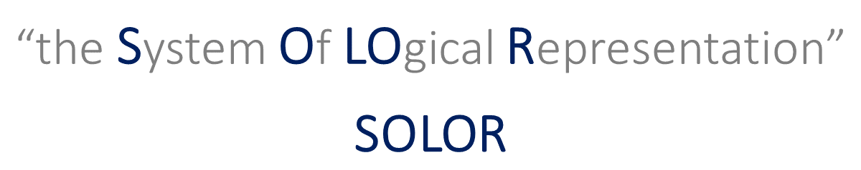
MDMI & SOLOR
Shared Goals and Principles
  Working to improve the quality and safety of healthcare
  Encoded data (ontologies and terminologies) is the foundation of meaning
  Big bang transitions don’t work
  Decision support will drive best practices and clinical workflow across the entire continuum of care, integrating multiple providers working in independent systems

Slide 6
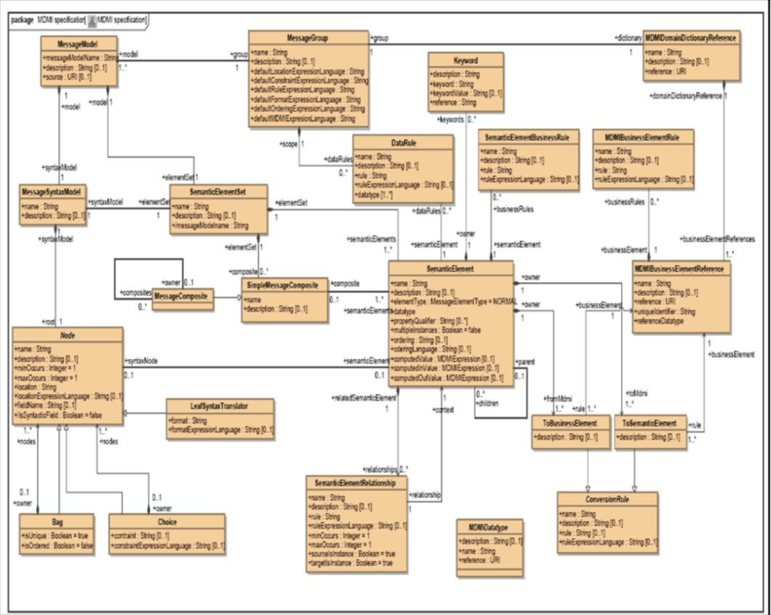
MDMI Meta Model (Transformation Model)
Examples:
Used to create a computable artifact for any format
Separates syntax from semantics
There is an iso-semantic relationship between the semantics in the format with the elements in the SEER (Business elements)
CCDA:
<entry typeCode="DRIV">
<substanceAdministration classCode="SBADM" moodCode="EVN" negationInd="false">
<effectiveTime value="20140510"/>
<consumable>
<manufacturedProduct classCode="MANU">
<manufacturedMaterial>
<code code="88" codeSystem= "2.16.840.1.113883.6.59“ displayName="Influenza virus vaccine" codeSystemName="CVX"/>
</manufacturedMaterial>
</manufacturedProduct>
</consumable>
</substanceAdministration>
</entry>
FHIR
{
"resourceType": "Immunization",
"vaccineCode": {
"coding": [
{
"system": "urn:oid:1.2.36.1.2001.1005.17",
"code": "FLUVAX"
}
],
},
"occurrenceDateTime": "2013-01-10",
}
ImmunizationAdministeredTime
ImmunizationAdministeredVaccine
HL7 V2
RXA|0|1|20090415132511|20090415132511|31^Hep B Peds NOS^CVX|999|||01^historical record^NIP0001||||||||

Slide 7
MDMI Transformations
Source
Map
Target
Map
Source
Message
Target
Message
Transformation Engine

Slide 8
Map Design Environment
Map Editing Tooling
Interoperability Model
Format /Model
Map Automation Tooling
Generation of Computable Map
Format
Map
SEER
(Semantic Element Exchange Repository)
SEER is the missing link between formats by providing semantic understanding between models.
Tooling to Administration of SEER

Slide 9
MDMI SEER & SOLOR: Similarities
Both SEER and SOLOR are open source.
Both SEER and SOLOR have unambiguous, unique atomic concepts.
Both SEER and SOLOR are extensible, with local and shared extensions that can be added if the desired concept does not already exist.

Slide 10
Our Need
The initial driver for MDMI Version 2.0 was based on experience: the description of a business element used in MDMI was the only resource for understanding the meaning of the business element. Descriptions are subject to interpretation.
  Example 1 – Industry Standards Experiences. HL7 projects.
  Example 2 – Transformations between existing implementations experiences. IPO and HIE projects.
Bottom Line:
  There can be data quality issues in transformations using current practices.

Slide 11
MDMI 2.0
The plan for MDMI 2.0 is to use SOLOR as the Reference Model to add Semantic Concepts for each Business Element in the SEER to provide a unique, post-coordinated description.

Slide 12
MDMI 2.0
The plan for MDMI 2.0 is to use SOLOR as the Reference Model to add Semantic Concepts for each Business Element in the SEER to provide a unique, post-coordinated description.
The business elements in MDMI 2.0 will have post-coordinated concepts linked to the semantic concepts in SOLOR.
SOLOR provides a harmonized understanding of many industry standard healthcare ontologies & terminologies.
MDMI 1.0
OMG ODM
SOLOR

Slide 13
Benefits of MDMI 2.0
Precision
Insurance that each business element is unique. The requirement is to have disjointed semantic concepts/classes in the SEER linked to Concepts in SOLOR.
Search
An improved search mechanism for the over 3,500 business elements in SEER (the number is continuously growing)
  New capability: a classification system based on disjoint classes where users can employ standard “programming” techniques
The use of semantic web technologies for discovery.
ImmunizationAdministeredDate
Subject: Immunization = SOLOR code
Object: Date
Property: was administered

Slide 14
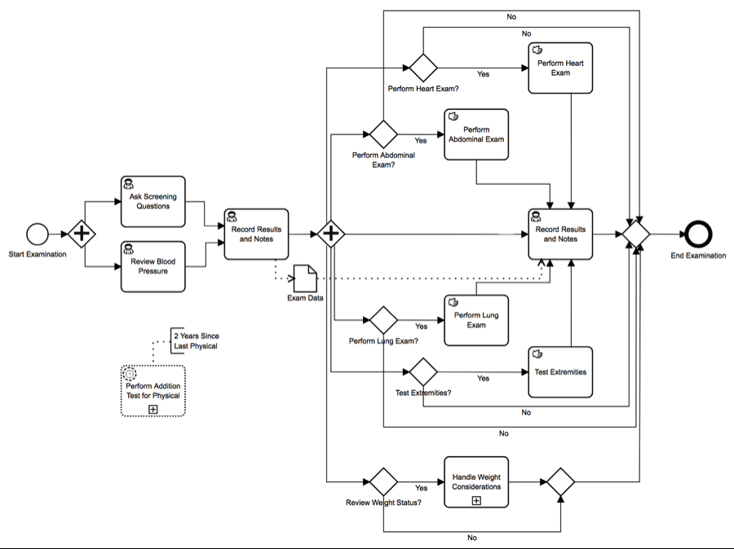
Benefits of MDMI 2.0 (cont’d)
Content Awareness
Shared Clinical Pathways
  Use of the SEER linked to SOLOR to annotate concepts in process models and services
Dynamic Discovery at Point of Care Service
  Florida and Massachusetts Behavioral
  Health Community, Opioid Crisis
  Point of Care service provider recognized problem
  How do they provide the What, Who,
  and When

Slide 15
In Summary
MDMI and SOLOR are complementary.
MDMI would like to use SOLOR as the Reference Model for meaning.
Filling the gap in the Information Architecture will continue to reveal new opportunities to drive best practices and clinical workflow across the entire continuum of care, integrating multiple providers working in independent systems.

Slide 16
Q&A
Questions may also be directed to Ken.Lord@bookzurman.com.

