Slide 1
FHIR ConstraintS and Terminology
FHIRPath and FHIR Terminology Server implications to SOLOR adoption

Slide 2
Objectives
FHIRPath introduction
Normative standard under development since 2016
Syntax, path for navigation, validation (“constraint” predicates), business rules
Open-source Reference Implementations (RI)
HAPI server uses FHIRPath for validation, business rules
Tools available editing/formulating expressions
Terminology Server features
to increase precision
Constraints and Extensions
Terminology

Slide 3
FHIRPath
Path based navigation and extraction language, somewhat like XPath.
Operations are expressed in terms of the logical content of hierarchical data models, and
support traversal,
selection and
filtering of data (for FHIR “search” criteria using _filter operator)
Use selection and formulation of invariants in both HL7 Fast Healthcare Interoperability Resources (FHIR) and HL7 Clinical Quality Language (CQL).
FHIR resource invariants and FHIR profile constraints
Clinical Quality Language (CQL) is a Health Level 7 (HL7) standard for the expression of clinical knowledge that can be used within a broad range of clinical domains, including Clinical Decision Support (CDS), and Clinical Quality Measurement (CQM).
Uses Antlr 4.0 grammar rules: http://hl7.org/fhirpath/2018Sep/grammar.html
http://hl7.org/fhirpath/2018Sep/index.html

Slide 4
FHIRPath Features and Conventions
Standard-based, Normative
Implemented by open-source community
Graph-traversal: FHIRPath is a graph-traversal language; authors can clearly and concisely express graph traversal on hierarchical information models (e.g. HL7 V3, FHIR, vMR, CIMI, and QDM).
Fluent: FHIRPath has a syntax based on the Fluent Interface pattern to chain operators
Collection-centric: FHIRPath deals with all values as collections, allowing it to easily deal with information models with repeating elements.
Platform-independent: FHIRPath is a conceptual and logical specification that can be implemented in any platform.
Model-independent: FHIRPath deals with data as an abstract model, allowing it to be used with any information model
All functions return a collection of matching objects unless explicitly
all(…​) : Boolean

Slide 5
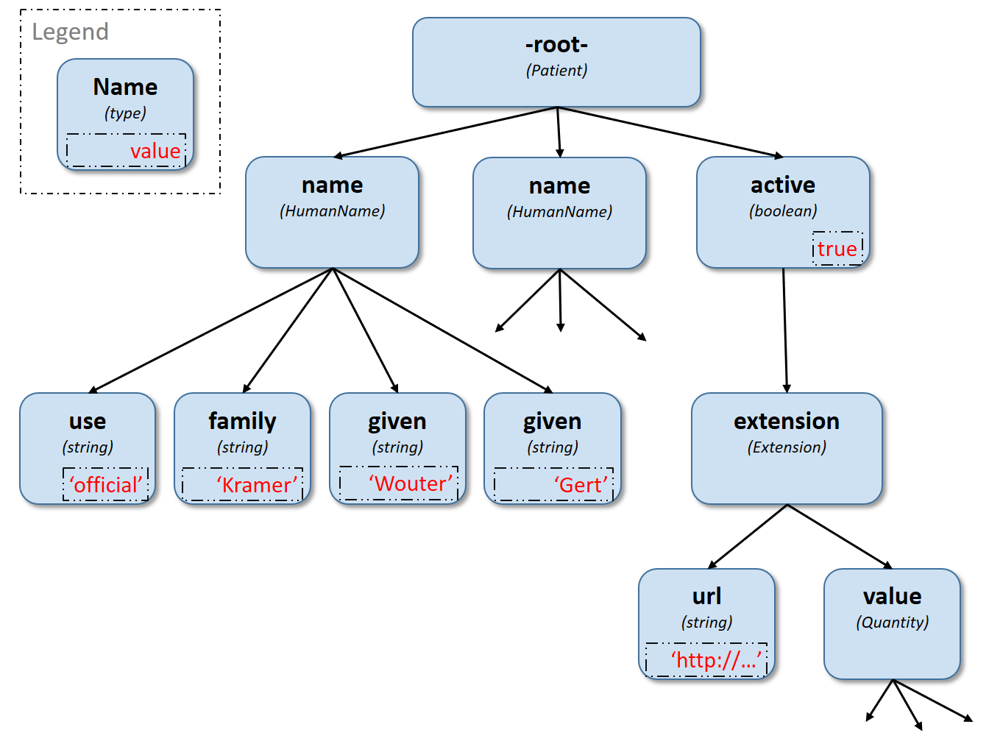
Path/Navigation syntax
Root: doesn’t have any parent note
Child nodes: recursive
name[0].use returns..”official”
name[0].familiy returns..”Kramer”
active.extension.url...
“.” is the default path separator
It can be used with any data structure including CIMI, FHIM, etc.
Tree navigation function are available to access graph notes
children():collection
descendants():collection

Slide 6
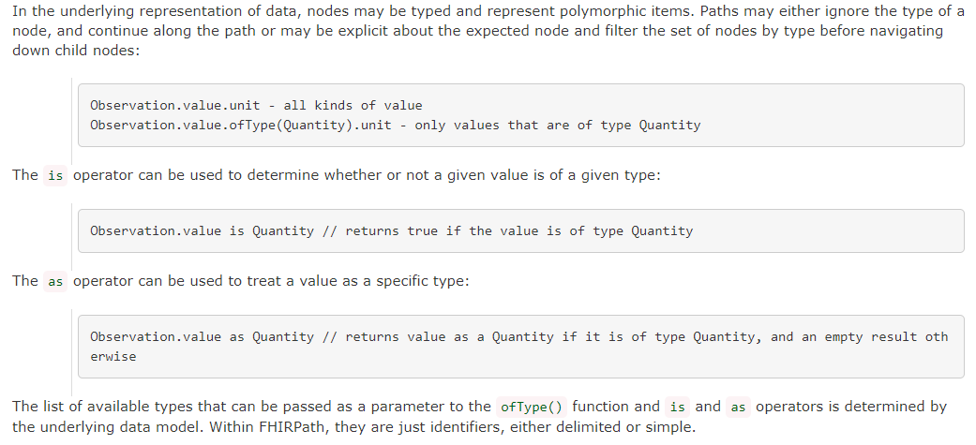
Polymorphism: Observation.value

Slide 7
Collections: default return type for all FHIRPath expression
Non-Unique - Duplicate elements are allowed within a collection. Some functions, such as distinct() and the union operator | produce collections of unique elements, but in general, duplicate elements are allowed.
Indexed - Each item in a collection can be uniquely addressed by it’s index, i.e. ordinal position within the collection.
Unless specified otherwise by the underlying Object Model, the first item in a collection has index 0. Note that if the underlying model specifies that a collection is 1-based (the only reasonable alternative to 0-based collections), any collections generated from operations on the 1-based list are 0-based.
Countable - The number of items in a given collection can always be determined using the count() function

Slide 8
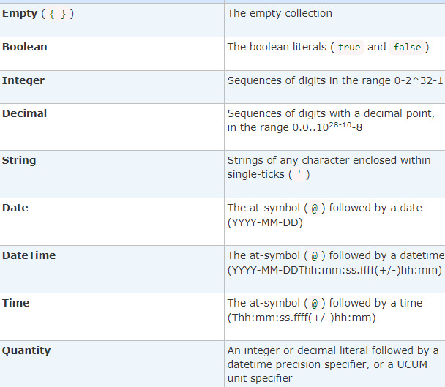
Data Types
Boolean: true, false
String: 'test string', 'urn:oid:3.4.5.6.7.8’
Integer: 0, 45
Decimal: 0.0, 3.141592653589793236
Date: @2015-02-04 (@ followed by ISO8601 compliant date)
DateTime: @2015-02-04T14:34:28Z (@ followed by ISO8601 compliant date/time)
Time: @T14:34:28+09:00 (@ followed by ISO8601 compliant time beginning with `T`)
Quantity: 10 'mg', 4 days

Slide 9
FHIRPath Constructs
Keywords
Operators: mathematical, boolean logic
Functions: processing collections, computing derived information
Null and empty: FHIRPath doesn’t have the concept of null; “empty collection” is used instead {}.

Slide 10
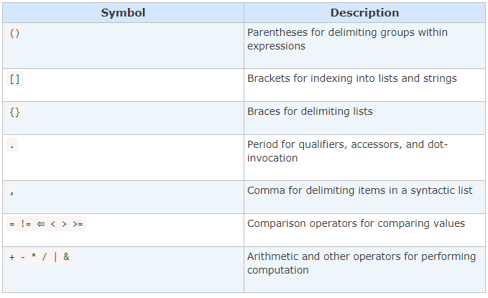
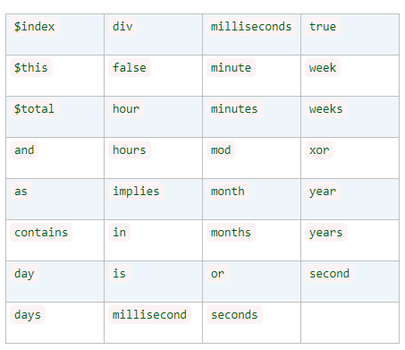
Keywords and Symbols

Slide 11
Operators: Comparison and Type
Left hand and right had must be the same type, including collection and complex types
Expressions may evaluate to true, false, or empty( { } )
@2019-01 = @2019 // January 2019 = 2019 returns “empty”
Equal (=), Equivalent (~), Not Equal (!=), Not Equivalent (!~)
Comparison:
Greater Than (>),Less Than (<),
Greater or Equal (>=), Less or Equal (<=),
Types:
is
as

Slide 12
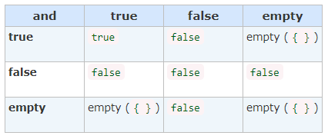
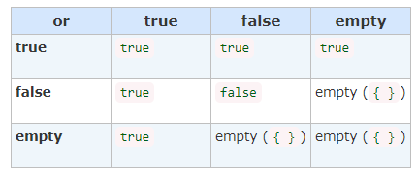
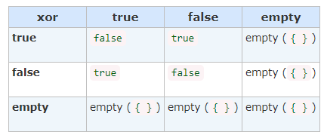
Operators: Boolean
and
or
xor
Implies

Slide 13
Other operators
Math: * (multiplication), /, +, - , div, mod,
String concatenation: &
Date/time arithmetic: uses keywords to add or subtract
@2014 + 24 months
aggregate(aggregator : expression [, init : value]) : value

Slide 14
Existence functions
empty():Boolean
not():Boolean
exists( criteria: expression]) : Boolean
all ( criteria: expression]) : Boolean
returns true if for every element in the input collection, criteria evaluates to true. Otherwise, the result is false. If the input collection is empty ({ }), the result is true.
Variants: allTrue, anyTrue, allFalse, anyFalse
subsetOf(other : collection) : Boolean
supersetOf (other : collection) : Boolean
count() : Integer – all elements, distinct() : collection – distinct elements, isDistinct() : Boolean – equivalent to collection.count() == collection.distinct()

Slide 15
Projection and Filtering Functions
Similar to SQL using fluent syntax (chaining)
select(projection: expression) : collection
Variation: repeat – returns nested nodes until no matches are found
where(criteria : expression) : collection
ofType(type : identifier) : collection
only the patient resources from the bundle.

Slide 16
Collection manipulation
Subsetting
Combining
equivalent
[ index : Integer ] : collection
single(), first(), last(), tail()
skip(num : Integer) : collection
take(num : Integer) : collection
intersect(other: collection) : collection
exclude(other: collection) : collection
union(other : collection)
Contains distinct items
combine(other : collection) : collection
May contain duplicates

Slide 17
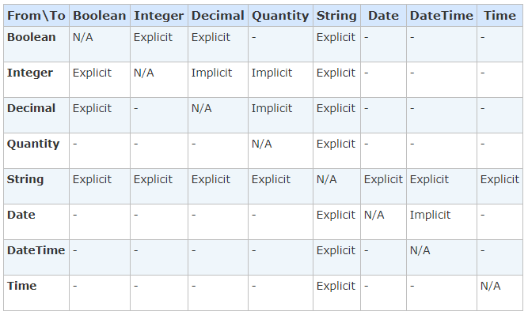
Conditional and Type Conversion Functions
iif(criterium: expression, true-result: collection [, otherwise-result: collection]) : collection
Explicit conversions
toInteger, toDecimal, toString
Implicit type conversions
“first” + “ “ + “last”
5 + 10.0 (toDecimal)

Slide 18
String and Utility Functions
indexOf(substring : String) : Integer
substring(start : Integer [, length : Integer]) : String
startsWith(prefix : String) : Boolean
endsWith(suffix : String) : Boolean
contains(substring : String) : Boolean
upper() : String
lower() : String
length() : Integer
toChars() : collection
replace(pattern : String, substitution : String) : String
matches(regex : String) : Boolean
replaceMatches(regex : String, substitution: String) : String
Utilities:
trace(name : String) : collection
today() : Date
now() : DateTime

Slide 19
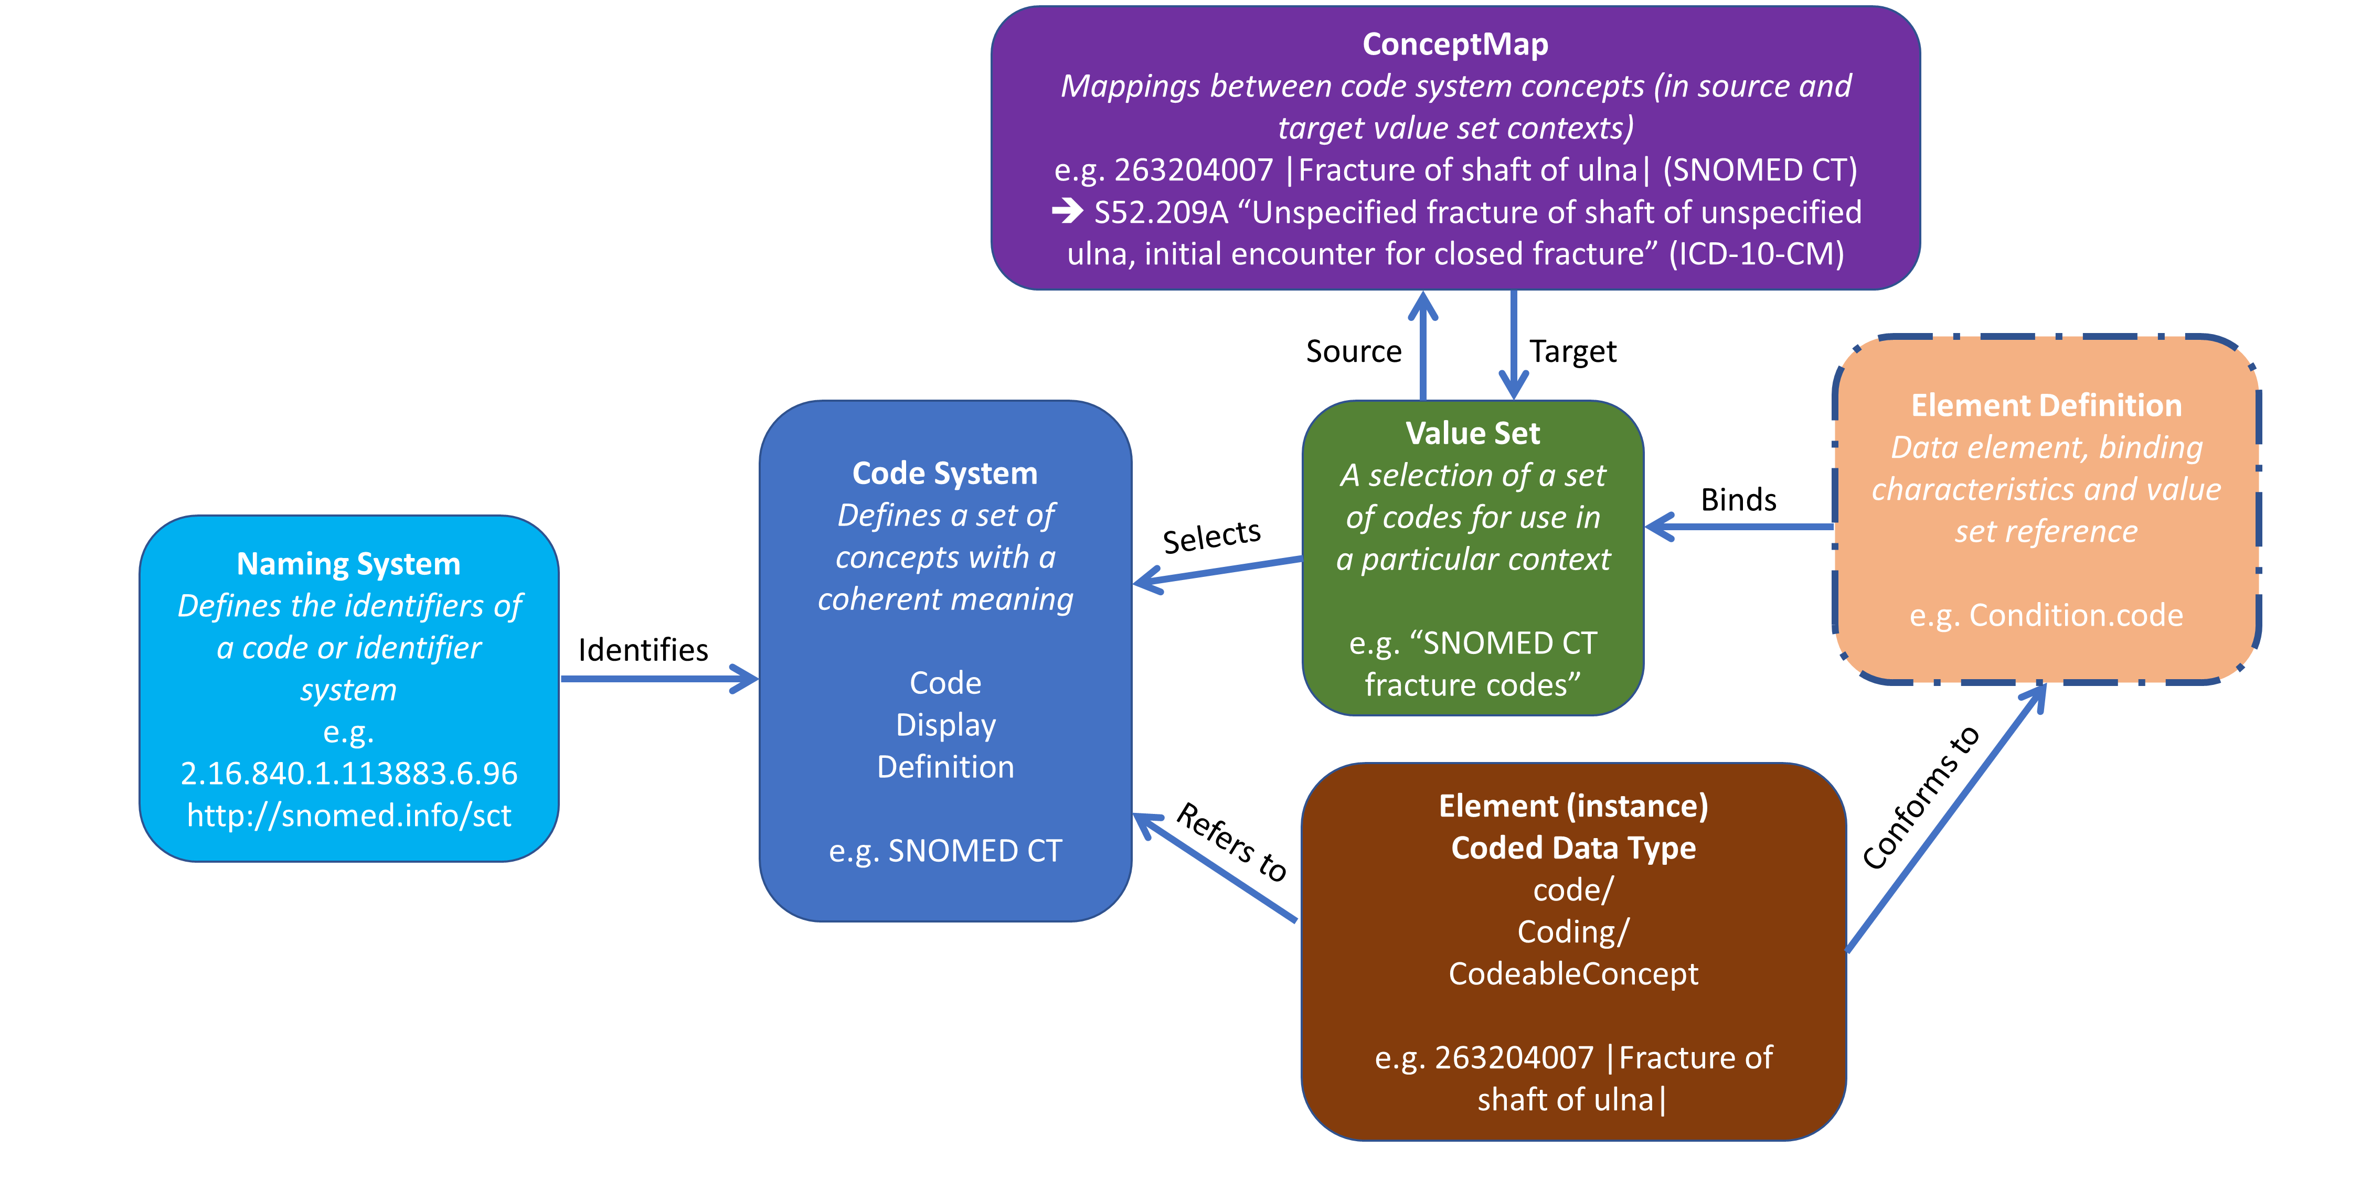
FHIR Terminology Model
Data Element

Slide 20
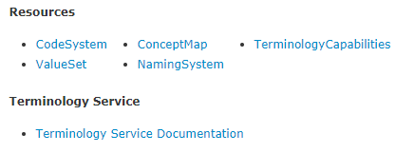
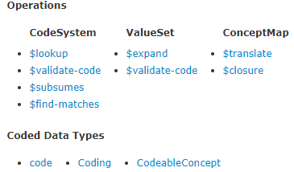
Terminology Resources and Operation
HL7 code/string
Coded concept
Coded concept with equivalent

Slide 21
Terminology Service: Conformance
Provides access to terminology needed to for data capture – coded data elements
It implements CodeSystem, ValueSet, and ConceptMap resources
Create, update, delete, search
Additional operations; CodeSystem->$lookup, ValueSet->$expand,
Expand, Lookup, Validate, Subsumes, and Translate account for most operational requirements associated with terminology use
Declares external code systems
LOINC, SNOMED CT, CPT, ICD 10, RxNorm
Terminology maintenance
Value set authoring/publication

Slide 22
Capabilities
Create or reference a code system
Create or reference a value set
Record data using pre-coordinated codes
Record data using post-coordinated expressions
Record data using multiple local or standard code systems (translations)
Expand a value set
Validate a code
Look up a display term for a code
Translate a code from one value set to another
Maintain a client-side transitive closure table on subsumption relationships
Test subsumption between concepts
For a set of property/concept pairs, return the set of concepts for the requested properties
Map data between different terminologies
Declare the capabilities of a terminology service

Slide 23
ValueSet Resource
The FHIR terminology specification is based on two key concepts, originally defined in HL7 v3 Core Principles :
CodeSystem - declares the existence of and describes a code system or code system supplement and its key properties, and optionally defines a part or all of its content. Also known as Ontology, Terminology, or Enumeration
ValueSet - specifies a set of codes drawn from one or more code systems, intended for use in a particular context. Value sets link between CodeSystem definitions and their use in coded elements
Value sets have 2 aspects:
.compose: A definition of which codes are intended to be in the value set ("intension")
.expansion: The list of codes that are actually in the value set under a given set of conditions ("extension") - see Value Set Expansion
The ValueSet resource can carry either the .compose or the .expansion, both of them, or neither of them (if only the metadata is being represented).
"$expand" operation which can be used request server to generate an expansion given the composition rules, in a particular context, and a "$validate-code" operation which can be used to ask a server to check whether a given code or concept is in the value set in a particular context.
Value sets are uniquely identified by an id, URI, or business identifier
Each expansion has a its own identifier

Slide 24
Intensional vs. Extensional Value Sets
An intensional value set is typically algorithmically defined. That is, the code group is defined as a rule e.g. all codes with the word diabetes in their description). The key benefit of intensional code groups is that they can be dynamically updated. Dynamic updating helps healthcare organizations keep current value sets
An intensional value set designed to contain all of the drugs in the beta blocker category can automatically receive a new beta blocker’s code as soon as it hits the market.
A predicate may be used to specify an intensional value set
Extensional value sets, meanwhile, are enumerated lists of codes where each code is listed individually. This gives the author and user of the value set more control over the which codes are in the value set, but there is a greater maintenance burden to ensure that the value set is kept up to date.

Slide 25
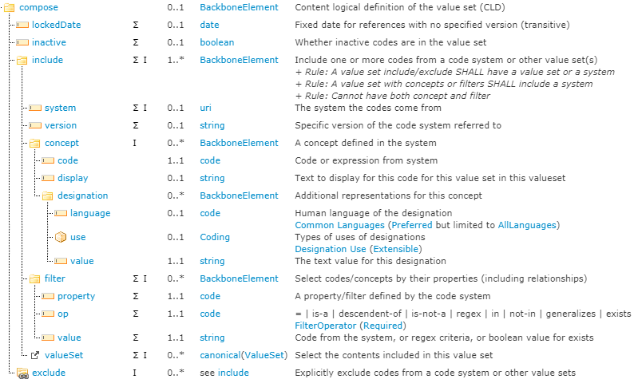

Slide 26
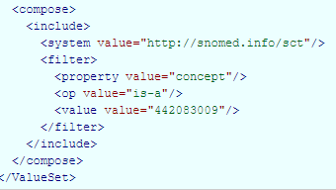
Intensional value set using filter expression: SNOMED CT Body Structures
This value set includes all codes from SNOMED CT where concept “is-a” 442083009 (Anatomical or acquired body site (body structure)).

Slide 27
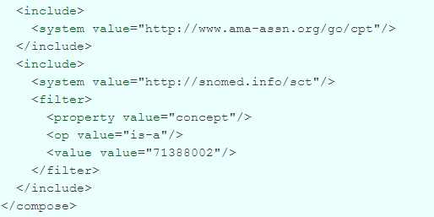
Value set using two coding systems: US Core Procedure
CPT and SNOMED CT (procedures: 71388002)

Slide 28
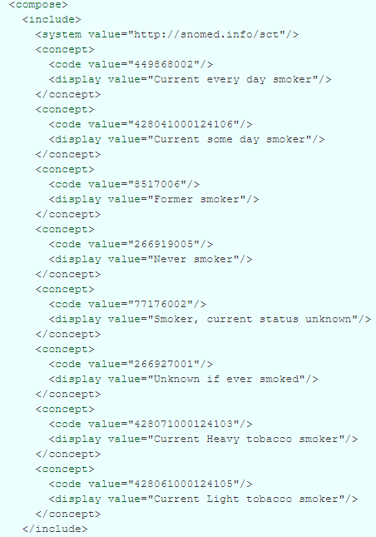
Smoking Status
US Core value set for
Enumerated/extensional

Slide 29
US Core: Medication Clinical Drug
All prescribable medication formulations represented using either a 'generic' or 'brand-specific' concept. This includes RxNorm codes whose Term Type is SCD (semantic clinical drug), SBD (semantic brand drug), GPCK (generic pack), BPCK (brand pack), SCDG (semantic clinical drug group), SBDG (semantic brand drug group), SCDF (semantic clinical drug form), or SBDF (semantic brand drug form)

Slide 30
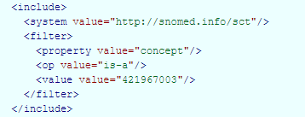
US Core: Medication form
value set includes all dose form codes from SNOMED CT

Slide 31
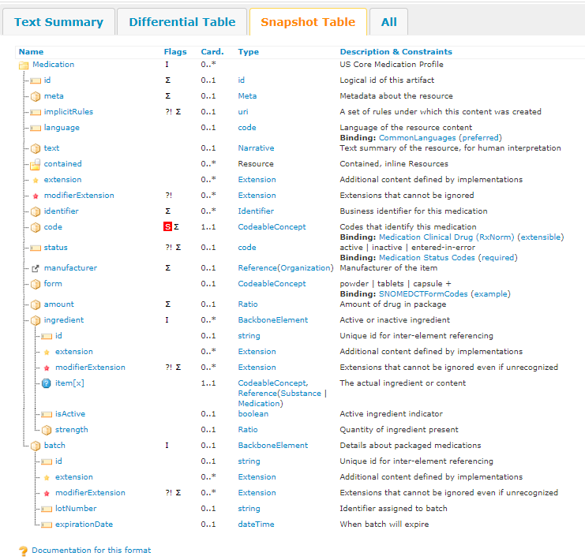
US Core Medication
Binding identifies:
Value set
Strength

Slide 32
ValueSet Expansion ($expand operation)
A FHIR-enabled application can simply ask a terminology server to figure out all the details and return a list of the current codes in the value set. This is known as "expanding" the valueset. As a summary, the client passes the server the following information:
the value set (either by its URL on the RESTful interface, by its logical identifier (ValueSet.url), or directly as a parameter to the call)
(Optionally) a text filter to use to restrict the codes that are returned (e.g. user input text). It is left to server discretion to choose how to apply the text filter
(Optionally) a date at which the expansion should be evaluated (usually, this is the current date/time, but there are circumstances where that is not appropriate)
(Optionally) which page to retrieve - asking the server to break the expansion into a set of pages
(Optionally) other parameters that supply additional information about how to perform the expansions

Slide 33
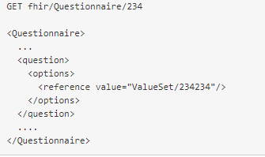
Referencing a value set in resource instance – dropdown list/options

Slide 34
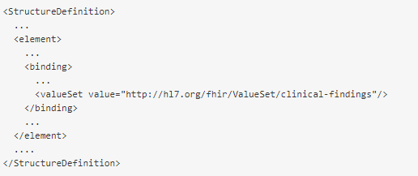
Logical a value set reference in a profile using its uri
Terminology binding

Slide 35
Binding strength
StructureDefinition resources specify FHIR profiles
Terminology constraints typically mandate a value set and require a qualifier: binding strength that affect conformance
Fixed values are also supported for coded data elements as well as other profiles

Slide 36
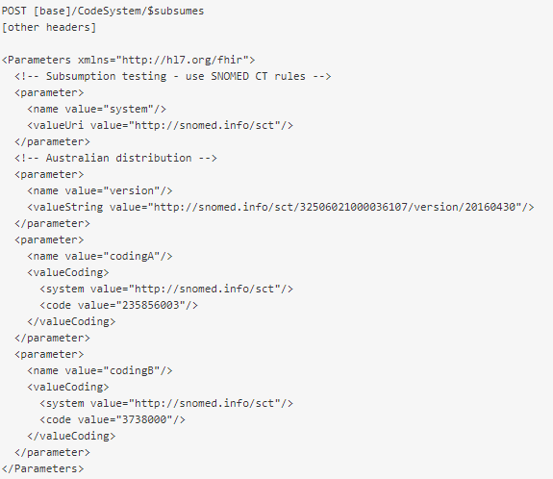
CodeSystem$subsumes

Slide 37
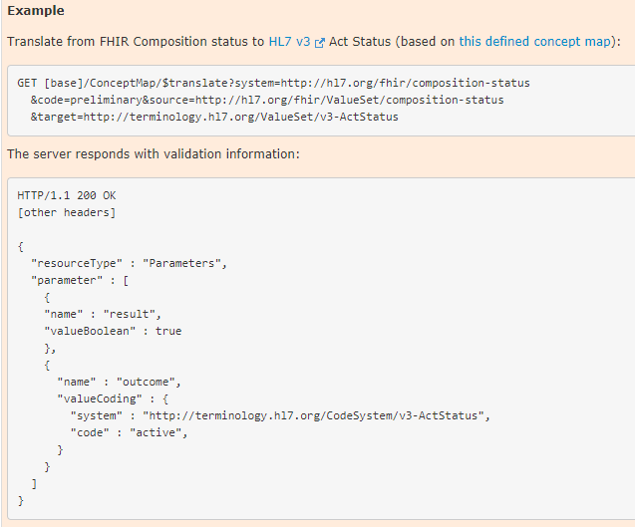
ConceptMap/$translate
ConceptMap stores the translations
$translate executes translations at runtime
Batch translations are also supported

Slide 38
ConceptMap/$closure
ConceptMap operation used to maintain the underlying closure table
The $closure operation takes 2 parameters:
closure table context name
concepts to enter into the table (0 or more - 0 codings is a request to (re-)initialize the table)

Slide 39
Summary
FHIRPath can be used to add precision to data capture, validation, patient-safety requirements
To validate data before it’s stored in a FHIR server
To validate data entry rules and ensure the information captured by systems meets patient safety needs
It has already been implemented and it’s part of open-source FHIR servers
Replaces “SHALL” conformance statements or need for Schematron – which is only available for XML payloads
Normative specification – not yet published/approved; we can contribute new content.
ValuetSet resources can be authored and deployed using Terminology Servers to improve the quality of the data captured during treatment and reused for decision support, analysis, quality, research, etc.
SOLOR can be a source of intensional or extensional value sets
If there are missing data elements – we can create an extension, try it out, and then propose it as an addition to the standard.

