Slide 1
FHIR Implementation for Patient Safety
Removing Ambiguity and Increasing Precision using Profiles and Implementation Guides

Slide 2
Objectives
Roadmap and standard maintenance
Tools, mythology
Open-source community
What’s new in R4 and what’s coming in R5
Additional APIs and integration options
Opportunity to improve support for patient care and safety
Clinical quality, analysis, “decision support” for admin and clinical purposes
FHIR Conformance: Profiling Methodology.
Increase precision, accelerate adoption using profiles
“Must support”, excluded data, constraint predicates
Terminology – using SOLOR

Slide 3
Roadmap for FHIR R4
Moving more resources to formal Normative status
Thus entering backwards-compatibility
Improving the support for publishing implementation guides
Adding additional content in newly developing domains
Improving support for applications using multiple FHIR releases seamlessly, and also multi-language support and federated servers
Burden primarily on application developers
Early release of DSTU2 need to be replaced by R4 (Argonaut → US Core)
Adding new facilities for migrating data from HL7 V2 messages and CDA documents
Complete API including:
CDSHooks for clinical decision support integration,
SMART launch/application integration,
BulkUpload,
FHIRCast for context sharing,
Clinical Quality Language (CQL)
R5 planned for Q3 of 2020 (20 month cycle, patch release are possible, if needed)
https://onfhir.hl7.org/2019/01/20/fhir-r5-roadmap/

Slide 4
R5 Planned Normative Resources
AuditEvent
Claim
ClaimResponse
ConceptMap
Consent
CoverageEligibiltyRequest
CoverageEligibilityResponse
Device
DiagnosticReport
Encounter
ExplanationOfBenefit
ImagingStudy
ImplementationGuide
Location
Medication
MedicationRequest
MedicationStatement
Organization
PaymentNotice
PaymentReconciliation
Practitioner
PractitionerRole
Provenance
Questionnaire
QuestionnaireResponse
SearchParameter
Subscription
VisionPrescription

Slide 5
Improving Clarity and Improve Patient Safety using Profiles
Precise Profiles can address all the issues identified:
Profiles or templates are mandatory for conformance. Projects and products implement profiles organized into implementation guides (e.g. US Core for common data elements required in the US)
Remove the ambiguity inherent in any base standard from DICOM, X12, NCPDP, HL7 V2, and CDA. The healthcare community has a very long track record with HL7 V2 profiles – introduced in HL7 V2.5.
“An unambiguous specification of one standard structure that has been analyzed for particular set of requirements. It prescribes a set of precise constraints upon this HL7 standard.” [based on HL7 V2 Control section]
CDA “profiles” or “templates”; they are logically equivalent to V2 and FHIR profiles.
FHIR profiles are represented as FHIR resources: StructureDefinition with reference ValueSet resources organized using ImplementationGuide; Testing resources: TestScript, TestReport
“Must support” data elements to highlights data elements required to implemented according to the Implementation Guide
Cardinality can be used to identify “excluded” data
A formal model of negation. All resources except Condition provide a “status” data element for an internal state machine (“preliminary” → “completed”
Condition R4 provides data elements that can be modified using change requests (see FHIR Issue Tracker)
Enhanced terminology, value-set, and predicate constraints. Terminology bindings, value sets, constraint predicates can be added/improved.
Prohibition of modifier extensions. FHIR, like HL7 V2, is extensible but profiles can limit the extensions to real-specific extension or prohibit modifier extensions, if needed.

Slide 6
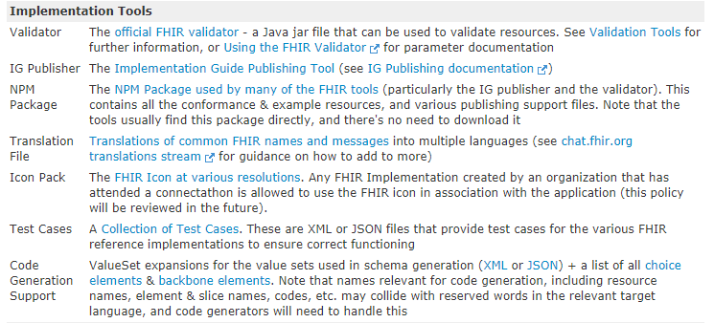
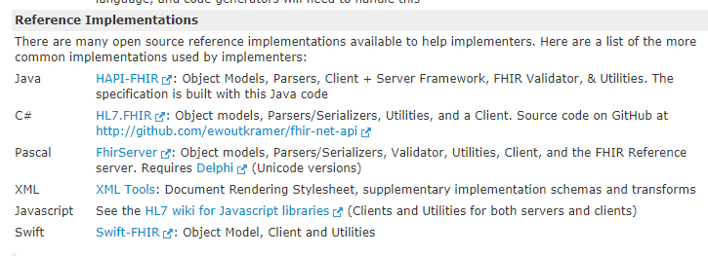
Tools...
Reference implementations...
http://build.fhir.org/downloads.html

Slide 7
Application Programming Interface and Open-source Community
Open-source community, reference implementations, and implementation tools
API
Java, .Net, Javascript
FHIR Server
HAPI is supported by a large open-source community and has a commercial version
FHIRPath:
path/syntax used to define resource invariants and constraint predicates
Java, .Net, Notepad++, etc.
SMART-on-FHIR to launch/integrate FHIR-based application
Authorization/Authentication using OAuth2, OpenID Connect
Single Sign-on, context sharing
Add-on application to optimize user experience for specific tasks

Slide 8
FHIR Issues and Approach
Issues
Approach
Ambiguity related to data required to support patient safety
Imprecise terminology
Ad-hoc extensions
Create profile
Based in existing US-mandated
Based on VA requirements
Based on patient-safety best-practices
Based on SOLOR
Constrains a resource/default profile, a parent profile (i.e. profile of a profile_
“must support”, cardinality, slicing repetitions
Terminology, fixed values, fixed coding systems
Predicates using Normative FHIRPath notation
Constrain/eliminate data elements and extensions

Slide 9
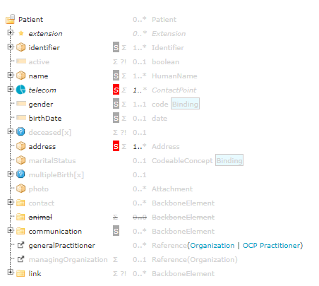
Profiling Methodology: Profile Derivation
Open optionality, allows support for any use cases/requirements
Invariants, “required”, “preferred”, “example” terminology bindings,
Base Resource
constrains/ extends
Additional constraints, adds “required” bindings and value sets, jurisdictional requirements
Optionality, allows support for any use cases/requirements
Realm Profiles
VA, DoD, IPO
constrains/ extends
Organization
Vendor/ Organization
Product
Veteran-specific extensions, VA/DoD terminology constraints
Inherited “must support” from US Core
Project

Slide 10
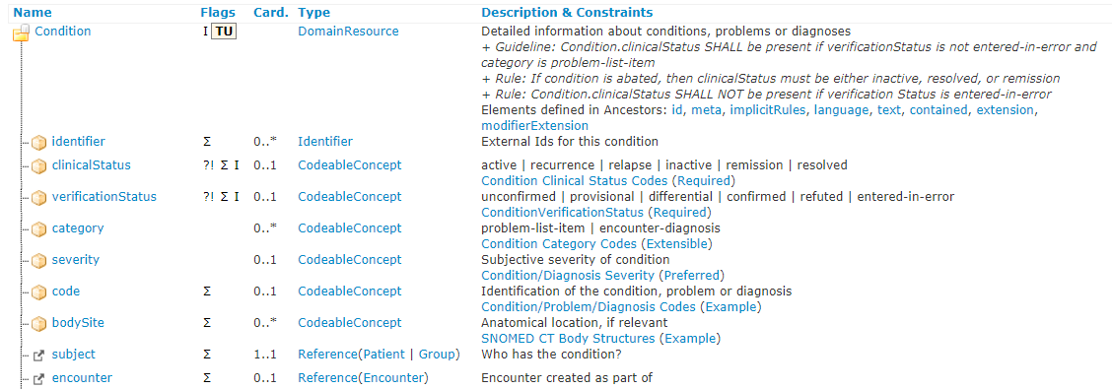
Example: Condition resource - R4
Cardinality to identify mandatory [1..1] not supported [0..0] data elements
Supports a mapping to SNOMED-CT, if required.
Modifiers that change the meaning of the business data in the resource
Value set binding may be changed in the profile
Value set binding may be changed in the profile
Value set binding may be changed in the profile
Value set binding may be changed in the profile
Mandatory reference to Patient resource

Slide 11
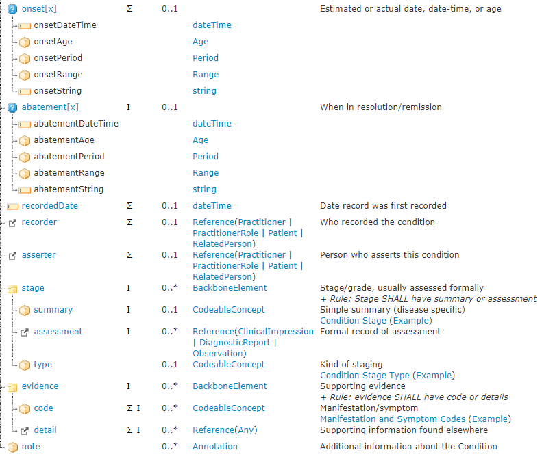
Invariant (i.e.FHIRPath) expression related to this data element
Summary data returned for “isSummary” searches
Observation or other resource(s) on which the finding in the Condition is based

Slide 12
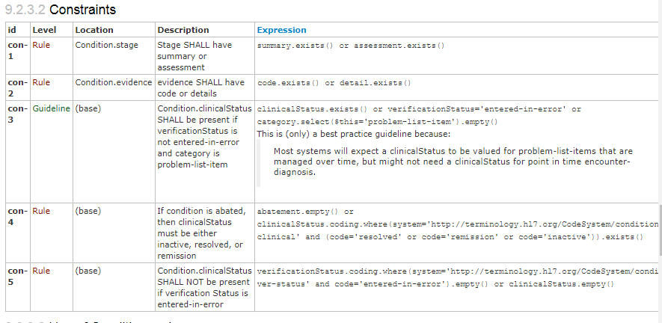
FHIRPath Expressions/Predicates
Valid: true
Error if “false”
Info if “false”
To promote best-practices, patient safety

Slide 13
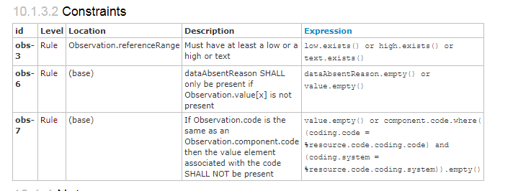
Observation invariants: part of the “default” profile
FHIRPath conditional expression
Path where it applies
FHIRPath uses “fluent” syntax to chain operators

Slide 14
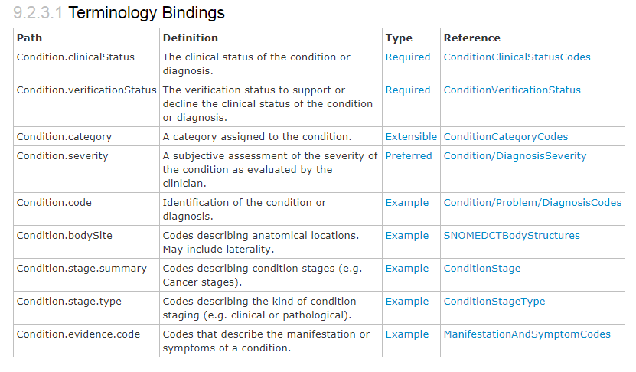
Condition R4: Default terminology bindings
Mapping to SNOMED-CT supported for all “required” bindings if the data type is “CodeableConcept”

Slide 15
Condition negation: R4 using Condition.code

Slide 16
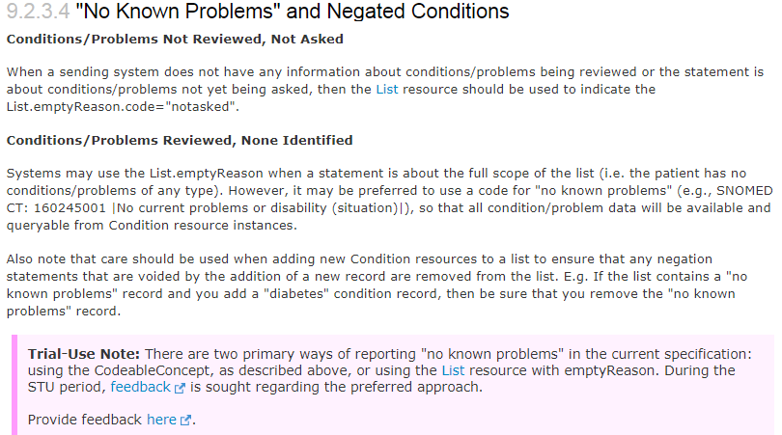
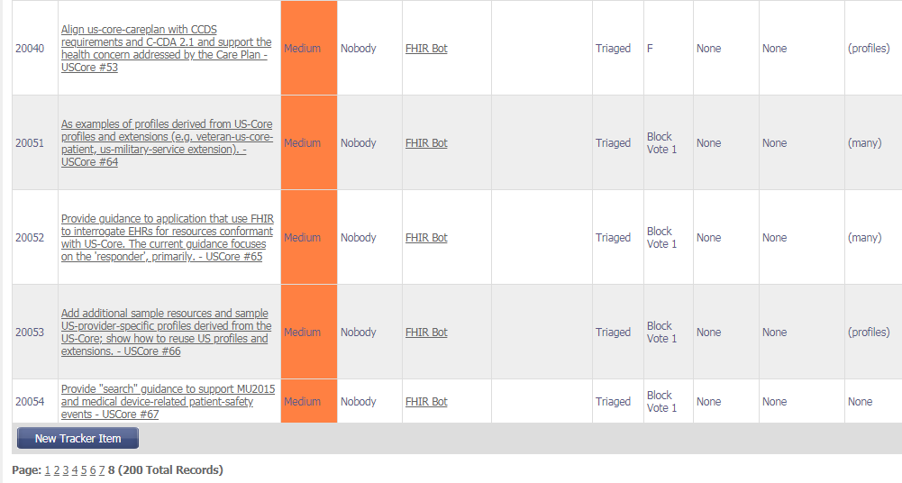
Condition negation: R4 Update and Trial Use feedback → Change Requests
FHIR Issue Tracker

Slide 17
US Core Condition profile: Minimum data set for US implementers
“Must support” data elements have to specified by an EHR if it’s collected
0..1 – data is supported by application but now always relevant
1..1 – data is mandatory
VA may add data elements and requirements to support SOLOR for “verification status”
VA may add example resources illustrating a “negated” condition and suggest improvements to any guidance included in the standards using the FHIR tracker to submit change requests against the “Trial Use” parts of the standards

Slide 18
Associations/relationships: contained and referenced resources
Association to other resources
“references” to stand-alone resources
Diagnostic report → references Observation resources.
The constituent observations may be queried/updated individually using RESTful services.
“contained” resources
Diagnostic report :: contains “impressions” – as Observations resources.
The constituent observation can be accessed only via the report and may be updated by updating the report
FHIR Profiles can constrain a reference to another resource:
Reference(Any) → Reference(us-core-Observation)
Reference(Observation) → Reference(us-core-Observation)

Slide 19
Summary
Conformance and testing capabilities can promote patient safety and best-practices
“must support” for patient safety or “must support” for treatment can be defined contextually per IG
US Core IG is intended to contain profiles and value set applicable to VA and other US implementers
The base profiles for a EHR queries using MU-certified EHR systems
FHIR-related APIs can promote seamless application integration and EHR extensions
Mobile or web application created by VA to improve patient safety in VistA/Cerner
Data capture profiles
Add-on applications to extend EHR systems
Single sign-on, context sharing, launching, clinical decision support, clinical quality
FHIRPath
Adds validation predicates to FHIR resources (constraint predicates)

