Slide 1
Department of Veterans Affairs
Veteran Health Administration
Knowledge Based Systems
Informatics Architecture Support Services
SOLOR Overview and Use Case Application
Kirsten Haake, Specialist Master, Deloitte & Touche, LLC
Andrew Sills, Specialist Senior, Deloitte & Touche, LLC
Veterans Health Administration, Office of Informatics & Analytics and Health Informatics Informatics Architecture Support Services Contract VA701-16-C-0039-01 (VET10380.01) Bi Weekly Web Based Workshops
11/20/2018

Slide 2
Workshop Agenda
The Problem
  SNOMED CT, RxNorm, LOINC et al: Ambiguity In Overlapping Standard Terminologies
  Mapping: Solution Or Part Of The Problem?
SOLOR Integration
  Integration – Not Replacement
  Terminology Content Delivered In A Single Model
  Use Case Demo: Genomics
  Advantage: SOLOR
Outlook: Bring It !

Slide 3
The Problem
SNOMED CT, RxNorm, LOINC, Local Terminologies and others
Different models
Different update cycles
Different use cases
Siloed
Overlapping

Slide 4
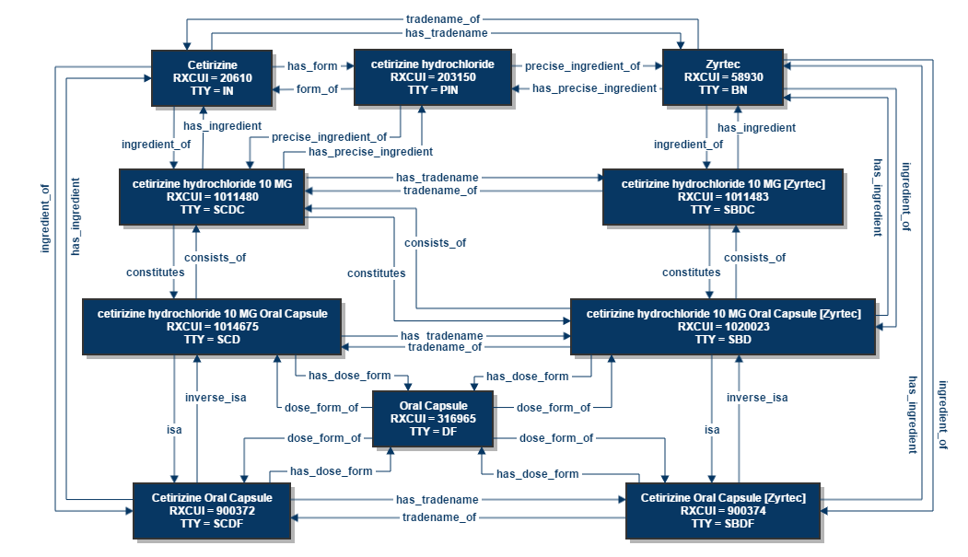
The Problem
SNOMED
RxNorm
LOINC
Different models
Different update cycles
Different use cases
Siloed
Overlapping
Local Terminologies
Others…..

Slide 5
The Problem
Mapping
Neither Standard-to-Standard nor Local-to-Standard mapping achieves consistent semantic equivalency
Many-to-one mappings, where the source term is more specific than the target term, cause loss of information
Mappings with a target term more specific than the source term add “false” information

Slide 6
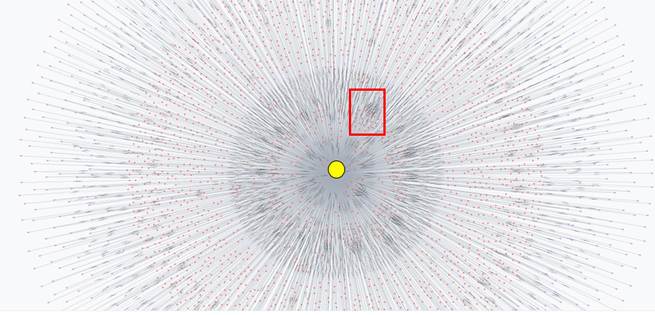
The Problem
Example: Radiology Results
Org A
Local Rad Results Map
LOINC Term

Slide 7
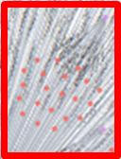
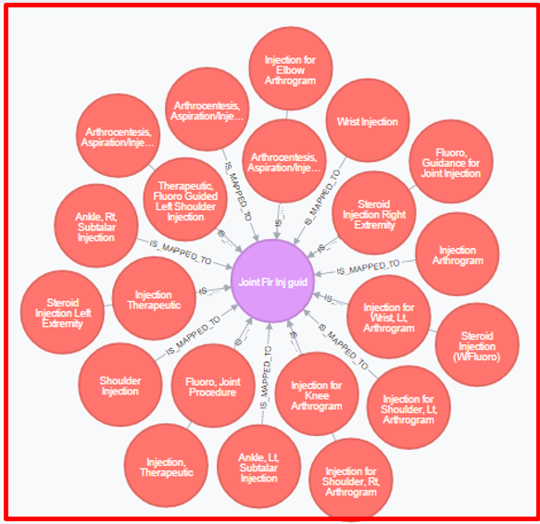
The Problem
Example: Radiology Results
Org A
Local Rad Results Terms
LOINC Term

Slide 8
The Problem
Example: Radiology Results
Org A
Local Rad Results Terms
LOINC Term

Slide 9
The Problem
Example: Radiology Results
Org B
LOINC
Org A
INJECTION(S), ANESTHETIC AGENT AND/OR STEROID, TRANSFORAMINAL EPIDURAL, WITH IMAGING GUIDANCE (FLUOROSCOPY OR CT); LUMBAR OR SACRAL, SINGLE LEVEL
70919-6 | Fluoroscopy Guidance for injection of Spine Lumbar
Injection Epidural Steroid, Lumb/Caud
Lumbar Puncture (W/Injection)
INJECTION, SINGLE (NOT VIA INDWELLING CATHETER), NOT INCLUDING NEUROLYTIC SUBSTANCES, WITH OR WITHOUT CONTRAST (FOR EITHER LOCALIZATION OR EPIDUROGRAPHY), OF DIAGNOSTIC OR THERAPEUTIC SUBSTANCE(S) (INCLUDING ANESTHETIC, ANTISPASMODIC, OPIOID, STEROID, OTHER
Interventional, Epidural Steroid Injection
Angiogram, Lumbar, Epidural-Neurolytic Injection, Single
The source terms are mapped to the same target term, but they are not equivalent

Slide 10
SOLOR - Integration
Localized terminologies remain necessary to satisfy operational needs
Standards can extend to other standards, e.g. SNOMED CT U.S. Extension
Standardize the standards by integrating them into a common model
Enable development, contribution and sharing of localized terminologies

Slide 11
SOLOR In Action - Integration
Status: Active
Time: 2002-1-31 08:00:00
Author: user
Module: SNOMEDCT core modules
Path: development path
Basic Building Blocks:
Concept
Unit of meaning
Assemblage
STAMP
Unit of meaning
English description: Mass in right breast; English language; synonym
Lump in right breast
Unit of meaning
English description: Lump in right breast (finding); fully specified name
Unit of meaning
EL++ inferred: Necessary And
1)Breast lump (finding)

Slide 12
SOLOR – Single Model
Source Files
SNOMED
LOINC
RxNorm
Other
Common Model – SOLOR Ecosystem
SNOMED
LOINC
RxNorm
Other
Conceptual Model
Versioned Descriptions
Status: Active
Time: 2002-1-31 08:00:00
Author: user
Module: SNOMEDCT core modules
Path: development path
Versioned Concept
Versioned Definitions
Versioned Extensions

Slide 13
Use Case – Precision Medicine
As the cost of genetic testing continues to decrease, genetic information is becoming a more common addition to an individual’s health records
COST OF GENETIC TESTING¹
> 3 MILLION
GENOMIC INFORMATION IS VALUABLE FOR:
genetic variations reported to date
Treatment
Genetic testing can lead to more effective treatment for patients
~ 1-1.3 THOUSAND
Basic Research
Genetic testing results can provide valuable ref sets for basic science
available genetic tests for
~ 2.5 THOUSAND
Clinical Research
Genetic testing results will enable researchers to preform large scale data analytics
¹ https://www.genome.gov/27565109/the-cost-of-sequencing-a-human-genome/
conditions
This data is not structured in the EHRs in a format useful for clinical decision support, research, or interoperability.

Slide 14
Use Case – Precision Medicine
NCBI - ClinVar
ClinVar aggregates information about genomic variation and its relationship to human health¹
ClinVar processes submissions reporting variants found in patient samples, assertions made regarding their clinical significance, information about the submitter, and other supporting data¹
Genotype variants are associated with phenotypes, e.g. disorders
¹ https://www.ncbi.nlm.nih.gov/clinvar/

Slide 15

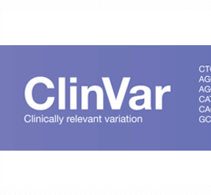
Use Case – Precision Medicine
The SOLOR Genomic Extension transforms concepts from ClinVar, establishing a relationship between a desired variant and a SNOMED concept
Genotype-Phenotype Content Integration
Genetic
Information
EHR
Genotype-Phenotype Terminology
External Data Resource
Improved Patient Outcomes
Mineable Research Data

Slide 16
Use Case Demo: Genomics
Use Case Demo
Andrew Sills

Slide 17
Advantage: SOLOR
Common format
  Using a common model, content is represented in a common format for downstream use
  Extend and integrate terminology standards and other terminologies
  Description-logic classification
Open system
  Apache 2 open source license
Existing off the shelf tools
  TermSpace
  Maven
Data exchange between entities semantically sound
  Enable knowledge representation to be shared
  Drive towards healthcare interoperability
Reduce cost
Improve curation/quality

Slide 18
Outlook: Bring It!
Bring your own license and content
Add concepts to your SOLOR extension if they do not exist
Share SOLOR extensions
  Care partners
  Standards providers
  Commercial customers
Migrate to native encoding standards + extensions

