Slide 1
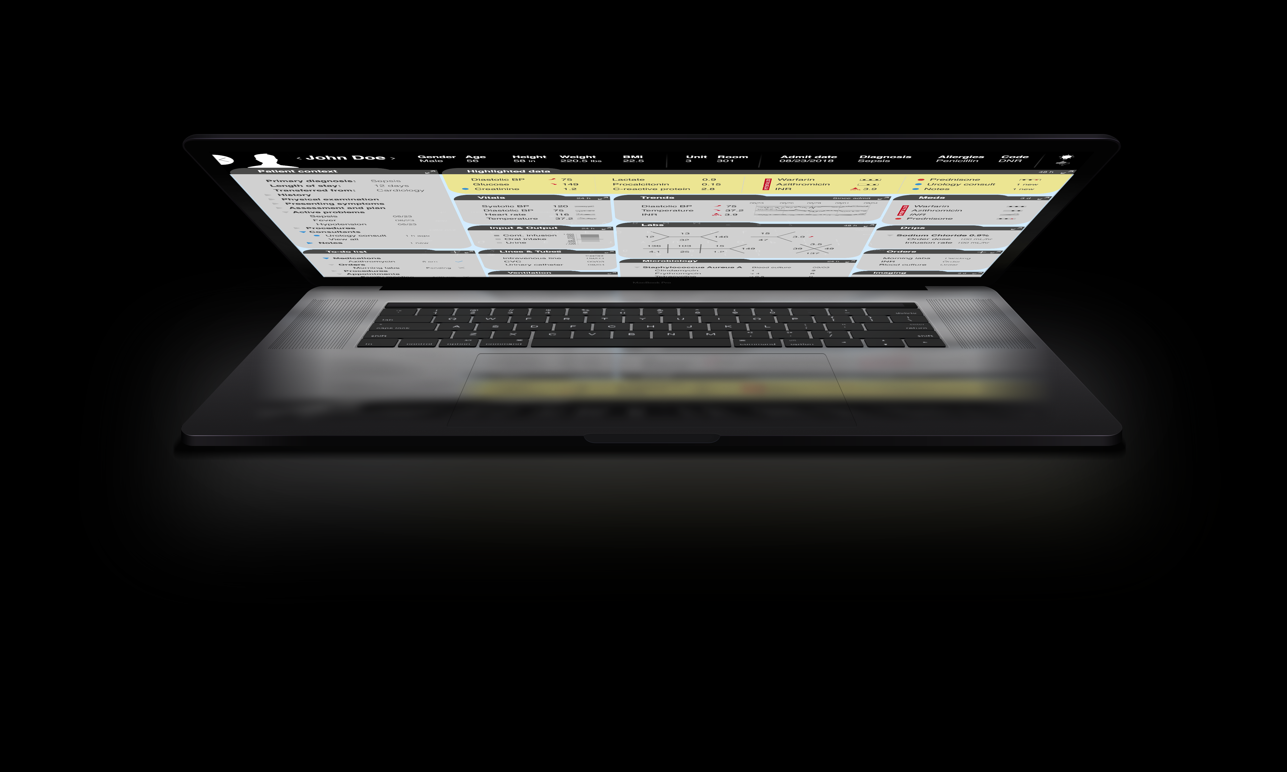
Novel graphical representations
of patient data in the EMR
Luca Calzoni, MD MS
University of Pittsburgh Department of Biomedical Informatics
Notes:
University of Pittsburgh

Slide 2

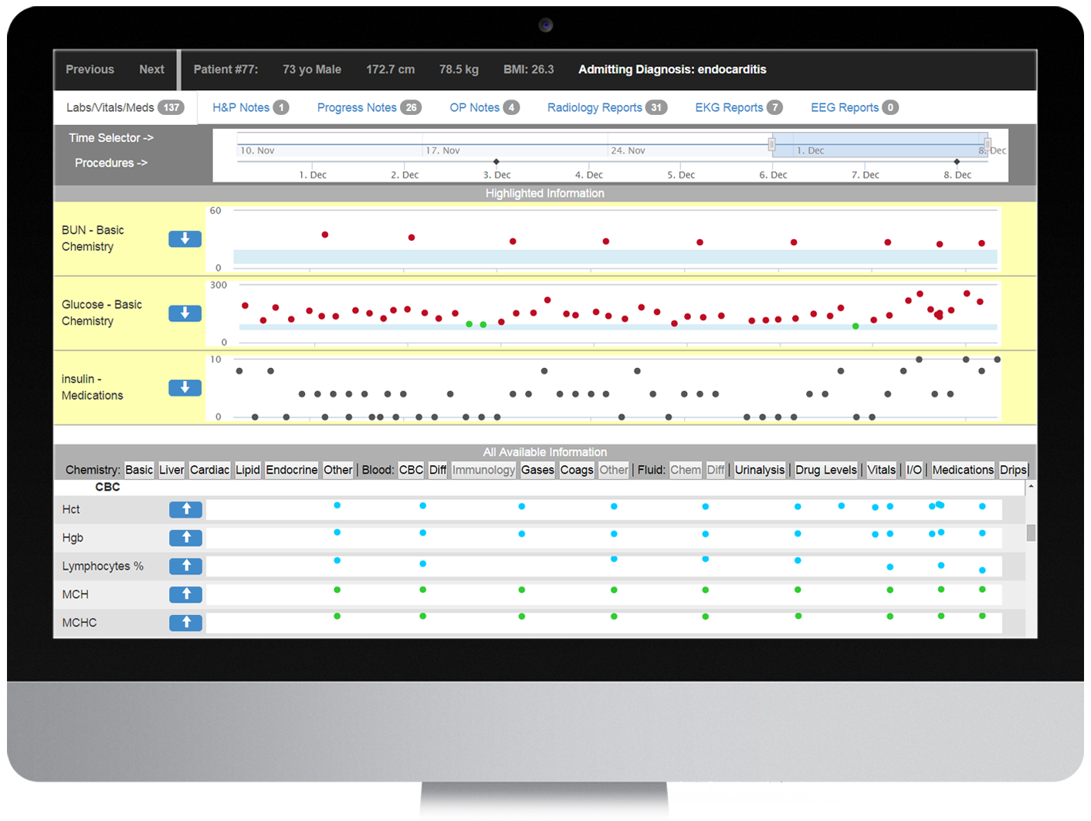
Study design
The Learning EMR
We are building an EMR that presents ICU physicians with the right patient data at the right time
(King et al. 2015)

Slide 3
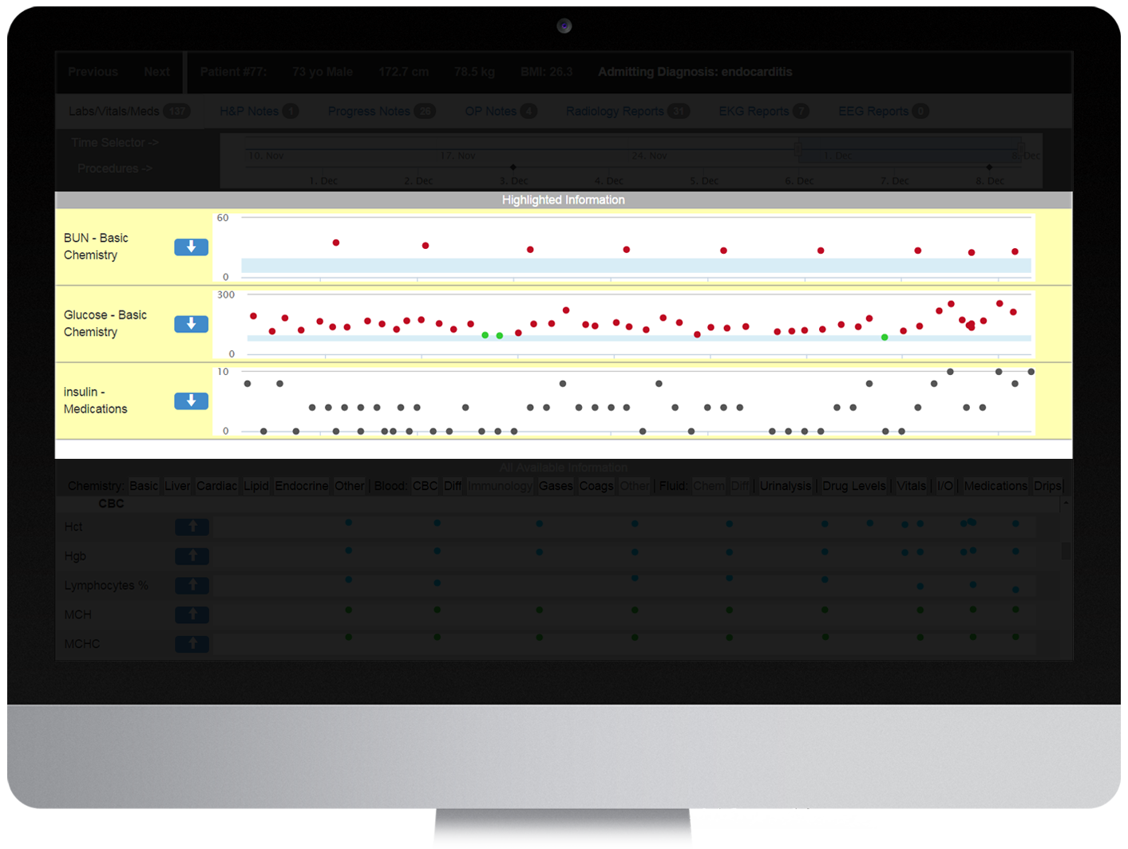
Study design
The Learning EMR
High-value data
for every patient case is predicted from past EMR usage by physicians in similar cases
(King et al. 2015)

Slide 4
Study design
Why a Learning EMR?
Modern EMRs collect enormous volumes of data, especially in ICUs
ICU physicians: EMR interfaces do not match user needs and workflow
  EMRs are “database centered”: the data source determines how data is presented
  Information is fragmented across multiple screens
  EMRs have limitations in graphing capabilities of clinical data
Overabundant data and suboptimal interfaces may impact physician performance, leading to medical errors and patient harm
(Faiola et al. 2015, De Georgia et al. 2015, Pickering et al. 2010, Wright et al. 2016)
Notes:
1300 data points / patient / day - UIs identified as the key problem – EMRs were conceived as accounting tools - A study evaluated the graphical displays of lab tests in 8 EMRs using criteria for optimal graphs: none of the EMRs met all criteria.

Slide 5
Study design
Why a Learning EMR?
The Learning EMR could provide cognitive support to ICU physicians
It requires a display capable of effectively prioritizing the display of high-value data
We informed prototype development with observations, interviews, and focus groups, to:
  identify ways to present high-value data
  understand user information needs and practices
  actively involve physicians in the design
1
2
3
(Faiola et al. 2015, Holden 2011, Karsh et al. 2006, Pickering et al. 2010)

Slide 6
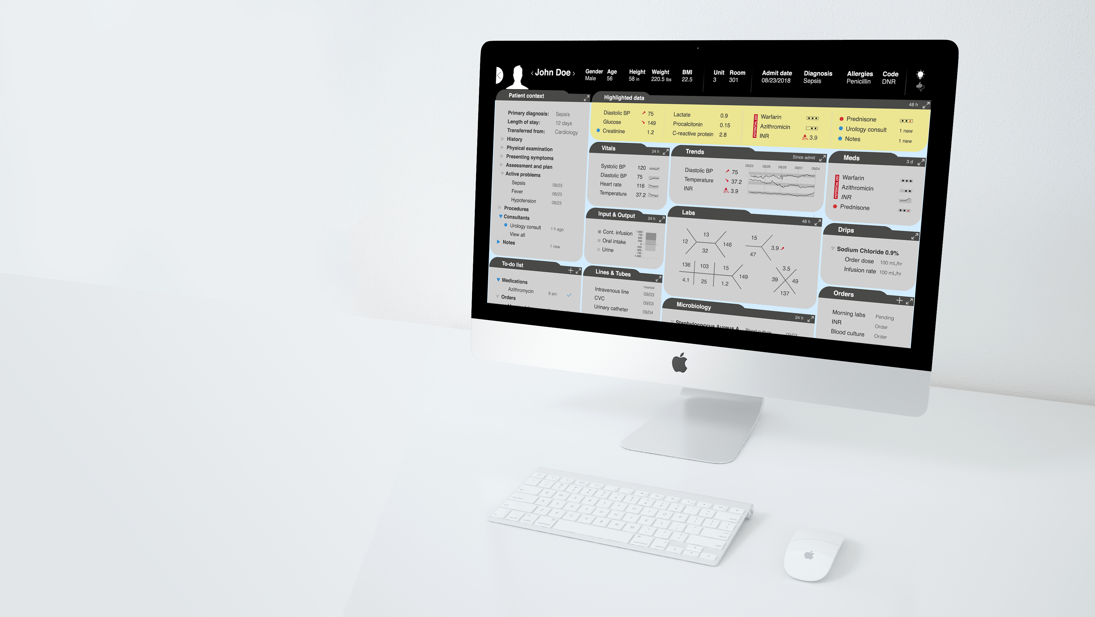

Study design
Design principles from literature review
Preliminary prototypes
Observations and interviews in the ICU
Revised prototypes
Focus group
Final prototypes

Slide 7
Study design
Design principles from literature review
Preliminary prototypes
Observations and interviews in the ICU
Revised prototypes
Focus group
Final prototypes

Slide 8

Literature review
We conducted a non-systematic qualitative evidence synthesis (1996-2019)
We identified papers describing clinical data visualization techniques
We selected 123 out of 1969 retrieved papers, grouped articles dealing with similar aspects, and identified design themes applicable to a Learning EMR
Our search informed the creation of low-fidelity paper prototypes of the user interface
(Faiola et al. 2015, De Georgia et al. 2015, Pickering et al. 2010, Wright et al. 2016)
Notes:
1300 data points / patient / day - UIs identified as the key problem – EMRs were conceived as accounting tools - A study evaluated the graphical displays of lab tests in 8 EMRs using criteria for optimal graphs: none of the EMRs met all criteria.

Slide 9
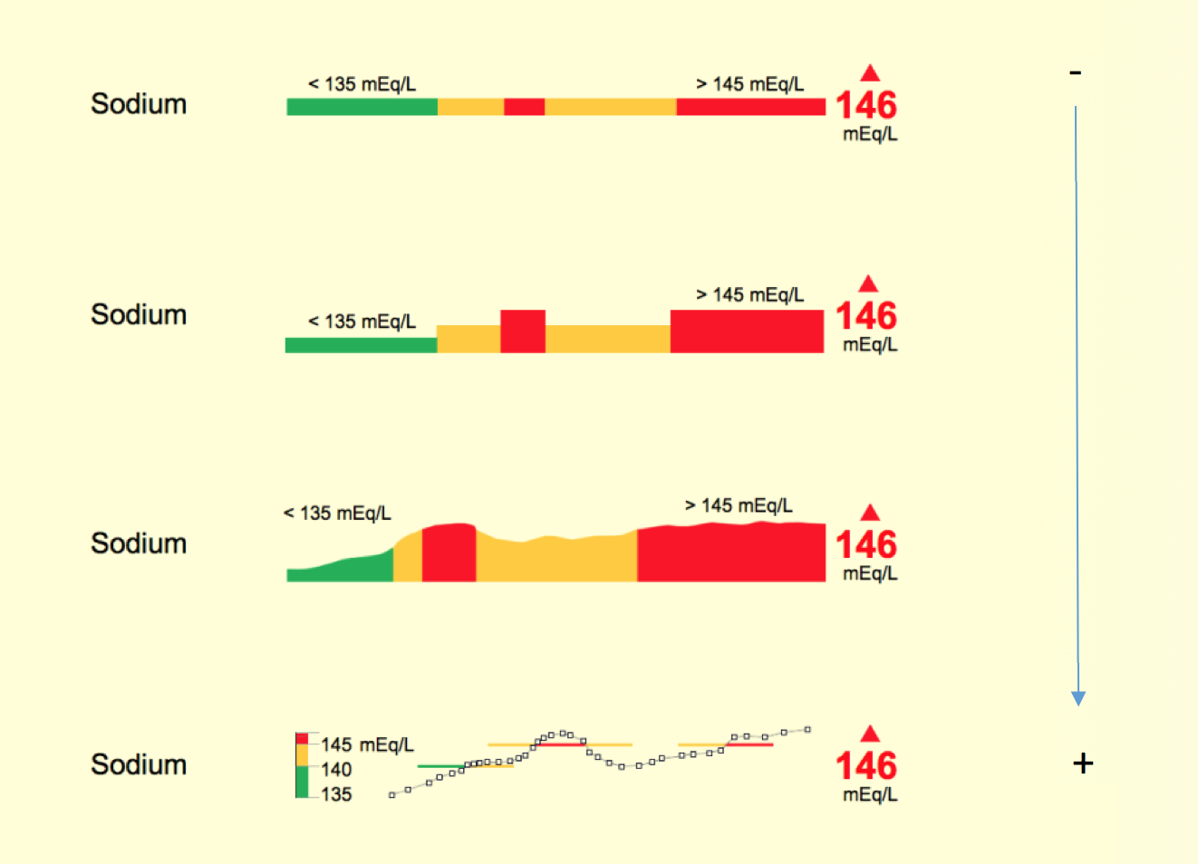
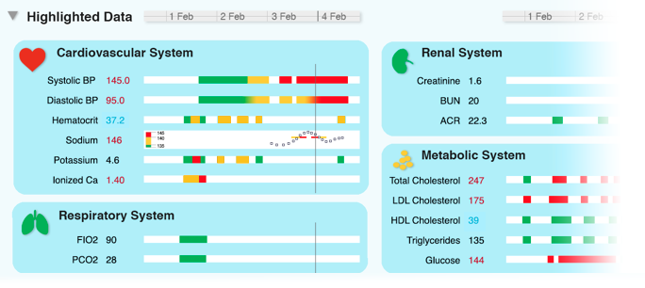
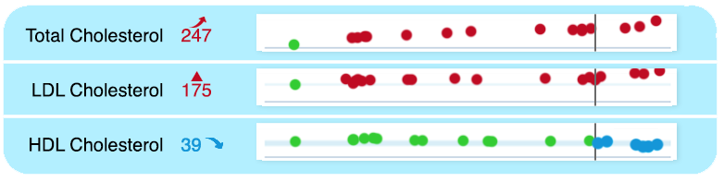
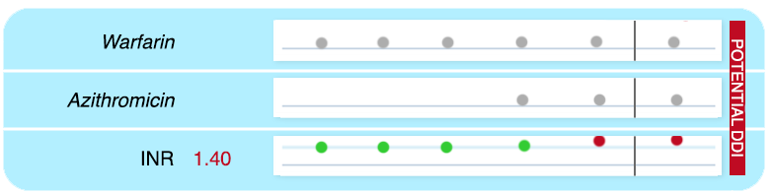
Study design
Traditional approaches
Design principles
We identified design solutions to:
convey clinical information effectively
  highlighting key data in a dedicated panel or in place
  semantic zoom techniques that improve information density
  panels that provide patient status overviews
highlight changes and trends
  condensed visual representations of data items that convey additional information
support analytical reasoning
  visual grouping of related data elements in the EMR
1
2
3
(Pickering et al. 2010)
(Bade et al. 2004)
Notes:
Many of the these visualization strategies have been demonstrated to reduce cognitive load and medical errors. However, they are not commonly used in healthcare.

Slide 10

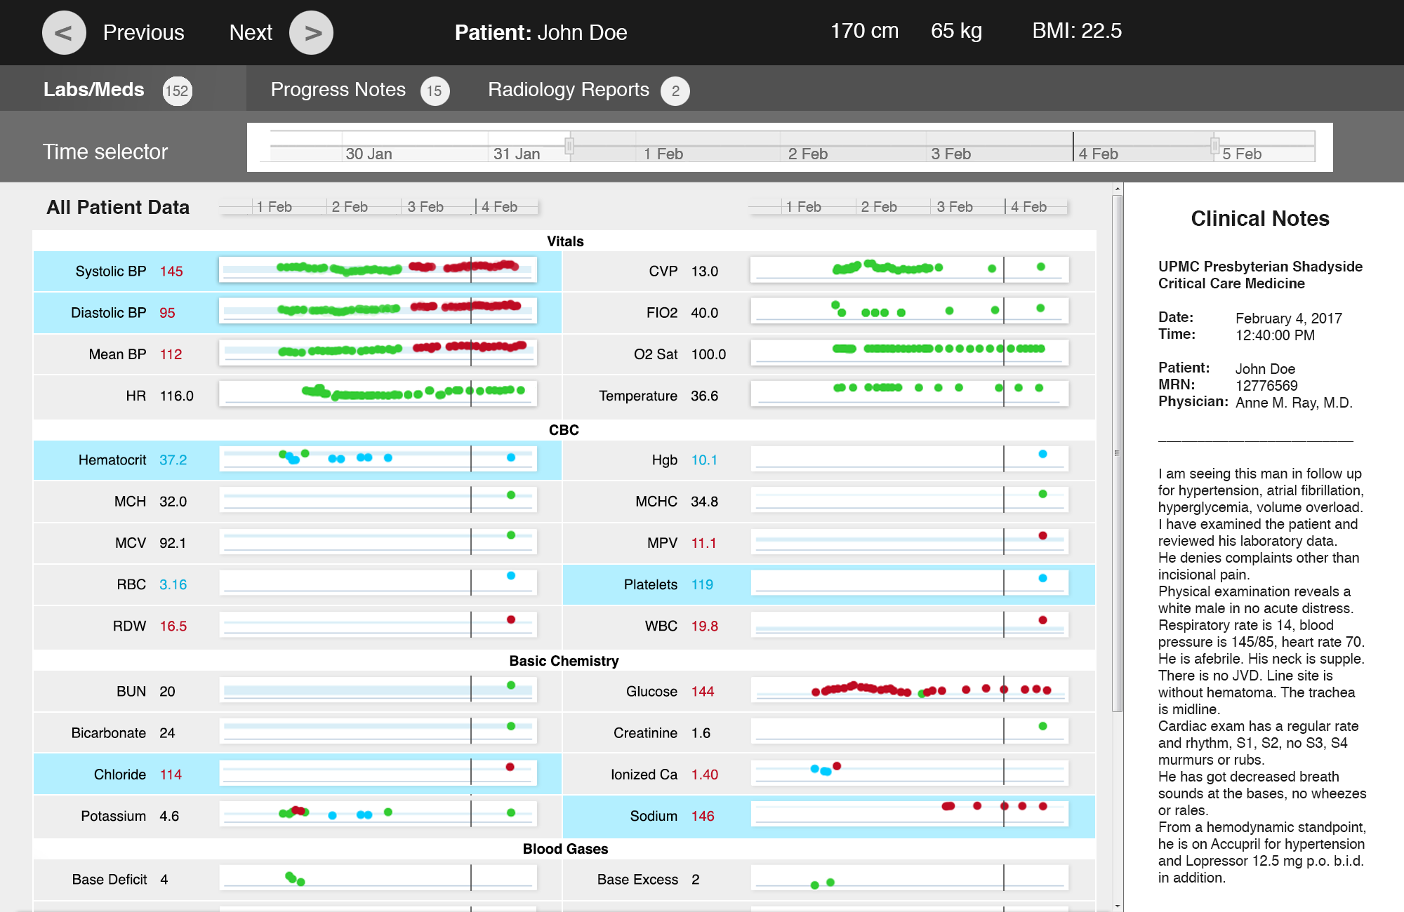
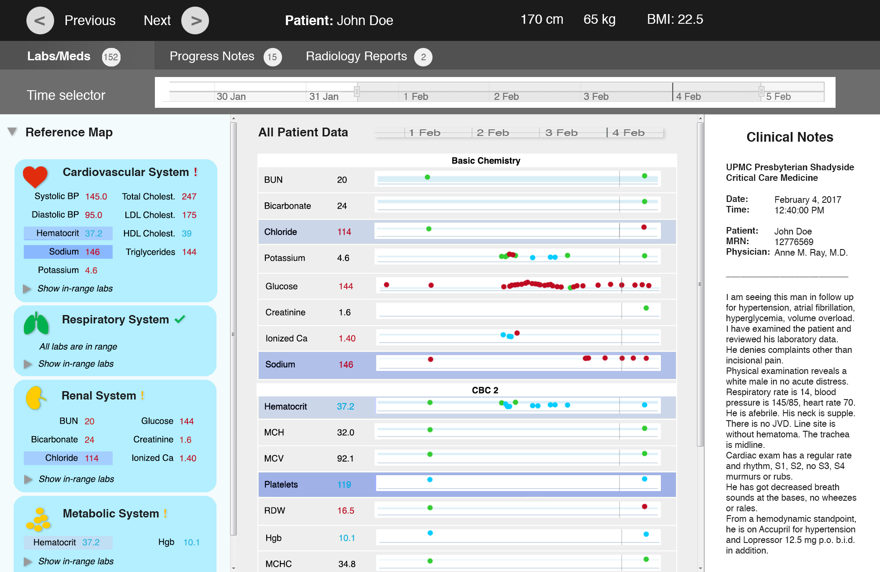
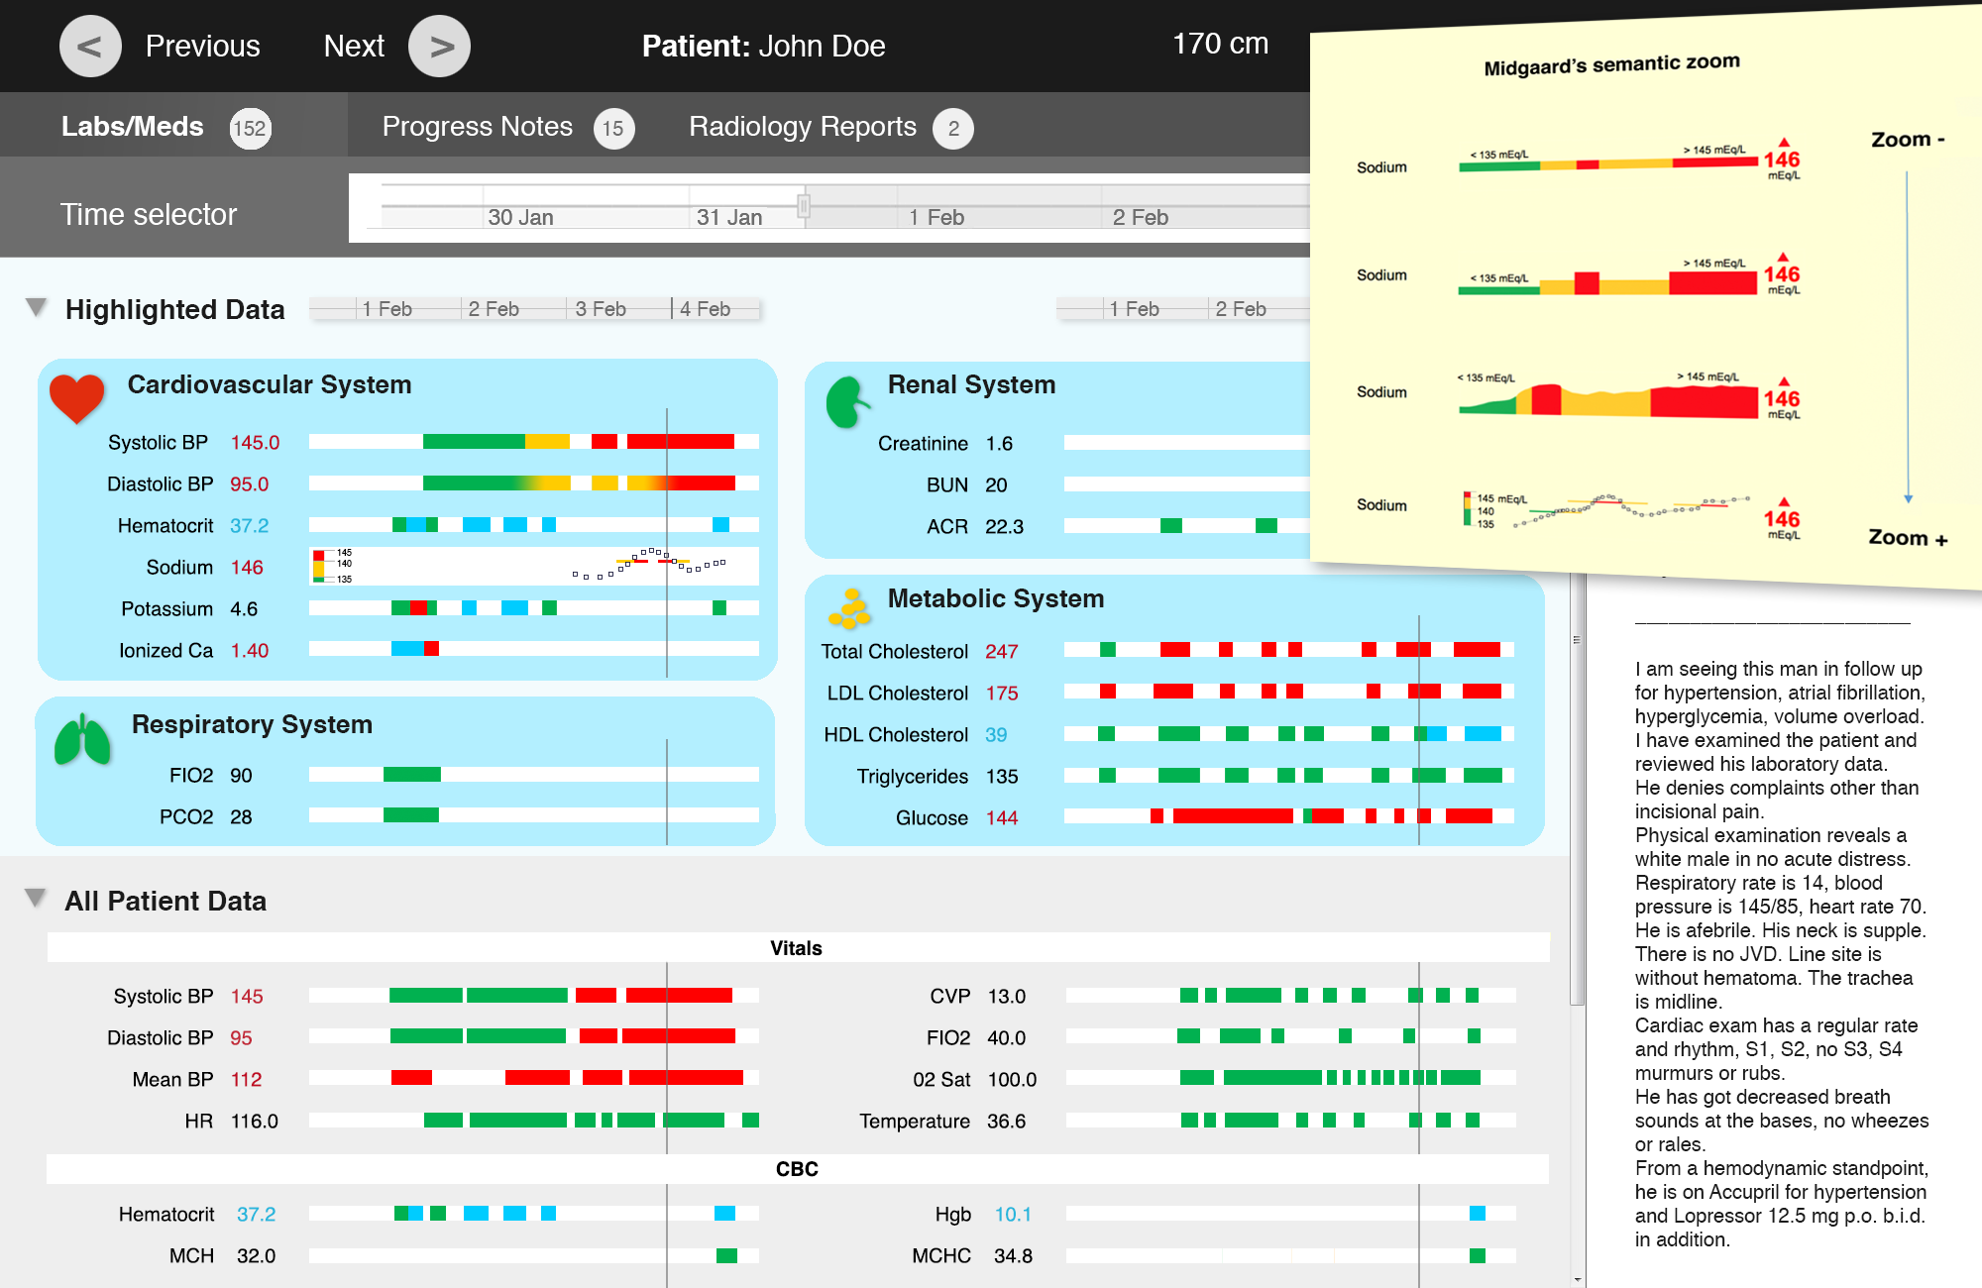
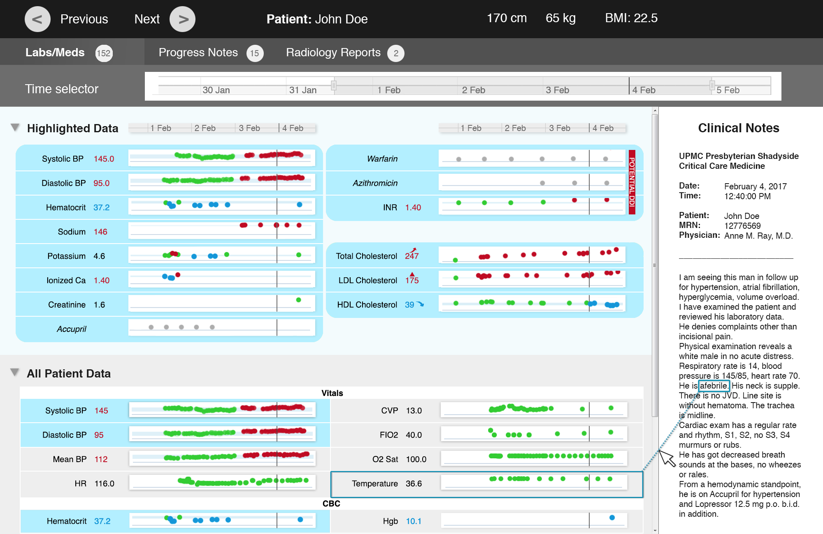
A
Preliminary prototypes

Slide 11
Study design
Design principles from literature review
Preliminary prototypes
Observations and interviews in the ICU
Revised prototypes
Notes:
Add indicator and replace prototype screenshot

Slide 12

Observations
We observed 5 ICU physicians in 5 ICUs:
  interacting with their EMRs to prepare for morning rounds
  dealing with issues finding information and workflow interruptions
We conducted semi-structured interviews with each physician
Field notes and audio recordings were transcribed and coded
Themes were generated by grouping data, to create a narrative
Notes:
Using descriptive coding

Slide 13
Observations: results
Unexpected values, changes and trends impact patient prioritization
Limitations of current EMRs include:
  overabundant information
  difficulties accessing frequently used data
  inability to tailor the system to individual needs
Workarounds are used to overcome limitations and data access difficulties
A limited subset of EMR data is visualized in a personalized order
(Pollack et al. 2016)
Notes:
Workarounds: note templates, manual annotations on paper

Slide 14

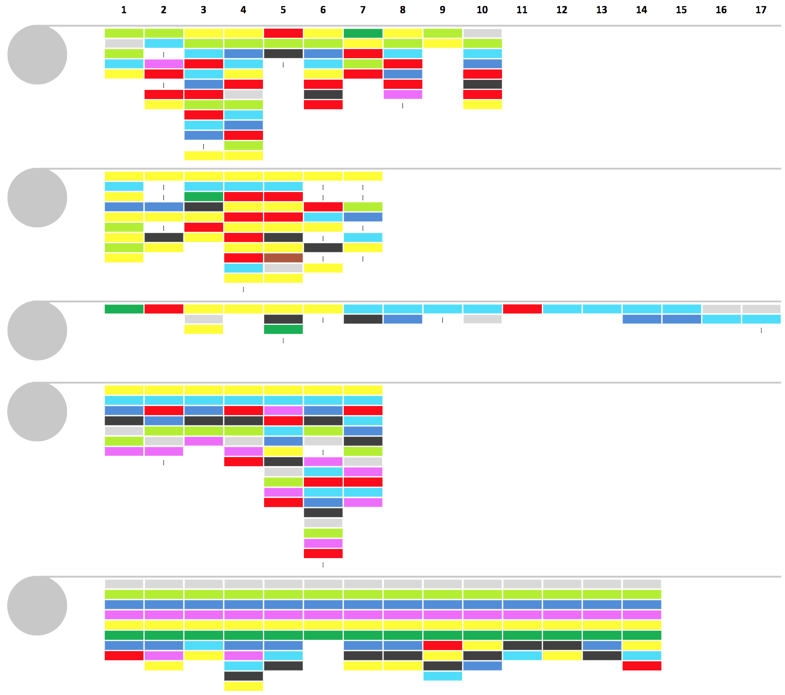
EMR data usage
Patients
Visualization order:
P1
Participants
Notes
Labs
Microbiology
Intake and output
Vital signs
Orders
Radiology
Medications
Other
P2
P3
P4
P5

Slide 15
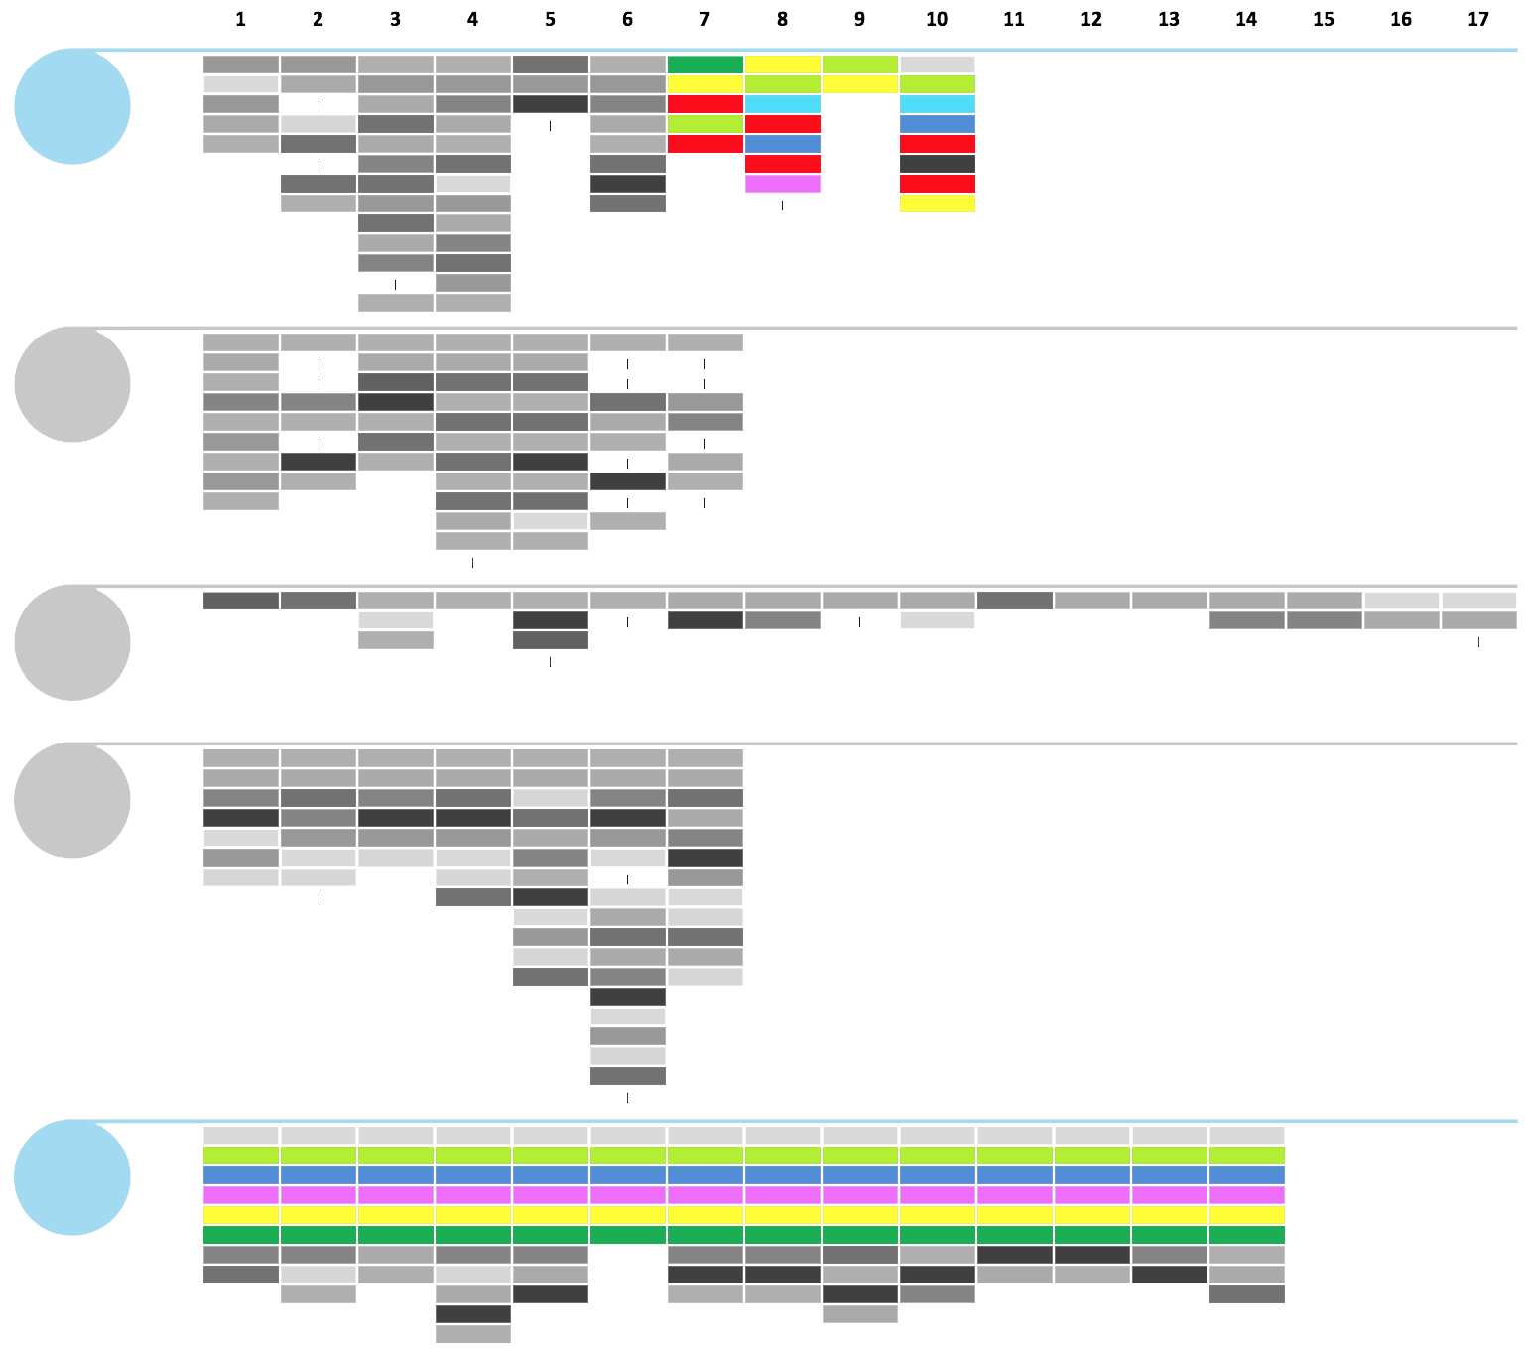
EMR data usage
Patients
Visualization order:
P1
Participants
Notes
Labs
Microbiology
Intake and output
Vital signs
Orders
Radiology
Medications
Other
P2
P3
P4
P5

Slide 16
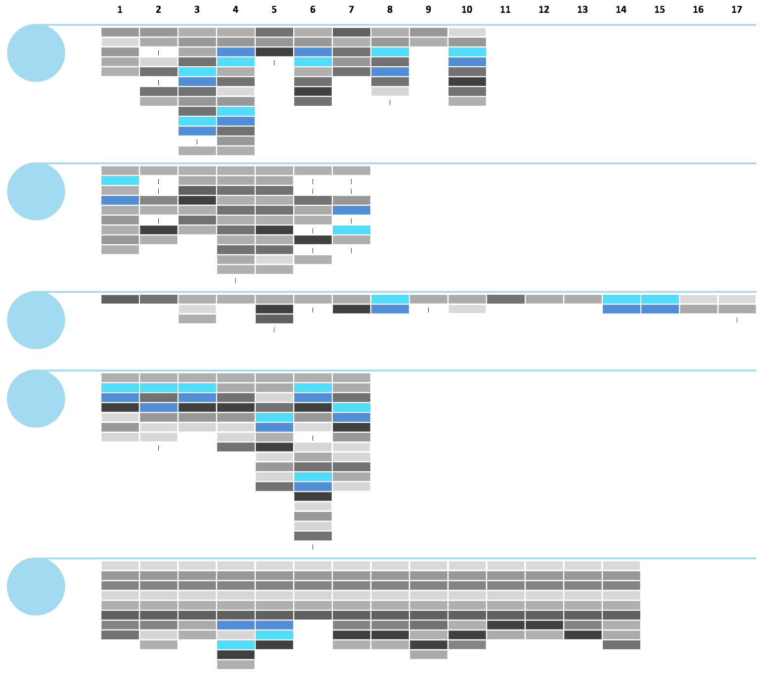
EMR data usage
Patients
Visualization order:
P1
Participants
Notes
Labs
Microbiology
Intake and output
Vital signs
Orders
Radiology
Medications
Other
P2
P3
P4
P5

Slide 17
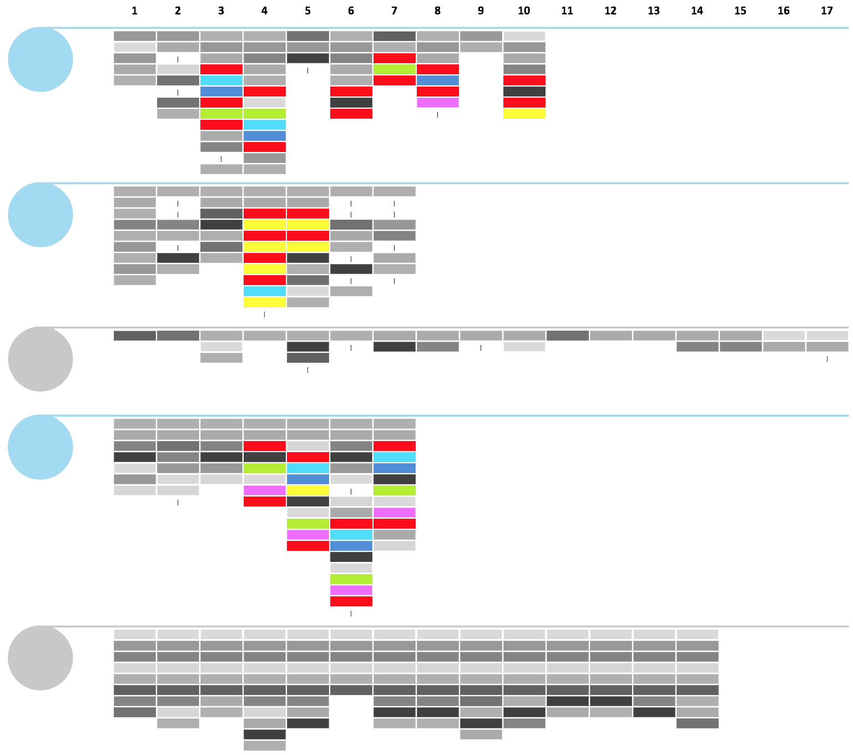
EMR data usage
Patients
Visualization order:
P1
Participants
Notes
Labs
Microbiology
Intake and output
Vital signs
Orders
Radiology
Medications
Other
P2
P3
P4
P5

Slide 18

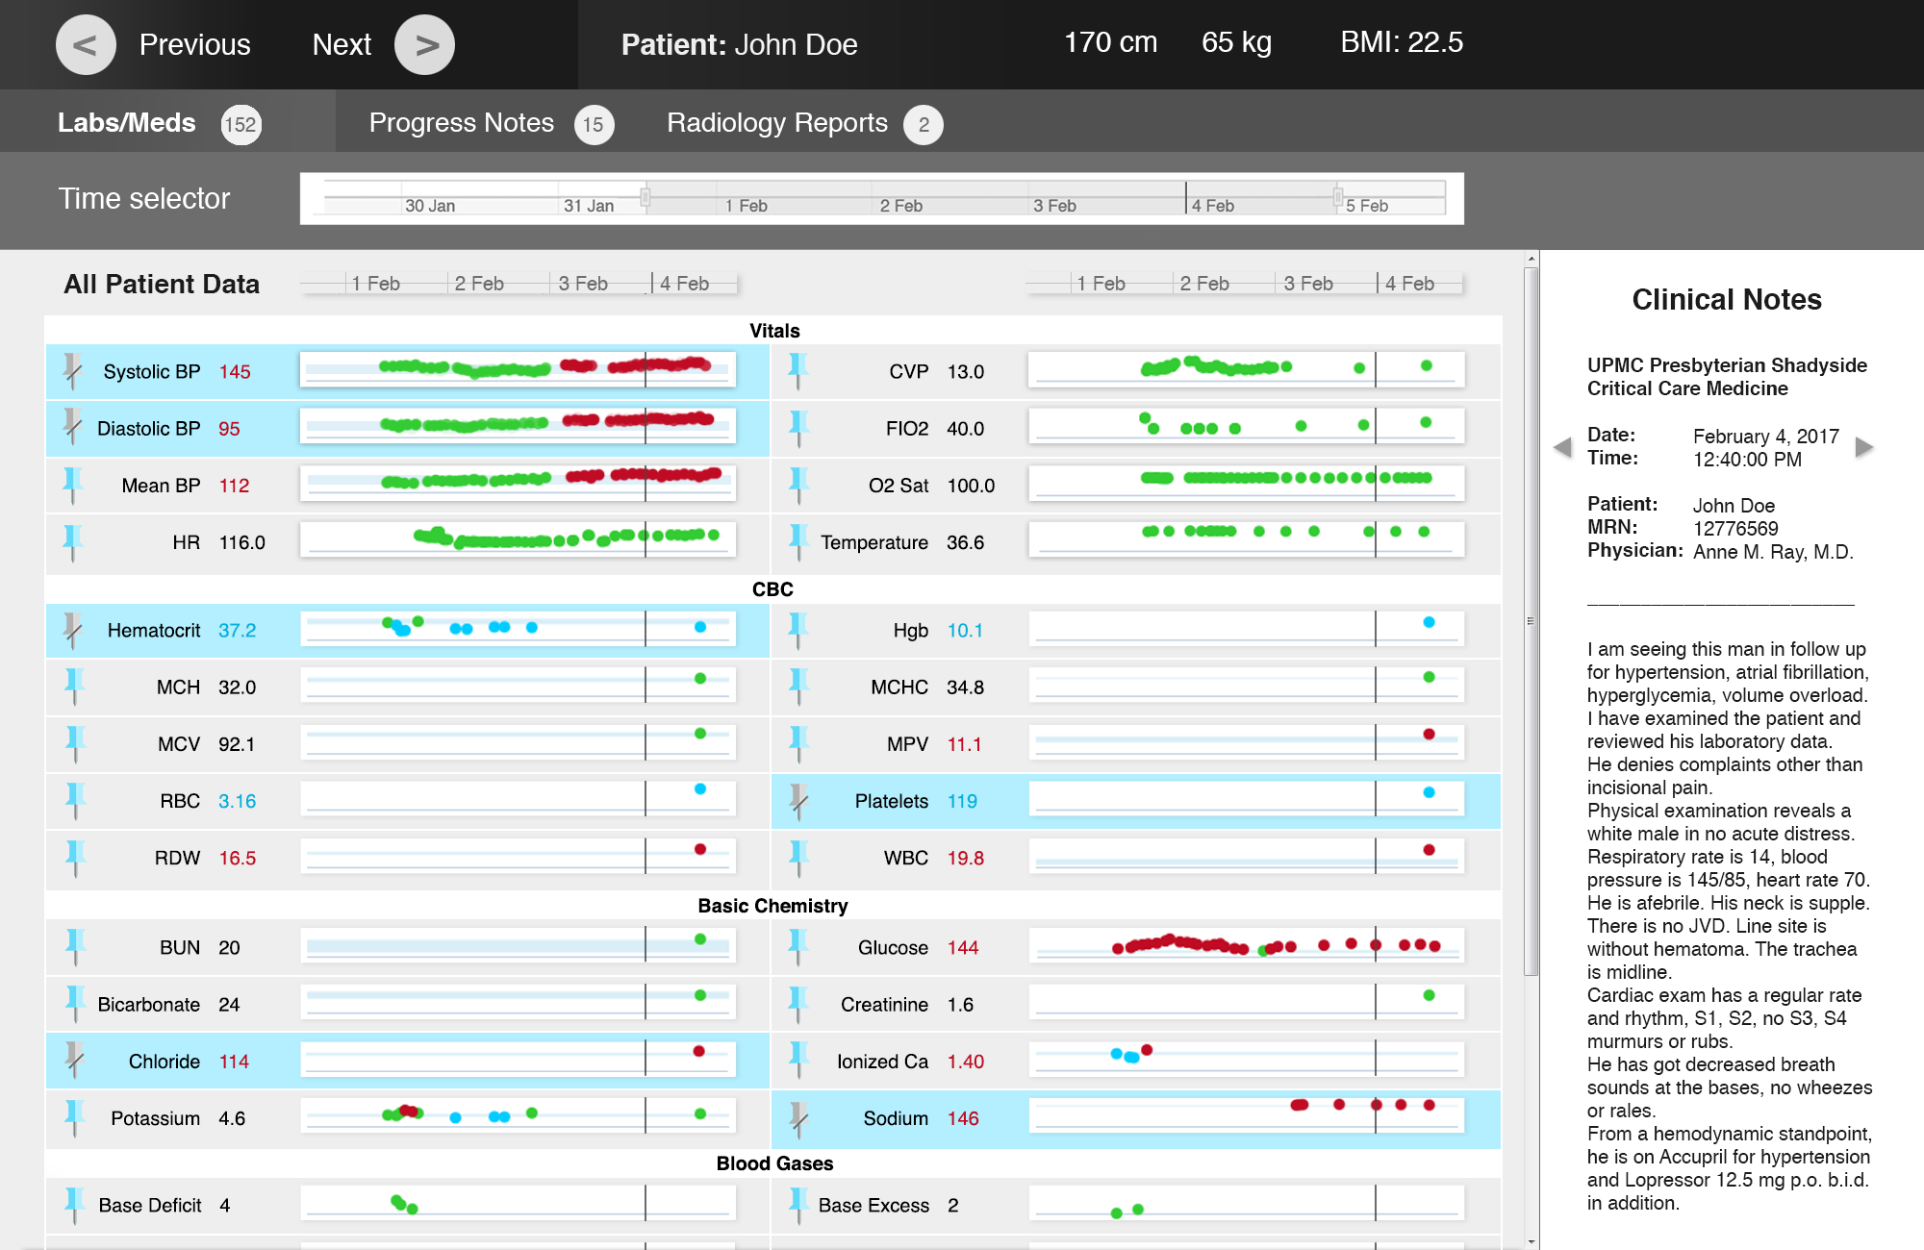
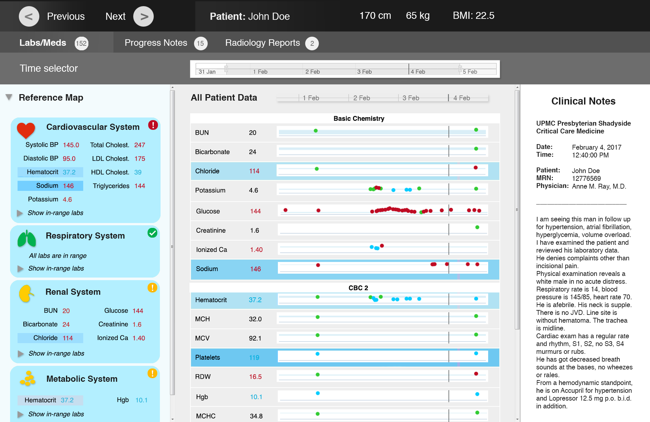
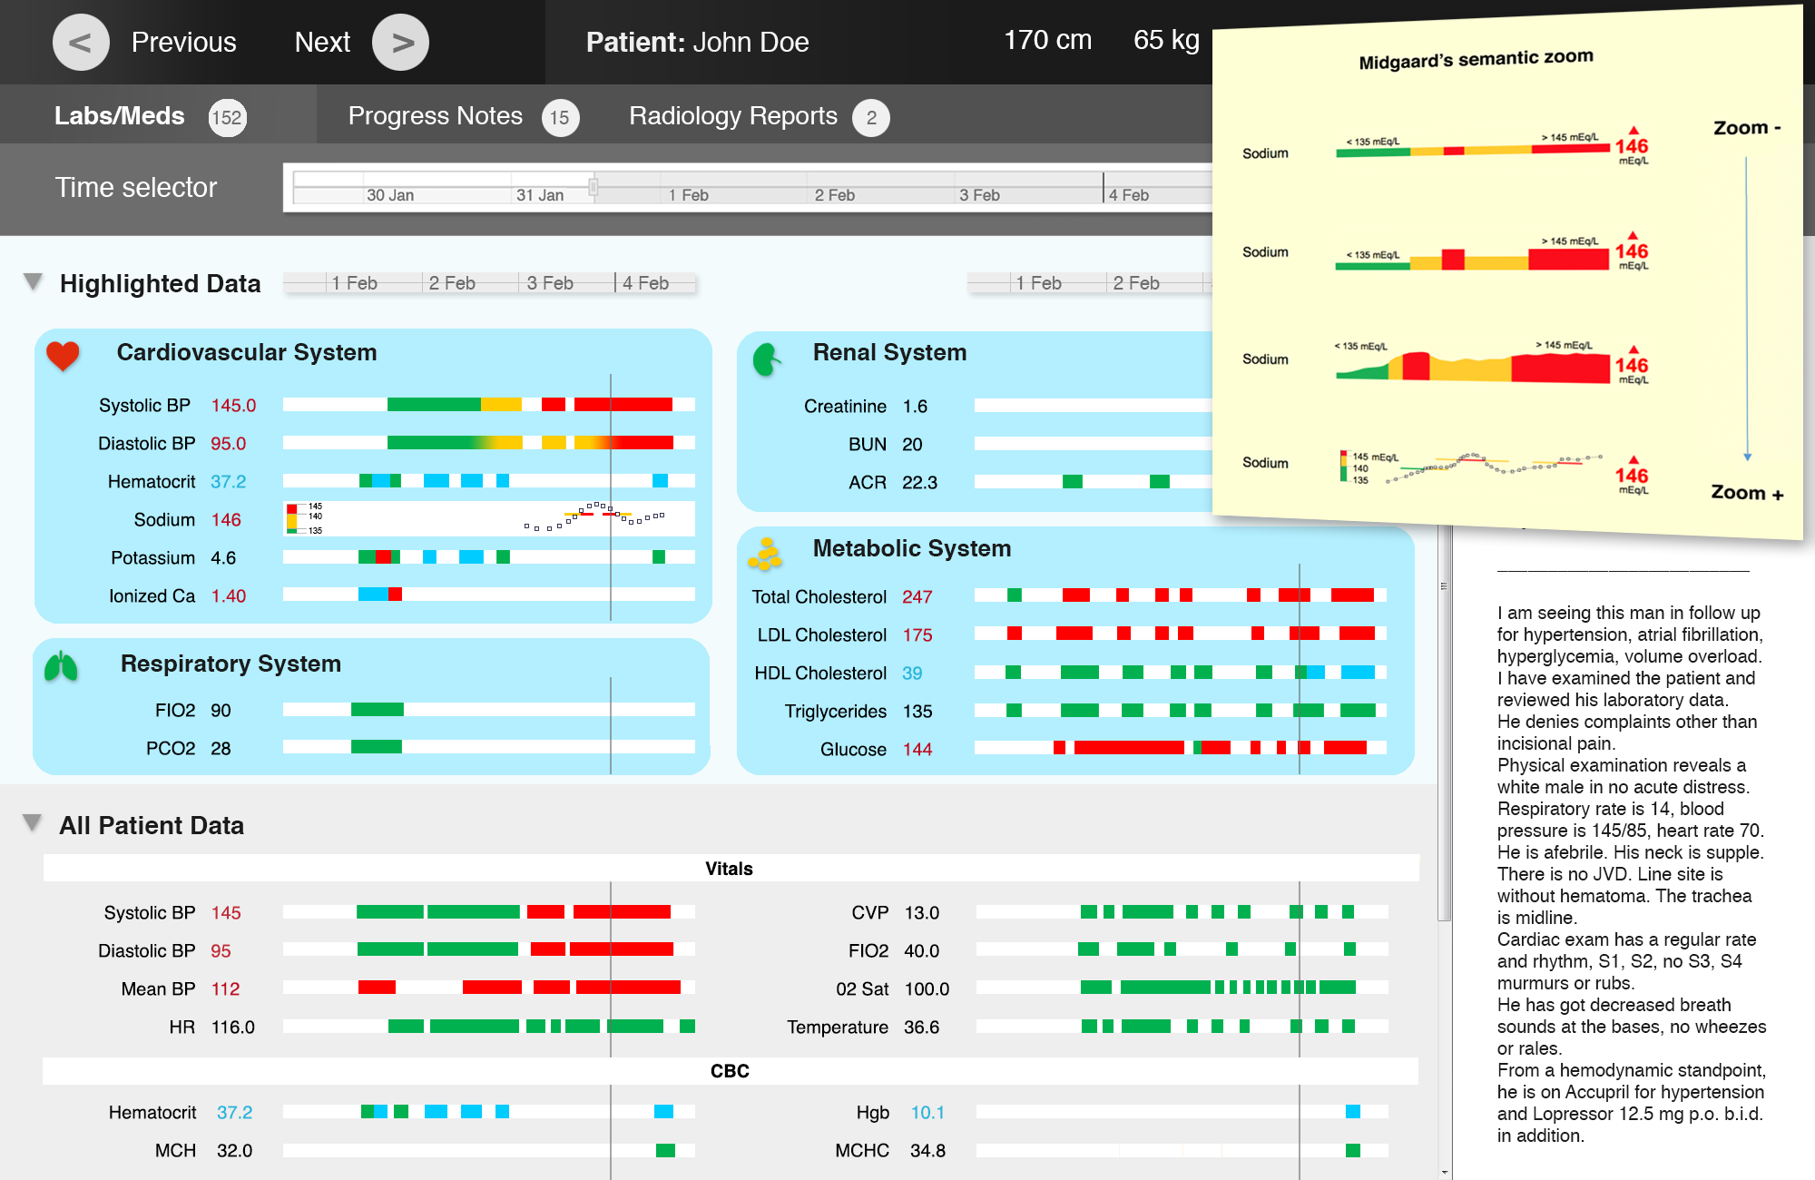
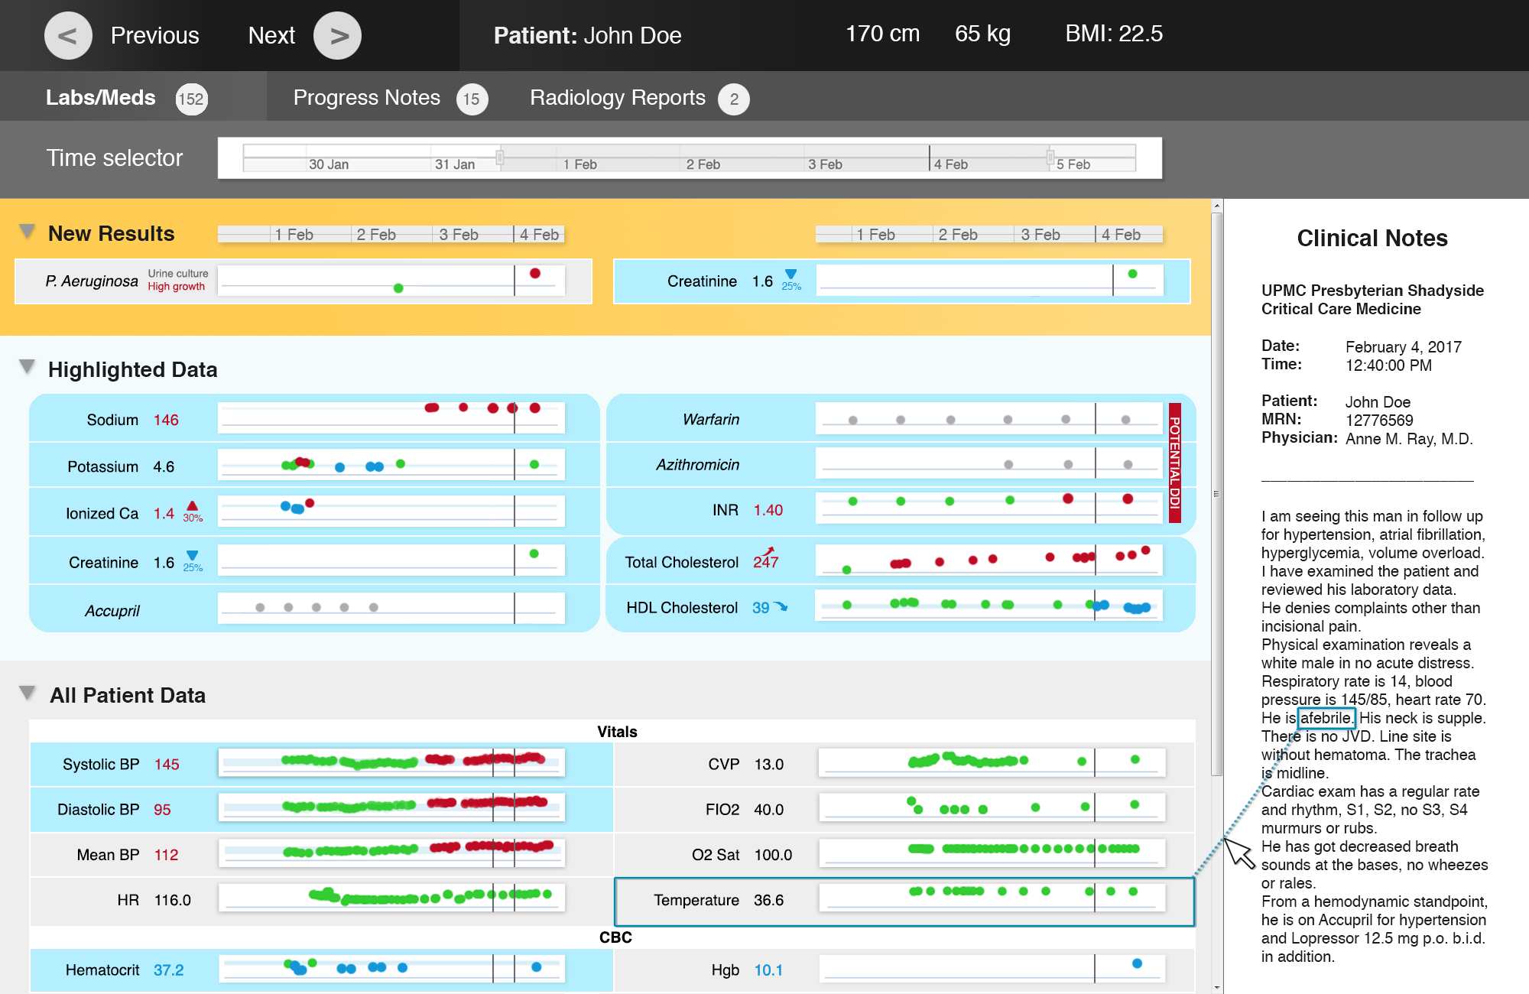
B
Revised prototypes
Notes:
The insights gained from our observations and interviews in the ICU informed the revision of our preliminary prototypes

Slide 19
Study design
Design principles from literature review
Preliminary prototypes
Observations and interviews in the ICU
Revised prototypes
Focus group
Final prototypes

Slide 20

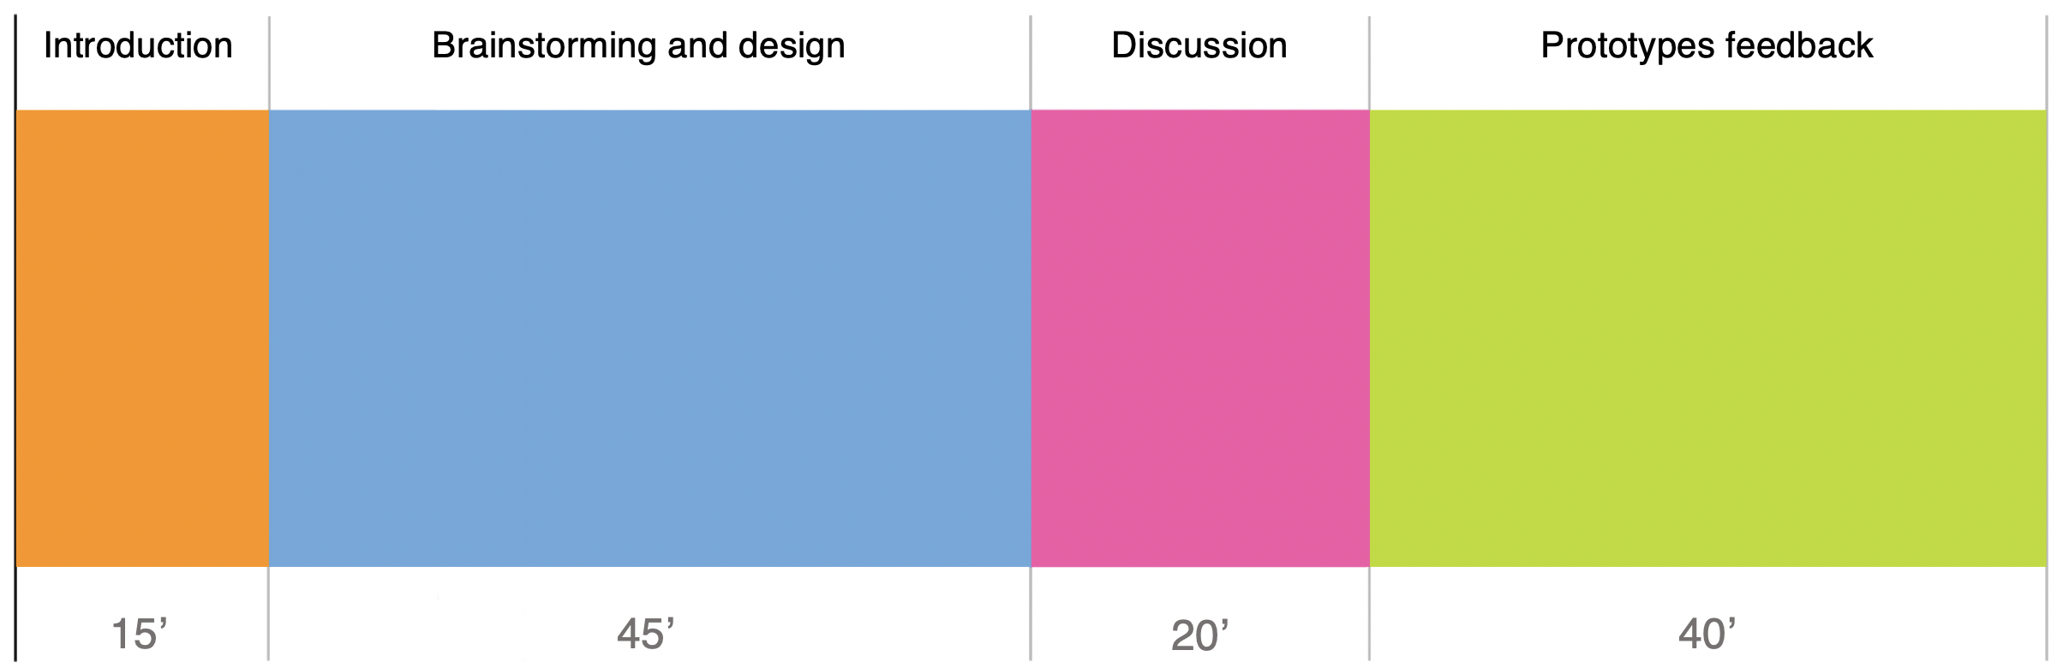
Focus group
We recruited 5 ICU physicians at the attending or fellow level, from 5 specialties
1 session, 2 hours in total:
Artifacts, field notes and audio recordings were analyzed and coded
Themes were generated by grouping data, to create a narrative
Notes:
Using descriptive coding

Slide 21
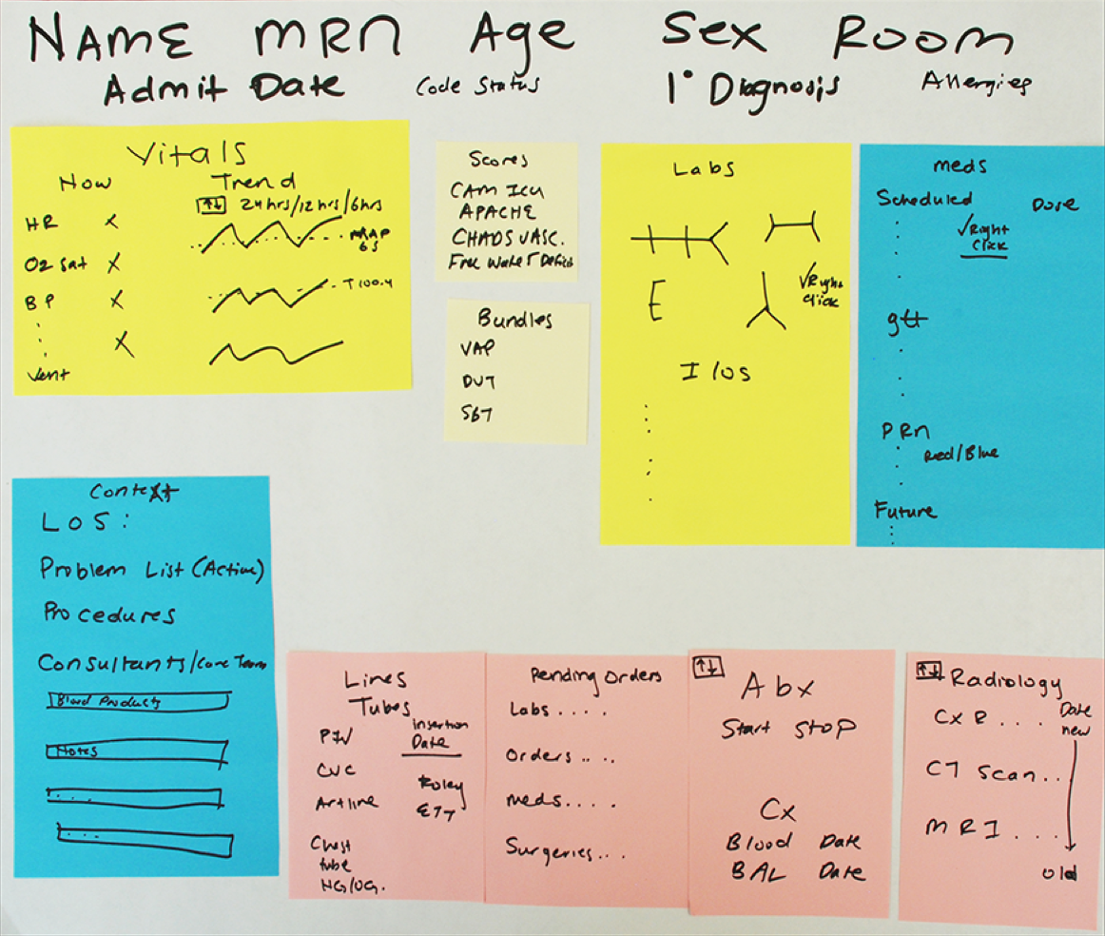
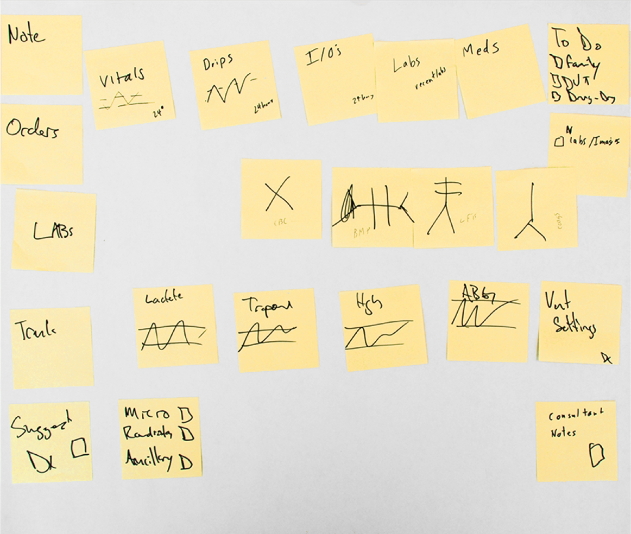
Artifacts
Group 1
Group 2

Slide 22

Focus group: results
Screen layout and contents
Two proposed layouts:
  high value data is displayed in a dedicated box
  static boxes display always important data; dynamic boxes show diagnosis-specific information
Boxes can be expanded and visualized side by side
Mouseovers provide access to trend information and customizable, diagnosis-specific views
Fishbones are used to display labs:
Unobtrusive flags highlight significant changes, trends and newly available data
Artifacts, field notes and audio recordings were analyzed and coded
Themes were generated by grouping data, to create a narrative
Notes:
Patient context information: history, physical examination, and presenting symptoms; assessment and plan, length of stay, and active problems list; links to relevant notes and consults.
New data: diagnostics, cultures, and select relevant labs.

Slide 23

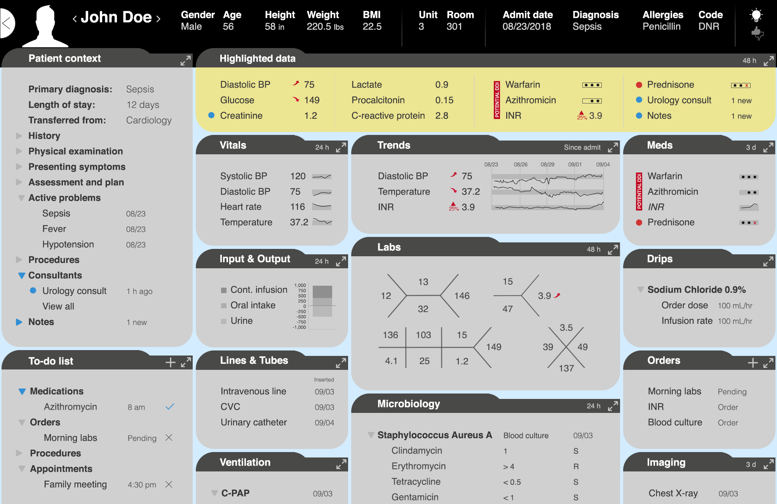
C1
Highlight area

Slide 24
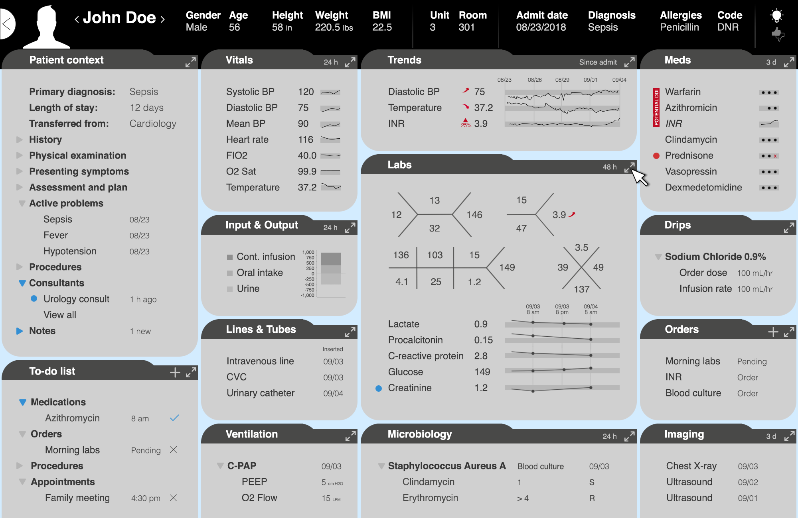
C2
Highlight in place

Slide 25
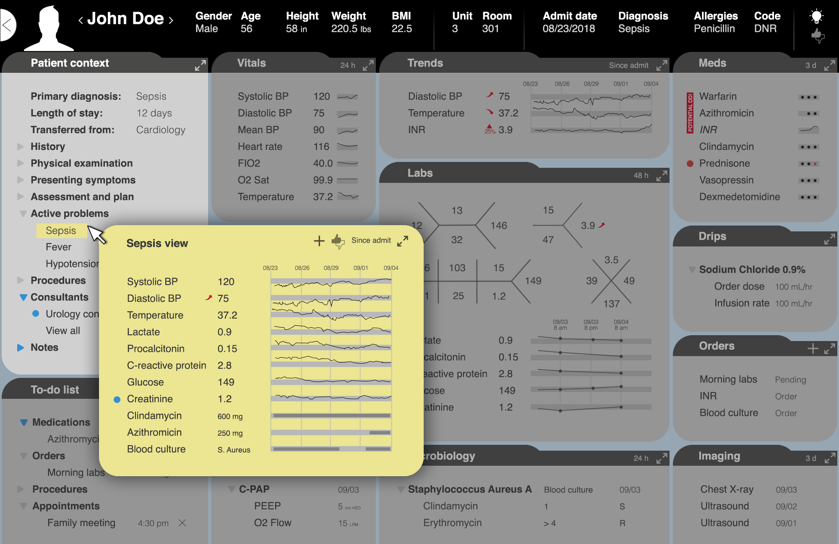
C3
Specific views

Slide 26
Focus group: results
Feedback on the Learning EMR
Unanimous support for the concept
Physicians desire mechanisms to provide feedback on the appropriateness of the highlights
Concern that over-reliance on the highlights might cause users to miss important data:
  Automation bias:
  Data not predicted to be of high value should remain easily accessible
Artifacts, field notes and audio recordings were analyzed and coded
Themes were generated by grouping data, to create a narrative
  propensity for users to favor system suggestions and to ignore contradictory information available without automation
Notes:
Patient context information: history, physical examination, and presenting symptoms; assessment and plan, length of stay, and active problems list; links to relevant notes and consults.
New data: diagnostics, cultures, and select relevant labs.

Slide 27
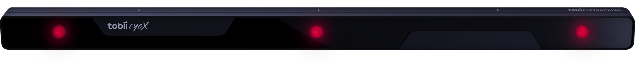
Study design
Next steps
Automation bias study
Little direct research has been conducted on EMR displays
Existing studies focus on decision support systems that provide advice on actions to be taken, not on data items to be considered
We plan to use eye-tracking to understand:
  how different highlighting modalities impact user attention allocation
  if there is any evidence of over-reliance on the highlights
  how the provision of correct and incorrect highlights affects physician performance
(Goddard et al. 2017)
Notes:
A more effective allocation of attention may be indicated by*:
shorter scanpaths
reduced number of saccades and fixations
a higher fixation/saccade ratio
reduced spatial density of gazepoints
a higher ratio of on-target vs. all-target fixations

Slide 28
Study design
Limitations
The single-center design of the study could limit the generalizability of the results
The small number of participants could limit the ability to capture the most representative feedback
Preferences expressed by participants in a focus group setting might not accurately reflect their needs in a real clinical system
Defining which changes are significant might present additional complications
Little direct research has been conducted outside of the aviation field
Existing studies focus on decision support systems that provide advice on actions to be taken, not on data items to be considered
We plan to use eye-tracking to understand:
  how different highlighting modalities impact user attention allocation
  how the provision of correct and incorrect highlights affects physician performance
Notes:
Significant changes: further study is needed to compare general definitions based on the magnitude of a change (compared to overall parameter variance) to alternative approaches, such as definitions that take specific disease mechanisms into account.

Slide 29
Study design
Advances of our work
Based on the feedback received, there is interest in pursuing the idea of a Learning EMR
Study findings provided insights into what information is relevant to ICU physicians:
We believe the design preferences and prototypes identified can usefully inform the implementation of a functional interface that provides cognitive support to ICU physicians
Little direct research has been conducted outside of the aviation field
Existing studies focus on decision support systems that provide advice on actions to be taken, not on data items to be considered
We plan to use eye-tracking to understand:
  how different highlighting modalities impact user attention allocation
  how the provision of correct and incorrect highlights affects physician performance
Notes:
Significant changes: further study is needed to compare general definitions based on the magnitude of a change (compared to overall parameter variance) to alternative approaches, such as definitions that take specific disease mechanisms into account.

Slide 30
Next steps
Final prototypes
EMR user interface
Laboratory studies:
- utility of designs
- automation bias

Slide 31
References
Manor-Shulman O, Beyene J, Frndova H, Parshuram CS. Quantifying the volume of documented clinical information in critical illness. J Crit Care 2008.
Hall A, Walton G. Information overload within the health care system: a literature review. Health Info Libr J. 2004.
Ash JS, Berg M, Coiera E. Some unintended consequences of Information Technology in health care : the nature of patient care information system-related errors. J Am Med Inf Assoc. 2004;11:104-112.
King AJ, Cooper GF, Hochheiser H, Clermont G, Visweswaran S. Development and preliminary evaluation of a prototype of a Learning Electronic Medical Record system. AMIA Annu Symp Proc. 2015; 2015.
Pickering BW, Gajic O, Ahmed A, Herasevich V, Keegan MT. Data utilization for medical decision making at the time of patient admission to ICU. Crit Care Med. 2013;41(6):1502-1510.
Kannampallil TG, Jones LK, Patel VL, Buchman TG, Franklin A. Comparing the information seeking strategies of residents, nurse practitioners, and physician assistants in critical care settings. J Am Med Informatics Assoc. 2014:1-8.
Kannampallil TG, Franklin A, Mishra R, Almoosa KF, Cohen T, Patel VL. Understanding the nature of information seeking behavior in critical care: Implications for the design of health information technology. Artif Intell Med. 2013;57(1):21-29.
Pollack AH, Tweedy CG, Blondon K, Pratt W. Knowledge crystallization and clinical priorities: evaluating how physicians collect and synthesize patient-related data. AMIA Annu Symp Proc. 2014; 2014.
Furniss D, Masci P, Curzon P, Mayer A, Blandford A. Exploring medical device design and use through layers of Distributed Cognition: how a glucometer is coupled with its context. J Biomed Inform. 2015;53:330-341.
Holden R. Cognitive Performance-Altering Effects of Electronic Medical Records: an Application of the Human Factors Paradigm for Patient Safety. Cogn Technol Work. 2011;13(1):11-29. doi:10.1007/s10111-010-0141-8.

Slide 32
References
Pollack AH, Miller A, Mishra SR, Pratt W. PD-atricians: leveraging physicians and Participatory Design to develop novel clinical information tools. AMIA Annu Symp Proc. 2016; 2016.
Ware C. Information Visualization; 2013. doi:10.1016/B978-0-12-381464-7.00016-8.
Pickering BW, Herasevich V, Ahmed A, Gajic O. Novel representation of clinical information in the ICU: developing user interfaces which reduce information overload. Appl Clin Inform. 2010.
Wang T, Wongsuphasawat K. Visual information seeking in multiple electronic health records: design recommendations and a process model. Int Heal. 2010:46-55.
Armijo D, McDonnell C, Werner K. Electronic Health Record usability: interface design considerations. Development. 2009;9(9):1-21.
Hu J, Perer A, Wang F. Data Driven Analytics for Personalized Healthcare. Cham: Springer International Publishing; 2016.
Senathirajah Y, Kaufman D, Bakken S. Beyond copy and paste: clinician approaches to meeting information needs during note writing. Stud Health Technol Inform. 2014.
Kannampallil TG, Franklin A, Mishra R, Almoosa KF, Cohen T, Patel VL. Understanding the nature of information seeking behavior in critical care: implications for the design of health information technology. Artif Intell Med. 2013;57(1):21-29.
Bier EA, Card SK, Bodnar JW. Principles and tools for collaborative entity-based intelligence analysis. IEEE Trans Vis Comput Graph. 2010;16(2):178-191.
Bade R, Schlechtweg S, Miksch S. Connecting Time-oriented Data and Information to a Coherent Interactive Visualization. Proc 2004 Conf Hum factors Comput Syst CHI 04. 2004;6(1):105-112.
Halbesleben JRB, Savage GT, Wakefield DS, Wakefield BJ. Rework and workarounds in nurse medication administration process. Health Care Manage Rev. 2010;35(2):124-133

Slide 33

Acknowledgments
Learning EMR Team Members:
Dr. Harry Hochheiser, PhD
Dr. Gilles Clermont, MD MSc
Dr. Gregory F. Cooper, MD PhD
Dr. Shyam Visweswaran, MD PhD
Dr. Andrew King, PhD
Amin Tajgardoon, MS
Louisa Zhang, MS
Funding sources:
NLM Institutional Training Grant T15 LM007059
NLM Research Project Grant R01 LM012095
University of Pittsburgh Department of Biomedical Informatics

Slide 34

Thank you
Luca Calzoni
lucacalzoni@lucacalzoni.us

Slide 35
Additional material

Slide 36
Study design
Poor user interfaces
EMRs, conceived as accounting tools, are “database centered”: the data source determines how data is presented
Information is traditionally fragmented across multiple screens
Many commercial EMRs have limitations in graphing capabilities of clinical data
Display fragmentation in a commercial EMR
37 clicks required to access data items in black
(Wright et al. 2016, Faiola et al. 2015, De Georgia et al. 2015, Pickering et al. 2010, Senathirajah et al. 2017)

Slide 37
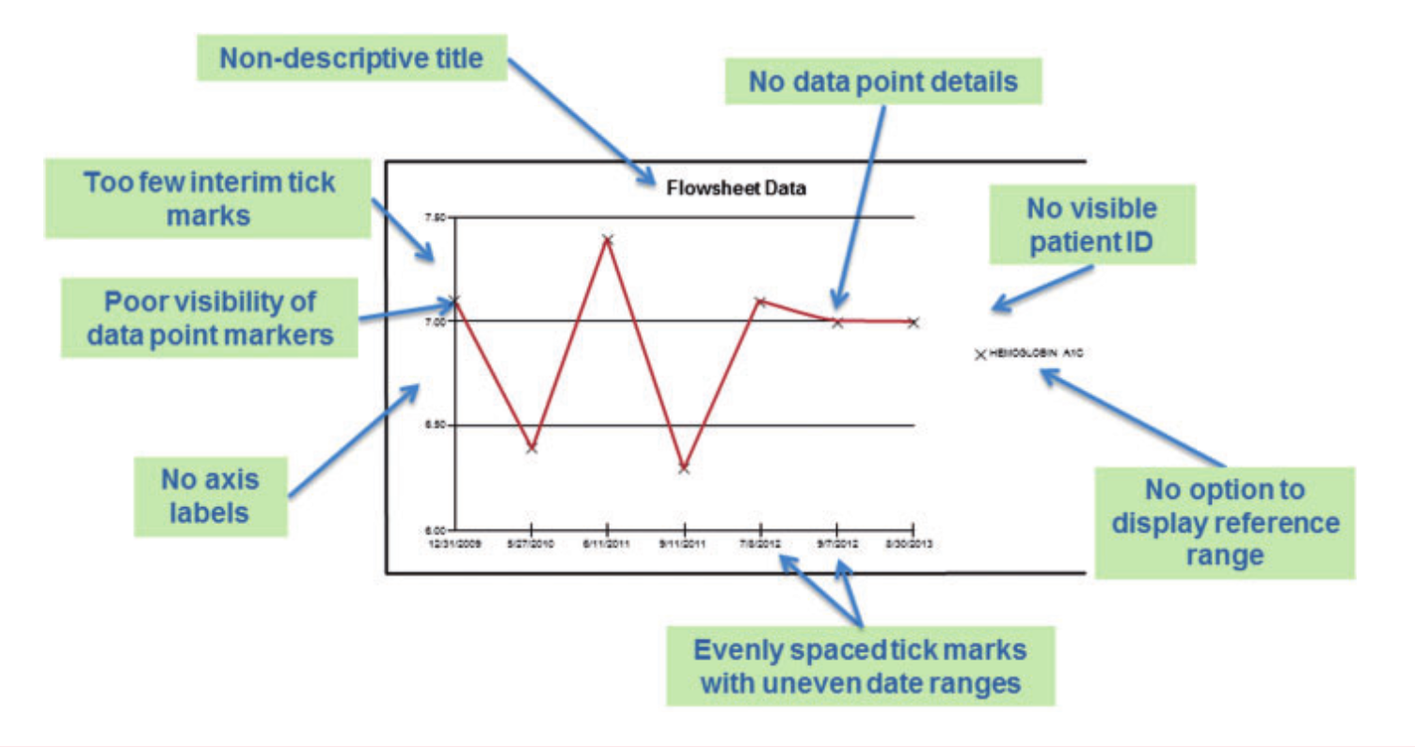
Study design
Poor user interfaces
A study evaluated the graphical displays of lab tests in 8 EMRs using criteria for optimal graphs: none of the EMRs met all criteria.
Many EMRs displayed results in non-standardized fashion:
(Sittig et al. 2015)

Slide 38
Study design
Traditional approaches
Literature review
Attempts at designing interfaces that provide cognitive support to clinicians include:

Slide 39
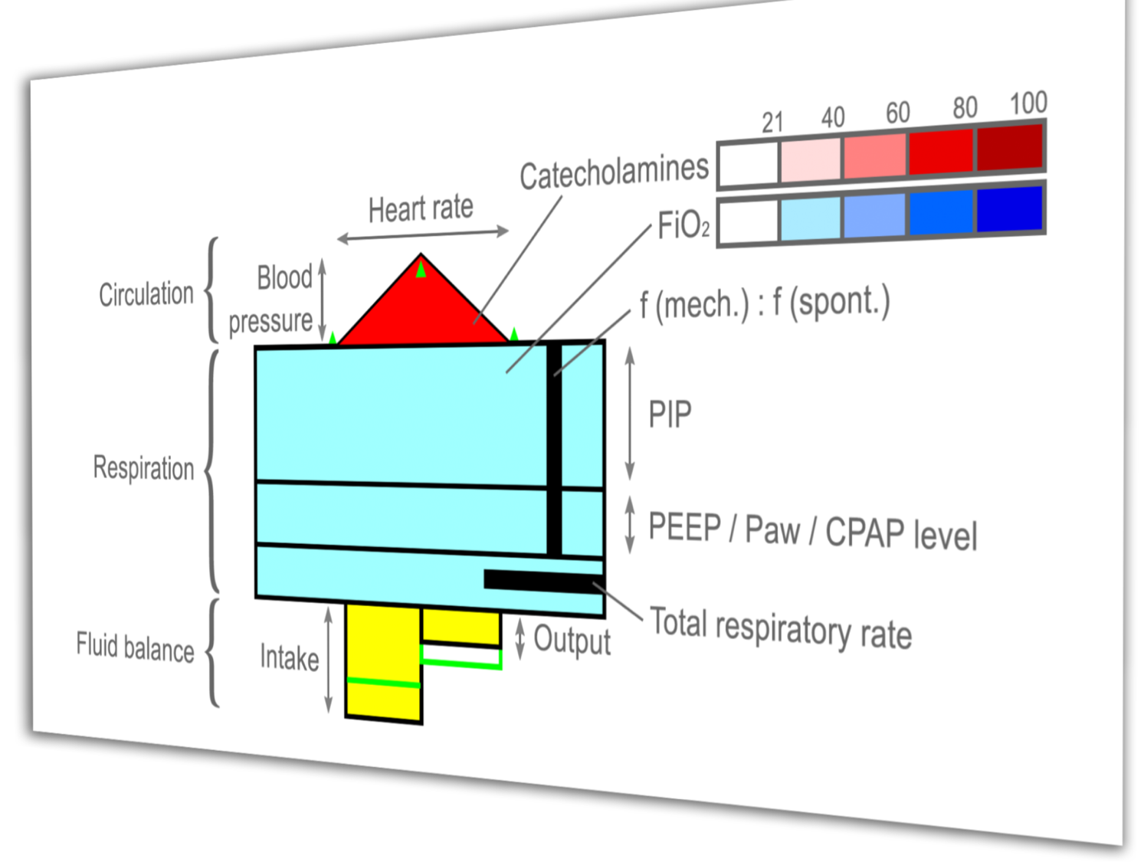
Study design
Traditional approaches
Literature review
Attempts at designing interfaces that provide cognitive support to clinicians include:
encoding health parameters to visual attributes (color, shape)
VIE-VISU, 2001
The width of the triangle’s base shows the heart rate, the height shows the blood pressure.
(Horn et al. 2001)

Slide 40
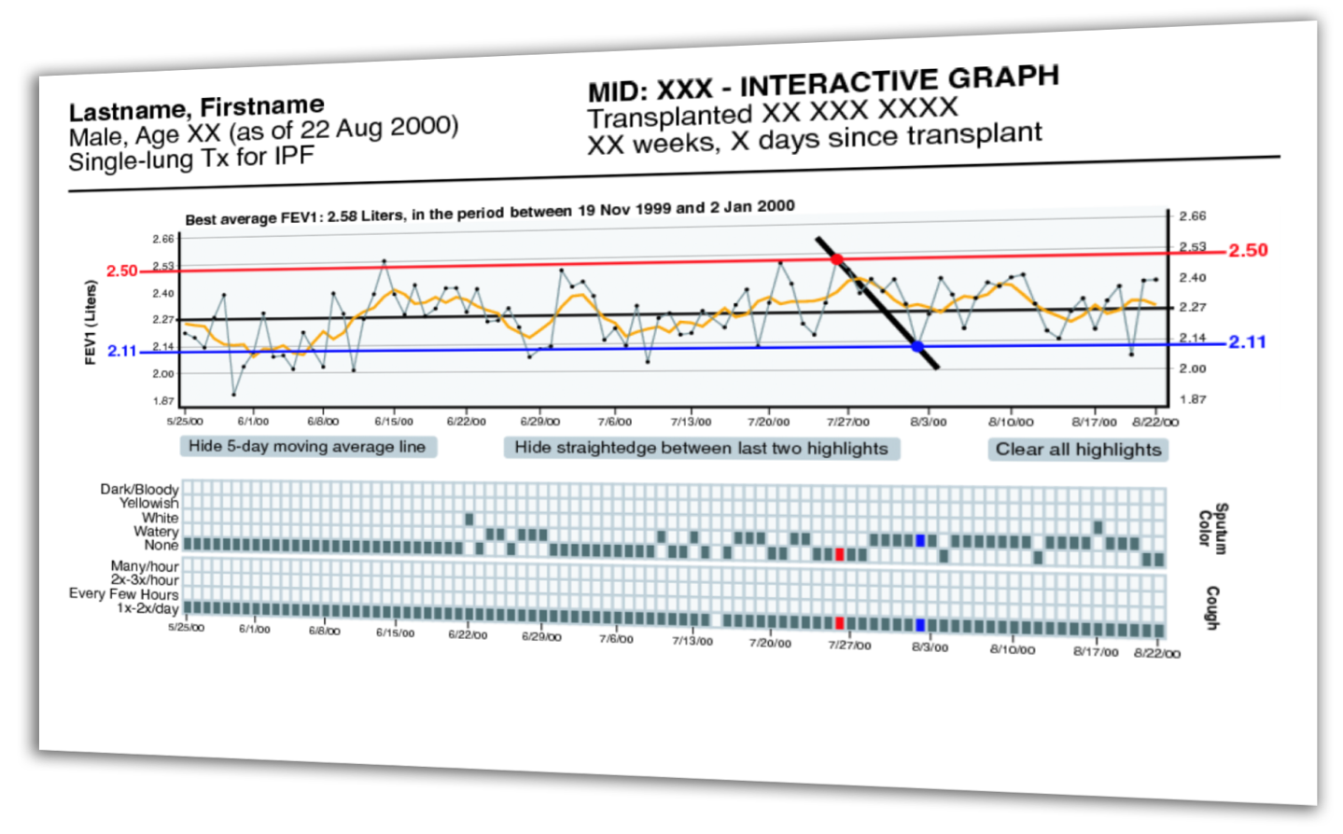
Study design
Traditional approaches
Literature review
Attempts at designing interfaces that provide cognitive support to clinicians include:
encoding health parameters to visual attributes (color, shape)
visual highlighting of key data, such as trends and changes
WBIVS, 2007
Five-day average lines highlight trends.
(Pieczkiewicz et al. 2007)

Slide 41
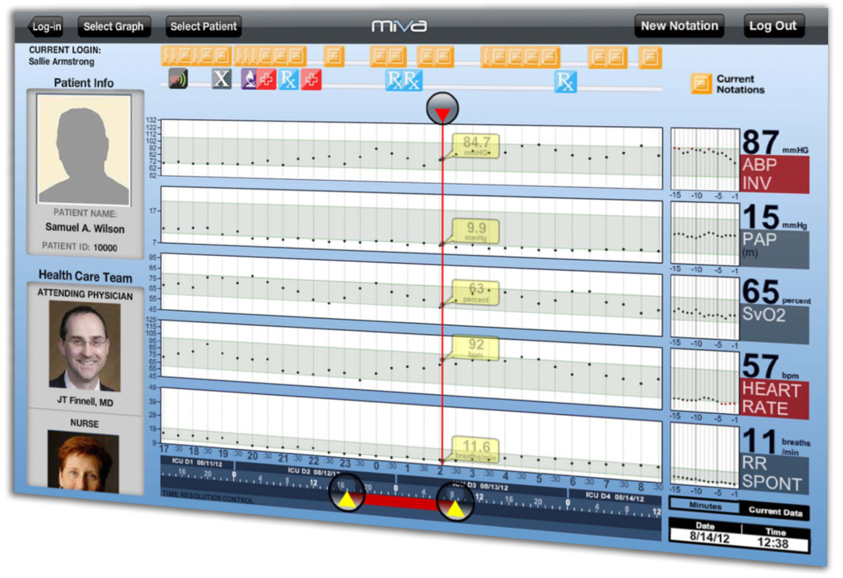
Study design
Traditional approaches
Literature review
Attempts at designing interfaces that provide cognitive support to clinicians include:
encoding health parameters to visual attributes (color, shape)
visual highlighting of key data, such as trends and changes
summary views aggregating data from different sources
MIVA, 2011
In this visualization system for ICUs, many parameters are combined into one view.
(Faiola et al. 2011)

Slide 42
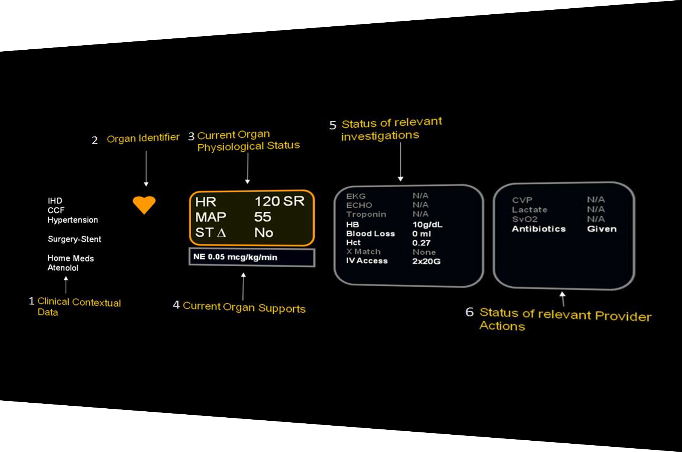
Study design
Traditional approaches
Literature review
Attempts at designing interfaces that provide cognitive support to clinicians include:
encoding health parameters to visual attributes (color, shape)
visual highlighting of key data, such as trends and changes
summary views aggregating data from different sources
organizing data around clinical concepts or by organ system
AWARE, 2010
Data items are organized into color-coded physiological systems.
(Pickering et al. 2010)
Notes:
Many of the these visualization strategies have been demonstrated to reduce cognitive load and medical errors. However, they are not commonly used in healthcare.

Slide 43
Study design
Traditional approaches
Literature review
AWARE is a clinical decision support system that reduces information overload by filtering for relevant patient data
A study compared outcomes before and after AWARE implementation using a prospective cohort and a historical control, showing decreases in:
ICU length of stay (-50%)
hospital length of stay (-37%)
total charges for hospital stay (-30%)
incidence of cognitive errors (-50%)
AWARE, 2010
Data items are organized into color-coded physiological systems.
(Pickering et al. 2010)
Notes:
Many of the these visualization strategies have been demonstrated to reduce cognitive load and medical errors. However, they are not commonly used in healthcare.

Slide 44
Participants
Healthcare facility
Presbyterian Hospital Surgical ICU | 2
Presbyterian Hospital Trauma ICU | 1
Children’s Hospital Pediatric ICU | 1
Mercy Hospital Cardiovascular ICU | 1
Chart review observations
Total observations | 5
Unique patient charts reviewed | 55
Average unique patient charts reviewed | 11
ICU team role
Fellows | 5
Gender
Male | 2
Female | 3
Age
Minimum | 31
Average | 32
Maximum | 33
Years in clinical practice
Minimum | 4
Average | 5.4
Maximum | 7

Slide 45
Cognitive processes
Prioritization factors
Clinical and non-clinical prioritization factors
Severity
Clinical
Unexpected changes
Diagnosis
Problem (e.g.: troubleshooting machine)
Patient location in the room
Non-clinical
Social dynamics
Familiarity with patient conditions
(Adapted from: Pollack et al. 2014)

Slide 46
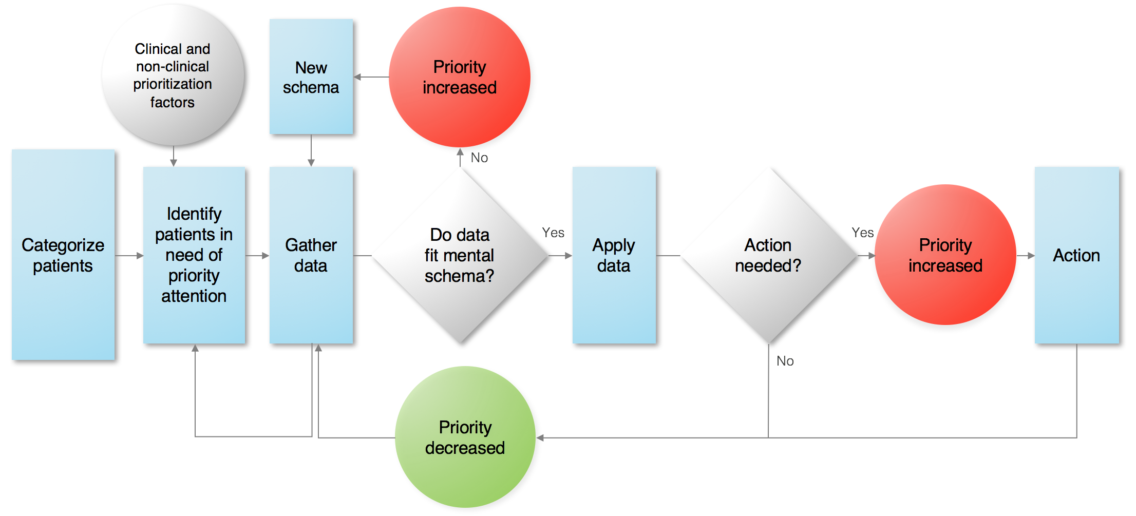
Cognitive processes
Unified process model
(Adapted from: Pollack et al. 2014)

Slide 47
Participants
Gender
Male | 3
Female | 2
Age
Minimum | 30
Average | 31
Maximum | 32
Years in clinical practice
Minimum | 4
Average | 5.6
Maximum | 8
Healthcare facility
UPMC Presbyterian Hospital | 5
UPMC Shadyside Hospital | 3
UPMC Mercy Hospital | 2
VA Pittsburgh Health System | 1
Medical specialty
Critical Care Medicine | 2
Pulmonary & Critical Care Medicine | 1
Emergency Medicine & Critical Care Medicine | 1
Surgery & Critical Care Medicine | 1
ICU team role
Fellows | 5

Slide 48
Limitations
→
Conducting the study in a single location could limit the generalizability of the results.
→
The presence of a researcher observing the physicians may have some influence on their behavior.
→
Focus groups stimulate discussion, but might be unbalanced due to different levels of professional experience.
→
The small number of observed users could limit the ability to capture every workflow pattern.
→
Preferences expressed by participants in a non-clinical setting might not accurately reflect their needs in a real clinical system.

Slide 49
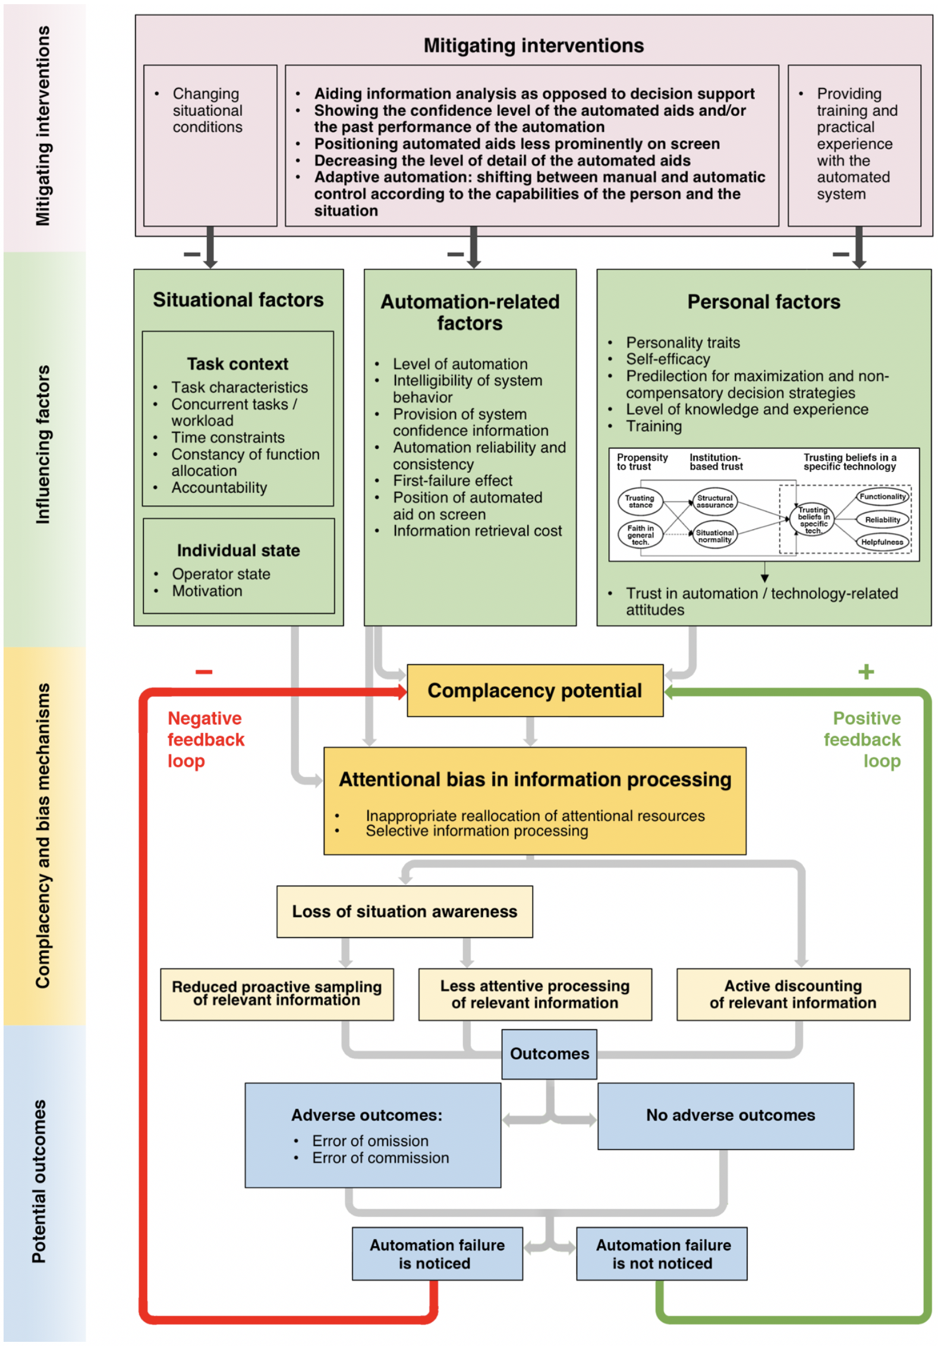
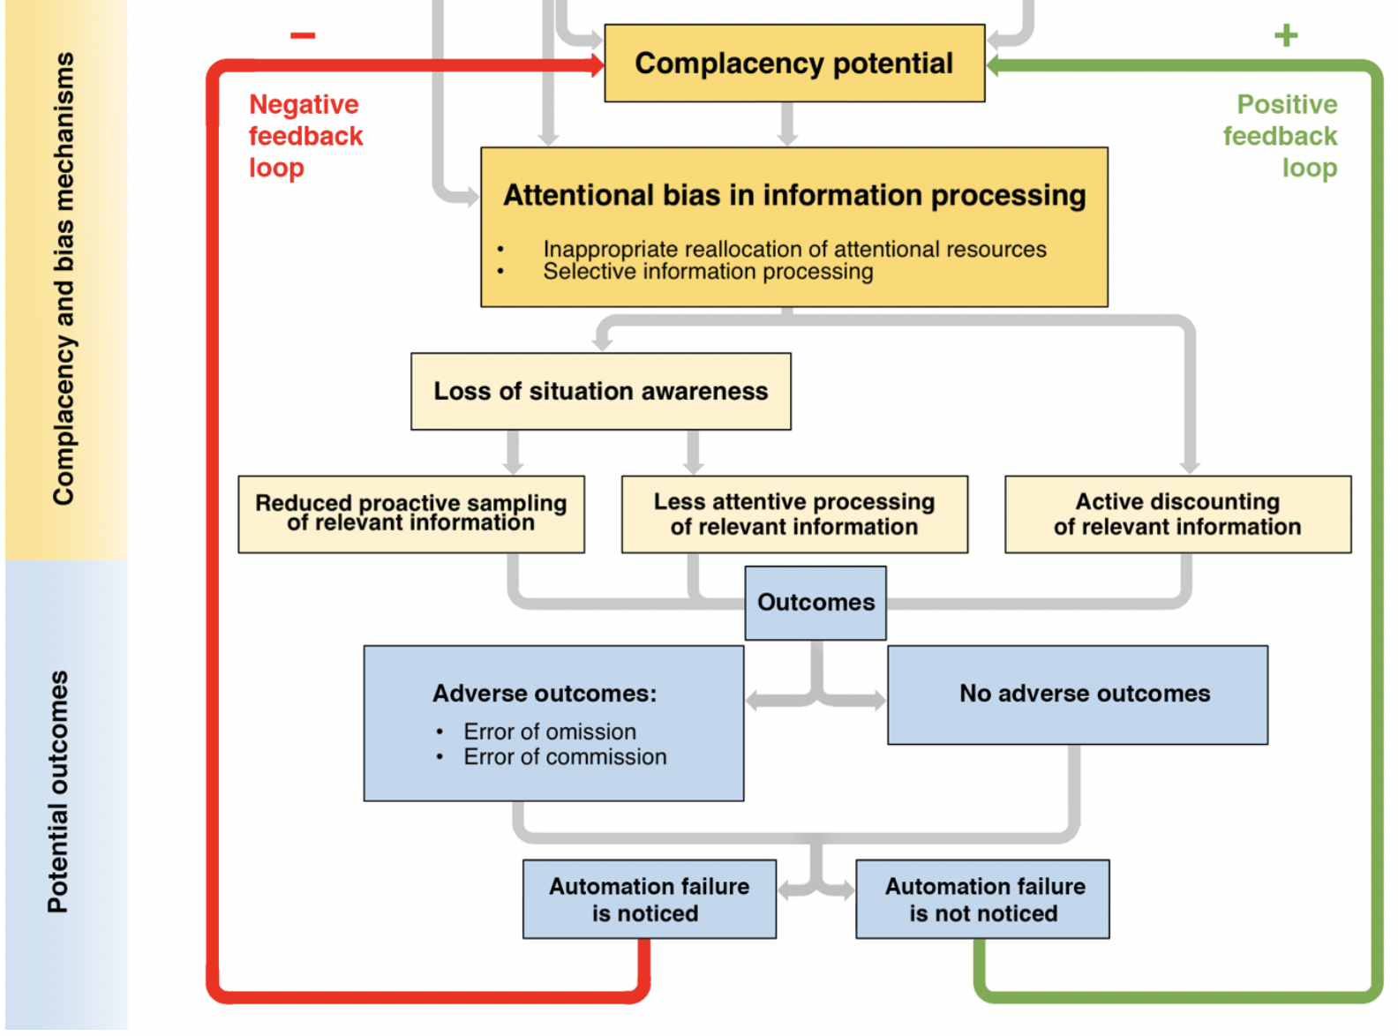
Study design
Automation bias
A unified theoretical framework
Ad. from: Parasuraman et al., 2010

Slide 50
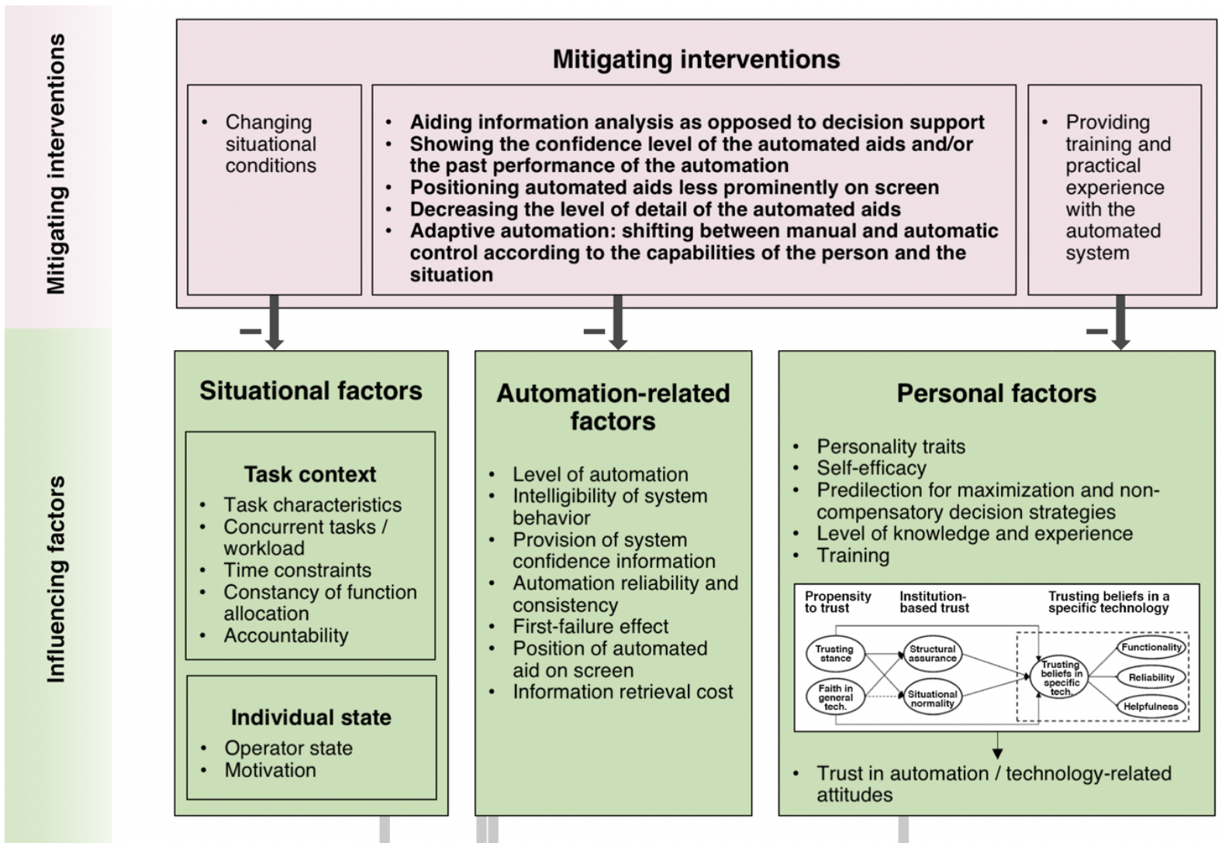
Study design
Automation bias
A unified theoretical framework
Ad. from: Parasuraman et al., 2010

Slide 51
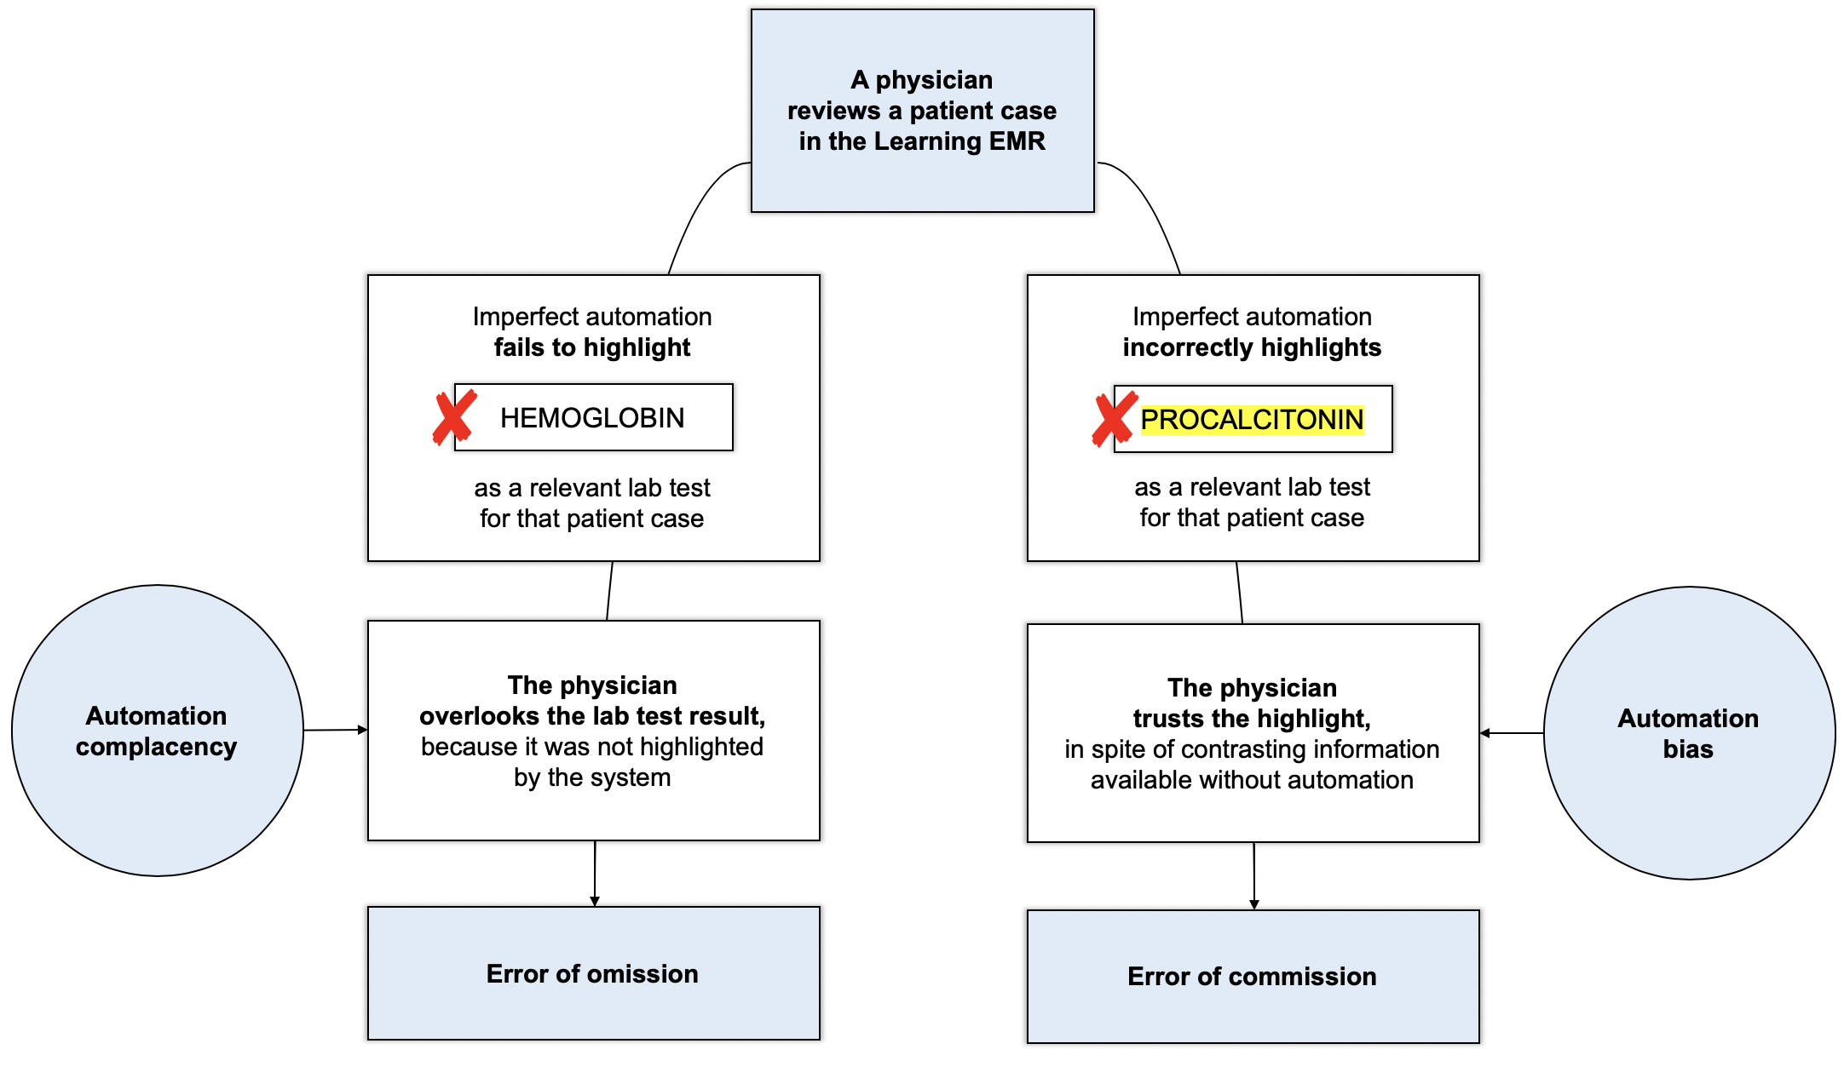
Study design
Automation bias
Example scenario
Automation complacency
vs.
automation bias

Slide 52
Study design
Automation bias study
  For each patient case, we will select:
  up to 16* lab test results, relevant to understanding
  that patient’s condition
  some** relevant labs that will NOT be highlighted and some** NON-relevant labs that WILL be highlighted in part of the scenarios in the Automation Bias study
Learning EMR prototype
Eye-tracking device
Clinical scenarios
* Upon consideration of the average number of data items that physicians deemed
as relevant to understanding each patient case in our previous study.
** Upon consideration of both power analysis calculations, and the need to avoid
making users become aware of the system’s unreliability (Goddard et al., 2014).

Slide 53
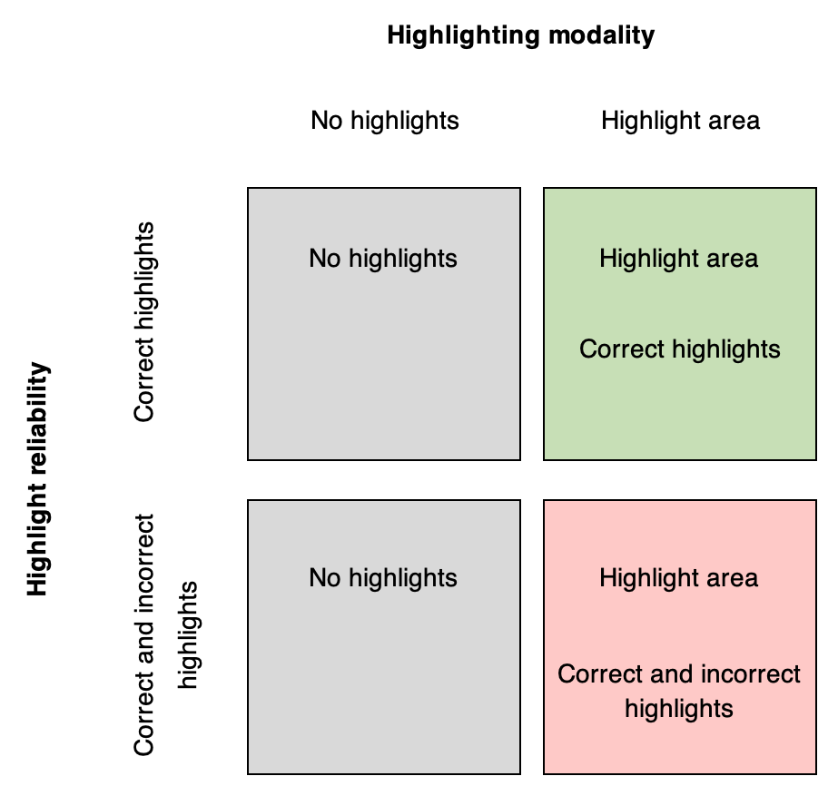
Study design
Automation bias study
Study design:
within-participant design, with two within-subject factors:

