Slide 1
Machine learning to highlight relevant patient information in the EMR
Shyam Visweswaran, MD, PhD
Department of Biomedical Informatics
University of Pittsburgh
HSPC
7 October 2019

Slide 2
Electronic Medical Records (EMRs)
Contain massive amounts of healthcare data
1,400 new data points per patient per day¹
4,000 mouse clicks in a 10-hour shift²
Can result in information overload³ and increase cognitive burden on physicians⁴
Can lead to patient safety concerns⁵
Missed test results^{3,6}
Treatment delays⁷
1. Manor-Shulman et al. J Crit Care 2008; 2. Hill et al. Am J Emerg Med. 2013; 3. Singh et al. Jama Intern Med. 2013; 4. American Medical Association. 2014; 5. Meeks et al. JAMIA 2014; 6. Callen et al. BMJ Qual Saf. 2011; 7. Wahls et al. BMC Fam Pract. 2007.

Slide 3
Cognitive overload in EMRs
Reducing cognitive workload as a top priority in improving EMR usability (American Medical Association)
EMRs should:
Support medical-decision making
Should be context sensitive
Data relevant to the condition of the patient
Data relevant to the user and setting

Slide 4
What is a learning electronic medical record (LEMR) system?
It is an electronic medical record (EMR) system that:
captures information on what patient data are considered relevant by physicians
and uses that information to improve future display of data in the EMR.
Goal of a LEMR system is to draw the physician’s attention to the right data of the right patient at the right time.

Slide 5
Rule-based approach: AWARE
[8. Pickering et al. Appl. Clin. Inform. 2010.]
Data relevant to patient condition is highlighted

Slide 6
Rule-based approach
Systems like AWARE are context sensitive and use rules to provide this functionality
Construction of rules is difficult and time consuming
It is not scalable to build EMRs that rely on rules

Slide 7
Data-driven approach: the Learning EMR (LEMR) system
Goal is to build a LEMR system that displays relevant data for the current patient case
Relevant data is something that we can learn to predict
We make predictions using machine learning models
The training data for developing models is the data in the EMR system that many physicians considered relevant for many different patient cases

Slide 8
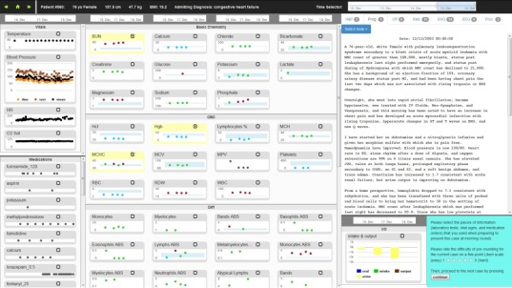
How do we build the LEMR system?
Supervised machine learning problem
Training data consists of EMR data and data that is considered relevant
Obtain EMR data
P=$\frac{e^{a+bX}}{1+e^{a+bX}}$
Train
Apply
Collect patient data that is considered relevant
Models
Predict data physician wants to view

Slide 9
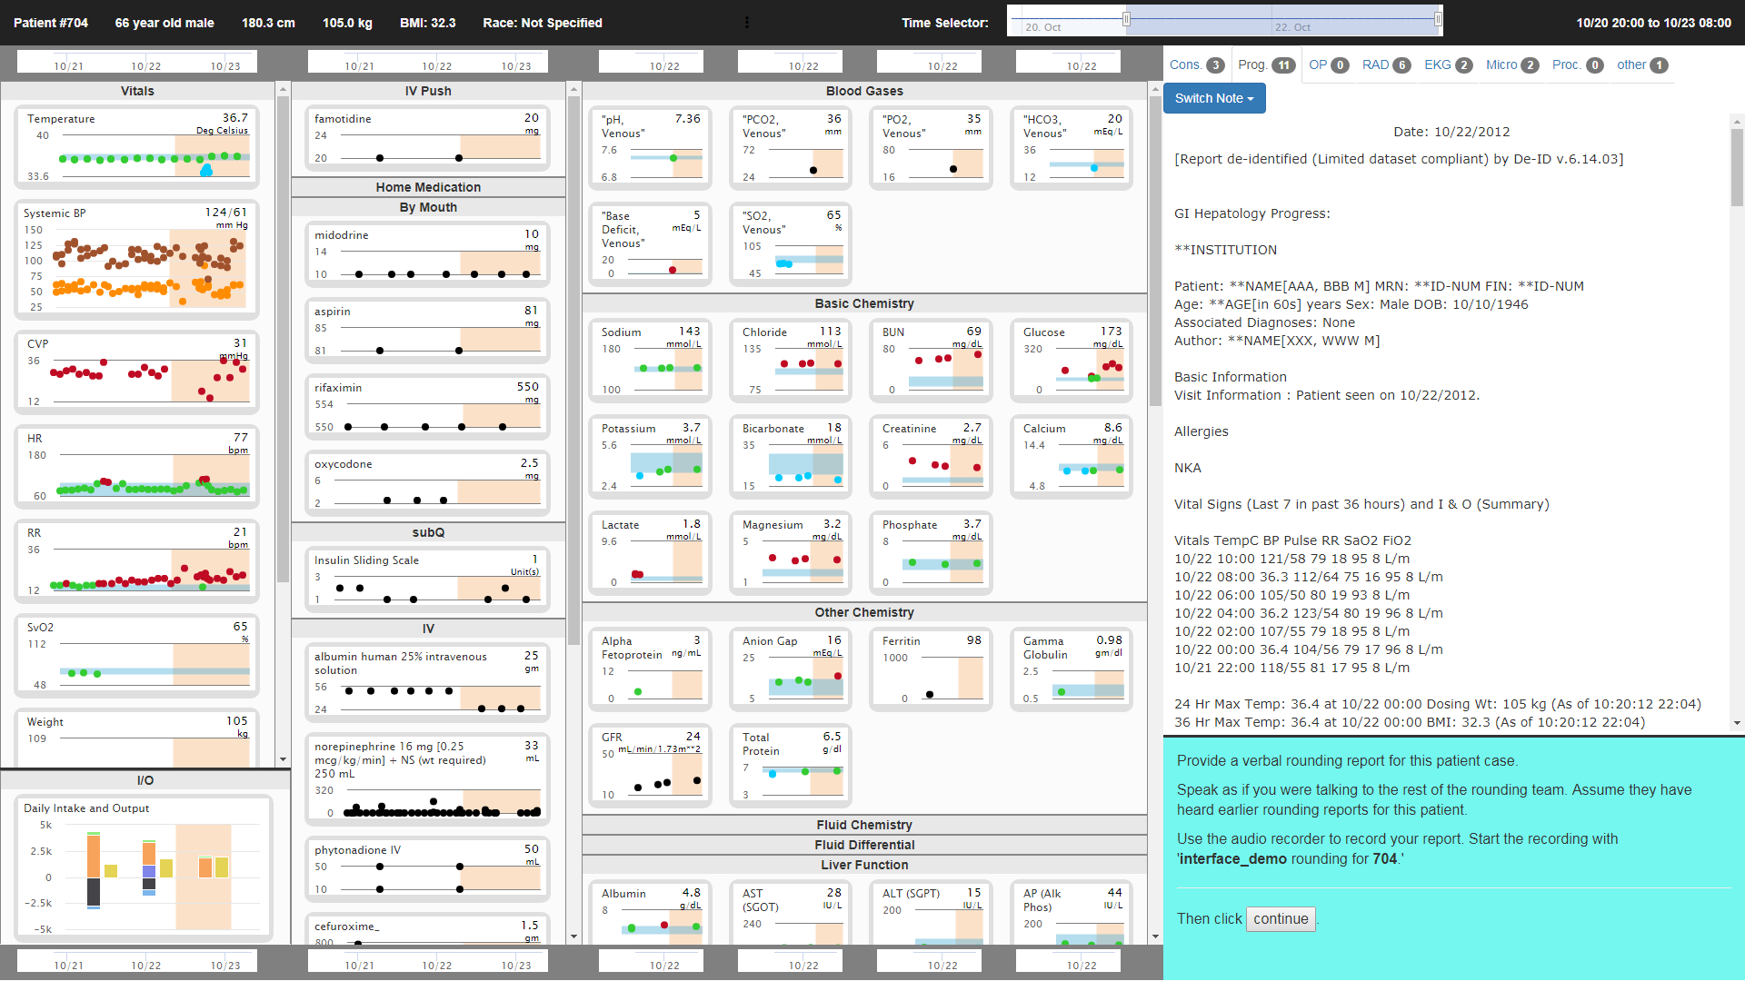
LEMR display

Slide 10
LEMR display
Demographics
Time range currently displayed across all data fields
Vitals and vent settings
Medications
(grouped
by route)
Laboratory test results
(grouped by type)
Free text data:
Notes, reports, & procedures
(grouped by tabs)
ICU Admission
Current time
Slide to change displayed range
Your tasks and navigation
Intake/output

Slide 11
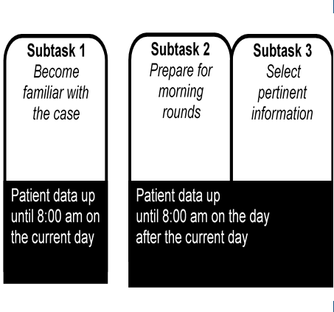
Protocol for obtaining targets

Slide 12
Targets: Before selections

Slide 13
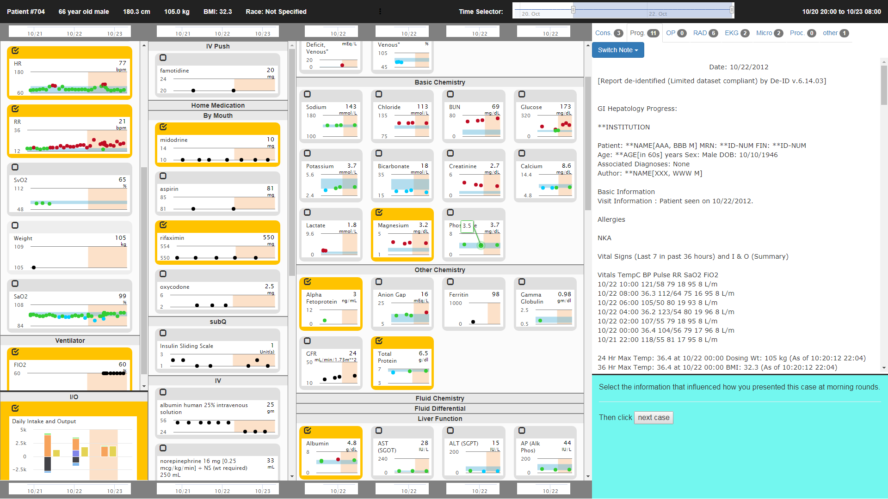
Targets: After selections

Slide 14
Training data representation
patient data
targets
Diagnoses
Diagnosis | cirrhosis
Age | 47
Sex | female
BUN | 39
Hemoglobin | 10.1
SGPT | 107
SGOT | 48
Bili, Total | 1.4
Metoprolol | 200
Diagnosis | cirrhosis
Age | 47
Sex | female
BUN | 39
Hemoglobin | 10.1
SGPT | 107
SGOT | 48
Bili, Total | 1.4
Diagnosis | cirrhosis
Diagnosis | cirrhosis
Age | 47
Sex | female
Diagnosis | cirrhosis
Age | 47
Sex | female
BUN | 39
Hemoglobin | 10.1
SGPT | 107
SGOT | 48
Bili, Total | 1.4
Metoprolol | 200
…
1
0
0
1
1
1
1
0
0
…
Demographics
Lab test results
Medications
Vital signs
Procedures
etc.
Mrs. Jones
Dr. A

Slide 15
Training data representation
Data on many patients with and corresponding targets constitute the training data
Obtained from EMR
patient data
targets
Diagnoses
Diagnosis | cirrhosis
Age | 47
Sex | female
BUN | 39
Hemoglobin | 10.1
SGPT | 107
SGOT | 48
Bili, Total | 1.4
Metoprolol | 200
…
1
0
0
1
1
1
1
0
0
…
Diagnosis | GI medical
Age | 27
Sex | male
BUN | 21
pHa | 7.32
Hematocrit | 55
INR | 1.1
PT | 12.7
Haloperidol | 2.5
…
1
0
0
1
1
1
0
0
0
…
Collected from physicians
Demographics
Diagnosis | Trauma
Age | 49
Sex | female
Sodium | 140
Calcium | 7.8
Magnesium | 1.7
RBC | 2.43
WBC | 6
Platelets | 418
…
1
0
0
1
0
0
1
0
1
…
Diagnosis | CABG
Age | 62
Sex | male
Sodium | 138
Potassium | 5.5
Hemoglobin | 16
RBC | 5.34
INR | 1
IV heparin | 1000
…
1
0
0
1
1
0
0
1
1
…
Diagnosis | Valve surg.
Age | 77
Sex | male
Phosphate | 14
Sodium | 135
Potassium | 12
PT | 14.2
PO2 | 70
Mg dose | 2
…
0
1
1
1
1
1
0
0
0
…
Diagnosis | GI medical
Age | 71
Sex | female
Glucose | 89
PTT | 43
Potassium | 3.8
SGPT | 17
SGOT | 18
IV Heparin | 0
…
1
1
0
0
1
0
0
0
1
…
Diagnosis | Hepatic fail.
Age | 46
Sex | male
BUN | 48
RDW | 13.5
WBC | 5.9
INR | 2.6
PT | 28.4
n-acetylcysteine | 6.65
…
1
0
0
1
0
0
1
1
1
…
Diagnosis | CABG
Age | 54
Sex | male
BUN | 14
GFR | 135
Creatinine | 0.8
Hemoglobin | 7.0
Glucose | 285
Insulin dose | 8
…
0
1
0
0
0
0
1
1
1
…
Lab test results
Medications
Vital signs
Procedures
etc.
Mr. Benton
Dr. B
Mrs. Kern
Dr. B
Mr. Carroll
Dr. B
Mr. Lewis
Dr. A
Mrs. Ross
Dr. C
Mr. Smith
Dr. C
Mr. Stark
Dr. A

Slide 16
Training data
11 clinician participants
A total of 178 cases reviewed
Cases had a diagnosis of acute kidney failure or acute respiratory failure
Predictive variables:
Demographics, laboratory tests, vital signs, ventilator settings, medication orders.
Imputed missing values with median or regression
ICU fellows & faculty manually provided targets

Slide 17
Machine learning models
For each lab, medication, vital, ventilator setting to predict, we built a separate model
We applied several machine learning algorithms such as penalized logistic regression, random forests, and support vector machines
We report area under the Receiver Operating Curve (AUROC) as the performance metric

Slide 18
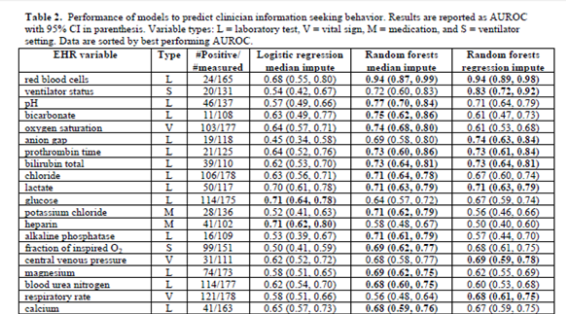
Results: AUROCs on training data

Slide 19
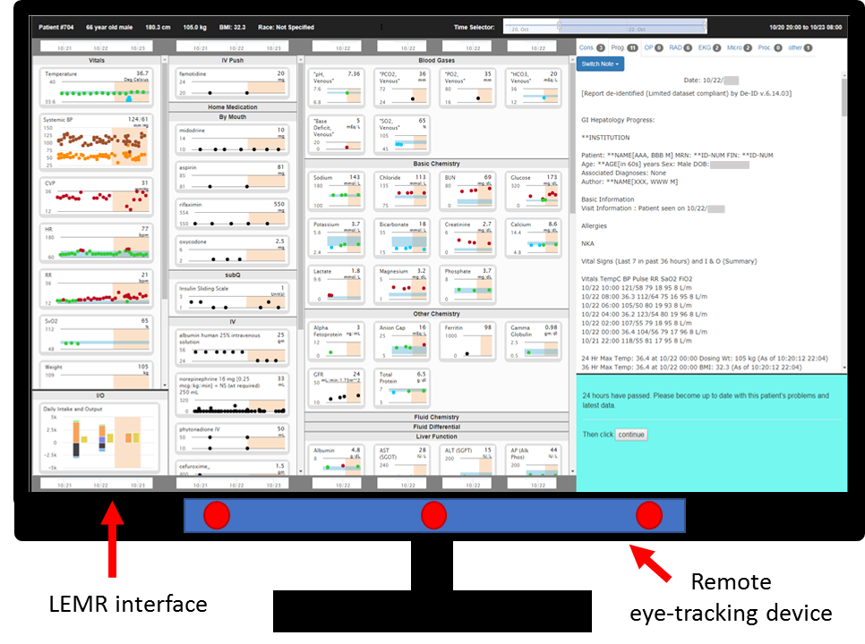
Obtaining targets using eye-tracking

Slide 20
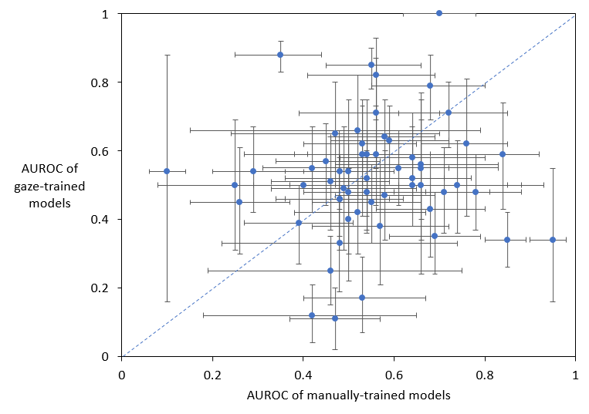
Performance of eye-tracking models
Wilcoxon signed rank test W = 935, p-value = 0.13

Slide 21
Conclusions
We have developed a prototype Learning EMR (LEMR) system that learns how to predict and highlight data that a physician is likely to view
Results show that the models have promising performance
More data is needed to train more models and to have better performance
A key challenge in developing machine learning models for LEMR is the high cost of obtaining targets
One potential solution is to use eye-tracking to obtain large amounts of labels
King AJ, Cooper GF, Clermont G, Hochheiser H, Hauskrecht, M, Sittig DF, Visweswaran S. Using machine learning to selectively highlight patient information. Journal of Biomedical Informatics (in press).
King AJ, Cooper GF, Clermont G, Hochheiser H, Hauskrecht, M, Sittig DF, Visweswaran S. Harnessing eye tracking to selectively highlight patient information. JMIR (in review).

Slide 22
Acknowledgements
The LEMR project members:
Shyam Visweswaran (PI, Biomedical Informatics))
Gregory Cooper (Biomedical Informatics)
Harry Hochheiser (Biomedical Informatics)
Gilles Clermont (Critical Care)
Milos Hauskrecht (Computer Science)
Dean Sittig (Clinical Informatics, UTHealth)
Titus Schleyer (Biomedical Informatics, Regenstrief Institute
Andy King (post-doctoral trainee)
Luca Calzoni (DBMI doctoral student)
Funding support:
NLM R01LM012095

Slide 23
Shyam Visweswaran, MD, PhD
shv3@pitt.edu
www.thevislab.com
[commons.wikipedia.com]

