Slide 1
Contextualized drug-drug interaction decision support
Richard D Boyce, PhD
19th General Meetings of HSPC/CIIC
10/7/19

Slide 2
Potential drug-drug interactions (PDDIs)
Exposure two or more drugs that are known to interact
“potential” because exposure does not necessarily mean a clinically meaningful effect
Exposure is very common
33% of general hospital patients and 67% of ICU patients [1]
1. Zheng WY, Richardson LC, Li L, Day RO, Westbrook JI, Baysari MT. Drug-drug interactions and their harmful effects in hospitalised patients: a systematic review and meta-analysis. Eur J Clin Pharmacol. 2018 Jan;74(1):15-27. doi: 10.1007/s00228-017-2357-5. Epub 2017 Oct 23. Review. PubMed PMID: 29058038.

Slide 3
Clues about the frequency of harm
Clinically important events attributable to drug-drug interactions [1]:
5.3% - 14.3% of inpatients
231,000 US emergency department visits
Hospital admissions associated with an adverse drug event attributable to drug-drug interactions [2]:
22.2% (interquartile range 16.6 - 36.0%)
Magro L, Moretti U, Leone R. Epidemiology and characteristics of adverse drug reactions caused by drug-drug interactions. Expert Opin Drug Saf. 2012;11(1):83-94. doi:10.1517/14740338.2012.631910
Dechanont S, Maphanta S, Butthum B, Kongkaew C. Hospital admissions/visits associated with drug-drug interactions: a systematic review and meta-analysis. Pharmacoepidemiol Drug Saf. 2014;23(5):489-497. doi:10.1002/pds.3592.

Slide 4
“When the Holes Line Up”
A + B
Prescriber’s Knowledge
Computer Screening
Pharmacist’s Knowledge
Patient Risk Factors
Drug Administration
Patient Education
Monitoring
Defenses
ADR
Latent Failures
Hansten PD, Horn JR. Modified from: James Reason, Human Error, 1990

Slide 5
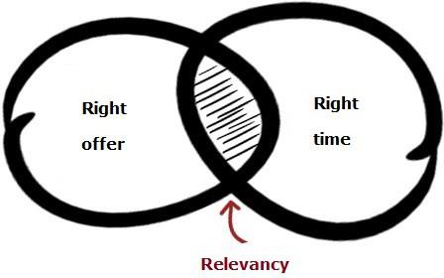
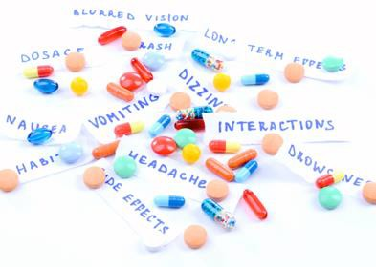
Harm from Exposure to PDDIs
… can be mitigated by clinical decision support (CDS)
with the relevant
reference information
presented
at appropriate times
Intelligently filtered

Slide 6
The PDDI CDS information paradox
https://www.redcanary.com/blog/alert-fatigue-how-to-tune-out-the-noise/
Clinicians want accurate and actionable PDDI information but…
…PDDI CDS systems often contribute to alert fatigue

Slide 7
Key point
PDDI CDS systems have high sensitivity but poor specificity. Specificity can be improved by contextualizing alerts to each patient case.

Slide 8
Example of need for Contextualization
Warfarin PDDIs:
Warfarin and Non-steroidal anti-inflammatory drugs (NSAID)
Warfarin and antidepressants
Warfarin and salicylate

Slide 9
Contextualization example…
Well known interactions and very common alerts in some settings
With no contextualization, alerts fire upon every concomitant medication request
Contextual factors:
Specific dose/formulation of the interacting drug
Age
Prior history of bleed
risk conferring or mitigating concomitant medications

Slide 10
warfarin and NSAIDS
No
https://ddi-cds.org

Slide 11
warfarin and antidepressants
https://ddi-cds.org

Slide 12
warfarin and salicylate
https://ddi-cds.org

Slide 13
Contextualization example…
Applied rules retrospectively
Three month sample of hospital data
January – March 2016
University of Arizona (Banner)
12 rules developed as part of an AHRQ grant
R21 HS023826 (Daniel Malone PI)
Showing results only for warfarin rules

Slide 14
Contextualization example…
warfarin and NSAIDS

Slide 15
Contextualization example…
warfarin and antidepressants

Slide 16
Contextualization example…
warfarin and salicylate

Slide 17
Contextualized PDDI alerting projects
Meaningful Drug-drug Interaction Alerts
AHRQ R01 (HS025984 – Daniel Malone PI)
Build and disseminate contextualized PDDI alert knowledge artifacts
Contextualized alert rules for > 20 PDDI that trigger frequently
Looking sites interested in trialing!
Email rdb20@pitt.edu or talk to me at lunch!

Slide 18
Contextualized PDDI alerting projects …
PDDI CDS as a service
HL7 CDS Workgroup project
Show how to implement contextualized PDDI CDA using standards
CDS Hooks, Clinical Quality Language (CQL), FHIR
Draft Implementation Guide
http://build.fhir.org/ig/HL7/PDDI-CDS/

Slide 19
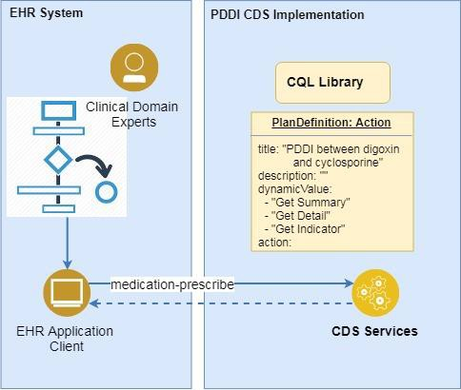
PDDI CDS - Services Based Architecture
CDS Service: near real-time support
as remote services
Context based CDS
order-select:
at the time of order selection
order-sign:
at the time of order authorization
Basic actions
registering for CDS services,
calling those services,
receiving the response : cards
order-select
https://github.com/HL7/PDDI-CDS.git

Slide 20
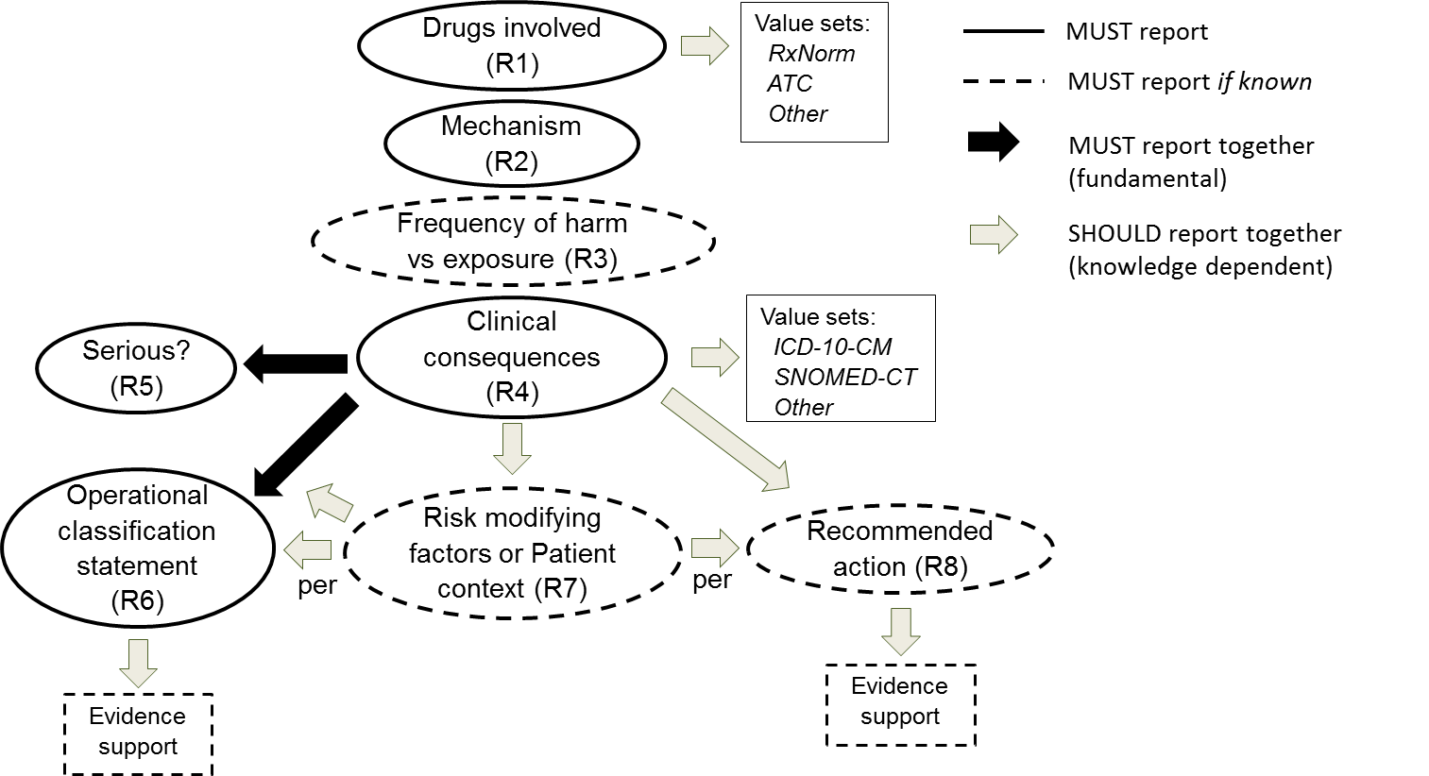
PDDI CDS Service – Response Information Model
https://w3id.org/hclscg/pddi

Slide 21
Contextualized PDDI alerting projects …
Enabling Shared Decision Making to Reduce Harm from Drug Interactions: An End-to-End Demonstration
AHRQ U18 (U18HS027099)
University of Utah, University of Pittsburgh
Advance the DDI CDS frontier beyond physician-centered decision making to patient-centered shared decision making

Slide 22
Discussion

