Slide 1

LOGICA Health SOA
Registries-Digital Health Services
and the
Evolution of the Future EHR
July 23, 2019

Slide 2


Supporting the Continuum of Care
Through Workflow and Clinical Process Automation

Slide 3
Current State
Poor support of combined operational and clinical workflows (within the EHR or across EHRs)
Every implementation is custom and proprietary
Duplicative data collection, inconsistent semantics
EHRs are coding, billing, and transaction focused - longitudinal patient care, treatment plans/goals, outcomes, and registries perspectives are not well represented in the persistence model
It takes years to new capabilities / functionality because of monolithic architectures and hard-coded, overfitted implementations

Slide 4
Registries: Similar Challenges
Expensive to create, maintain and enhance
Require considerable investments of time and labor to participate
Lack of canonical architecture, data models, semantics and services resulted in:
  Siloed data stores with significant technical limitations impeding optimal secondary reuse of data
  Fragmented, proprietary vendor ecosystem with limited interoperability and misaligned incentives
ACS exploring ways to better support their members, reduce costs, and leverage its intellectual property to provide additional value-add services

Slide 5
Managed Complexity -An Achievable Reality
Clinical Best Practices
Clinical Complexity
HIPAA
Regulatory Complexity
Risk Management
CMS Reimbursement
Diagnosis & Treatment
Optimal
Decision Making & Outcomes
Accreditation
Social Determinants
Supply Chain Management
Precision Medicine
Policies &
Procedures
Patient-Centric Complexity
Informed
Consent
Capacity
Planning
Administrative Complexity

Slide 6
Deploying Multiple Digital Services
Requirements
  Mechanism for making services available
  Input data for the services to operate on
  Logic/ domain knowledge to create output of value
  Orchestration capabilities
  Communication tools to deliver output to a user
Service Oriented Architecture (SOA)
  Preferred approach in most other industries
  Architectural pattern optimized for digital services
  Leverages/reuses existing assets, systems, and resources
  Can incorporate proprietary or non-standard products into a single, more consistent technology infrastructure

Slide 7
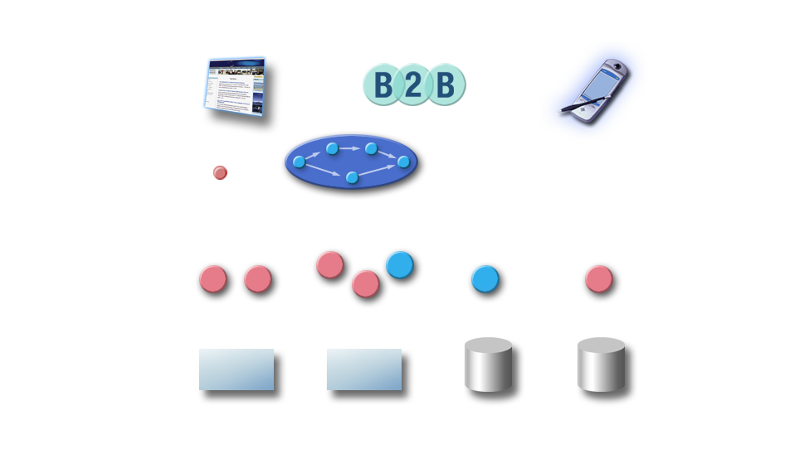
SOA Architecture For Healthcare...
EMR
Quality Measures
Population Health
Mobile Apps
Research Support
Presentation
Layer
Common Presentation Layer
Identity Management
Services
Data Management
Clinical/Admin
Processes
Rule Engine
& Knowledge
Repository
Authorization
Vocabulary Server
Patient Consent
Application Service
Layer
Master Patient Index
Natural Language Server
Relationship Models
Business
Process
Modeling
Record Locator
Authentication
Decision Support
Enterprise Service Bus
IDM Auditing and Logging
Master Data Management
HL7 v2/v3/FHIR
Workflow Knowledge Templates
Continuous Delivery, Micro Services, Containers
Context
Management
Consent/Access Management
HSPC Semantic Models
HSPC Models Services
Data Federation Layer
Healthcare Data Adapters
Data Access
Layer
CLI
ETL
CLI
ETL
CLI
ETL
CLI
ETL
EMR
(Epic, Cerner, etc.)
Financial Systems
Inventory Systems
Human Resources

Slide 8
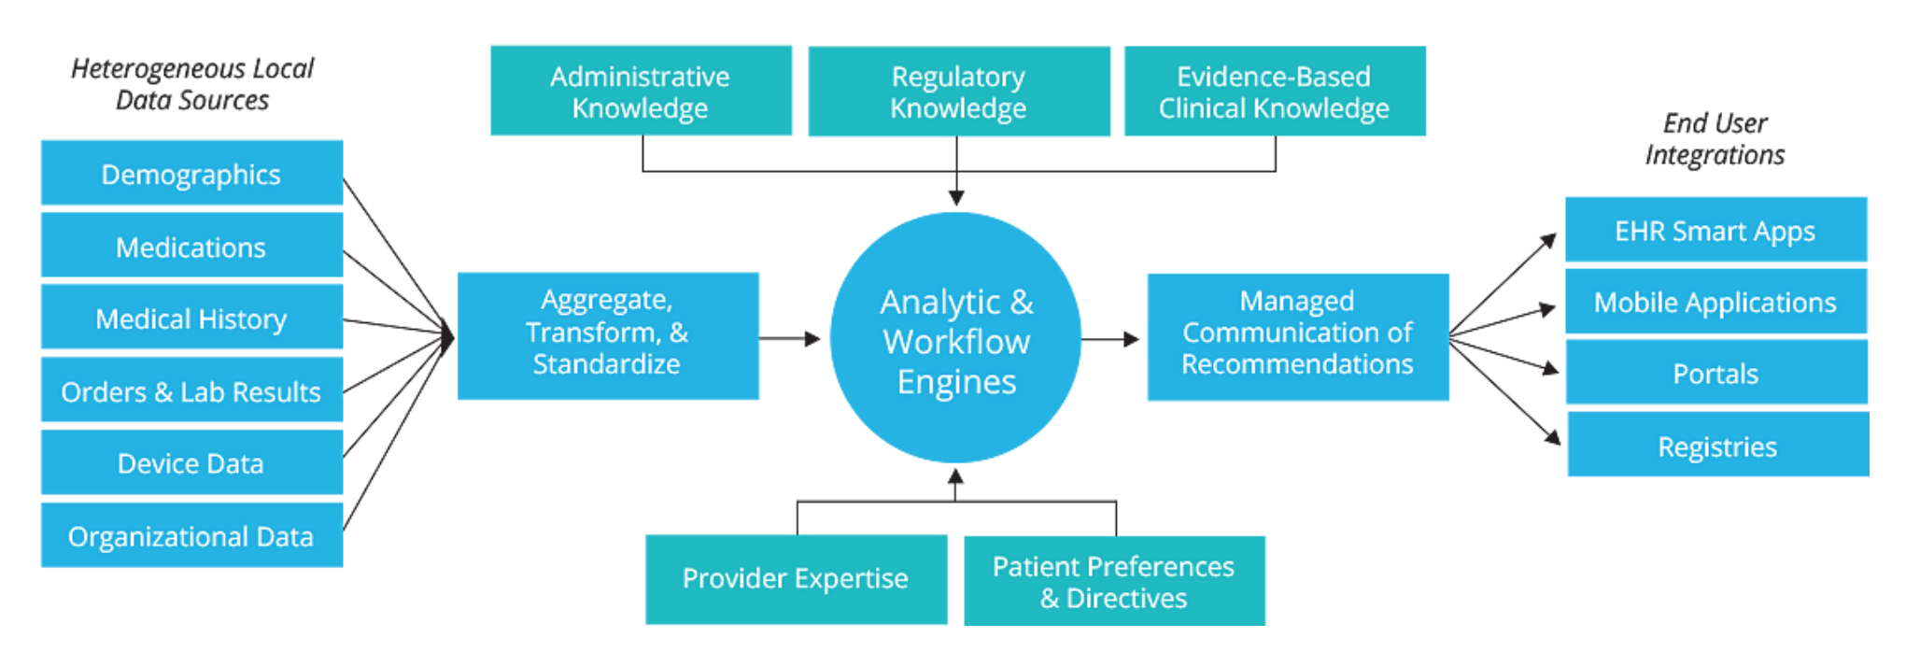
… Enhanced With Knowledge Management Services
The domain expertise that drives patient care, outcomes and value can be represented as knowledge artifacts
Knowledge management services can deploy and execute those artifacts
Designed to extend SOA systems with configurable reasoning and workflow functionality
Knowledge management systems are designed to identify, execute, monitor and share an enterprise's critical information assets
8

Slide 9
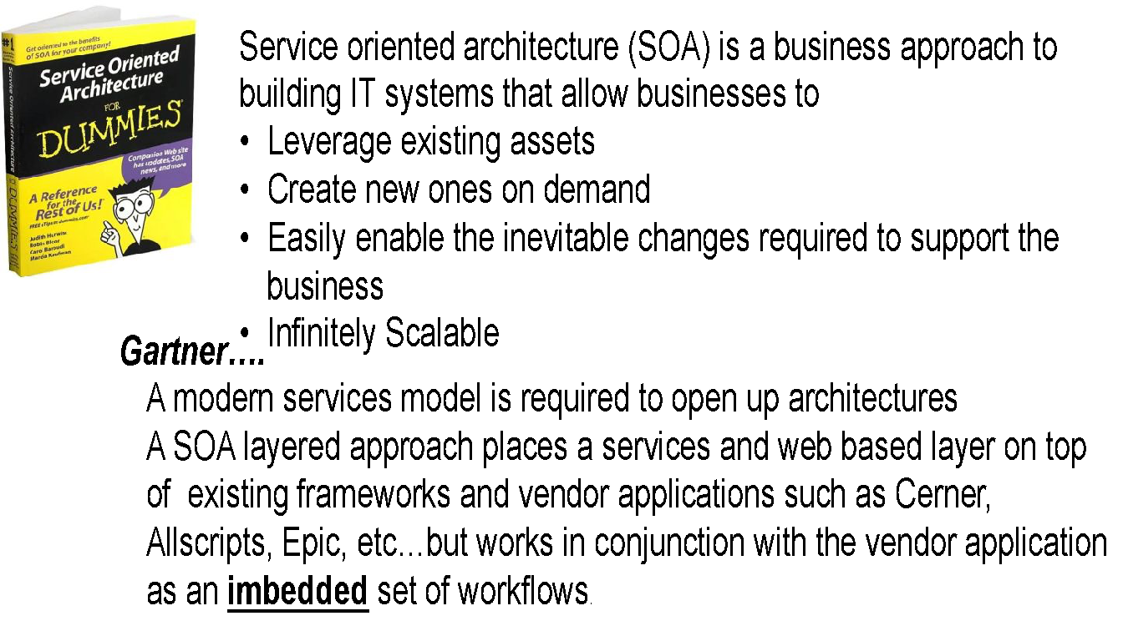
SERVICE ORIENTED ARCHITECTURE (SOA)

Slide 10
Service Oriented Architecture
A Rational Approach
Accelerates innovation in healthcare by facilitating the creation and sharing of applications, tooling and services
Creates a reference implementation of a healthcare Service Oriented Framework
Develops a data liquidity and digital services framework that supports terminology and modeling and the evolution of Restful Services (FHIR and related standards) in healthcare
Deliver tooling and libraries that support the sharing and curation of knowledge and content
Delivers a platform that supports a sandbox environment, a marketplace for distribution and commercialization of assets
Supports Open Source and Proprietary models but provides all Logica Health assets (services, libraries, tooling) as open source

Slide 11
Platform as a Service Model
Micro-Services support multi-dimensional scaling of the platform. This concept supports the notion of:
  Dynamic scaling where the platform constantly adjusts its computing capacity to the required consumption based on predetermined performance characteristics of individual component or the platform as a whole. This supports the real-time requirements,
  Component based architecture that supports volatility decomposition. This means that we characterize models into two categories:
    Knowledge, Services/components that are stable and require minimal change over an 18 month timeframe into the FHIR services layer.
    Knowledge components and models that are constantly changing need to be moved to the mid layer of the architecture.
Continous Delivery is a concepts used in cloud delivery models such as AWS to automate the versioning of services and other components of the platform. This allows versioning to be completely automated with checkpoints as required.
  Supports the versioning of individual component of the architecture and/or multiple components of a platform
Muti-tenancy This concept allows for the use of the platform across multiple consumer/customers. The platform can then can support multiple clients simultaneously and maintain the consistency of a single ecosystem.
  Each customer or consumer hs its own space/work environment
  They are separete but are part of a single platform.
Hybrid Cloud Model this concept allows for the use of one virtual platform running across multiple cloud vendors. This provide the lowest cost commodity based pricing for computing services
  Needs to support Microsoft/Azure; Amazon and EMC models at a minimum.
  Platform/Services can be hosted on all three
Administrative and Financial Management This support distribution, licensing, billing and other consumer services that are required to support the Market Place.
  Services to manage consumption, account management for costs /consumption analytics
  Services support billing and licensing costs and payments

Slide 12
Why consider a Platform Approach?
Virtualizes and commoditizes healthcare IT
Provide a trusted curation, compliance and distribution source
Maintain consistent implementation of standards
Supported by the advances in cloud computing and internet services/standards
Provides a utility model that supports healthcare specific needs of vendors and consumers (the healthcare ecosystem of users)

Slide 13
Key objectives for the initiatives
Accelerate innovation in healthcare by facilitating the creation and sharing of applications, tooling and services
Create a reference implementation of a healthcare Service Oriented Framework
Develop a data liquidity and digital services framework that supports terminology and modeling and the evolution of Restful Services (FHIR and related standards) in healthcare
Deliver tooling and libraries that support the sharing and curation of knowledge and content
Deliver a platform that supports a sandbox environment, a marketplace for distribution and commercialization of assets
Continue not to be a Standards Development Organization (SDO) but (like Underwriters Laboratories) harmonize standards multi-industry and healthcare industry standards for the industry with a strong certification and conformance process
Support Open Source and Proprietary models but provide all Logica Health assets (services, libraries, tooling) as open source

Slide 14
Registry API Proposal
Implement a standards-based, Logica Health (Logica Health) compliant SOA Platform
Develop a data management architecture for ACS/AAFP/ACC…
Create clinical registries: Supported by common information models, APIs, and well-generalized digital health services
Automate data extraction, semantic normalization, quality checks and case registration
Optimize analytic services to deliver actionable information to the clinical process

Slide 15
Objective #1
PlatfDevelop, document, and prioritize functional requirements
  Develop a Platform Independent Model (PIM) design document that describes required data models, semantics, components, services and capabilities that a vendor must implement to be Logica compliant
  Implement an integrated services demonstration platform conformant to the PIM

Slide 16
Objective #2
Pilot Demonstration
  Develop detailed deployment plan, training schedule, cost analysis, outcome measures, evaluation criteria, and success metrics, for pilot
  Implement platform specific SOA and digital registry services at a partner site
  Candidates facilities include Stanford, Ascension, Intermountain, VA and others
  Pilot will be run for 6-9 months and will serve as a real-world validation of the platform’s functional and performance capabilities.

Slide 17
Objective #3
Governance & Sustainability
  Develop a licensing and endorsement plan for ACS intellectual property that is conducive to dissemination and aligns market incentives
  Reserve endorsement of actual products to those vendor implementations that satisfy published conformance criteria
  Transition long-term governance and sustainment of SOA platform to Logica Health
  Establish the role Federal agencies such as CMS and other specialty societies might have in governance

Slide 18
Registry Services
Trauma
Pediatric
Breast
Cancer
Bariatric
Geriatric
Surgeon
Specific
Common Registry API
Canonical Data Model & Semantics
Privacy Services
Analytic Services
Quality Metrics
Cohort Services
Open Source Platform (PIM)
Logica Health Compliant SOA
Security Services
Consent Services
Data Quality Services
Case
Registration
Canonical Data Model & Semantics
Common Registry API
Vendor
API
Vendor
API
Vendor
API
Vendor
API
Vendor
API
Vendor Api
Vendor API
EMRs
Other Registries
Disease
Management
Research
Precision
Medicine
Social Determinants
Insurance

Slide 19
Value Proposition For Current Registries
Modernized, standards-based infrastructure reducing vendor lock-in
Automated data extraction & semantic normalization
Improved data quality and validation
Standardized APIs across all ACS registries upon which to build next-gen digital services
Latency reduction and improved responsiveness
Standards-based security and privacy services supporting fine-grained, role-based, consent driven access control
Mid-tier services that support event-drive interoperability across distributed, federated systems

Slide 20
Near Term Implications
The proposed standards-based SOA, augmented with well generalized registry services, will accelerate:
  Enhanced analytics, reporting, and outcomes research
  Optimum information delivery and better integrated into EHR / clinical practice workflow
  Ability to enrich registries with secondary data sources including fiscal, administrative, non-surgical registry records and even patient reported outcomes/consent directives/device data
  Registry-enabled risk stratification, CDS reminders, and process adherence feedback at the point of care

Slide 21
Longer Term Implications
Improved patient-centeredness of registry design, oversight, and operation
Enhanced patient access to registry information for self-care, shared decision making, financial planning, and research participation
Services required to better manage the deluge of precision medicine data that is rapidly transforming healthcare delivery
Development of a vendor ecosystem enhanced by ACS intellectual property, held more accountable to community functional requirements, and better prepared to utilize knowledge assets effectively in their products

Slide 22
Major initiatives
The puzzle pieces:
Clinical data models
Sandbox
Logica SOA Architecture
Solution Reference Implementations
Certification and Compliance
Marketplace
How do these initiatives relate to each other? What are the influences they assert on each other? What dependencies exist between them? What is their relationship to external stakeholders?
Business Process Models
Service platforms and orchestration engines
Knowledge Artifacts
Infrastructure – Health Cloud

Slide 23
LOGICA Health Ecosystem

Slide 24
Logica Health SOA Platform
The vision and plan for developing the reference architecture

Slide 25
Motivations
Deliver the operational integrity of a production platform based on an evolving “SOA Reference Architecture”.
This kind of platform will need to address, optimize and bring cohesion to the the Healthcare IT ecosystem beyond today’s EMRs.
Help industry shift away from an EMR focused ecosystem to a patient-centric ecosystem where data, knowledge, workflows are shared assets and the complete knowledge of a patient’s condition is not constrained by system and organizational boundaries.

Slide 26
Intentions
Define an architecture that:
Breaks down ecosystem functionality into atomic, succinct “services”
  Services should be defined to deliver a discrete unit of functionality (atomic decomposition), and the implementation details (products, technologies, etc.) should be hidden from the consuming applications through standards-based APIs
Enables participating systems to have awareness of each other with clear delineations of responsibility
Allows systems to cooperate, share information and leverage standards for APIs (application programmer interfaces), security and data definitions
Defines how systems participate in well-defined, orchestrated workflows that cross system and organizational boundaries
Enumerates and operationalizes the best practices, patterns, standards, profiles and conceptual solution architectures that enable cohesion across future healthcare IT ecosystems

Slide 27
Desired characteristics
Data democratization where no one system “owns” or blocks access to data.
Seamless patient/beneficiary experience across organizations and the continuum of care.
Semantic interoperability where all systems involved in a data exchange can not only share data, but can be assured of having a common and correct understanding of the shared data and the context for using and interpreting the data.
Foster opportunities for automation, machine processing, comprehensive analytics and clinical decision support.
Standardization of knowledge artifacts (e.g., clinical decision support rules, heuristics, analytical models, calculators, etc.) delivered independent of EMRs and accessed through standard APIs.
A computing infrastructure that optimizes common, cross-cutting capabilities needed by many other systems such as patient record access, terminology access, identity management, security functions, knowledge management and workflow management.
An open, compatible ecosystem of products, tools and data.
The purpose of the Logica Health SOA Reference Architecture is to provide an architectural description of what this broader ecosystem looks like

Slide 28
Relevance within Logica Health
The Logica Health Reference Architecture will:
Inform the future Health IT architecture of Logica Health member organizations and other interested stakeholder groups
Provide requirements and specifications for designing operational architectures and procuring solutions
Provide criteria for product certification and compliance
Define candidates and specifications for reference implementations that may ultimately be deployed into the Sandbox

Slide 29
Candidate “Services”
Service = atomic, self-contained unit of data and/or functionality accessed through a standards based interfaces
Candidates
  Record Service (FHIR interface)
  Terminology Service
  Patient Identity Service
  Clinical Decision Support Service
  Provider Directory Service
  Security Service(s) (authentication, access control…)
  Text Processing Service
  Notification and Alert Service
  Composite business services including Ordering Services, Referral Services, Care Planning Services
Need underpinning infrastructure like an orchestration engine, cloud platform, data persistence, etc.
  The platform is the collection of all of these things
Example: DaVinci is an example of an ecosystem that contains (needs) some of these components

Slide 30
Expected deliverables
Identification of the specific common services.
The interfaces provided by each service to expose the data and/or functionality that the service is deemed to be authoritative for.
The information payloads and standards used to describe the information (e.g., data models and messaging standards such as FHIR) used to communicate with services.
The common patterns for developing and using services and the orchestration of services that solve common business needs.
The organization of the services stratified into logical layers (service taxonomy) based on the nature of the service and the level of commonality of a given service.

Slide 31
LOGICA Health
American College of Surgeons
In collaboration with
HarmonIQ HSC and Saperi

