Slide 1
FHIR and HSPC Meeting
July 7
Grahame Grieve

Slide 2
Agenda: DCMs and FHIR
Strategy for representing DCM content in FHIR
How do DCMs fit within the FHIR strategy/objectives?
Which FHIR artifacts are appropriate for representing DCMs?
How should individual, very specific DCMs be represented?
How should collections/panels be represented?

Slide 3
FHIR Scope
FHIR is a platform specification
Wide set of uses, general purpose
Intended to allow re-use of common infrastructure
Implementation Guides to describe specific use
National Standards, Projects
Institutional Policy, Vendor Implementations
Clinical Specialities

Slide 4
Overall FHIR Structure
Layer | Description | Mantra
Meaning | Mappings to ontologies, other specifications, logic formalism - Where meaning comes from | Thorough, Deep, Authoritative
Exchange | Definitions of resources (engineering constructs) and their operational APIs - What is exchanged | Simple, Concise, Modular
Conformance | Structures and Tools that allow implementers to deal with variation between use cases and implementations - How resources are used | Capable, Comprehensive, fine-grained

Slide 5
Overall FHIR Structure
Meaning
Exchange
Conformance

Slide 6
Conformance
Conformance
Statement of system functionality
Profile
Rules about how a particular resource is used
ValueSet
Represents a set of terms defined by a code system

Slide 7
Relationship to DCMs
All 3 layers relate to DCMs
Meaning – DCMs provide meaning
Exchange – Base clinical resources correspond to coarse-grained DCMs
Conformance:
Conformance resource: what services are offered
Profile = fine grained derived DCMs
Valueset = a set of codes. Most DCMs define / refer to value sets

Slide 8
Clinical Resources
AdverseReaction
Condition (Problem)
Procedure
CarePlan
Family History
Pharmacy (x4)
Observation
Diagnostic/Device Report + Specimen
Questionnaire
Referral
Alert
… more coming

Slide 9
DCMs and FHIR
Implementing a DCM in FHIR:
Might become a base resource
Might a profile on an existing resource (or set)
Might be a statement of knowledge that is out of scope of FHIR
FHIR does not try to represent medical knowledge (for now)

Slide 10
Artifacts for DCMs
Profile + Valuesets
Whether or not it’s a base resource
Base resources
Are not derived from an existing resource
Get treated differently by engineering layer
Must be approved by HL7 processes

Slide 11
Brief Profile Tutorial
Metadata (based on HL7 template specification / ISO 11179 / 13606)
0..* Extension Definitions
0..* Structure Constraints
Element usage rules (cardinality, type, invariants)
Changed definitions & mappings
Search parameters
0..* Query definitions (not hereafter relevant?)

Slide 12
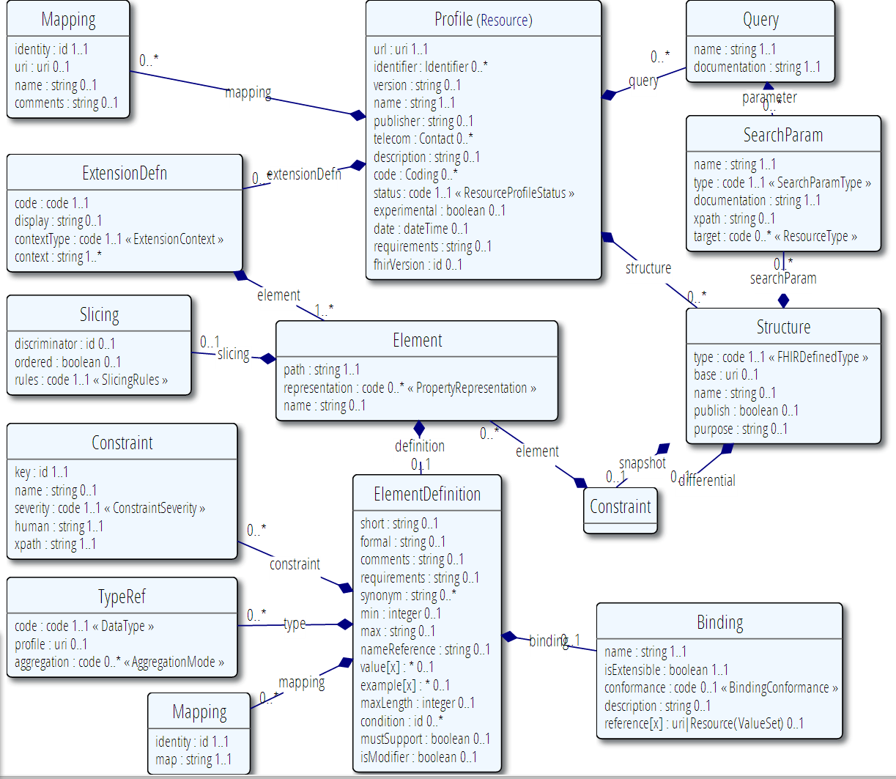

Slide 13
Structure Constraint
Name – human name (= DCM name)
Type – underlying FHIR type this is based on
Base – profile this derives from
Differential
What this constraint says compared to base
Snapshot
What the outcome of applying this constraint to base is

Slide 14
Differential vs Snapshot
Base (snapshot)
a : string [0..*] name
b : string or integer [0..1] amount
Differential
b : integer [1..1] volume in mL
Snapshot
a : string [0..*] name
b : integer [1..1] volume in Ml

Slide 15
Differential vs Snapshot
Differential is an author’s view
What does this constraint mean to say?
How should I think about this constraint?
Snapshot is a users view
Is this instance conformant to this constraint?
Generating the snapshot is moderately tricky
FHIR project provides libraries and servers to do it

Slide 16
Leveraging Profiles
FHIR Project provides (or will do):
Renderer – shows a profile to a human
Validator (tests conformance)
Questionnaire Builder (e.g. Simple UI builder)
Code generators (Java, C#, XSLT, etc)
Full featured repository (Private or Public)
Publishing Tooling for Implementation Guides

Slide 17
Authoring Profiles
Options for Authoring Profiles:
Edit XML by hand (for weenies like me)
Use FHIR Project Tools:
Profile Editor (Forge) – Furore (Chicago)
ValueSet Editor (Me) – Already released
Simple UI tools for editing content directly
Use conversion tools from other forms
Leverage existing modeling frameworks

Slide 18
Why Generate
Leverage Existing knowledge, eco-systems, communities
Ease Interoperability with systems based on other frameworks
FHIR profiles are technical artefacts; other frameworks are more orientated to human level design discussions

Slide 19
Generating Profiles
Can generate resources and value sets using any tooling imaginable
What is generated must be valid constraints of existing resources
It’s not just a question of syntax
Design has to be based on constraints imposed by existing resources
You can use extensions as well

Slide 20
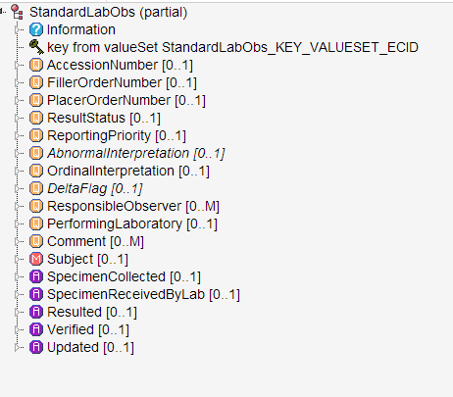
Example Issue
http://www.clinicalelement.com/#/20130723/Intermountain/StandardLabObs

Slide 21
Example Issue: Mappings
CEM | FHIR
StandardLabObs | Observation Profile
Key | Observation.code
Comment | Observation.comments
AccessionNumber | DiagnosticReport.identifier
PlacerOrderNumber | DiagnosticReport.order->identifier
How to handle this?
Re-organise existing source models
Propose change to FHIR resources
Define Extensions in profile

Slide 22
Scope of Profiles
What do you define profiles for?
Different Structures with consequences for how system handles information
e.g. Numerical Lab Observation, Procedure Profile
Different clinical cases of information
E.g. Hematocrit, Cholecystectomy
Different individuals
E.g. all procedures for John Smith, MR 123456

Slide 23
Scope of Profiles
There are a few cases where there’s a single structural profile with a few fields that differ depending on the code in first field, and thousands of codes
Lab Observations
Claims & Billing
Medication related
May be more efficient to define a “profile template” and complete it from a catalogue

Slide 24
Profile/Catalogue Example
Profile says:
Observation.code is a LOINC code from field “code” in table X
Observation.units is the field “unit” for the matching code
Observation.referenceRange.low is for the field “Range.low” for the code
Observation is a panel, &Observation.relatedItem.target->code is defined in detail table Y for code in X

Slide 25
Profile / Catalogue
FHIR doesn’t have a way to do this now
It could be added
Is there a simple syntax that solves enough cases to be useful?
Is that a value proposition?

Slide 27
Agenda: Terminology Services
Terminology infrastructure requirements imposed by representing DCMs in FHIR

Slide 28
Value Set Resource
Value set resource initially defined to support the Profile resource
“this set of codes here”

Slide 29
Brief Value Set Tutorial
Metadata (same as Profile)
0..1 Inlined code system definition
0..* Composition Statements
Include other value sets
In/Exclude some or all codes from a codesystem
In/Exclude codes based on codesystem properties
0..1 Expansion (=actual content at a given time)

Slide 30
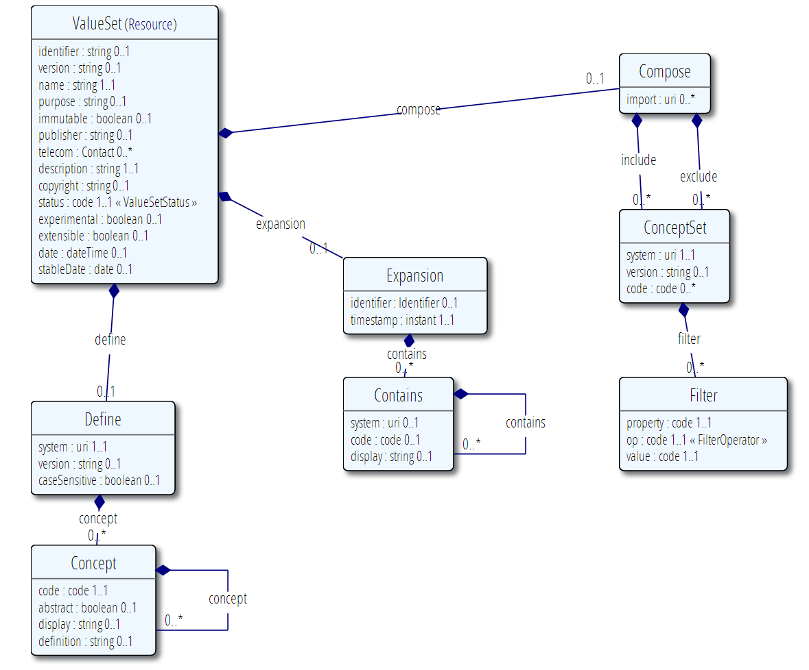

Slide 31
Value Set Resource
Examples – from specification / IHC set

Slide 32
Inducting a Code system
What URI will be used to identify it?
What are valid codes? (syntax, expression?)
What are valid display names?
What properties can be used to define extensional value sets?

Slide 33
Leveraging Value Sets
FHIR Project provides (or will do):
Renderer – shows a value set to a human
Value Set Expansion (code & server)
Including with text filtering for UI support
Conformance Testing (code & server)
Full blown terminology server (open source)
Full featured repository (Private or public)
All with full mapping support (ConceptMap resource)

Slide 34
Generating Value Sets
Value sets based on underlying common HL7 notions (e.g. v3 core principles)
Have specific packaging & identification policy
Metadata requirements purposefully loose
HL7 has a “value set registry profile”
Are intended to be implementable as a facade over CTS2 (not done yet)
Intended to allow easy generation of valuesets

Slide 35
Functions for Value Sets
Support the conformance process:
May be design time functionality only
Provide Run time services (optional):
Populate UI from value set expansion
Test value set membership
Use from operational resources:
Questionnaire, Device, Coding data type
Value set is part of medical record
Does not require services, but can leverage them

Slide 36
Terminologies and HSPC
HSPC needs value sets & Tx services for specification and testing
No implication on run time servers or clients
HSPC could choose to require server to provide some Tx services
Expansion
Mapping
Conformance testing
Search functionality
Could be a different server (auth/config issues) (master?)

Slide 38
Other Subjects
Profile inheritance/hierarchies
Complex extension definitions
Profile compliance
Defining the set of query capabilities

Slide 39
Profile inheritance/hierarchies
DSTU:
Profiles were defined as stand-alone
Derivation could be inferred, but not stated (not yet implemented)
Dev (draft):
Profiles explicitly state their derivation (except for resource profiles)
Author a differential
Publish tool generates the snapshot

Slide 40
Complex extension definitions
DSTU:
Extensions have a type
An extension with no type – a complex extension
Define other extensions with the 1st as Context
Dev (draft):
Extensions can define their own inner extensions
Can be constrained using the same profile tooling

Slide 41
Profile compliance
Tools to check profile compliance exist and are well tested
The need to be packaged better so they are more accessible without knowing the build tool code base
There are online services to do validation (demo) but these need better documentation

