Slide 1
Logistics
I need to leave by 9:30 am, I will be back tomorrow (Tuesday)
Continental breakfast both days
Buy lunch from the cafeteria
Buy coffee or treats from the cafeteria
Monday – 8:30 am to 5:30 pm
Tuesday – 8:30 am to 3:00 pm (so folks can catch planes going east)

Slide 2
HSPC SMART Meeting Goals and Assumptions
July 7, 2014
Stanley M. Huff, MD
Chief Medical Informatics officer
Intermountain Healthcare

Slide 3
Healthcare Services Platform Consortium
Short Version: Create a new marketplace for plug-n-play interoperable healthcare applications
Long Version: Enable the acceleration of application development through an open, standards based, services oriented architecture platform and business framework that supports a new marketplace for interoperable healthcare applications
Why?
To improve the quality and decrease the cost of health care.

Slide 4
HSPC History
Initiated by Intermountain and Harris
Meetings
May 2013 Salt Lake City
August 2013 in Phoenix
January 2014 Salt Lake City
May 2014 in Phoenix
July 2014 Salt Lake
(August 2014, Washington DC, hosted by IBM)
Currently working on bylaws and membership agreements to form a business entity
For more information: Craig Parker, Oscar Diaz, Stan Huff

Slide 5
HSPC and SMART
Entirely different groups
No plans to merge
Highly aligned goals and values: open platform services
Mutual respect
HSPC has decided to use SMART technology as the initial strategy for integration of applications into EHRs

Slide 6
Why is Intermountain interested in the Consortium?

Slide 7
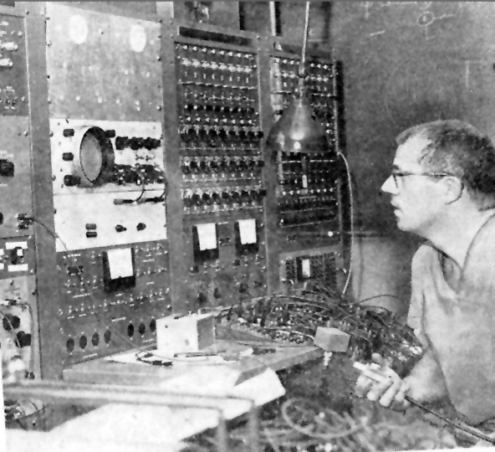
Homer Warner and HELP
Intermountain can only provide the highest quality, lowest cost health care with the use of advanced clinical decision support systems integrated into frontline clinical workflow
Dr. Homer Warner
Notes:
7

Slide 8
Decision Support Modules
Antibiotic Assistant
Ventilator weaning
ARDS protocols
Nosocomial infection monitoring
MRSA monitoring and control
Prevention of Deep Venous Thrombosis
Infectious disease reporting to public health
Diabetic care
Pre-op antibiotics
ICU glucose protocols
Ventilator disconnect
Infusion pump errors
Lab alerts
Blood ordering
Order sets
Patient worksheets
Post MI discharge meds

Slide 9
Strategic Goal
Be able to share data, applications, reports, alerts, protocols, and decision support modules with anyone
Goal is “plug-n-play” interoperability

Slide 10
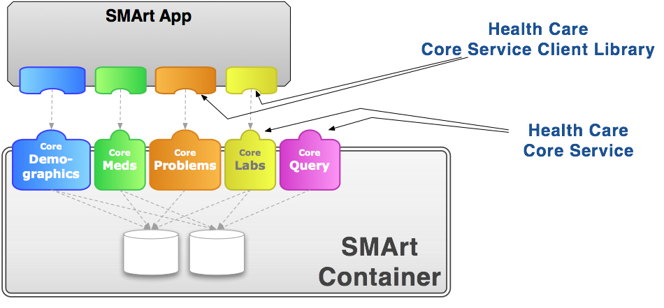
From Ben Adida and Josh Mandel
Notes:
SMArt is using RDF to represent models and data. Right now they have very simple models. We are hoping to collaborate on model development.

Slide 11
A few details about HSPC

Slide 12
Essential Functions of the Consortium
Select the standards for interoperable services
Standards for models, terminology, security, authorization, context sharing, transport protocols, etc.
Modeling: SNOMED, LOINC, RxNorm – FHIR Profiles – do it together
Publish the models, and development instructions openly, licensed free-for-use
Provide testing, conformance evaluation, and certification of software
Gold Standard Reference Architecture and its Implementation
We will work with an established company to provide this service
Fees that off set the cost of certification will be charged to those who certify their software
Commitment from vendors to support the standard services against their database and infrastructure
Everyone does not have to do every service
There must be a core set of services that establish useful applications

Slide 13
Other Functions of the Consortium
Participation in “other” functions is optional for a given member
Enable development “sandboxes”
Could be provided by companies or universities
Could be open source or for-profit
Set up an actual “App Store”
Many companies already have their own app stores
Vendor certification that a given application can be safely used in their system
Accommodate small contributors that won’t have their own app store
Create a business framework to support collaborative development
Pre-agree on IP, ownership, co-investment, allocation of revenue
Try to avoid unique contracts for each development project
Provide a way for people to invest (Venture capital)

Slide 14
Principles
Not-for-profit entity
There could be an associated for-profit entity
Simple majority of providers on the Board of Directors
All organizations will have equal influence and opportunity
Intermountain and Harris will not be “special”
Start small, be effective, and then grow
We want to allow everyone that is interested to participate
Allow diverse strategies and participants
Open source and for-profit
One person business up to multi-national corporations
Healthcare providers and healthcare software developers
Students and professional software engineers
Initially, focus on the minimum set of standards and technology
Increase options as we gain experience and success
HSPC is not producing software (mostly)
HSPC members or groups of members produce software
HSPC may need to provide a reference implementation for purposes of certification
No “central planning” by HSPC of app development
Participants decide what they want to build and invest their own resources
We DO need to agree about the minimum set of services that will enable a marketplace

Slide 15
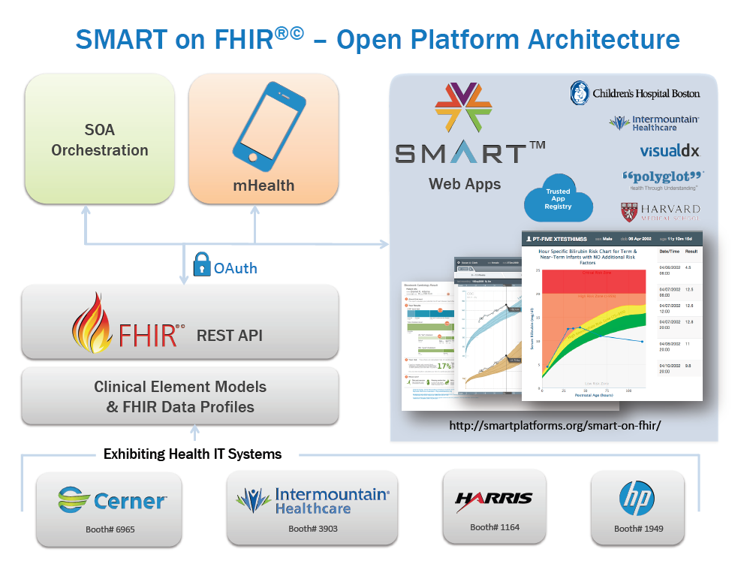

Slide 16
Relevant Core Assumptions
We use existing standards whenever possible
We need comprehensive and unambiguous models of clinical data (hematocrit, white count, temperature, blood pressure, adverse reactions, health issues (problems), prescriptions, substance administration, etc.)
The models are the basis for querying and retrieving data for storing data through services
We need a single set of consistent models for HSPC based interoperability
It would be even better if there was one common set of FHIR profiles industry wide
We want to create needed FHIR profiles from existing content

Slide 17
HSPC Technology Assumptions (already decided)
Services – FHIR
Generate FHIR profiles from existing model content
Data modeling
Clinical Element Models (now)
CIMI models as soon as they are available
Terminology
LOINC, SNOMED CT, RxNorm, HL7 tables
EHR Integration – SMART

Slide 18
Goals for this meeting

Slide 19
FHIR Profile Goals for This Meeting
Determine the best way to represent explicit detailed clinical model information in FHIR
Option #1:
Create FHIR profiles to the level of structural difference
Lab Results Example: numeric, coded, ordinal, textual, titer
Additional essential information in a knowledge resource
Hematocrit, white count, glucose, BP, temperature, HR, etc.
Option #2: Create FHIR profiles for the specific measurements
Hematocrit, white count, glucose, BP, temperature, HR, etc.
Option #3: ???
Binding terminology to models
Value Set resource, terminology binding, value sets, and other terminology issues

Slide 20
SMART Goals for This Meeting
Determine as much detail as possible about strategies for
Authorization
Authentication
Context passing

Slide 21
Things to be done but that we are NOT doing this meeting
Select a single preferred modeling approach
Select a single source of modeling content
Merge all current modeling activities
Agree on tooling
Agree on specific model content
Review all of the modeling activities that are currently underway
Debate which terminologies to use (already decided)
Determine the process for generating FHIR profiles from existing content (this is homework for the various modeling groups)

Slide 22
Questions and Discussion

Slide 23
Sources of Models
Clinical Element Models
openEHR
Results4Care
Logical Record Architecture
EN 13606 Organization
LEGOs, ISAAC, SOLOR
Common Data Elements
Australia
South Korea
Singapore
Others
(CIMI)

