Slide 1

Intro to HSPC, SMART on FHIR, & Developing HSPC Apps
by Rick Freeman, Travis Cummings, & Amy Ballard
iSalus Solutions
8/10/2016

Slide 2
Agenda
Overview of HSPC – Rick Freeman
Overview of SMART on FHIR – Rick Freeman
Demo of an HSPC Application – Rick Freeman
The HSPC Development Resources & Sandbox – Rick Freeman
Demo of HSPC Sandbox and Tools – Rick Freeman
Live Coding Demo: Creating a simple SMART on FHIR App – Amy Ballard
Overview of Functional Standard – Travis Cummings
  OAuth2
  FHIR
Lab: Build your first HSPC/SMART on FHIR App – Amy Ballard & Travis Cummings

Slide 3
Acknowledgement to Intermountain Healthcare
Intermountain Healthcare one of founding member of HSPC.
Pays for iSalus Solutions team to:
  Do trainings like this.
  Build out HSPC tools and SMART on FHIR Reference Implementation.
  Engage with EHR vendors, HIT App Developers, Providers, etc.

Slide 4
OUR MISSION
Improve health by creating a vibrant, open ecosystem of interoperable platforms, applications, and knowledge assets.

Slide 5
OUR VISION
Be a provider-led organization that accelerates the delivery of innovative healthcare applications that improve health and healthcare.

Slide 6
OUR GOAL
Our goal is to create an open marketplace featuring the industry’s first vendor-neutral Healthcare Marketplace and to foster a vibrant entrepreneurial community to deliver the best solutions quickly, easily and seamlessly to improve the quality of today’s accountable care.
Achieving the gold standard of true semantic interoperability, our services platform seeks to dramatically augment today’s standards efforts by providing a ground-breaking collaborative platform and real world laboratory to advance the native interoperability of healthcare applications.

Slide 7
ABOUT HSPC
The Healthcare Services Platform Consortium (HSPC) is a provider-driven organization of leading healthcare organizations, IT vendors, systems integrators, and venture firms dedicated to unlocking the power of entrepreneurial innovation to improve healthcare outcomes.
Through HSPC’s open marketplace and services platform, we seek to foster a new level of provider-vendor collaboration and innovation to meet one of the industry’s greatest needs -- accelerating the creation, sharing and delivery of promising software applications at the point of care.

Slide 8

Application Model
Write Once, Deploy Anywhere

Slide 9
HSPC & SMART on FHIR Overview
Standards­-based platform for medical apps.
  Standard APIs: HL7® Fast Health Information Resources (FHIR®), OAuth2, OpenID Connect
  Common data models via FHIR from HSPC
  Standard medical vocabularies for coding medical data (e.g. RxNorm, LOINC, SNOMED CT)
  Web­-inspired, modern standards would be tapped (e.g. HTML, JavaScript, OAuth, RDF)
Designed to lower the barriers for EHRs to participate in its emerging app ecosystem.
Creates platform specification allowing app developers to write medical apps once and have them run (“plug­-and-­play”) across diverse healthcare IT systems.
Shields medical app developers from the low-­level and widely divergent details of each healthcare IT vendor’s system, such as:
  Vendor­-specific data schemas
  Proprietary coding
  Workflow environment
Helps developers concentrate on creating value by melding innovative clinical informatics with a modern user experience by providing:
  Lightweight common data models
  Corresponding API
  Ancillary app­-development tools

Slide 10
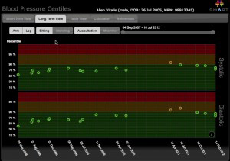
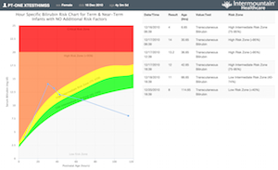
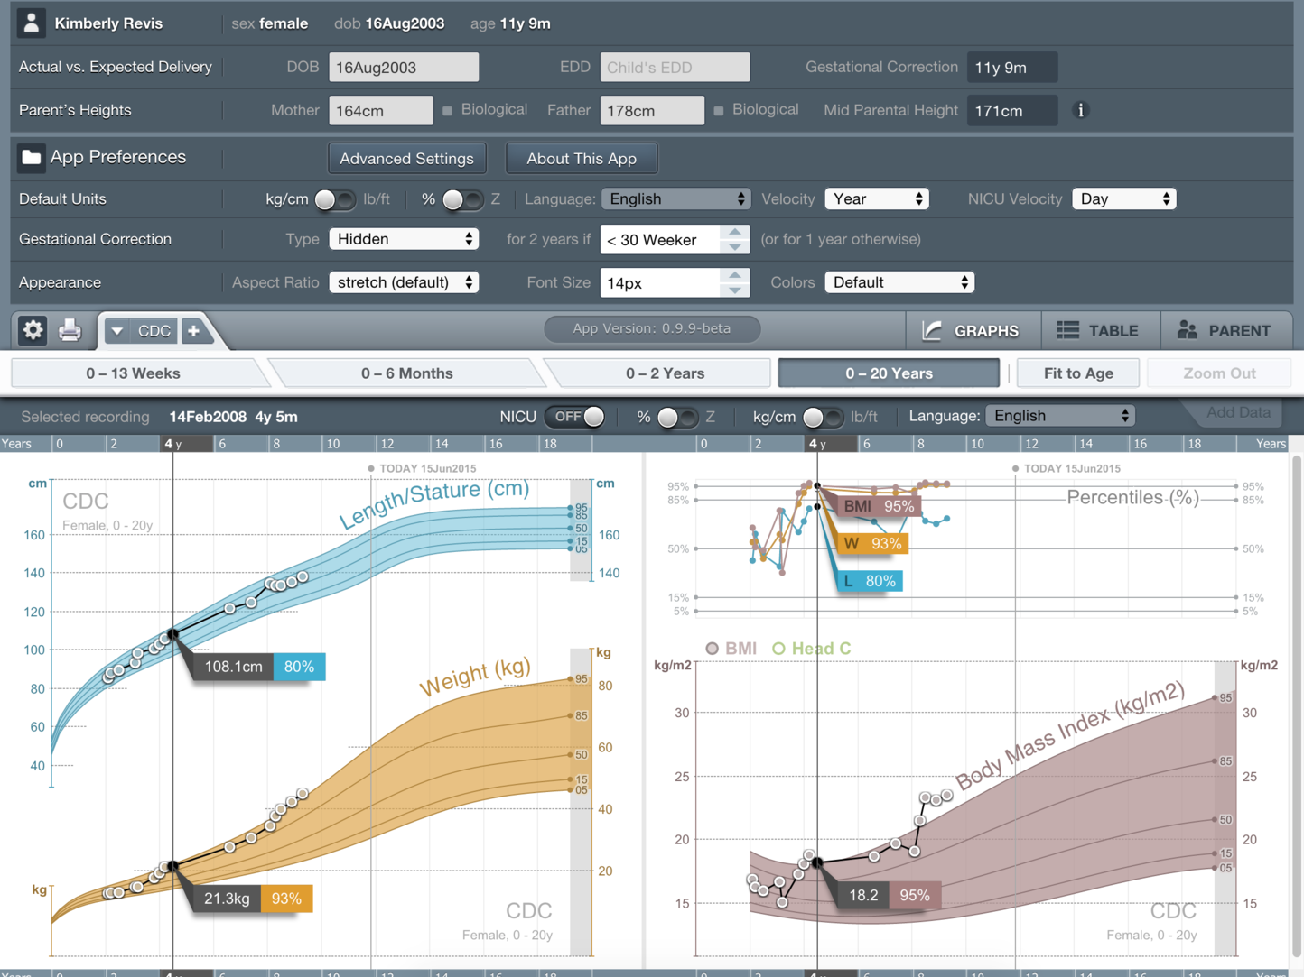







Apps Integrate Using a Common API
HSPC Compliant Apps
To Supporting Platforms/EHRs
Standardized Functional Services
Security
Launch Context
Data Models
Data Access
HSPC Application Model
Write Once Deploy Anywhere
on
Profiles
Compliant Platforms

Slide 11
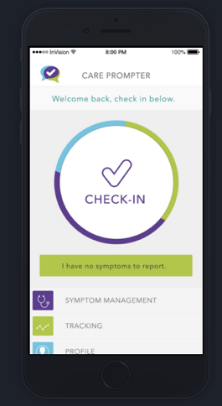
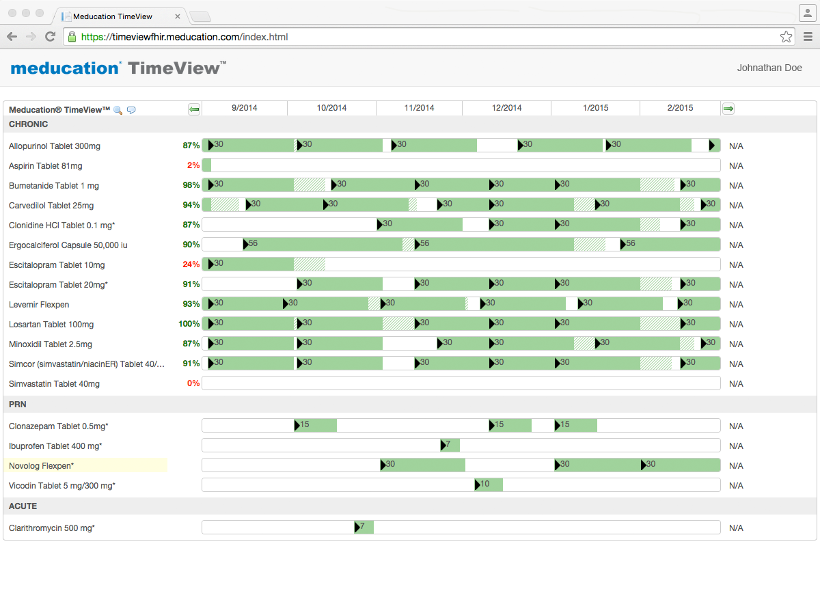
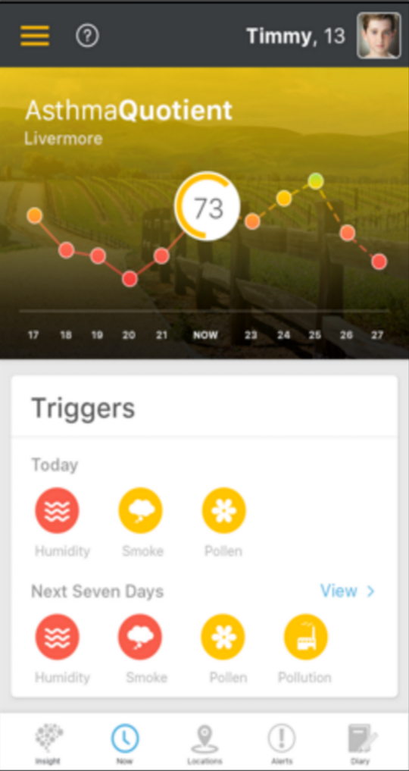
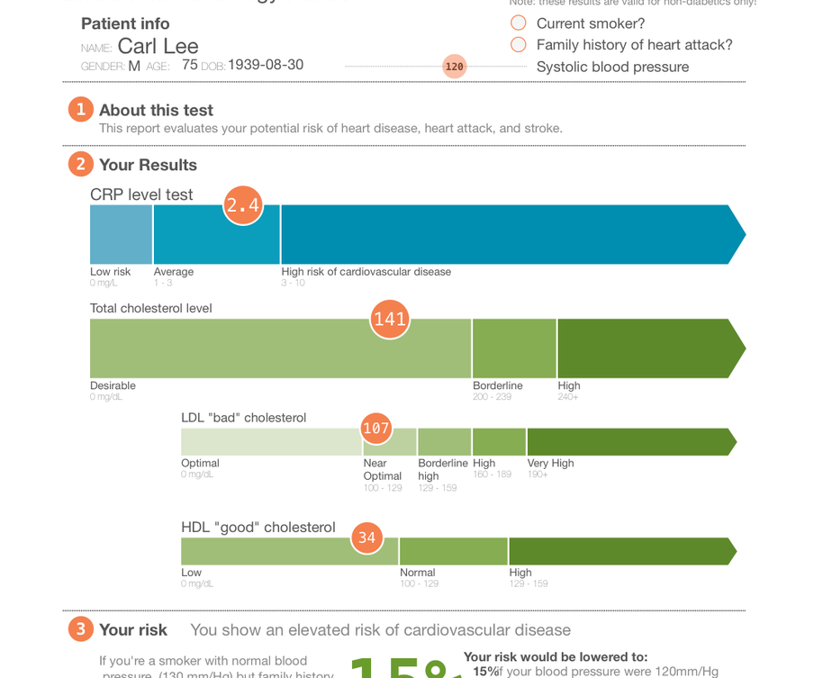


Example App SMART on FHIR Design
Patient Mobile App
EHR User Interface
Clinician-facing Web App
Clinician-facing Web App
Web Apps can integrate inside of EHR UI. No need for user to open and log into a separate app.
on
Data specific to the app can be accessed directly.
Application Specific Server
SMART on FHIR Compliant EHR/Platform
Patient data is accessed directly from the EHR.

Slide 12




Example HSPC App Workflow
Patient logs data.
Patient Mobile App
App writes to App Server
Application Specific Server
App server generates an alert, sends Clinician alert message
Clinician reviews Patient Dashboard in EHR and calls patient.
EHR User Interface
Clinician launches Dashboard within their EHR.
Application Specific Server
Clinician-facing Dashboard
Dashboard queries App Server for App Specific data.
on
Dashboard queries EHR for patient data.
SMART on FHIR Compliant EHR
on

Slide 13







Supported Application Types
Mobile
Web
Other
Patient
Provider
Related Person
System

Slide 14
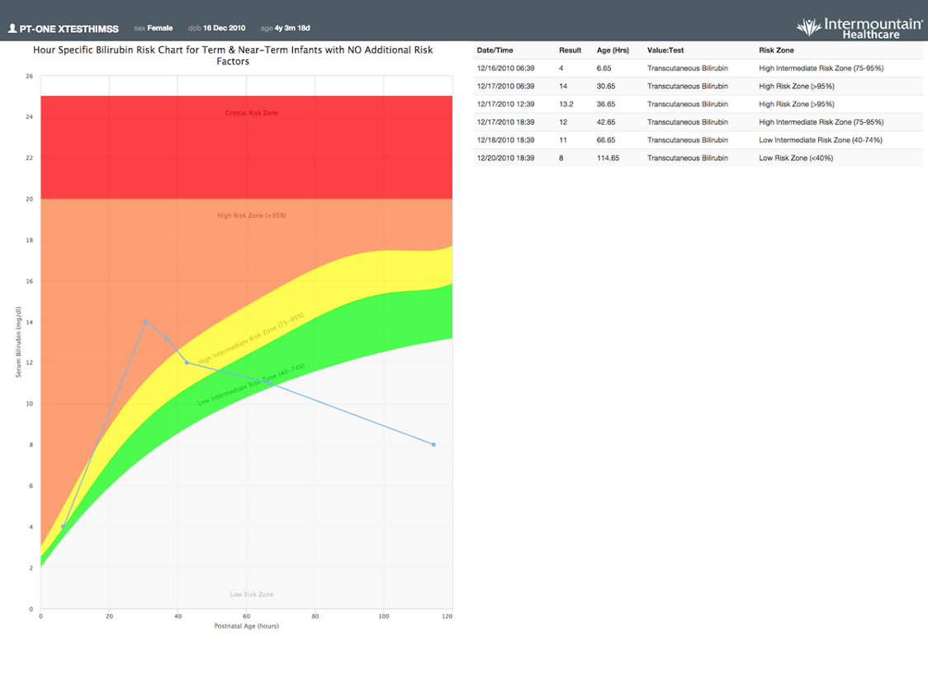
Demo HSPC App: Bilirubin Risk Chart

Slide 15


Introducing
http://Developers.HSPConsortium.org

Slide 16
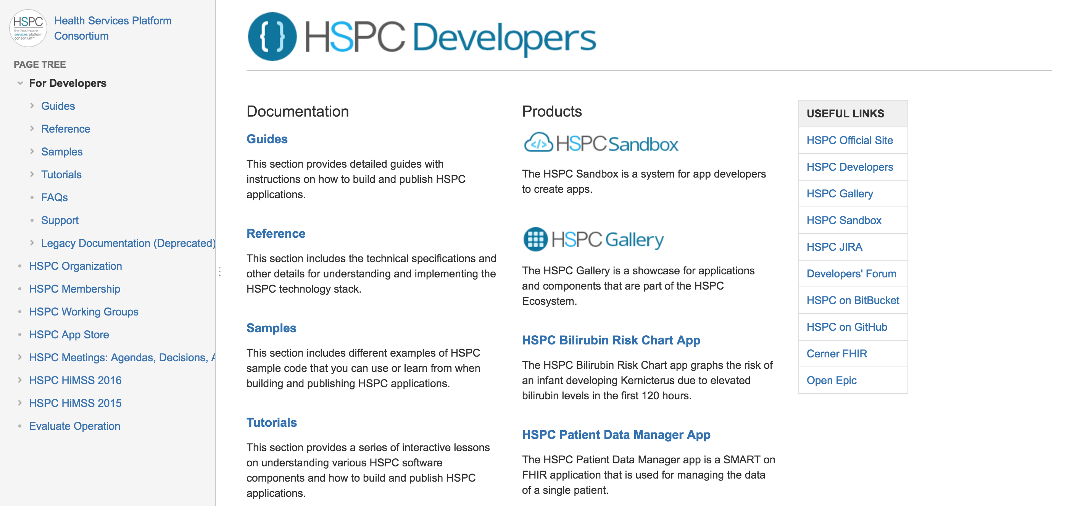
HSPC Developers Documentation

Slide 17

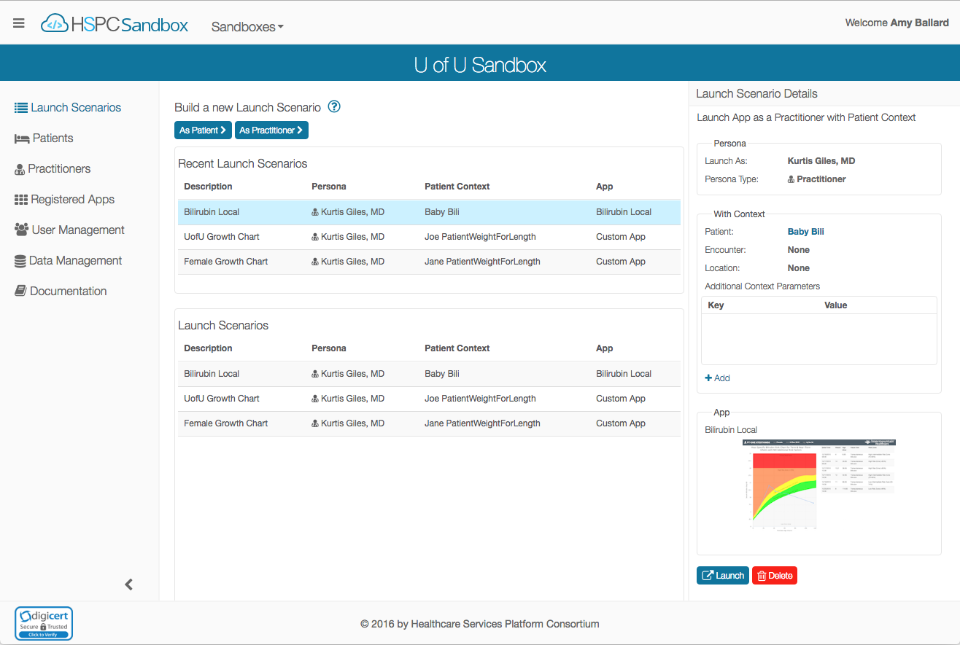
Introducing
http://Sandbox.HSPConsortium.org

Slide 18
Goals
Accelerate development of health apps by providing:
  Development focused reference implementation hosted in the cloud
  SDKs
  Tools & Utilities
  Tutorials, Implementation Guides, Samples, and Documentation
Reduce time to integrate with commercial SMART on FHIR capable platforms (such as EHRs, HIEs, etc.)
Contribute to the Health IT Community:
  Free to use (membership in HSPC is not required)
    Funded by Intermountain Healthcare & HSPC
  Open source: https://bitbucket.org/hspconsortium/

Slide 19
Features
The HSPC Sandbox is a personal instance of a SMART on FHIR platform in the cloud, with tools and data to help build and test health apps.
Create your own cloud-based sandbox, w/default data set, in a few clicks.
Run against your own FHIR server.
Invite your team to join and collaborate with you on your sandbox.
Create or import clinical data to test your apps.
Test apps by creating personas and Launch Scenarios.
Verify your app follows the SMART security and launch context standards.

Slide 20
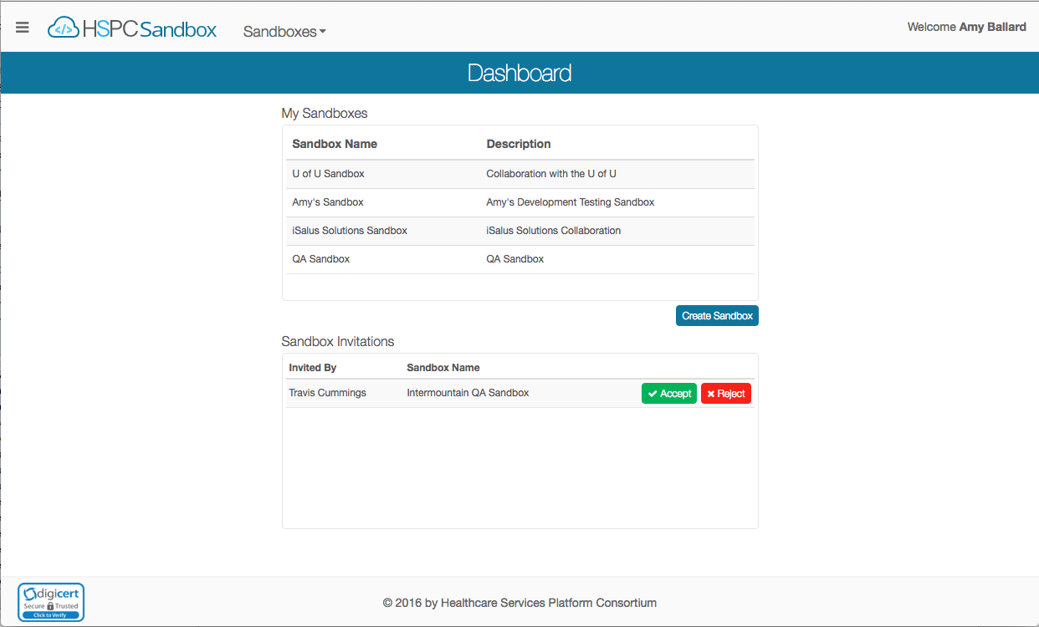
Demo of HSPC Sandbox

Slide 21
Current State & Future Plans
Currently live at sandbox.hspconsortium.org.
  New feature releases monthly.
Future Plans
  User Roles (admin, read-only, etc.)
  Additional Data Management Tools
  FHIR Profile Discovery & Support

Slide 22

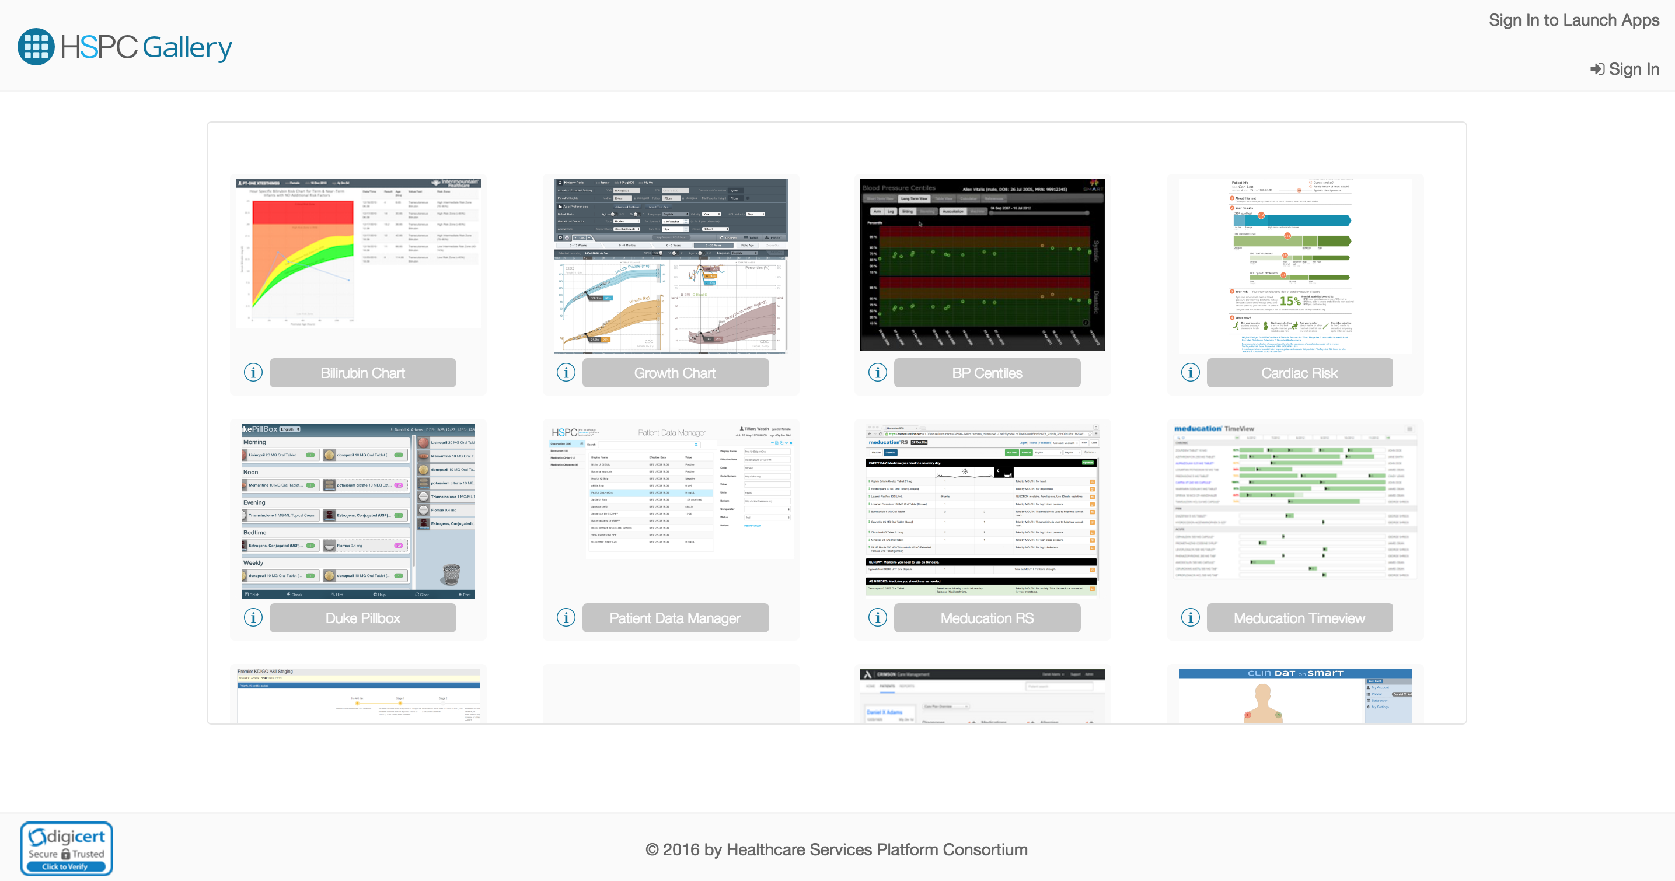
Introducing
http://Gallery.HSPConsortium.org

Slide 23
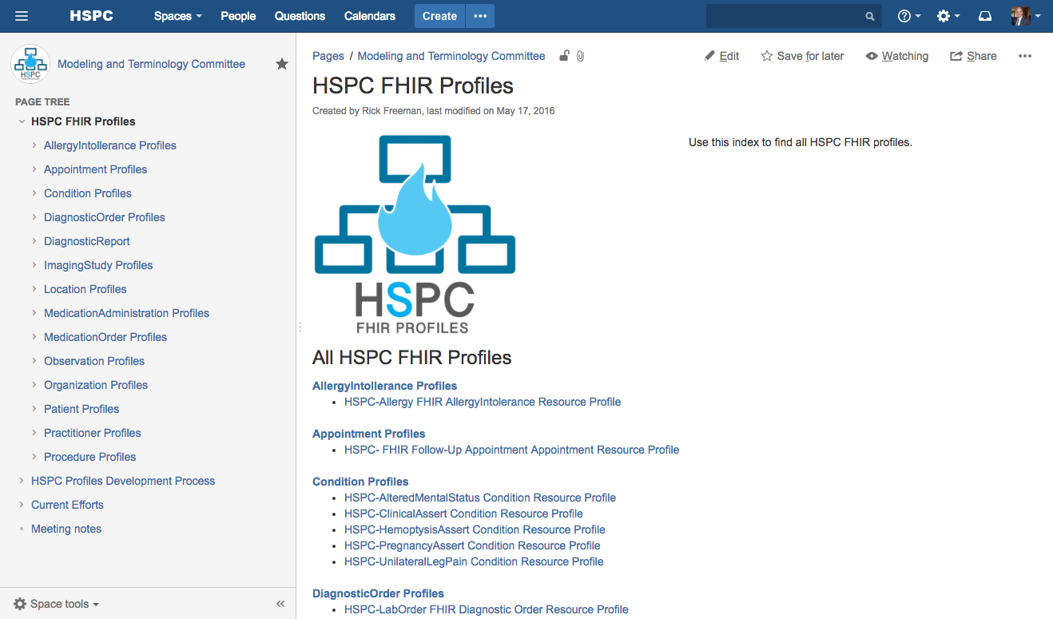
HSPC FHIR Profiles
https://healthservices.atlassian.net/wiki/display/SKCC/HSPC+FHIR+Profiles

Slide 24
What about the HSPC Marketplace?
It’s central to the mission and vision of HSPC. Where is it?
  Work has yet to begin… But, it’s on the roadmap for 2017.
There is a lot to figure out.
  Certification Testing (Will vendors require an extra certification?)
  Hosting
  Deployment
  Payment model & commission.
  Security
  Customer support model
What’s next?
  Need a committee and resources dedicated to building the app store and working through all the process and legal mumbo jumbo.

Slide 25
Developer Resources
HPSC
  For Developers: http://developers.hspconsortium.org
  HSPC Sandbox: http://sandbox.hspconsortium.org
  HSPC Gallery: http://gallery.hspconsortium.org
  HSPC general wiki: https://healthservices.atlassian.net/wiki/
HL7 FHIR:
  Main documentation: http://www.hl7.org/fhir/
  Resources List: https://www.hl7.org/fhir/resourcelist.html
SMART on FHIR
  Main site: http://smarthealthit.org/smart-on-fhir/
  General Documentation: http://docs.smarthealthit.org/
  Security Documentation: http://docs.smarthealthit.org/authorization/scopes-and-launch-context/

Slide 26



Q & A

Slide 27
Live Coding Demo
Creating a simple SMART on FHIR App

Slide 28
Apps Integrate Using a Common API
Functional Standard Overview
HSPC Compliant Apps
To Supporting Platforms/EHRs
Standardized Functional Services
Security
Launch Context
Data Models
Data Access
on
Profiles
Compliant Platforms

Slide 29


OAuth2 Access Delegation
User
Authorize
Data Holder
EHR, Hospital, Clinic, HIE, Lab, Insurer, etc
App
Decision Support, eRX, visualization, pop health, etc.
Get Data

Slide 30
What is FHIR?
Next Generation HL7 Standard
    Current Version: DSTU2 - http://www.hl7.org/fhir
Vision
  Combine best features of HL7 V2, V3, and CDA product lines
  Leverage latest Web standards
    JSON, XML, REST API, Search API
  Focus tightly on implementation

Slide 31
FHIR Features
FHIR consists of two main features:
API
  RESTful interface for consistent and granular data operations
Data Modeling
  Data types, Resources, and Profiles for defining clinical and administrative data

Slide 32
FHIR API
FHIR defines a set of interactions that can be used to manage resources in a consistent and granular manor. Applications that conform to this API are “RESTful FHIR”. HTTP, HTTPS, REST, and JSON are the HSPC standard. XML is not supported by HSPC (but is supported by FHIR)
  create: POST [base]/[type] {?_format=[mime-type]}
  read: GET [base]/[type]/[id] {?_format=[mime-type]}
  vread: GET [base]/[type]/[id]/_history/[vid] {?_format=[mime-type]}
  update: PUT [base]/[type]/[id] {?_format=[mime-type]}
  delete: DELETE [base]/[type]/[id]
  search:
    GET [base]/[type]{?[parameters]{&_format=[mime-type]}}
    POST [base]/[type]/_search{?[parameters]{&_format=[mime-type]}}

Slide 33
FHIR Search Samples
API
  Show all patients
    https://open-api.hspconsortium.org/data/Patient
  By ID
    https://open-api.hspconsortium.org/data/Patient/BILIBABY
  By Name (search)
    https://open-api.hspconsortium.org/data/Patient?name=R
  By Name and Gender
    https://open-api.hspconsortium.org/data/Patient?name=R&gender=female
  By Name, Gender, and Birth Date
    https://open-api.hspconsortium.org/data/Patient?name=R&gender=female&birthdate=>2010-12-01

Slide 34
FHIR Data Modeling
Data Model
  Primitive Data types: Single element based on XML Schema
  Complex Data types: Reusable clusters of elements
  Resources: Modular set of components built to solve clinical and administrative problems (80/20 rule)
  Profiles: A statement of use of one or more resources

Slide 35
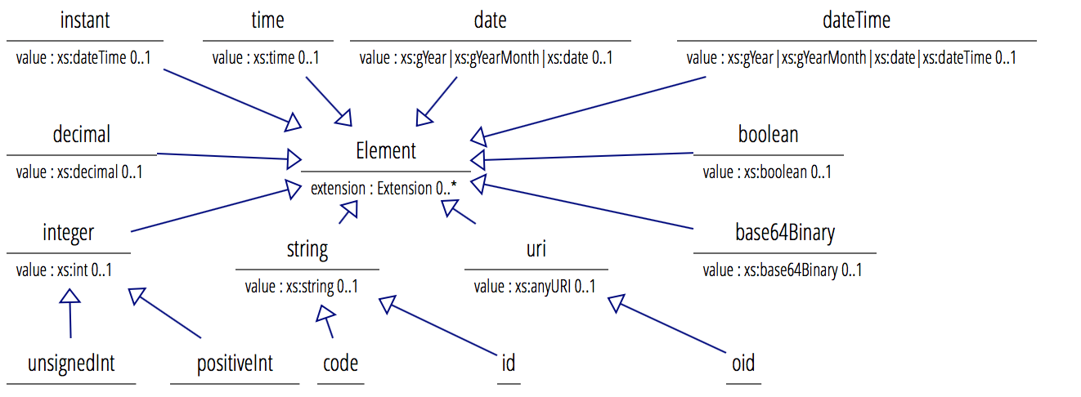
FHIR Simple Data Types
http://www.hl7.org/fhir/2015Sep/datatypes.html - 1.19.0
Primitives: Imported from XML Schema
* Simple restrictions

Slide 36
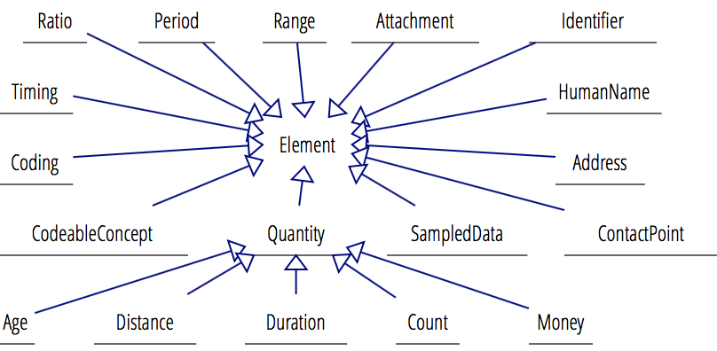
FHIR Complex Data Types
http://www.hl7.org/fhir/2015Sep/datatypes.html#complex
Complex Types: Re-usable clusters of elements
Element
extension : Extension 0..*
Ratio
numerator : Quantity 0..1
denominator : Quantity 0..1
* Defined variations on quantity

Slide 37
FHIR Resources
http://www.hl7.org/fhir/2015/resourcelist.html
Resource <<Resource>>
id: id 0..1
meta: Meta 0..1
implicitRules: uri 0..1
language: code 0..1
Meta
versionId: id 0..1
lastUpdated: instant 0..1
profile: uri 0..*
security: Coding 0..*
tag: Coding 0..*
DomainResource <<Resource>
text: Narrative 0..1
contained: Resource 0..*
extension: Extention 0..*
modifierExtention: Extention 0..*
Bundle <<Resource>>
type: code 1..1
base: uri 0..1
total: unsignedInt 0..1
signature: base64Binary 0..1
Bundle Usages
- RESTful Search
- History
- Messaging
- Documents
- Transactions
Patient <<DomainResource>>
identifier: Identifier 0..*
name: HumanName 0..*
telecom: ContactPoint 0..*
…
active: boolean 0..1
Observation <<DomainResource>>
code: CodeableConcept 1..1
value[x]: Quantity|string|…
encounter: Reference 0..1
subject: Reference 0..1
…

Slide 38
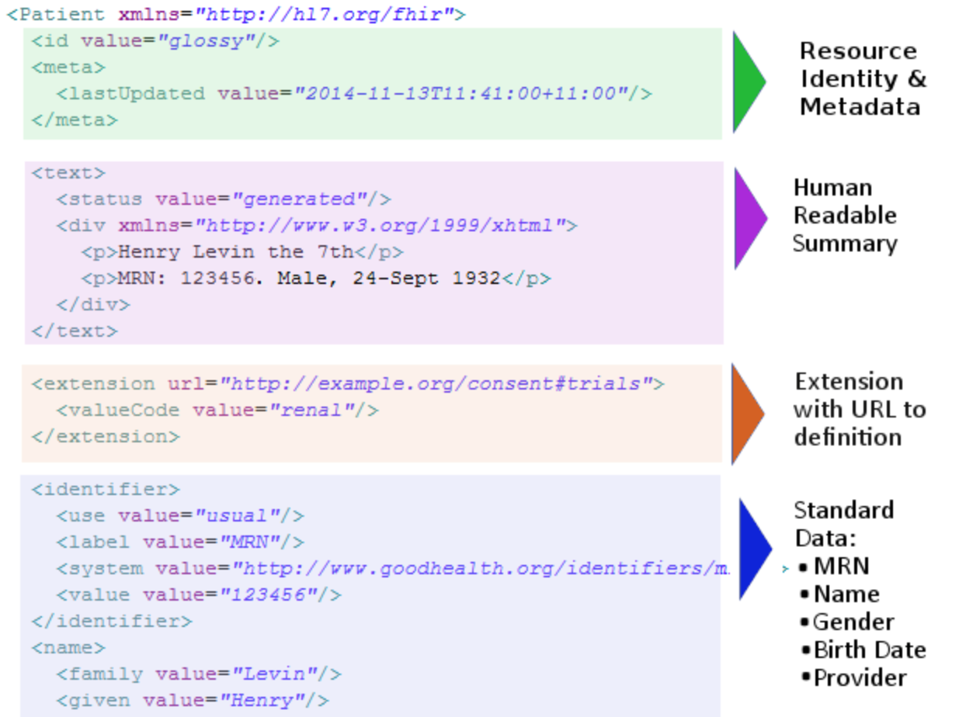
FHIR Resources - Patient

Slide 39
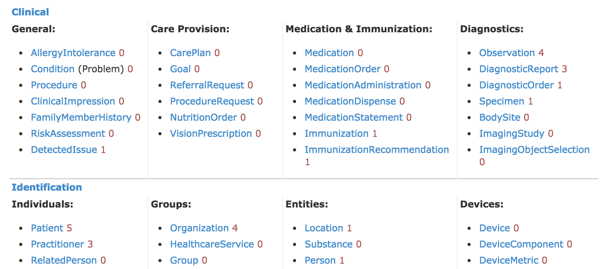
FHIR Resources - Categorization
http://www.hl7.org/fhir/2015Sep/resourcelist.html

Slide 40
FHIR Resources - Collections
List <<DomainResource>>
identifier: Identifier 0..*
title: string 0..1
subject: Reference 0..1
source: Reference 0..1
status: code 1..1 (ListStatus)
ordererBy: CodableConcept 0..1
mode: code 1..1
note: string 0..1
emptyReason: CodeableConcept 0..1
Group <<DomainResource>>
identifier: Identifier 0..*
type: code 1..1
actual: boolean 1..1
code: CodeableConcept 0..1
name: string 0..1
quantity: unsignedInt 0..1
member: Reference(Patient|…) 0..*
Composition <<DomainResource>>
identifier: Identifier 0..*
type: CodeableConcept 1..1
title: string 0..1
confidentiality: code 0..1
subject: Reference(Any) 1..1
author: Reference 1..*
custodian: Reference 0..1
encounter: Reference 0..1
section 0..*
Section
title: string 0..1
code: CodeableConcept 0..1
content: Reference(List) 0..1
entry 0..*
characteristic 0..*
Entry
flag: CodeableConcept 0..*
deleted: boolean 0..1
date: dateTime 0..1
item: Reference(Any) 1..1
Characteristic
code: CodeableConcept 0..*
value[x]: CodeableConcept 1..1
exclude: boolean 0..1
attester 0..*
Attester
mode: code 0..1
time: dateTime 0..1
party: Reference (Patient|…)
event 0..*
Event
code: CodeableConcept 0..1
period: Period 0..1
detail: Reference(Any) 0..*
Notes:
List resource - enumerates a flat collection of resources and provides features for managing the collection.
Group resource - defines a group of specific people, animals, devices, etc. by enumerating them, or by describing qualities that group members have.
Composition resource – defines a set of healthcare-related information that is assembled together into a single logical document that provides a single coherent statement of meaning, establishes its own context and that has clinical attestation with regard to who is making the statement.

Slide 41
FHIR Resources – Collections (cont)
Bundle <<Resource>>
type: code 1..1
base: uri 0..1
total: unassignedInt 0..1
signature: base64Binary 0..1
DomainResource <<Resource>
text: Narrative 0..1
contained: Resource 0..*
extension: Extention 0..*
modifierExtention: Extention 0..*
Link
relation: string 1..1
uri: uri 1..1
link 0..*
entry 0..*
link 0..*
contained: allows for multiple resources nested in a resource, however, each nested resource looses its identity (has no ID)
Entry
base: uri 0..1
resource: Resource 0..1
Search
mode: code 0..1
score: decimal 0..1
search 0..*
transactionResponse 0..1
transaction 0..1
TransactionResponse
status: string 1..1
location: uri 0..1
etag: string 0..1
lastModified: instance 0..1
Transaction
method: code 1..1
uri: uri 1..1
ifNoneMatch: string 0..1
ifMatch: string 0..1
ifModifiedSince: instance 0..1
ifNoneExist: string 0..1
Notes:
Bundle resource is an infrastructure container for a group of resources.
DomainResource.contained element allows multiple resources to be nested inside any DomainResource. This is a special type of grouping where the grouped resources lose independent existence - they no longer have their own identifiers, can't easily be queried independently, etc.

Slide 42
FHIR Resource Profile
A Resource Profile - a statement of use of one or more FHIR Resources. It may include constraints on Resources and Data Types, Terminology Binding Statements and Extension Definitions.
Resources cover 80% of common use cases and data elements, Resource Profiles allow for extension and restriction.
One of HSPC’s primary missions is to create and distribute a common set of FHIR profiles

Slide 43
Q & A

Slide 44
Lab: Building your first SMART on FHIR App
https://healthservices.atlassian.net/wiki/display/HSPC/Quick+Start+JavaScript+App+for+a+Provider

Slide 45
Developer Resources
HPSC
  For Developers: http://developers.hspconsortium.org
  HSPC Sandbox: http://sandbox.hspconsortium.org
  HSPC Gallery: http://gallery.hspconsortium.org
  HSPC general wiki: https://healthservices.atlassian.net/wiki/
HL7 FHIR:
  Main documentation: http://www.hl7.org/fhir/
  Resources List: https://www.hl7.org/fhir/resourcelist.html
SMART on FHIR
  Main site: http://smarthealthit.org/smart-on-fhir/
  General Documentation: http://docs.smarthealthit.org/
  Security Documentation: http://docs.smarthealthit.org/authorization/scopes-and-launch-context/

Slide 46
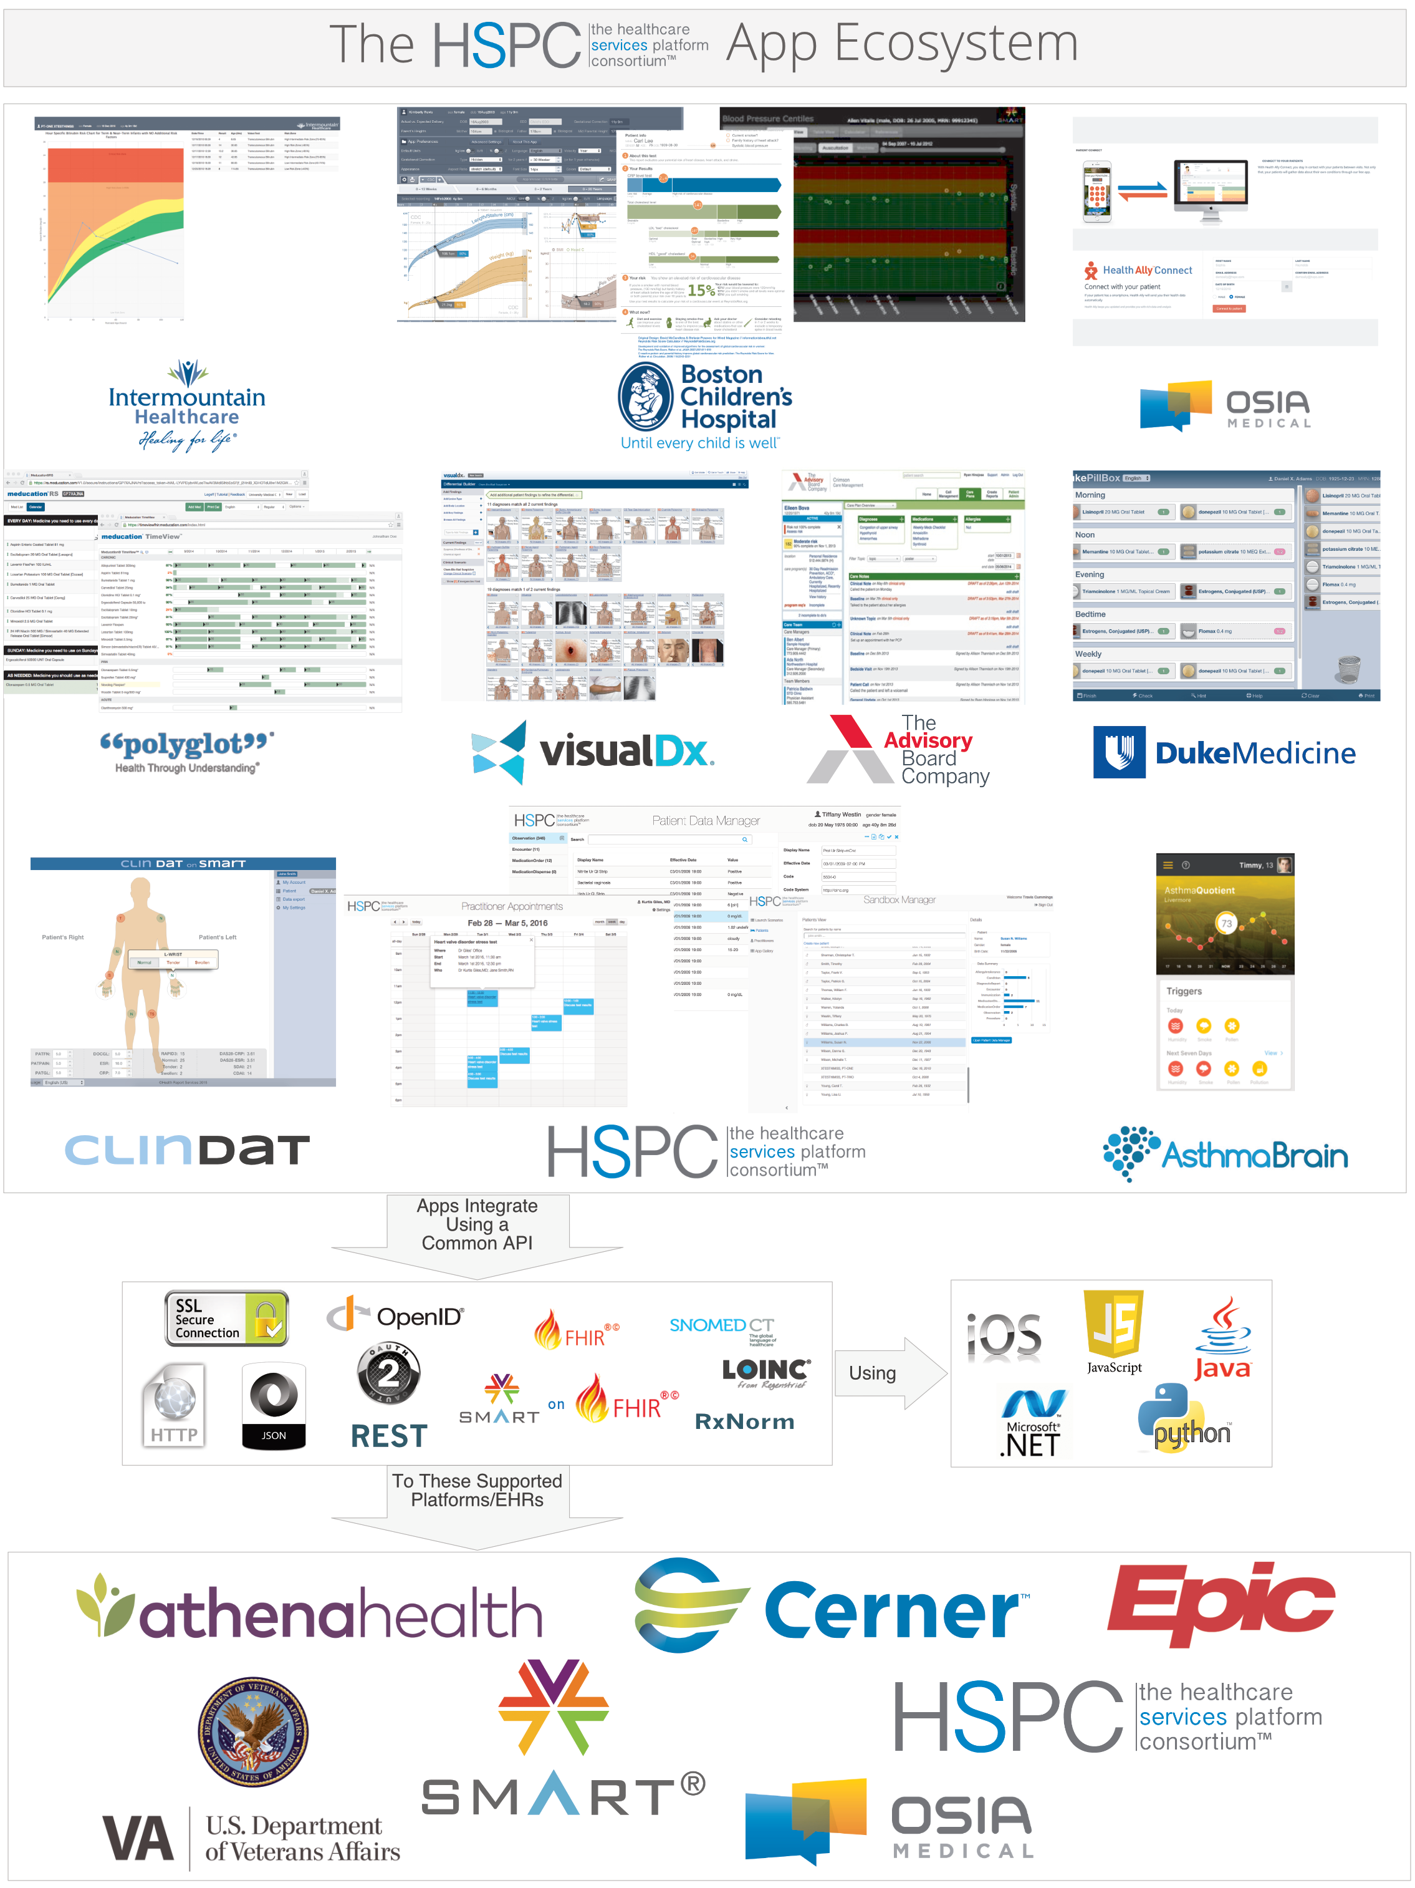
Q & A

Slide 47










HSPC Compliant Apps
Template Libraries to Speed Application Development
Apps Integrate Using a Common API
Development Libraries
Common API: Data, Security, Identity, etc.
Using
on
REST
RxNorm
To Supporting Platforms/EHRs
Identity,
Authorization,
& Data Provider

Slide 48
Phase 1 vs. Phase 2
Phase 1 Goals
Phase 2 Goals
Semantically Interoperable Data Exchange
Data Access Authorization
Launch Context Sharing
EHR or EMR embedded application launching
Event based applications and applications that run outside of the EHR or EMR.
Simple Eventing & Alerting
User Notification & Messaging
Care Coordination between independent EHRs or EMRs
Clinical Workflow Modeling and Orchestration
Population Health Management

Slide 49
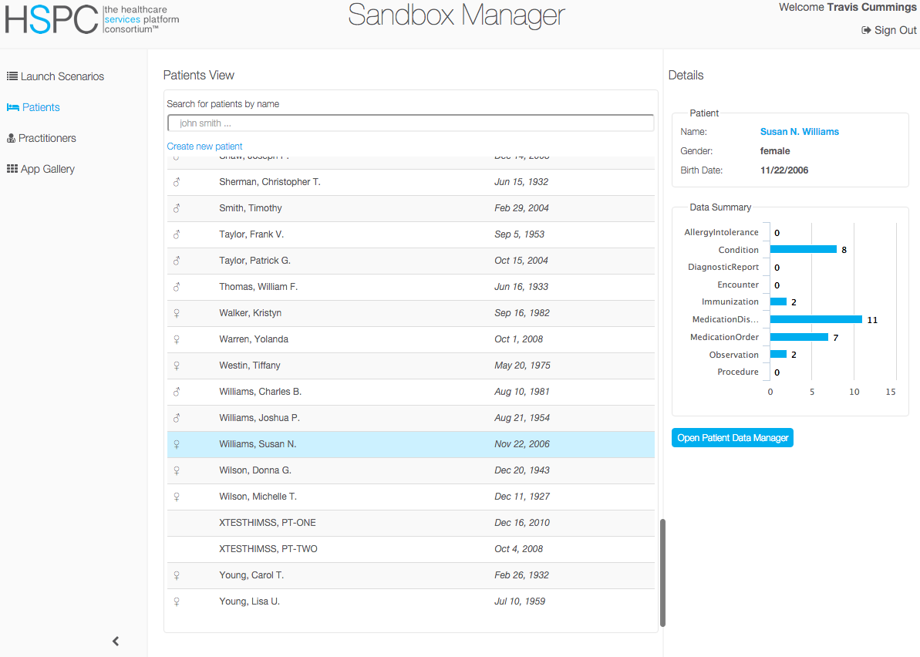


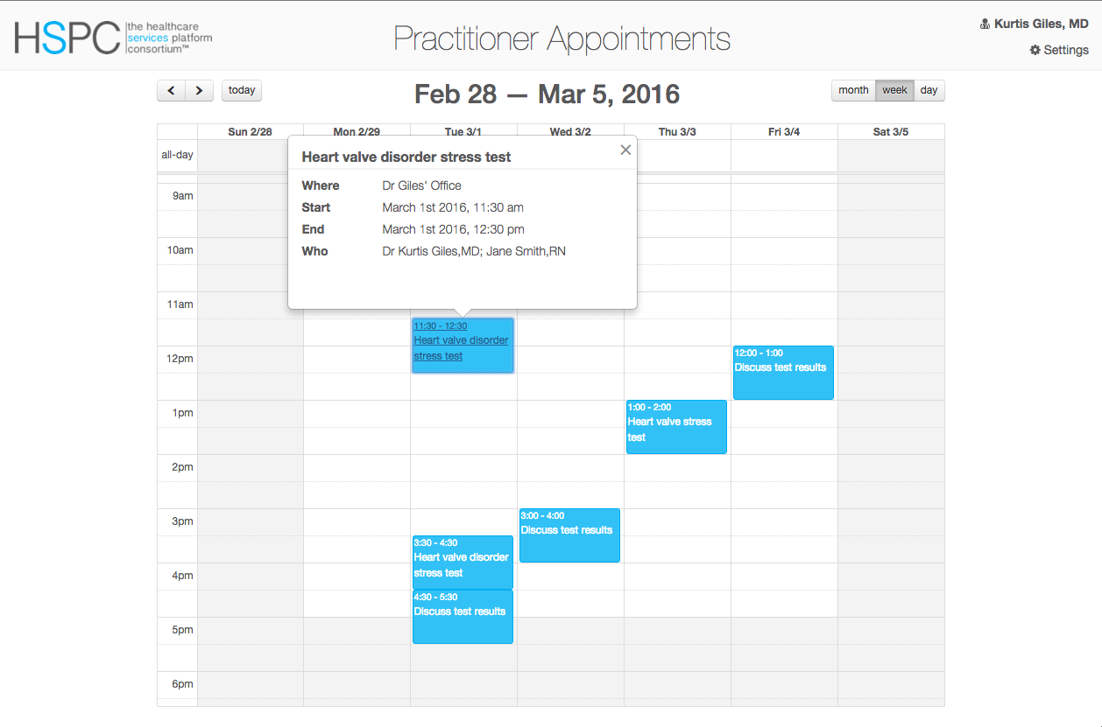

Federated Data Demonstration
REST
Sandbox App Launcher
on
Data Federation Platform
Appointments Manager
Sandbox
on
Sandbox

