Slide 1
Community Cloud

Slide 2
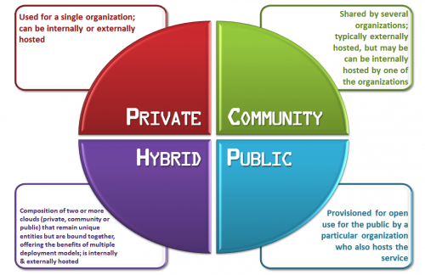
What is it?
Multiple “deployment models” for cloud computing
Familiar ones are: public, private and hybrid cloud
A community cloud is a multi-tenant infrastructure that is shared among several organizations from a specific group with common computing concerns.

Slide 3
Industry-specific community cloud
Each highly regulated industry has special requirements
Community cloud governance body
Cloud consumers
Regulatory entities:
http://www.thoughtsoncloud.com/2015/09/community-cloud-the-answer-to-the-publicprivate-debate/
Notes:
, best practices and guidelines describing the rules of cloud computing consumption models. Therefore, an industry-specific community cloud makes sense as it groups the similar organizations within one generally accepted platform. To address data privacy and placement concerns, IBM is working with the local, in-country partners to define, deploy and run industry-specific community clouds. In general, the concept of such a cloud is based on 4 types of participants:
Community cloud governance body: Publicly trusted entity that takes responsibility for governing the community cloud platform.
Community cloud provider/technology partner: A trusted and reliable partner that will be able to set up and operate the community cloud platform while fulfilling industry-specific requirements and laws.
Cloud consumers: Organizations that belong to the specific industry, sharing similar data processing regulatory concerns. Cloud consumers have a chance to utilize services provided by the community cloud according to their needs and their cloud adoption maturity level.
Regulatory entities: Organizations responsible for defining, enforcing and controlling industry-specific regulations. Their role is to assure that the platform is compliant with the international and local law.

Slide 4
Why the need?
Adoption of cloud computing in health care has lagged
‘Organic’ approaches are not resulting in rapid enough adoption of cloud
Still significant security/privacy barriers to adoption among Health IT leaders
HSPC ‘Reference Architectures” would be readily accessible

Slide 5
Advantages to the HSPC Community
Standards-based data acquisition, aggregation and quality enrichment
Intelligent cohort definition
Population health services
Tailored big-data analytics
Clinical rules engine processing
Clinical natural language processing
Custom-built end-user interaction models

Slide 6
CMS and ONC "critical principles” (MACRA)
Reward providers for outcomes
Allow for the flexibility to customize health IT
Innovation through open APIs
Level the technology playing field
Prioritize interoperability and real world use of technology
All furthered by cloud computing
EHR Incentive Programs: Where We Go Next
January 19
By Andy Slavitt and Karen DeSalvo
http://blog.cms.gov/2016/01/19/ehr-incentive-programs-where-we-go-next/
Notes:
EHR Incentive Programs: Where We Go Next
January 19
By Andy Slavitt and Karen DeSalvo
http://blog.cms.gov/2016/01/19/ehr-incentive-programs-where-we-go-next/

Slide 7
Some existing examples
VMWare/EMC Financial Services
On-Demand Services for financial trading
IBM Federal Community Cloud
Dedicated Federal Data Centers service
Microsoft Azure US Government Cloud
State, local, and federal government agencies.
AWS GovCloud
Direct or indirect ties to US government functions, services, or regulations

Slide 8
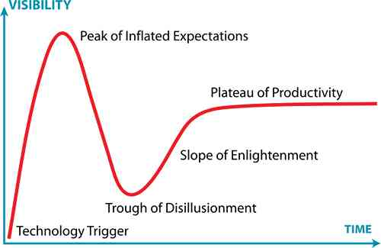
Current state of the cloud in Healthcare
Many ‘clouds’ – most vendor-specific
Overwhelming majority are SaaS model
SaaS model expressly precludes middleware services
Very few meet the NIST “Essential Characteristics”
On-demand self-service
Broad network access
Resource pooling
Rapid elasticity
Measured service

Slide 9
How to get there
Big vision – baby steps
Identify high-value use cases
Identify already ‘in-flight’ projects that can be deployed
Establish governance elements on ‘as needed’ basis
We need your input on how to best meet your needs

Slide 10
Next Steps
Need your input
Follow-up web meeting
Working group to define:
Governance
Feature set
Use Cases
Target technology partners
Target customers

