Slide 1




Slide 2
ACOG Wish List
Clinical
  BHAG – ACOG Antenatal Record
    500 data elements, time span of 9 months
    Perfect use case for interoperability
    After delivery, outputs back to outpatient OB AND Peds
  Maternal Quality Improvement Project (MQIP)
    180 data elements
  Office of Population Affairs (OPA)
  Mini-Apps
    GBS

Slide 3
ACOG Wish List
Quality
  Data Quality
  Clinical quality
eCQMs
  Basis of BOTH MIPS and APMs
  But it all starts with discrete data elements
    (as FHIR Resources, of course……….)

Slide 4
OPA
Clinical need
  Family Planning Services
  Learning Healthcare system
  Interoperability
  FHIR
Operationalizing to meet the need
  Dataset
  FHIR Standard
  Vendors
  Registry
Results

Slide 5
Family Planning in USA
6 M Pregnancies every year
  4 M births
  1M Spontaneous miscarriages
  1M pregnancy terminations
    Actually 700,000 in 2012, and falling
Half of all pregnancies are unintended
  Not necessarily unwanted……

Slide 6
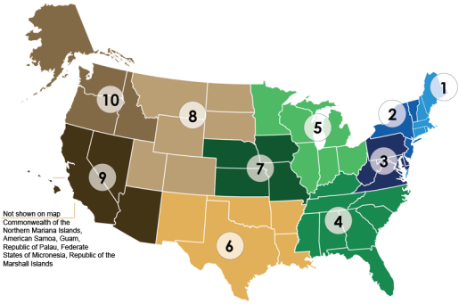

Title X: A diverse and wide network
Office of Population Affairs
The 10 HHS Federal Regions
7.2 | million encounters annually
4.1 | million clients
4,127 | Service delivery sites
1,134 | Sub recipients
50+ | States & territories funded by
94 | Grantees monitored by
20 | Regional OPA FTEs supported by
10 | Regional Health Administrators
5 | National Training Centers
1 | OPA HQ
Family Planning saves tax payers $7.09 for every $1 invested!
Source: www.guttmacher.org
Source: Family Planning Annual Report: 2014 (Aug 2015)

Slide 7
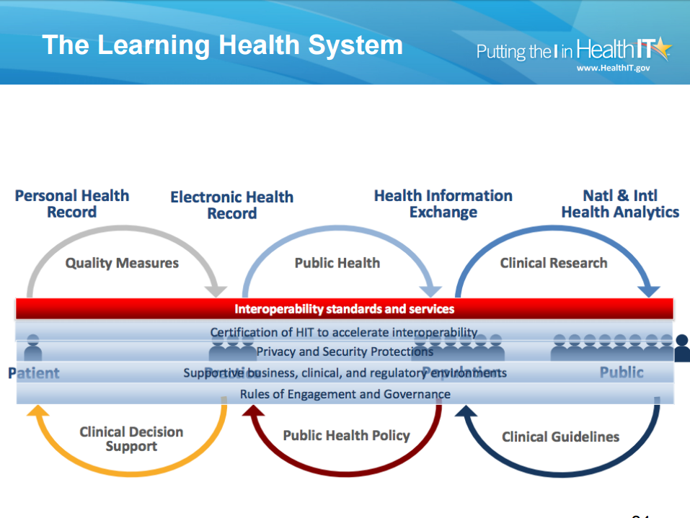

Slide 9
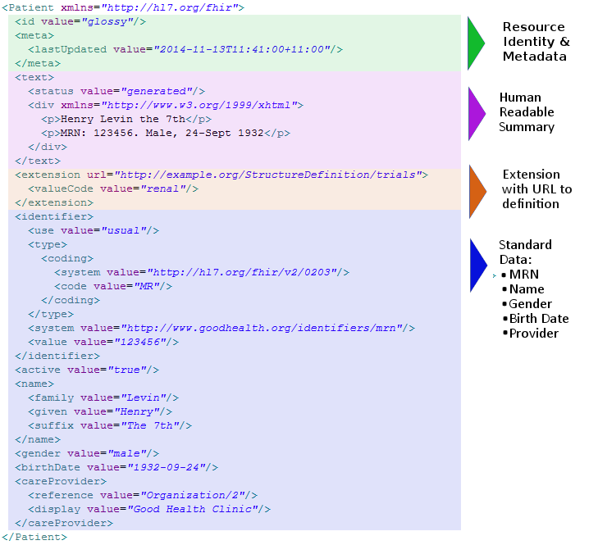
FHIR

Slide 10
So how do all these pieces fit together?
Create a Data Dictionary
Transform into a FHIR Profile
Engage Vendors to integrate FHIR Profile into their FHIR server
  So that regulations are met
Set up a registry/data warehouse
Define metrics for data and clinical quality
Feedback to system-wide changes for care delivery improvement

Slide 11
Comprehensive 2.0 Activities Timeline
Public Comment IHE Profile
Go live with 2.0 system
Connectathon
Interoperability Showcase
Jul 2017
Jun 2014
Jan 2015
Apr 2015
2014
2015
2016
2017
Jul 2014
FPAR 1.0 system contract
Sep 2019
Jan 2014
OMB approval of current FPAR forms
Sep 2016
Apr 2014
Sep 2017
Pilot Performance Measures & Targets
Engage OMB on 2.0
Jul 2015
Dec 2015
Jan 2016
OMB review of 2.0
Dec 2016
Jan 2014
Preg Intentions Study
Sep 2014
Jan 2014
JSI Data System & Feasibility Prep Contract
Sep 2015
Jan 2014
RFD and CQF pilot activities
Aug 2015
Jan 2014
Market research for 2.0
Apr 2016
Fund & solicit 2.0
May 2016
Sep 2016
Build & test 2.0 system
Oct 2016
Apr 2017
Jan 2017
Phase into 2.0 system
Sep 2018

Slide 12
Looking Forward
We need an operational victory
Better can be the enemy of good enough
We cannot let open APIs become the Wild West

