Slide 1
Modeling and Terminology
ACS and HSPC Summit
July 26, 2016
Stanley M. Huff, MD

Slide 2
Acknowledgements
Tom Oniki
Joey Coyle
Craig Parker
Yan Heras
Linda Bird
Patrick Langford
Keith Campbell
Roberto Rocha
Lee Min Lau
Alan James
Harold Solbrig
Thomas Beale
Grahame Grieve
Susan Matney
Many others…

Slide 3
Outline
Current situation and a vision for the future
What is plug-n-play interoperability?
The path to interoperability
Where we are today

Slide 4
Why?
“To help people live the healthiest lives possible.”
4

Slide 5
Graphic Presentation of a Detailed Clinical Model
SystolicBPObs
SystolicBP
data
138 mmHg
LOINC
quals
BodyLocation
BodyLocation
data
Right Arm
SNOMED CT
PatientPosition
PatientPosition
data
Sitting
5

Slide 6
Current Situation
Each EHR vendor uses a proprietary database schema, proprietary models and unique terminology to represent clinical data
Some standardization of codes is now occurring, but
Data is not consistent vendor to vendor, or even organization to organization within the same vendor
This means that:
Sharing data is difficult
Sharing executable software across vendors is impossible
Each useful application is created or re-created on each different platform
There are unmet needs for health care applications and decision support
Software costs are higher than they need to be
6

Slide 7
The Future Ecosystem
Standards are defined that enable “truly” interoperable systems using standards based services
Old and new EHR vendors:
Support standards based services (HL7 FHIR®)
Support SMART® applications
Thousands of people develop software that runs on truly interoperable platforms
Open source, academics, and for profit developers
Apps, including clinical decision support algorithms, are for sale in a vendor neutral app store
Apps can be certified as HSPC compliant
Platform vendors certify apps as safe for use in their platform
7

Slide 8
The Future Ecosystem (2)
People buy a patient data platform
Includes auditing, security, authorization, patient selection, etc.
May include some core apps: order entry, results review, notification, etc.
People buy the apps they need
There is also a marketplace for sharing knowledge, especially protocols, workflows, order sets, ontologies
Patients receive better care at a lower cost because lower cost higher quality apps are available as driven by market forces
8

Slide 9
“True Interoperability”
Data shared through standard messages
Data accessed via standard services
The data has a standard logical structure
Standard information models
Standard terminology
Sharing of applications, data, information, and knowledge
9

Slide 10
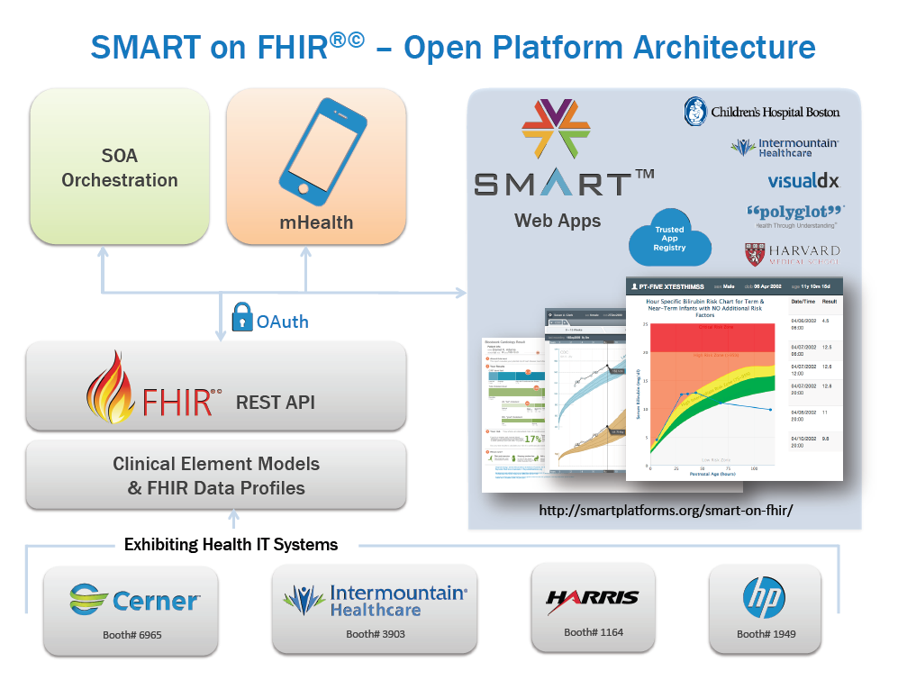
FHIR Profiles from CIMI Models
(using standard terminology)
Heterogeneous Systems
Commercial
EHR
Home Grown
System
System
Integrator
Others…
10

Slide 11
MQIP Data Collection
SMART Form
Data from EHR
User entered data
Calculations
Provenance
FHIR Profiles for Maternity Data Elements
Heterogeneous Systems
MQIP
Others…
11

Slide 12
Apps that enable data sharing…
Quality
Registry
Next-gen Interoperability
Disease and quality registries
Population Health integration
HIE integration
Data capture for research
Clinical Trial recruiting
EHR
1
EHR
2
EHR
3
12

Slide 13
The path to interoperability
13

Slide 14
What is HL7 FHIR©®?
A set of modular components called “Resources”
Resources refer to each other using URLs
Build a web to support healthcare process
Exchange resources between systems
Using a RESTful API (e.g. web approach)
As a bundle of resources (messages, documents)

Slide 15
FHIR: Core Resources
AdverseReaction
Alert
AllergyIntolerance
CarePlan
Composition
ConceptMap
Condition
Conformance
Device
DeviceObservationReport
DiagnosticOrder
DiagnosticReport
DocumentReference
DocumentManifest
Encounter
FamilyHistory
Group
ImagingStudy
Immunization
ImmunizationRecommendation
List
Location
Media
Medication
MedicationAdministration
MedicationDispense
MedicationPrescription
MedicationStatement
MessageHeader
Observation
OperationOutcome
Order
OrderResponse
Organization
Other
Patient
Practitioner
Procedure
Profile
Provenance
Query
Questionnaire
RelatedPerson
SecurityEvent
Specimen
Substance
Supply
ValueSet

Slide 16
Observation Resource
Observation (DomainResource)
identifier : Identifier [0..*]status : code [1..1]« ObservationStatus! »
code : CodeableConcept [1..1] « LOINC ?? »
subject : Reference [0..1]« Patient|Group|Device|Location »
encounter : Reference [0..1] « Encounter »
effective[x] : Type [0..1]« dateTime|Period »
value[x] : Type [0..1]
« Quantity|CodeableConcept|string|Range|Ratio|SampledData|
Attachment|time|dateTime|Period »
interpretation : CodeableConcept [0..1] « Observation Interpretation+ »
method : CodeableConcept [0..1] « Observation Methods?? »
specimen : Reference [0..1] « Specimen »
device : Reference [0..1] « Device|DeviceMetric »

Slide 17
Profile for “Blood pressure”
Observation = Blood Pressure
Subject.reference: Patient URL
Coding: LOINC 55284-4
Related:
type: has-component
target.reference:
Observation URL
type: has-component
target.reference:
Observation URL
Observation = Systolic BP
name: “Systolic”
coding: LOINC 8480-6
value.units: “mmHg”
Observation = Diastolic BP
name: “Diastolic”
coding: LOINC 8462-4
value.units: “mmHg”

Slide 18
What if we use different models?
Site #1
70
Dry Weight:
70
kg
Site #2
70
Dry
Weight:
70
kg
Wet
Ideal

Slide 19
Too many ways to say the same thing
A single name/code and value
Dry Weight is 70 kg
Combination of two names/codes and values
Weight is 70 kg
Weight type is dry

Slide 20
Implications of different models
Patient Identifier
Date and Time
Observation Type
Observation Value
Units
123456789
7/4/2005
Dry Weight
70
kg
123456789
7/19/2005
Current Weight
73
kg
Patient Identifier
Date and Time
Observation Type
Weight type
Observation Value
Units
123456789
7/4/2005
Weight
Dry
70
kg
123456789
7/19/2005
Weight
Current
73
kg
How would you calculate the desired weight loss during the hospital stay?

Slide 21
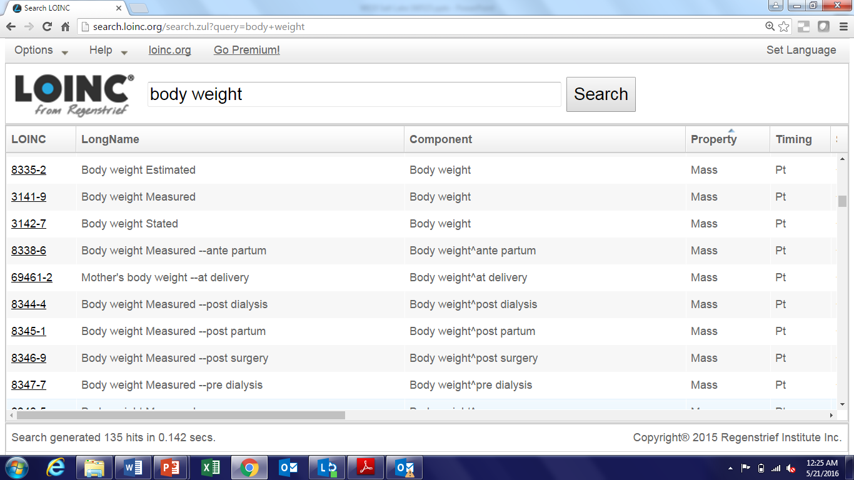
LOINC Codes for Weight

Slide 22
LOINC and SNOMED CT
Logical Observation Identifiers Names and Codes
~80,000 Observation codes
Regenstrief Institute
Licensed free-for-use
Systematic Nomenclature of Medicine – Clinical Terms
International Health Terminology Standards Development Organization
Licensed by country, organization, or individual
22

Slide 23
Graphic Presentation of a Detailed Clinical Model
SystolicBPObs
SystolicBP
data
138 mmHg
LOINC
quals
BodyLocation
BodyLocation
data
Right Arm
SNOMED CT
PatientPosition
PatientPosition
data
Sitting
23

Slide 24
The General Pattern
LOINC is the question, and SNOMED CT is the answer
24

Slide 25
CIMI
The Clinical Information Modeling Initiative (CIMI) is an HL7 Work Group that is producing detailed clinical information models to enable interoperability of health care information systems
CIMI was initiated during a “Fresh Look” session at an HL7 meeting in 2011
CIMI models are free for use for all purposes
See http://www.opencimi.org/ for more details

Slide 26
CIMI Goals
Create a shared repository of detailed clinical information models
Repository is open to everyone and models are licensed free for use at no cost
Where the models:
Are expressed in an approved formalism
Archetype Definition Language (ADL)
Archetype Modeling Language (AML)
Are based on a core reference model, including a set of base data types
Have formal bindings to standard coded terminologies

Slide 27
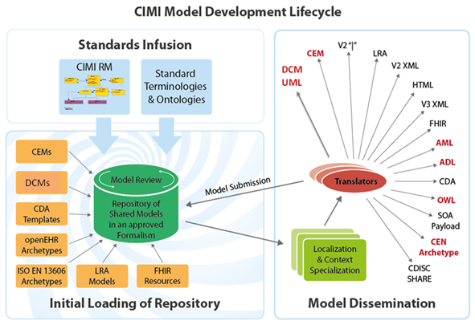

Slide 28
The danger
No true interoperability because
Vendors use different models/profiles
Government agencies use different models/profiles
Provider organizations use different models/profiles
Professional organizations use different models/profiles

Slide 29
The danger
No true interoperability because
Vendors use different models/profiles
Government agencies use different models/profiles
Provider organizations use different models/profiles
Professional organizations use different models/profiles

Slide 30
Healthcare Services Platform Consortium MISSION
Improve health by creating a vibrant, open ecosystem of interoperable applications, content, and services
30

Slide 31
Membership
3 Benefactor members
Veterans Administration
Louisiana State University Health
Intermountain Healthcare
Key alliances
Center for Medical Interoperability (C4MI)
OSEHRA
3 Associate (organizational) members
Regenstrief
Motive
Allscripts
11 Individual members
Society Members: AMA, MHII and ACOG
31

Slide 32
HSPC Goals
Be a provider led collaboration agent by convening providers, professional organizations and vendors to facilitate the creation and sharing of applications and services
Create a reference SOA Platform architecture to support improved healthcare.
Develop terminology and information models as a foundation for true semantic interoperability
32

Slide 33
HSPC Goals (2)
Support standards based interoperability by participating in standards development groups including HL7 FHIR, HL7 CIMI, IHE, Argonauts and other related industry efforts (SMART, SOLOR, C4MI, Commonwell, Sequoia etc).
Support reliable sharing of a variety of knowledge content to support clinical decisions and processes
Support conformance and certification testing to ensure true semantic interoperability
33

Slide 34
HSPC Goals (3)
Support a vendor and provider neutral marketplace for interoperable healthcare applications, tools, services and knowledge
Coordinate with members to have the HSPC endorsed specifications adopted by vendors
Create a sandbox to enable simple and efficient development of HSPC compliant applications and services
34

Slide 35
Plans for this Meeting
Agree to a process for creating models which we use to create FHIR profiles
We should be driven by the needs of real world implementations
Discuss common modeling challenges and opportunities by working on examples
35

Slide 36
Appendix
36

Slide 37
The Value of “Truly” Interoperable Systems
37

Slide 38
Decision Support Modules
Antibiotic Assistant
Ventilator weaning
ARDS protocols
Nosocomial infection monitoring
MRSA monitoring and control
Prevention of Deep Venous Thrombosis
Infectious disease reporting to public health
Patient worksheets
Diabetic care
Pre-op antibiotics
ICU glucose protocols
Ventilator disconnect
Infusion pump errors
Lab alerts
Blood ordering
Order sets
Post MI discharge meds

Slide 39
We can’t keep up!
We have ~150 decision support rules or modules
We have picked the low hanging fruit
There is a need to have 5,000+ decision support rules or modules
There is no path from 150 to get to 5,000 unless we fundamentally change the ecosystem
39

Slide 40
The cost of medical software
Becker’s Health IT & CIO Review
Partners HealthCare: $1.2 billion Boston-based Partners HealthCare is one of more recent implementations, going live the first week of June to the tune of $1.2 billion. This is the health system's biggest investment to date. The implementation process took approximately three years, and in that time, the initial price tag of $600 million doubled.
Intermountain Medical Center $550 million
40

Slide 41
Apps that enable data sharing…
ACOs and Registries
Next-gen Interoperability
Population Health integration
HIE integration
Data capture for research
Clinical Trial recruiting
Quality Repositories
App 1
EHR
1
EHR
2
EHR
3
41

Slide 42
(from Research America)
42

Slide 43
The start of a Learning Healthcare System is accurate, computable, data.
43

Slide 44
More Reasons
Agile software development
Widely distributed
Directed daily by front line clinicians
Increased usability of software, creativity, innovation
Increased choice in software
Thousands of independent developers
Centrally planned economy vs free market
Think “app store for healthcare” or of innovations like Uber

Slide 45
Pre and Post Coordination
45

Slide 46
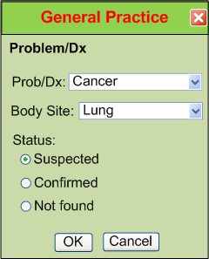
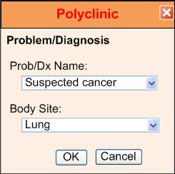
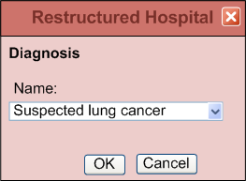
IsoSemantic Models – Example of Problem
(from Dr. Linda Bird)
e.g. “Suspected Lung Cancer”
46

Slide 47
Data Comes in Different Shapes and Colors
Finding – Suspected Lung Cancer
Finding – Suspected Cancer
Location – Lung
Finding – Cancer
Location – Lung
Certainty – Suspected
(Let’s say this is the preferred shape)
47

Slide 48
Data Standardized in the Service
Application
Application
and User
Data in preferred shape and color
Shape and color translation
Shape and color of data
in the local database
48

Slide 49
Partial Interoperability
Application
Application
and User
Standard Terms
(Non-standard Structure)
Term
Translators
Local databases,
CDA, HL7 V.2, etc.
49

Slide 50
Preferred Strategy – Full Interoperability
Application
Application
and User
Standard Structure
AND Standard Terms
(As defined by CIMI Models)
Requirements
Term and
Structure
Translators
Local databases,
CDA, HL7 V.2, etc.
50

Slide 51
Reasons to do it on the server side
Person writing the translation is most likely to understand the meaning of the data in their own database.
The person writing the translation only has to understand their own data and the preferred model.
They can optimize query execution for their own system
The query for the data is simpler. If the application has to write a query that will work for all shapes, the query will be inefficient to process by every system.
51

