Slide 1

Intro to HSPC Model Development Process
7/26/2016

Slide 2
Agenda
Overview of Model Development Process
Understanding your use case and content analysis
Model Request Process
Model Development
Review Model Similarities and Differences
Terminology Mapping
Coordination of content across settings

Slide 3

Model Request Process

Slide 4




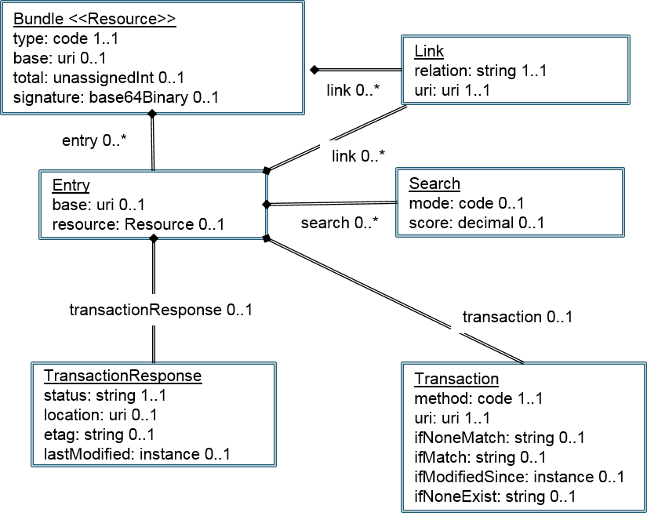
Model Request Workflow
Identify Use Case
Document Use Case
Send Use Case to HSPC
Review the Use Case with HSPC
Model development agreement between HSPC and Partner
Model Request
Content Mapping
Request New Standard Content
Partner Completes Model Request.
Create Models and SMART on FHIR Profile
Model Exists.
Develop the App
on

Slide 5
Understanding and Your Use Case
Viet Nguyen, M.D.
Steve Hasley , M.D.

Slide 6
Model Request Process
Susan Matney, PhD, RNC-OB, FAAN

Slide 7
Registry and Population Data
Data from individual patients, but organized for population queries and analysis
Specific questions of interest
Average, minimum, maximum, last value for measurements during an “episode”
Discreet data for statistical analysis, rather than free text

Slide 8
EHR Data Characteristics
Organized to take care of a single patient at a time
General purpose data – what happened
Time stamped observations, findings, and events
  Hcts, WBCs, Temperatures, Blood Pressures
Data from automated instruments
Textual notes
Images

Slide 9
Greater Value from the EHR
Reuse EHR data element whenever possible (same data type, UoM, etc.)
  NOTE: The data element may not yet be in the standards space
Try to reduce the work of data entry by calculating the registry items from EHR elements
Many common data elements are found in the EHR and Registry
  Height, weight, race, etc.
Use of standard names and codes is critical
  Automatic transfer of data
  Sharing of decision logic that calculates registry data
Many things still need to be asked
  Details of the procedure, devices used, etc.

Slide 10
Typical EHR Data
Date | Time | Event
12/25/2013 |  | Myocardial Infarct
12/26/2013 | 08:00 | 2+ pedal edema
12/26/2013 | 08:00 | Blood pressure | 150/90 mmHg
12/26/2013 |  | Lisinopril | 20 mg p.o. | once a day
12/26/2013 | 09:00 | Temperature | 37.5 degrees C
01/01/2014 | 10:00 | Blood pressure | 135/80 mmHg
01/02/2014 | 06:30 | Surgery start time
01/02/2014 | 07:36 | Blood pressure | 80/50 mmHg
01/02/2014 | 07:50 | Packed red cells | 1 unit
01/04/2014 | 08:00 | Temperature | 39.0 degrees C
01/04/2014 | 09:00 | WBC | 15.1
01/04/2014 | 11:25 | Keflex | 500 mg p.o.

Slide 11
Many things can be derived from the EHR
Accept primary data, then make the calculation/inference in the STS Database
  Lowest Temperature (º C):
  Appropriate Antibiotic Selection: ◻ Yes ◻ No
  Peak Glucose within18-24 hours of anesthesia end time
  Additional intraoperative prophylactic antibiotic dose given : ◻ Yes ◻ No
  Diabetes-Control: ◻ None ◻ Diet only ◻ Oral ◻ Insulin ◻ Other subq ◻ Other ◻ Unknown
  Other In Hospital Postoperative Event Occurred

Slide 12
Issues in data representation

Slide 13
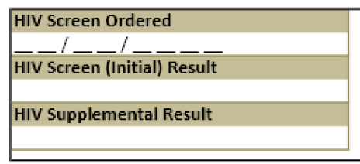
General Concepts
Know what decisions or conclusions you want to make before you collect the data
  No “Recreational” data collection!
The more the computer can do, the better.
  The computer does not critically think without rules
Type of HIV Supplemental Test (may be reported only if positive)
⃝ HIV-1 IFA
⃝ HIV-1/2 Antibody differentiation multispot
⃝ HIV-1 RNA Qualitative result
⃝ HIV-1 RNA Quantitative result
⃝ HIV Western Blot

Slide 14
Be Careful in the Use of “or”
Nausea or vomitting
ACE or ARB Within 48 hours
Previous cardiac or thoracic surgery

Slide 15
Model Request Workflow
Identify Use Case
Document Use Case
Send Use Case to HSPC
Review the Use Case with HSPC
Model development agreement between HSPC and Partner
Model Request
Partner Completes Model Request.

Slide 16
Modeling Approach
Analyze clinical models
Define Models Patterns
  Observations
  Findings
  Procedures
Compare against existing models
Add Terminology bindings
Value set bindings
Clinical Verification / Review

Slide 17
LOINC Panels
Logical groupings of clinical observations or survey instruments
Registry form sections are grouped in panels
Scales and instruments are made as Panels
  Morse Fall Scale
  Braden Scale
Interoperability Issue = Scale/Instrument has to be free and copyright obtained
  Requires LOINC obtain copyright from developer
  Braden Q cannot be created in LOINC – journal will not release copyright
  Johns Hopkins Fall Risk Assessment cannot be created – cost per use

Slide 18
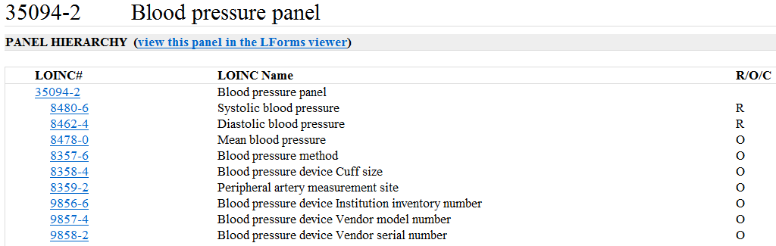
Registry Data Modeled using the
LOINC Panel Structure
Organized Groups of Codes in Hierarchical Format
Useful for finding and organizing but not for messaging
Unclear where the modifiers are used

Slide 19
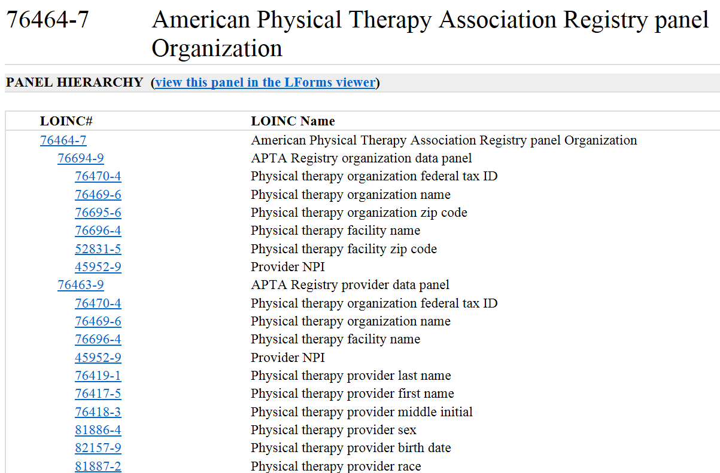

Slide 20
Reference Model Patterns
ITEM GROUP
ITEM GROUP
ELEMENT
Clinical Document
Clinical Statement
Cluster
Compound
Clinical Statement
Indivisible
Clinical Statement

Slide 21
Clinical Patterns
ITEM GROUP
ITEM GROUP
ELEMENT
Clinical Document
Clinical Statement
Cluster
Action
Compound
Clinical Statement
Indivisible
Clinical Statement
Observation Set
Observation
Clinical Activity

Slide 22
Registry Models
ITEM GROUP
ITEM GROUP
ELEMENT
Clinical Document
Clinical Statement
Cluster
Action
Compound
Clinical Statement
Indivisible
Clinical Statement
Observation Set
Observation
Clinical Activity
Panel
Clinical Observations

Slide 23
Model Request Form Review
Row Num
Panel, Element, Qualifier Name
Definition
Unit of Measure (UoM) or Values
Datatype
Cardinality
Optionality

Slide 24
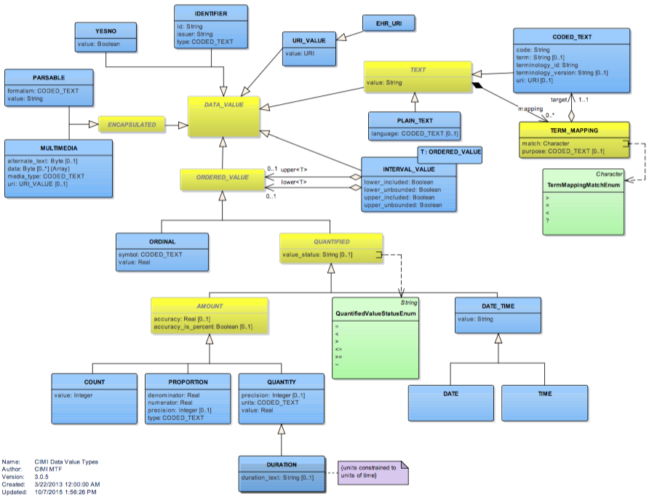
CIMI Data Types

Slide 25
DataTypes
CWE - coded with exceptions
CO - Coded Ordinal
PQ - Physical Quantity
ED - Binary
TS - Time Stamp
ST - String
REAL
INT - Integer
II - Instance Identifier
RTOPQ - Ratio PQ
IVLPQ - Interval Physical Quantity

Slide 26
Model Request Workflow
Identify Use Case
Document Use Case
Send Use Case to HSPC
Review the Use Case with HSPC
Model development agreement between HSPC and Partner
Model Request
Content Mapping
Request New Standard Content
Partner Completes Model Request.
Create Models and SMART on FHIR Profile
Model Exists.
Develop the AMM.
on

Slide 27
Use Case Discussion
Viet Nguyen, M.D.

Slide 28
Review Requests and Similarities
Viet Nguyen, M.D.

Slide 29
Day 3: Terminology Mapping
Susan

Slide 30
Standards for data exchange – HL7
MSH|^~\&|||||19981105131523||ORU^R01|
PID|||100928782^9^M11||Smith^John^J|
OBR||||Z0063-0^BP^LN|
OBX||CE|8361-4^POSITION^LN||SIT^Sitting|
OBX||NM|8479-8^SBP^LN||138|mmHg|
Segment
Data Field
Component

Slide 31
Name-value pair approach
Other data fields include: date of observation, identity of provider giving observation, normal ranges, abnormal flags
A code that identifies the datatype
of OBX-5
OBX-5: Data
Status
OBX||NM|11289-6^^LN||38|C^^ISO+|||||F
A code that identifies the data in OBX-5
(Temp Reading)
A code that identifies the units of numerical data in OBX-5

Slide 32
OBX: with a coded value
A code that identifies the datatype as a
coded element
The code is
from LOINC
The code is
from SNOMED
OBX||CE|883-9^Blood Group^LN||58460004^Group O^SMI|
A code that identifies the data in OBX-5
(ABO Blood Group)
OBX-5: Data
A code for Group O

Slide 33
So we are all using HL7, what is the problem?
Site 1:
  OBX|1|CE|SysBP^Systolic BP||132||mmHg|
Site 2:
  OBX|1|CE|SBP^Systolic BP||132||mmHg|
Site 3:
  OBX|1|CE|BP^Systolic BP||132/70||mmHg|
You and I may know that these are similar results, but our computers will not.

Slide 34
The Goal
Site 1:
  OBX|1|CE|8479-8^SysBP^LN||132||mmHg|
Site 2:
  OBX|1|CE|8479-8^SBP^LN||132||mmHg|
Site 3:
  OBX|1|CE|8479-8^Systolic BP^LN||132/70||mmHg| (error!)
Agree on a universal coding system for clinical observations.

Slide 35
Standard Terminologies
Logical Observation Identifiers Names and Codes (LOINC)
  Names and codes for “observation” – “The Question”
  BP, HR, Temperature, Diagnosis, Pain Severity, Body Part
Systematic Nomenclature of Medicine – Clinical Terms (SNOMED CT)
  Names and codes for the value of textual observations
  Diabetes Mellitus, E coli, Mitral Valve, Heart Failure
RxNorm
  Names and codes for medications

Slide 36
LOINC®
Logical Observation Identifiers Names and Codes (LOINC®)
  Provides a standard set of universal names and codes for identifying individual laboratory and clinical results (observations made on specimens)
  Also facilitates standardization of observations (other than lab) made on patients such as entries for vital signs, intake/output, EKG, and scales (e.g., Glasgow Coma Scale)
  (Regenstrief Institute, 2011)

Slide 37
General Form of Clinical LOINC® Names
LOINC® codes are created systematically using a six axis model
<component> : <property> :
<timing> : <system> :
<scale> : <method>
8331-1 Body Temperature :TEMP :PT :MOUTH :QN
The first 5 parts are mandatory, but method is optional. Subparts of the six axes are created as needed in specific subject areas.

Slide 38
Anatomy of a LOINC Term
39126-8:Length:Len:Pt:Wound:Qn::
39126-8
LOINC Code
Length
Component
Len
Property Measured
Pt
Timing
Wound
System
Qn
Scale
none
Method
There are six major LOINC axes
Notes:
LOINC Axes
What a Challenge Is.

Slide 39
LOINC Panels
Logical groupings of clinical observations or survey instruments
Nursing - Assessments are grouped in panels
  Skin Assessment Panel
  Wound Assessment Panel
  Vital Signs Panel
Scales and instruments are made as Panels
  Morse Fall Scale
  Braden Scale
  Norton Scale
  Neonatal Pressure Ulcer Risk Assessment
Interoperability Issue = Scale/Instrument has to be free and open
  Braden Q cannot be created in LOINC – journal will not release copyright
  Johns Hopkins Fall Risk Assessment cannot be created – cost per use

Slide 40
Online LOINC browser
search.loinc.org

Slide 41
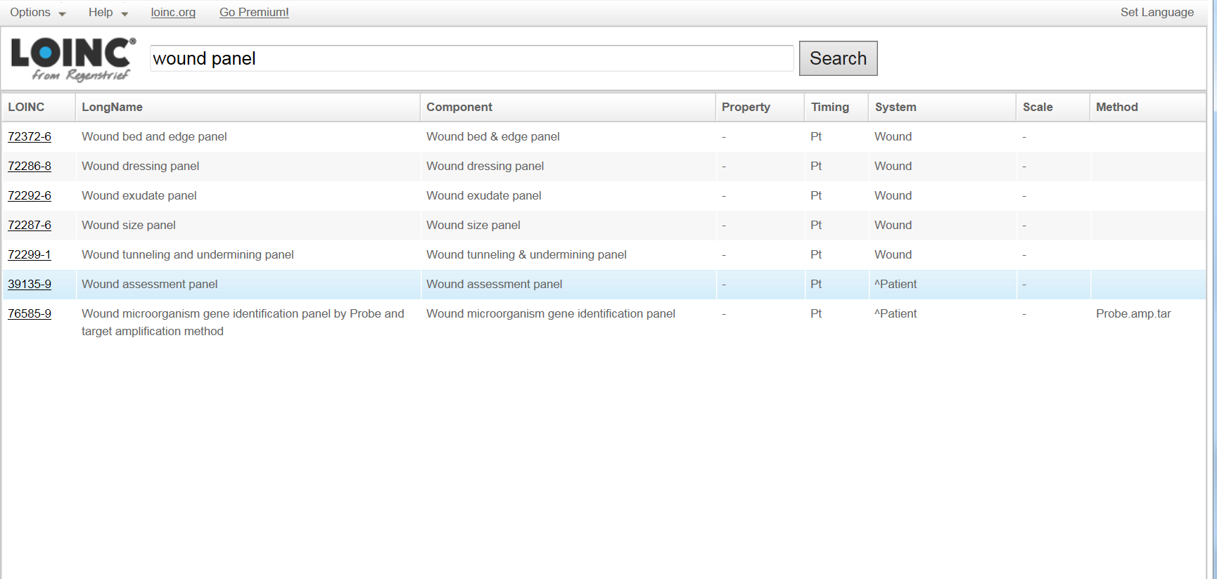
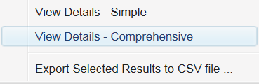
Finding your LOINC code
Enter your search string
Highlight the match
Right Click and view details, select either simple or comprehensive

Slide 42
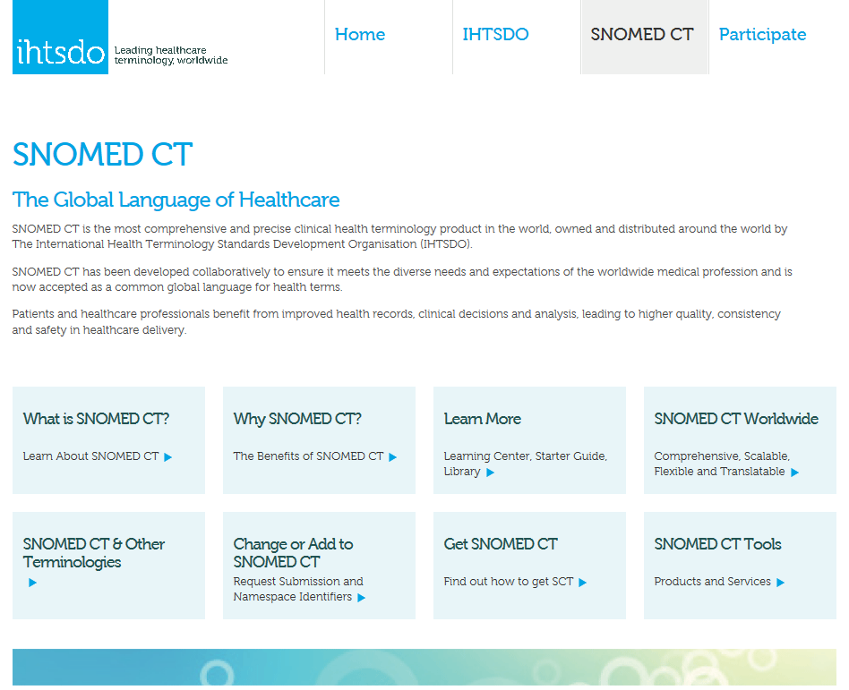
www.ihtsdo.org

Slide 43
SNOMED CT Hierarchies
Clinical finding
Finding by site
Disease
Finding of body region
19 upper level hierarchies
Each hierarchy has sub-hierarchies
A concept in SNOMED CT can reside in more than one sub-hierarchy of a top-level hierarchy
Disorder by body site
Finding of limb structure
Disorder of extremity
Finding of lower limb
Finding of ankle or foot
Disorder of lower extremity
Disorder of free lower limb
Finding of foot region
Ulcer
Disorder of foot
Ulcer of lower extremity
Foot Ulcer

Slide 44
Multiple Levels of Granularity
Pain (finding)
Is_a
Abdominal pain (finding)
Is_a
Upper abdmonial pain (finding)

Slide 45
Online SNOMED CT browser
http://browser.ihtsdotools.org

Slide 46
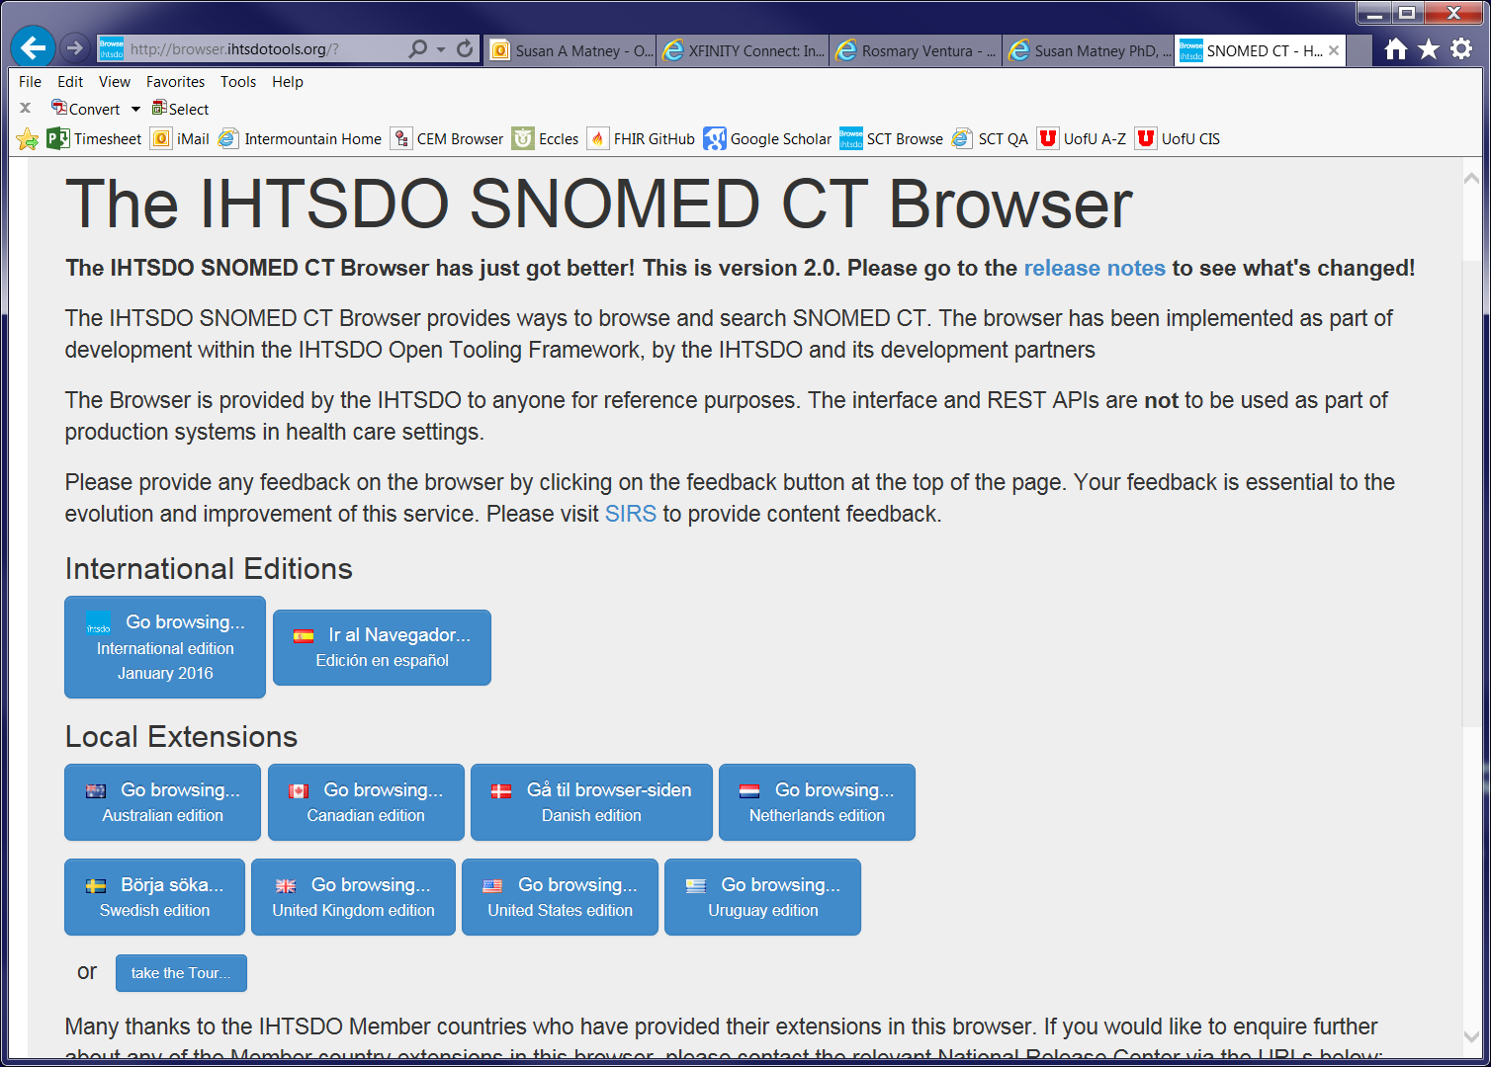

Slide 47
Online RxNorm Browser
https://rxnav.nlm.nih.gov/

Slide 48
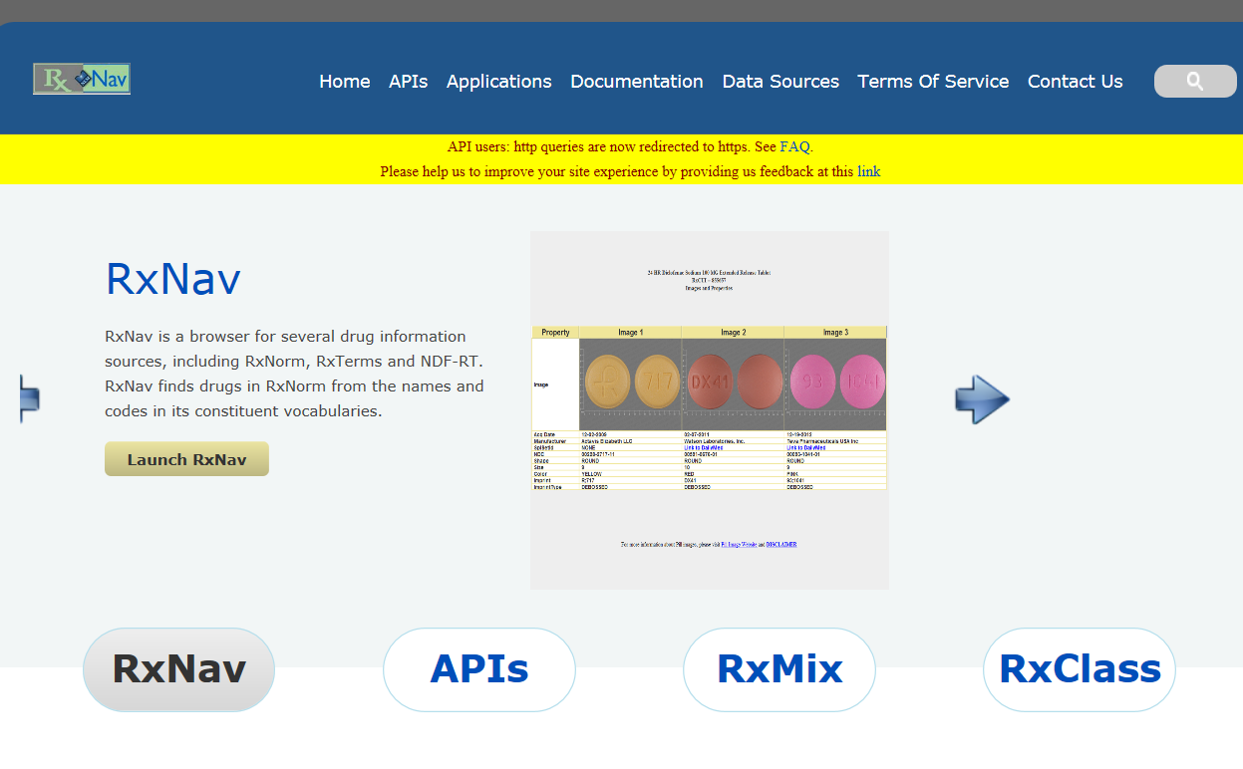

Slide 49
Web Model Request Tool
Patrick

