Slide 1

HSPC Model Request Workflow and ACOG OPA FPAR Use Case
Susan Matney, PhD, RNC-OB, FAAN
08/02/2016

Slide 2
Agenda
Overview of Model Development Process
Present ACOG OPA FPAR

Slide 3




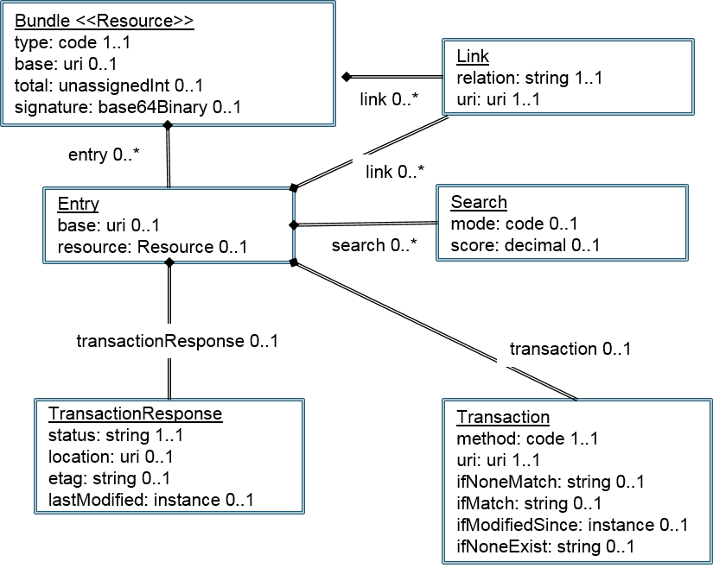
Model Request Workflow
Identify Use Case
Document Use Case
Send Use Case to HSPC
Review the Use Case with HSPC
Model development agreement between HSPC and Partner
Model Request
Content Mapping
Request New Standard Content
Partner Completes Model Request.
Create Models and SMART on FHIR Profile
Model Exists.
Develop the App
on
Adapted from a workflow diagram developed by Rick Freeman

Slide 4

ACOG on FHIR
Slides prepared by Steve Hasley, MD
CMIO, ACOG

Slide 5
Office of Population Affairs
Family Planning Annual Reports
Clinical need
  Family Planning Services
  Interoperability
  FHIR
Operationalizing to meet the need
  Dataset
  FHIR Standard
  Vendors
  Registry
Results

Slide 6
Family Planning in USA
6 M Pregnancies every year
  4 M births
  1M Spontaneous miscarriages
  1M pregnancy terminations
    Actually 700,000 in 2012, and falling
Family Planning desires assessed during an encounter
Encounters are collated and submitted to OPA

Slide 7
Encounter Form

Slide 8
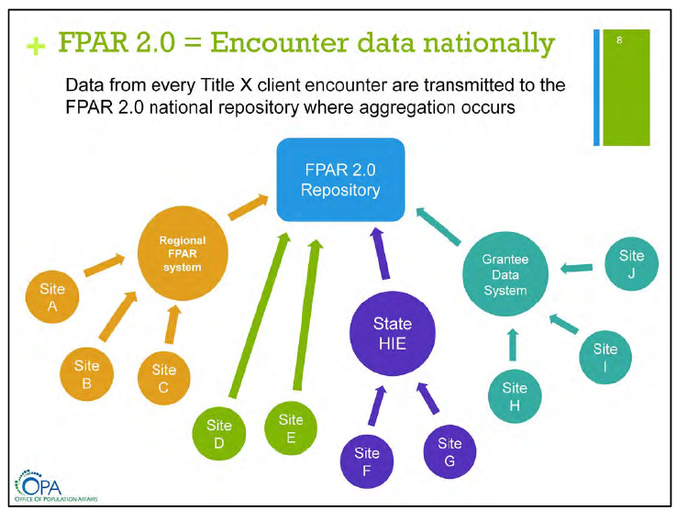

Slide 9
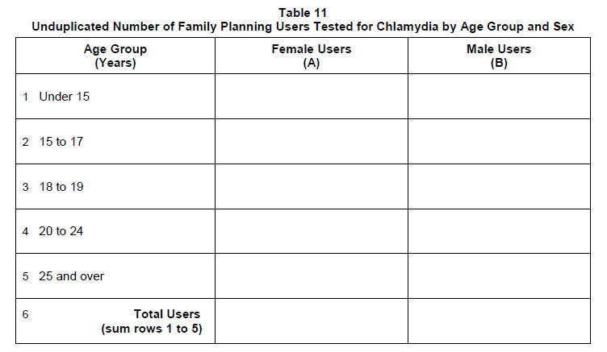
Reporting to DHHS
Annually reported
Collated data
Different data elements from collection form

Slide 10
Comprehensive 2.0 Activities Timeline
Public Comment IHE Profile
Go live with 2.0 system
Connectathon
Interoperability Showcase
Jul 2017
Jun 2014
Jan 2015
Apr 2015
2014
2015
2016
2017
Jul 2014
FPAR 1.0 system contract
Sep 2019
Jan 2014
OMB approval of current FPAR forms
Sep 2016
Apr 2014
Sep 2017
Pilot Performance Measures & Targets
Engage OMB on 2.0
Jul 2015
Dec 2015
Jan 2016
OMB review of 2.0
Dec 2016
Jan 2014
Preg Intentions Study
Sep 2014
Jan 2014
JSI Data System & Feasibility Prep Contract
Sep 2015
Jan 2014
RFD and CQF pilot activities
Aug 2015
Jan 2014
Market research for 2.0
Apr 2016
Fund & solicit 2.0
May 2016
Sep 2016
Build & test 2.0 system
Oct 2016
Apr 2017
Jan 2017
Phase into 2.0 system
Sep 2018

Slide 11
Looking Forward
We need an operational victory – hence this small project
HSPC has given the green light to ACOG for model and FHIR creation
Processes and tools need to be developed, tested, and refined
  Model request
  Terminology mapping
  CEM creation
  CEM to ADL
  CEM to FHIR or ADL to FHIR
  Implementation Guide development

Slide 12

Questions

