Slide 1
National Evaluation System for health Technology (NEST): The role of registries and Unique Device Identification (UDI)
Clearly identifying a device as part of real-world evidence
Terrie. L. Reed, MS Industrial Engineering
Senior Advisor for UDI Adoption

Slide 2
CDRH 2016-2017 Strategic Priority
Establish a National Evaluation System for Medical Devices
GOAL: ACCESS and USE of
Real-World Evidence
To Support Regulatory Decision Making

Slide 3
CDRH 2016-2017 Strategic Priority
Access to Real World Evidence:
Electronic patient records from national and international clinical registries, claims data, and EHRs

Slide 4
CDRH 2016-2017 Strategic Priority
Use of Real World Evidence:
Satisfying post-market data requirements
Expansion of label/indications
Identifying and clarifying potential safety signals
Leveraging current registry infrastructures to study iterative improvements to approved devices

Slide 5
Device Registry Data: 5 General Domains
Indications for the procedure
Patient characteristics
Procedural or treatment details
Device details - USE Unique Device Identifier
Patient outcomes

Slide 6
What is UDI?
UDI requirement #1 Label of every medical device shall bear a unique device identifier (UDI)…
UDI requirement #2 UDI device labeler must provide the information required for each model or version…
606,000+
Link to RWE
accessgudid.nlm.nih.gov

Slide 7
UDI vs. VIN
2010
1
New Cars Sold
Medical Procedures
2
1,000,000
Cardiac Catheterizations
1,230,500
Hondas
719,000
Total Knee Arthroplasties
908,600
Nissans
332,000
Total Hip Replacements
358,500
Volkswagens
1
Source: CDC/NCHS National Hospital Discharge Survey, 2010
2
2
Source: WardsAuto - 2010 New Vehicle Sales

Slide 8
REFERENCE

Slide 9
UDI =Device Identifier (DI) + Production Identifiers (PI)
Unique Device Identifier (UDI) – globally unique in accordance with ISO standards
Device Identifier (DI) - mandatory, fixed portion of a UDI that identifies the specific version or model of a device and the labeler of that device
Production Identifier (PI)—a conditional, variable portion of a UDI that identifies one or more of the following when included on the label of the device:
lot or batch within which a device was manufactured;
serial number of a specific device;
expiration date of a specific device;
manufacturing date
distinct identification code

Slide 10
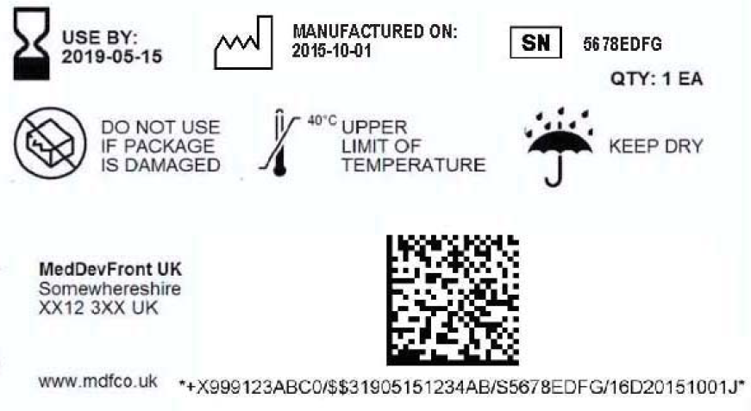
UDI System Success
Interoperability
Identifier used across data sources
http://accessgudid.nlm.nih.gov
Public Access
AIDC
APIs
Standards-based
Searches
UDI, DI + PI
GUDID Attributes
Downloads

Slide 11
CDRH 2016-2017 Strategic Priority
Access:
By December 31, 2016, gain access to 25 million electronic patient records (from national and international clinical registries, claims data, and EHRs) with device identification
By December 31, 2017, gain access to 100 million electronic patient records with device identification

Slide 12
CDRH 2016-2017 Strategic Priority
Use:
By December 31, 2016, increase by 40 percent the number of premarket and postmarket regulatory decisions that leverage real-world evidence. (compared to FY2015 baseline)
By December 31, 2017, increase by 100 percent the number of premarket and postmarket regulatory decisions that leverage real-world evidence.

