Slide 1
The Role of Health IT In Quality Health Care
Healthcare Services Platform Consortium
July 25, 2016
Dr. Vindell Washington, Principal Deputy National Coordinator

Slide 2
My Personal Introduction to Health IT

Slide 3
Hospital Survey Results
Nearly all of the nation’s hospitals have adopted certified electronic health records
Represents a nine-fold increase since 2008
Over 85 percent of hospitals sending key clinical information electronically
Visit HealthIT.gov to learn more!

Slide 4
Interoperability is Foundational to Our National Priorities
Precision Medicine Initiative
Delivery System Reform
Cancer Moonshot
Fighting the Opioid Crisis
Enhancing Public Health
Research and Innovation
Notes:
Precision Medicine Initiative: Making usable electronic health data readily available and easily transferable for patients, providers, and researchers is fundamental to successfully assembling a research cohort of over a million participants and effectively analyzing that data.
Delivery System Reform: Unlocking health data is essential to rewarding quality of care over quantity of services, tracking and responding to public health trends in specific communities or populations, and providing well-coordinated, person-centered care.
Cancer Moonshot: As Vice President Biden recently emphasized, the flow of electronic health data using the latest technology is critical to accelerating efforts to cure cancer by, for example, providing access to millions of cancer pathologies, genomic sequences, family histories and treatment outcomes at once.
Opioids: Prescription drug monitoring programs—databases which help doctors track the controlled substances issued to a certain patient—must communicate seamlessly and securely with the electronic health records that doctors use in routine care in order to most effectively impact the opioid epidemic.
Public Health: Interoperability is critical to upgrading public health practice to a modern version that emphasizes actions across sectors – environmental, policy, and systems – that directly affect all the determinants of health.
Research and Innovation: Interoperability is critical to creating a truly learning health care system in which the latest research and clinical trials inform clinical care and patient encounters, and the results of clinical care and patient encounters in turn inform subsequent research and scientific inquiry and the future of health and health care.

Slide 5
Interoperability Improves Patient Care

Slide 6
Drivers of Success
Common Standards: Health IT products throughout the market use ONC’s list of federally recognized, national standards so that systems speak the same language.
Culture Change Around Access to Information: Individuals and clinicians ask for - and receive - electronic health information as a matter of course.
Business Case for Interoperability: The health system demands interoperability because it is vital for success under new payment models.

Slide 7
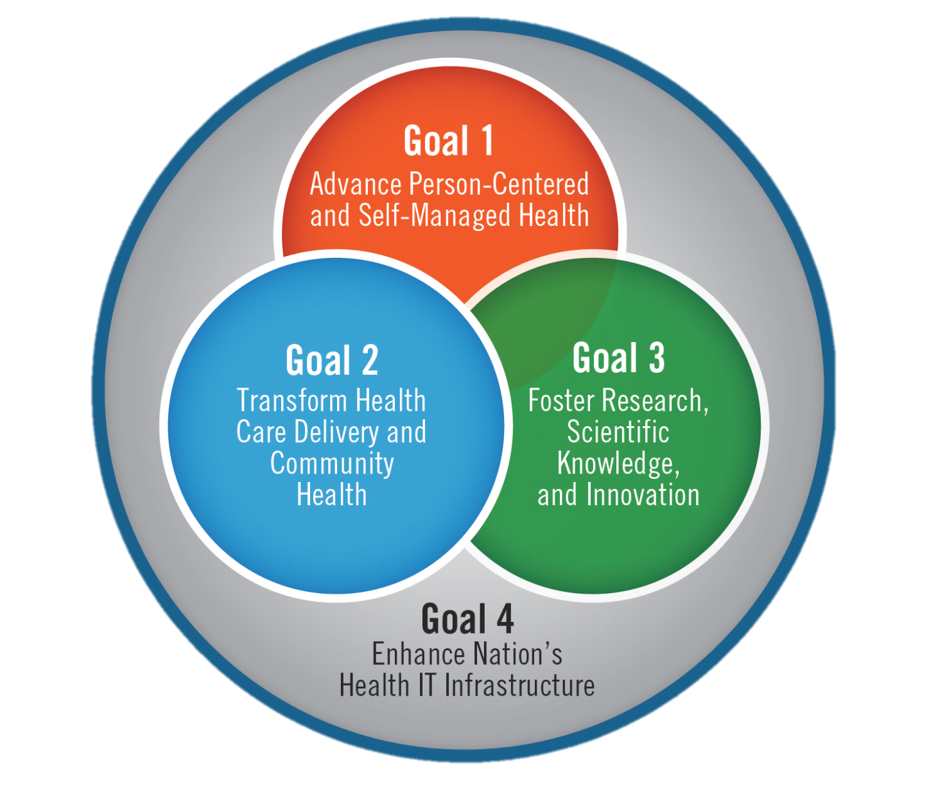
Federal Health IT Goals

Slide 8
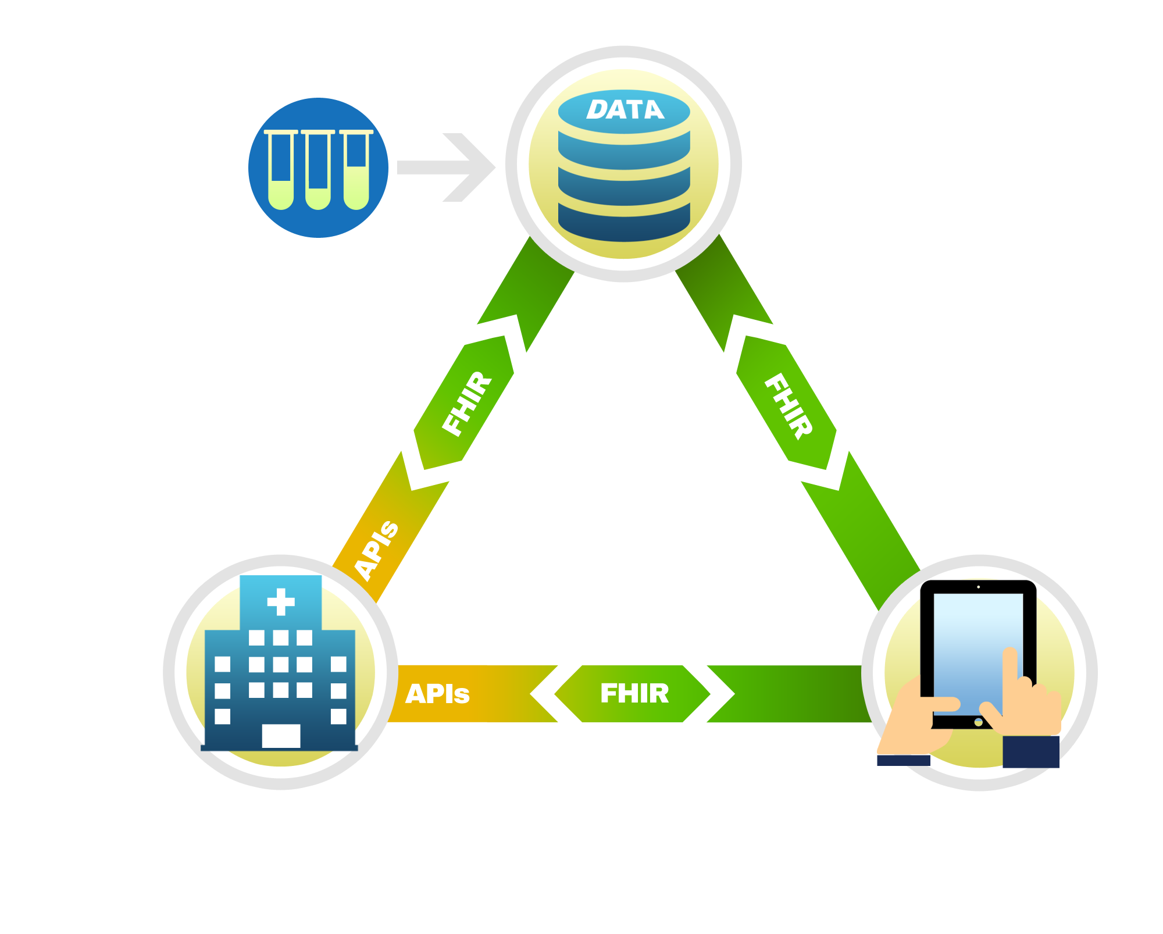
Vision for Learning Health Data Ecosystem
Research and Public Health Databases
Bench Research
Backbone of Data Ecosystem
Data Access, Privacy, and Security
API Framework
Movement of Data
Common Standards and Structure (e.g. FHIR)
Common Terminology for Data Content
NIH/Grantees
CDC/Public Health
FDA/Pharma
Provider EHRs
Consumer App
Diagnosis Prescriptions | X-Rays Labs
Hospital
Academic Med Center
Small Practice
Veterans Affairs
Behavioral Health
Long-term services and supports
Patient Reported Data Patient Consent

Slide 9
Thank you!
Dr. Vindell Washington
Principal Deputy National Coordinator
Twitter: @vindellW

