Slide 1
CQL & BPM+
Considerations and approaches
Bryn Rhodes, CTO Dynamic Content Group
OMG Technical Meeting and BPM+ Workshop
September 23rd, 2019

Slide 2
Overview
What is CQL?
Where is CQL used?
Why use CQL?
CQL & BPM+
CQL & DMN
What next?

Slide 3
Reduce the development effort required for clinical systems to support evolving standards of care
Notes:
Has many facets
Reduce duplicate effort while supporting innovation
Reduce inconsistency while supporting settings-specific factors
Reduce accidental complexity so we can focus on essential complexity
Takes many forms
Guidelines, interventions, measures, documentation templates, order sets, flow sheets, SMART apps, CDS services
Some principles
Declarative vs Imperative (i.e. "what" not "how")
Separation of Concerns
Various types of Independence
History of computing is a history of raising the level of abstraction
No Silver Bullet!

Slide 4
Enable precise and unambiguous sharing of clinical logic

Slide 5
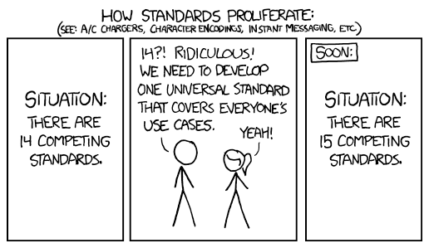
https://xkcd.com/927/

Slide 6
But... what do we really need?
To be able to create and share computable clinical knowledge
Formalism that is
Clinician/domain-expert friendly
Clinically focused
Unambiguous
Platform/technology independent
Sufficiently expressive

Slide 7
Clinical Quality Language (CQL)
Health Level 7(HL7) standard designed to:
Enable automated point-to-point sharing of executable clinical knowledge
Provide a clinically focused, author-friendly, and human-readable language
Currently a Standard for Trial Use (STU) publication
http://cql.hl7.org
Language Characteristics
query language
pure functional
relationally complete
conceptual/logical

Slide 8
Components of Sharing Logic
Logic
Value > 100
Encounter
Medication
Observation
Model
Terms
SNOMED-CT
LOINC
RxNorm
Definitions:
SNOMED CT – Systematized Nomenclature of Medicine – Clinical Terms
LOINC – Logical Observation Identifiers Names and Codes

Slide 9
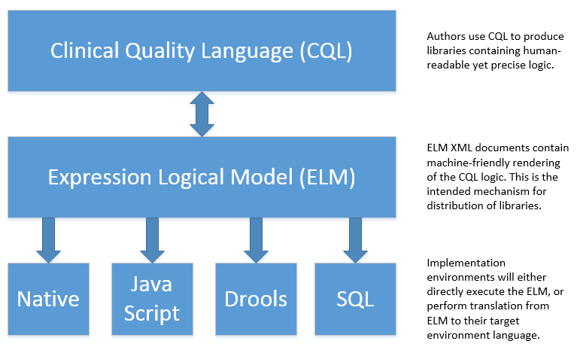

Slide 10
Current Status
Clinical Quality Language has been a published DSTU/STU specification since May of 2015
Has been used to represent decision support as well as quality measurement in a variety of projects
Pharmacogenomics
Zika virus management
Opioid management
Radiology appropriateness
Immunization
Centers for Medicare and Medicaid (CMS) is using CQL for eMeasure specification as of the 2018 update
CQL was balloted and published STU4 in May 2019

Slide 11
Why use CQL?
Reuse clinical knowledge
Growing community of CQL authors
CQL implementation/tooling/evaluation community
Notes:
Reuse clinical knowledge coming from eCQMs, decision support, and clinical guidelines projects
There is a fast-growing community of CQL authors
Supported by a growing community of CQL tooling, implementation, and evaluation vendors and open source projects

Slide 12
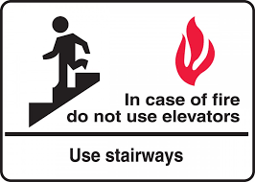

Slide 13
Potential Integration Points
FormalExpression
Expression
S-FEEL/FEEL

Slide 14
CQL comparison w/ FEEL
Initial exploratory work has been done on this problem
Preliminary results are that the two languages are semantically very closely aligned
There are some caveats and potential gotchas, but...
In general it should be possible to convert between the two languages
There may be a need to define some additional functions in one or the other
CQL is designed to support this use case
(i.e. translation to an execution target)

Slide 15
Potential go-forward steps
Exploratory group
Engage with specific projects (e.g. CDS Kaizen)
Support cross-pollination (OMG/HL7)
Support continued alignment between CQL/FEEL

Slide 16
Other Considerations
Support terminology throughout BPMN, CMMN, and DMN
Support definition of and reference to a common model
Consider FHIR and QUICK for that model

Slide 17
Questions?

