Slide 1
Snorocket & Ontoserver HSPC tooling meeting
Michael Lawley, PhD
Health Informatics Group Leader
Australian e-Health Research Centre, CSIRO

Slide 2
Snorocket

Slide 3
Modelling with DL
Clinical Finding
Body Structure
is a
is a
Pain
Lower limb finding
is a
finding site
finding site
Pain in lower limb
Lower limb structure
finding site
Pain in calf
Calf structure
|Pain in lower limb|
=== |Pain| + |Lower limb finding|
|Pain in calf|
=== |Pain| : |finding site| = |Calf structure|
|Lower limb finding|
=== |Clinical finding| : |finding site| = |Lower limb structure|

Slide 4
What is a classifier?
Description Logic reasoning engine

Slide 5
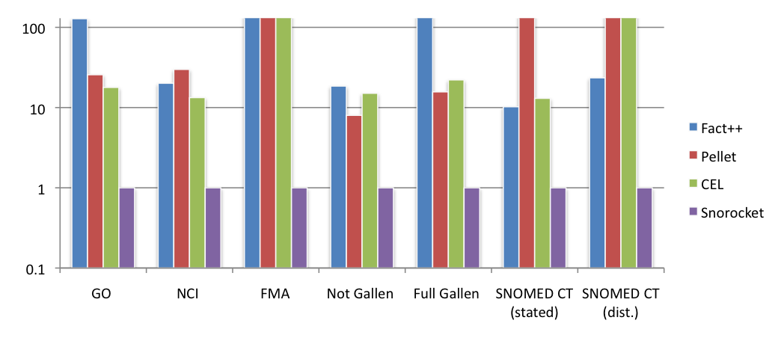
Transformational improvement
2007, 2013 – Snorocket Reasoner Lawley & Metke
now << 30 sec to classify
incremental classification*
licensed to the IHTSDO
time
speed relative to other algorithm implementations
“Snorocket will enable fundamental change in the way clinical terminologies are authored.”
Dr Kent Spackman former Chief Terminologist, International Health Terminology Standards Development Organisation (IHTSDO)

Slide 6
Why do I want a classifier?
Scalability:
avoid (reduce) combinatorial explosion
Quality Assurance:
avoiding missing/incorrect relationships
clarity and precision of meaning
Foundation for querying / retrieval, decision support & reporting
record using precise / detailed concepts
retrieve using broad, general codes
Notes:
Skeletal dysplasia
Rector – Getting the foot out of the pelvis
AMT V3

Slide 7
SNOMED CT and OWL2 EL++
SNOMED CT uses a limited subset of OWL2 EL++
Unused capabilities include:
disjointness
multiple sufficient sets (multiple axioms for a single concept)
general concept inclusions (axioms for anon concepts)
role inclusions
transitive roles
role chaining
(limited) concrete domains (eg numeric / string datatypes)*
Notes:
Although are currently used in Australian Extension and Singapore drug model

Slide 8
Availability
Snorocket (Apache 2.0)
https://github.com/aehrc/snorocket (also https://github.com/aehrc/ontology-core)
Includes:
Concrete domains support (limited)
OWL API
Protégé integration
Does not include:
Regression tests against SNOMED and AMTv3 content
RF2 DNF exporter
Notes:
Not the same version as used by IHTSDO – this has concurrent classification, concrete domains, no incremental classification support

Slide 9
Alternative classifier
ELK Reasoner (Apache 2)
https://github.com/liveontologies/elk-reasoner
Supports:
Concrete domain support (limited)
OWL API and Protégé support
Incremental reasoning
NamedIndividuals (instances)
Some additional constructs
https://github.com/liveontologies/elk-reasoner/wiki/OwlFeatures

Slide 10
Ontoserver

Slide 11
Ontoserver – some history
Focus on terminology use, not authoring
Simple REST API, pared back over several versions
Deep SNOMED CT support (RF2 native, versioning, snorocket)
Fast start-of-art search ranking algorithm
https://ontoserver.csiro.au/shrimp
FHIR Terminology Services:
Open API
Strong support for SNOMED CT
Closely aligned with existing APIs
Other APIs solved problems on our roadmap

Slide 12
Ontoserver today
Basis for Australia’s National Clinical Terminology Service
Includes a syndication model (using ATOM) for content distribution (monthly SNOMED CT-AU releases)
Single National instance
Many local instances in syndication “web”
https://www.healthterminologies.gov.au/ncts/#/tools?content=nts
https://ontoserver.csiro.au

Slide 13
Ontoserver – Syndication Model
Ontoserver
FHIR API
Admin API
Syndication API
list, get
Ontoserver
FHIR API
Admin API
Syndication API
Ontoserver
FHIR API
Admin API
Ontoserver
FHIR API
Syndication API
Admin API
Syndication API

Slide 14
FHIR® terminology subsystem
Value Set
rules for what codes are in the value set
Code System
codes, properties of codes, available filters
Concept Map
source code, target code, relationship
Operations
$expand, $lookup, $validate-code, $translate, $closure, $subsumes, ...
$batch
_elements parameter
All
Metadata – identity, version, publisher, description

Slide 15
FHIR SNOMED CT Support
http://build.fhir.org/snomedct.html
Implicit ValueSets
Simple exposure of hierarchy and (simple) reference sets
Post coordination intrinsically included*
ValueSet content can be defined using SNOMED’s ECL
http://snomed.org/ecl
http://ontoserver.csiro.au/shrimp-fhir/ecl.html
[*] $closure and $subsumes, but also $lookup

Slide 16
FHIR & SNOMED CT Versioning
Based on SNOMED CT URI Specification http://snomed.org/uri
based in turn on RF2 and MDRS
Versioning model is a partial order; a set of ordered branches
Version URI | Meaning
http://snomed.org/sct | Any version (usually latest)
http://snomed.org/sct/{sctid} | Any version (latest) of specific Edition (UK, US, AU, etc)
http://snomed.org/sct/{sctid}/version/{date} | Specific version of specified Edition

Slide 17
Cross-edition queries
Open question:
How to resolve (potential) conflicts from different base versions?
AU
INT
US
Notes:
Not problems with SCT in FHIR, but problems with SCT that are highlighted and brought to the fore by the success of FHIR

Slide 18
Languages & Dialects
“Dialects and language are features/characteristics of a terminology system, they are not separate terminology systems themselves. So it should not be ‘Spanish version of SNOMED’ and ‘English version of SNOMED’ as separate systems, it should be ‘return the Fully Specified Description of SNOMED in the English Language, US Dialect’.” - KC
/CodeSystem/$lookup?displayLanguage={code}
{code} comes from BCP-47; human languages
Doesn’t easily map to SNOMED CT which separates Language from preferred term status (interface term selection)
Notes:
A version may contain multiple language reference sets; FHIR API doesn’t have mechanism to select one

Slide 19
Representational limits
Code properties are only simple values
Special-case of sub-properties:
limited solution to SNOMED role grouping
doesn’t handle general nesting (SNOMED CT-AU)
Will struggle further if/when SNOMED uses more of OWL2 EL++
Notes:
But perhaps this is pushing FHIR TS beyond its

Slide 20
Rough edges
Some newer aspects:
$compose operation
ExpansionProfile
Medication Resource(s) and corresponding terminology
Implementation pragmatics
injecting terminology service implementation into an EHR server / FluentPath engine
parametric $batch

Slide 21
Questions?
Michael Lawley, PhD Research Group Leader, Health Informatics michael.lawley@csiro.au aehrc.com
Health & Biosecurity

