Slide 1
Content Management and Modeling
Feb 2016

Slide 2
Contents
Content Problems
Tooling Overview
NORM
Content Maintenance Process
Content Structure
Use Cases

Slide 3
Caveats
I work for Cerner.
  But, I’m not the solution owner for this tool.
I can (and have) advocate(d) for development work or design approaches,
  I’m working on a proposal for an standalone version of this tool with modular plugins.
  But, requirements and prioritization come from Cerner clients (e.g. Intermountain)
  And, I have significant bandwidth limitations.
Nonetheless, an interesting thought exploration or issues encountered, and potential solutions.
If nothing else, the import and export from whatever tools will be an important goal for us.

Slide 4
Some important problems in Content

Slide 5

Problem: Alignment
Stakeholders requests for “Content”.
  Customer A wants “ED content”
  Customer B wants “Physician Content”
  The ambulatory project wants “Medcin Content”
  MU requires NQF Quality Measure Content.
  HSPC wants us to include CIMI Content
Vendor sells “content”
  Medication Content
  Discharge Instructions
  Ordersets
  ...
These are NOT separate things in our solution.
They are Perspectives of a single thing.
  Not Orthogonal with product functionality
  Not Orthogonal with each other.
“On Discharge patients admitted with AMI’s should be started on Aspirin”

Slide 6
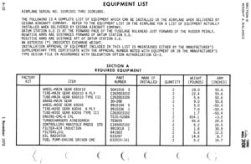
Problem: Partitioning
Care Management
BPM / CEP.
Quality Measures
Rules
Inferences / Conclusions
Soarian Quality Measures
Heatlhcare Intelligence
Optional
Base Content
Optional
Optional Packages
Optional
Order Sets
Documentation Templates
Computed Values
Clinicals, Revenue Cycle
& Foundations
Terminology & Hierarchy
Text Blobs (e.g., patient education documents)
Additional Software Functionality

Slide 7
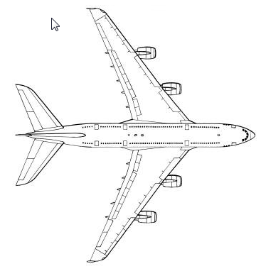
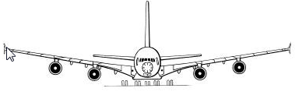
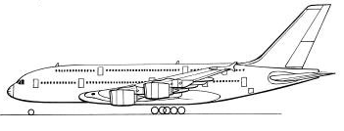
Content Perspectives
The SAME Content Item may be viewed from many Perspectives.
Specialty (e.g. Cardiology, Oncology, OBGYN, Pediatric ….)
Setting (e.g. Inpatient, Outpt, ED, ICU, Surgery, LTC, …)
Application / Module (e.g. SC, Pharm, Provider Doc,…)
Purpose (e.g. Quality Measure, Pt Education, …)
Function (e.g. Orders, MedRec, …)
Domain (e.g. Medication, Problem, Lab, Dietary,…)
User / Role (e.g. Nurse, Physician, …)
Source Vendor / License Required
Standards Required
Definition Tool used
Use Version (eg. Demo, Production, Testing, …)
Technical Format (e.g. PDF, XML, …)
Element type (e.g. Process, Composite Structure, Set, Term,…)
Deployment Method
Timing(e.g. Deployed vs Uploaded,.. Admission, Discharge, …)
Many more…

Slide 8
Problem: Agreement
Clients agree on a lot of things.
  80%
  But, they don’t agree on everything.
Content vendors agree on a lot of things.
  Agreement varies depending on the use case of the vendor
  They often disagree.
Workflows overlap and interact
How do you allow for standardization of the agreed parts, while still allowing flexibility for the things where there isn’t agreement?

Slide 9
Other Problems in Content:
License management
Version control
Quality control, maintenance and upkeep
Deployment
Sharing
…
Tooling

Slide 10
Tooling

Slide 11

Content Management Workspace
One resource for structured clinical knowledge and terminology
DRG
CPT
ICD
Motive
LOINC
SNOMED
NDDF
RxNorm
Zynx
Medcin
Etc.
3rd party sources
Content Management
Mixing /
Alignment
Cerner Model
Mapping
Referencing
Authoring
License Mgt
Version Mgt
Deployment
Modification /
Extensions
Customer Model
Runtime Content
SC
Master Files and Catalogs
Runtime Content
CXL
App 1
…
Runtime Content
…
App2
App3

Slide 12
CMW = A System
of Content Management
Tools
IDE
Editor
IDE
Editor
IDE
Preview
Version
Content
Server
Reporting
Preview
CRUD API
Customer Environment
Version Ctl API
CMW
Services
Pub API
SC Prod
Content
Packages
SC Test
DeployAPI
Legacy
extract
API
SC Train
eNORM
Load API
sNORM / cNORM Create API
Licence Mgt API
SF Test
ICD
SF Train
Medcin
eNORM
Models
sNORM
Model
SNOMED
cNORM
Model
External
Content
App3 Test
App3 Train
LOINC

Slide 13
CMW Data Base
A Large Graph
Vertex
Index of relationships
Edge
Holds Concept Definitions and Instances
SOLR
Index of keywords

Slide 14
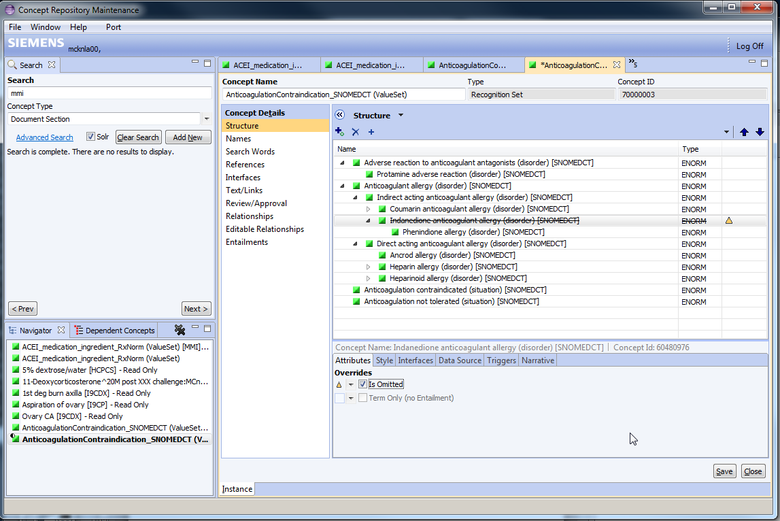
Overrides

Slide 15
Building Blocks: Types, Composition (Example)
Value
Value Set
Observation
Parameter
Sets
Section
Template
Document
Template
Answer
Answer list
Question
Context
Layout / Filtering
Assembly
Examples:
Left
Right
Arm
Leg
Pain
Injury
(Left, Right)
(Arm, Leg)
(Pain, Injury)
Complaint:
Location:
Laterality:
Complaint: Pain
- Location: Arm
- Laterality: Left

Slide 16
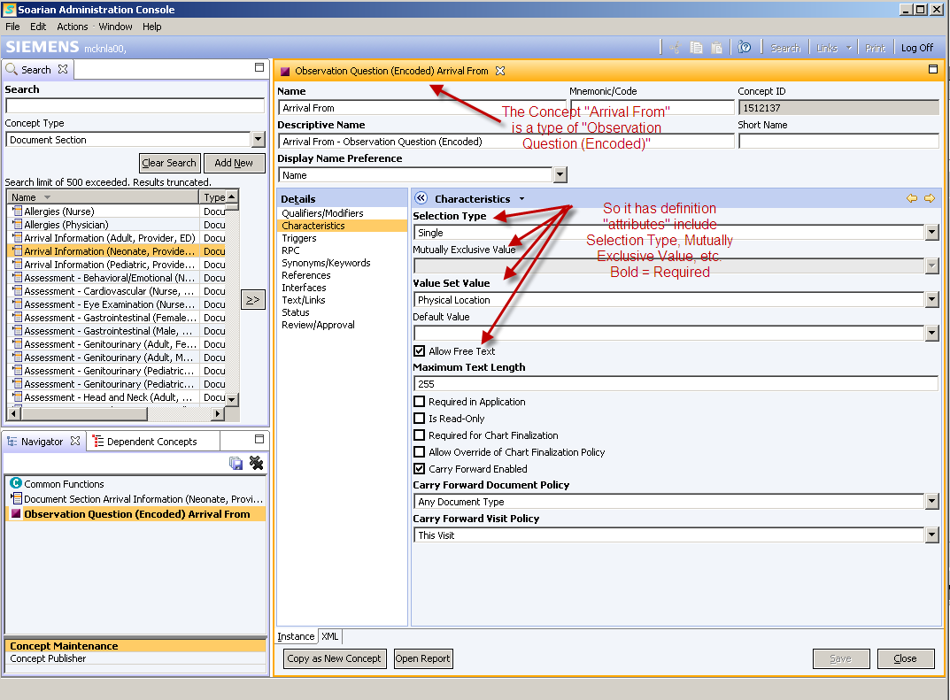
Types
Metamodel defined
Much like the old frame based Protégé
Types dictate which attributes allowed / required
Type Hierarchy
  E.g. All things have names
First use case was Documentation, but metamodel makes this agnostic of content types

Slide 17
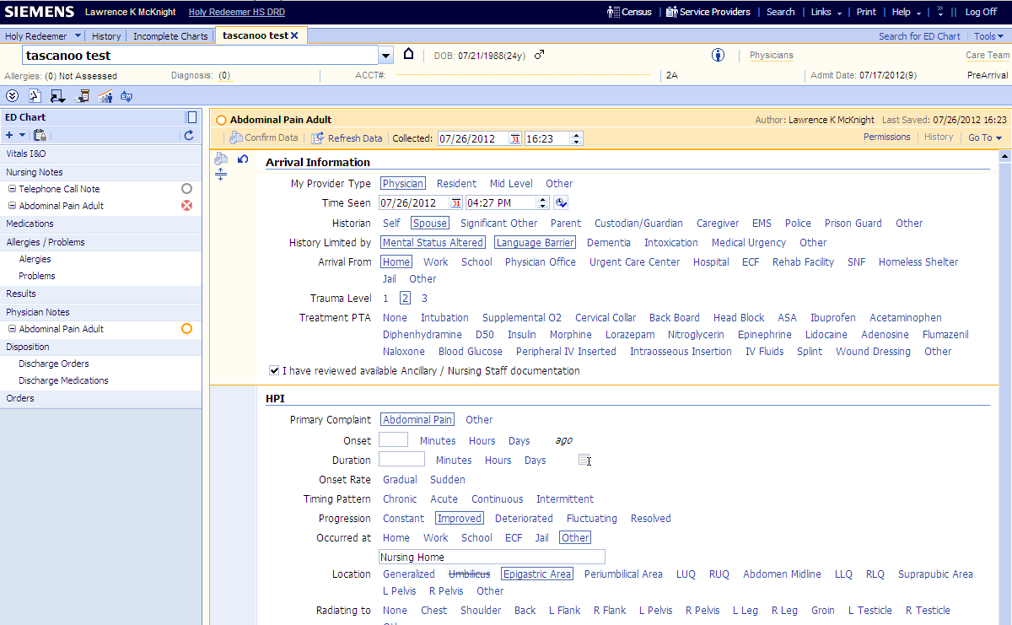
“Show More”
“Time Is Required”=True
Timestamp Enabled=True
Selection Type=multiple
Selection Type=Single
Don’t Allow Free text
Don’t Allow Negation
Allow Free text
Allow Negation

Slide 18
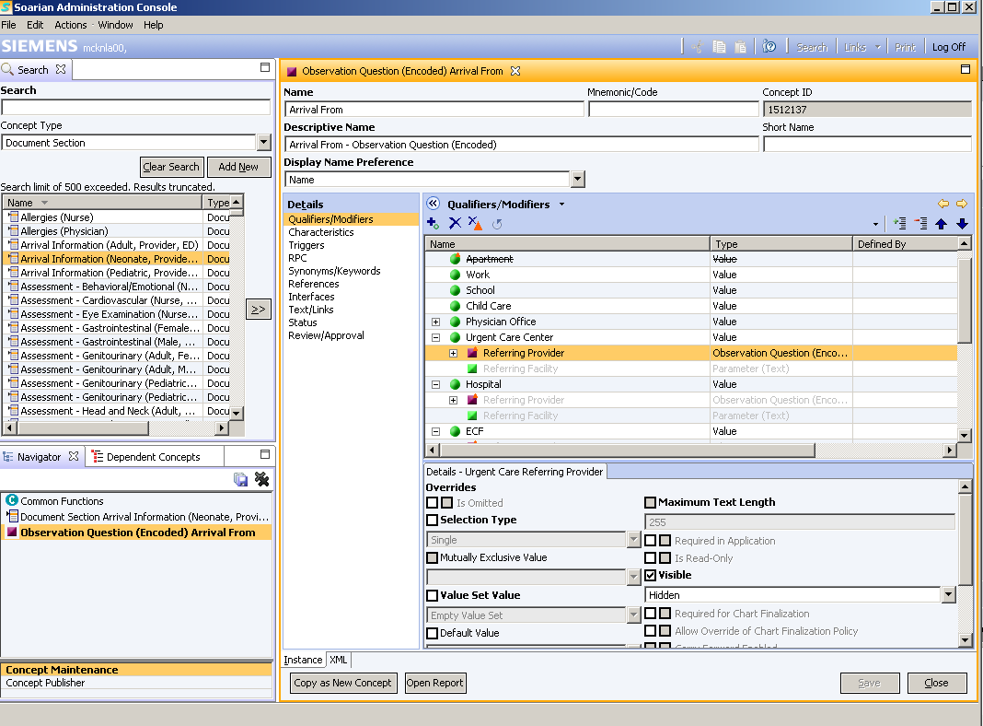
Referencing
In composites, there is a context of reference.
Concepts may be constrained
  Omit
  Change Default
  Subset
Most loops disallowed
Some Attributes are more complicated, and refer to
Other building blocks.
As a concept is referenced
Eg. Referring Provider
Some Attributes of the referenced concept
can be overriden with “fields”
These are part of the referring concept
(eg “Arrival From” as it uses “Referring Provider”

Slide 19
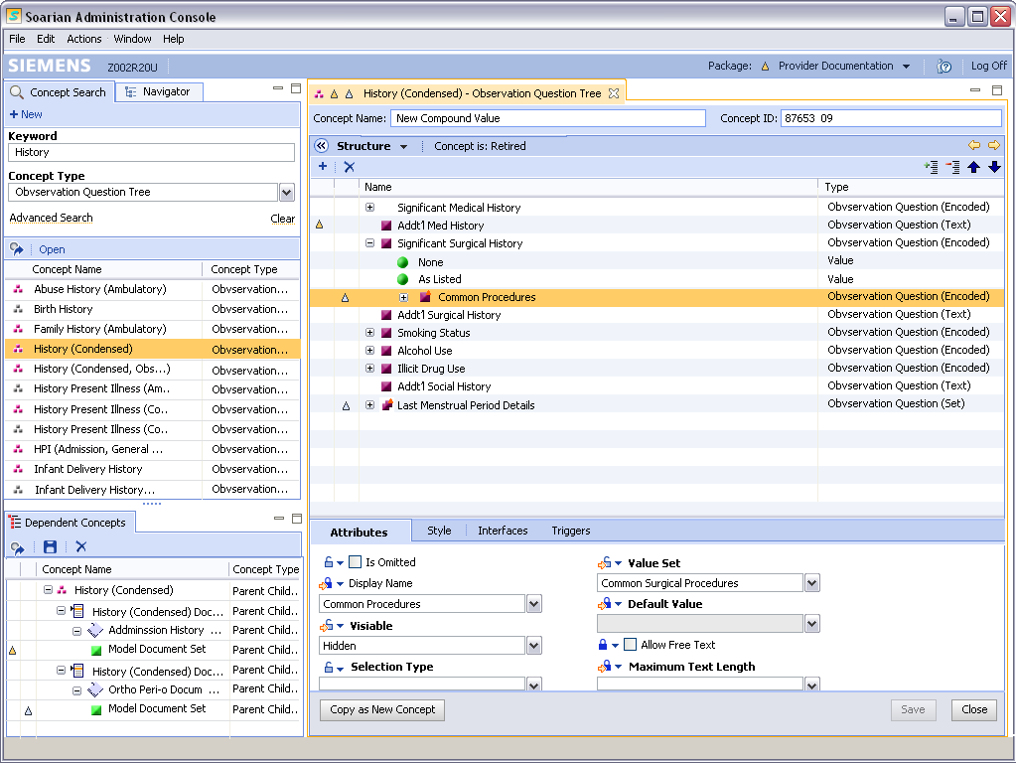

Client Overrides define changes to the Cerner Model and how to accept updates
Inherit - in this use context, apply the default setting of the base concept.
Blocked – In this use context this value should be used instead of the default.
Adapted Inherit – Inheriting a customer change of the base concept, but next model update, OK to accept any Siemens model Block for this use context
Adapted Blocked – Ignore future model updates of this attribute.

Slide 20
NORM
Normalized Ontologic Reference Model

Slide 21
Flavors of NORM
cNORM
sNORM
eNORM
cNORM
  Content that Clients are defining and maintaining
sNORM
  Content that Cerner HS is actively defining and maintaining
  Starting with Soarian Clinicals but not limited to it
eNORM
  Content that External Vendors are defining and maintaining

Slide 22
eNORM
In upload of external content, the structures may be altered in minor ways and some parts of content may be omitted. However the original concept semantics and relationships remain.
Read only
Generally latest version.
sNORM may be derived
  “Derived” does NOT imply “sameAs”
  Eg. “Medcin Terms” are not just “values”.
  MEDCIN:isa is NOT a SNOMED:isa
cNORM
sNORM
eNORM
ICD
SNOMED
FDB
LOINC
Upload

Slide 23
NORM is “Relationship Based”
UMLS
NORM
CUI
SNORM
SNORM:InterpretedAs
LUI
LUI
SNORM:RecognizedBy
ENORM.C
C:SameAs
C:SameAs
SUI
SUI
SUI
ENORM.A
D:Narrower
ENORM.B
A:Isa
AUI.A
AUI.B
AUI.C
AUI.D
ENORM.D
Semantics of all sources assumed the same
Always Generate a CUI
Semantics NOT Assumed the same
Semantics defined by the Vendor
Generate SNORM, when use case
Follow links IFF use case trusts rels

Slide 24
sNORM references eNORM
sNORM references eNORM thru relationships
  sameAs
  recognizedBy
  interpretesTo
  derivedFrom
  …
eNORM flavors may reference each other
  Medcin:narrowerThan
  RxNORM:hasIngredient
  …
snorm:SmokingStatus::OQE
snorm:hasAllowableValue
snorm:sameAs
snorm:Current Smoker::Val
snorm:sameAs
snorm:sameAs
LOINC:History of Tobacco Use::Observable
medcin: Current Smoker::Term
medcin:parent
medcin:sameAs
medcin:broaderThan
medcin: Tobacco Use::Term
SNOMED:Current Smoker::Concept

Slide 25
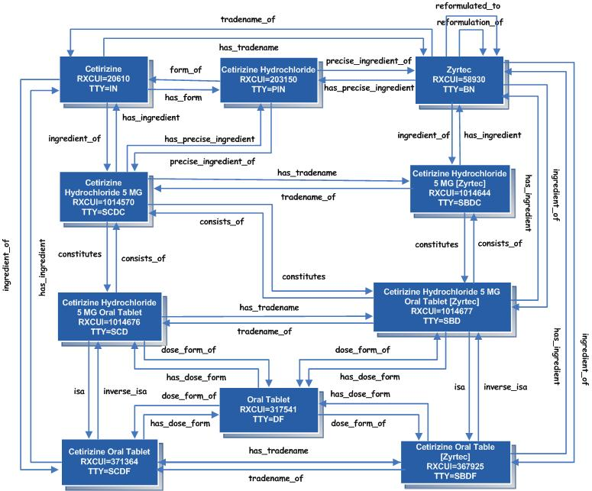
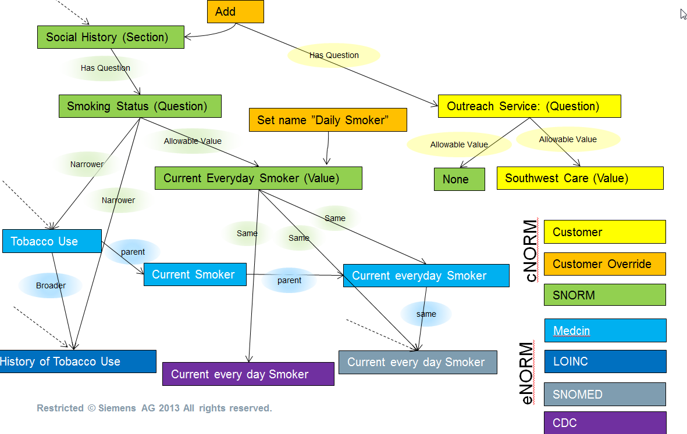
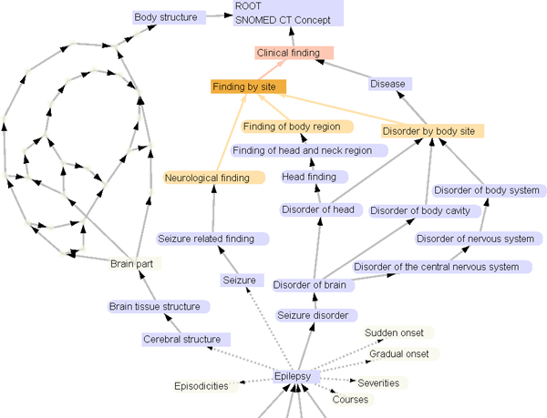
eNORM sub graphs supplement sNORM

Slide 26
cNORM references sNORM
Customers may define their own concepts and/or ‘override’ use of Siemens concepts
Cust:Outreach Service::OQE
Cust:Southwest Care::Val
Cust:Social History::DocSect - Override
Cust:”Smoking”::Val-Override
snorm:Stroke Workflow:: Workflow
snorm:ED Provider Note::DocTempl
snorm:None::Val
snorm:Social History::DocSect
snorm:SmokingStatus::OQE
snorm:Current Smoker::Val

Slide 27
Example: Meaningful Use 2014 requires
Using SNOMED, not CDC Codes for Smoking
Add
Social History (Section)
Has Question
Has Question
Smoking Status (Question)
Outreach Service: (Question)
Set name ”Daily Smoker”
Allowable Value
Allowable Value
Allowable Value
Narrower
Current Everyday Smoker (Value)
None
Southwest Care (Value)
Narrower
Same
Tobacco Use
Same
Same
Customer
parent
cNORM
Current Smoker
Customer Override
Broader
parent
Current everyday Smoker
SNORM
same
Medcin
History of Tobacco Use
Current every day Smoker
eNORM
LOINC
Current every day Smoker
SNOMED
CDC
Notes:
In a document there is a reference to the Social History Section which has a question about Smoking. This is Siemens model content, represented in Green.
In 2012, this value is required to be from the CDC codes – The values of this external coding system is represented in Purple.
Additionally, there may be a customer modification of that code and they want the display on the form to be more simple and just display “Daily Smoker” Orange means “modify” the Siemens model.
Additionally, the customer may want additional question about Outreach services asked. Siemens model content does not have this. But, they build that in their own system – represented in Yellow.
The customers new question has some values for the question. Some values like “None” are already defined by Siemens, but others are missing and they can create those.
The customer wants that new question to show up anywhere where Social history is asked (they can tune this later to specific contexts). They modify the Siemens model social history to add the question.
Siemens adds some new content including new interface terms and relationships from an external vendor like Medcin. The customers using the Siemens model don’t see changes end forms and have no day one impacts because their changes can be applied to the Siemens version.
Medcin Provides links to Other external terminologies like SNOMED and LOINC.
Because of this the SNORM content can be appropriately updated too.
MU 2014 now changes to requiring SNOMED instead of CDC for Smoking status codes. All of this is managed behind the scenes with little or no customer impact.

Slide 28
Content Management – In House

Slide 29
CMW, A Content Pipeline
Vendors
Vendor
Version Stream
Vendor
WK XML
Sources
WK XML
Load / Update
Normalize /
Relate
Cerner
ENORM
CMW :
Model Mode
Promote
SNORM
Edit / Mix
Deploy
Base Model
Clients
Model Content
V:yyyy-mm-ddThh:mm
Model Content
Draft Package
Model Content
CMW :
Client Mode
Draft Package
Adaptation
Publish
Application
Published Package

Slide 30
Loader / Content Maintenance
1 “Driver” 1 per source “content product”
  Assumes a stream of content product versions.
  Purpose is to repeatedly load content updates from source file downloaded
Keep the source semantics as much as possible.
Normalization:
    Graph structure -> Concept|Name|Attribute|Relationship
    Internal identifier assigned for each concept
    One preferred source to define an official unique concept name.
      This Concept name has codesystem +/- version and [ENORM] appended.
      Truncation of official concept name to <256 chars.
    All strings to UTF-8
    Boolean: True/False
    Numeric attributes as string that can use “CAST()”. Unit to UCUM.
    Date to UTC ISO-8601

Slide 31
Loader Details
1 Vendor may have 1..n Products. Products typically have versions.
1 Product may have 1..n CodeSystems. CodeSystems may or may not have versions
  The source Schema is its own CodeSystem, so generally at least 2 CodeSystems per Product.
  Some products like FDB have a different CodeSystem for every table.
A “Source” is a Vendor:Product:CodeSystem:CSVersion
1 ENORM concept = CodeSystem:(CSVersion):Code
  Semantics ~ “Somebody (the codesystem) said this thing (the code) exists”
  Names, Attribute, Relations ~ “Somebody (a source) said this (the code) has (that)”
  For CodeSystems that follow concept permanence – only last product version kept, and diffs are generated
  For CodeSytems that do not have concept permanence (e.g. ICD) the codesystem is versioned to make distinct sources. The new source is linked as replacing prior source.
  If there are multiple sources for same CodeSystem:CSver:Code (e.g. Optum and CDC provide different attributes and relationships) then only 1 ENORM concept, and names are merged, but Attributes and Relationships are distinct by source.

Slide 32
ENORM “Type”
Very generic ~ “Node”
  Concept ID (Version Hx)
  Names
  Boolean, Numeric, Date and Text Properties (Namespaced)
  Relationships (Namespaced)
Schema values typically as a relation to another ENORM concept.

Slide 33
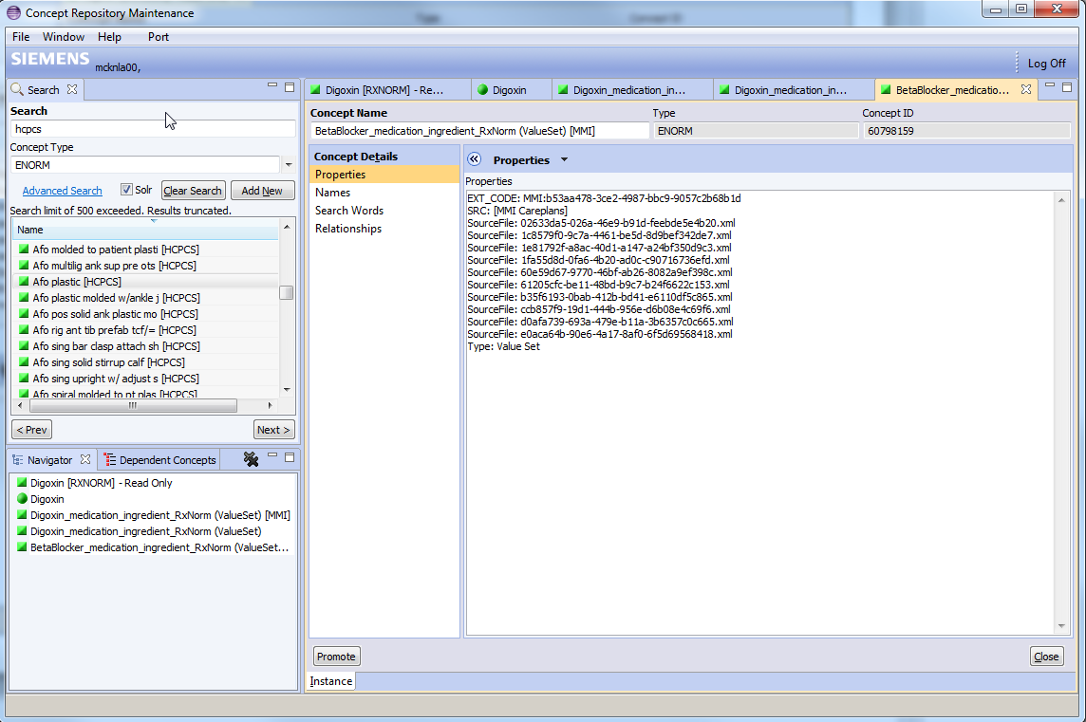
XML example:
One GUID = One Concept.
-Notify vendor when Name
conflicts

Slide 34
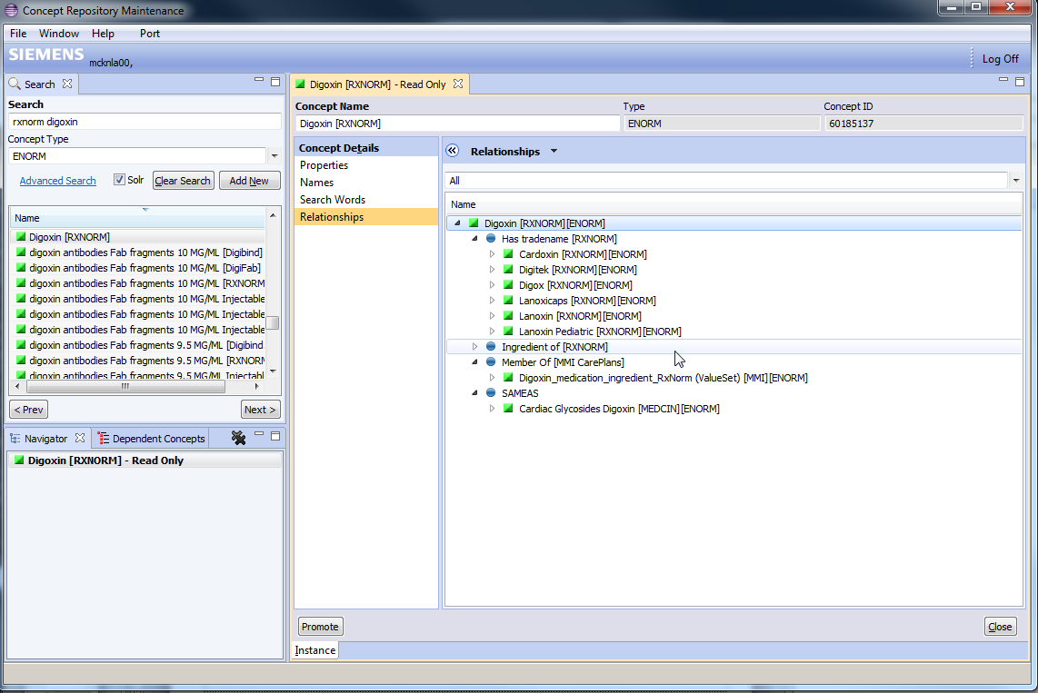
RxNorm Relations
To other concepts
From other concepts
Referenced By Motive
Referenced By Medcin

Slide 35
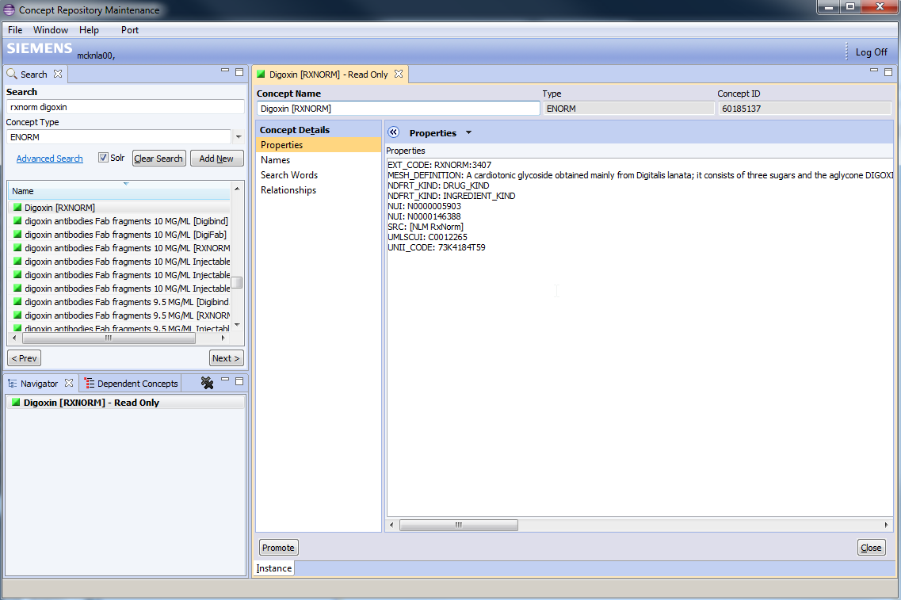
Loaded into eNORM
Reference
Concept Code
Concept Source(s)
Other Attributes

Slide 36
Promotion
ENORM concepts may be “Promoted” to SNORM / CNORM.
  Only when have use case to actually use the concept.
  May occur Individually or in bulk.
  Different concept mainly because different owner/maintainer of the concept and potentially different semantics.
  Keeps (editable) relationships to source ENORM concept.
    SNORM:DerrivedFrom (Meaning License fees may apply)
    SNORM:SameAs (Meaning, warn about duplicate SNORMs here)
  If “SNORM:SameAs” relationship exists already, then option replace/merge on subsequent attempts to promote.
  Copies the concept Names and search words (with adjustments).
  For Sets, copies links to members.
SNORM is Typed for the Application
  On promote, SNORM Type and semantics (e.g. is this a “Value” or a “Question”)
  SNORM types indicate specific attribute sets and capabilities and required for runtime applications.

Slide 37
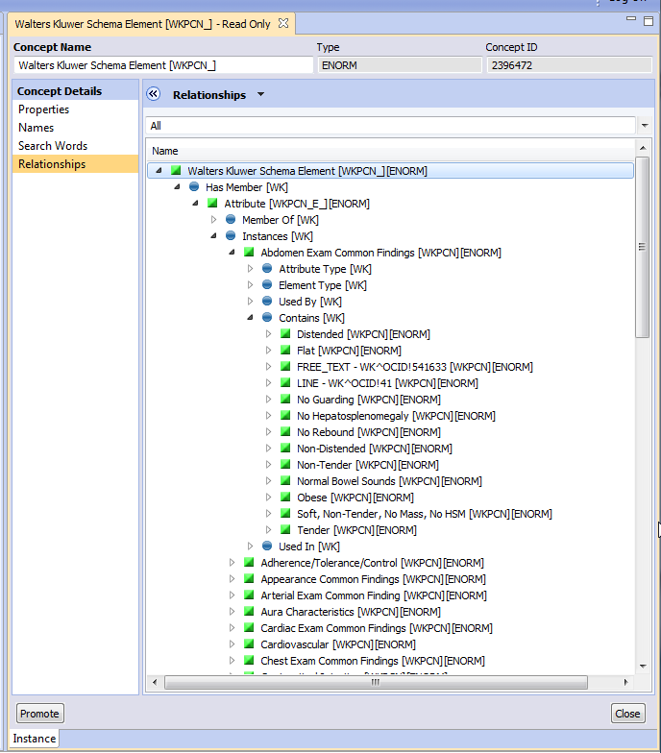
Example – Walters Kluwer

Slide 38
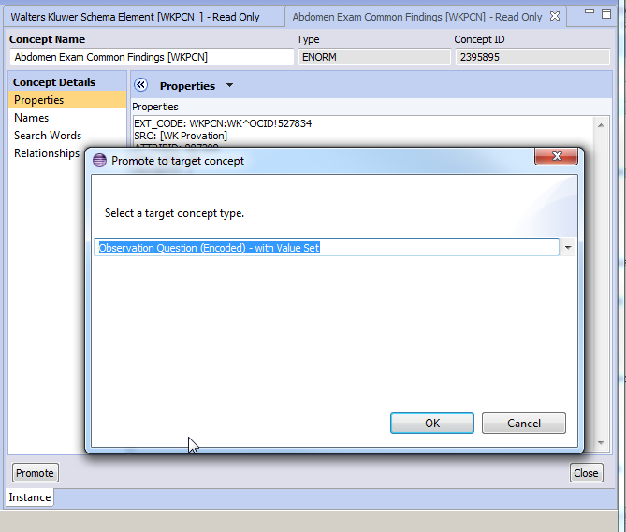
Pick SNORM
Type

Slide 39
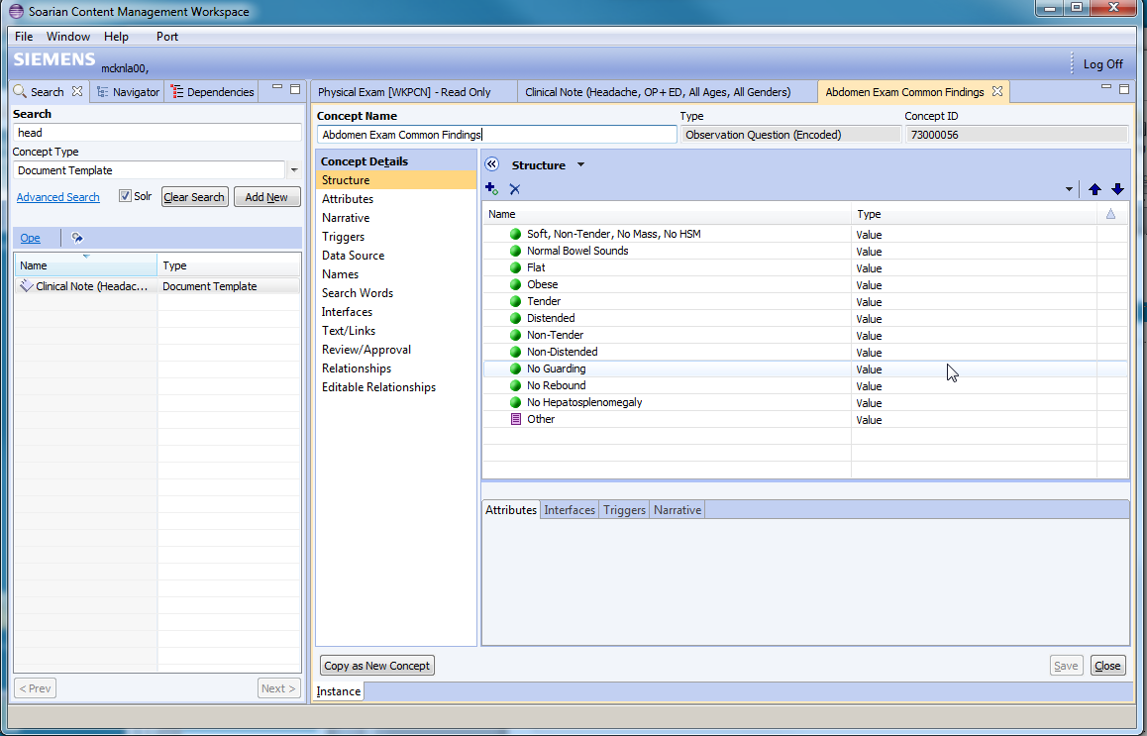
(Creates Dependencies/Children
If they don’t exist)
Generates New Concept
Sets Names
Sets Search words
Sets attributes
Create relations

Slide 40
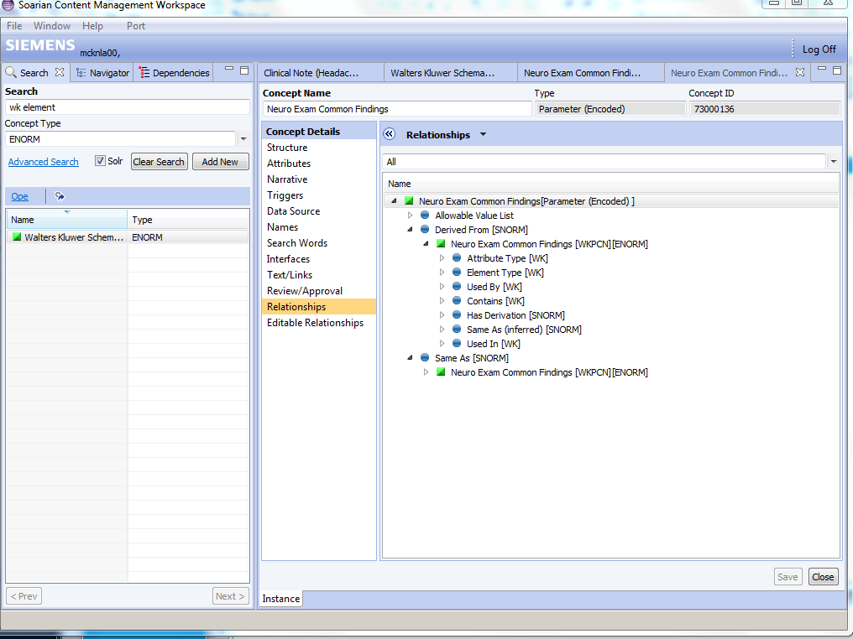
Keeps Links
Back to source
ENORM

Slide 41
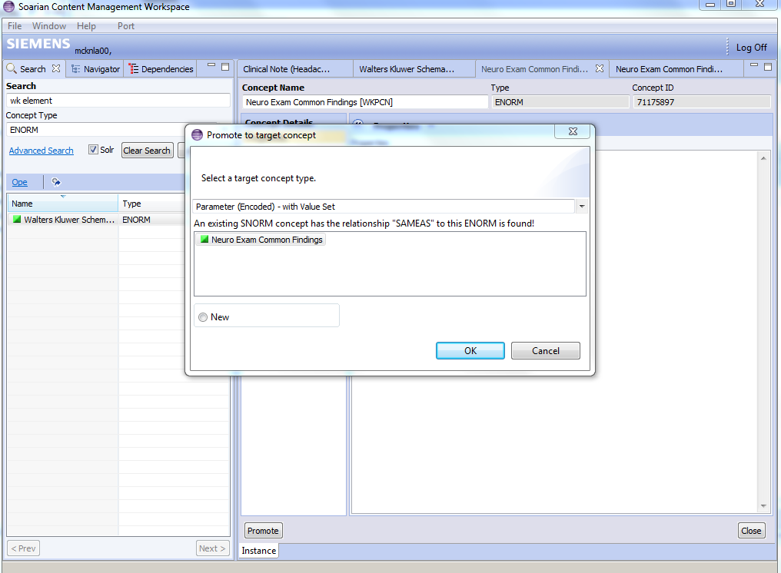
Subsequent Attempts to
Promote gives warning/options

Slide 42
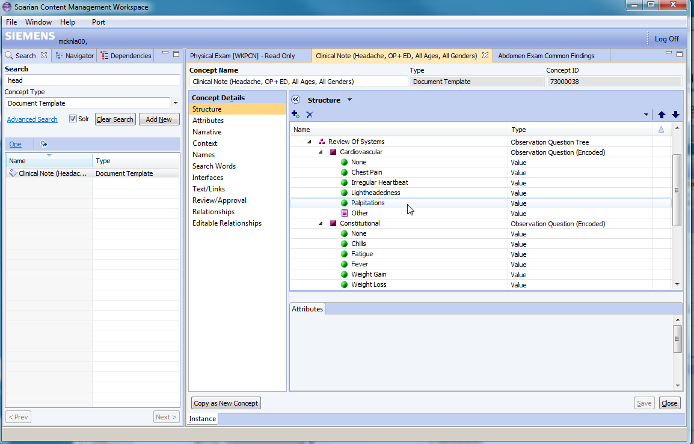
Cerner Modelers
Edit/Combine/Fix
Build
As needed.

Slide 43
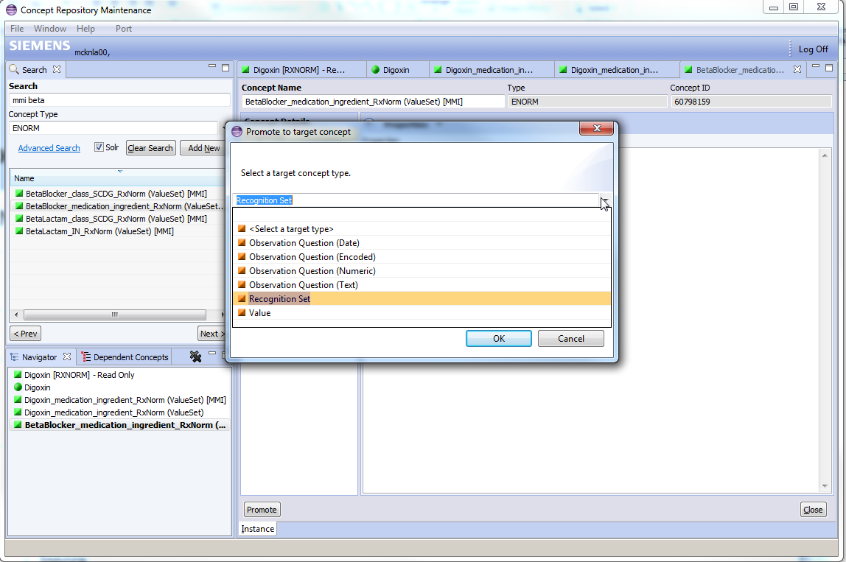
Example – Promote to Recognition Set

Slide 44
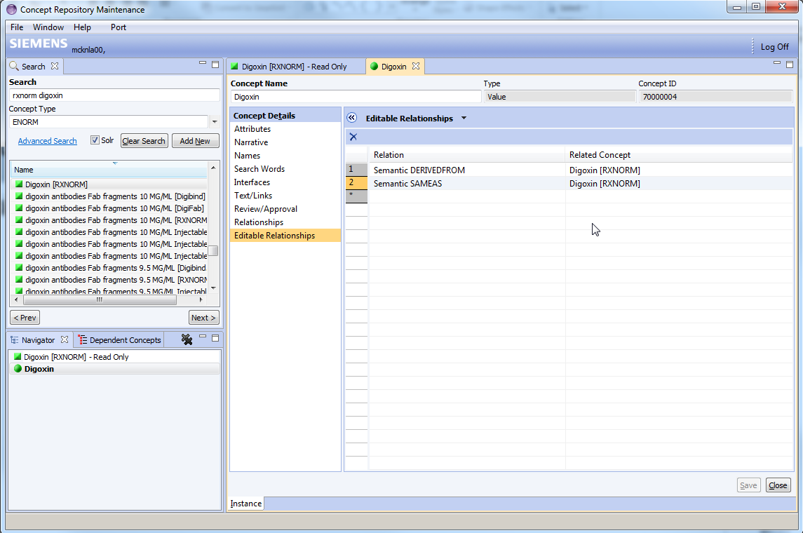
Semantics of a SNORM Value
Siemens Maintenance
Relationship(s) to the Reference Concept(s)

Slide 45
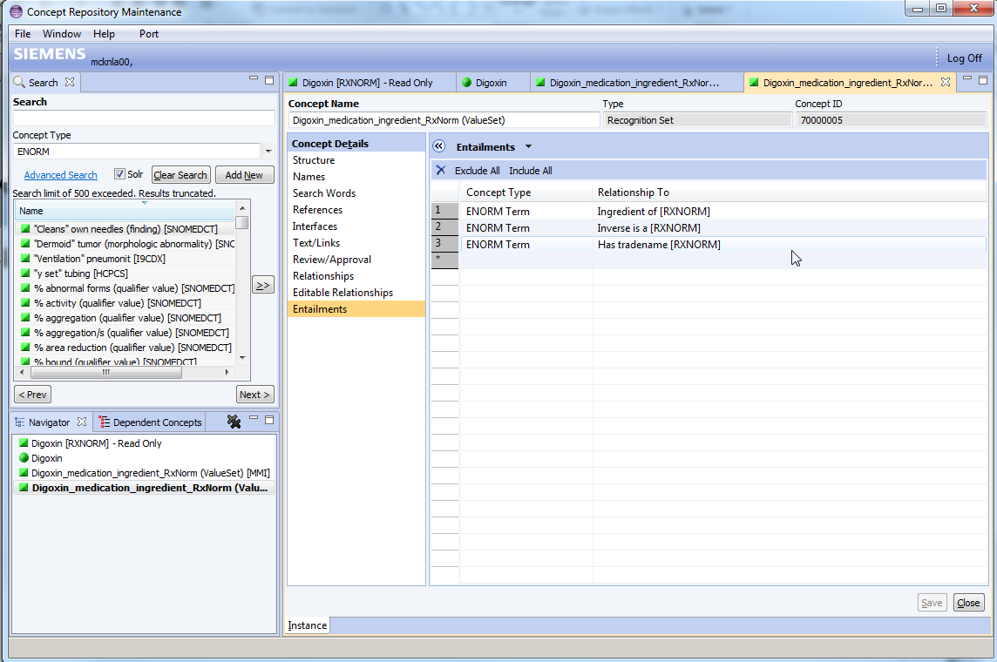

Slide 46
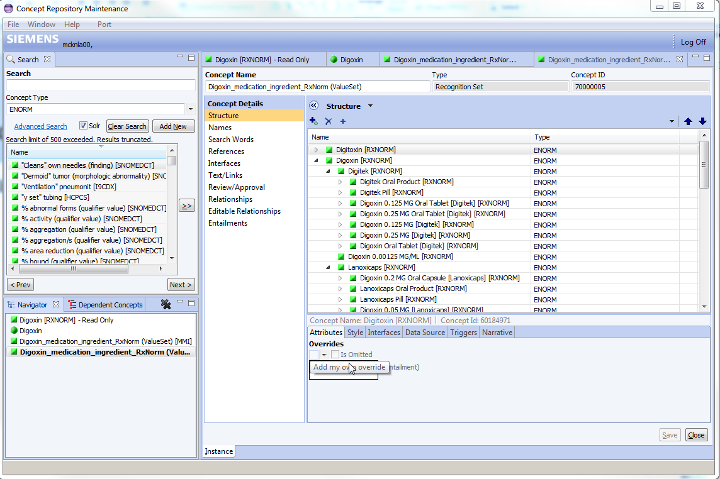

Slide 47
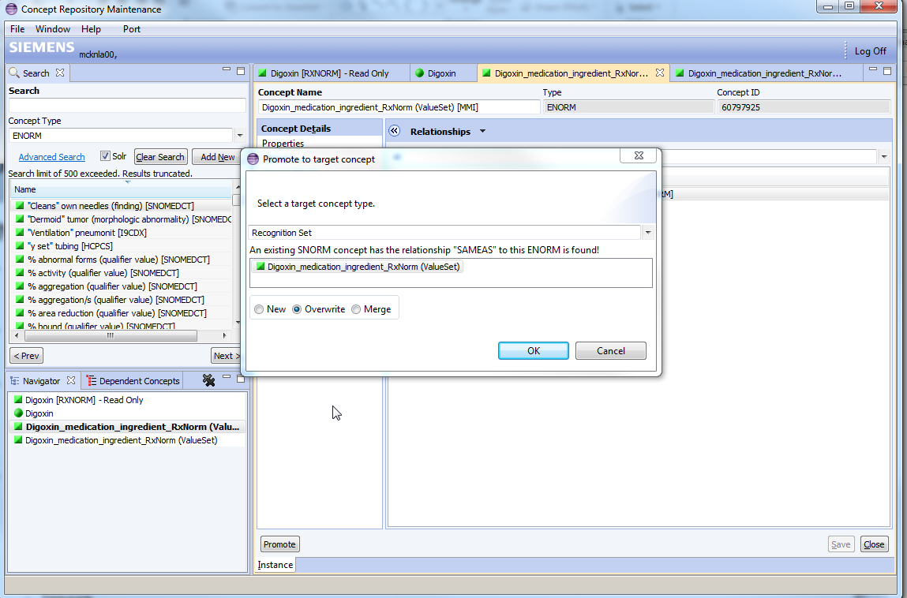

Slide 48
Deployment

Slide 49
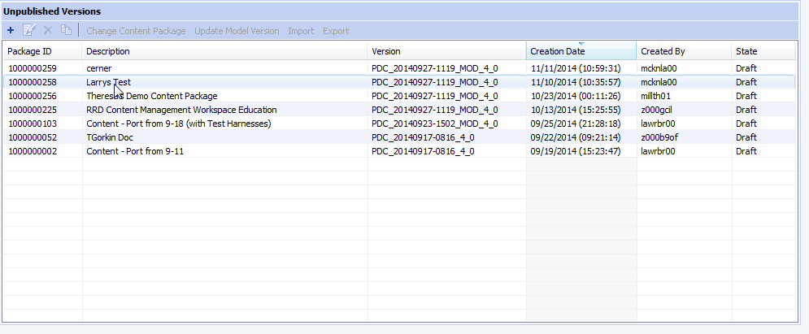
Deployment
Each month, Cerner Creates a “Model Content Product“ (versioned)
  This is a snapshot of the model (sub)graph
Currently delivered to the customer as ezipped bcp file. Ideally web service.
Customer uploads and binds to a “Content Package’
  This is a like a customer patch of the Siemens model graph
  Possible to port Content to another model version with minor editing.

Slide 50
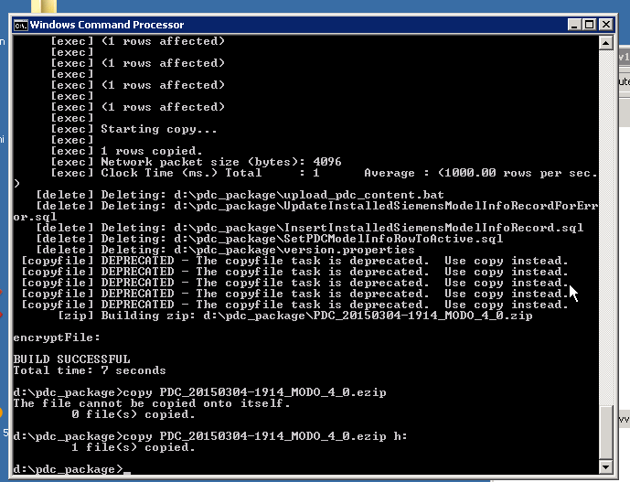
Deployment
Create an ‘ezip’ (snapshot version of model)
Ship to ‘Client’
Ideally make this step use UCA

Slide 51
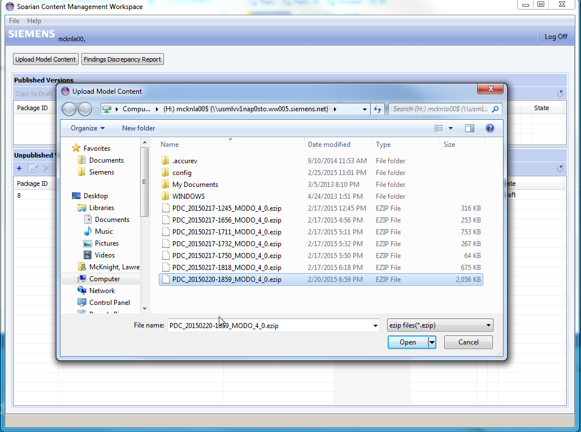
In ‘Customer’ Mode,
Client uploads a version
Of model (‘ezip’)

Slide 52
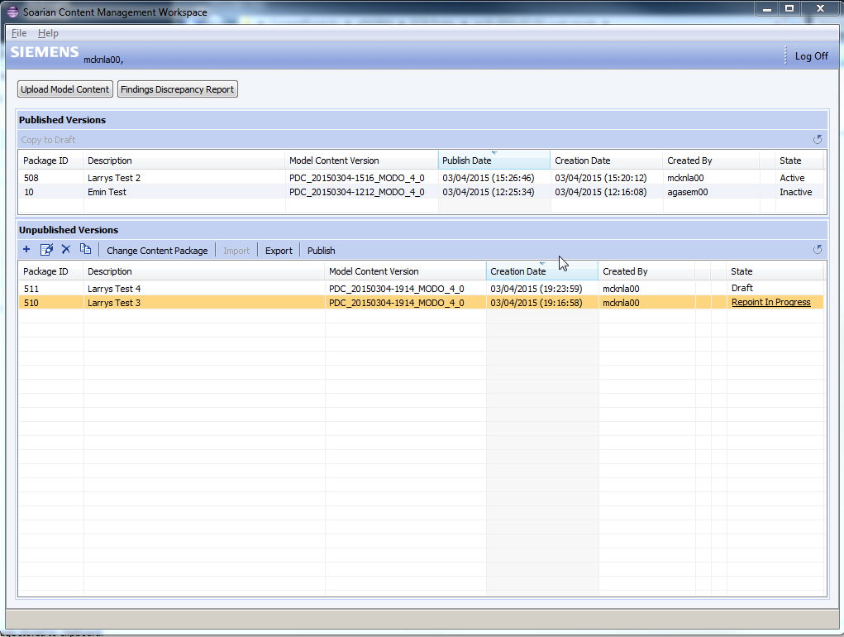
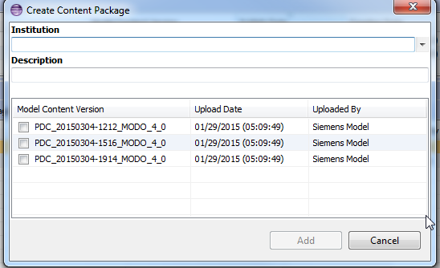
Client builds
a Package from
A base model
Or “Repoints”
Existing package
To a new model

Slide 53
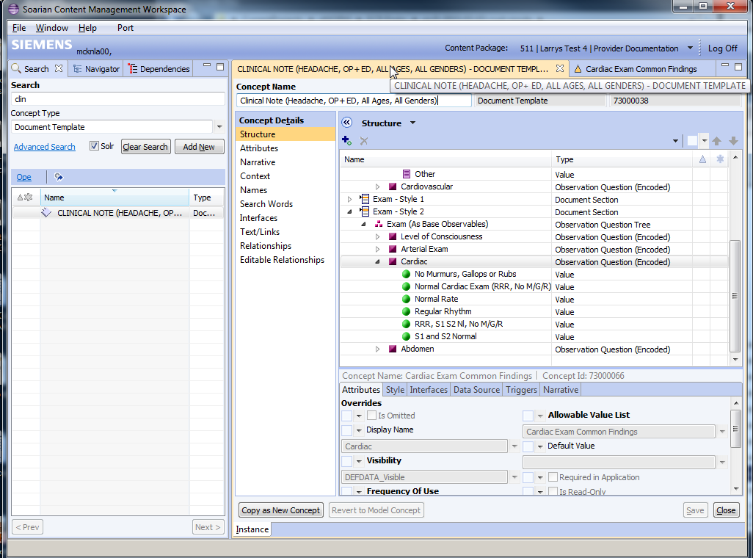
Client Edits or Builds
~Same functions as Cerner
Model = 80-90% Common
Client = 10-20% Tweaks
View of the mixed model,
But stored as changes
To the model, so
Can be applied to
Another similar model

Slide 54
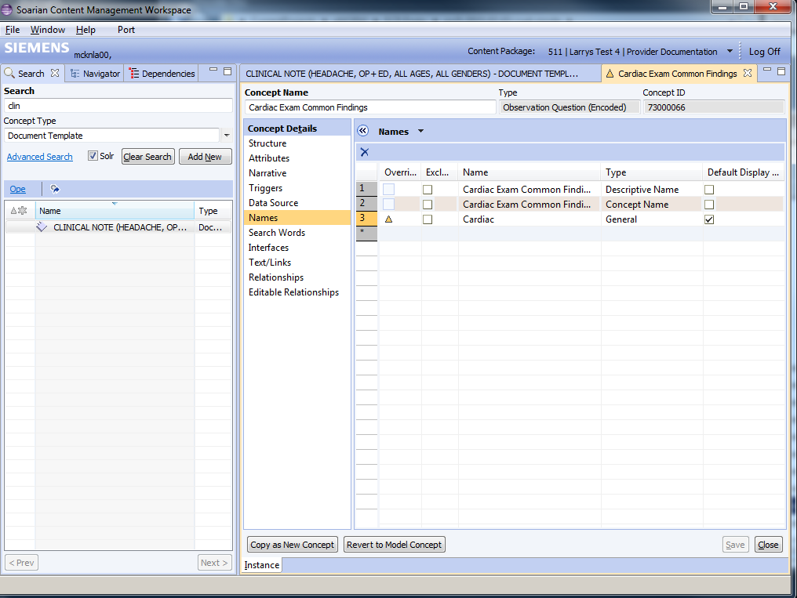
Example:
Add a new label

Slide 55
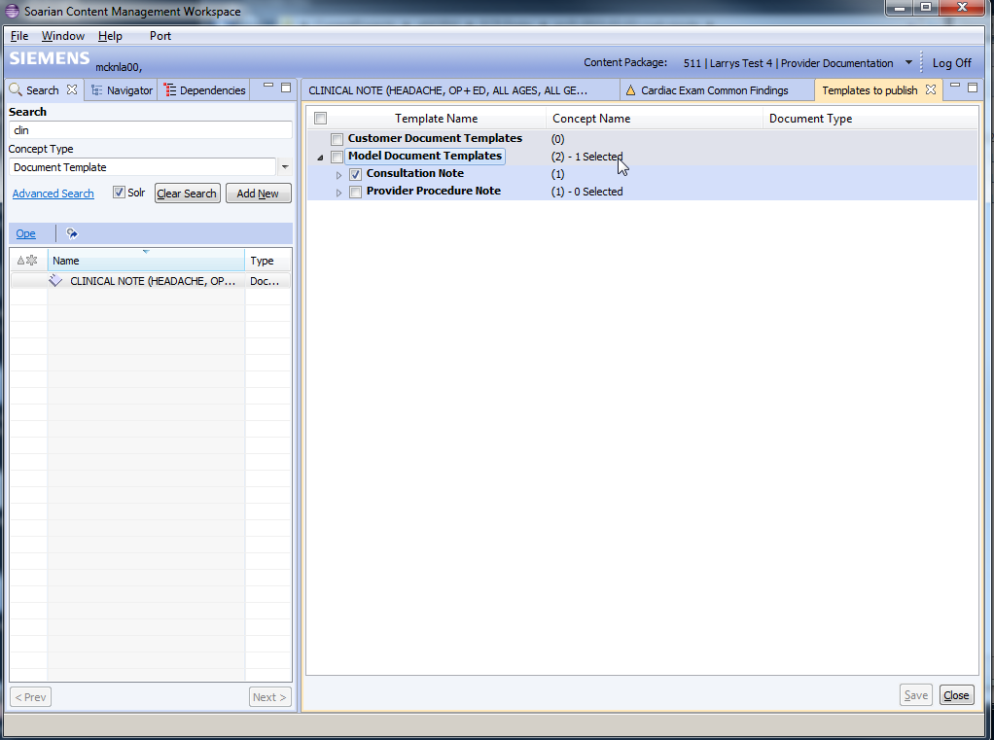
Client Picks which
Templates to publish
Out of the package

Slide 56
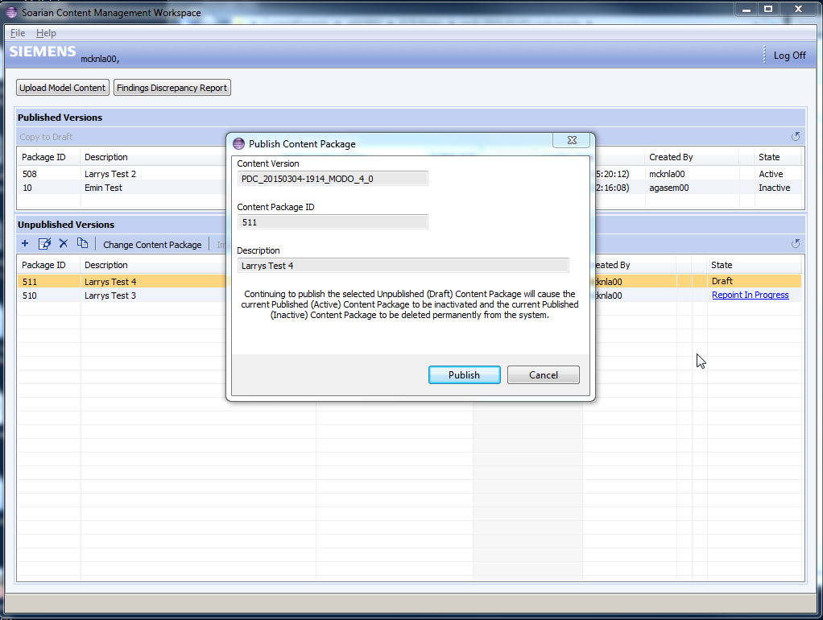

Slide 57
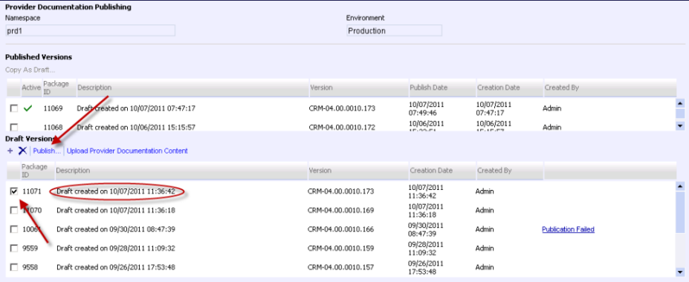
Publishing a Content Package

Slide 58
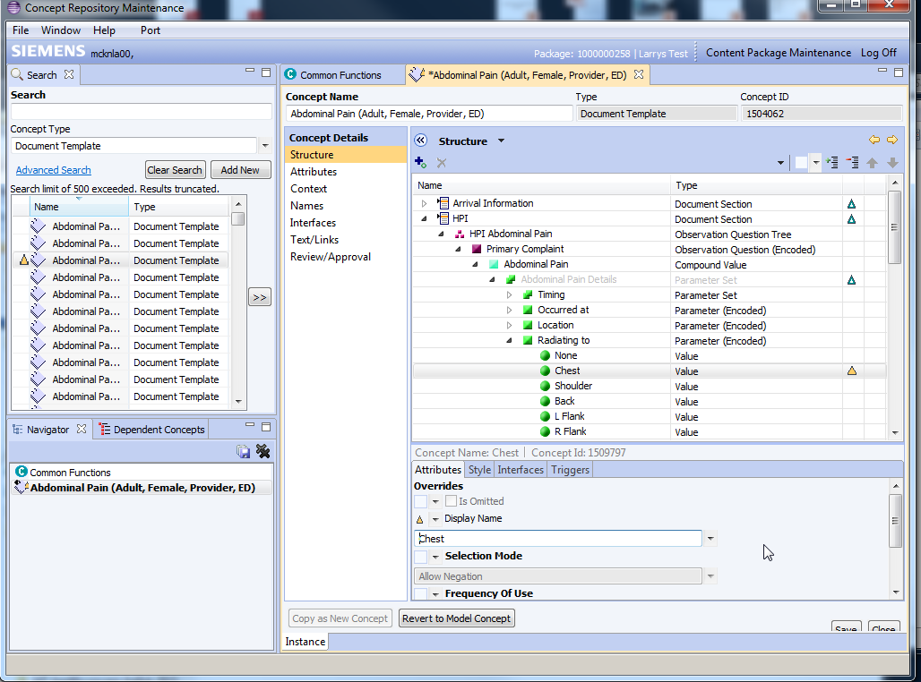
Customer Adaptation
Customers have (nearly) the same build tools and functions
New concepts in a customer namespace
Adapted concepts are keep concept Id but add publication package id.

Slide 59
Content Structure

Slide 60
SNORM Concepts
Value Range
Fields
C1
Default
Reference Overrides
Path
New Default
Names
Attributes
Fields
Relations

Slide 61
Overrides (Logically, Definitional)
C5
C2
C10
C6
Concept Graph
C1
C3
C11
C7
C12
C4
C8
C13
C9
On C2/C6/C11
@x=y
On C8
Omit C12
On C13
@x=z
Overrides =
Constraints on use
Limit Range
Set Default
Omit Reference
On C4/C8
@t=v

Slide 62
Overrides
Overrides / Exception Edits
applied to subgraph in a context

Slide 63
Inflation
Design
Runtime
C5
C10
C2
C5
C10
C6
C11
@x=y
C2
C6
C11
C10
C1
C3
C7
C1
C5
C12
C13
C4
C8
C3
C7
C11
C13
C8
C9
C12
On C2/C6/C11
@x=y
On C13
@x=z
C13
@x=z
On C8
Omit C12
On C4/C8
@t=v
C11
C8
@t=v
C13
@x=z
C4
C9
C11
C13

Slide 64
Valueset Expansion
Default
Warn
C2
C5
C10
C3
C2
C6
C4
C11
C1
C3
C5
C7
C12
C6
C4
C8
C1
C13
C7
C9
C8
@t=v
C8
On C2/C6/C11
@x=y
On C8
Omit C12
On C13
@x=z
On C4/C8
@t=v
C9
C10
Theoretically overrides apply…and can cause issues.
In practice, omission is the only instruction
Typically only override at highest level
Therefore rare.
Default rule = if omitted once, intent to omit for all
C11
@x=y
C11
C12
C13
@x=z
C13

Slide 65
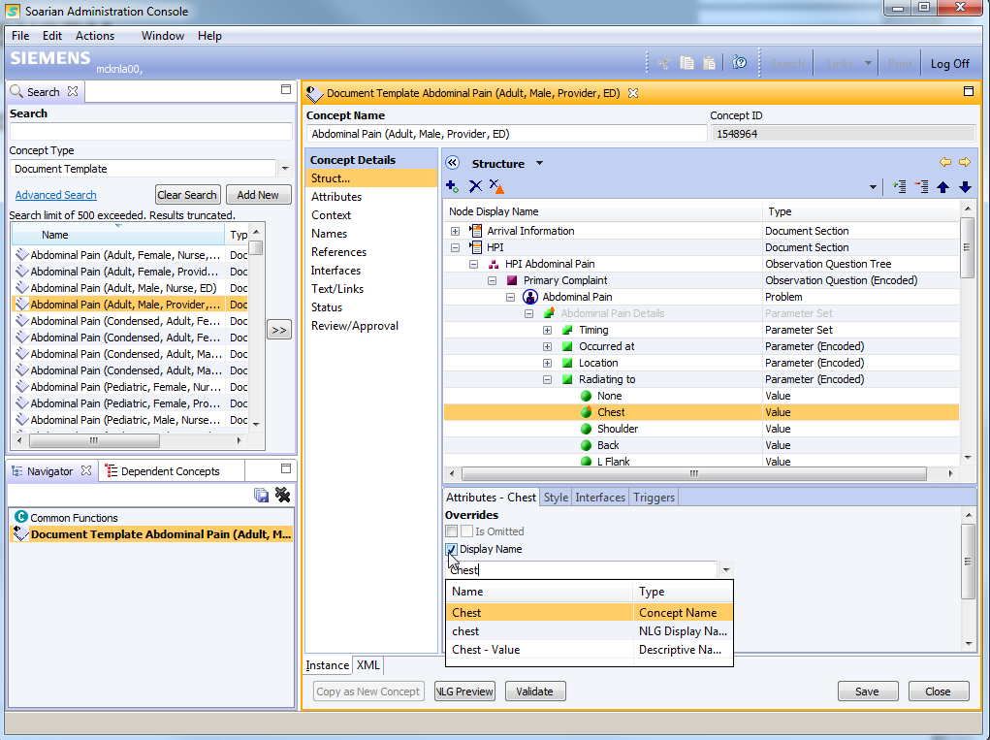
Editing in SNORM
Same Graph links
Different products and use cases

Slide 66
Dealing with Legacy

Slide 67
seNORM
Like eNORM. Read only clone represents link to content that is formally defined outside the graph
ECR/NORM
SC/Service Catalog
OrderableService:
Chest XRay
Service:
Chest Xray
@Form Use: Radiology
@Interface: Rad

Slide 68
Legacy concerns “ceNORM”
Like seNORM, except represents what the customer may have content that is defined. Read only references in the graph
ECR/NORM
SC/Service Catalog
Value: 3 West
Unit: 3 West
@phone:555-1212

Slide 69
Selected Business Cases

Slide 70
Interoperability

Slide 71
Example: Millennium/ Soarian Interop
Is the patient on a ‘Beta Blocker’ at least ‘daily’
Orders (Soarian)
Rules/Workflow
Analytics
Medication List (Millennium)
Billing
Coreg 3.125 mg oral tablet every morning
Carvedilol 3.125 mg PO QAM
Beta Blocker
Daily
Routed
dose
Freq
Frequency
Drug
member
member
Carvedilol PO
3.125
mg
QAM
Every morning
Coreg 3.125 mg oral tablet
Form
Ingredient
Same
Same
Oral
carvedilol phosphate
Every Morning
Same
same
eNORM
SNOMED
carvedilol
Form Of
Multum
Has ingred
carvedilol 3.125 MG Oral Tablet [Coreg]
carvedilol phosphate
RXNORM
Motive
FDB
Notes:
Points to note:
The base coding systems are different
The granularity of codes being recorded is different (brand/generic)
The model structure (routed med vs drug) is is different
There are many code systems and sources of truth involved to relate
Not always just “isa”
The rule builder doesn’t care.
These kind of abstractions are not atypical.
Meds by various representations of theraputic class (example)
Problems (e.g. Does the patient have ‘Breast Cancer’)

Slide 72
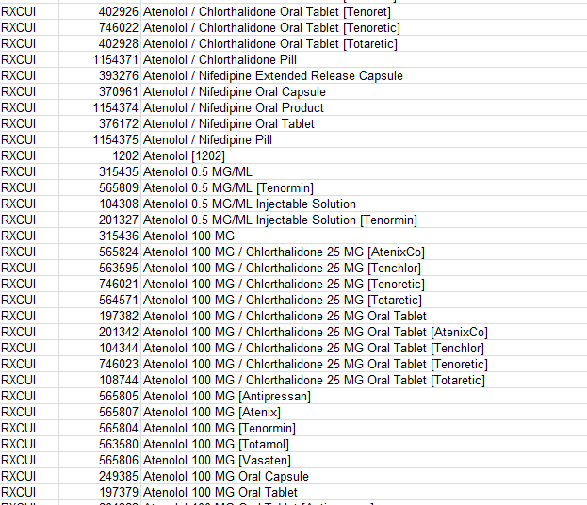
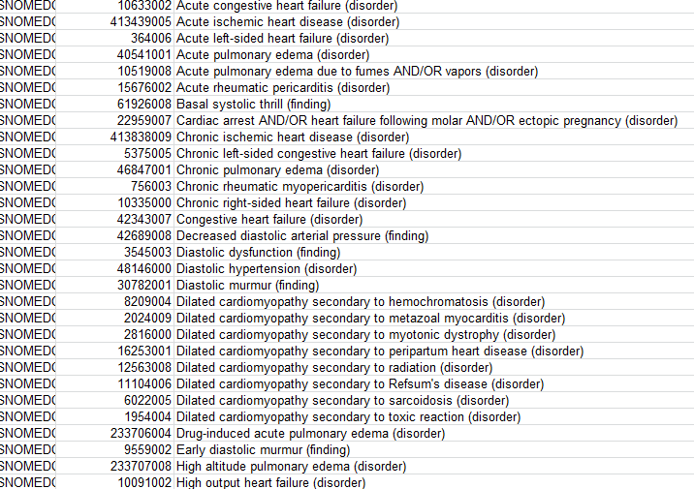
Recognition Sets
That which is sent isn’t always exactly where and how you want it to be. You’ll be more effective if you have a bigger net, and direct the ball where you want it to go.
Example - “if the patient has CHF, check to see if they are on a Beta blocker”
  “CHF” could be any of 42 ICD9CM codes or 57 SNOMED codes.
  “Beta blocker” could be any of >1400 RxNorm Codes
Used by rules, analytics, quality measures
How do you maintain this?

Slide 73
Content Evolution

Slide 74
Example: Meaningful Use 2014 requires
Using SNOMED, not CDC Codes for Smoking
Add
Social History (Section)
Has Question
Has Question
Smoking Status (Question)
Outreach Service: (Question)
Set name ”Daily Smoker”
Allowable Value
Allowable Value
Allowable Value
Narrower
Current Everyday Smoker (Value)
None
Southwest Care (Value)
Narrower
Same
Tobacco Use
Same
Same
Customer
parent
cNORM
Current Smoker
Customer Override
Broader
parent
Current everyday Smoker
SNORM
same
Medcin
History of Tobacco Use
Current every day Smoker
eNORM
LOINC
Current every day Smoker
SNOMED
CDC
Notes:
In a document there is a reference to the Social History Section which has a question about Smoking. This is Siemens model content, represented in Green.
In 2012, this value is required to be from the CDC codes – The values of this external coding system is represented in Purple.
Additionally, there may be a customer modification of that code and they want the display on the form to be more simple and just display “Daily Smoker” Orange means “modify” the Siemens model.
Additionally, the customer may want additional question about Outreach services asked. Siemens model content does not have this. But, they build that in their own system – represented in Yellow.
The customers new question has some values for the question. Some values like “None” are already defined by Siemens, but others are missing and they can create those.
The customer wants that new question to show up anywhere where Social history is asked (they can tune this later to specific contexts). They modify the Siemens model social history to add the question.
Siemens adds some new content including new interface terms and relationships from an external vendor like Medcin. The customers using the Siemens model don’t see changes end forms and have no day one impacts because their changes can be applied to the Siemens version.
Medcin Provides links to Other external terminologies like SNOMED and LOINC.
Because of this the SNORM content can be appropriately updated too.
MU 2014 now changes to requiring SNOMED instead of CDC for Smoking status codes. All of this is managed behind the scenes with little or no customer impact.

