Slide 1
The Interoperable App Development Process
Domain Analysis
Create Logical Models (CIMI)
Approve Models
Model Repository
Create Physical Artifacts (FHIR Profiles)
Project Needs
Pediatric Growth Chart
Neonatal Bilirubin
Comm Acq Pneumonia
OPA Data Collection
MQIP
ACC registries
Terminology
Server
(SOLOR)
Conformance Testing
Create Software (Apps, Services, CDS)
Artifact Repository (FHIR Profiles)

Slide 2
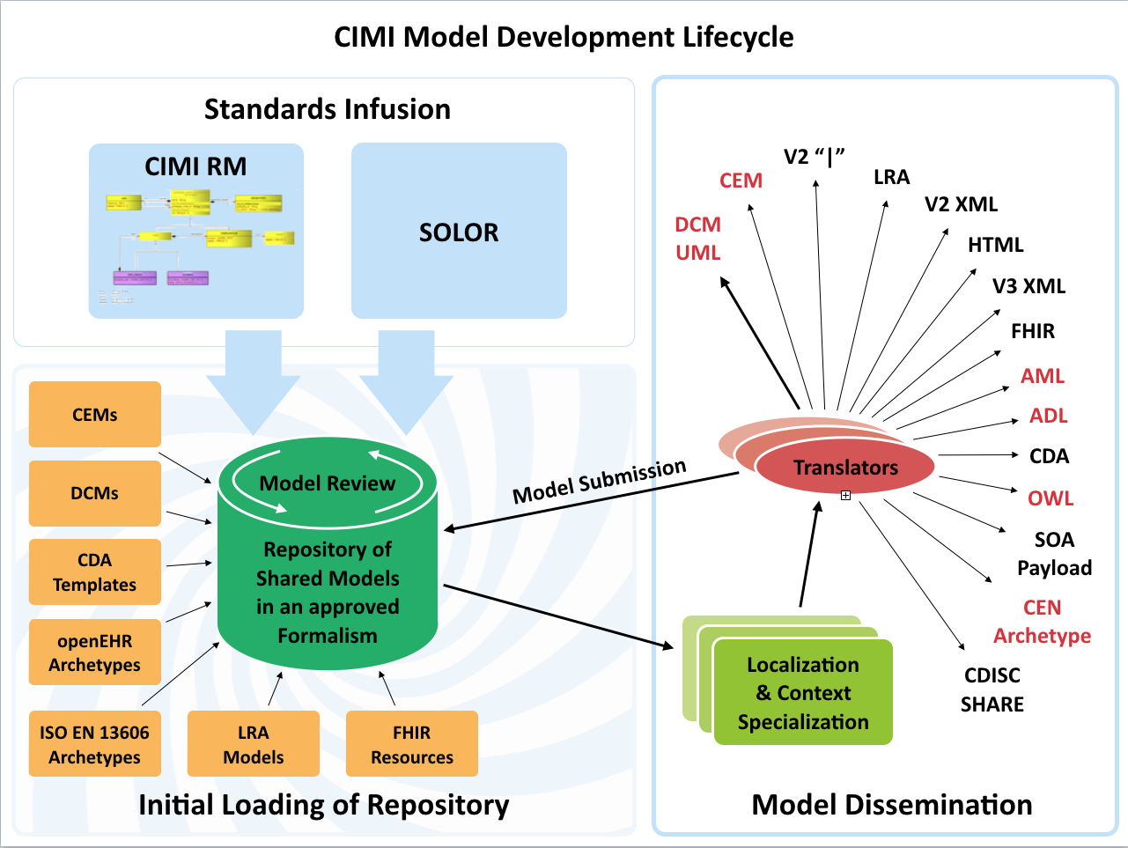

Slide 3
Meeting Goals
Determine model authoring requirements
Determine terminology services requirements
Review existing tools
Discuss feasibility and approach for collaboration

