Slide 1
COVID-19 Interoperability Alliance
Logica General Meeting
August 18th, 2020

Slide 2
COVID-19 Interoperability Alliance: Background
Notes:
The COVID-19 global pandemic has placed significant pressure on existing healthcare information technology systems to accurately document and share data.
The scale of this pandemic, in the modern age of electronic health records, had yet to be seen.
Case reporting, health system capacity management, collaborative research, and supply chain management data has become critical to coordinated response efforts from health systems and public health agencies.
Collaborative effort of multiple organizations via the COVID-19 Interoperability Alliance to align the use of standard terminologies to improve data quality and interoperability.

Slide 3
COVID-19 Interoperability Alliance: Contributors
Notes:
Clinical Architecture –
Founding member of the COVID-19 Interoperability Alliance,
Convene the alliance
Introduce the publicly available collaboration tools used in the effort to rapidly meet terminology
Logica
Who’s use case to build the repository of COVID-19 FHIR profiles spurred on the creation of the alliance
MITRE
C19HCC - Real-life issues found when trying to author and use value sets to support federated observational research initiatives among multiple major electronic health record systems and health analytics platforms.
Regenstrief – LOINC
Rapid response to industry need to standardize coding of SARS CoV2 related tests and documents
Apelon
Fellow terminology management SMEs
Care Evolution – Provides Interoperability solutions and a critical contributor to early collaboration efforts
NACHC – Newest member who will undoubtedly bring some point of care and aggregated reporting use cases to the alliance

Slide 4
COVID-19 Interoperability Alliance: Content Collaboration

Slide 5
Community Collaboration
COVID-19 Interoperability Alliance
Standards Development
Clinical Research
Clinical Decision Support
Case Reporting
Notes:
Collaborators have brought uses cases from various areas, including but probably not limited to the ones listed here.

Slide 6
Community Collaboration
COVID-19 Data Coding using SNOMED CT
http://snomed.org/cv19
Logica FHIR IG
https://covid-19-ig.logicahealth.org/
COVID19 Healthcare Coalition
https://mcovid.org/
…plus individuals from US Food and Drug Administration, Association of Public Health Laboratories (APHL), Health Level 7 (HL7) etc..
Notes:
Standards - SNOMED COVID-19 Coding Guidance and Logica FHIR IG – collaborating with HL7
CDC PUI and hospitalization forms, along with WHO case reporting forms
MITRE/C19HCC – clinical research and CDS, working with EMR vendors directly
APHL – specimen types

Slide 7
Value Set Curation
Stewardship
Value set eligibility/prioritization
Community-driven
Evidence-based
Terminology bindings
Code systems
Scope
Pre-release terms
Updates and maintenance
Notes:
Add curation leads to posting in VSAC?

Slide 8
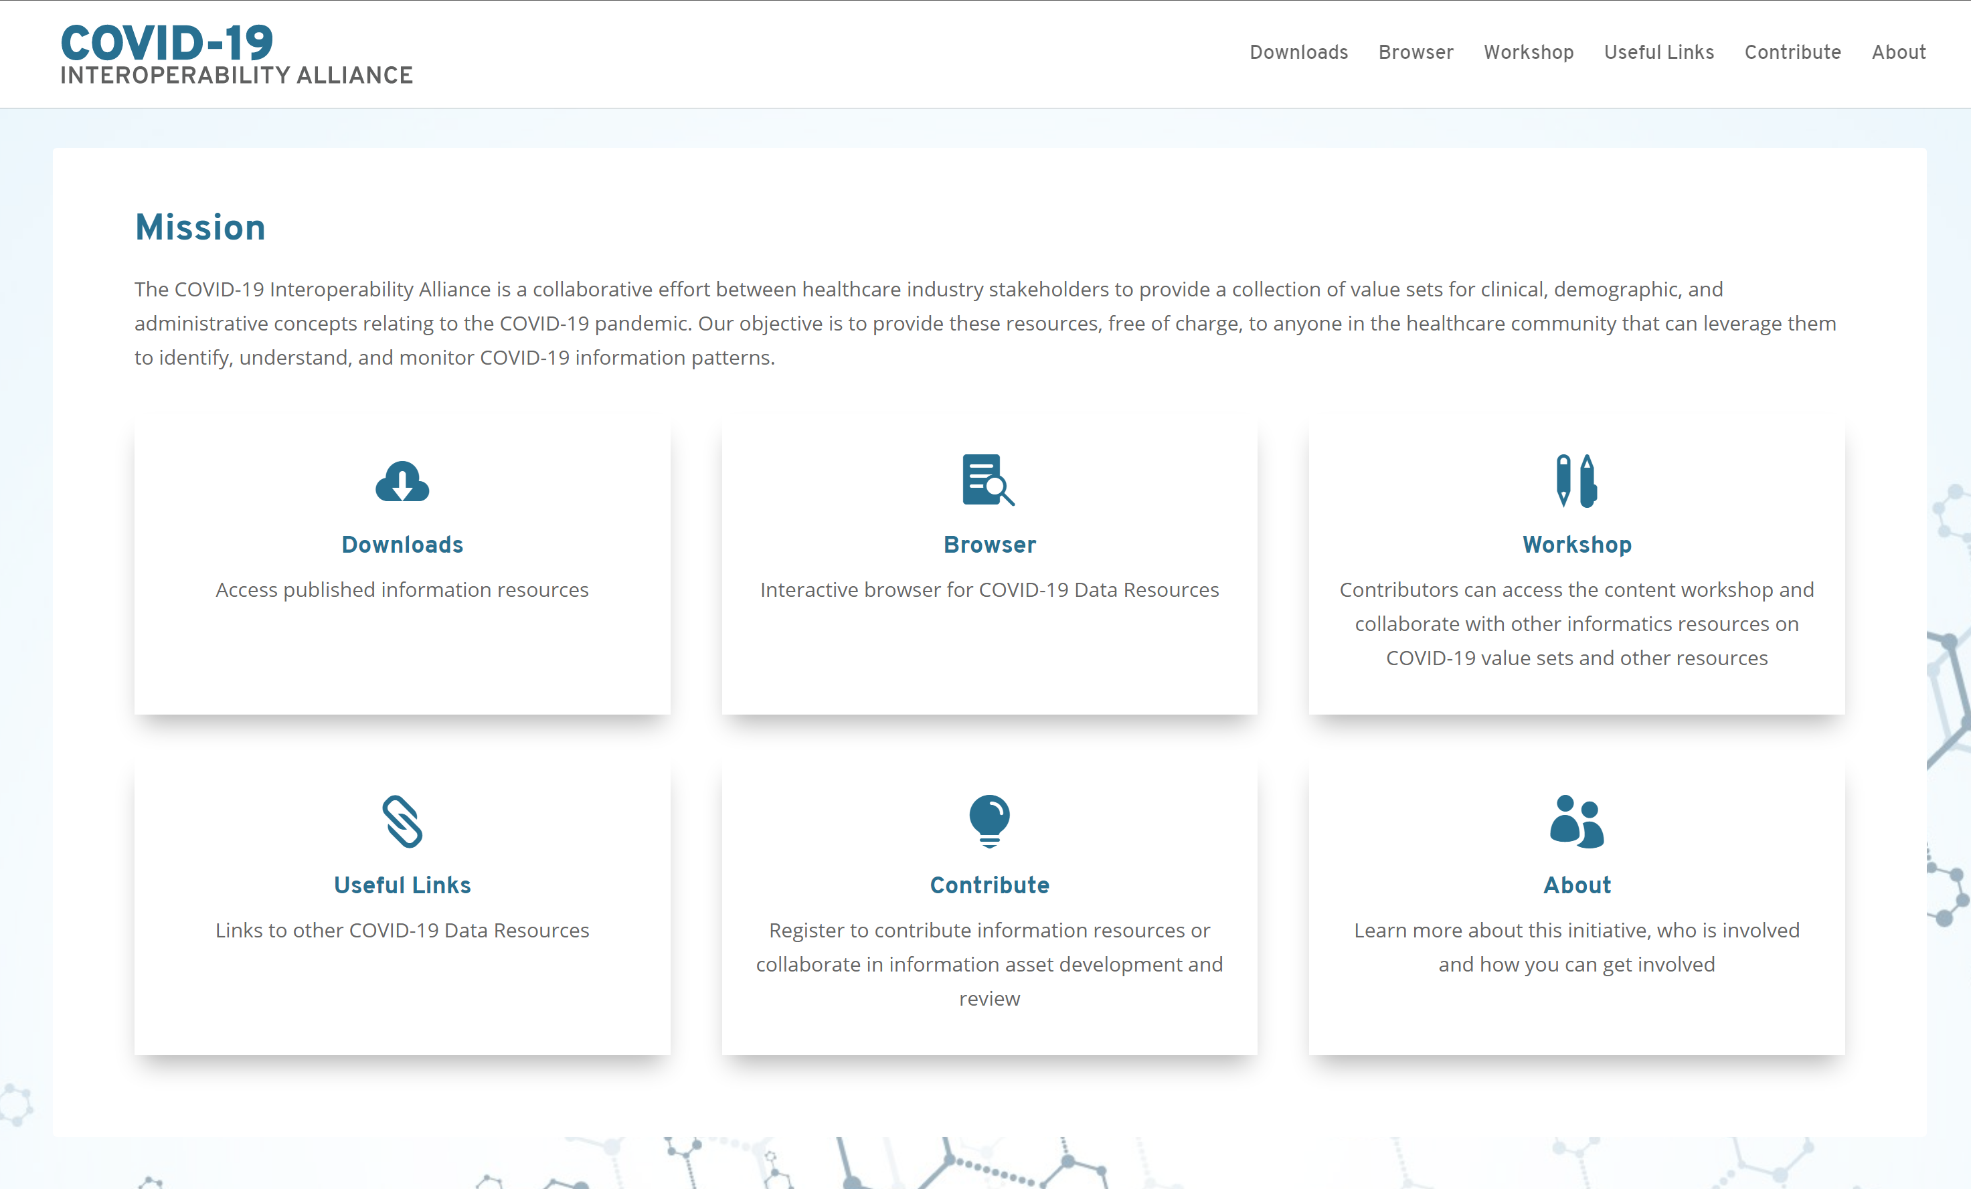

Slide 9
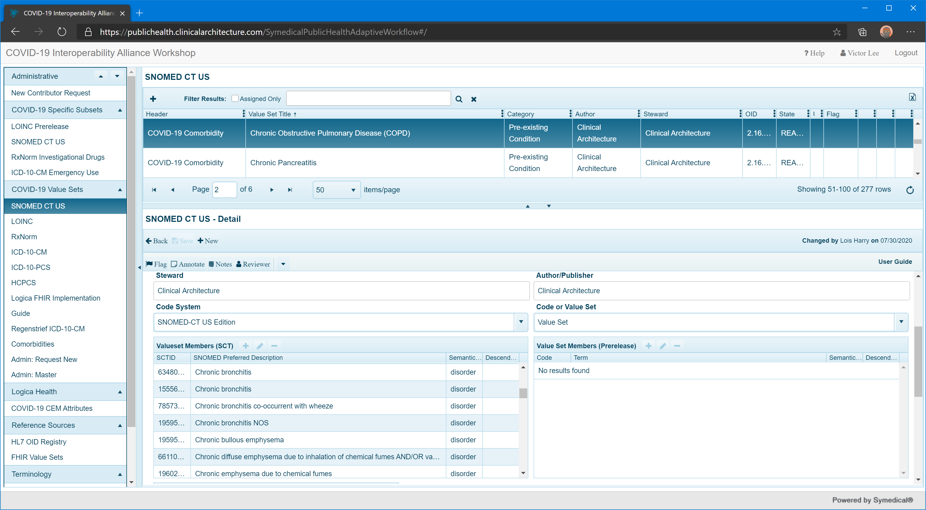

Slide 10
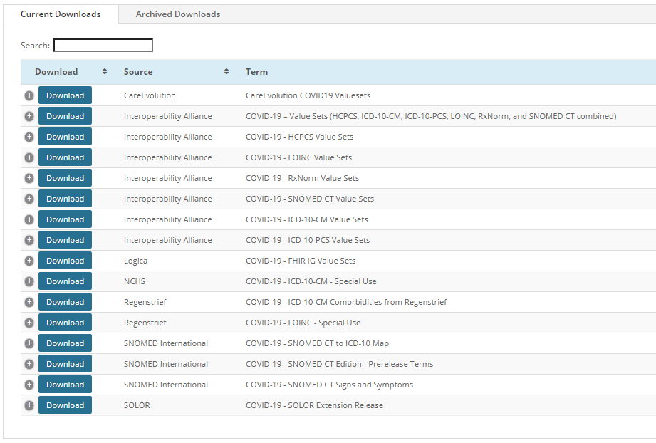

Slide 12
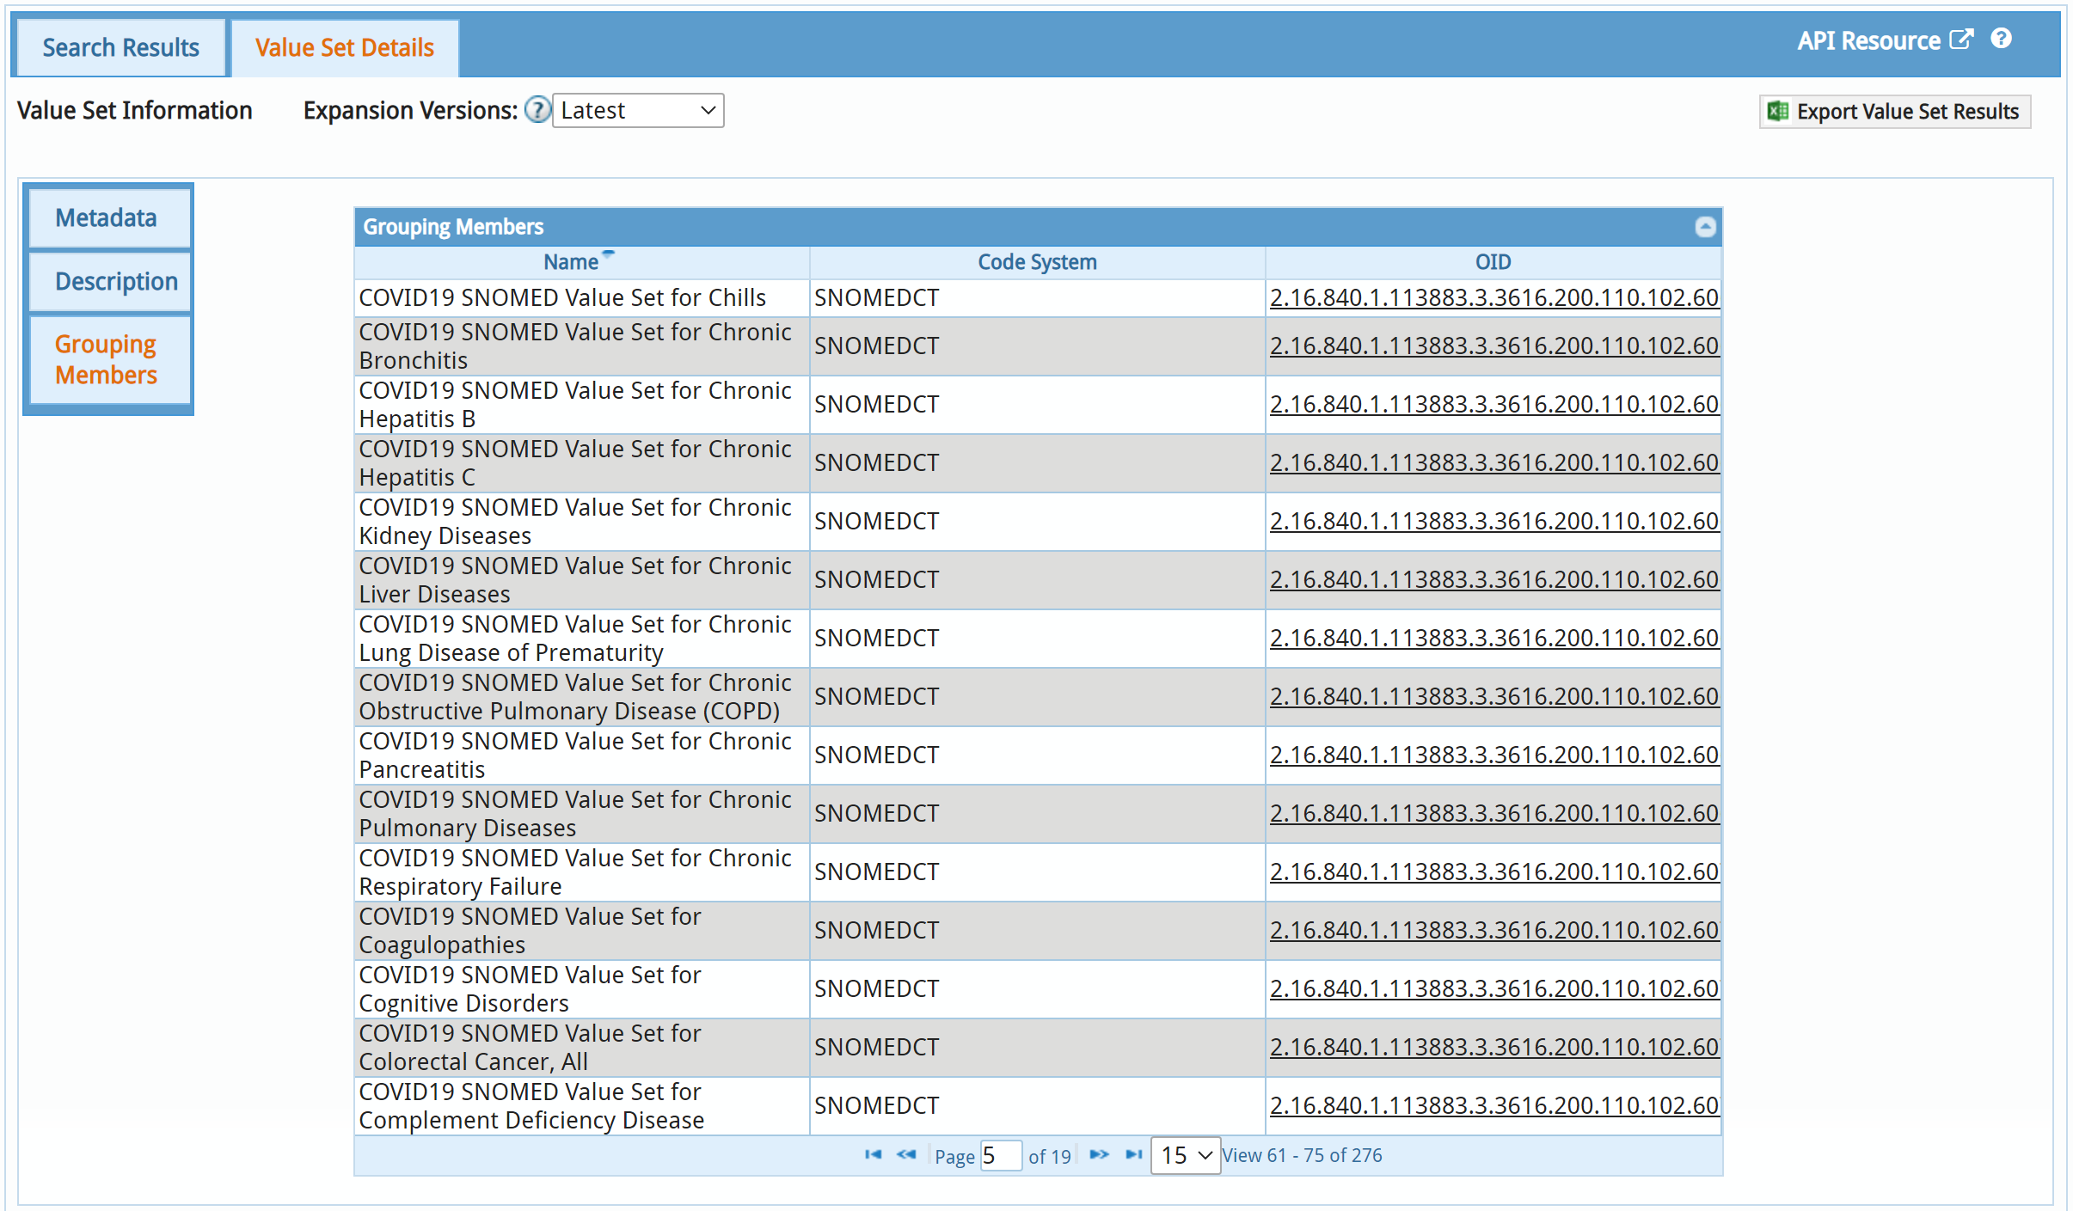

Slide 13
Closing Thoughts
Ongoing collaboration for COVID-19
Additional future public health efforts
“Never allow a crisis to go to waste” – Rahm Emanuel
Notes:
Phrase is often quoted in relation to stressed financial and economic systems.
However we can certainly relate to how it also applies to the stress placed on the healthcare system.
How do we plan for the future, learn from the current pandemic?

Slide 14
Call to Action
Join us
Weekly Calls – Monday 5-6 pm Eastern
Workshop Collaboration
Submit Use Cases/Terminology Needs
Learn More: https://covid19ia.org/
Notes:
Patient Care WG on 8/31
Epic – report out on C19HCC initiatives and use of C19IA value sets

