Slide 1
Logica Virtual Meeting
August 18th, 2020
COVID-19 Guidance To Action ACTS* Collaborative
*ACTS = AHRQ evidence-based Care Transformation Support initiative

Slide 2
Outline
ACTS Goal and Stakeholder Community
COVID-19 Guidance to Action Collaborative
Stakeholder Implications/Opportunities

Slide 3
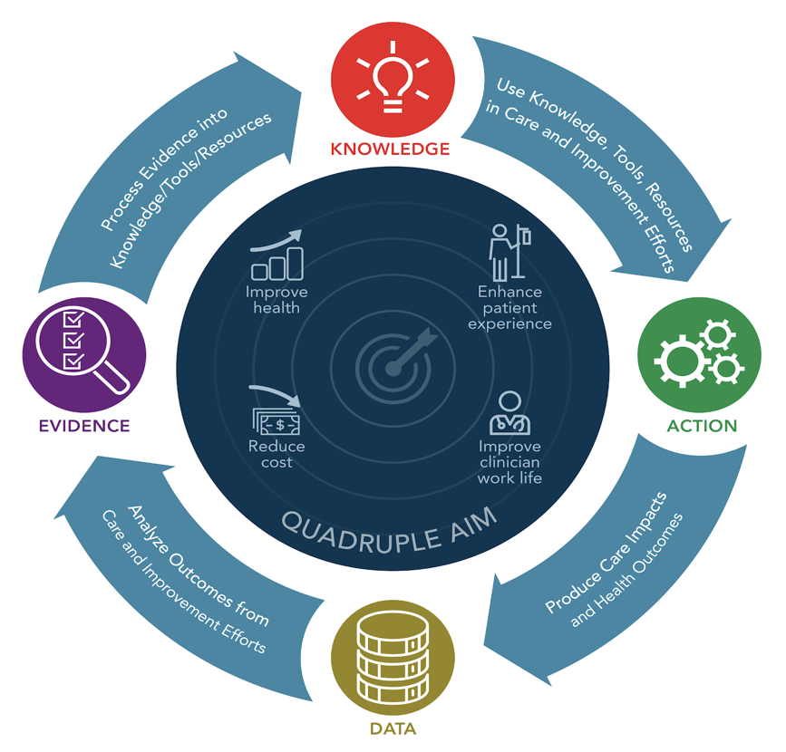
ACTS Goal: High Functioning Knowledge Ecosystem Supports Quadruple Aim
Virtuous-Cycle Knowledge Ecosystem
AHRQ Mission:
Produce evidence to make health care safer, higher quality, more accessible, equitable, and affordable.
Work within the US DHHS and with other partners to make sure that the evidence is understood and used.
Improve
Health
Enhance Patient Experience
Reduce
Costs
Improve Clinician
Work Life

Slide 4
ACTS Stakeholder Community
(n = 255* as of 08/03/20)
Care Delivery Organizations (78) |  | Quality Organizations/ Consultants (38) | HIT/CDS Suppliers (42)
Adventist Healthcare ASU Cedars-Sinai Children’s Hospital of Atlanta (2) Children’s Hospital of Philadelphia City of Hope National Med Center Emory University George Washington University Harvard Medical School/BWH HealthPartners Hennepin Healthcare Inova Health System (2) Intermountain Healthcare (3) Kaiser Permanente Kittitas Valley Healthcare Lehigh Valley Health Network Mayo Clinic (4) Montefiore Medical Center | Northwestern Medicine Oregon Health & Science University (2) Peninsula Regional Med Center (2) RWJBarnabas Health/Rutgers Health Sparrow Health Texas Health Resources University of Chicago/ Cochrane US Network (2) University of Arizona University of Kansas Medical Center University of Minnesota (2) University of Pennsylvania Medicine (3) University of Utah (5) University of Washington VA (18) Vanderbilt University Medical Center (9) Virginia Commonwealth University (2) Virginia Mason Medical Center | Advanced Health Outcomes Arizona Alliance for Community Health Centers BookZurman Clinical Informatics Database Consulting Group EBQ Consulting ecGroup Inc. Fusion Consulting HLN Consulting IPRO (2) JBI (2) KLAS Klesis Healthcare Mathematica MITRE (2) NACHC (3) NCQA (7) Overhage Premier Principled Strategies RTI (5) sEA Healthcare Stratis Health | AgileMD AiCPG Apervita (2) Cerner (2) Clinical Architecture Clinical Cloud Solutions Crisp Health Decisions/UMN EBSCO EHRA/Allscripts Elimu Informatics, Inc. Epic (2) EvidenceCare (4) Health Catalyst (2) Healthwise (2) International Guidelines Center | Intersystems (2) Logica/HSPC MAGIC Evidence Ecosystem Foundation (2) Medisolv Inc. Meditech (2) Microsoft (2) Motive Medical Intelligence Optum Semedy Triostech Verily Life Sciences Visible Systems Corporation Wolters Kluwer
*Names in parentheses are counted elsewhere; numbers in parentheses are individuals

Slide 5
ACTS Stakeholder Community - Continued
(n = 255* as of 08/03/20)
Informatics/ Researchers (16) | Specialty Societies (14) | Patient Advocates (2) | Other Govt Agencies (17) | AHRQ (36) | Payers (2) | Other (10)
Brown University EPC Duke University (2) Idaho State University Indiana University Johns Hopkins EPC (Mayo Clinic) Stanford University UCSF University of Michigan (3) University of Pittsburgh (2) (University of Utah) UT Health at San Antonio UT Southwestern (Vanderbilt University) West Virginia University | AAFP AAP (3) ACCME (2) ACEP (3) ACP AMA AMIA (2) Society of Critical Care Medicine | Health-Hats Engaging Patient Strategy | CDC (4) CMS (5) Idaho Dept of Health NIDDK - NIH (2) NLM - NIH ONC (2) Pima County Health Department (VA) Washington State Dept of Health | Center for Evidence & Practice Improvement (25) Center for Financing, Access and Cost Trends (5) Center for Quality & Patient Safety (1) Office of Management Services (3) ACTS Project (2) | (CMS) BCBS CA BCBSMN | Australia Living Guideline Initiative (2) COVID-END HL7 Jodi Wachs McMaster (2) OHRI UK National Health Service University of Melbourne
*Names in parentheses are counted elsewhere; numbers in parentheses are individuals

Slide 6
Evidence/Knowledge/Guidance Ecosystem
Source: to ACTS from MAGIC Foundation (Per Olav Vandvik and Linn Brandt); see ecosystem diagrams here

Slide 7
AHRQ Digital Knowledge Platform is Key Ecosystem Component
AHRQ Digital Knowledge Platform
Non-AHRQ Knowledge Resources & Platforms
AHRQ Resources / Tools
LHS &
Quadruple Aim
AHRQ INSIGHTS Engine
Make Resources FAIR &
Useful
SYSTEMATIC EVIDENCE REVIEWS
Benefits
RESEARCH STUDIES
Knowledge Consumers
Health Systems
  Care Teams
  Quality Improvement Teams
Patients/Public
Resource Developers
Payers, Policy Makers
Researchers
Population Health, States, others
DISSEMINATION / IMPLEMENTATION
(e.g., User interface/ API)
LHS cycle
OUTPUTS Performance Utilization Costs
Quality
GUIDANCE
Clinical
Quality Improvement
INTERVENTIONS Guidance /
CDS
Knowledge Supply Chain
Outputs
Performance, Quality Measures, Lessons Learned (to Support Virtuous Cycle)

Slide 8
ECOSYSTEM = AHRQ + Other Digital Platforms, Reference Architecture, Public-Private Partnership
Digital Healthcare Knowledge Ecosystem
PUBLIC SECTOR KNOWLEDGE MARKETPLACES
Federal / Open / Free
COMMERCIAL SECTOR KNOWLEDGE
MARKETPLACES
Private / For Profit
Achieves LHS / Quadruple Aim CDS 5 Rights
FAIR
Examples
AHRQ DKP
Other Public / Non-Profit DKPs
Commercial/ Private
DKPs
Knowledge
Creation
Knowledge (Consumers
L1, L2, L3, L4
Provides underlying
Reference Architecture
Governance, Trust, Standards, Tools
Governs
Public Private Partnership

Slide 9
Next Steps
Roadmap Report
RFI
ACTS COVID-19 Guidance Collaborative
Roadmap Status / Actions – Under Advisement by AHRQ leadership

Slide 10
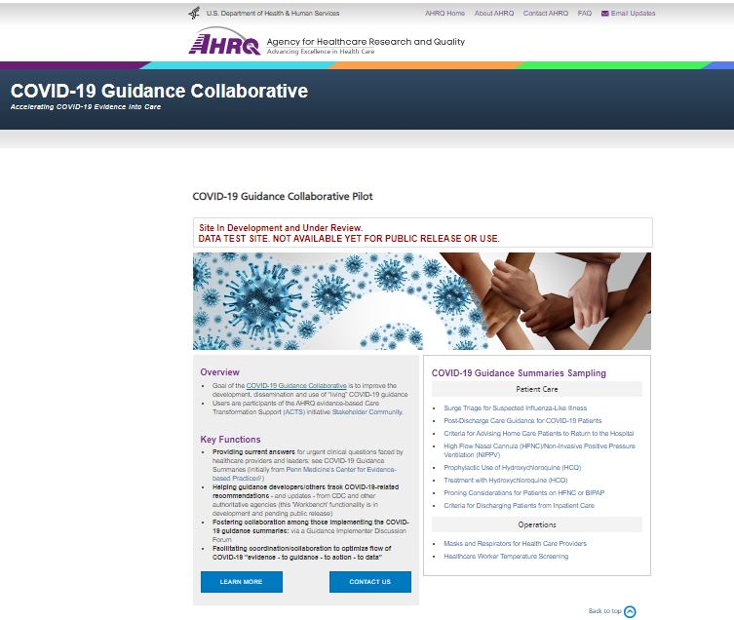
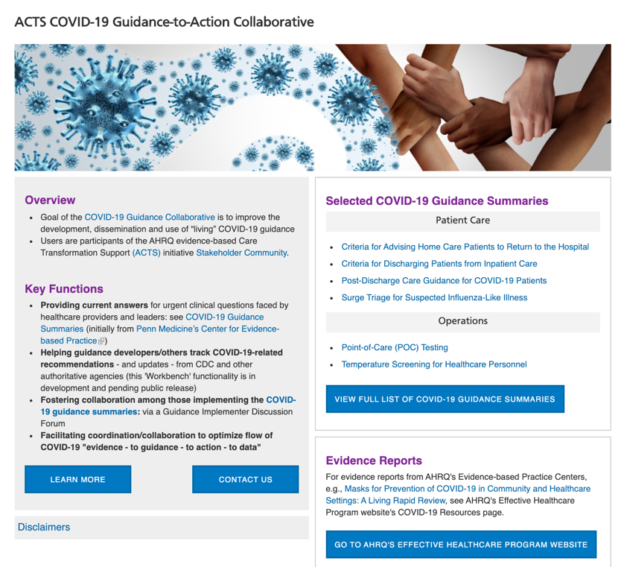
COVID-19 Guidance to Action
Collaborative ACTS Website
Guidance summaries
  from Penn CEP
Learning Community
  For those developing, implementing, evaluating, living CDS for selected targets
  Network of Networks (e.g., COVID-END, COKA, C19HCC, etc.)
Workbench
  Automates retrieval/change tracking of web-based information
digital.ahrq.gov/covid-acts

Slide 11
Collaborative Goals
Cross-fertilize / accelerate current efforts to develop/deliver to care teams COVID-19 evidence-based guidance, tools to apply it;
Measurably improve care / outcomes for COVID-19 in limited settings for selected targets addressed by Learning Community participants in ways scalable to many other targets / settings;
Advance tools, standards, collaborations to seed digital knowledge platforms (AHRQ/others), reference architecture, public private partnerships to achieve effective knowledge ecosystem.

Slide 12
COVID - ACTS Learning Community:
Cultivate Ecosystem Synergies

Slide 13
Stakeholder Initial Targets for ‘Living CDS’
(Opportunistic – driven by participant efforts)
COVID-19
  Symptom eval/triage/test & mgt recs
    Remote triage of patients with possible COVID-19 symptoms
    ED - Severity assessment/optimal disposition
    Monitoring /managing COVID patients at home
  Inpatient/ICU
    patient deterioration risk
    whether/how to anticoagulated
  Scale to other targets
    COVID-19 and ideally beyond
Cross-fertilizing content, processes, tools to provide living reviews that inform living guidelines that drive the living CDS

Slide 14
A Theoretical Enhanced Ecosystem Flow Building on Current Efforts by Collaborative Participants
UMN EPC: Process Evidence [SRDR+/COKA]
AU National Evidence TF: Provide Living Guidelines [NIH/CDC?]
C19HCC Agile KE Team: Develop CDS
UMN CDO: Implement Living CDS, Assess Results
CDS Connect: Provide CDS Repository/ Authoring
Key:
Blue: happening now
Gray: potential enhancement
Flow more efficient, scalable: standards-based computability, best practices
Working on similar flows within/across:
other CDOs (e.g., VA, health centers)
other targets (e.g., testing )

Slide 15
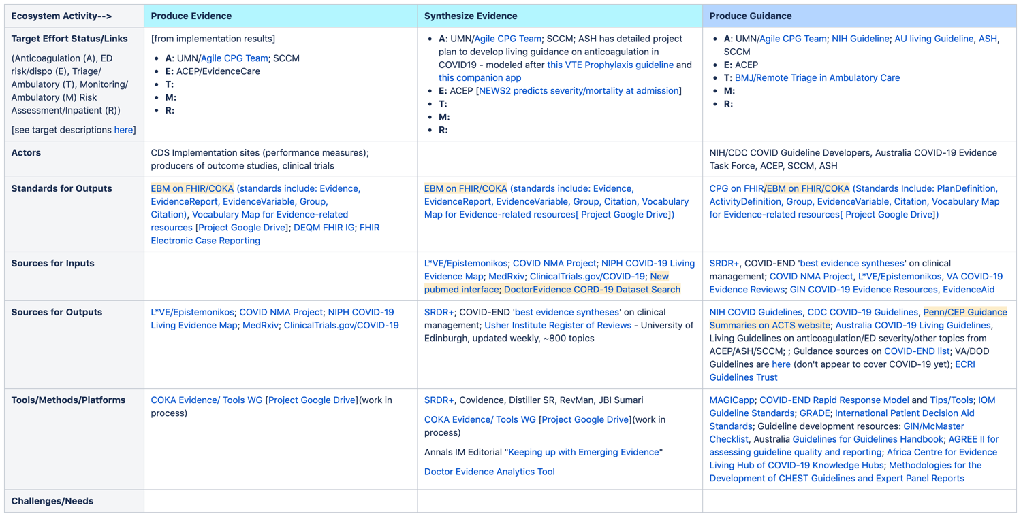
Ecosystem Links CoPs Are Improving and Connecting
Early Rough Draft ‘Developing Evidence/Guidance’ CoP Dashboard
https://covid-acts.ahrq.gov/pages/viewpage.action?pageId=13605911

Slide 16
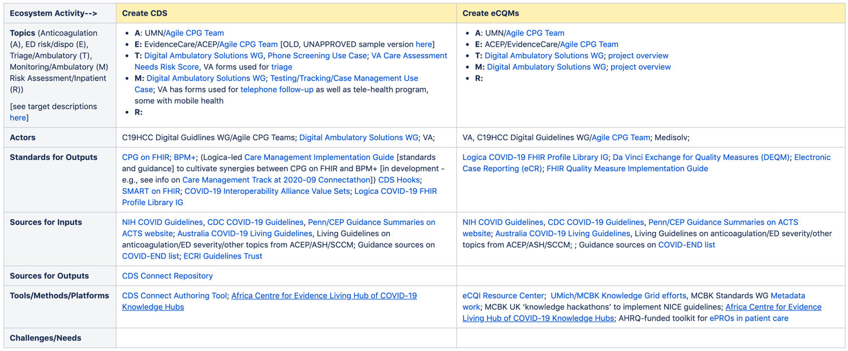
Ecosystem Links CoPs Are Improving and Connecting
Early Rough Draft ‘Developing CDS/eCQMs’ CoP Dashboard
https://covid-acts.ahrq.gov/pages/viewpage.action?pageId=13605912

Slide 17
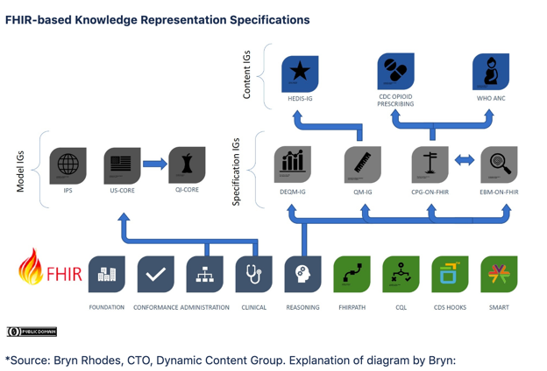
Synthesize Ecosystem Best Practices/Toolkit?
Posted, with talking points from Bryn, on Developing CDS/eCQMs CoP page, beneath Dashboard
Flesh out to fully include offerings by Logica Health, others;
Organize information about tools, resources, standards, IGs, etc. into ‘playbooks’/architecture for addressing each ecosystem step?

Slide 18
Stakeholder Implications/Opportunities
Examine Learning Community CoP pages
  Valuable take/give with your efforts? (for specific targets/beyond)
Leverage Collaborative effort to co-create better ecosystem
  Standards, methods, tools, end-to-end concept demonstrations
  Playbooks, etc.

