Slide 1
Logica Models Clinical Review Process Task Force
August 18, 2020

Slide 2
Task Force Members
Joey Coyle
Laura Heermann Langford
Stan Huff
Patrick Langford
Susan Matney
Jim McClay
Viet Nguyen
Julia Skapik
Jimmy Tcheng

Slide 3
Today’s Agenda
Review Development Process
Types of Clinical Model Review
Scope of Today’s Discussion
Proposed Clinical Model Review Process
Model Review Criteria
Next Steps

Slide 4
The Interoperable App Development Process
Domain
Analysis
Create Logical
Models
(CIMI)
Approve
Models
Model
Repository
Project Needs
Pediatric Growth Chart
Neonatal Bilirubin
OPA Data Collection
MQIP
ACC registries
Comm Acq Pneumonia
Etc.
Terminology
Server
Create
Physical
Artifacts (FHIR
Profiles)
Create
Software
(Apps, CDS)
Artifact
Repository
(FHIR profiles)
Conformance
Testing

Slide 5
The Interoperable App Development Process
Domain
Analysis
Model
Repository
*NEW*
Approve
Model
content
request
Create Logical
Models
(CIMI)
Approve
Models
*NEW*
Approve
New FHIR
Profiles
Project Needs
Pediatric Growth Chart
Neonatal Bilirubin
OPA Data Collection
MQIP
ACC registries
Comm Acq Pneumonia
Etc.
Terminology
Server
Create
Physical
Artifacts (FHIR
Profiles)
Conformance
Testing
Create
Software
(Apps, CDS)
Artifact
Repository
(FHIR profiles)

Slide 6
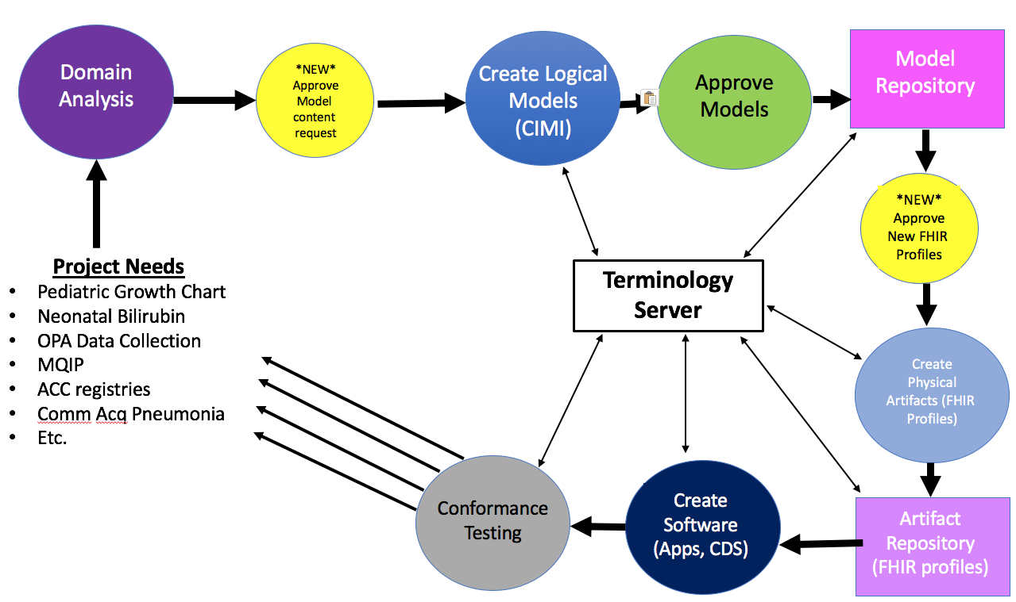
Model Review
When
What ??
Who ??
How ??

Slide 7
The Interoperable App Development Process
What?
Who?
How?
What?
Who?
How?
Domain
Analysis
*NEW*
Approve
Model
content
request
Create Logical
Models
(CIMI)
Approve
Models
Model
Repository
*NEW*
Approve
New FHIR
Profiles
What?
Who?
How?
Project Needs
Pediatric Growth Chart
Neonatal Bilirubin
OPA Data Collection
MQIP
ACC registries
Comm Acq Pneumonia
Etc.
Terminology
Server
Create
Physical
Artifacts (FHIR
Profiles)
Conformance
Testing
Create
Software
(Apps, CDS)
Artifact
Repository
(FHIR profiles)

Slide 8
TECHNICAL VS. CLINICAL REVIEW
What
Technical Conformance Review Elements
Clinical Conformance Review Elements
Determine if model is redundant
Are there similar elements
Syntax
Consistency with Logica required style, e.g., Logica will have models for body location that can be applied consistently wherever it is used
Presence of a terminology binding – attributes and value sets
Conformance to FHIR resource definition
Identify potential duplicates
Does it come from the correct sub-domain
Is the concept validated in the correct terminology
Clinical accuracy
Does it match evidence-based standards of clinical care?
Clinical completeness
Does it include all elements that would be clinically relevant?
Are metadata requirements appropriate to the use case?
Does it include data that is not clinically relevant?
Clinical consistency
Semantic consistency
Consistency across related artifacts
Value set alignment
Alignment with use case
Workflow
Value sets
Goal is to automate this process to the extent possible
Need clinician friendly representations of the models that can be automatically generated

Slide 9
TECHNICAL VS. CLINICAL REVIEW
Current Focus
Technical Conformance Review Elements
Clinical Conformance Review Elements
Determine if model is redundant
Are there similar elements
Syntax
Consistency with Logica required style, e.g., Logica will have models for body location that can be applied consistently wherever it is used
Presence of a terminology binding – attributes and value sets
Conformance to FHIR resource definition
Identify potential duplicates
Does it come from the correct sub-domain
Is the concept validated in the correct terminology
Clinical accuracy
Does it match evidence-based standards of clinical care?
Clinical completeness
Does it include all elements that would be clinically relevant?
Are metadata requirements appropriate to the use case?
Does it include data that is not clinically relevant?
Clinical consistency
Semantic consistency
Consistency across related artifacts
Value set alignment
Alignment with use case
Workflow
Value sets
Goal is to automate this process to the extent possible
Need clinician friendly representations of the models that can be automatically generated

Slide 10
Focus and Starting Point of Peer Review Process
The clinical review is focused on clinical content not the structure of the model
The clinical content review group will be comprised of people with both clinical and informatics expertise
The clinical content peer review process begins when the project’s subject matter experts have completed their internal quality review of the models
Assumptions
Project has done quality review of their clinical content including crowd sourcing
The models are provided along with information on the purpose/use/context of the model, e.g., IG
Once the models are received a review team is assembled based on the clinical expertise relevant to the models and their associated use case
What
Who
When
When
What
Who
This is a peer review process

Slide 11
Focus and Starting Point of Peer Review Process
Points of Discussion
The clinical review is focused on clinical content not the structure of the model
The clinical content review group will be comprised of people with both clinical and informatics expertise
The clinical content peer review process begins when the project’s subject matter experts have completed their internal quality review of the models
Assumptions
Project has done quality review of their clinical content including crowd sourcing
The models are provided along with information on the purpose/use/context of the model, e.g., IG
Once the models are received a review team is assembled based on the clinical expertise relevant to the models and their associated use case
This is a peer review process

Slide 12
The Interoperable App Development Process
Technical Review of New Models
Number of Reviewers? (until automated)?
Discipline/Affiliation of Reviewers?
Iterate until accepted for progression in the process
Clinical Review of New Models
Domain specific reviewers (2)
Cross Domain reviewers (2)
Using CEDAR with modifications made for review
Iterate until accepted for progression in the process
Clinical Review of data elements submitted for model creation
Domain specific reviewers (2)
Cross Domain reviewers (2)
Iterate until accepted for progression in the process
Domain
Analysis
*NEW*
Approve
Model
content
request
Create Logical
Models
(CIMI)
Approve
Models
Model
Repository
Technical Review of New FHIR Profiles
Number of Reviewers? (until automated)?
Discipline/Affiliation of Reviewers?
Iterate until accepted for progression in the process
Clinical Review of New FHIR Profiles
Domain specific reviewers (2)
Cross Domain reviewers (2)
Using ?? TBD
Iterate until accepted for progression in the process
*NEW*
Approve
New FHIR
Profiles
Project Needs
Pediatric Growth Chart
Neonatal Bilirubin
OPA Data Collection
MQIP
ACC registries
Comm Acq Pneumonia
Etc.
Terminology
Server
Create
Physical
Artifacts (FHIR
Profiles)
Conformance
Testing
Create
Software
(Apps, CDS)
Artifact
Repository
(FHIR profiles)

Slide 13
CLINICAL MODEL REVIEW PROCESS OVERVIEW
How
Clinical Models Ready for Review
Context Assessment
Does the content match the use case
Is there sufficient clinical context to assess the clinical models
Clinical Review
Provide Feedback
Repeat Review
Finalize Review
Triage
Submission package checked for completeness
Identify review team
Finalize Review
Assess models against the criteria
Inform submitter of the results of the review
Provide opportunity for submitter to discuss comments
Ensure that updated models meet criteria and address comments
Formally endorse model
Assign designations (preferred/ allowed) and specific uses
Develop
Cycle until all the comments are addressed
Technical Review

Slide 14
CLINICAL MODEL REVIEW PROCESS OVERVIEW
How
Be aware: the purpose of the model may be different for different reviewers and could affect the review – consider how to address this.
Use cases can really help mitigate this…
Clinical Quality Review Board (final word, for issues/disputes)
Clinical Models Ready for Review
Context Assessment
Does the content match the use case
Is there sufficient clinical context to assess the clinical models
Clinical Review
Provide Feedback
Repeat Review
Finalize Review
Triage
Submission package checked for completeness
Identify review team
Finalize Review
Assess models against the criteria
Inform submitter of the results of the review
Provide opportunity for submitter to discuss comments
Ensure that updated models meet criteria and address comments
Formally endorse model
Assign designations (preferred/ allowed) and specific uses
Develop
Cycle until all the comments are addressed
Technical Review

Slide 15
CMO/CMIO
Review
CMO/CMIO
Clinical design in conjunction with projects
Clinical Council
CMO/CMIO provides staff support
(Planned) Provider Implementation Council
Projects Strategic Coordination Group
Strategic Clinical
Quality Assurance Group
Clinical Content Management
Operational Infrastructure to Support Clinical Content
Projects
(Execution)
Terminology + Data Modeling Content
Contracts to support clinical content delivery (with support from COO)
Clinical support for MOUs
Budgeting for clinical products
Liaison to medical societies, provider groups and vendors on clinical content issues
Support for governance groups
Collaborations
Coordinate with project representatives
Project management – either provide or ensure that it exists
Provides staff support to the Project Strategic Coordination Group
Workflow Modeling Content
Knowledge Content Authoring
Quality Assurance
(Execution)
Research and Publications
Executes the model approval process
Identifies overlap of work across projects
Provides staff support to Strategic Clinical Quality Assurance Group
Content creation and management
Alignment with standards
SDO participation
Resourced
Not Currently Resourced

Slide 16
Clinical Council
Review
Purpose | Ensures that the work of Logica aligns with the priorities of the clinical community and that Logica clinical and knowledge models are clinically valid
Scope | Approves and establishes clinical data models and knowledge artifacts as having Logica clinical endorsement Defines and oversees the process for clinical model and knowledge artifact governance with input from the Quality Assurance Group and resolves issues that rise above the Project Coordination and Quality Assurance Groups Establishes priorities for the clinical projects and activities of Logica Approves the process for recruiting and engaging clinically driven projects with Logica (Does NOT conduct the process itself) Oversight and monitoring of clinical projects with support of the Projects Group (NOT day to day coordination with the projects) Facilitates collaboration across medical societies Aggregates and consolidate clinical input to Technical and Commercial Adoption Councils Receives operational support from the Executive Offices of Logica for project management and other requirements Recommends clinical representatives to the Board Nominating Committee
Chair | Elected by Council members
Membership | Each member organization can appoint a representative as a voting member to the Clinical Council. Member organizations are encouraged to appoint representatives with a clinical background Board appoints one voting board member to the Council to act as a liaison between the Council and the Board Related C-Suite representatives
Member Commitment | Participate in Clinical Council calls Attend Logica meetings Promote Logica

Slide 17
Clinical Council – Groups
Review
Clinical Council
Projects Strategic Coordination Group
CMO/CMIO provides staff support
Strategic Clinical Quality Assurance Group
CMO/CMIO provides staff support
Define and validate the processes around projects
Solicit project applications
Review project applications
Oversee the status of projects
Inform and advise the Clinical Council on projects
Define and oversee the model governance process
Ensures that work across projects is aligned
Ensures that project work complies with Logica adopted standards and specifications
Chairs of each group are appointed by the Clinical Council

Slide 18
Projects Strategic Coordination Group
Review
Purpose: Oversee Logica projects and Inform and advise the Clinical Council on projects
Role
Define and validate the processes around project intake, approval, oversight, and coordination
Solicit project applications
Review project submissions including scope, workflow, use cases, timeline, and resources
Oversee the status of projects
Ensures that Logica resources are available to support project requirements
The role of this group requires the support of clinical, technical, and operational experts
Structure
Reports to Clinical Council
Has Clinical and Technical Council representation
Chair – appointed by the Clinical Council
Technical Council appoints one member to the Group
The COO appoints one representative to the Group
Other members of the Group are appointed by the Clinical Council
Expectation of total membership is up to seven. This may be changed by the Clinical Council
Must represent an Logica member organization to participate on the Group

Slide 19
Strategic Clinical Quality Assurance Group
Review
Purpose: Ensure that the expert content (e.g., terms, models, knowledge, services, workflows) produced is clinically coherent and consistent
Role
Ensures that clinical concepts expressed in models, knowledge artifacts, and services are aligned and clinically appropriate
Ensures that project work complies with Logica adopted standards and specifications
Establishes and oversees the cross-domain/cross-specialty expert content approval processes
Structure
Reports to Clinical Council
Has clinical and technical Council representation
Chair – appointed by the Clinical Council
Technical Council appoints one member to the Group
Other members of the Group are appointed by the Clinical Council
Expectation of total membership is up to seven. This may be changed by the Clinical Council
Must represent an Logica member organization to participate on the Group

Slide 20
TRIAGE
Who
Logica designated resource
Intent
Is submission complete?
Establish Review Team
Identify gaps in the submission and request missing information
Assign a 3-person (or more)team of reviewers representing specific roles and expertise
One reviewer is designated to coordinate the review process
Consider the appropriate level of expertise for terminology, clinical care, technical correctness
.
Process

Slide 21
Submission Package (1 page or less)
Overview/Context
Scope statement
Use case(s)
Workflows (if relevant)
Models
Can be URL, spreadsheet
Points of Contact
Developers
Evidence base/reference materials
Levels of evidence from a pick list such as Cochran

Slide 22
CONTEXT ASSESSMENT
Who
One clinical reviewer
Intent
Does the content meet the use case?
Is there sufficient clinical context to assess the clinical models?
Workflow
Is the workflow described and does the content match the use case?
Is the information captured reasonably in the course of the workflow?
Integration:
Are related resources identified and discussed in the context of integration?
.
Process

Slide 23
CLINICAL REVIEW
Who
Reviewers
Intent
Assess models against the criteria
Three or more reviewers individually assess the models against the criteria and document comments
Reviewers will use a comment sheet with an area for each category of criteria. Reviewers will provide narrative comments for each category of criteria
This could be done in a common computer tool using templates
Reviewers gather to compare comments
Document consolidated feedback on models
Process

Slide 24
MODEL REVIEW CRITERIA
Is Model Feasible to Implement?
Clinical Representation
Level of detail
Is there a feasible workflow?
Does the model correspond to clinical reality?
Are the cardinalities appropriate?
Model Clinical Review
Clinical Completeness
Are all the models present that are needed for the use case?
Are all the attributes present?
Are metadata requirement appropriate to the use case?
Does the model include data that is not clinically relevant?
Clinical Consistency
Semantic consistency
Consistency across related artifacts
Value set alignment
Assessment is at the individual model level

Slide 25
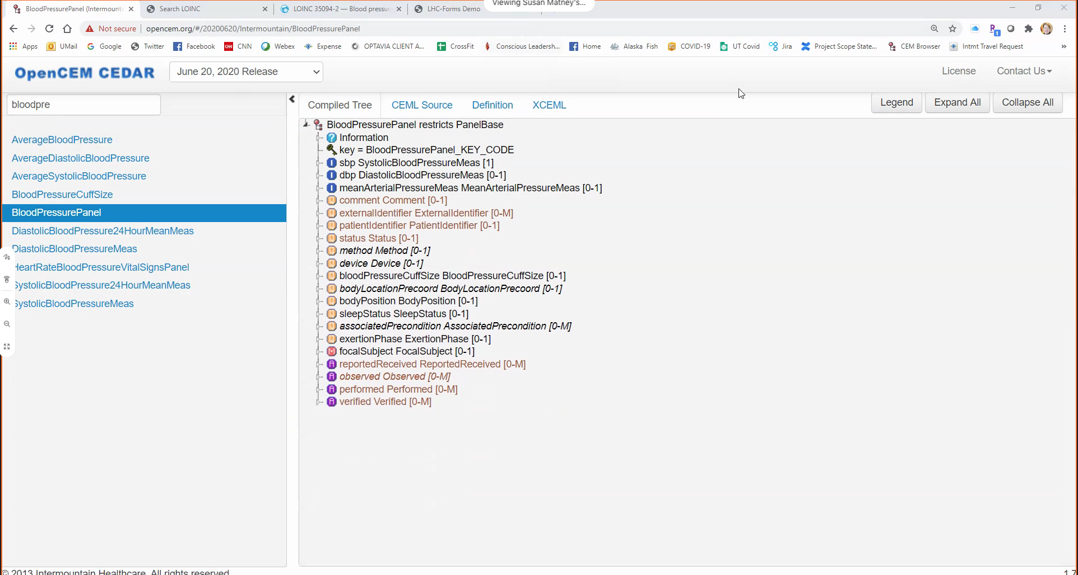
Is model feasible to implement?
Level of detail
Is there a feasible workflow?
Clinical Representation
Does the model correspond to clinical reality?
Are the cardinalities appropriate?
Clinical Completeness
Are all the models present that are needed for the use case?
Are all the attributes present?
Are metadata requirement appropriate to the use case?
Does the model include data that is not clinically relevant?
Clinical Consistency
Semantic consistency
Consistency across related artifacts
Value set alignment

Slide 26
PROVIDE FEEDBACK
Who
Review Coordinator
Intent
Inform submitter of the results of the review
Provide opportunity for submitter to discuss comments
Process
Review Coordinator sends consolidated comments to submitter
If requested, reviewers meet with submitter to discuss comments

Slide 27
REPEAT REVIEW
Who
Review Coordinator
Intent
Ensure that updated models meet criteria and address comments
Submitter updates and resubmits models
Review Coordinator determines if the suggested changes have been made
Review Coordinator may confer with other members of the review team
Document feedback on revised models
Process

Slide 28
FINALIZE REVIEW
Endorsement
Endorsement requires that the model meet both Logica’s clinical and technical criteria
Who
Model Review Board
2 -3 individuals with specialized skills
Report to Quality Review Committee
Endorsement Types
Preferred
Allowed – the model is iso-semantic and can be algorithmically converted to the preferred model
Intent
Formally endorse model
Assign designations (preferred/allowed) and specific uses
Documented results of the clinical and technical review teams are submitted to the Model Review Board.
Clinical review will be a Word document
Technical review will be the output of a compiler
Model Review Board confirms or modifies the determinations of the review teams and provides feedback to review coordinators
Determine level of endorsement and the use for which the model is endorsed
Process

Slide 29
The Interoperable App Development Process
Additional Notes
Need to add the loop backs along the process
Repository has all models with indication of clinical review progress
Domain
Analysis
*NEW*
Approve?/Preview
Model
content
request
Create Logical
Models
(CIMI)
Approve Logical
Models
Model
Repository
Recognize
other model development has a different starting point
Content reviewed by SMEs prior to creating logical models
Create
Physical
Artifacts (FHIR
Profiles)
Project Needs
Pediatric Growth Chart
Neonatal Bilirubin
OPA Data Collection
MQIP
ACC registries
Comm Acq Pneumonia
Etc.
FHIR Profiles Created by Clinical Entity
Terminology
Server
*NEW*
Approve
New FHIR
Profiles
Conformance
Testing
Create
Software
(Apps, CDS)
Artifact
Repository
(FHIR profiles)

Slide 31
Next Steps

