Slide 1
Logica Developer’s Platform & Sandbox
Scott Narus & Nikolai Schwertner
08/19/2020

Slide 2
Agenda
Developer’s Platform
Sandbox Overview
Updates & New Functionality
Demo
Roadmap
Discussion

Slide 3
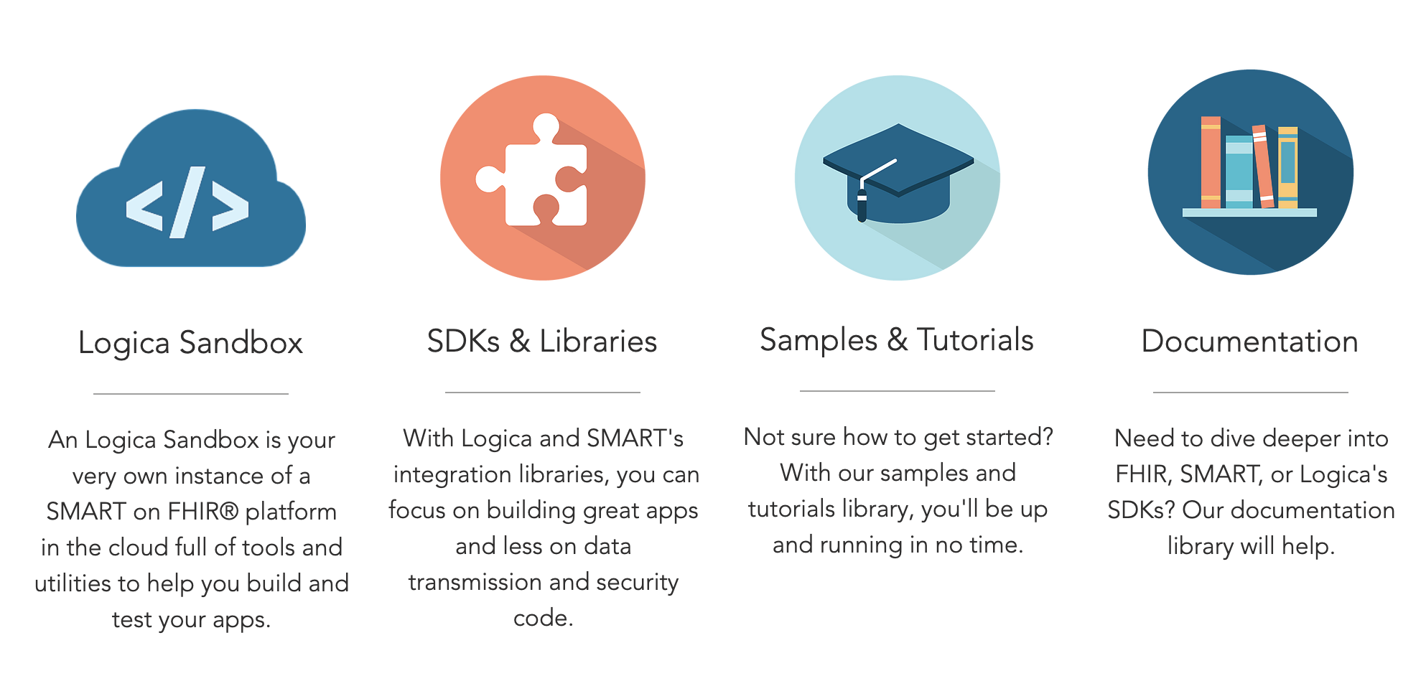
Logica Developer’s Platform
Forum: https://groups.google.com/a/logicahealth.org/forum/#!forum/developer
https://developers.logicahealth.org/

Slide 4
Sandbox Overview
Personal/Group instance of a SMART on FHIR platform
Build, test, demo SMART/FHIR apps/services
Run against your own FHIR server and repository
DSTU2, STU3, R4
Create or import clinical data
Verify apps follow security, launch context and data access standards
Test/Demo apps in Sandbox EMR simulator
Support for CDS Hooks
Support for CQF Ruler
Support for FHIR Profiles
https://sandbox.logicahealth.org

Slide 5
Sandbox Stats
Total Sandboxes = 2148
DSTU2|STU3|R4: 476|1016|656
Total Users = 4585
Last 365 days:
Active Sandboxes: 1160 (234|338|588)
Active Users: 1888
New Sandboxes: 882 (1x|1.5x|4x)
New Users: 1555
FHIR Tx: 2,360,980
Last 90 days:
Active Sandboxes: 433 (83|90|260)
Active Users: 551
New Sandboxes: 231 (1x|1x|7x)
New Users: 347
FHIR Tx: 656,701
https://sandbox.logicahealth.org

Slide 6
Updates & New Functionality
Primarily backend updates
Update to new Logica domain
Update to latest HAPI FHIR version
Update to new SSO
Database, Java and performance/stability updates
Improved support for FHIR Profiles (validation)
Enhanced CDS Hooks support
Enhanced data import/export
https://sandbox.logicahealth.org

Slide 7
Sandbox Demonstration

Slide 8
Sandbox Roadmap
Terminology server support:
Embedded support for terminology services within the Sandbox
Provision of FHIR Terminology Services to sandbox users for development and testing
Support for current FHIR Profiles
Support for FHIR Bulk Data
Organizational support (i.e., sandbox ownership/management by an organization vs. individuals)
Enhanced CDS Hooks support (e.g., additional hooks)
Enhanced EHR simulator
Enhanced Patient Data Manager
Stability and performance improvements
Implementing backup strategy
*Dropping support for Gallery
*Cleaning up unused sandboxes
https://sandbox.logicahealth.org

Slide 9
Discussion

Slide 10
https://sandbox.logicahealth.org
https://developers.logicahealth.org/
Forum: https://groups.google.com/a/logicahealth.org/forum/#!forum/developer

