Slide 1
Multiple Chronic Conditions (MCC) electronic Care Plan Project IG Development
Gay Dolin MSN RN

Slide 2
AHRQ-NIDDK MCC eCare Plan Project Goals
Promote the interoperable collection, use, and sharing of comprehensive, person-centered health and social data across settings;
Facilitate coordinated, person-centered care planning approaches that integrate the full care team (including the patient) across settings; and
Build data capacity to conduct pragmatic Patient Centered Outcomes Research (PCOR).
Chronic Kidney Disease
Cardio
vascular Disease
Diabetes
Chronic Pain

Slide 3
AHRQ-NIDDK MCC eCare Plan Project Scope
NIH NIDDK TEP:
Identify use cases to support the documentation and exchange of MCC eCare Plan data within EHRs and related systems;
Identify, develop, and prioritize the necessary MCC data elements to enable the standardized capture and transfer of data across health settings;
HL7:
Develop, test, and ballot an HL7® Fast Health Interoperability Resource (FHIR®) Implementation Guide based on the defined use cases and MCC data elements.
App Development:
Develop and test an open-source clinician facing SMART on FHIR eCare Plan application for managing persons with MCC

Slide 4
September 2020 and Beyond
Care Planning, Plan Definition, Care Team, Care Coordination and Clinical Guidelines Framework for MCC eCare Plan | June 2020
Draft IG (non -balloted, ready for testing) | September 2020
SMART on FHIR App v1.0 (ready for testing) | September 2020
Connectathon 1-6 | September 2020 – May 2022
Submit for STU Ballot | September 2022

Slide 5
Project Collaboration: Care Recommendations + Instantiated Plan = A Patient Care Plan
Patient Centered Care and Care Planning is a hot topic
Despite different funding mechanisms we must work together for the benefit of patients, providers and implementers
Among the many related projects most important is:
What is defined in the Logica Care Management Implementation Guide and the Multiple Chronic Conditions (MCC) eCare Plan HL7 Implementation Guide must work together
In January – we should be in the same HL7 connectathon track
Notes:
HL7 Care Plan Domain Analysis Model 2.0 (DAM)
HL7 CDA R2 Pharmacist Care Plan Document R1
HL7 Pharmacist Care Plan FHIR Implementation Guide
HL7 electronic Long-Term Services and Supports (eLTSS) Implementation Guide
SAMSHA Omnibus Care Plan FHIR Profiles
HL7 Nutrition Care Plan Supplemental Templates
HL7 Gravity Project
ONC FAST Shared Care Planning Use Case
IHE Dynamic Care Plan
CDS Hooks SMART on FHIR integration
Gravity Project: FHIR R4 Profiles for SDOH Content
Da Vinci: CDex (Clinical Data Exchange)
FHIR Plan Definition and FHIR Clinical Guidelines

Slide 6
Reusing and Constraining
Process
Example
Added constraints for CKD:
CKD value set
Time stamps
Cause/Etiology
ESRD Indicators
Etc.
Constrained Profile
CKD Profile
FHIR Profile
US Core Condition Profile
Added constraints for USA
FHIR Resource
Condition Resource
Basic Structure – All Realms
FHIR Standard
FHIR R4 Standard

Slide 7
Profile Relationship Diagrams
Profiles can reference other profiles
Promotes reuse
Efficiency
Builds a construct to represent a cohesive model
Examples:
Chronic Kidney Disease
Supporting evidence represented in other profiles (Other conditions, procedures, etc.)
Care Plan
Backbone Structure for the IG
Will pull together all the identified CKD (and other) Data elements (CIMs) now represented in profiles
Care Plan structure identifies goals, activities, outcomes by referencing profiles in specific locations
Profile Relationship Diagrams – to study the big picture

Slide 8
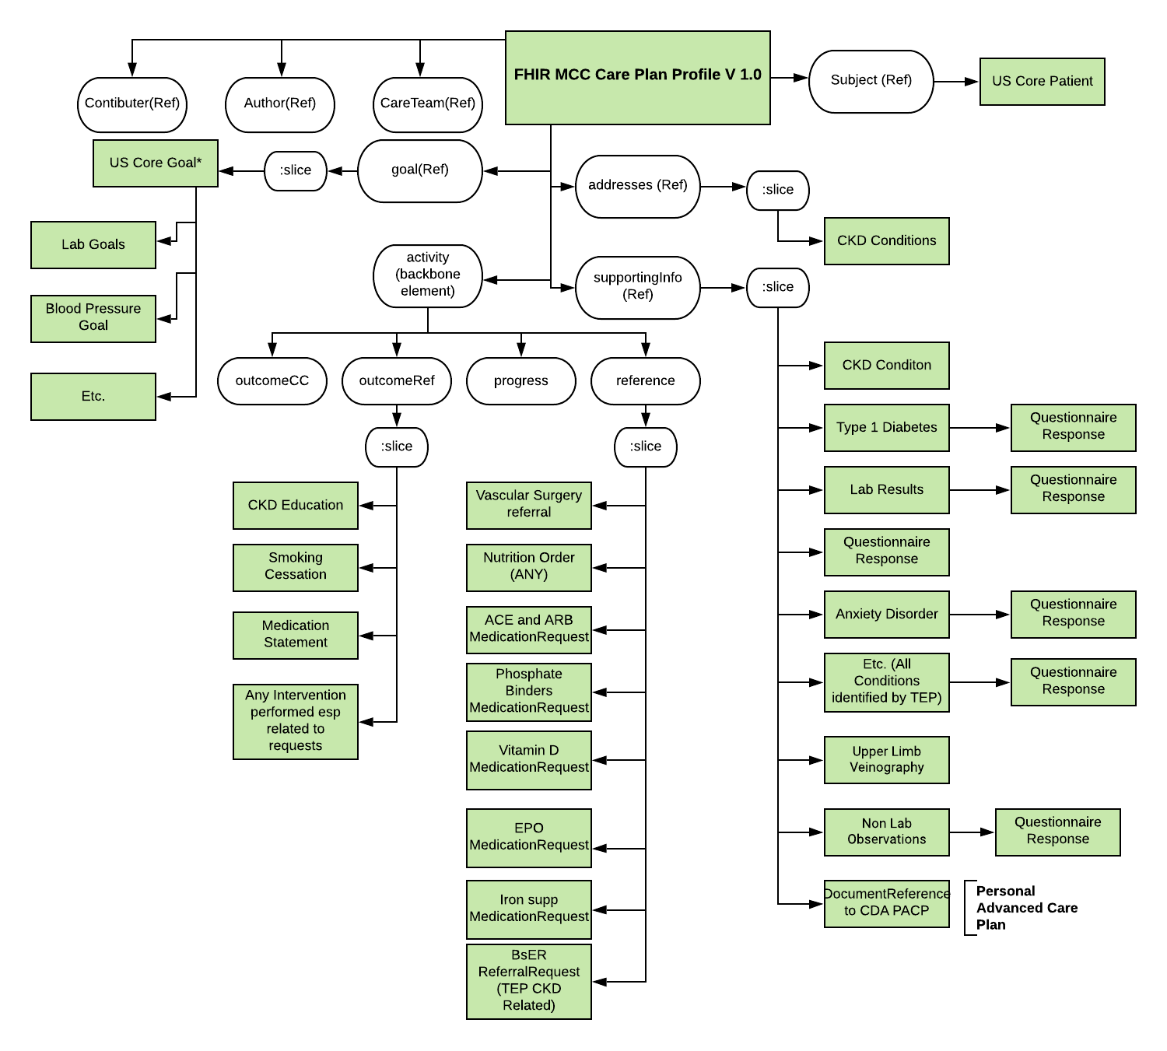
MCC FHIR Care Plan Profile Relationship Diagram

Slide 9
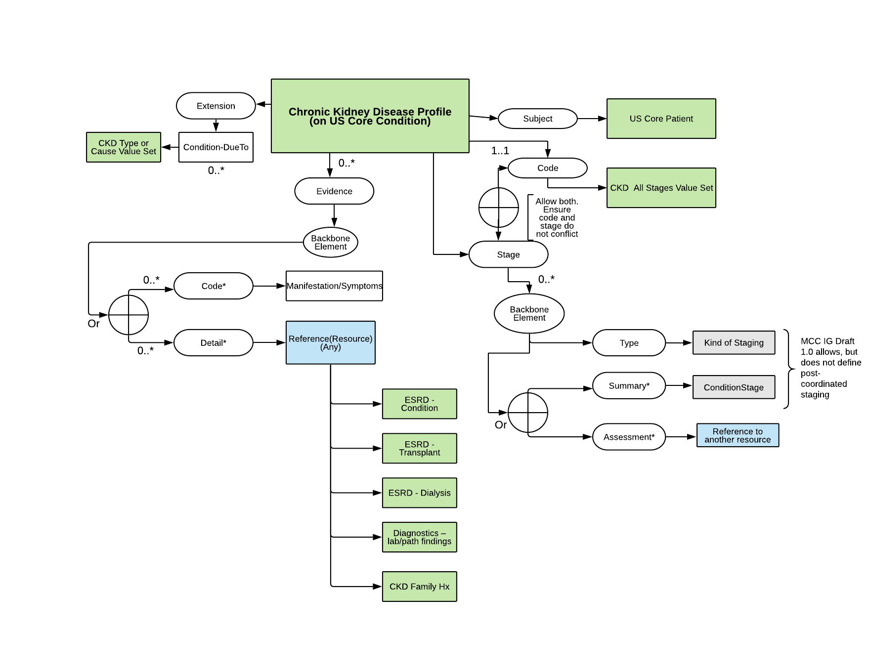
Chronic Kidney Disease Condition Profile Relationship Diagram

Slide 10
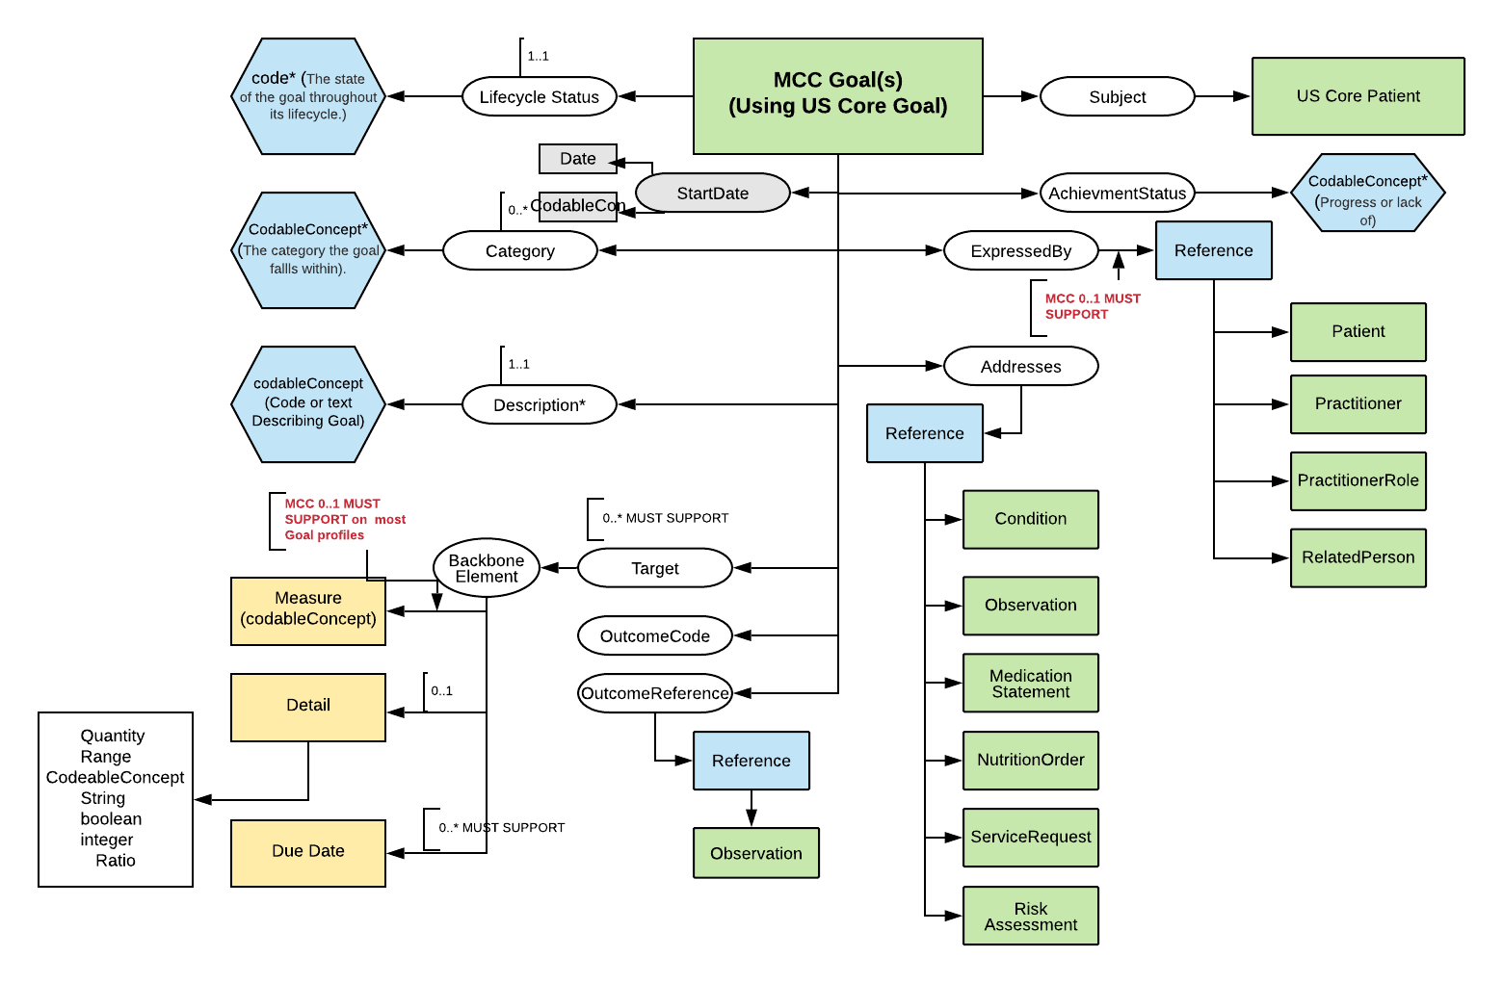
Goal Profile Relationship Diagram
Notes:
https://app.lucidchart.com/documents/edit/cce16968-c0d8-45d2-831c-8ad9b4579f05/rKEiIv2Jws3hg

Slide 11
Questionnaire/Questionnaire Response (QQR) Integration
Questionnaire - May come in via
CarePlan.instantiatesCanonical.Questionnaire
CarePlan.supportingInfo.Reference.Condition.evidence.detail.QuestionnaireResponse or Questionnaire
CarePlan.supportingInfo.Reference.Observation.hasMember.QuestionairreResponse
Notes:
May come in via instantiates Canonical
May come in via Supporting info
May come in a condition Condition.evidence.detail.QuestionairreResponse
What does it mean to have a questionnaire (without responses) that is “adhered to in whole or in part by a CarePlan.”? (https://www.hl7.org/fhir/careplan-definitions.html#CarePlan.instantiatesCanonical)
CarePlan.supportingInfo.Reference.Observation.hasMember.QuestionairreResponse
(https://build.fhir.org/ig/HL7/US-Core-R4/StructureDefinition-us-core-observation-lab-definitions.html#Observation.hasMember)

Slide 12
MCC FHIR Care Plan Profile Relationship Diagram and QR
Notes:
https://app.lucidchart.com/documents/edit/f2339ac5-ac6d-4ad6-a913-a3e5392072ca/0_0

Slide 13
QR Integration
Provide narrative guidance within the profile rules wrt questionnaire integration point recommendations
Do not create multiple profiles to cover questionnaires of interest to MCC (focusing on CKD initially)
Rather….

Slide 14
QQR Integration
Provide narrative guidance of pointing to tooling, such as:
FHIR SDC LHC SMART App
Only renders a Questionnaire Instance??
Or does it create form and the instance? (example: https://loinc.org/81526-6/)
Refer also to Structured Data Capture for further guidance
Provide table of LOINC panel codes of interest

Slide 15
QR Possible Integration – Example table
Topic | LOINC Panel Code | LOINC Long Name
Alcohol Use | 72109-2 | Alcohol use disorder identification test-consumption
Alcohol Use | 77003-2 | PROMIS short form - alcohol - alcohol use 7a - version 1.0
Chronic Kidney Disease Progression Risk | 85626-0 | Kidney fail 2Y + 5Y risk KFRE.dyn Pnl
Cognitive Health | 71130-9 | Cognitive functioning
Cognitive Health | 79115-2 | General Practitioner Assessment of Cognition
Cognitive Health | 72133-2 | Montreal cognitive assessment
Functional status | 76804-4 | PROMIS short form - physical function 6b - version 1.2
Functional status | 76805-1 | PROMIS short form - physical function 8b - version 1.2
Functional status | 79063-4 | PROMIS short form - physical function w mobility aids - version 1.0
Nutrition Status | 75282-4 | Nutr assess Pnl
Nutrition Status | 75304-6 | Nutr Dx Pnl
Nutrition Status | 62282-9 | PhenX - diet supplement proto

Slide 16
MCC eCare Plan IG Tour
https://trifolia-fhir.lantanagroup.com/igs/lantana_hapi_r4/MCC-IG/index.html

Slide 17
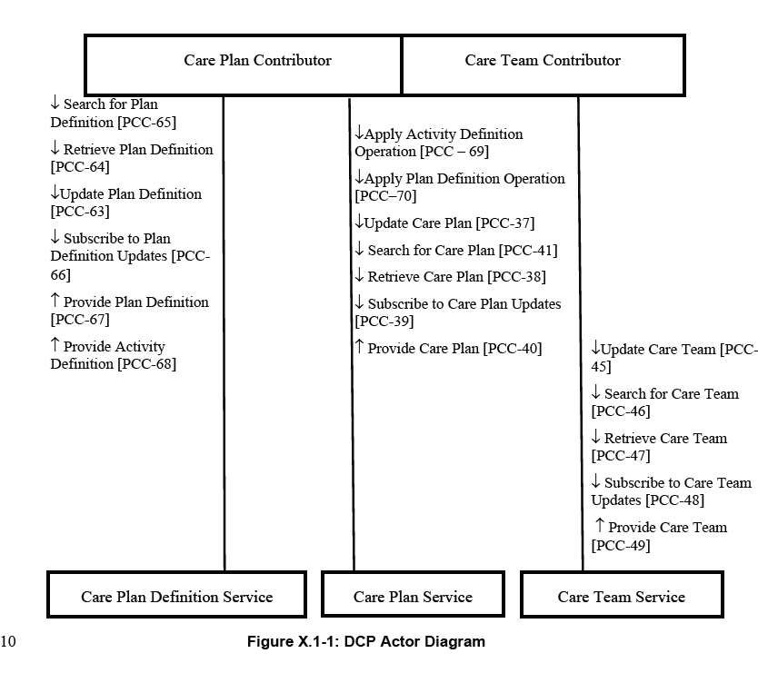
MCC FHIR Care Plan Actor Transaction Diagram
Notes:
IHE DCP Relationship

