Slide 1


mCODE: A Cancer Model for a Learning Health System
Mark Kramer, Ph.D.

Slide 2



45%
3%
increase in cancer drugs in development over the past ten years with
as targeted therapies
Only of adult
cancer patients participate in clinical trials that gather high-quality data
87%
Most of the nearly
15 million individuals living with cancer
in the U.S. have
Electronic Health
Records (EHRs)
EHR data challenges:
  Significant variation
  Unstructured data
  High Burden

Slide 3
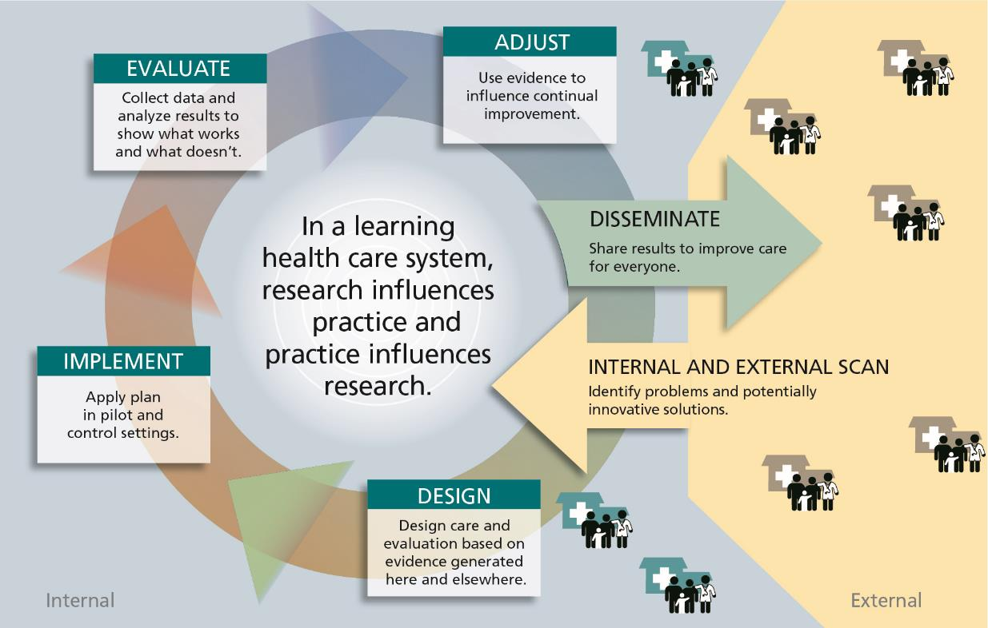


Every patient’s journey can improve all future care
Source: Greene, S. M., R. J. Reid, and E. B. Larson. 2012. Implementing the learning health system: From concept to action. Annals of Internal Medicine 157(3):207-210.
Notes:
Photos use under creative commons license: https://creativecommons.org/licenses/by-nc-nd/4.0/legalcode

Slide 4

mCODE, or Minimal Common Oncology Data Elements, is a data standard that can be widely adopted. It holds promise to greatly increase high-quality data for all cancer types.
A standard health record for oncology
Patients
Providers
Research
CANCER
Minimal set of critical data elements
Standardized for collection and sharing
Recommended by top oncologists
Supports multiple cancer use cases
Improves cancer care and research
Payers
Pharma
Vendors
Government/ Regulatory

Slide 5







Early Community Leaders
TM
®
®
®
®
®
®

Slide 6


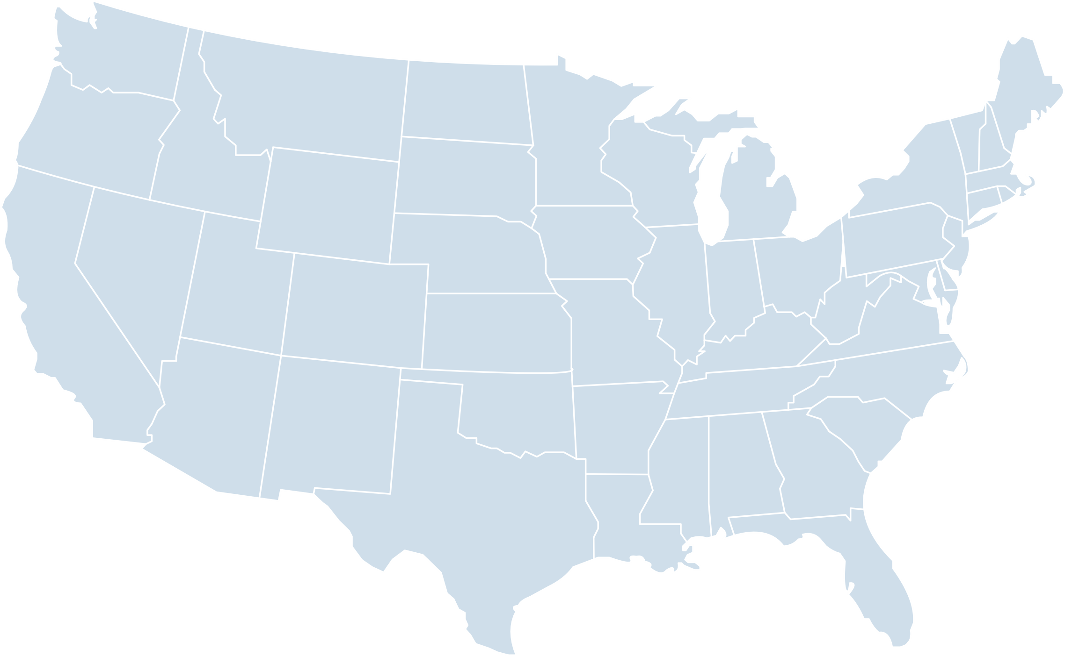





Building a Trusted Network of Health Systems
®
®
®
TM
®
®
®
®
®
TM
®
®
MD Anderson
Cancer Center
®
TM

Slide 7
HL7 FHIR Implementation Guide: minimal Common Oncology Data Elements
Release 1 - US Realm | STU1 | http://hl7.org/fhir/us/mcode/

Slide 8

HL7 FHIR Accelerator
A community and platform to accelerate interoperable data modeling and implementation
around mCODE, leading to
step-change improvements in
cancer care and research
http://hl7.org/CodeX

Slide 9









Community Leaders
The Centers for Disease Control and Prevention
Many others considering membership

Slide 10


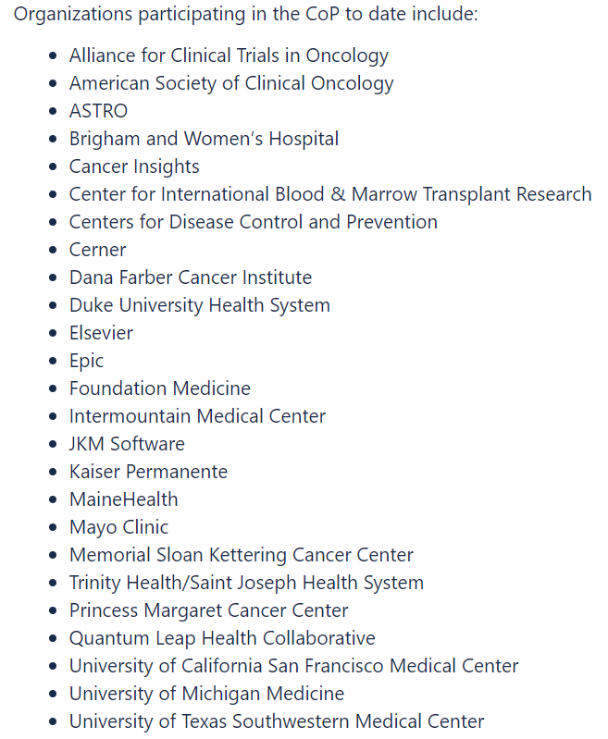


Community of Practice
A group of health systems and supporting organizations, working together within the CodeX HL7 FHIR Accelerator.
Latest developments on mCODE, CodeX, and cancer data exchange
Develop and share best practices for clinical workflows, data modeling, and exchange
Ask questions and learn from the experience of other community members

Slide 11
Active
In Design
Use Cases
1
EHR Endpoints for
Clinical Trials
5
Radiation Therapy Data for Care Coordination
2
Empowering Patients to
Find Clinical Trials
6
Clinical Cancer Data Exchange (Providers/Payers)
3
7
Alternative Payment Model Data Reporting
Registry Reporting
4
Oncology Clinical
Pathways Navigation
8
Drug Value Based Agreements

Slide 12





Implementation Projects
Clinical
Research
TM
ICAREdata
EHR-based clinical trials endpoints collection:
Develop and validate data elements that define clinical utility (treatment response, toxicity, change in treatment, deviation from clinical pathway).
Clinical
Care
Compass
TM
Demonstrate the use of mCODE elements to allow providers and patients to make informed, shared, data-driven decisions and provide data back to generate new knowledge.
Clinical
Care
Camino
TM
Oncology Clinical Pathways are evidence-based treatment protocols for delivering cancer care. This initiative uses mCODE elements in producing computable pathways, which provide key decision support in the selection of treatment options.

Slide 13






Oncology Standard Health Record
2018
2019
2020
2021
Minimal Common Oncology Data Elements
Defining an
Approach
Community and Adoption
Sustainable
Model

Slide 14
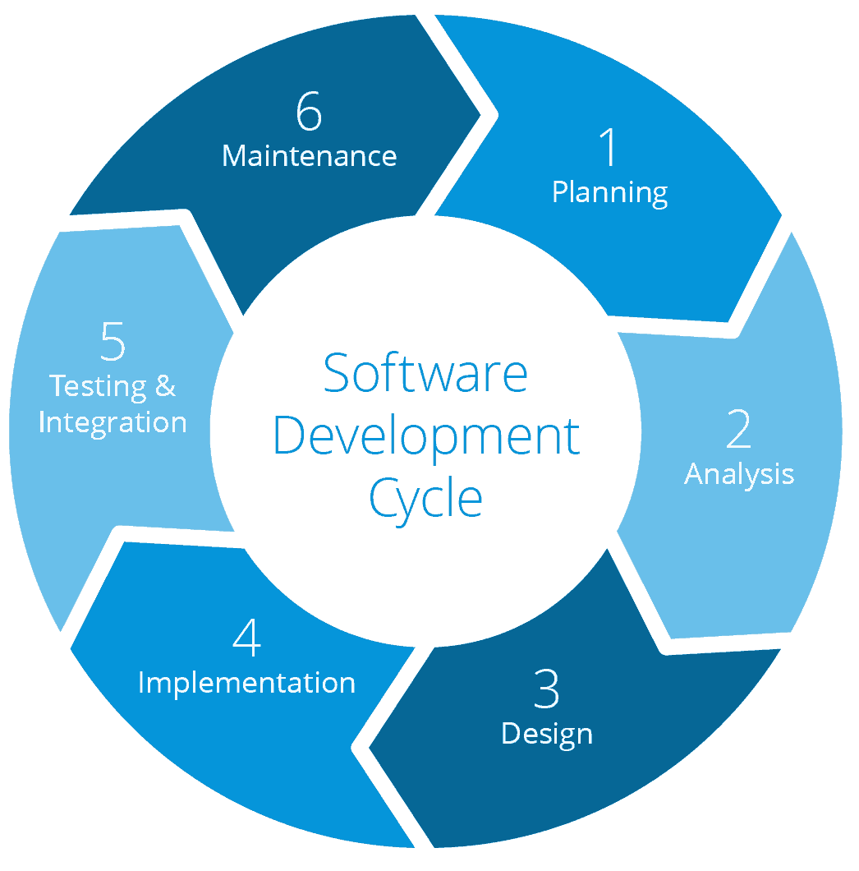



Technology Platform
Scope
Governance
Community
Finance
Landscape Analysis
Domain Knowledge
Relationships
Harmonization
Profile Reuse
FHIR Best Practices

Slide 15

FHIR Shorthand (aka FSH)
A language for defining FHIR Artifacts and Implementation Guides (IG)
Defines Profiles, Value Sets, Instances (Examples), and more
Works with tooling (SUSHI) and the HL7 FHIR IG Publisher to produce an IG
Progress:
Started in October 2019
STU 1 Ballot in May 2020 - Nearing official publication
    Now used by more than 40 projects worldwide, including Logica COVID-19 FHIR Profile Library and SANER (Situational Awareness for Novel Epidemic Response)

Slide 16

https://fshschool.org
New home for SUSHI documentation, tutorials, resources
  Coming soon:
  FSH Online – allows users to interact with FHIR Shorthand see the output side-by-side
  GoFSH – Takes a Structure Definition JSON file and produces a FSH file representing the Structure Definition
  FSHingTrip – Roundtrip from StructureDefinition to FSH and back to verify SUSHI and GoFSH

Slide 17
A repeatable process for disciplines beyond oncology?
An agile and iterative approach grounded by implementation
Create a guiding coalition of health systems, specialty societies, and leaders
Work with clinicians and patients to develop the requirements
Identify data elements through use cases that demonstrate tangible impact
Focus on core data elements that are cross cutting to use cases
Execute targeted implementation pilots at the point of care
Enable early adoption and scale by engaging industry and health systems
Notes:
Mention work with NAS to expand to CVD+
Although applicable to cancer, this is applicable to other therapeutic areas

